Slide 1
Musculoskeletal and Integumentary System
By Tebelay Dilnessa
For contact: tebelay@gmail.com; 0912198715

Slide 2
Objectives
To describe microorganism causing skin and bone infection
To describe common virulent factors for each organisms
To describe clinical, Dx and treatment of infections
Outline
  Bacteria causing skin and bone infection
  Virus causing skin and bone infection
  Fungus causing skin and bone infection
Notes:
A psoas abscess is defined as a purulent infectious collection within the psoas muscle.
The integumentary system is the organ system that protects the body from various kinds of damage, such as loss of water or abrasion from outside.
The system comprises the skin and its appendages (including hair, scales, feathers, hooves, and nails).
The integumentary system is an organ system consisting of the skin, hair, nails, and exocrine glands. The skin is only a few millimeters thick yet is by far the largest organ in the body.

Slide 3


Introduction to Musculoskeletal & Integumentary Systems
Bones
Bursae
Muscles
Musculoskeletal
System
Cartilage
Joints
Ligaments
Tendons
Notes:
Diseases of the integumentary system. Dermatologists specialize in treating diseases, disorders and injuries of the skin, hair and nails. They treat common conditions such as acne and warts; chronic skin conditions such as eczema and psoriasis; and more serious diseases like skin cancer, according to the AAD (American Academy of Dermatologists ).The integumentary system consists of the skin, hair, nails, glands, and nerves. Its main function is to act as a barrier to protect the body from the outside world.

Slide 4
The musculoskeletal system includes the bones, joints, muscles, tendons, ligaments, and bursae of the body.
The problems associated with these structures are common and affect all age groups.
Problems with the musculoskeletal system are generally not life-threatening, but have a significant effect on the client’s normal activities and productivity.
The integumentary system consists of the skin, hair, nails, glands and nerves.
Its main function is to act as a barrier to protect the body from the outside world.

Slide 5
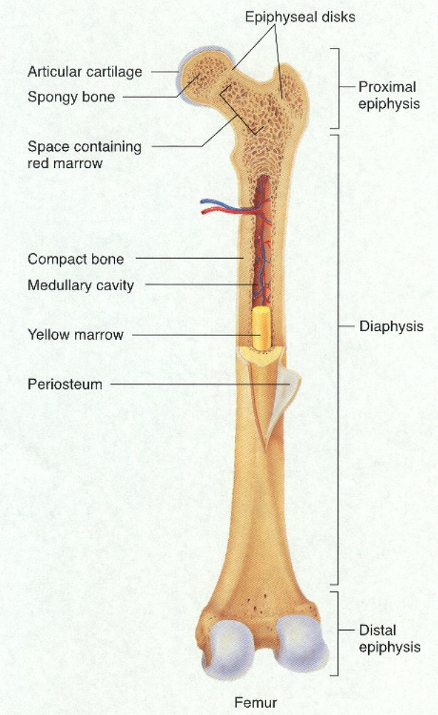
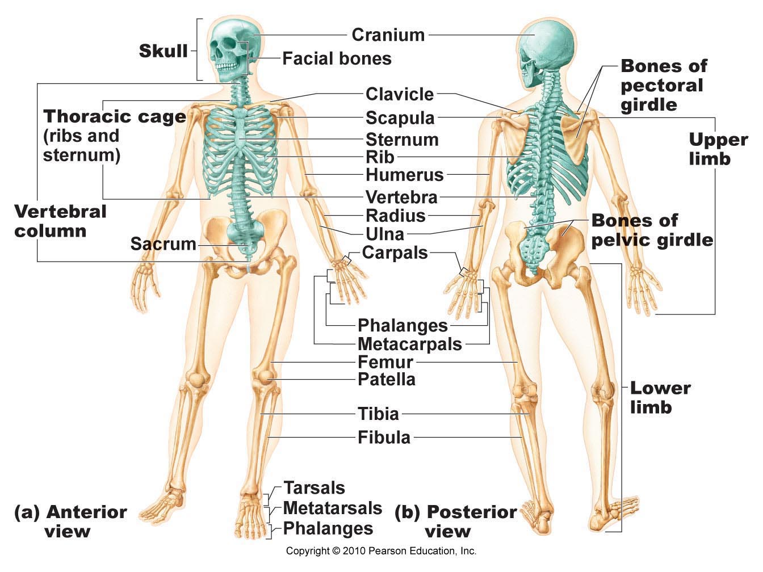

Slide 6
Skin
Skin is tough membrane (cutaneous membrane)
A bout 2 square meters (0.05mm -4.0 mm thickness)
Skin is composed of two distinct layers—the deeper dermis
and outer epidermis
Functions:
  Prevents excessive water loss,
  Helps regulate body temperature,
  Formation of vitamin D,
  Involved in sensory phenomena,
  Barrier against microbial invaders.
Notes:
It limits infection and disease unless it has been burned, broken, cut, or in some other way wounded. An adult’s skin covers about 2 m2, making it one of the larger organs of the body. Human skin varies in thickness from 0.05 mm on the lips to 4.0 mm thick on the soles of the feet and in calluses, which cover areas of greatest wear and tear.

Slide 7
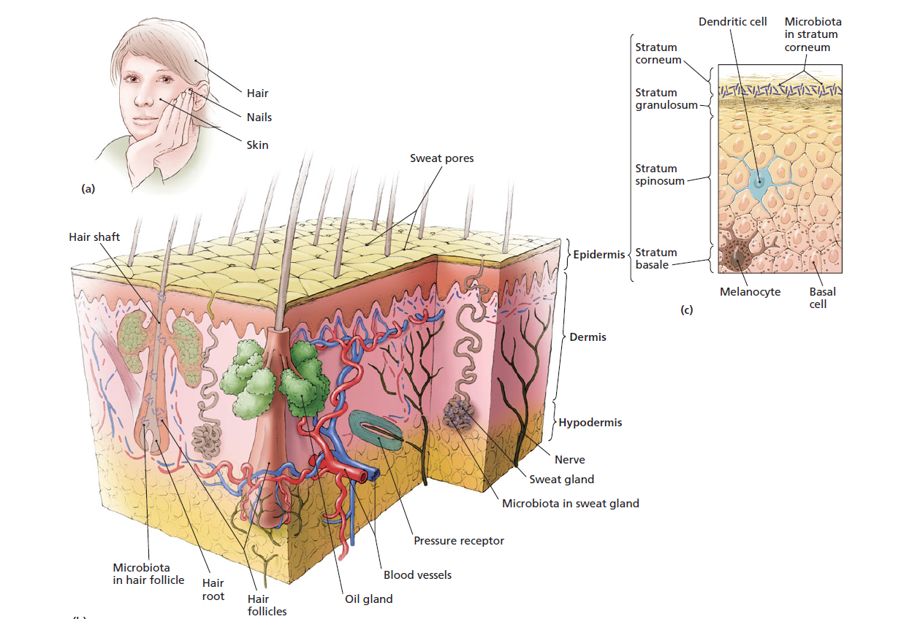
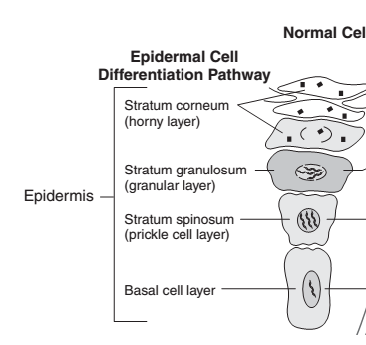
(c) Detail of the epidermis.
(b) Skin is composed of the outer epidermis and the deeper dermis. In addition, a layer of fat cells called the hypodermis lies beneath the dermis.

Slide 8
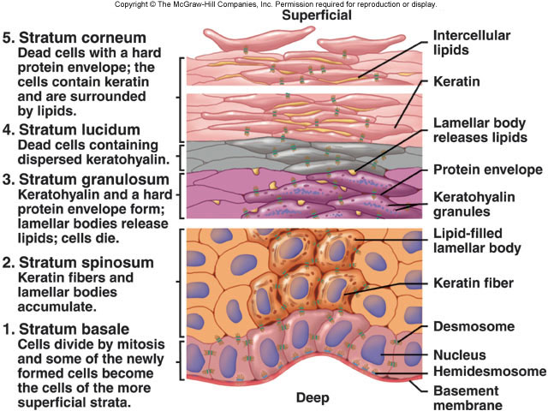
Notes:
The bloodless epidermis consists of four to five layers of tightly-packed cells. Basal cells of the epidermis, which adjoin the dermis, divide continuously, pushing their offspring toward the surface. As the daughter cells are pushed away from the dermal blood supply they flatten and die, but not before modifying themselves. They absorb melanin, a pigment that is secreted by other cells in the basal layer and that gives skin its color. The more melanin, the darker the skin. Epidermal cells also fill with a waterproofing protein called keratin. A hardened form of keratin forms nails and hairs, which are accessory structures to the skin. Between the dying cells, defensive cells called dendritic cells phagocytize microbes that penetrate into the deeper layers of the epidermis and deliver microbial antigens to defensive lymphocytes.

Slide 9
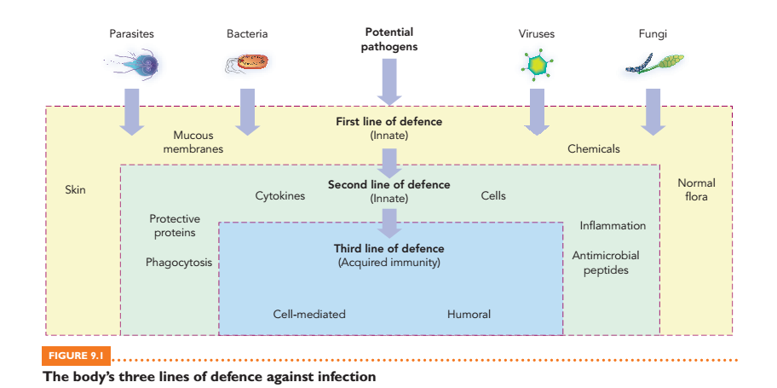
Notes:
The dermis is a tough, leathery structure composed of loosely packed cells, connecting protein fibers, small muscles, sweat glands, sebaceous (oil) glands, blood vessels, nerve endings, and hair follicles, which produce hairs that grow up through the dermis and epidermis. The dermis provides strength and flexibility and, along with its blood vessels, supports the growth of the overlying epidermis.

Slide 10
Normal Microbiota of the Skin
Found in epidermis, hair follicles & in the interiors of the sweat ducts
Compete with potential pathogens for nutrients and space
Produce chemicals that interfere with the growth of other microbes, providing further defense against infection.
The common microbiota are:
  Staphylococcus (Staphylococcus epidermidis) & Micrococcus
  Diphtheroides--- Propionibacterium acnes
  Yeast ---Malassezia
Notes:
Organisms of the microbiota typically grow in small clusters, particularly in the armpits and between the legs where conditions are more moist. Their waste products produce body odor.
Significant members of the microbiota include small lipophilic yeasts such as Malassezia, which digest sebum.
Staphylococcus and micrococcus can tolerate salt concentrations of 5–10%.
P. acne resides in hair follicles, where it ferments carbohydrates to form propionic acid, which lowers the pH of the skin, acting as a further defense against additional infection.

Slide 11
Microbial infections of MSK and INT System
Myositis is defined as inflammation of a muscle, especially a voluntary muscle, characterized by pain, tenderness, swelling, and/or weakness.
Etiologies of myositis include infection, autoimmune conditions, genetic disorders, medication adverse events, electrolyte disturbances, and diseases of the endocrine system.

Slide 12
Infectious myositis: uncommon acute, or chronic infection of skeletal muscle
It is caused by a wide variety of pathogens, including bacteria, fungi, parasites and viruses.
Localized collections within the muscles are referred to as pyomyositis

Slide 13
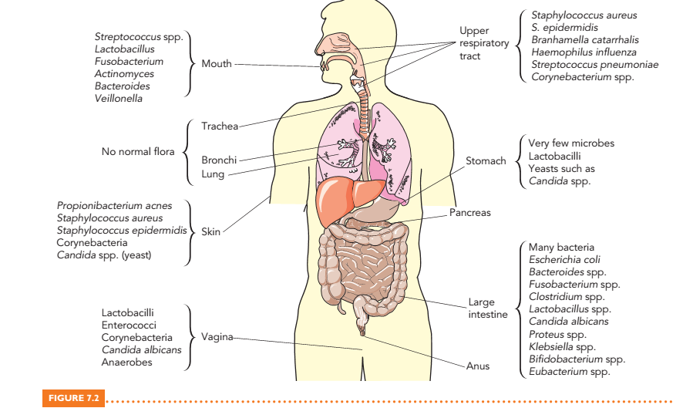

Slide 14
Infections of the Skin
Tissue damage is the most common factor leading to infection of the skin,
  Minor trauma, surgery, puncture wounds or burns
It is caused by a variety of organisms from different sources
  Endogenous infection caused by skin flora
  Exogenous infection caused by organisms in the natural environment
  Infection from systemic infections: A skin rash may be the major manifestation

Slide 15
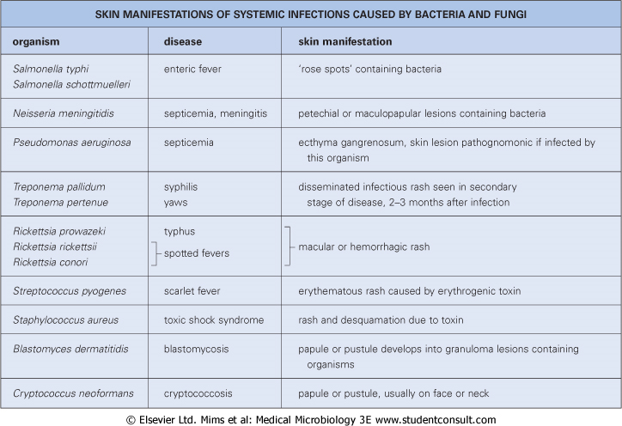
Notes:
Lesions on the skin do not necessarily indicate an infection of the skin;

Slide 16
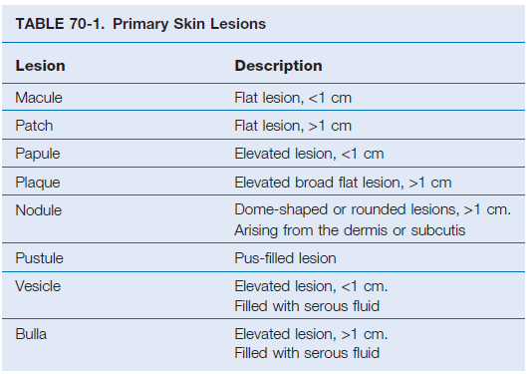

Slide 17
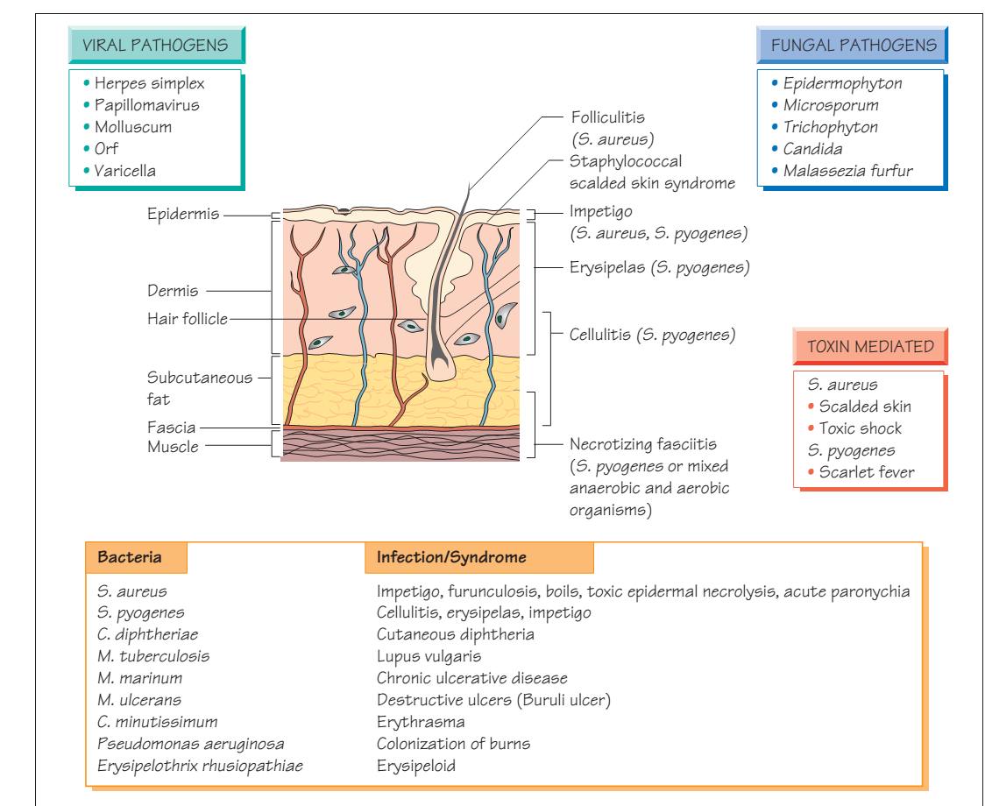
Etiologies

Slide 18
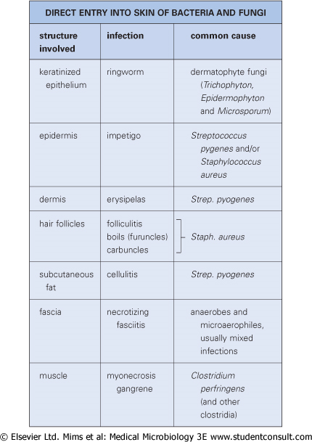

Slide 19
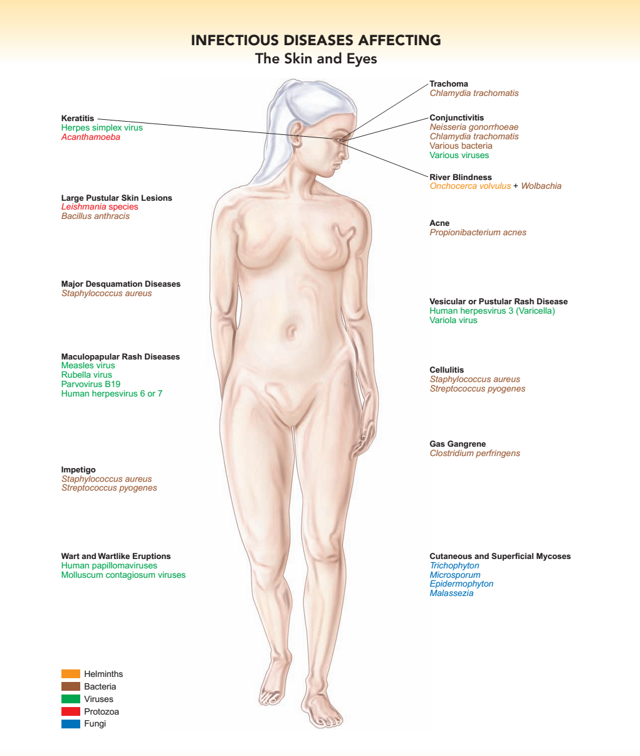
Notes:
Scabies is a skin infestation caused by a mite known as the Sarcoptes scabiei. Untreated, these microscopic mites can live on your skin for months. They reproduce on the surface of your skin and then burrow into it and lay eggs. This causes an itchy, red rash to form on the skin.
The hallmark symptoms of scabies include a rash and intense itching that gets worse at night. Continuous scratching of the infected area can create sores that become infected. If this occurs, additional treatment with antibiotics for the skin infection may be recommended.
Common sites for scabies in older children and adults include the:
wrist
elbow
armpit
nipple
penis
waist
buttocks
area between the fingers

Slide 20
  Bacteria infecting the Musculoskeletal and
  Integumentary System

Slide 21
  Bacteria cause diseases that range from mild acne to life-threatening infections such as “flesh-eating strep”
  infections.
    Staphylococcus aureus
    Streptococcus pyogenes
    Propionibacterium acne
    Clostridium perfringens
    Mycobacterium leprae
    Bacillus anthracis
    Treponema pallidum (secondary & tertiary syphilis)
Notes:
Bacteria infecting the skin cause diseases that range from mild acne to life-threatening conditions such as “flesh-eating strep” infections. Such bacteria include Staphylococcus, Streptococcus, Propionibacterium, Bartonella, Pseudomonas, and Rickettsia.

Slide 22
Bacillus anthracis
It is gram-positive, form endospores, and are either strictly or facultative aerobic.
It is found in soil and water, and are usually encountered in the medical laboratory as airborne contaminants.
Capsulated (Polypeptide- D-glutamic acid)
B. anthracis primarily infects herbivores with humans being accidental hosts.
Infection can be acquired by inoculation, ingestion or inhalation.

Slide 23
B. anthracis spores may remain viable for many years in contaminated pastures, or in bones, wool, hair, hides, or other animal materials.
Virulence factors
1. Capsule- is made of a polypeptide D-glutamic acid
  It is anti-phagocytic
2. Protein exotoxin- it has three parts
  Protective antigen (PA) binds to host cell
  Edema factor (EF) is adenylate cyclase that catalyzes the production of cAMP
  Lethal factor (LF) is cytotoxic that can kill cells

Slide 24
Pathogenesis and Clinical features
The pathogenesis of B. anthracis is by the interaction of three parts of the toxin.
To cause disease:
  The PA will attach to host cell
  Binding of EF to PA produces edema
  The binding of the LF to the PA produces cell death
  There are three forms of anthrax: Cutaneous, Pulmonary, GIT anthrax

Slide 25
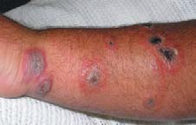
Cutaneous anthrax (Malignant pustule):
  Bacilli enter through damaged skin
  95 % of anthrax presentation
  It is characterized by a black necrotic lesion with a definite edematous margin on hands, arms, face or neck with regional lymphadenitis associated systemic symptoms.
  Figure: Cutaneous anthrax

Slide 26
Laboratory Diagnosis
Specimen: Fluid or pus from skin lesion
Smear: Non-capsulated gram-positive rods with spores from culture
Capsulated gram +ve rods without spores from primary specimen
Culture
Grows aerobically in ordinary media over wide range of Tº
When grown on blood agar plates, the organisms produce non-hemolytic gray to white mucoid colonies with a rough texture.
The edge of the colony is composed of long, interlacing chains of bacilli; resembling locks of matted hair under the low power microscope. This is called the ‘Medusa head appearance

Slide 27
  Staphylococcus
  Gram +ve, spherical cocci, grape-like clusters
  Catalase positive and coagulase positive (S. aureus)
  Forms β hemolytic “golden” colonies on BA
  Grow at 15 to 45 oC & at 5- 15% NaCl
  Resistant to high osmolarity, detergents, as well as alcohol
  Includes both a commensal and a pathogen

Slide 28
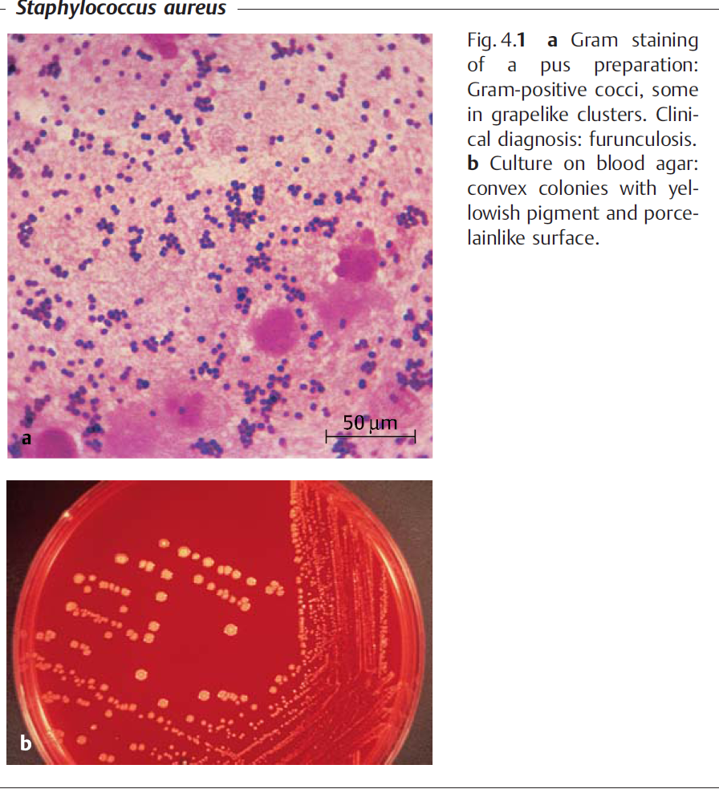

Slide 29
It colonize anterior nares, throat, vaginal wall, behind ears, groin, axilla, and the perineum, etc
Colonization provides a reservoir for infection & source for transmitted among individuals
There are about 33 spp of Staphylococci
Species of medical importance:
  Staphylococcus aureus
  S. epidermidis
  S. saprophyticus
  S. haemolyticus

Slide 30
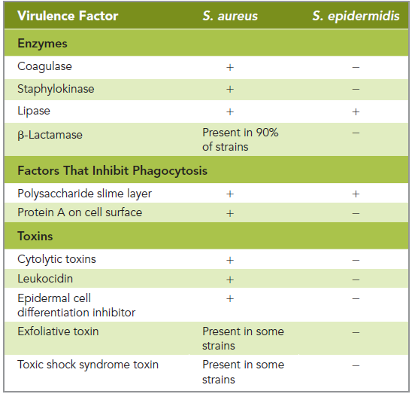
Staphylococcal virulent factors
Notes:
.Coagulase clots blood, which may hide the bacterium from phagocytes.
• Hyaluronidase breaks down hyaluronic acid, a major component of the matrix between cells, thus enabling the bacterium to spread between cells throughout the body.
• Staphylokinase dissolves blood clots, which also allows staphylococci to spread to new locations.
• Lipases, which are present in S. epidermidis as well, digest lipids, including sebum, providing staphylococci with food on the surface of skin, in hair follicles, and in sebaceous glands.
• b-Lactamase plays no role in inhibiting the natural defenses of the body, but it does convey resistance to many betalactam antimicrobial drugs such as penicillin and cephalosporin—drugs which β-lactamase inactivates.
Both S. aureus and S. epidermidis evade the body’s defenses by synthesizing loosely organized polysaccharide slime layers (sometimes called capsules) that inhibit chemotaxis of and phagocytosis by leukocytes.
The slime layer also facilitates attachment of staphylococcal biofilms to artificial surfaces such as catheters, shunts, artificial heart valves, and synthetic joints. Cells of S. aureus are uniformly coated with protein A, which binds to the stems of class G antibodies (IgG).

Slide 31
Pathogenesis
Transmission via direct contact as well as via fomites
Staphylococcus on the surface of the skin grows into hair follicles and invades sebaceous glands.
This triggers fever and inflammation and causes follicle to enlarge and fill with pus composed of leukocytes, dead cells and bacteria.
Spread into hypodermis to form a furuncle or into neighboring hair follicles to form a carbuncle.
S. aureus may also spread to blood (bacteremia) and be carried to the lining of heart, lungs, and bones, causing endocarditis, pneumonia, and osteomyelitis, respectively.
Notes:
S. aureus (infrequently S. epidermidis)

Slide 32
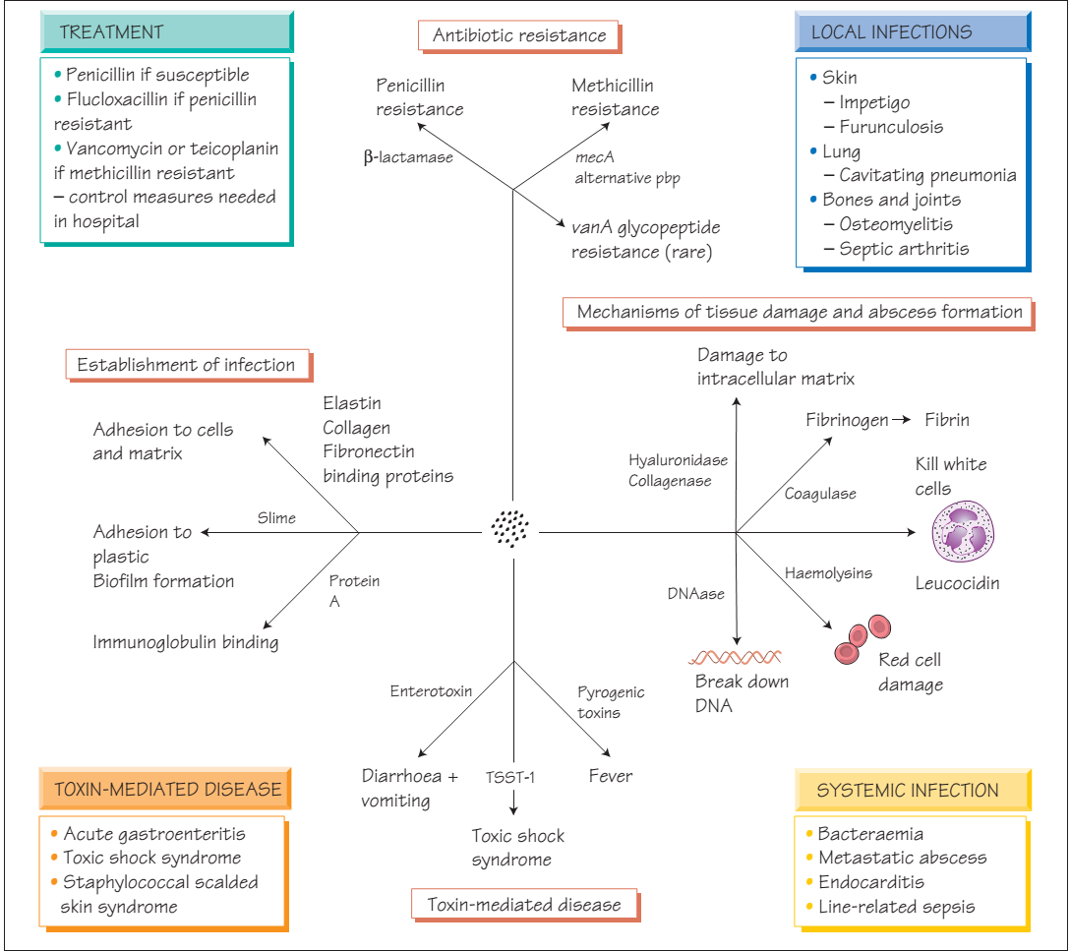
Notes:
Leukocidin kills leukocytes, providing Staphylococcus with additional protection against phagocytosis, and epidermal cell differentiation inhibitor is a protein that induces large holes in the linings of blood vessels, allowing access for the bacterium to invade body tissues.
Some strains of S. aureus also produce exfoliative toxin or toxic shock syndrome toxin—proteins that cause staphylococcal scalded skin syndrome and staphylococcal toxic shock syndrome, respectively

Slide 33
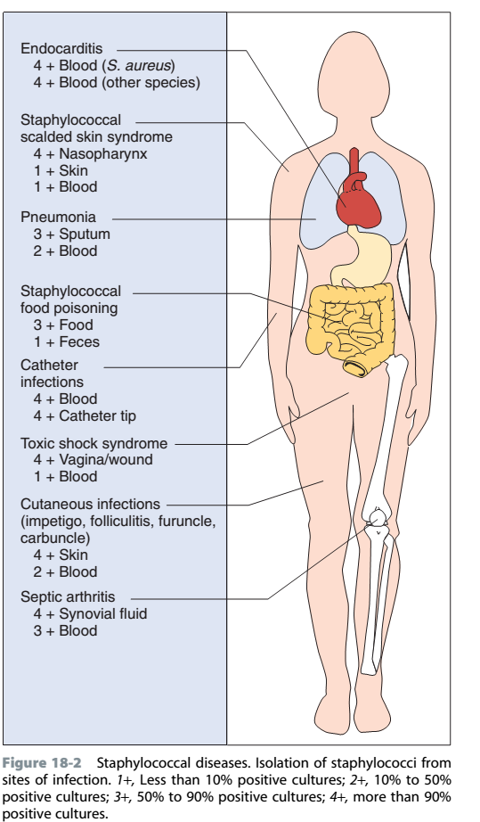

Slide 34
Staphylococcal infections and clinical features
Staphylococcal Scalded Skin Syndrome (SSSS)
Disseminated desquamation of epithelium in infants
The bacteria secrete one or two distinct exfoliative toxins affect which keratinized cells of the epidermis.
Blisters contain clear fluid but no organisms or leukocytes
The blood carries exfoliative toxins from sites of infection throughout the body (called toxemia)
Scarring does not occur
Disease due to secondary bacteria infection (60%)
Notes:
Positive Nikolsky sign
In staphylococcal scalded skin syndrome (SSSS), cells of the outer epidermis separate from one another and from the underlying tissue. SSSS involves a reddening and wrinkling of the skin that typically begins near the mouth, spreads over the entire body, and is followed by large blisters that contain clear fluid lacking bacteria or white blood cells.
Five percent of strains of Staphylococcus aureus secrete one or two distinct exfoliative toxins that cause SSSS. Each toxin causes the dissolution of epidermal desmosomes, which are intercellular bridge proteins that hold together cytoplasmic membranes of adjoining cells. Both toxins affect keratinized cells of the epidermis.
The blood carries exfoliative toxins from sites of infection throughout the body. Such circulation of toxins in the blood is called toxemia.

Slide 35
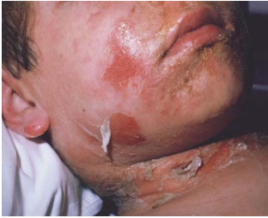
Figure: Staphylococcal scalded skin syndrome. Exfoliative toxin, produced by some strains of S. aureus, causes reddened patches of the epidermis to slough off.

Slide 36
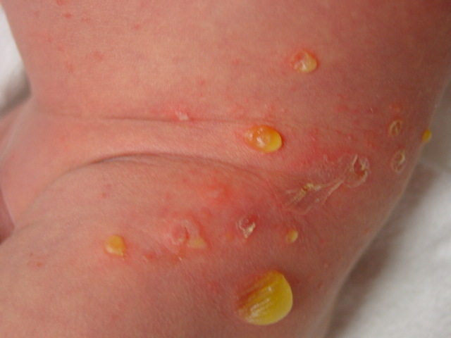
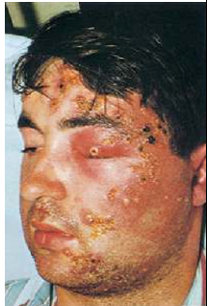
b. Impetigo (Bullous)
  It is a localized form of SSSS chx by:
  Superficial, fragile bullae on the trunk and the extremities
  Systemic signs of infection uncommon
Non -bullous type can be caused by both S. aureus (80%) and S. pyogens (20%)
  Pus-filled vesicle on an erythematous base
  Crusting occurs after the pustule -honey-crusted exudate
Notes:
Impetigo also called pyoderma—is a contagious disease characterized by small, flattened, red patches that appear primarily on the face and limbs.
When such an infection of the skin spreads into surrounding lymph nodes and triggers pain and inflammation, the condition is called erysipelas. Erysipelas manifests as reddening of the skin on the face, arms, or legs.
.M protein is a cytoplasmic membrane component that destabilizes complement and interferes with phagocytosis and lysis of the bacterium.
• A hyaluronic acid capsule serves to “camouflage” the bacterium, hiding it from phagocytes since hyaluronic acid is a natural chemical in the body.
• Pyrogenic toxins (formerly called erythrogenic13 toxins) are proteins that stimulate macrophages and helper T lymphocytes to release cytokines that in turn stimulate fever, a widespread rash, and shock.

Slide 37
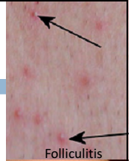
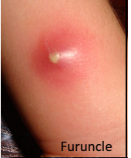
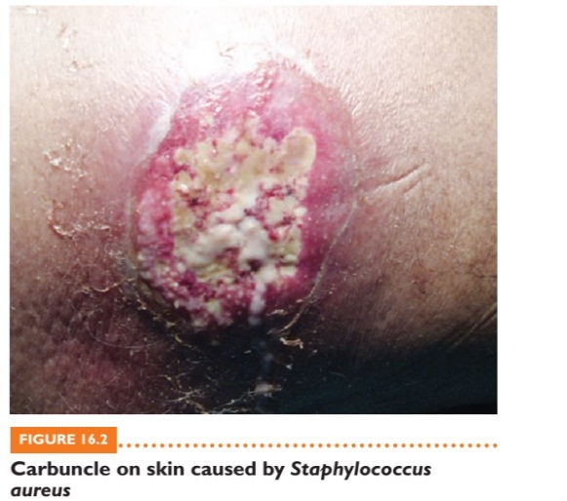
c. Folliculitis
  A pyogenic infection in the hair follicles
  Inflammation is superficial & pus is found only in the epidermis
d. Furuncles (boils)
  An extension of folliculitis, large, painful, nodules ,have collection of dead and necrotic tissue
e. Carbuncles
  Furuncles coalesce & extend deeper subcutaneous tissue
  Chxed by multiple drainage points
  Patients with carbuncles have chills and fevers
Notes:
Folliculitis is an infection of a hair follicle in which the base of the follicle becomes red, swollen, and pus filled. This condition is often called a pimple. When it occurs at the base of an eyelid, it is called a sty.
A furuncle or boil, is a large, painful, raised nodular extension of folliculitis resulting from spread of the infection into surrounding tissues.
When several furuncles join together—more frequently in areas where the skin is thick, such as at the back of the neck—they form a carbuncle. In severe cases, the body responds to folliculitis by triggering fever.

Slide 38
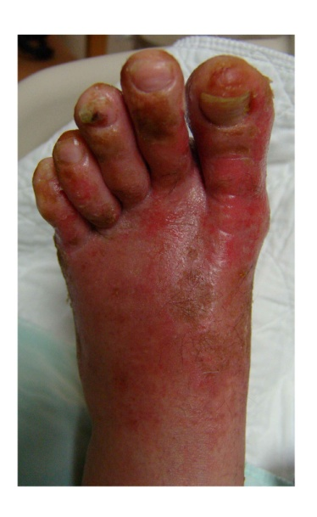
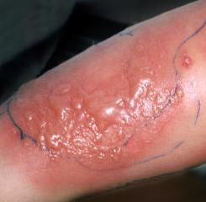
f. Cellulitis
Acute infection of dermis & subcutaneous tissues
Lesions chxs by edema, pain, tenderness, warmth, erythema, & spreading irregular margins
Cellulitis remains a clinical diagnosis

Slide 39
g. Osteomyelitis & Septic arthritis
Osteomyelitis
Osteomyelitis denotes inflammation of bone and marrow and the common use of the term virtually always implies infection
Osteomyelitis is a purulent infection of bone
All type of organisms including viruses, parasites, bacteria and fungi can produce osteomyelitis
Pyogenic osteomyelitis mostly caused by bacterial infection
Notes:
pyro­genic exotoxin=TSST-1
Osteomyelitis
• Staphylococcus aureus accounts for 90% of infections; rarer
causes include Streptococcus pyogenes (4%), Haemophilus inﬂuenzae (4%), Escherichia coli, Salmonella spp., Mycobacterium tuberculosis and Brucella.
• Patients with sickle cell disease are especially prone to Salmonella infection.

Slide 40
The microorganisms enter to bone by three different ways:
  Hematogeneous spread (most common)- clinically hematogenous osteomyelitis may manifest as an acute systemic illness with malaise, fever, chills, leukocytosis and throbbing pain over affect site
  Direct inoculation (traumatic or surgical, etc)
  Local invasion/extension from contagious infection
Long bones and vertebral bodies most commonly involved
Notes:
Throbbing= burning

Slide 41
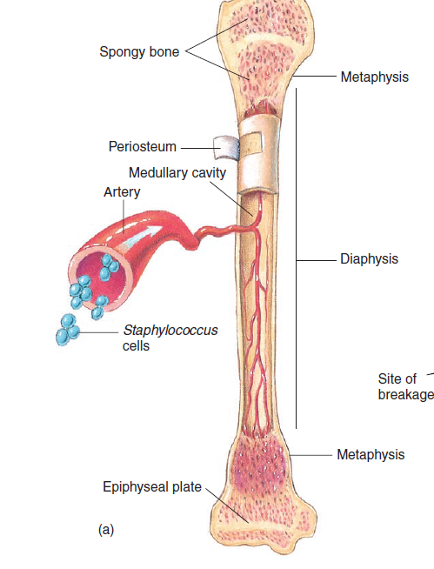

Slide 42
Etiologies and distribution of Osteomyelitis
S. aureus is responsible for 80-90% of cases
E. coli, Pseudomonas and Klebsiella are more commonly isolated from patients with UG tract infections or are drug users
Mixed infections seen in cases of surgery or open fractures
Neonatal period: H. influenzae and group B Strept.; Salmonella in patients with sickle cell
Complications may include: pathologic fracture, endocarditis, sepsis, etc.

Slide 43
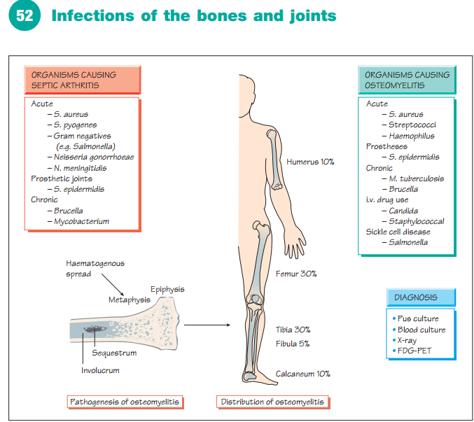

Slide 44
Tuberculosis Osteomyelitis
1-3% of patients with pulmonary or extrapulmonary TB have osseous (bone resembling) infection
Typically, pts. present with pain on motion, localized tenderness, low-grade fevers, chills and weight loss
Severe destruction of vertebrae (Pott’s disease) may cause skeletal deformities and neurologic deficits

Slide 45
Pathogenesis
The ends of long bones (metaphysis) are commonly affected
The presence of bacteria in the metaphysis with a local increase in vascular permeability, resulting in edema, increased vascularity and influx of polymorphonuclear leukocytes
Pressure increases as pus collects and is confined within rigid bones
Relatively inelastic periosteum may become elevated.
The blood supply to the area of involvement is decreased secondary to the pressure; necrosis of the infected bone may result in the formation of a sequestrum.

Slide 46
A protein-rich liquid containing inflammatory cells may collect in an adjacent joint but such effusions are sterile.
After the vascular supply to the involved area has been interrupted and necrosis has occurred.
The residual dead bone acts as a foreign body, making the eradication of bacteria impossible until the sequestrum is removed.
Pus may accumulate between the vertebral periosteum and dura mater, forming an extradural abscess.
Compression of the spinal cord may result, yielding a paraplegia.
If a subdural abscess ruptures into subarachnoid space, meningitis results.

Slide 47
Hematogenous osteomyelitis is often preceded by the signs and symptoms of bacteremia:
- Fever - Inflammation
- Malaise - Cephalgia
- Myalgia - Anorexia
The second phase of the disease is the clinical onset of involvement of bone:
Restricted motion
Pseudoparalysis
Soft tissue around the inflamed bone which is: warm, edematous, tender and bone tenderness

Slide 48
Septic Arthritis
It is bacterial infection of the joints (synovial membrane) lead a collection of purulent material in the joint space
Etiologies:
  Staphylococcus aureus – the most common cause
  Group A Streptococcus, Streptococcus pneumoniae
  Group B Streptococcus
  Gonococcus
Notes:
Septic arthritis, the invasion of the synovial membrane by microorganisms, usually with extension into the joint space, is generally secondary to infection elsewhere in the body.

Slide 49
  Epidemiology and Pathogenesis
  Commonly hematogenous origin in health people
  Joints of the lower extremity constitute 75% of all cases of septic arthritis
  Bacterial products--cytokine--inflammatory cascade resulting in destruction of cartilage and synovium
  Increased pressure in joint space (purulent material) --pressure necrosis of the cartilage
  When joint infection occurs as a result of bacteremia, the initial growth of m/oms is either in synovial membrane or in adjacent bone.

Slide 50
Inflammation of the synovial membrane is quickly established and results in a marked increase in leukocytes in synovial fluid
When the m/oms have spread into the joint fluid, culture of the fluid reveals the etiology of the infection.
Early in the infection, only inflammatory changes in synovium seen.
Late in the course of untreated septic arthritis, destruction of joint structures is marked.
Articular cartilage is particularly vulnerable because it is an avascular tissue.

Slide 51
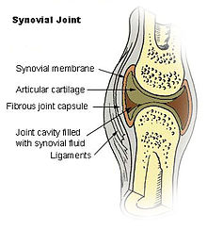

Slide 52
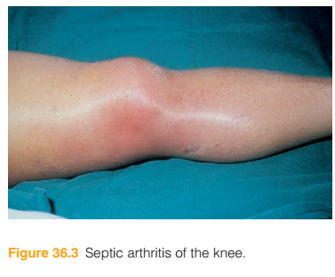
Clinical feature of septic arthritis
Adults have fever, pain, with localizing signs such as swelling, erythema, and warmth of the affected joint.
Increased pressure
Low pH
Low concentration of glucose
Activation of proteolytic enzymes
Increased turbidity
Presence of mucin precipitate

Slide 53
Laboratory Diagnosis
Specimen: Based on the affected tissue (wound swab, pus, blood, synovial fluid)
Microscopy: Gram-positive cocci in cluster
Culture:
  S. aureus grow readily on most bacteriologic media: BA, MSA
  S. aureus usually forms gray to deep golden yellow colonies
Notes:
Presence of microorganisms
Presence of antibody directed against the microorganisms
Turbidity
More than 10,000 pmns/mm³
Decreased glucose concentration (< 0.6% of blood glucose)
Increased lactic acid concentration (> 65 mg/dl)

Slide 54
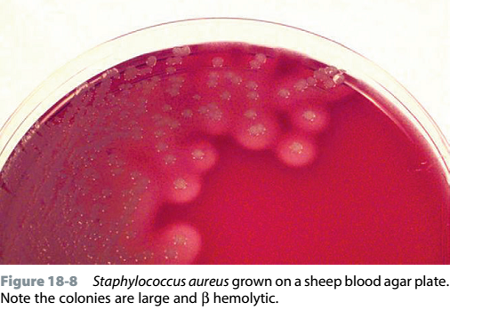
Coagulase test
Tube coagulase test- detects free coagulase
Slide test- detects bound coagulase
Catalase test
DNase test

Slide 55
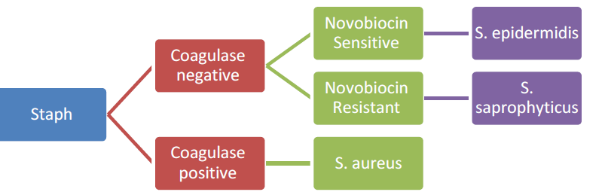
Identification of Staphylococcus
Notes:
Septic arthritis must be differentiated from acute rheumatoid arthritis, osteoarthritis, gout, pseudogout or reactive arthritis.

Slide 56
  Treatment
  Simple abscesses or boils are usually managed by incision and drainage
  β-lactamase-resistant penicillin's, Vancomycin
Penicillin resistance:
  Due to plasmid encoded β-lacatamase production
    β-lactamase hydrolyzes the β-lactam ring of penicillin
  Today less than 10% of strains are susceptible to this antibiotic.

Slide 57
Methicillin Resistance
  Due to mecA/mecC carried in staphylococcal cassette chromosome (SCCmec) that encode for alternative penicillin-binding proteins (PBP-2')
  HA-MRSA, CA-MRSA
Resistance to vancomycin thickening of the S. aureus cell wall (VISA), vanA gene (VRSA)
Notes:
Suppurative arthritis
Follows bacteraemia or injection of the joint.
95% of cases are caused by S. aureus and S. pyogenes.
Other causes include Enterobacteriaceae, N. gonorrhoeae, H. inﬂuenzae, Salmonella spp., Brucella spp., B. burgdorferi, Pasteurella and M. tuberculosis.
Large joints (e.g. the knee) are most commonly affected.
Prosthetic joints are at risk of early and late infections.

Slide 58
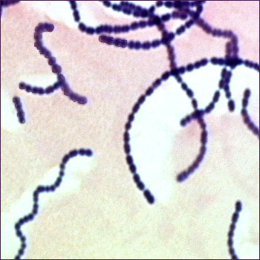
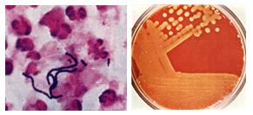
Streptococcus
Catalase-negative gram positive cocci arranged in chains
Widely distributed in nature, some are commensals &cause human diseases
Most are facultative anaerobes
More than 30 spp are identified

Slide 59
Classification
Based on polysaccharide on the cell wall (serologic reactivity)
  Group A:- S. pyogenes - pharyngitis, skin infections
  Group B:- S. agalactiae - neonatal septicemia, meningitis
  Group C:- S. equisimilis – endocarditis, bactermia, meningitis
  Group D:- Enterococci – UTI, endocarditis
  Group H:- S. sanguis, S. mutans – endocarditis, dental caries
  Group K:- S. salivarius - endocarditis, caries
N.B Non- grouped, Streptococcus pneumoniae

Slide 60
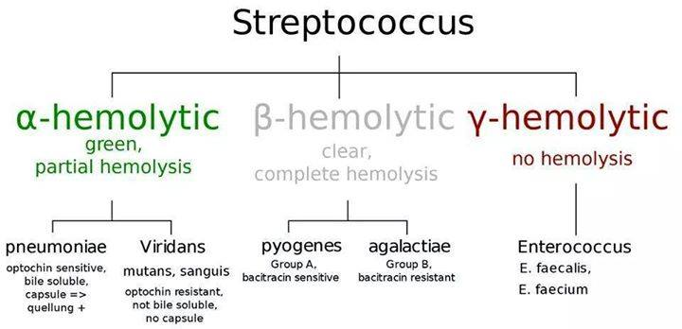
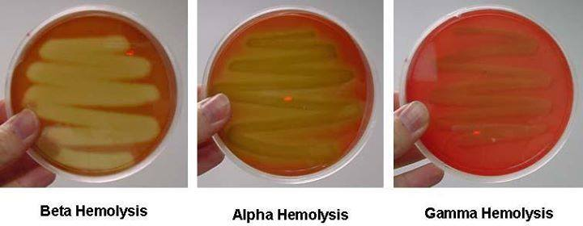
Based on hemolytic activities

Slide 61
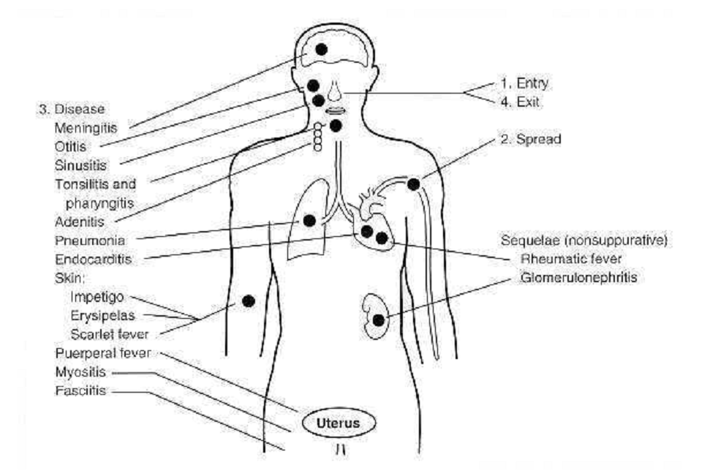
Group A Streptococcus (GAS): Streptococcus pyogenes
Consists with 40 antigenic types
It causes different types of diseases
  Some strains produce capsule and pathogenic strain contain M protein (attachment factor, antigenic and anti-phagocytic)

Slide 62
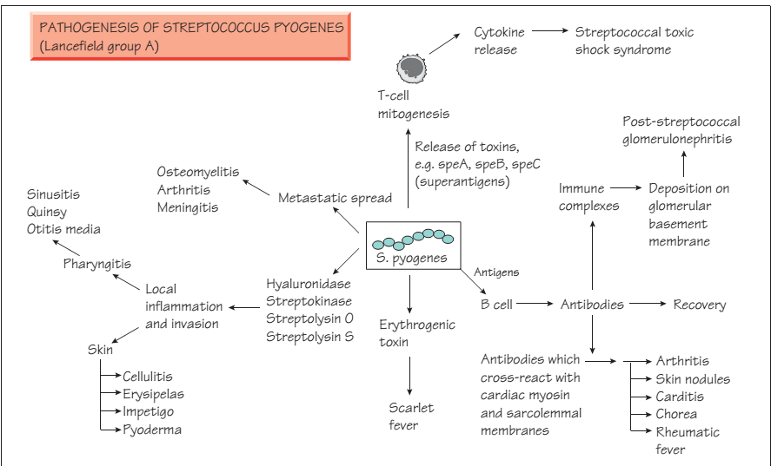
M- protein, F protein & lipoteichoic acid for attachment
Notes:
Shock is a systemic state of low tissue perfusion which is inadequate for normal cellular respiration
Streptolysin O is an oxygen-labile hemolysin capable of lysing erythrocytes, leukocytes, platelets, and cultured cells. This hemolysin is antigenically related to oxygen labile toxins produced by Streptococcus pneumoniae, Clostridium tetani, Clostridium perfringens, Bacillus cereus,and Listeria monocytogenes. Antibodies are readily formed against streptolysin O (antistreptolysin O [ASO] antibodies),a feature differentiating it from streptolysin S, and are useful for documenting recent group A streptococcal infection (anti-ASO test). Streptolysin O is irreversibly inhibited by cholesterol in skin lipids, so patients with cutaneous infections do not develop anti-ASO antibodies.

Slide 63
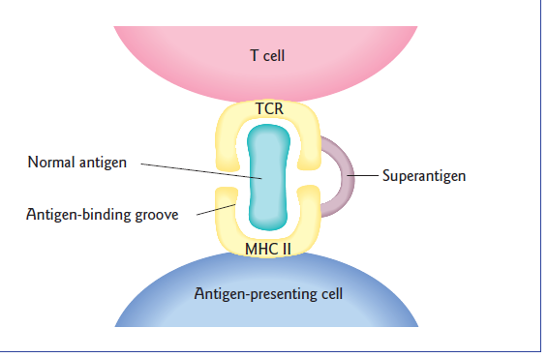
Notes:
Scarlet fever=an infectious disease with a fever, sore throat and a red rash

Slide 64
Virulence factors
It produces enzymes and toxins that allow to invade body tissues.
These enzymes include:
Deoxyribonucleases-which break down DNA,
Streptokinases- which dissolve blood clots, and
Hyaluronidase- which breaks down hyaluronic acid between cells.
S. pyogenes also secretes toxins: Exotoxin A causes toxemia and triggers an overactive response by immune system, contributing to tissue damage.
Streptolysin S is one of the more active bacterial toxins known; it is able to kill many kinds of human cell types in laboratory testing.
Notes:
Several bacteria can instigate necrotizing fasciitis, including Staphylococcus aureus, but Streptococcus pyogenes (group A Streptococcus) is the most common cause.

Slide 65
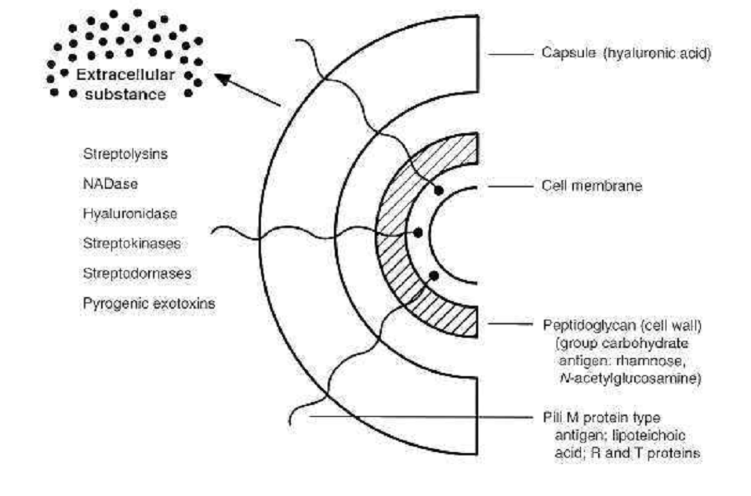
Virulence factors, cont…

Slide 66
i. Streptolysin O- is so called because it is oxygen &heat-labile
Seen in pour plates and anaerobic cultures, not in surface culture
It is a protein, antigenic, cytolytic and capable of lysing erythrocytes, leukocytes, platelets and cultured cells.
It is lethal on intravenous injection into animals and has a specific cardiotoxic activity.
Notes:
Streptokinase: Lyses blood clots (fibrinolysin) and facilitate spread of bacteria

Slide 67
ii. Streptolysin S
Streptolysin S is oxygen-stable and causes hemoly­sis colonies on aerobic blood culture.
It is produced in the presence of serum (S indicates serum dependence).
It is protein but non-antigenic which may be due to its small size.
It can lyse erythrocytes, leukocytes, and platelets.

Slide 68
Pathogenesis
S. pyogenes enters the body through wounds to the skin and spreads rapidly along muscle fascia.
It secretes the enzymes and toxins that destroy tissues at a rate of several centimeters of tissue an hour.
It causes organ failure so that more than 50% of patients die.
The usual route of transmission is from person to person.
Necrotizing fasciitis has developed following lowing surgery, abortion, and seemingly harmless events such as a needle stick to draw blood.

Slide 69
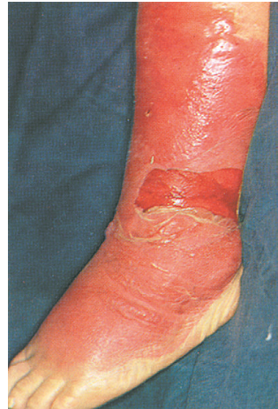
Streptococcus infections, clinical features
a. Erysipelas
  Painful, well-demarcated, infection of the dermis
  Intensely erythematous lesion raised above the level of the surrounding
  Patients experience localized pain, inflammation superficial lymph node enlargement, and systemic signs
  Different strain from causing pharyngitis
  S. agalactiae, or S. aureus can also cause erysipelas
Notes:
Pyoderma (Impetigo) is seen primarily in young chil­dren (2 to 5 years old) with poor personal hygiene. Group A streptococci causing impetigo are frequently nephritogenic, that leads to acute glomerulonephritis. The main causes leading to acute glomerulonephritis in children in the tropics are impetigo and streptococcal infection of scabies lesions.

Slide 70
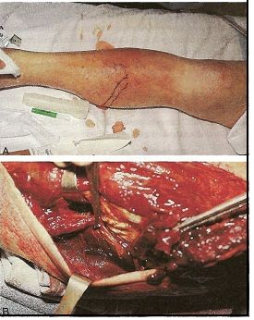
b. Cellulitis
  Involves skin and deeper subcutaneous tissues
  Diffuse- no distinction b/n infected and not infected
  Involve local & systemic manifestations
c. Necrotizing fasciitis (Streptococcal gangrene)
  Occurs deep in the subcutaneous tissue
  Chxs by an extensive destruction of muscle and
  fat
  It is a medical emergency requiring prompt surgical debridement
Notes:
S. pyogenes can cause necrotizing soft tissue infection, sensationalized by the news media as “flesh-eating strep” and medically known as necrotizing fasciitis.

Slide 71
Laboratory Diagnosis
Microscopy: Gram-positive cocci in pairs and chains in association with leukocytes
Culture: Fastidious, susceptible to bacitracin, β-hemolytic colonies on blood agar
S. pyo­genes hydrolyzes PYR (Pyrrolidonyl Aminopeptidase)
  Antigen/antibody tests are not used for cutaneous
Notes:
PYR (Pyrrolidonyl Aminopeptidase) Test is used for the detection of pyrolidonyl arylamidase (also called pyrrolidonyl aminopeptidase) activity in Streptococcus pyogenes (group A strep), Enterococcus spp., some coagulase-negative staphylococci, and some Enterobacteriaceae. It is also known as PYR (L-pyrrolidonyl-β-naphthylamide) which serve as a substrate for the detection of pyrrolidonyl peptidase.
The Quellung (or Neufeld) reaction is the gold standard technique for serotyping Streptococcus pneumoniae (pneumococcus). ... This method involves testing a pneumococcal cell suspension with pooled and specific antisera directed against the capsular polysaccharide.
The quellung reaction, also called the Neufeld reaction, is a biochemical reaction in which antibodies bind to the bacterial capsule of Streptococcus pneumoniae, Klebsiella pneumoniae, Neisseria meningitidis, Bacillus anthracis, Haemophilus influenzae, Escherichia coli, and Salmonella. The antibody reaction allows these species to be visualized under a microscope. If the reaction is positive, the capsule becomes opaque and appears to enlarge.

Slide 72
In quellung reaction, polyvalent anti-capsular antibodies are mixed with the bacteria, and then the mixture is examined microscopically and show ringed appearance.
A greater refractiveness around the bacteria is a positive reaction for S. pneumoniae.
Treatment
  Penicillin is drug of choice
  Oral cephalosporin or vancomycin is used for patients allergic to penicillin
Notes:
Principle of PYR Test
PYR is a rapid method for presumptive identification of bacteria based on the pyrrolidonyl arylamidase enzyme. The enzyme L-pyrrolidonyl arylamidase hydrolyzes the L-pyrrolidonyl- β-naphthylamide substrate to produce a β-naphthylamine. The β-naphthylamine can be detected in the presence of N,N-methylaminocinnamaldehyde reagent by the production of a bright red precipitate.
Following hydrolysis of the substrate by the peptidase, the resulting b-naphthylamide produces a red color upon the addition of 0.01% cinnamaldehyde reagent. When a visible inoculum of microorganism is rubbed onto a small area of a disk impregnated with the substrate, the hydrolysis occurs within 2 min, at which time the cinnamaldehyde reagent is added to detect the reaction by a color change to purple.
Uses of PYR Test
It is used for the presumptive identification of group A streptococci (Streptococcus pyogenes).
It is used for the rapid differentiation of enterococci from group D ß-hemolytic streptococci.
It also differentiate some Staphylococci (positive haemolyticus from negative S. auricularis).
It is used in the identification of E. coli, separating it from other indole positive, lactose positive, gram-negative rods.

Slide 73
Lyme Disease (Infectious Arthritis)
This illness is named after the town of Lyme, in USA where a number of cases were first discovered in 1975
It is caused by the spirochete Borrelia burgdorferi
It is transmitted from rodents to people by tiny, hard deer ticks (Ixodes dammini, I. ricinus, etc.)
Rodents & deer are the main animal reservoir
Joint involvement is the most common manifestation of disseminated infection and develops in approx. 80% of patients

Slide 74
The disease has early & late manifestations:
    The early stages are characterized by a skin lesion called "erythema chronicum migrans" associated with fever, chills, muscle pain & headache.
    Muscular and joint pain, often meningeal irritation
Late manifestations which appear weeks or months later are arthritis, myocarditis & neurologic manifestations
Laboratory Diagnosis
Detection of IgM antibodies by immunoflurorscence or ELISA
Cultures are possible, but difficult
Giemsa stain for light microscope

Slide 75
Treatment
Tetracyclines, penicillin & erythromycin
About 15% of patients develop Jarisch-Herxheimer reaction following antibiotics.
Jarisch Herxheimer reaction is produced following antibiotic treatment.
It is a reaction to endotoxin-like products released by the death of harmful microorganisms within the body during antibiotic treatment.

Slide 76
Typically, the death of these bacteria and the associated release of endotoxins or lipoproteins occurs faster than the body can remove the substances.
It usually manifests as fever, chills, rigor (rigidity), hypotension, headache, tachycardia, hyperventilation, vasodilation with flushing, exacerbation of skin lesions and anxiety.
Herxheimer reaction increases inflammatory cytokines during the period of exacerbation, including tumor necrosis factor alpha, interleukin-6 and interleukin-8.
Notes:
myalgia (muscle pain),

Slide 77
Acne
Acne is a skin disease marked by pimples (spots) on the face, chest and back
Acne is the most common skin disease
Propionibacteria is the most common cause
  Small, gram-positive, rod-shaped diphtheroids
  Fermentat carbohydrates to propionic acid
  Propionibacterium acnes, causes acne in 85% of afflicted adolescents and young adults
Staphylococcus aureus may also cause acne
Notes:
Paronychia- is an often tender infection of inflammation around the base of the nail fold. It can start suddenly (acute paronychia) or gradually (chronic paronychia). It is usually due to “Staphylococcus” bacteria germs.

Slide 78
Pathogenesis
Increased levels of androgens (male hormones) cause the sebaceous glands to secrete an excessive amount of sebum into hair follicles.
The excess sebum combines with dead, sticky skin cells to form a hard plug that blocks the follicle.
Bacteria that normally lives on skin then invades the blocked follicle.
Weakened, the follicle bursts open, releasing the sebum, bacteria, skin cells, and white blood cells into the surrounding tissues.
A pimple/white spot then forms
Notes:
Propionibacterium typically grows on sebum within the sebaceous glands of the skin . Excessive oil production triggered by the hormones of adolescence, particularly testosterone in males, stimulates the growth of the bacteria, which secrete chemicals that attract leukocytes and trigger inflammation. The leukocytes phagocytize the bacteria and release chemicals that stimulate local inflammation. The combination of dead bacteria and dead and living leukocytes makes up the white pus associated with the pimples of acne . A blackhead is formed when a plug of dead and dying bacteria blocks the pore . In cystic acne, a particularly severe form of the disease, bacteria form inflamed pustules (cysts) that rupture, triggering the formation of scar tissue. Acne typically develops on those areas of the skin where sebaceous glands are most numerous, including the face, scalp, neck, chest, back, upper arms, and shoulders.

Slide 79
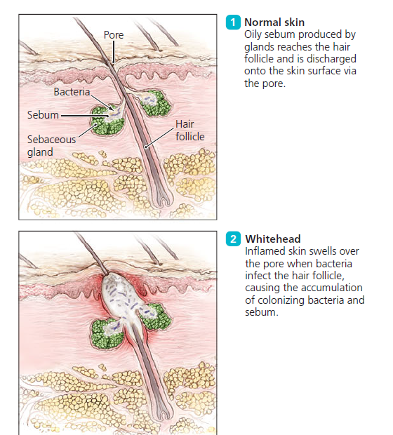
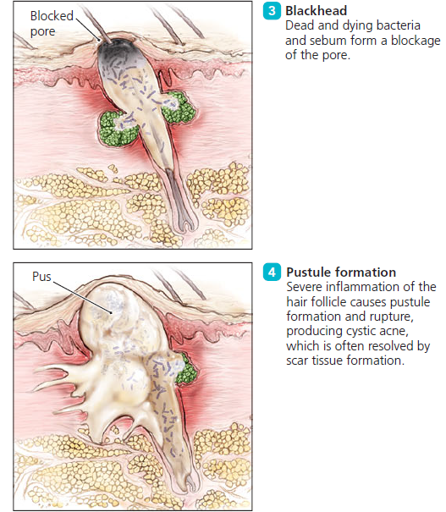
Pathogenesis, cont…

Slide 80
Diagnosis and Treatment
Diagnosis of acne is easy—it is visible on the skin
For more severe cases, doxycycline, benzoyl peroxide,
Retinoic acid, a derivative of vitamin A, inhibits the formation of sebum, reducing the amount available for bacterial metabolism.

Slide 81
Cat Scratch Disease
Cat scratch disease involves fever for a few days, prolonged malaise
Localized swelling at the site of infection and nearby lymph nodes for several months.
Bartonella henselae a Gram-negative aerobic bacillus, causes cat scratch disease.
Its primary virulence factor is endotoxin (lipid A) found in the outer membrane of Gram-negative bacteria.
Bartonella can grow and reproduce inside red blood cells and in cells lining blood vessel walls.
Notes:
in individuals who exhibit the characteristic signs and symptoms following exposure to cats.

Slide 82
Pathogenesis
Cat scratches or bites, particularly wounds by kittens, introduce the bacterium into the skin.
Blood-sucking arthropods such as fleas may also transmit the bacterium from cats to people.
In the skin, the bacterium grows intracellularly.
Bartonella releases endotoxin when it dies, which triggers inflammation.

Slide 83
Diagnosis and Treatment
A positive indirect fluorescent antibody test against Bartonella antigens confirms a diagnosis of cat scratch disease.
Azithromycin
Prevention involves avoiding cat-inflicted wounds and adequate cleansing of bites or scratches.

Slide 84
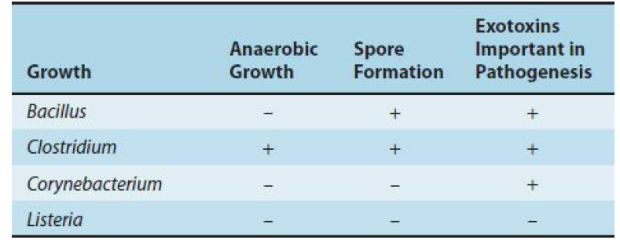
Skin infection by Gram-Positive Rods
There are 4 medically important genera of gram-positive rods:

Slide 85
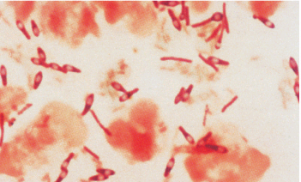
Clostridium
Anaerobic, gram-positive, spore forming
The spore is placed centrally, subterminally, or terminally
Grow well on the blood-enriched media
Many produce a zone of hemolysis on blood agar
Live in soil or the intestinal tract of
animals and humans

Slide 86
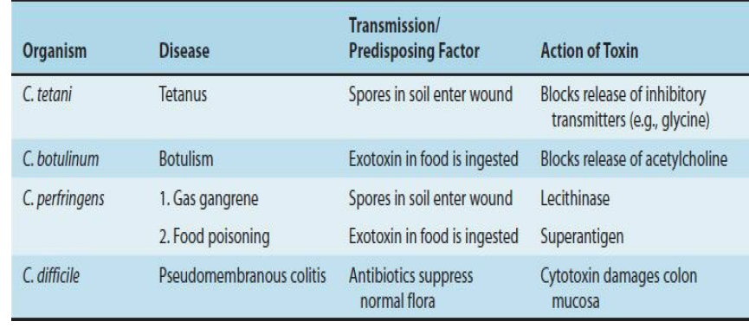
There are four medically important species:
N.B. Toxin is the principal virulent factor of all species

Slide 87
Clostridium perfringens
The most common cause of:
  Gas gangrene (myonecrosis, necrotizing fasciitis, cellulitis)
  Food poisoning
It can also caused by other species of Clostridium such as C. novyi, and C. septicum, but 90% by Clostridium perfringens
Bacterium is members of the normal flora of the colon and vagina.

Slide 88
Three types of infections with increasing severity:
Cellulitis: gas formation in the soft tissue-wound
Fasciitis or suppurated myositis: accumulation of pus in muscle planes, but muscle necrosis and systemic symptoms are absent
Myonecrosis or gas gangrene: a life-threatening disease
Clostridial Myonecrosis is a bacterial infection that produces gas tissues in gangrene (necrotic damage of tissue specifically muscles).
It is a deadly form of gangrene caused by C. perfringens bacteria.
This bacterium causes Myonecrosis via specific exotoxins

Slide 89
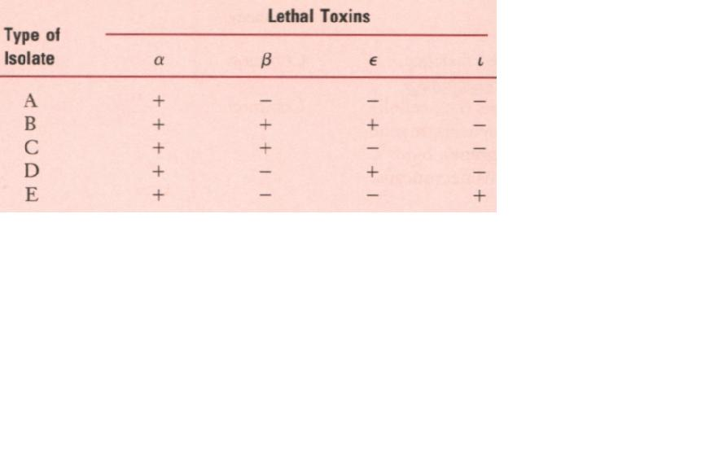
Subdivided into 5 types based on the four major lethal toxins they produce. Type A causes most of the human infections.

Slide 90
Type A strains are most commonly isolated from human infections cause a spectrum of diseases primarily by producing toxins and enzymes:
α-toxin: lecithinase (phospholipase C) that lyses a variety of cells
Lethal, necrotizing and hemolytic, increases vascular permeability, resulting in massive hemolysis and bleeding, tissue destruction, hepatic toxicity, and myocardial dysfunction
Other necrotizing and hemolytic toxins: DNase, hyaluronidase, enterotoxin.

Slide 91
Pathogenesis of gas gangrene
Spores germinate to vegetative cells multiply, ferment carbohydrates and produce gas in the tissue.
This results in distension of tissue and interference with blood supply
The bacteria produce necrotizing toxin and hyaluronidase, which favor the spread of infection
Tissue necrosis extends, resulting in increased bacterial growth, hemolytic anemia, then severe toxemia and death.
Incubation: 1-7 days after infection

Slide 92
Symptoms: Crepitation in the subcutaneous tissue and muscle, foul smelling discharge, rapidly progressing necrosis, fever, hemolysis, toxemia, shock, renal failure, and death.
It can be also caused by other Clostridium species.
Organisms grow in traumatized tissue (especially muscle) and produce a variety of toxins
The most important is alpha toxin (lecithinase)

Slide 93
  The presence of dead and dying tissue further compromises the blood supply
  The organisms multiply and produce more toxin and more damage
  Pain, edema, foul smelling, cellulitis, and gangrene (necrosis), crepitation occur in the wound area
Notes:
Germination and outgrowth of clostridia spores occurs. Alpha toxin and other exotoxins are secreted and extensive cell killing ensues. The production of enzymes that break down ground substance facilitates the spread of infection. Fermentation of tissue carbohydrates yields gas, and an accumulation of gas bubbles in the subcu­taneous spaces produces a crinkling sensation on pal­pation (crepitation), hence the name gas gangrene.

Slide 94
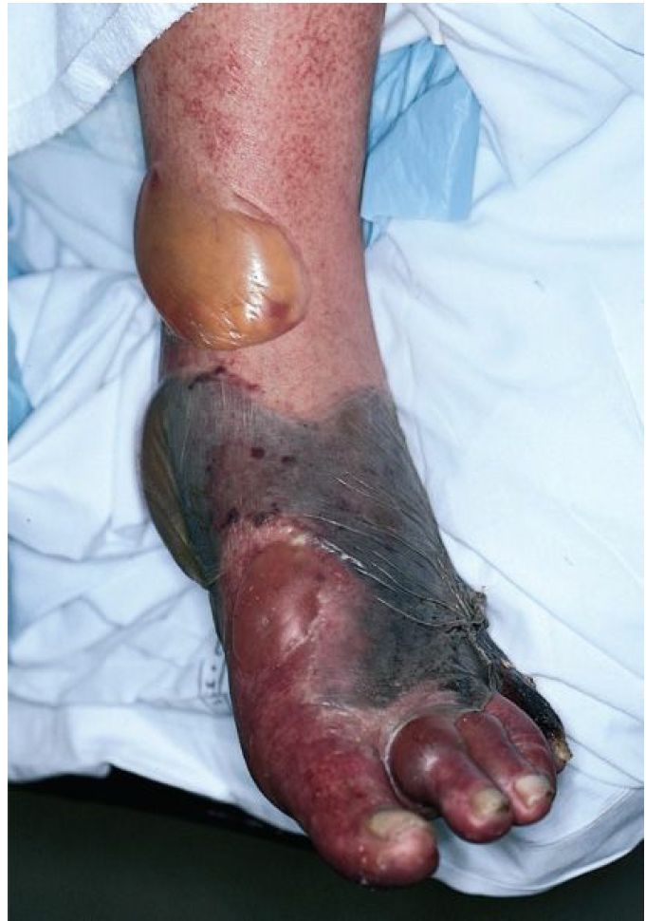
Fig: Gas gangrene

Slide 95
Laboratory Diagnosis
  Specimens consist of material from wounds, pus, feces, food and necrotic tissue
  The presence of large gram-positive rods in gram-stained smears
  With or without spores, usually in the absence of leukocytes
  Anaerobic culture in chopped meat-glucose medium, thioglycolate medium and onto blood agar plates
Storming clot fermentation -- clot torn by gas in 24 hrs
Nagler’s Reaction-- precipitate formed around colonies on egg yolk media.

Slide 96
Storming Clot Fermentation
Inoculate the litmus milk with the test organism
Incubate anaerobically at 37ºC for 18-24 hours (you can use a candle jar or heated iron)
After incubation, examine for the presence of a stormy clot.
Lactose in the milk is fermented
Acid and gas are produced
This acid causes coagulation of the casein
Casein combines with the gas to produce the distinctive and characteristic stormy clot
A stormy clot is the production of whitish cloud like coagulation at the top of the litmus milk
Notes:
In litmus milk medium, fermentation of lactose leads to formation of acid, which is indicated by the change in the color of litmus from blue to red. The acid clots the milk—casein (acid clot) and the clotted milk is disrupted due to the vigorous gas production. This is known as ‘stormy fermentation or ‘stormy clot’ reac­tion.

Slide 97
Nagler’s Reaction
Lecithinase C (phospholipidase C) splits lecithin into phosphoryl choline and diglycer­ide, in the presence of Ca++ and Mg++ ions because the toxin is activated by Ca++ and Mg++ ions.
This reaction is seen as an opalescence in serum or egg-yolk media and is specifically neutralized by the antitoxin.
Fig: Nagler’s reaction. Cl. perfringens colonies on the right half of the plate are surrounded by haloes, while colonies on the left half (containing antiserum to alpha toxin) have no haloes around them

Slide 98
Treatment
  Penicillin G is the antibiotic of choice
  Wounds should be debrided
  Hyperbaric oxygen may "detoxify" patients rapidly
Prevention
  Wounds should be cleansed and debrided
  Penicillin may be given for prophylaxis
  There is no vaccine

Slide 99
Mycobacterium leprae
It is the causative agent of Leprosy
Typical acid-fast bacilli, arranged in singly, parallel bundles or in globular masses.
Not grown in non-living bacteriologic media.
Characteristic lesions are grown in laboratory animals. E.g. Foot pads of mice & Armadillos
An obligate intracellular pathogens replicate within skin histocytes, endothelial cells, and the schwann cells of nerves.

Slide 100
These bacteria infect macrophages and Schwann cells, leading to skin lesions and peripheral nerve degeneration
If left untreated, permanent skin and nerve damage can result along with deterioration in the limbs and eyes
Contrary to popular thought, leprosy is not highly communicable
Prolonged contact with patients who have open lesions and are not in treatment is generally required for infection
The incubation period is generally about five to seven years, although symptoms can take as long as twenty years to appear

Slide 101
Route of infection is through air-borne spread of droplets from the nasal mucosa secretion and mouth, containing the bacilli expelled by untreated leprosy patients and inhaled by healthy persons.
Disease: Hansen’s disease or leprosy
Leprosy is a chronic granulomatous disease of humans primarily involving the skin, peripheral nerves and nasal mucosa but capable of affecting any tissue or organ.
The lesion involves the cooler parts of the body Eg. Ear lobes.
Two major types of leprosy:
    Lepromatous leprosy &
    Tuberculoid leprosy

Slide 102
Tuberculoid leprosy
Limited disease and relatively few bacteria in the skin and nerves, while lepromatous patients have widespread disease and large numbers of bacteria.
It is characterized by a few flat or slightly raised skin lesions of various sizes that are typically pale or slightly red, dry, hairless, and numb to touch (anesthetic).
T-helper1 cells specific for M. leprae antigens are capable of activating macrophages and inducing destruction of M. leprae.

Slide 103
Lepromatous Leprosy
Much more generalized disease, diffuse involvement of the skin, thickening of many peripheral nerves, and at times involvement of other organs, such as eyes, nose, testicles and bone.
Lepromatous leprosy results from the failure to produce an effective cell-mediated immune response and predominance of humoral immune responses.

Slide 104
Comparison of the two types of Leprosy
Characteristics Lepromatous leprosy Tuberculoid leprosy
1. Course Progressive Non-progressive
2. Manifestation Nodular skin lesion Macular skin lesion
3. Involvement of nerve Slow Severe
4. Cell mediated immunity Weak Strong
5. AFB from skin lesion Abundant Scanty
6. Lepromin skin test Usually negative Usually positive

Slide 105
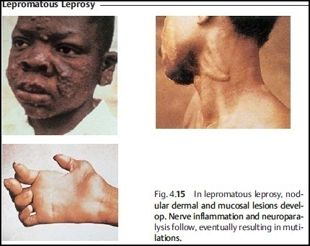

Slide 106
Laboratory Diagnosis
Microscopic examination
Diagnosis depend on smears prepared from nasal scraping, ulcerated skin nodules or material obtained by needle puncture of intact nodules/skin slit.
These are stained with modified Ziehl-Neelsen in which 5% H₂SO₄ is used for decolourization.
The presence of AFB in bunches intracellularly is diagnostic

Slide 107
Lepromin test
The diagnosis, based on clinical suspicion, is confirmed through bacteriological and histopathological analyses as well as by means of lepromin test
Lepromin test is an intradermal test similar to tuberculin.
The test is done by intradermal injection of heated exudate from lepromatous nodules or from armadillo lesions.
Intradermal reaction that is usually negative in lepromatous leprosy form and positive in the tuberculoid form

Slide 108
A positive test indicates the presence of cell mediated immunity due to past or recent exposure to M. leprae bacilli.
The test may be negative in severe cases of lepromatous leprosy.
Treatment
Sulphones - e.g. Dapsone (DDS) and rifampicin, are used for Rx
Clofazimine is given to sulphone resistant cases
Prevention
No confidential vaccine is available
BCG vaccine is widely used for protection against M. tuberculosis has some protective qualities against leprosy.
Chemoprophylaxis may be used to contacts of case
Notes:
Bacille Camelette-Guerin-

Slide 109
Spirochetes
Spirochetes are long, slender, motile, flexible, undulating, bacilli that have a characteristic corkscrew or helical shape
Large heterogeneous group of spiral shaped organisms
Habitat
Most are free living & non pathogenic, but few cause important human diseases.
Spirochetes have unique helical structure
  Cell wall of similar structure to that of gram negative bacteria

Slide 110
Syphilis
Syphilis is a highly infectious, chronic, sexually transmitted disease characterized by lesions that may involve any organ or tissue
It is caused by Treponema pallidum, is a microaerophilic
Transmission by:
Sexual intercourse or contact with bodily fluids
Direct contact with infected lesions
Transfusion of blood
Notes:
Bacterium Treponema pallidum, is a microaerophilic, it requires very low concentration of oxygen

Slide 111
Virulence Factors
Outer membrane proteins- promote adherence to host cells
Hyaluronidase- may facilitate peri-vascular infiltration
Coating of fibronectin- protects against phagocytosis
Molecular mimicry- The outer sheath that encases T. pallidum contains glycosylaminoglycans modified with sialic acid residues.
These antigens resemble common molecules found on the surface of human cells and help T. pallidum evade the host's immune response.
Notes:
peri-vascular infiltration = Inflammatory cells are clustered around blood vessels

Slide 112
Pathogenesis
Inoculation of T. pallidum during sexual contact, it gain access to sub epithelial cell spaces
Spirochetes multiply locally at the site of entry, and some spread to nearby lymph nodes and then reach the blood stream
In 2–10 weeks after infection, a papule develops at the site of infection and breaks down to form an ulcer with a clean, hard base (hard chancre) due to inflammation

Slide 113
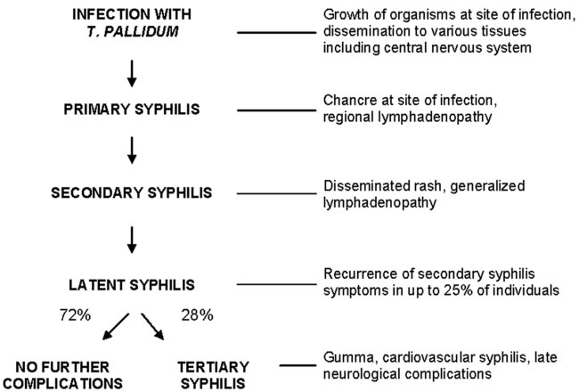
Clinical disease: Syphilis

Slide 114



ii. Secondary Syphilis

Slide 115
The clinical evidence of disseminated disease marks the second stage of syphilis
Flulike syndrome with sore throat, headache, fever, myalgia (muscle ache), anorexia, lymphadenopathy and a generalized mucocutaneous rash
The flulike syndrome and lymphadenopathy generally appear first and then are followed by disseminated skin rash
The rash can be variable (macular, papular, pustular), cover the entire skin surface (including the palms and soles), and may resolve slowly over a period of weeks to months
Notes:
The rest remain asymptomatic.
1. Maculopapular rash notable on the palms and soles, or as moist papules on skin and mucous membranes. Classic lesions have been
described as “raw ham” or copper-colored. Moist lesions in the
genital area are called condylomata lata.
2. There may be multi-organ involvement including meningitis, hepatitis, nephritis, etc.
3. The skin rash, which is rich in spirochetes and highly infectious, disappears spontaneously (without treatment) over a 2-6 week course.

Slide 116
As with the primary chancre, the rash in secondary syphilis is highly infectious
Condylomata lata; enlarged lesions, appearing in warm and moist areas including perineum and anus, are highly infectious
The rash and symptoms gradually resolve spontaneously, and the patient enters the latent or clinically inactive stage of disease
In rare individuals, lesions may become necrotic, a condition called lues (syphilis) malignancy
Notes:
Lues =a former name for syphilis or the plague

Slide 117
Localized inflammation of the oral cavity, tongue and genital mucous membranes can cause mucous patches
Infrequently, gastric and renal involvement and hepatitis
Glomerulonephritis resulting from immunoglobulin-treponeme antigen complexes deposited in the glomeruli appears to cause kidney damage

Slide 118


iii. Tertiary syphilis
Figure: Patient with tertiary (gummatous) syphilis

Slide 119
Without treatment, one- third of infected people develop tertiary disease
May occur 3 -15 years after the initial infection
It can be divided into three different forms:
  Gummatous- granulomatous lesions (gummas) in skin, bones, and liver
  Neurosyphilis- degenerative changes in the central nervous system (meningovascular syphilis, paresis, tabes dorsalis)
  Paresis= partial inability to move muscle caused by disease of the NS
Notes:
Paresis=partial inability to move: muscular weakness or partial inability to move caused by disease of the nervous system

Slide 120
  Tabes dorsalis- a disorder of the nervous system characteristic of late-stage syphilis and marked by degeneration of nerve fibers, wasting, pain
  Cardiovascular syphilis- cardiovascular lesions (aortitis, aortic aneurysm, aortic valve insufficiency)
People with tertiary syphilis are not infectious (treponemes are rare)
Aortic aneurysm=bulge in artery: a fluid-filled sac in the wall of an artery that can weaken the wall
Notes:
Tabes dorsalis=a disorder of the nervous system characteristic of late-stage syphilis and marked by degeneration of nerve fibers, wasting, pain, and inability to move the leg muscles

Slide 121
Laboratory Diagnosis
Specimen
  Tissue fluid, surface lesions for demonstration of spirochetes; blood serum for serologic tests.
Microscopy (detection of spirochetes in the lesion):
  A wet mount is prepared from exudate and examined by:-
  Dark field Examination
  Immunofluorescence
  T. pallidum cannot grow in artificial media

Slide 122
a. Dark field Examination:-
  A drop of tissue fluid or exudate is placed on a slide and a cover slip pressed over it to make a thin layer
  The preparation is then examined under oil immersion with dark field illumination for typical motile spirochetes
b. Immunofluorescence:-
  Tissue fluid or exudate is spread on a glass slide, air dried and sent to the laboratory
  It is fixed, stained with a fluorescein-labeled anti-treponeme serum and examined by means of immunofluorescence microscopy for typical fluorescent spirochetes

Slide 123

Figure. Dark field Examination T. pallidum

Slide 124

Figure: Immunofluorescence examination of T. pallidum

Slide 125
Serologic Tests for Syphilis
These tests use either non treponemal or treponemal antigens.
Non treponemal antigen tests:
Non specific test for syphilis to detect Wassermann Abs
The tests are sensitive, but non specific
The Ags employed are lipid extracted by alcohol from normal mammalian tissue
The purified cardiolipin from beef heart is diphosphatidyglycerol
It requires the addition of lecithin & cholesterol to react with syphilitic "reagin"
Notes:
Nontreponemal tests. Syphilitic infection leads to the production of nonspecific antibodies that react to cardiolipin. This reaction is the foundation of “nontreponemal” assays such as the VDRL (Venereal Disease Research Laboratory) test and Rapid Plasma Reagin (RPR) test.
A nontreponemal test (NTT) is a blood test for diagnosis of infection with syphilis. Nontreponemal tests are an indirect method in that they detect biomarkers that are released during cellular damage that occurs from the syphilis spirochete. In contrast, treponemal tests look for antibodies that are a direct result of the infection thus, anti-treponeme IgG, IgM and to a lesser degree IgA. Nontreponemal tests are screening tests, very rapid and relatively simple, but need to be confirmed by treponemal tests.^{[1]} Centers for Disease Control and Prevention (CDC)-approved standard tests include the VDRL test (a slide test), the rapid plasma reagin (RPR) test (a card test), the unheated serum reagin (USR) test, and the toluidine red unheated serum test (TRUST).^{[2]} These have mostly replaced the first nontreponemal test, the Wassermann test.

Slide 126
Reagin: a mixture of IgM & IgA abs directed against some antigens widely distributed in normal tissues
Found in pt serum after 2-3 wks of untreated syphilitic infection
Two types of tests determine the presence of reagin:
Complement fixation (CF) tests=Wassermann reaction
CF tests are based on the fact that reagin containing sera fix complement in the presence of cardiolipin Ag
2. Flocculation tests:
I. VDRL test- particles of cardiolipin form visible flocculation when combined with reagin.
  The suspension is shaken & reactions occurs in few minutes
  It requires microscope to observe the reaction

Slide 127
ii. Rapid plasma reagin (RPR):
It can be used as agglutination test that employs cardiolipin coated carbon particles
It does not require microscope to observe the agglutination
These tests being non-specific may give false +ve in other diseases, e.g. autoimmune disease, measles, leprosy, malaria...
A positive test should be confirmed by one of the specific Treponemal Ag tests
The non- treponema Ag tests are used for screening and epidemiologic purposes due to their low cost
Notes:
They may be used to evaluate the effect of treatment since they revert to negative 6-18 months after effective treatment

Slide 128
B. Treponemal antigen tests:
Ags for these tests are prepared from virulent treponema
The tests are highly specific as they detect anti-treponemal Abs but they are more complex & expensive
They are used primarily as confirmatory tests
1. Fluorescent treponemal antibody (FTA) test
The first test to give positive result early
An indirect immunofluorescence test in which pt sera is applied to a smear of pathogenic T. pallidum (i.e. Nichol's strain) on a slide. After 30min incubation at 37ºC, the slide is washed

Slide 129
2. Treponema pallidum haemagglutination (TPHA) test
It depends on the ability of Abs in syphilitic pt serum to bring about agglutination of sheep red blood cells coated with an extract of T. pallidum
Treatment
One single treatment with penicillin is curative for primary and secondary syphilis
In cases of patient allergic to penicillin, alternate therapy with erythromycin or tetracyclines may also be effective
For pregnant women- erythromycin
Jarisch-Herxheimer reaction my occur

Slide 130
Viral infection of Musculoskeletal and Integumentary
System

Slide 131

Outcomes from a viral infection of a cell
Notes:
Viroids are agents that do not fit the definition of classic viruses. They are nucleic acid molecules without a protein coat.
Prions are infectious particles composed solely of protein with no detectable nucleic acid. They are highly resistant to inactivation by heat, formaldehyde, and ultraviolet light that inactivate viruses.
131

Slide 132
Viral infection of Musculoskeletal and Integumentary System
Pox virus
Polio virus
Measles virus
Mumps virus
Varicella-Zoster virus (chickenpox & shingles)
Herpes virus
Warts causing virus, etc.
Many viral diseases are systemic in nature and spread by respiratory and oral routes; nevertheless, they manifest signs and symptoms in the skin.
Notes:
These include diseases of poxviruses, herpes infections, warts, chickenpox, shingles, rubella, measles, roseola, erythema infectiosum, and coxsackie viral infections.

Slide 133
Poxviruses
Human diseases caused by poxviruses include smallpox
Three diseases of animals—orf (sheep and goat pox), cowpox, and monkey pox—which rarely affect humans.
Human poxvirus (Orthopoxvirus), known commonly as variola virus, attaches only to human cells.
The poxviruses of cows (Vaccinia), sheep, goats, and monkeys are less easily contracted by humans because they do not attach as readily to human cells.
Poxviruses are DNA viruses.
Notes:
ፈንጣጣ
Smallpox and cowpox have played important roles in the history of microbiology, immunization, epidemiology, and medicine. Edward Jenner first demonstrated immunization using the relatively mild cowpox virus to protect against smallpox. He was successful because the antigens of cowpox virus are chemically similar to those of smallpox virus, so that exposure to cowpox results in immunological memory and subsequent resistance to both cowpox and smallpox.
Transmission of these poxviruses to humans requires prolonged close contact with infected animals, as Edward Jenner observed for milkmaids who contracted cowpox.

Slide 134
Transmission of these poxviruses to humans requires prolonged close contact with infected animals.
Virulence Factors
They have adhesion molecules allowing them to attach to a host cell’s cytoplasmic membrane, where they trigger their own endocytosis.
They carry genes for transcription enzymes, which allow them to replicate entirely in the cytoplasm of a cell.
The viruses also code for proteins that interfere with the actions of interferon, complement, and inflammation.
Notes:
Smallpox was also the first human disease to be eradicated globally in nature, but stalk in the labs.
Unlike other DNA viruses, they carry genes for transcription enzymes, which allow them to replicate entirely in the cytoplasm of a cell.

Slide 135

Figure: Small pox

Slide 136
Pathogenesis
Close contact is necessary for infection with smallpox viruses.
This occurs primarily through inhalation of viruses in droplets
or dried crusts.
Smallpox viruses replicate in the respiratory tract and then spread via the blood and lymph throughout the body, causing lesions on the skin
Poxviruses spread by direct contact
Infections of humans with these viruses are usually relatively mild, resulting in pox and scars.
Notes:
Crusts can remain infective for two years.
In the case of cowpox, the advent of milking machines has reduced the number of cases to near zero in the industrialized world.

Slide 137


Figure: The stages of lesions of poxviral skin infections. Red macules may become hard papules, then fluid-filled vesicles that become pus-filled pustules (pox), which sometimes crust over and leave scars.
Notes:
The lesions begin as flat, reddened macules, which then become raised sores called papules. When the lesions fill with clear fluid, they are called vesicles, which then progress to pus-filled pustule.

Slide 138


Slide 139
Clinical features
All poxviruses produce lesions that progress through a series of stages.
The lesions begin as flat, reddened macules, which then become raised sores called papules.
When the lesions fill with clear fluid, they are called vesicles.
Which then progress to pus-filled pustules known as pox.
Poxvirus pustules then dry to form crusts.
B/c lesions penetrate the dermis, they result scars, particularly on face
Characterized by high fever (42°C), malaise, delirium, and prostration.
Infection of the eye may induce blindness.
Notes:
1. Poxvirus causes smallpox, orf, cowpox, and monkey pox. Lesions progress from flat macules to raised papules, vesicles, and pus filled pustules (also called pox).
2. Smallpox virus (variola virus) exists in two strains: variola major and variola minor. Worldwide immunization has eradicated smallpox except for laboratory stocks

Slide 140
Diagnosis, treatment and prevention
Diseases of poxviruses by their distinctive pox
They confirmed the diagnoses by inoculating fertilized chicken eggs with fluid from the lesions
Poxviruses produce characteristic lesions on the membranes of developing chicken embryos.
Immediate immunization of people exposed to smallpox virus prevents the disease from developing.
No treatment exists once smallpox develops.
Notes:
Smallpox vaccination was discontinued in the 1980s because the vaccine caused adverse effects such as inflammation of the heart and rarely death.
Now, in an effort to ward off potential bioterrorism, military personnel and selected health care providers are immunized.
Interestingly, researchers have determined that adverse reactions to the vaccine are currently lower than historical rates, possibly because of better overall health care.
They have also determined that previously immunized individuals can be successfully revaccinated with a diluted vaccine containing only 10% of the cowpox viruses in a standard vaccine.

Slide 141
Poliomyelitis
Condition first known as infantile paralysis
  Risk of paralysis actually increases with age
It belongs to picornaviridae, 3 serotypes of poliovirus (1, 2, and 3)
Still a major problem in underdeveloped countries
Transmitted by ingestion
Initial symptoms: Sore throat and nausea
Viremia may occur; if persistent, virus can enter the CNS destruction of motor cells and paralysis occurs in <1% of cases
Notes:
Poliomyelitis is an acute infectious disease that in its serious form affects the central nervous system (CNS). The destruction of motor neurons in the spinal cord results in flaccid paralysis. However, most poliovirus infections are subclinical. Poliovirus has served as a model enterovirus in many laboratory studies of the molecular biology of picornavirus replication.

Slide 142
Pathogenesis
Virus is an enterovirus with an affinity for the CNS
  Normally crosses the blood-brain barrier
  Can also use axons or the perineural sheath of the peripheral nervous system
Motor neurons are particularly vulnerable
Various levels of neuronal destruction cause:
  Necrosis of neural tissue
  Infiltration by mononuclear cells, primarily lymphocytes

Slide 143
The destruction of motor neurons in the spinal cord results in flaccid paralysis
90% of poliomyelitis infections are very mild and subclinical
Incubation time varies from 4 to 35 days.
Average is about 10 days
Three types of polio infection:-
  Abortive poliomyelitis:
    Nonspecific febrile illness
    Lasts two to three days
    No signs or symptoms

Slide 144
  Non-paralytic poliomyelitis (aseptic meningitis):
    Characterized by meningeal irritation, stiff neck, back pain, and back stiffness
    Rapid and complete recovery
  Paralytic poliomyelitis:
  Occurs in 2% of persons infected
  Characterized by asymmetric flaccid paralysis
  Extent varies from case to case
  Temporarily damaged neurons can regain function
  Recovery can take six months
  Paralysis persisting after this period is permanent

Slide 145
Laboratory Diagnosis
Specimen: Throat swabs, rectal swabs or stool
Specimens should be kept frozen during transit to the laboratory
Cultures of human or monkey cells are inoculated, incubated, and observed.
Cytopathogenic effects appear in 3–6 days
An isolated virus is identified and typed by neutralization with specific antiserum
Virus can also be identified by PCR assays
Notes:
Cytopathic effect (abbreviated CPE) refers to degenerative changes in cells, especially in tissue culture, and may be associated with the multiplication of certain viruses.

Slide 146
Prevention and Control
Polio vaccine essentially wiped out this infection
Two types of vaccine:
  Inactive/killed form (Salk)– developed by Jonas Salk
  It is prepared from virus grown in monkey kidney cultures
  Live attenuated form – developed by Albert Sabin

Slide 147
  Measles (Rubeola) Virus Infections
  It is also called Morbillivirus, an RNA virus
  Highly contagious skin disease that is endemic throughout the world
Morbilliviruses occur only as one cross-reactive antigenic type
The natural disease is limited to humans and monkeys
Notes:
Measles (ኩፍኝ) and mumps become disseminated throughout the body and produce generalized disease

Slide 148
Pathogenesis
Measles virus infects cells of the respiratory tract before spreading via lymph and blood throughout the body to infect the conjunctiva, blood vessels, lymphatics, central nervous system, and skin.
Cytotoxic T cells kill infected cells, causing most of the symptoms.
Most patients recover within two to three weeks, though 1–5% of infected children will die.
Secondary infections by bacteria such as Staphylococcus or Streptococcus can increase the seriousness of measles.
Patients with compromised cellular immunity, such as AIDS patients, can have continued measles infection, resulting in death.

Slide 149

Pathogenesis, cont…
Enters the body through the respiratory tract or the conjunctiva of the eyes.

Slide 150


Slide 151
Measles has several important features as follows:
  Nearly all infected individuals become unwell and develop disease:- 85%
  Contagion period precedes symptoms
  Developed complete resistance to re-infection
  Virus can pass directly from cell to cell and escape antibody control
  Persistent infections without lysis can occur in certain cell types (e.g., human brain cells)

Slide 152


Clinical manifestation

Slide 153
Diagnosis
Measles is usually diagnosed clinically: Koplik spot in the mouth cavity rash
Isolation & Identification of virus
  Nasopharyngeal, conjunctival swabs, blood samples, respiratory secretions
  Grow on cell culture (CPE)
  Multinucleated giant cells
Serology: Confirmation by measles IgM assay to the nucleoprotein of the virus either on blood or saliva samples

Slide 154

Figure: Measles Koplik Spots

Slide 155
Cytopathic Effect (CPE)
Cytopathic effect of Measles and HSV in cell culture respectively: note the ballooning of cells

Slide 156
Treatment
There is no antiviral treatment
Prevention
Immunization with the combined MMR (measles, mumps, and rubella) vaccine
It is live, attenuated vaccine
Not be given to immunocompromised persons & pregnant women
Natural immunity is life long
Prophylaxis (Immunoglobin) could be given for exposed

Slide 157
  Germans Measles (Rubella Virus)
  The virus has identified in 1941 in Germen by observing child with eye cataract
  Rubella virus is enveloped, a member of the togavirus family
  It is composed of one piece of positive single-stranded RNA
  Its surface spikes contain hemagglutinin
  The virus has a single antigenic type
  Antibody against hemagglutinin neutralizes infectivity
  Humans are the natural host
Notes:
Also called 3-day measles, an acute febrile illness characterized by a rash and lymphadenopathy that affects children and young adults

Slide 158
Pathogenesis & Immunity
  Transmitted via respiratory droplets and from mother to fetus transplacentally
  Initial replication of the virus occurs in the nasopharynx and local lymph nodes.
  From there it spreads via the blood to the internal organs and skin.
  Natural infection leads to lifelong immunity

Slide 159
Clinical features
Milder, shorter disease than measles
Incubation period of 14 to 21 days
Maculopapular rash, which starts on the face and progresses downward
Posterior auricular lymphadenopathy is characteristic
Polyarthritis caused by immune complexes often occurs

Slide 160
Congenital Rubella Syndrome
If non-immune pregnant woman is infected during the first trimester: teratogen
Significant congenital malformations can occur as a result of maternal viremia and fetal infection
Malformations involve primarily the heart (e.g., patent ductus arteriosus), the eyes (e.g., cataracts), and the brain (e.g., deafness and mental retardation).
Severe bilateral deafness, severe bilateral visual defects
Cataract
Corneal opacity

Slide 161

Congenital Rubella Syndrome
• Severe bilateral deafness
• Severe bilateral visual defects
Cataract
Corneal opacity

Slide 162
Laboratory Diagnosis
  Rubella virus can be grown in cell culture
  IgM & IgG titer
  Amniocentesis can reveal whether there is rubella virus in the amniotic fluid
Treatment
There is no antiviral therapy
Prevention
  Live attenuated vaccine
  Prophylaxis

Slide 163
Herpesviruses
Herpesviruses are relatively large, enveloped viruses with linear dsDNA
Nearly 100 viruses- infect many different animal species
  8 routinely infect only humans
In cells infected with herpesviruses, the viral dsDNA can exist as a provirus
A universal property of herpesviruses is latency
Persist indefinitely in infected hosts
Some are cancer-causing (CMV, EBV, Herpes virus 8 … )

Slide 164
Herpes Virus types
Herpes simplex (HSV-I & II) (cold sores, genital herpes)
Varicella Zoster (chicken pox, shingles)
Cytomegalovirus (microcephaly, infectious mono)
Epstein-Barr virus (mononucleosis, Burkitt’s lymphoma)
Human herpesvirus 6 & 7 (Roseola)
Human herpesvirus 8 (Kaposi’s sarcoma)
Notes:
Roseola infantum - a sudden infection of small children, with fever, swelling of the lymph glands and a rash. It is caused by herpesvirus 6
Kaposi’s sarcoma - a cancer which takes the form of many haemorrhagic nodes affecting the skin, especially on the extremities

Slide 165
Virus Subfamily Disease Site of Latency
Herpes Simplex Virus I α Orofacial lesions Sensory Nerve Ganglia
Herpes Simplex Virus II α Genital lesions Sensory Nerve Ganglia
Varicella Zoster Virus α Chickenpox Sensory Nerve Ganglia Recurs as Shingles
Cytomegalovirus β Microcephaly/Mono Lymphocytes
Human Herpesvirus 6 β Roseola Infantum CD4 T cells
Human Herpesvirus 7 β Roseola Infantum CD4T cells
Epstein-Barr Virus γ Infectious Mono B lymphocytes, salivary
Human Herpesvirus 8 γ Kaposi’s Sarcoma Kaposi’s Sarcoma Tissue

Slide 166

Herpes Simplex Virus I & II
Mucocutaneous: prodrome followed by grouped tensed vesicles over an erythematous base
HSV- 1
  Oral herpes (Cold sores, gingivostomatitis)
  Can cause encephalitis
HSV- 2
  Genital herpes
  Neonatal herpes
  Can cause encephalitis
Fig. Gingivostomatitis
Notes:
Human herpes viruses produce various proteins that act as virulence factors: glycoproteins in the viral envelope mediate viral adhesion and fusion, and other proteins inactivate complement and IgG. The virus also produces DNA-scavenging enzymes.

Slide 167
Two Simplex virus cause herpes: human herpesvirus 1 (HHV-1) and human herpesvirus 2 (HHV-2).
HHV-1 has also been known as “above the waist herpes” virus
HHV-2 has been known as “below the waist herpes” virus
HHV-2 is also usually the species involved in neonatal herpes.
Virulence Factors
Human herpesviruses produce various proteins that act as virulence factors: glycoproteins in the viral envelope mediate viral adhesion and fusion, and other proteins inactivate complement and IgG.
The virus also produces DNA-scavenging enzymes.
Notes:
Though either strain can occur in either location.

Slide 168


Slide 169
Pathogenesis
A herpesvirus attaches to a host cell through the fusion of its envelope with the cytoplasmic membrane.
After the viral genome is replicated and assembled in the cell’s nucleus, the virus acquires envelope from the nuclear membrane and exits the cell via exocytosis or cell lysis.
After entering the body through cracks or cuts in mucous membranes, viruses reproduce in epithelial cells.
Produce inflammation and cell death, resulting in painful, localized lesions on the skin.
Notes:
Active lesions are the usual source of infection, though asymptomatic carriers can shed HHV-2 genitally.

Slide 170
By causing infected cells to fuse with uninfected neighboring cells to form a structure called a syncytium, spread and avoid the host’s humoral immune system.
Initial infections with herpes simplex viruses are usually age specific.
Most HHV-2 infections are acquired between the ages of 15 and 29 as a result of sexual activity.
Notes:
Primary HHV-1 infections typically occur via casual contact during childhood and produce no signs or symptoms; in fact, by age 2, about 80% of children have been asymptomatically infected with HHV-1.

Slide 171


Herpes labialis
Herpetic whitlow
Notes:
A Tzanck smear of a scraping obtained from a vesicle on the skin demonstrates multinucleated giant cells. Multinucleated giant cells are associated with which of the following viruses?

Slide 172



HSV-1/2
HSV-1/2
Burkett’s lymphoma due EBV
Notes:
Burkett’s lymphoma HSV-1/2

Slide 173

Notes:
Pathogenesis
Herpesvirus attaches to a host cell through the fusion of its envelope with the cytoplasmic membrane. After the viral genome is replicated and assembled in the cell’s nucleus, the virus

Slide 174
Diagnosis and treatment
Diagnose herpes infections by the presence of their characteristic, recurring lesions, especially in the genital region and on the lips.
Microscopic examination of infected tissue reveals syncytia.
Diagnosis is achieved by immunoassay that demonstrates the presence of viral antigen.
With chemotherapeutic agents such as acyclovir.
Topical applications of the drugs limit the duration of the lesions and reduce viral shedding
Notes:
Health care workers can reduce their exposure to infection with herpes simplex by wearing latex gloves. Since a whitlow is a potential source of infection, symptomatic personnel should not work with patients, especially newborns, until the whitlow has healed.
Topical applications of the drugs limit the duration of
the lesions and reduce viral shedding, though the drugs do not cure the diseases or free nerve cells of latent viral infections.

Slide 175
Varicella-Zoster Virus (VZV) infection
Properties of the Virus
  VZV is morphologically identical to HSV
  Has no animal reservoir
  VZV causes two distinct clinical entities
    Varicella (chickenpox)
    Herpes zoster (shingles)

Slide 176
Varicella-Zoster Virus, cont…
Primary infection (chickenpox) is one of the classical rash diseases of childhood.
Following primary infection, the virus remains latent in the cranial-spinal ganglia.
Reactivation leading to the appearance of shingles occurs in 10-20% of infected individuals and usually occurs after the fourth decade of life.

Slide 177
Pathogenesis
Infection with VZV begins in the mucous membrane of the respiratory tract and then spreads into the liver, spleen, and lymph
nodes via the blood and lymph.
After two weeks, a second wave of viruses spreads via the blood throughout the body and to the skin.
In the dermis, infected cells develop the characteristic rash, which is associated with fever and malaise.
Viruses are shed before and during symptoms through respiratory droplets and the fluid in lesions; dry crusts are not infective.
Notes:
Usually the disease is mild, but it may rarely be fatal, especially if associated with secondary bacterial infections.

Slide 178
The virus becomes latent in nerve ganglia and can reactivate in adults, usually after age 45.
Reactivated virus travels down the nerve to manifest the lesions of shingles in the band of skin innervated by the infected nerve.
Varicella (Chickenpox)
  Acute disease that follows primary contact with the virus
  The incubation period of typical disease is 10–21 days
  Malaise and fever are the earliest symptoms
  Rash, first on the trunk and then on the face, the limbs and the buccal and pharyngeal mucosa in the mouth

Slide 179


Slide 180


Slide 181


Slide 182
  Zoster (Shingles)
  Reactivation of varicella virus
  Present in latent form in neurons in sensory ganglia
  The response of the partially immune host or incapacitating disease of adults or immunocompromised individuals
  A rash limited in distribution to the skin innervated by a single sensory ganglion
  Lesions are similar to those of varicella

Slide 183


Slide 184
Diagnosis
Mainly clinical (characteristic appearance of the lesions)
Fourfold or greater rise in VSV IgG antibodies is confirmatory of acute infection.
VZV can be identified quickly by direct fluorescence assay (DFA)
Infectious virus may be recovered by means of tissue culture methods.
Antibody tests are available to verify the diagnosis of both VZV infections.

Slide 185
  Treatment and prevention
  Antiviral treatment modifies the course of both varicella and herpes zoster: acyclovir
  Varicella is a vaccine preventable disease
  Varicella vaccine contains live, attenuated VZV (Oka strain) and is indicated for subcutaneous administration
Notes:
The CDC recommends a more potent form of the live chickenpox vaccine for people older than 19 years to prevent shingles in those who had chickenpox as children. Treatment of shingles involves management of the symptoms and bed rest. Loose-fitting clothing and nonadherent dressings may help prevent irritation of the lesions. Acyclovir provides relief from the painful rash for some patients, but it is not a cure. It is more difficult to distinguish shingles from other types of skin lesions, though the localization within a band of skin on one side of the body is characteristic.

Slide 186
Warts (papillomas)
They are generally benign growths of the epithelium of the skin or mucous membranes.
Warts form on many body surfaces, on the fingers or toes (seed warts);
deep in the soles of the feet (plantar warts);
on the trunk, face, elbow, or knees (flat warts); or
on the external genitalia (genital warts).
Generally, warts are painless, though they may itch or hurt, particularly plantar warts.

Slide 187
Virulence Factors
Almost 60 different strains of Papillomavirus cause warts.
Various strains infect either cutaneous or mucosal tissues, causing infected epithelial cells to divide.
This produces warts on the skin or mucous membranes.
Some strains of papillomaviruses integrate into host cell chromosomes, potentially triggering the action of oncogenes, which cause cancers.

Slide 188
Pathogenesis
Besides causing infected epithelial cells to divide, papillomaviruses cause the cells to develop distinctive vacuoles surrounding their nuclei and to form dense cytoplasm.
The incubation time from infection to the development of a wart is usually three to four months.
Warts are often unsightly, but most are harmless.
Nevertheless, evidence suggests that papilloma viruses precipitate various head, neck, anal, vaginal, penile, and oral cancers.
Papillomaviruses of genital warts definitely cause almost all cervical cancer.

Slide 189

Figure: Various kinds of warts—lesions caused by papillomaviruses. (a) Plantar warts on the sole of a foot. (b) Flat warts, which often occur on the trunk, face, elbows, or knees. Genital warts can occur on the genitalia or anal perineum in both sexes.

Slide 190
Diagnosis and Treatment
Diagnosis of warts is usually a simple matter of observation
DNA probes can determine the exact strain of Papillomavirus.
Warts usually regress as the cell-mediated immune system recognizes and attacks virally infected cells.
Removing warts (infected tissue) via surgery, freezing, burning, laser, or the use of caustic chemicals.
Notes:
Cosmetic concerns and the pain associated with some warts may necessitate removing infected tissue via surgery, freezing, burning, laser, or the use of caustic chemicals, as are found in over-the-counter medications.

Slide 191
Molluscum Contagiousm
It is caused by pox virus, MCV
The wart like growths that result from this infection can be found on the mucous membranes or the skin of the genital area
Transmitted through fomites such as clothing or towels and through autoinoculation and sexually
Flesh colored, dome shaped, pearly with typical central umbilication
Common in children
Autoinoculation spreads to neighboring areas
Rx: self resolving sometimes or cryotherapy (using liquid nitrogen)

Slide 192






Molluscum contagiosum
Common wart
Plantar wart

Slide 193
Viral arthritis
Some viruses are associated with arthritis
For example parvovirus, rubella, mumps and hepatitis B.
Rubella-related arthritis is more common in females and develops a few days after the rash.
Several of the alphaviruses cause severe bone and joint symptoms.
Notes:
Reactive arthritis caused by an immune response to the pathogen can follow recovery, for example after meningococcal disease, or Shigella or Chlamydia infection.
The latter can be associated with uveitis and is known as Reiter’s syndrome.

Slide 194

Laboratory diagnosis of viral disease
Notes:
Development of cytopathic effects (i.e, morphologic changes in the cells). Types of virus-induced cytopathic effects include cell lysis or necrosis, inclusion formation, giant cell formation, and cytoplasmic vacuolization

Slide 195
Fungal infection of Musculoskeletal and Integumentary System

Slide 196
Properties of fungi
Properties | Fungi | Bacteria
Nucleus | Eukaryotic; nuclear membrane; more than one chromosome: mitosis | Prokaryotic: no membrane; nucleoid; only one” Chromosome"
Cytoplasm | Mitochondria: endoplasmic reticulum: 80S ribosomes | No mitochondria: No endoplasmic reticulum: 70S ribosomes
Cytoplasmic membrane | Sterols (ergosterol) | No sterols
Cell wall | Glucans, mannans, chitin, chitosan | Murein, teichoic acids (Gram - positive), protein
Metabolism | Heterotrophic: mostly aerobes: no photosynthesis | Heterotrophic; obligate aerobes and anaerobes; Facultative anaerobes

Slide 197


Morphology of the Fungi
1. Molds (filamentous fungi)
Most fungi are composed of filamentous structures called hyphae.
They are easily disseminated.

Slide 198


2. Yeasts
Unicellular
They are commonly egg-shaped
Colonies are usually characterized by a smooth surface
Some can form buds

Slide 199
3. Dimorphic Fungi
Able to grow in two different forms
As molds at room temperature( at 25°C)
As yeast on incubation at 37⁰C & during infection in body
“Mold in the cold, yeast in the heat”
Most of the more dangerous human pathogenic fungi are dimorphic

Slide 200

Structure and Morphology
Figure Saprophytic and invasive tissue forms of pathogenic fungi

Slide 201
Fungal Pathogenicity (Virulence factors)
Fungi have developed cause disease by different mechanism
  The ability to grow at 37°C is one of the most important
  Ability to damage host by secreting enzymes such as keratinase, elastase, collagenase
  Dimorphism allows many fungi to become pathogenic
  Some fungal resist phagocytosis and killing by capsule
  Being intracellular e.g. H. capsulatum
  Ability to secrete mycotoxins (toxin)
  Blocking immunity, e.g. pseudohyphae of Candida albicans

Slide 202
Mycotoxicosis
Mainly spores are constantly in the air expose the individuals
Individual develop-rhinitis, conjuctivitis, bronchial asthma, alveolitis
Some fungi produce toxic substances that poison a person who ingest them.
Mycotoxcosis may result from ingestion of fungal contaminated foods.
  Example: Poisonous mushroom

Slide 203

Fungal infection

Slide 204

Levels of invasion by fungal pathogens

Slide 205
Mycoses/fungal infection
Dermatomycoses
    Superficial infection
    Cutaneous infection
    Subcutaneous infection
  B. Systemic infection
  C. Opportunistic infection

Slide 206
  Superficial mycoses
  Superficial mycoses, limited to outmost layers of the skin and hair
  It causes discoloration or de-pigmentation of the skin.
    Pityriasis versicolor: Malassezia furfur
    Tinea nigra: Hortae werneckii
    Black pidera: Piedraia hortae
    White piedra: Trichosporon begille

Slide 207
Pityriasis (Tinea) Versicolor
  Small irregular, well-demarcated patches of discoloration that may be raised and covered by a fine scale.
  Common, it may affect up to 60% of the population
  It is caused by the lipophilic yeast Malassezia furfur
      Clusters of spherical or oval, thick-walled yeast like cells
      Young adults are most commonly affected
      Because M. furfur tends to interfere with melanin production, lesions are hypopigmented in darks skinned individuals.
Notes:
Superficial mycoses are fungal infections that produce the enzyme keratinase, which dissolves keratin of the hair, nails, and
skin. Black and white piedra are infections on hair shafts, while pityriasis versicolor results from interference with melanin production in patches of skin.

Slide 208


hypopigmented
Figure: Pityriasis versicolor

Slide 209

Figure: In light-skinned individuals, the lesions are pink to pale brown and become more obvious when they fail to tan after exposure to sunlight.

Slide 210
Cutaneous mycoses
  Infections that involve epidermis, the hair and nails
  Caused by mainly dermatophytic fungi (dermatophytocytes)
  Dermatophytosis refers to a complex of diseases caused by any of several species of taxonomically related genera:
    Trichophyton, Epidermophyton, and Microsporum
  These fungi are keratinophilic and keratinolytic so break down the keratin surfaces of these structures
Notes:
Three genera of ascomycetes are responsible for most dermatophytoses: Trichophyton, Epidermophyton, and Microsporum

Slide 211
Pathogenesis
Dermatophytes use keratin as a nutrient source and thus colonize dead layers of skin, nails, and hair.
They also trigger destruction of living cells by the immune system.
Cutaneous mycoses are not common because infection requires traumatic introduction of fungal elements into the living, deeper layers of skin.
Thus, exposure is common, but infection is rare.
Most dermatophytoses remain localized to the dermis and hypodermis; infections rarely become systemic.
Notes:
Fungi involved in cutaneous and subcutaneous mycoses are common soil saprobes,

Slide 212
  Various forms of dermatophytosis-“tineas” or ringworm
  Clinically, the tineas are classified according anatomic site:
    Tinea capitis --- scalp, eyebrows and eyelashes;
    Tinea barbae --beard;
    Tinea corporis --smooth or glabrous skin;
    Tinea cruris ----groin;
    Tinea pedis -----foot;
    Tinea unguium ----nails (also known as onychomycosis)

Slide 213


a. Tinea capitis (ring worm of head): on scalp and hair,
  It is caused by Trichophyton and Microsporum spp.
  Cause scaly, erythematous lesions
  Transmitted from animals (cats and dogs) to man

Slide 214
b. Tinea pedis (Athlete's Foot)
Tinea pedis is the most prevalent of all dermatophytes
Causes- Trichophyton mentagrophytes, Trichophyton rubrum and Epidemophyton floccosum
Transmission- floor of shared baths, swimming pools & gymnasiums
Men and urban people are mostly affected
They are prone to develop secondary bacterial infection

Slide 215




Figure: Fungal infection of the feet invading particularly the toe webs and soles, red or purple scaly patches pruritic vesicles and bullae.

Slide 216


c. Tinea corporis (ring worm of the body):
It is caused by species of Trichophyton, Microsporum and rarely Epidermophyton
Involves the glabrous skin and produces lesions vary from those of simple scaling to deep granulomatous

Slide 217


d. Tinea cruris ("jock itch”):
  On groin, perineum and perianal region
  By Epidermophyton floccosum and species of Trichophyton
  Well marginated, scaly patches of dermatitis with active spreading peripheries.
  Public bathroom seats, laundry cloths, sexual intercourse

Slide 218


e. Tinea barbae (Ring worm of the beard, Barbers’ itch)
Chronic fungal infection of the bearded area of the face and neck
It is caused by Trichophyton and Microsporum
Follicular inflammation, or cutaneous granulomatous lesion
Most common among agricultural workers,

Slide 219


f. Tinea manuum (ringworm of the hand)
  Fungal infection of one or both hands
  It is caused by T. rubrum, T. mentagrophytes, E. floccosum
  Characterized by peeling, dryness and mild itching on the mainly palm of a hand

Slide 220


g. Tinea unguium (ring worm of the nail):
  It is caused by T. rubrum, T. mentagrophytes and E. floccosum
  Characterized by dry, brittle and friable nails

Slide 221


Slide 222
B. Subcutaneous mycoses
These are infections confined to:
    The subcutaneous tissue (dermis or fatty tissues)
    The deeper layer of the skin
Symptoms include: ulcers, that progress and do not heal and the presence of draining sinus tracts.
The following subcutaneous mycoses are common:
      Sporotrichosis (Sporothricum schenckii)
      Rhinosporidiosis (Rhinosporidium seeberi)
      Chromoblastomycosis (e.g. Phialophora verrucosa)
      Maduromycosis (e.g. Allescheria boydii)

Slide 223
Humans and animals serve as accidental hosts after traumatic inoculation of the organism into cutaneous and subcutaneous tissues.
Chromoblastomycosis
It a chronic, localized disease of the skin and subcutaneous tissues, most often involving the limbs and characterized by crusted, brown-pigmented and usually raised lesions
Affects the limbs particularly of lower extremities
It is associated with decaying vegetation or soil, especially by Phialophora verrucosa, Fonsecaea pedrosoi and Cladosporium carrionii

Slide 224


Fig. Chromoblastomycosis (by Phialophora verrucosa)

Slide 225
Sporotrichosis
Primarily a chronic infection of the cutaneous or subcutaneous tissues and adjacent lymphatics characterized by nodular lesions which may suppurate and ulcerate.
It is caused by Sporotrichum schenckii- dimorphic fungus
Sporotrichum schenckii exists in nature where it has been isolated from soil, wood and plants.
The infection is an occupational hazard for farmers, nursery workers, gardeners, and miners.
It is commonly known as “rose gardener’s”disease

Slide 226


Figure: Sporotrichosis
The infection is characterized by the development of nodular lesions of the skin or subcutaneous tissues at the point of contact

Slide 227
Laboratory Diagnosis
Culture
Inoculate pus aspirated from subcutaneous tissue, drainage from skin with antibacterial antibiotics
Incubation
Incubate plates or slants at 23-30⁰C for a few days to 3 weeks.
Colony characteristics
Moist and glabrous but become membraneous and wrinkled with age
The color usually changes from a cream or light brown to dark brown with age but pigmentation is variable

Slide 228


Sporothrix schenckii

Slide 229
  Maduromycosis (Madura foot, Mycetoma)
  The infection occurs most often in the feet but may appear on the hands or buttocks.
  Mycetoma is a localized chronic and granlomatous (contains masses of mycelia called granules or grains)
The disease results from the traumatic implantation of the aetiologic agent and usually involves the cutaneous and subcutaneous tissue, fascia and bone of the foot or hand.
Mycetoma caused by true fungi is called eumycotic mycetoma
Notes:
Actinomyces spp and Propionibacterium propionicus (previously Arachnia propionica) are members of a large group of pleomorphic Gram-positive bacteria, many of which have some tendency toward mycelial growth. Both are members of the oral flora of humans or animals. Actinomyces species, in particular, are major components of dental plaque. A israelii, A gerencseriae (previously A israelii serotype II), and P propionicus
cause actinomycosis in humans and animals. Other species of Actinomyces can be involved in mixed anaerobic and other infections, where they may not always play an obviously pathogenic role. In addition, some coryneform bacteria (diphtheroids) isolated from clinical samples, which had been placed into the Centers for Disease Control Coryneform groups 1, 2 and E, have been identified as new species of Actinomyces

Slide 230
Areas where the disease is endemic have abundant amount of thorny trees
At least six distinct species of filamentous fungi can cause this type of infection.
Among these: Acremonium kiliense, Allescheria boydii, Exophiala jeanselmei, Fusarium moniliforme, Aspergillus nidulanus, Curvularia spps, etc

Slide 231
  One of the etiologic agents, Pseudallescheria boydii, can invade the blood stream in the rare instances and cause lesions of the
    brain, meninges, lungs, sinuses,
    prostate, bones and other internal organs
    Source of infection: injury, such as a minor scratch, a bruise or a wound produced by a splinter.
    It occurs more commonly in men than in women and can be related to the soil and opportunity for trauma or injury to an exposed surface of the body.
Notes:
Bruise =discoloration
Mycetoma caused by actinomycetes is called actinomycotic mycetoma, caused by Nocardia, Actinomadura and Streptomyces.

Slide 232
With or with out a history of previous injury, the first detectable lesion may be:
    small papule
    a small nodule which is deep- seated and fixed
    an indurated area surmounted by a vesicle or
    an abscess which ruptures with subsequent formation of a fistula
The classical picture of swellings and deformities may develop with in a period of months, but it usually takes much longer
Nodules frequently develop about the openings of fistulas from which an “Oily” fluid, containing the diagnostic granules, is draining.

Slide 233


Figure: Mycetoma of foot

Slide 234

Diagnosis of fungal infections
Specimen collection - based on the site infection
1. Direct Microscopic Preparation:
  a). Unstained preparation: KOH preparation
  b). Stained preparation:
    Lactophenol, India ink,
Notes:
The Lactophenol Cotton Blue preparation is used to stain fungal elements, which aids in the microscopic identification of mycotic agents. The cotton blue dye stains the chitin, a nitrogenous substance present in the cell walls of most fungi. The phenol kills any organisms and the lactic acid preserves fungal structures.

Slide 235
Potassium hydroxide (KOH)
KOH preparation is used for the rapid detection of fungal elements in clinical specimen
It clears the specimen making fungal elements more visible during direct microscopic examination.
KOH is a strong alkali
When specimen such as skin, hair, nails or sputum is mixed with 20% w/v, it softens, digests and clears the tissues
e.g., Keratin present in skins, surrounding the fungi so that the hyphae and conidia (spores) of fungi can be seen under microscope
Notes:
(Note: To identify the fungal isolate, specimen must be cultured in either general purpose fungal culture media such as Sabouraud Dextrose Agar (SDA) or specific media based on the type of anticipated isolate.)

Slide 236
It is used as a primary screening tool, it detects fungal elements present but may not necessarily identify the species of the fungi.
Procedure of KOH preparation
Place a drop of KOH solution on a slide.
Transfer the specimen (small pieces) to the drop of KOH, and cover with glass.
Place the slide in a petri dish, or other container with a lid, together with a damp piece of filter paper or cotton wool to prevent the preparation from drying out.

Slide 237

Figure. Malassezia furfur yeast cells and hyphae in KOH blue–black ink preparation.

Slide 238
2. Culture for isolation of fungi:
Sabouraud`s dextrose agar (SDA): can be supplemented with antibiotics
Dermatophyte test medium (DTM) – for dermatophytes
Mycosel agar – for dermatophytes
Brain heart infusion (BHI) medium

Slide 239
Identification of fungi from culture
Colonial morphology
Texture (cottony, velvety, granular, glabrous, powdery, etc)
Topography (hills, valleys)
Rate of growth (how fast the fungi grow)
Color of culture
Notes:
Serology test- for fungal infection is useless because it suffer from cross reaction

Slide 240






Slide 241
3. Indirect method of diagnosis
A. Tests used for detecting fungal antibodies (serological tests)
B. Fungal skin tests:
It has no value in diagnosis
It does not differentiate between active and past infection
Control of Mycotic Infections
Immunization is not usually effective
In some cases surgical removal of damaged tissues

Slide 242
Treatment
Topical or systemic antifungal drugs
Since fungi are eukaryotic, antibacterial agents are useless in eradicating mycoses
Antibiotics called: Polyenes, Azoles
Polyenes- are those that bind ergosterol, in funal membranes, creating membrane pores and causing leakage of cell metabolites
E.g. Crptococcosis, Coccidiomycosis, Aspergillosis, Candidiasis
Groups of polyenes: Amphotercin B, Nystatin

Slide 243
  Azoles - are synthetic compounds that inhibit the synthesis of ergosterol
5-Fluro cytosine Griseofulvin
Miconazole Fluconazole
Ketoconazole Itraconazole
Clotrimazole
Caspofungin is a lipopeptide that inhibits fungal cell wall synthesis by blocking the synthesis of β-glucan, a polysaccharide component of the cell wall

