Slide 1
Violation of Classical Assumptions
Inferences made based on the results of OLS estimations
are valid so long as the assumptions of the classical linear
regression model hold.
Unfortunately, one or more of those assumptions are
violated.
The seriousness and implications of the violations of the assumptions depend on which assumption is violated.
In most cases, econometricians can test for and remedy such problems.

Slide 2
Heteroskedasticity
The homoskedasticity assumption states that the variance of the unobservable error /explanatory variables, is constant.
Homoskedasticity is needed to justify the usual t tests, F tests, and confidence intervals for OLS estimation of the linear regression model, even with large sample sizes.
Homoskedasticity fails whenever the variance u, conditional on the of the unobservables changes across different segments of the population, which are determined by the different values of the explanatory variables.
For example, regressing typing skills against time

Slide 3
Hetro….
Heteroskedasticity tends to occur when the variance of the unobservable changes across different segments of the population with the explanatory variables.
Under heteroskedasticity, the OLS estimates of β‘s‘s are still unbiased, and consistent.
Moreover, the interpretation of the R2 and adjusted R2 is is not affected under heteroskedasticity.

Slide 4
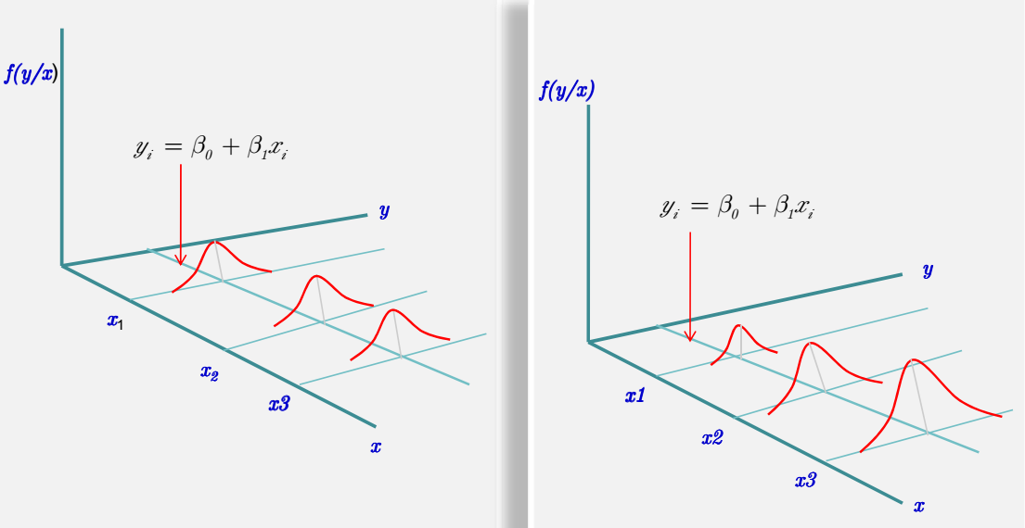
hetro

Slide 5
Hetro….
Cause of Heteroschedasity:
Error learning model
Improvement in data collection technique
Presence of outliers

Slide 6
Hetro….
consequences of heteroskedasticity for ols:
Unbiased estimators
Biased variance and they are no longer valid for constructing confidence intervals and t statistics.
Inefficient estimators
the usual OLS t statistics do not have t distributions in the presence of heteroskedasticity, similarly, F statistics are no longer F distributed,
thus, the statistics we used to test hypotheses are not valid in the presence of heteroskedasticity.
OLS is no longer BLUE

Slide 7
Detecting Heteroskedasticity
It may be generally the rule instead of expectation to face heteroskedasticity in cross sectional data.
The graph of the square of the residual against the dependent variable gives rough indication of the existence of of heteroskedasticity.
If there appears a systematic trend in the graph it may be an indication of the existence of heteroskedasticity.
There are however formal methods of detecting
heteroskedasticy.

Slide 8
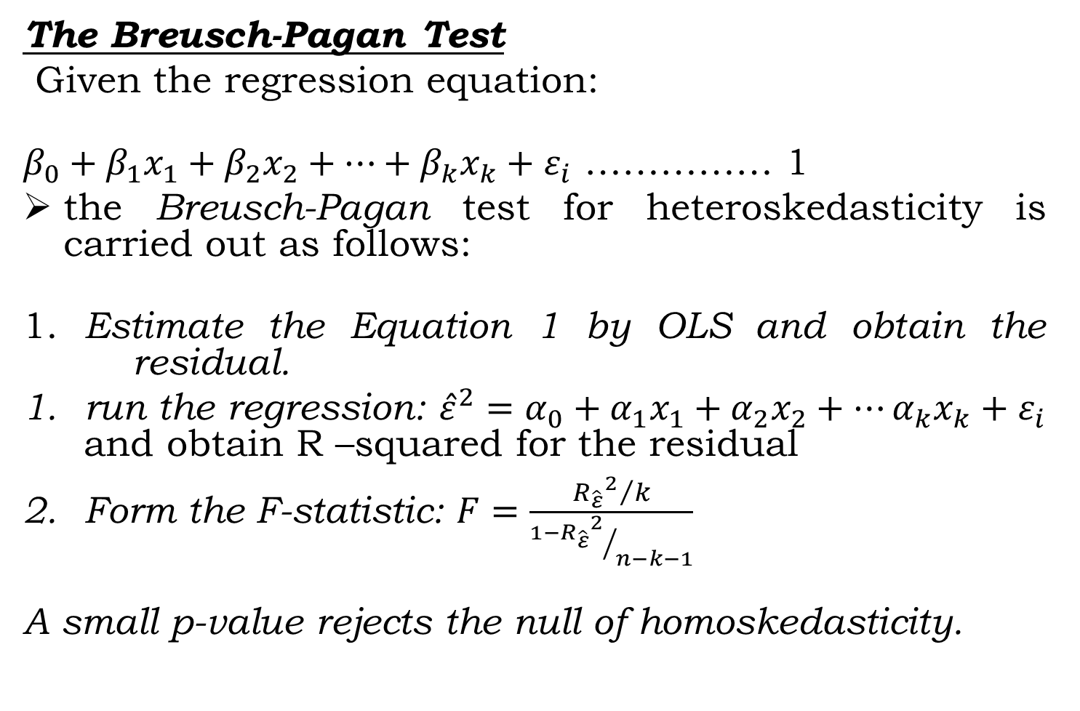
Hetro….
The Breusch-Pagan Test
Given the regression equation:
$β_{0}+β_{1}x_{1}+β_{2}x_{2}+…+β_{k}x_{k}+ε_{i}$ …………… 1
the Breusch-Pagan test for heteroskedasticity is carried out as follows:
1. Estimate the Equation 1 by OLS and obtain the residual.
run the regression:${\hat{ε}}^{2}=α_{0}+α_{1}x_{1}+α_{2}x_{2}+…α_{k}x_{k}+ε_{i}$ and obtain R –squared for the residual
Form the F-statistic: $F=\frac{{{R_{\hat{ε}}}^{2}}/k}{{1−{R_{\hat{ε}}}^{2}}/{n−k−1}}$
A small p-value rejects the null of homoskedasticity.

Slide 9
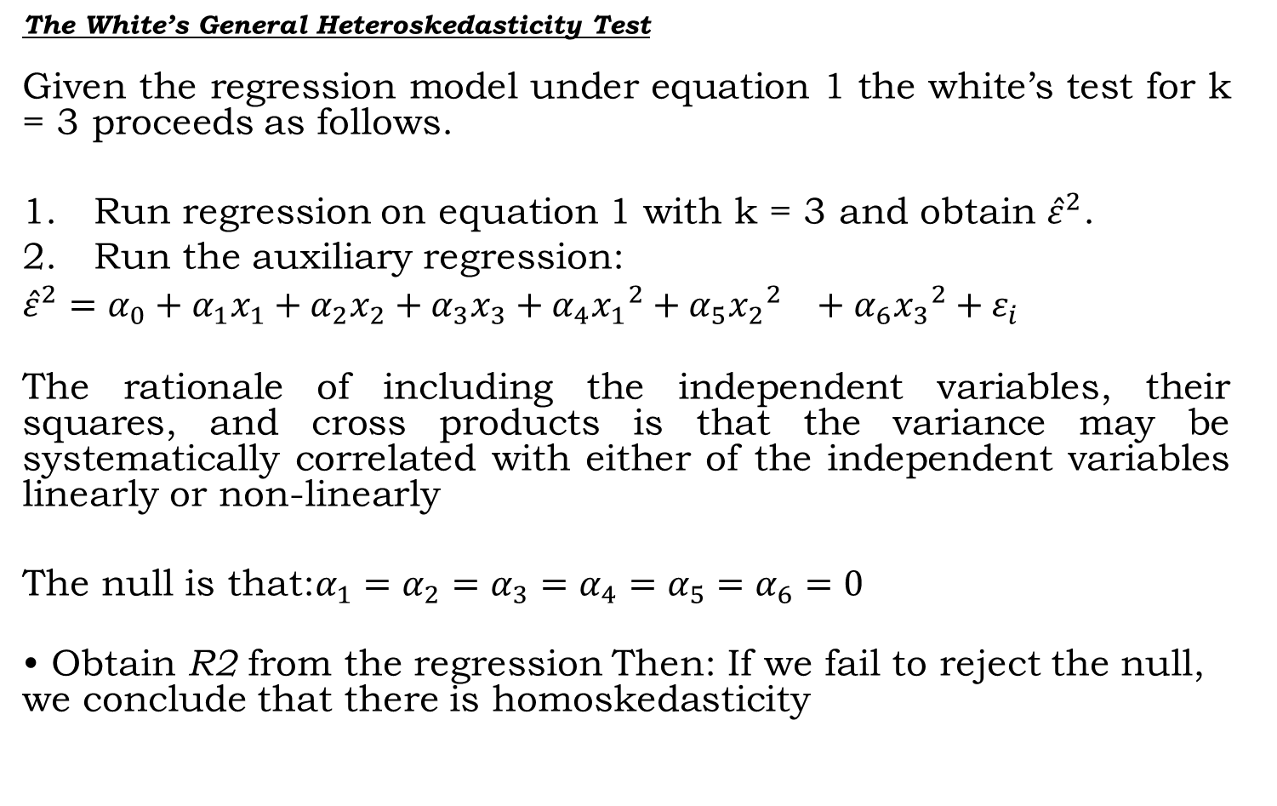
Hetro….
The White’s General HeteroskedasticityTest
Given the regression model under equation 1 the white’s test for k = 3 proceeds as follows.
Run regression on equation 1 with k = 3 and obtain ${\hat{ε}}^{2}$.
Run the auxiliary regression:
${\hat{ε}}^{2}=α_{0}+α_{1}x_{1}+α_{2}x_{2}+α_{3}x_{3}+α_{4}{{x_{1}}^{2}+α_{5}{x_{2}}^{2}}_{}+α_{6}{x_{3}}^{2}+ε_{i}$
The rationale of including the independent variables, their squares, and cross products is that the variance may be systematically correlated with either of the independent variables linearly or non-linearly
The null is that:$α_{1}=α_{2}=α_{3}=α_{4}=α_{5}=α_{6}=0$
• Obtain R2 from the regression Then: If we fail to reject the null, we conclude that there is homoskedasticity

Slide 10
Hetero….
Dealing with Heteroscedasticity
In the last two decades, econometricians have learned how to adjust standard errors, so that t, F, and LM statistics are valid in the presence of heteroskedasticity.
This is very convenient because it means we can report new statistics that work, regardless of the kind of heteroskedasticity present in the population.

Slide 11
Hetero….
While heteroscedasticity is the property of disturbances, the
above tests deal with residuals.
Thus, they may not report the genuine heteroskedasticity.
Diagnostic results against homoskedasticity could be due to
misspecification of the model.
But, if we are sure that there is a genuine heteroskedasticity
problem, we can deal with the problem using:
Heteroskedasticity-robust statistics after estimation by OLS.
Weighted least squares (WLS) estimation.

Slide 12
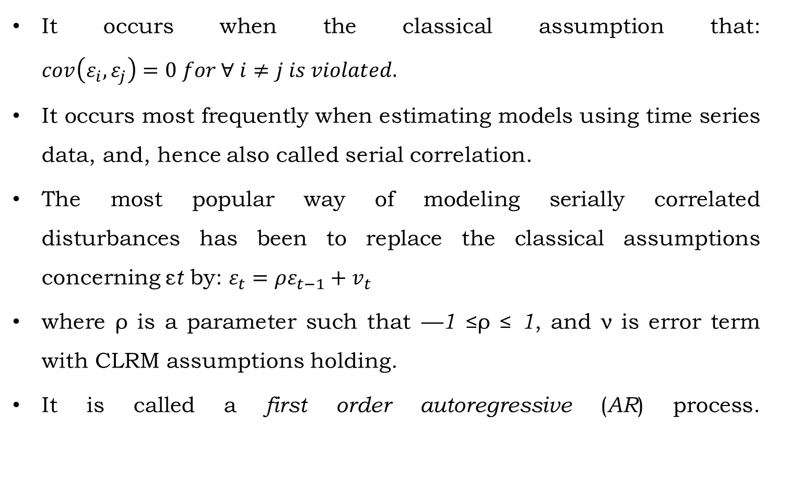
Autocorrelation
It occurs when the classical assumption that:$cov\left(ε_{i},ε_{j}\right)=0 for ∀ i≠j is violated.$
It occurs most frequently when estimating models using time series data, and, hence also called serial correlation.
The most popular way of modeling serially correlated
disturbances has been to replace the classical assumptions
concerning εtby: $ε_{t}=ρε_{t−1}+v_{t}$
where ρ is a parameter such that —1 ≤ρ ≤ 1, and ν is error term with CLRM assumptions holding.
It is called a first order autoregressive (AR) process.

Slide 13
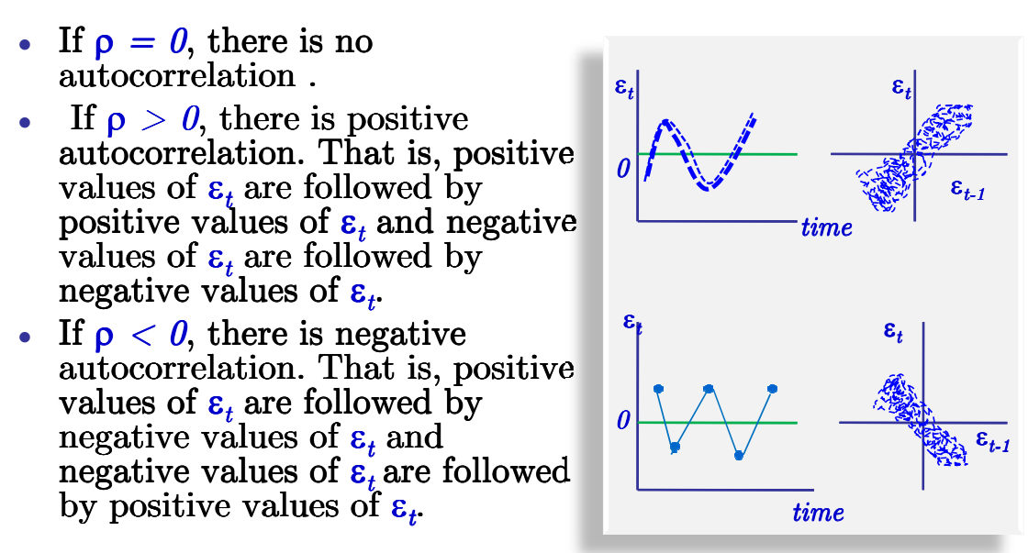
Autocorrelation

Slide 14
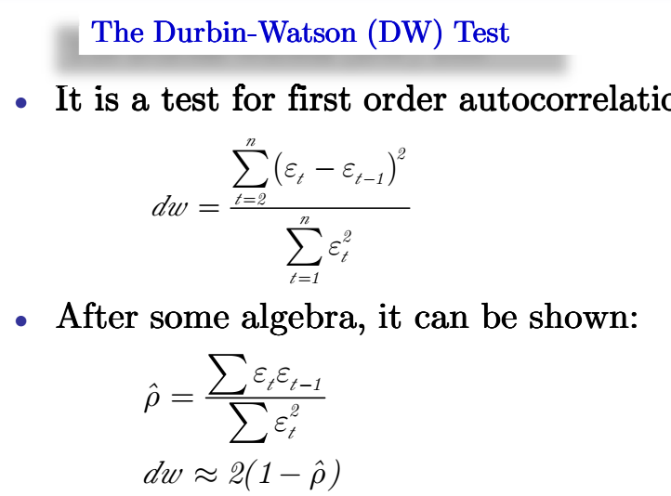
Autocorrelation

Slide 15
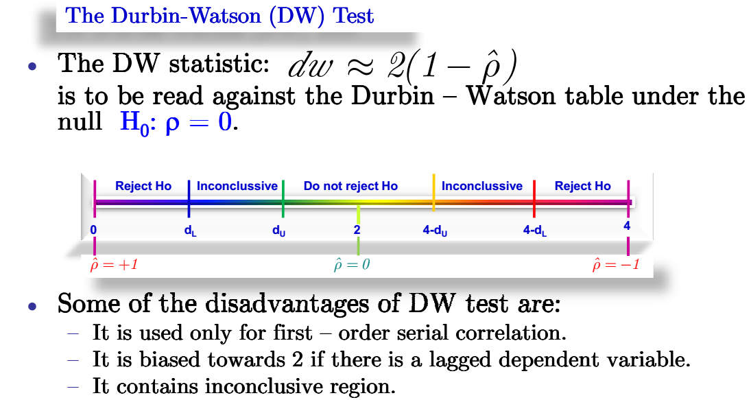
Autocorrelation

Slide 16
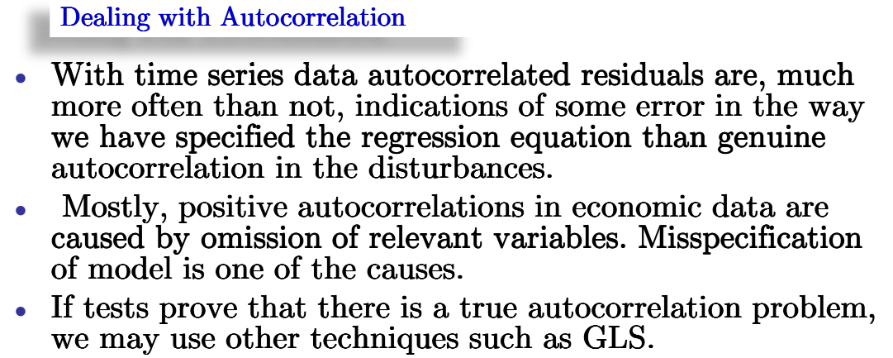
Autocorrelation

Slide 17
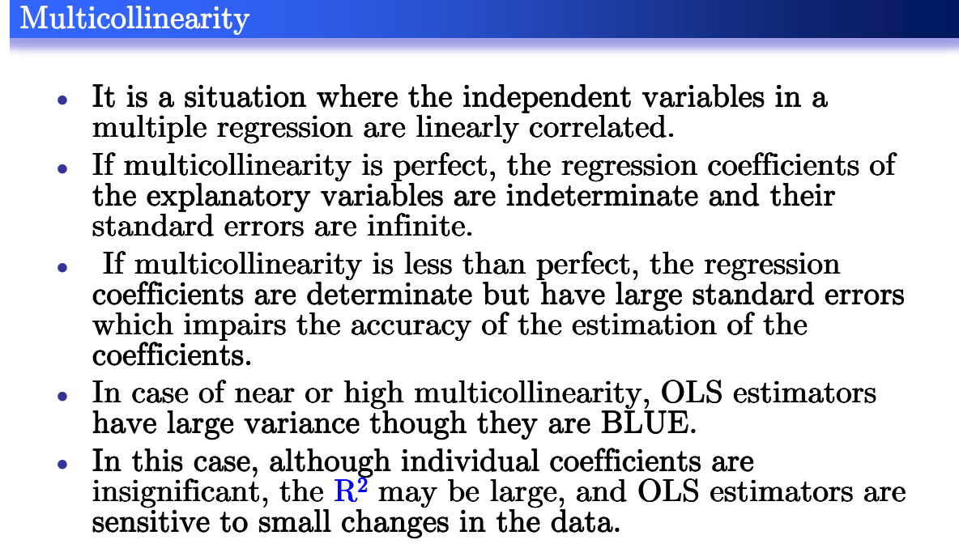
Multicollinearity

Slide 18
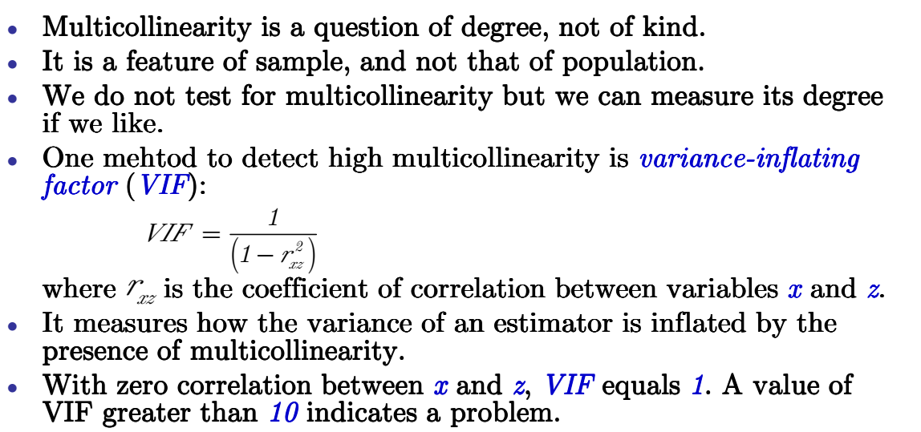
Multicollinearity

