Slide 1
Chapter -2
CHEMISTRY OF F-BLOCK ELEMENTS
by: Leyela H.
DMU,2012 E.C

Slide 2
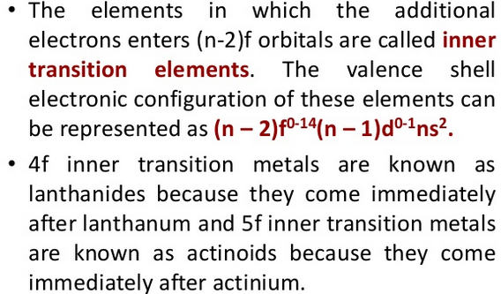
CHEMISTRY OF F-BLOCK ELEMENTS

Slide 3
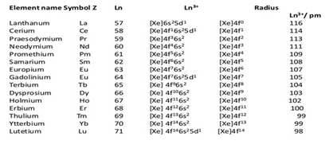

Slide 4

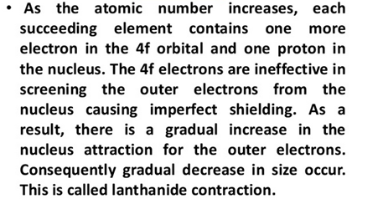

Slide 5

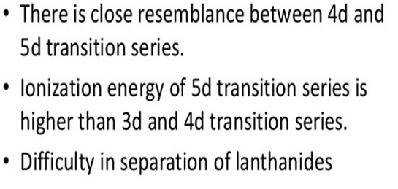

Slide 6
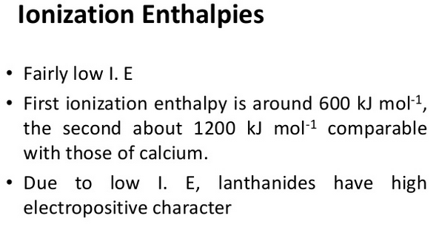

Slide 7
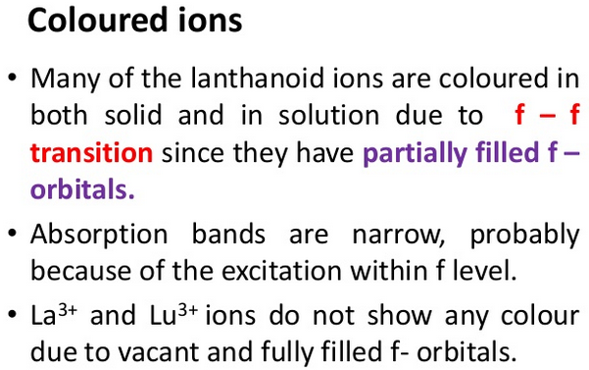

Slide 8
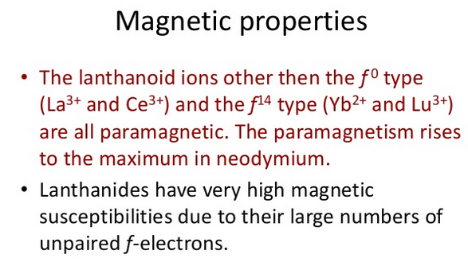

Slide 9
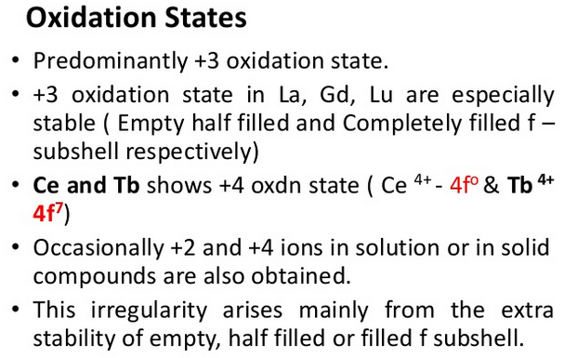

Slide 10
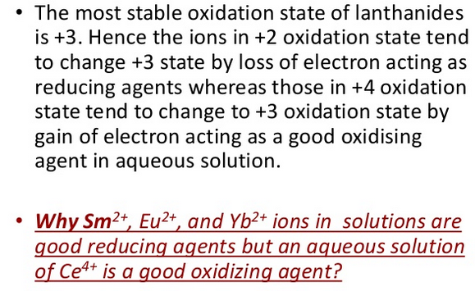

Slide 11
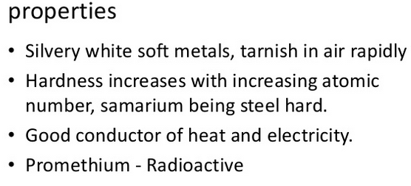

Slide 12
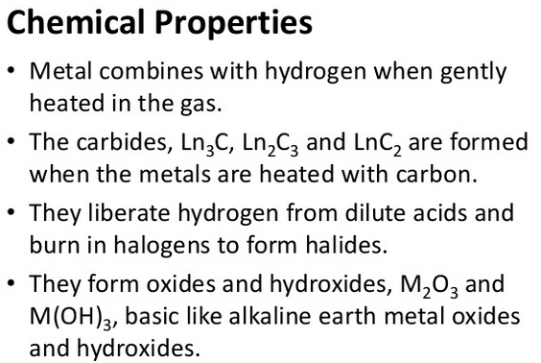

Slide 13
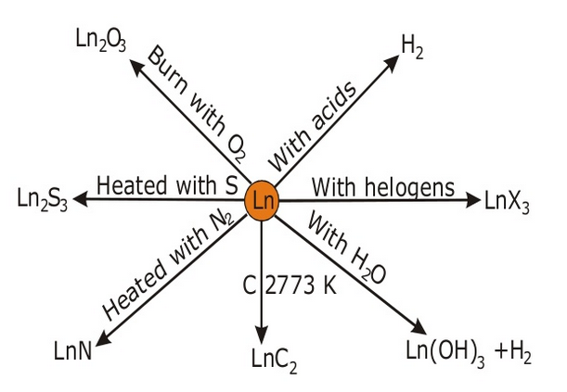

Slide 14
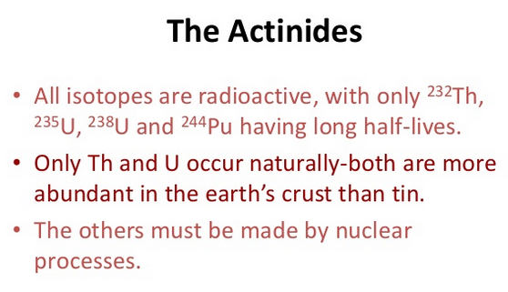

Slide 15
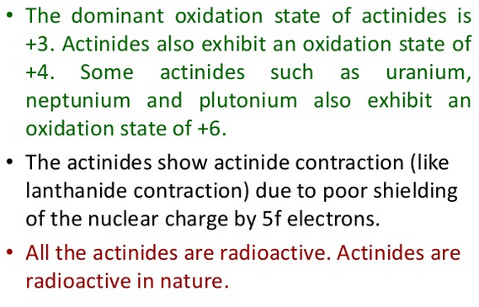

Slide 16
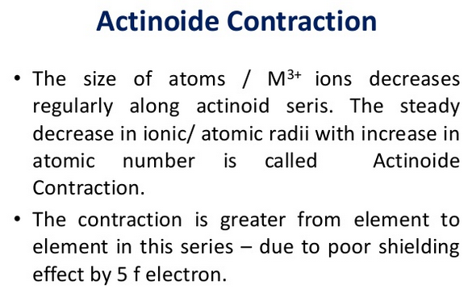

Slide 17
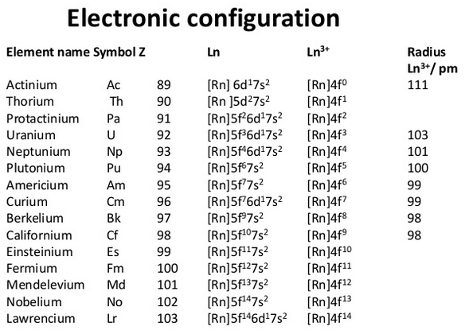

Slide 18
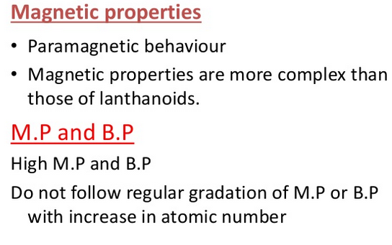

Slide 19
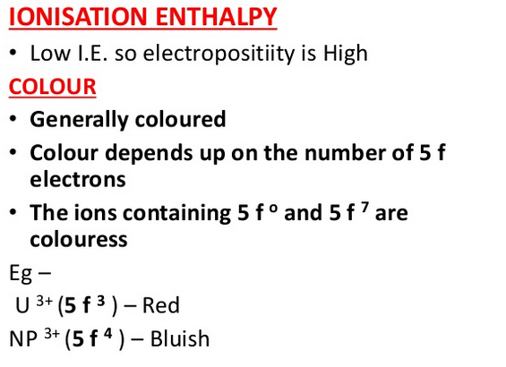

Slide 20
Chapter- 3
COORDINATION
CHEMISTRY OF
TRANSITION
METALS

Slide 21
3.1 Introduction
Coordination Compounds are the backbone of modern inorganic, bioinorganic chemistry and chemical industry.
Transition metals form a large number of complex compounds which is called coordination compounds in modern terminology.
The chemistry of coordination compounds is an important and challenging area of modern inorganic chemistry.
New concepts of chemical bonding and molecular structure have provided insights into the functioning of vital components of biological systems.
Example, Chlorophyll, haemoglobin and vitamin B₁₂ are coordination compounds of Mg, Fe and Co respectively.
Variety of metallurgical processes, industrial catalysts and analytical reagents involve the use of coordination compounds.

Slide 22
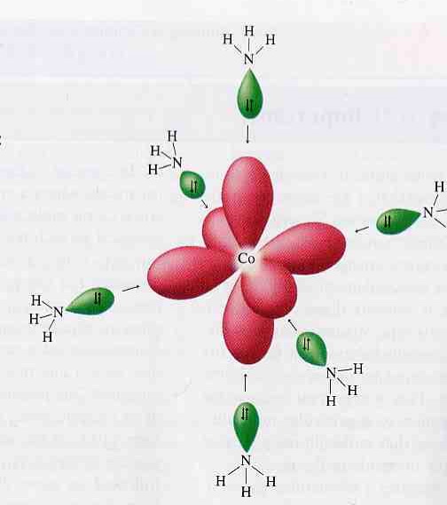
  Definition of coordination compounds
A.Werner, the first person who formulates the ideas about the structures of coordination compounds.
He prepared and characterised:
        large number of coordination compounds
        studied their physical and chemical
behaviour by simple experimental techniques.
Coordination compounds are species in which a central metal ion (or atom) is attached to a group of surrounding molecules or ions by coordinate covalent bonds.
Lewis acid: Co³⁺
Lewis base: NH₃
Coordination complex: Ligand (electron donor) coordinated to a metal (electron acceptor)

Slide 23
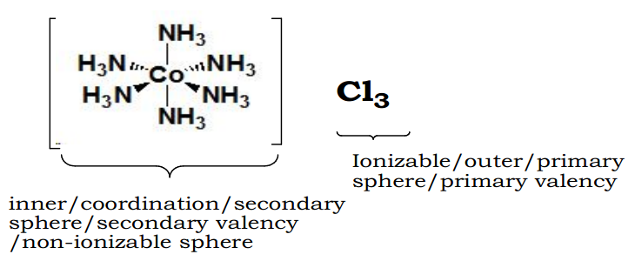
Cont’d
Werner’s explanation of coordination complexes
Metal ions exhibit two kinds of valence:
          primary and secondary valences
The primary valence is the oxidation number (positive charge) of the metal.
The secondary valence is the number of atoms that are directly bonded (coordinated) to the metal.
The secondary valence is also termed the “coordination number” of the metal in a coordination complex
Counter ion
Activity 3.1
1. State the Werner’s postulate
2. Write the limitation of
Werner theory.

Slide 24
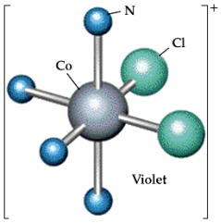
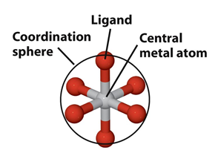
START UP!!!!
Terms Related to Coordination Compounds
Coordination entity: a central metal atom or ion bonded to a fixed number of ions or molecules. Eg. [CoCl₂(NH₃)₄]⁺
In this coordination complex
ion the central metal ion, chloride anion and ammonia molecule are
coordination entity.
Coordination number (CN) :
number species attached to central metal ion.
Ligand: directly attached species
to central metal ion
Coordination entity
Coordination sphere
Coordination atom or ion

Slide 25
Ligands and types of ligand
Ligands: The ions or molecules bound to the central atom/ion in the coordination sphere.
These may be simple ions such as Cl–, small molecules such as H2O or NH3, larger molecules such as H2NCH2CH2NH2 or macromolecules, such as proteins.
Monodentate ligand: Bound to a metal ion through a single donor atom. Example; Cl–, H₂O or NH₃.
Bidentate ligand: Bound through two donor atoms.
Example; H₂NCH₂CH₂NH₂ or C₂O₄^{2–}
Polydentate ligand: bond using the electron pairs of many atoms and also known as chelating agents. This group includes bidentate. Example; EDTA⁴⁻
Ambidentate ligand: Ligand which can ligate through two different atoms.
Example; NO₂– and SCN– ions.

Slide 26
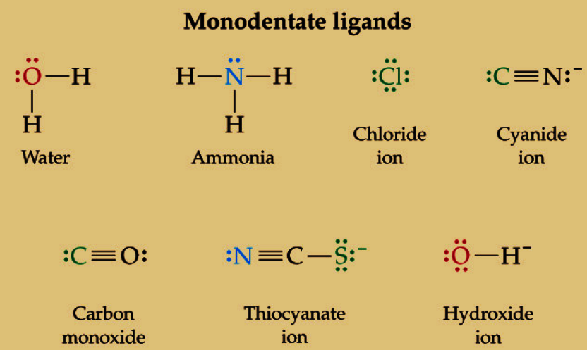
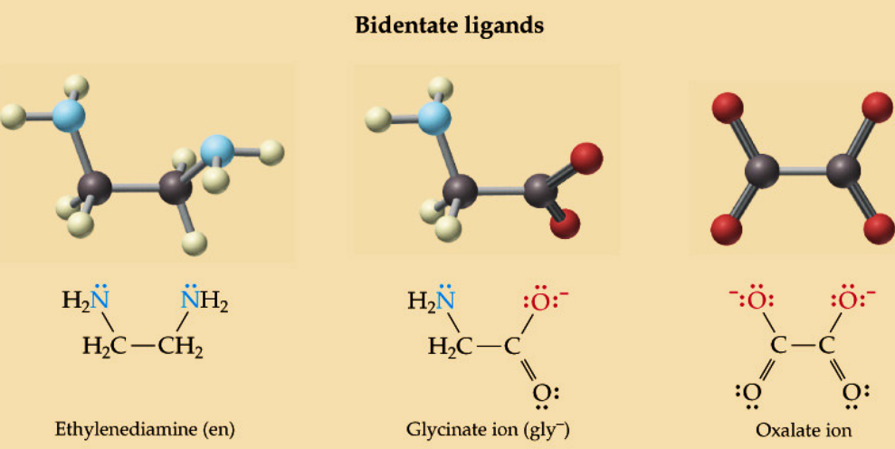

Slide 27
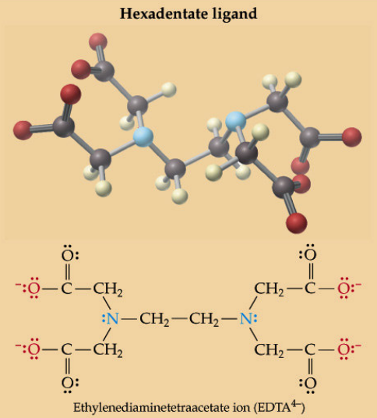
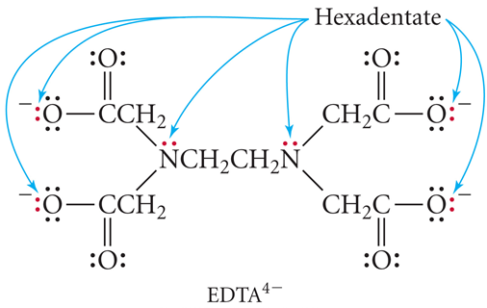

Slide 28
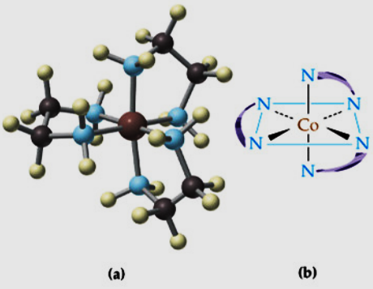
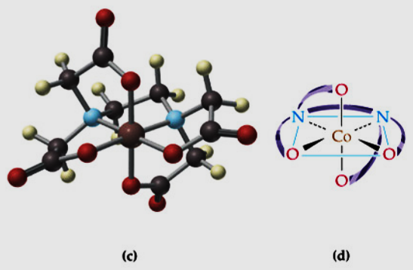
(a) and (b) represent bidentate ligands bound to cobalt.
(c) and (d) represent a hexadentate ligands bound to cobalt.
How polydentate bound to central metal atom.

Slide 29
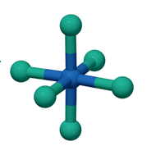
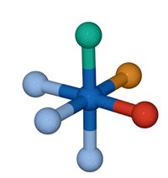
Cont’d
Oxidation number of central metal atom:
defined as the charge it would carry if all the ligands are removed
along with the electron pairs that are shared with the central metal
atom.
Complex can be classified based on the kind of donor atoms.
a. Homoleptic complexes
b. Heteroleptic complexes

Slide 30
Cont’d
Based on the type of charge on the complex they can classified in to three, as listed below.
Cationic complexes- are where the complex ion has a positive charge.
Ex., [Co(NH₃)₆]³⁺
Anionic complexes- Those in which the complex carries a negative charge.
Ex., [Ag(CN)2]⁻
Neutral complex- The complex does not carry a charge.
Ex., [Ni(CO)4], [Co(NH3)3(NO2)3], [Pt(NH3)2Cl4]

Slide 31
Nomenclature of Coordination Compounds
Like that of naming simple inorganic and organic compounds, coordination compounds are named according to set of rules given by IUPAC system.
Name of the compound is written in two parts
(i) name of cation, and
(ii) name of anion.
2.The cation is named first in both +vly and -vly charged coordination complexes with space between them.
Eg. K₂[PtCl₄],
potassium tetrachloroplatinate(II)
[Cr(NH₃)₆][IrCl₆],
hexaamminechromium(III) hexachloroiridate(III)
3. When giving the name of the complex ion or molecule, name the ligands first as follow.

Slide 32
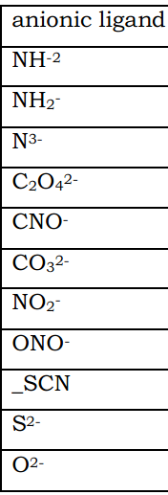
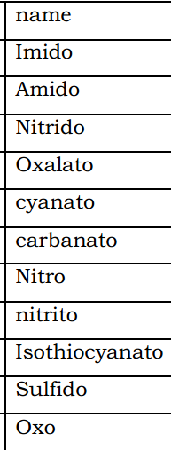
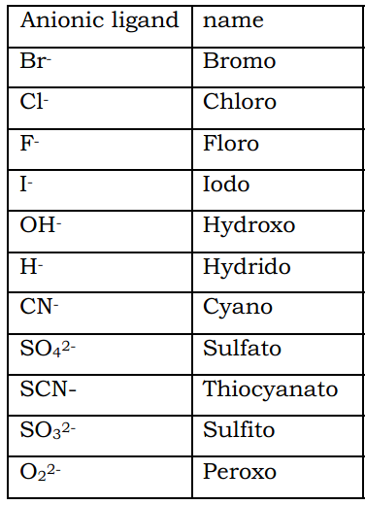
Naming ligand in coordination sphere.
a. If a ligand is an anion whose name ends in -ite or -ate, the final e is changed to o (as in sulfate → sulfato or nitrite → nitrito).
b. If the ligand is an anion whose name ends in -ide, the ending is changed to o (as in chloride → chloro or cyanide → cyano)
O₂⁻

Slide 33
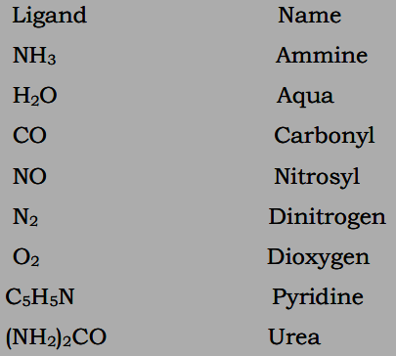
Cont’d
If the ligand is a neutral molecule, its common name is usually used Neutral ligands have no special endings but some of them have special names.
d. Use pre-fix: di, tri, tetra, penta,
hexa, etc. for more than one of a
particular monodentate ligand
with a simple name.
And bis, tris, tetrakis, pentakis, etc
For the ligand name is complicated
(whether monodentatelbidentate).
If there are more than one ligands of different type, these are quoted in alphabetical order.
However, prefixes are not to be included in alphabetizing.

Slide 34
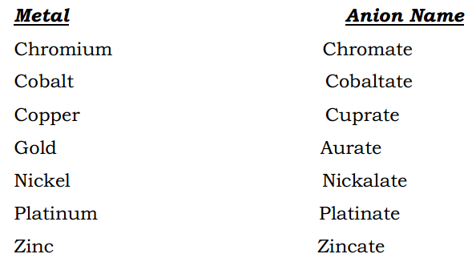
h
  CONT..
4. After naming the ligands in alphabetical order, and indicating their respective numbers, name the metal and mention its oxidation state in Roman number in simple parenthesis.
5. If the complex ion is an anion, the suffix -ate is added to the metal name.

Slide 35
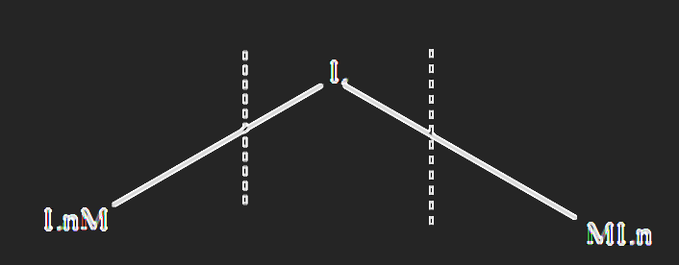
Cont’d
6. If cation and anoin are both complex ions, the metal in the negative coordination sphere are to be named as metal –ate.
Example, [Co(NH₃)₆][Cr(CN)₆]
hexaamminecobalt(III) hexacyanocromate(III)
[Pt(NH3)4][pt(Cl)4]
tetraammineplatinium(II) tetrachloroplatinate(II)
7. If the complxes with bridging ligands, the coordination sphere is divided into three hyphothetical parts for the purpose of nomenclature.
bridge ligand = µ
The bridging ligand is separated from the units to its left and the units to its right by hyphen.

Slide 36
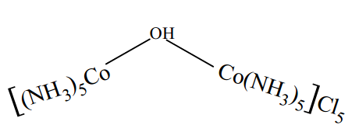
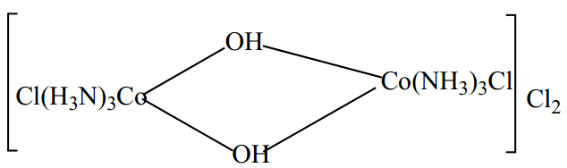
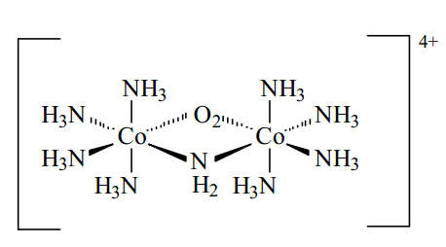
Cont’d
Example,
PentaammineCobalt(III)-µ-hydroxo–pentaamminecobalt(III)Chloride
8. If there are more than one bridging ligands, suffix di, tri, etc are used to indicate their number.
triamminechlorocobalt(III)-µ-dihydroxo-triamminechlorocobalt(III)chloride
tetraamminecobalt(III)-µ-amido-µ-superoxotetraamminecobalt(III)

Slide 37
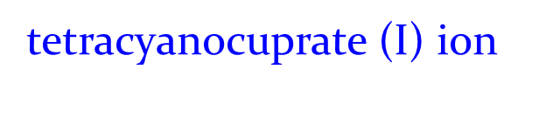
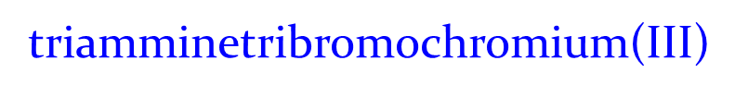
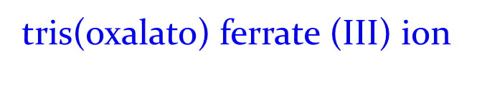
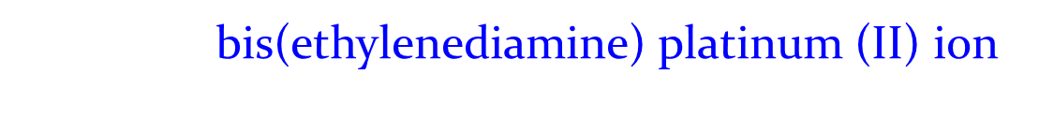
Activity 3.1
Name the following complex ions / coordination compounds.
[Ni(NH₃)₆]²⁺
Answer =
hexaamminenickel(II) ion
[Cu(CN)₄]³⁻
Answer =
c. [Cr(NH₃)₃Br₃]
Answer =
d. [Fe(ox)₃]³⁻
Answer =
e. [Pt(en)₂]²⁺
Answer =

Slide 38
Activity 3.1 (cont. )
f. [Co(NH ₃)₄ (NO₂)Cl]+
Answer =
tetraamminechloronitrocobalt(III) ion
g. [Cr(NH₃)₆][Co(CN)₆]
Answer =
hexaamminechromium(III)heaxacyanocobaltate(III)
h. [Co(en)₃]Cl₃
Answer=
tris(ethylenediamine)cobalt(III)chloride

Slide 39
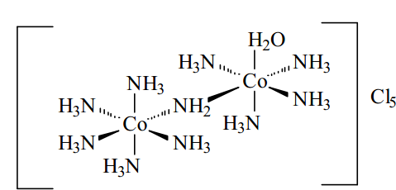
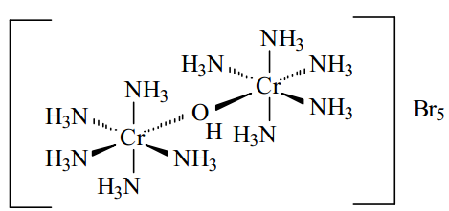
Activity 3.1 (cont. )
j.
pentamminecobalt(III)-µ-amidotetraamineaquacobalt(III) chloride
k. CLASS WORK
µ-Hydroxobis[pentaamminechromium(III)] bromide

Slide 40

h
  3.1.3. Structure and Isomerism of Coordination Compound
Structure and geometry of coordination compounds:
Ligand (Lewis base)
An empty metal orbital
Interact by their s and p orbital with
d orbital of metal.
s, p, and d orbitals of the metal can
accommodate 18 electrons.
(Lewis acid)
Coordinate covalent
bond
By donating a pair of e-
from ligand

Slide 41
h
Cont’d
The maximum coordination number for a certain metal is thus related to the electronic configuration of the metal ion (more specifically, the number of empty orbitals) and to the ratio of the size of the ligands and the metal ion.
Large metals/ small ligands → high CN.
Small metals / large ligands →low CN.
Different ligand structural arrangements result from the coordination number.
Most structures follow the points on a sphere pattern, where orbital overlap (between ligand and metal orbitals) and ligand-ligand repulsions tend to lead to certain regular geometries.

Slide 42
h
  3.1.3.2 Isomerism
Same atoms
No
Isomers
Compounds have the same formula
But different structures
Yes
Different chemical bond
Atoms linked to the same partners
same chemical bond
Structural isomers
No
Yes
Stereoisomers
Complex identical to
its mirror image
Ionization isomerism
Yes
No
Solvate isomers
geometric isomers
optical isomers
Linkage isomerism
(diasteromers)
Enantiomers
Chiral
nonsuperposable
Coordination isomerism
Coordinate position isomerism
cis
trans
Ligand isomerism

Slide 43
h
A. Structural Isomerism
Structural isomers are those which contain different atom-to-atom bonding sequences.
These involve either more than one coordination sphere or different donor atoms of the same coordination sphere.
Ionization isomerism:
involve exchange of ligands between coordination sphere and ionization spheres. Eg. [Co(NH₃)₅Cl]SO₄
Pentaamminechlorocobalt(III)sulfate and
[Co(NH₃)₅SO₄]Cl
Pentaamminesulfatocobalt(III)chloride
ii. Solvate isomers:
is similar to ionization isomerism and known as hydrate isomerism which arises due to replacement of a coordinate group by water of hydration. Eg. [Cr(H₂O)₄Cl₂]Cl.2H₂O
[Cr(H₂O)₅Cl]Cl₂.H₂O
[Cr(H₂O)₆]Cl₃
Different physical & chemical
Properties but same CN = 6

Slide 44
h
  CONT..
iii. Linkage isomerism: arise when one or more of the ligands can coordinate to the metal ion in more than one way.
Eg. in [SCN], both the N and S atoms are potential donor sites.
In [(Co(NH₃)₅(NCS-N)]⁺², the thiocyanate ligand coordinates through the nitrogen donor atom; In [(Co(NH₃)₅(NCS-S)]⁺², the thiocyanate ion is bonded to the metal centre through the sulfur atom.
iv. Coordination isomerism: are possible only for salts in which both cation and anion are complex ions; the isomers arise from interchange of ligands between the two metal centers.
Examples,
[Co(NH₃)₆][Cr(CN)₆] and [Cr(NH₃)₆][Co(CN)₆]
[Co(NH₃)₆][Co(NO₂)₆] and [Co(NH₃)₄(NO₂)₂] [Co(NH₃)₂(NO₂)₄]

Slide 45
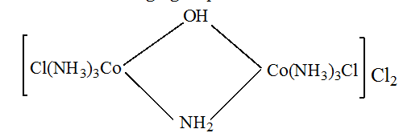
h
  CONT..
Coordinate position isomerism:
occurs in complex possessing bridging ligands. Involve an exchange of ligands between the two metal atoms that are linked through one or more bridge groups.
triamminechlorocobalt(III)-µ-amido-µ-hydroxo-triamminechlororcobalt(III)chloride

Slide 46
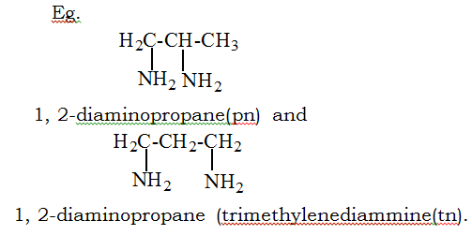
Cont’d
vi. Ligand isomerism: some ligand exists as isomers in their own right and can coordinated to the same metal ion to form isomeric complex.
The complex such as [Co(Pn)₂Cl₂]Cl and [Co(tn)₂Cl₂]Cl contain these isomeric ligands.

Slide 47
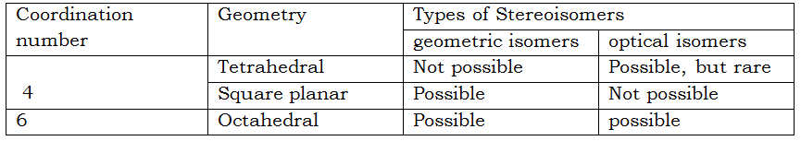
B. Stereoisomers
same number and types of atoms bonded together but in different spatial arrangements.
same molecular formulas but different chemical and physical properties.
Amongst the complexes, CN = 4 & 6 are the most frequently encountered
Two types of stereoisomers exist,
              geometric isomers and
              optical isomers.

Slide 48
Cont’d
I. Geometric Isomers:
Have same types and number of atoms, but they differ in the spatial arrangements of the ligands.
Have different colors, melting points, boiling points, reactivities, solubilities, etc.
known as cis-trans isomers.
distinguished by dipole moment studies, thus trans isomer has a zero dipole moment, while cis has analog possesses a positive dipole moment.

Slide 49
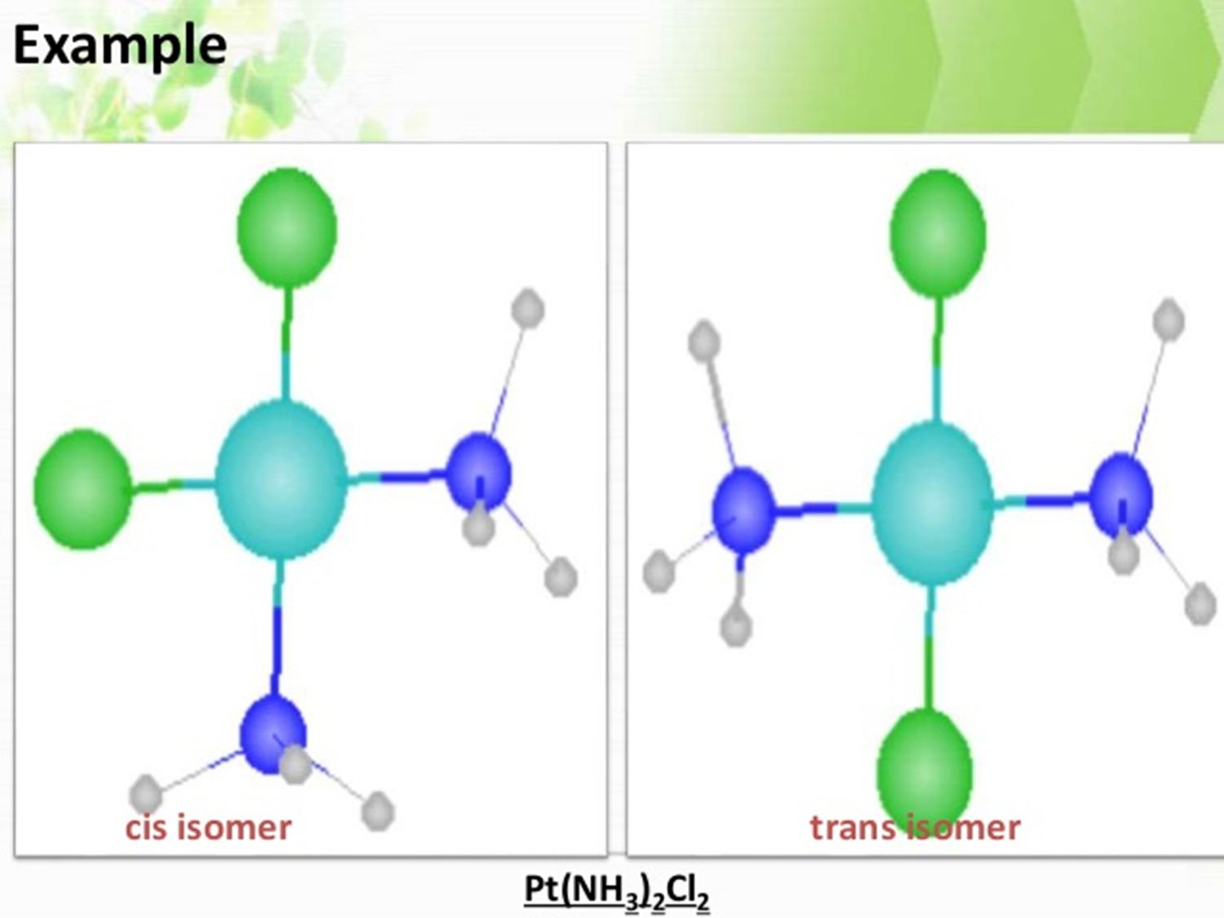
Cont’d

Slide 50
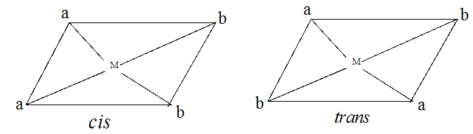

Cont’d
Coordination number 4: square planar complexes
The square planar complexes, cis-trans isomers exist for the following categories.
[Ma₂b₂]:
Eg. [Pt(NH₃)₂Cl₂], diamminedichloroplatinium(II)
[Ma₂bc]
Eg. [Pt(NH₃)₂ClBr], diamminebromochloroplatinium(II)

Slide 51


CONT..
[Mabcd]
b. Coordination number 6: octahedral complexes
[Ma₄b₂] :The type of isomer is decided by the ligands whose number is less that is b in the present case
Eg. [Co(NH₃)₄Cl₂]⁺

Slide 52



CONT..
[Ma₃b₃] : Two isomers are designated facial (fac.) and meridinal (mer.) and correspond to cis and trans geometry, respectively.
Eg. [Co(NH₃)₃(NO₂)₃]

Slide 53


Cont’d…
II

Slide 54

CONT..
Enantiomers: non superimposable mirror images
A structure is termed chiral if it is not superimposable on its mirror image
Mirror image
Of structure
Structure
Two chiral structures: non superimposable mirror images

Slide 55


Slide 56
CONT..
Optical isomerism:
Optically active molecules
nonsuperimposable mirror images of each other.
have the same physical (color, melting point, solubility) and chemical properties
But rotate the plane of polarized light in opposite directions, that was one of the first ways used to detect them.
Chiral Complex: A complex that is not identical with its mirror image.
Chiral molecules are optically active because effect on light.
Chiral Complexes are also called enatiomers
The phenomena by which plane of polarized light is rotated is called optical activity.
It is measured by polarimeter.

Slide 57
CONT..
Note:
Chiral Complex: A complex that is not identical with its mirror image.
  If something is chiral it will have an optical isomer.
Achiral Complex: A complex that is identical to its mirror image.
  If something is achiral it will not have an optical isomer.
  Enantiomers: A chiral complex and its mirror image.

Slide 58

Exceptions to Octet Rule in Ionic Compounds
a. Less than Octet (Central Atom is Deficient of Electrons):
The principal exceptions to the octet rule are found in ionic compounds in which the cations do not acquire noble gas electron configuration.
Ions of atoms such as (H, Li, Be and B) do not obey the octet rule.
The tendency of these atoms is to attain an arrangement of two electrons like the noble gas He (duplet configuration), which is also a stable configuration.
Eg. H^{-,} Li^{+,} Be²⁺ and B³⁺are isoelectronic with He.

Slide 59


CONT..
a. Coordination number four
Eg. ethylmethylpropylsulfidoarsenic(V).
b. Coordination number six
i. [M(AA)₃] : Eg. tris(en)cobalt(III) ion, [Co(en)₃]³⁺
Where AA is a symmetrical bidentate chelating ligand

Slide 60

CONT..
ii. [M(AA)₂b₂] : Here b is monodentate ligand.
Eg. [Co(en)₂Cl₂]⁺, this types of complexes show both geometrical and optical isomers.
cis geometry
I and III optical isomerism
I and II geometrical isomerism
?
trans geomtry
What do you think about the image of II?
Enantiomer ???
superimpossible???

Slide 61

  3.2 . Valence bond theory
This theory was proposed by L. Pauling in 1930 s.
According to this theory, when a complex is formed, the metal ion/atom provides empty orbitals to the surrounding ligands.
Coordination number shows the number of such empty orbitals, i.e., number of empty orbitals = CN
These empty orbitals hybridised before participation in bonding and the nature of hybridisation depends on the nature of metal and on the nature of approaching ligand.
Complex geometry can be linked to five main orbital hybridization processes.

Slide 62
Cont’d
The valence bond theory proposes the formation of a complex in a number of steps.
1. Write the valence shell of electronic configuration of the metal.
2. Write the valence shell of electronic configuration of the ion
3. Write the configuration of the complex.

Slide 63


Cont’d
I. Two-Coordinate Compounds: Linear sp hybridized transition metal complexes:
a. Consider [Ag(NH₃)₂]⁺ Ag = 5s¹4d¹⁰ Ag+= 5s⁰4d¹⁰

Slide 64

Cont’d
II. Four Coordinate Compounds:
Four ligands around a central metal atom can give either a square planar or a tetrahedral arrangement.
Which geometry shall prevail depends on the nature of the ligand and the configuration of the metal atom.
In general, strong ligands tend to pair up metal electrons and give square planar complexes, however, there are notable exceptions to this generalization.
The re-alignment of electron based on the strength of the ligands
which is given from spectro chemical series
CO > CN⁻ > NO₂⁻ > en > py ≈ NH₃ / H₂O > OH⁻ > F⁻ > Cl⁻ > Br⁻ > I⁻
Strength
Weakness

Slide 65


Cont’d
II. Four CoordinateCompounds: (Tetrahedral Complexes)
b.
Outer orbital or sphere
Determine the magnetic properties, and
Spin of the above complex.

Slide 66

Cont’d
Ni(NH₃)₄²⁺ ²⁸Ni 3d⁸4s^{2 ,} Ni²⁺ 3d⁸ 4s⁰ 4p⁰
4 :NH₃
hybrid
[Ni(NH₃)₄ ]²⁺ (tetrahedral)
sp³ hybridization( outer orbital )
[Ni(NH3)4]⁺²
Ni

Slide 67
cont;’d
III. Four Coordinate Compounds: (Square Planar Complexes):
When very strong ligands are present, four-coordinated d⁸
metal ions usually form square planar complexes (rather than tetrahedral).
realignment
4 :CN⁻
Diamagnetic
Square planar
(spin paired
hybrid
dsp² hybridization inner orbital
[Ni(CN)₄ ]²⁻( square planar)

Slide 68

cont;’d
[Ni(CN)4] ⁺²
Ni⁺²

Slide 69

IV. Six Coordinate Complexes (Octahedral):
Six ligand donor atoms in an octahedral complex are located at the corners of an octahedron.
Valence bond postulates that the orbitals best shaped and best oriented to receive electron pairs from these directions are the dx²-y² and dz² orbitals (directed on the x, y, and z-axes).

Slide 70


IV. Six Coordinate Complexes (Octahedral):
Inner orbital or sphere
CN
Paramagnetic
Octahedral
Low spin
Fe

Slide 71


IV. Six Coordinate Complexes (Octahedral):
Outer orbital or sphere
Because of the weak ligand, the electron do not re-align themselves
and indicate it paramagnetic properties.
Yet we need two vacant orbitals for otcahedral coordination.
It is therefore, pertinent that we use two d subshells of the 4d shell.

Slide 72
Limitations of valence bond theory
It is a qualitative approach describing bonding in coordination compounds.
It offers no explanation for the wide range of colors of coordination compounds.
It does not explain the spectra of coordination compounds
It fails to give a satisfactory explanation for the formation of [Cu(NH₃)₃]²⁺

Slide 73
Limitations of valence bond theory
Expected electronic configuration of [Cu(NH₃)₃]²⁺
sp³
Tetrahedral
Paramagnetic
Spin free
But its geometry is square planar.
This indicate that metal atomic orbitals are dsp2 hybridized.
In order to account for the experimental findings, the valence bond
theory postulates that the single electron in the 3d subshell is excited
to the 4p level.
This vacates one d orbital and paves the way for dsp2 hybridization

Slide 74

Limitations of valence bond theory
The observed electronic configuration of [Cu(NH₃)₃]²⁺ ion.
[Cu(NH₃)₃]²⁺
dsp² hybridization
Square planar
paramagnetic
inner orbital
Cu
NH₃
+2
Exciting one electron from 3d to 4p shell is not energetically
favorable.
VBT offers no explanation for this controversial step.

Slide 75
Crystal Field Theory
.
According to this theory, bonding in a complex ion is due to electrostatic interactions between the positively charged nucleus of the central metal ion and electrons in the ligands i.e., attractive as well as repulsive interactions.
The electron pairs on the ligands are viewed as point negative charges that interact with the d orbitals on the central metal.
There are two interactions in a given coordination compounds.
I. The attractive forces will arrive due to the positive metal ion and the negatively charged ligand.
II. The repulsive forces arise between the lone pairs on the ligand and the electrons in the d-orbital of the metal.
In this context, crystal field theory addresses the effect of ligands on the d orbital energy levels of the central metal ion only.

Slide 76
CONT..
Crystal Field Theory (cont..)
d Orbitals

Slide 77
Crystal Field Theory (cont..)
Ligands, viewed as point charges, at the corners of an octahedron affect the various d orbitals differently.

Slide 78

Crystal Field Theory (cont..)

Slide 79
CONT..
Crystal Field Theory (cont..)
There are five d orbitals, dxy, dyz, dxz, dz² and dx² - y², having equivalent energies in the absence of a crystal field.
In an octahedral crystal field, the lobes of the dz² and dx²-y²
orbitals are pointed directly at the six octahedrally-oriented ligand orbitals.
The electrons in those d orbitals will be repelled by the ligand electrons, making it harder for metal electrons to enter those orbitals.
On the other hand, the dxy, dyz, dxz orbitals are not directly in line with the ligands and their energy is lowered.
They experience less repulsion from the electrons in the ligand orbitals.
The result is a crystal filed splitting, ∆ which is the energy difference between the two subsets of orbitals.

Slide 80
CONT..
Crystal Field Theory (cont..)
The magnitude of ∆ depends on the metal ion itself and the nature of the ligands.
The energy difference, ∆ , influences the number of unpaired electrons in the metal ion (magnetic properties) and the energy of spectral transitions (spectral properties, color) between the levels.
The repulsion between ligand lone pairs and the d orbitals on the metal results in a splitting of the energy of the d orbitals.

Slide 81

CONT..
Crystal Field Theory (cont..)

Slide 82
CONT..
Crystal Field Theory (cont..)
Optical isomerism:
Optically active molecules
nonsuperimposable mirror images of each other.
have the same physical (color, melting point, solubility) and chemical properties
But rotate the plane of polarized light in opposite directions, that was one of the first ways used to detect them.
Chiral Complex: A complex that is not identical with its mirror image.
Chiral molecules are optically active because effect on light.
Chiral Complexes are also called enatiomers
The phenomena by which plane of polarized light is rotated is called optical activity.
It is measured by polarimeter.

Slide 83

YOU
THANK

