Slide 1
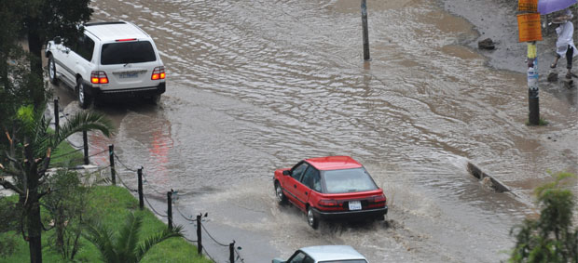
Hydraulic and Water resources Eng’g
2012e.c
Urban Drainage

Slide 2

Chapter 1 - 2
Introduction
Objective of urban drainage
Need to drain off storm water
Hydrological process, natural and urban water cycles
Effects of urbanization on urban drainage
Mitigation of adverse effects of urbanization
Storm water drainage approaches

Slide 3
Introduction
Drainage systems are needed in developed urban areas because of the interaction between human activity and the natural water cycle
This interaction has two main forms:
  The abstraction of water from the natural cycle to provide a water supply for human life
  The covering of land with impermeable surfaces that divert rainwater away from the local natural system of drainage

Slide 4
Introduction
These two types of interaction give rise to two types of water that require drainage
  Wastewater – water that has been supplied to support life, maintain a standard of living and satisfy the needs of industry
    70 – 80 % of the domestic water consumed end up with WW
  Storm water – rainwater (or water resulting from any form of precipitation) that has fallen on the built-up area

Slide 5
Introduction
Wastewater contains dissolved material, solids originating from WCs, from washing of various sorts, from industry and from other uses
  If not drained properly,
    could cause pollution and create health risks
Storm water contains some pollutants, originating from rain, the air or the catchment surface
  If not drained properly,
    cause inconvenience, damage, flooding and further health risks

Slide 6
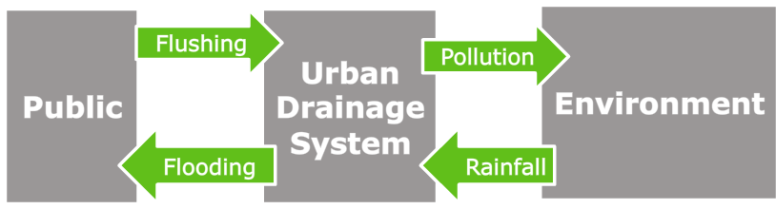
Introduction
Urban drainage systems handle these two types of water
  to minimize the problems caused to human life and the environment
Urban drainage has two major interfaces:
  with the public and with the environment

Slide 7
Introduction
In many urban areas, drainage is based on a completely artificial system of sewers: pipes and structures that collect and dispose of wastewater and/or storm water
In contrast, isolated or low-income communities normally have no main drainage.
  Wastewater is treated locally (or not at all) and storm water is drained naturally into the ground

Slide 8
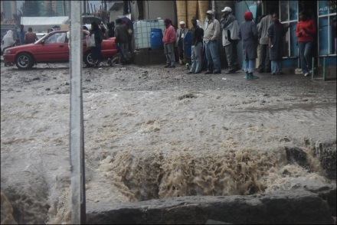
Introduction
Recent thinking- towards more sustainable drainage practices – is encouraging the use of more natural drainage arrangements wherever possible
Overall, urban drainage presents a classic set of modern environmental challenges:
  The need for cost effective and socially acceptable technical improvements in existing systems
  The need for assessment of the impact of existing systems
  The need to search for sustainable solutions

Slide 9
Basic definition
What do we mean by:
  Urban drainage
  Urban land and water management through the processes of collecting and removing excessive rain water (urban surface runoff/storm water) and sewage/ wastewater from urban areas
  Urban land and water management through the processes of redirecting water in space and time manipulating water levels in urban areas

Slide 10
Major objectives of UD
The major objectives of urban drainage are:
  Public hygiene
  Flood protection
  Environmental protection (pollution control)
In developed countries, the first two objectives have been accomplished and emphasis is placed mainly on pollution control
In developing countries, hygiene and flooding protection are still the major issues

Slide 11
Urban Strom water
Is exactly what it sounds like the water that falls during a storm
Is pure rainwater plus anything the rain carries along with it
Is a term used to describe water that originates during precipitation events

Slide 12
Storm water (surface) runoff
The storm water that does not soak into the ground and runs off the ground or impervious surfaces like roads, parking lots, roofs … and drains into natural or man made drainage facilities.

Slide 13
Why it is necessary to drain off storm water from an area?
To prevent flooding of cities
To prevent environmental pollution – protect the environmental values and physical characteristics of receiving waters from degradation by urban runoff
To provide adequate convenience at cities – minimize damage to properties and inconvenience to residents
To ensure that streets operate adequately during and after rainfall

Slide 14
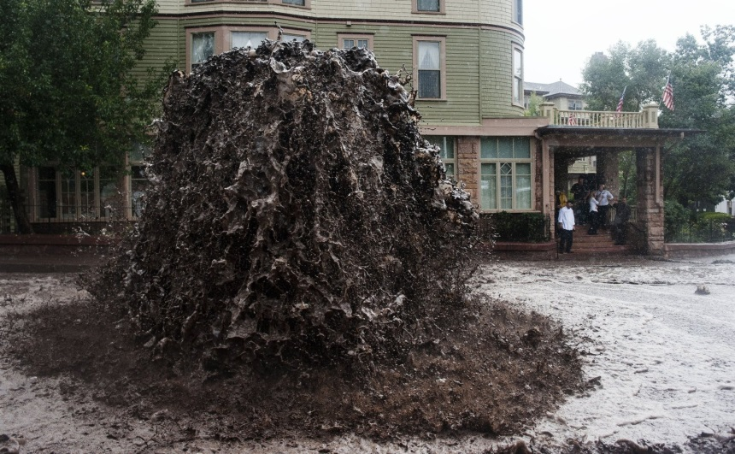
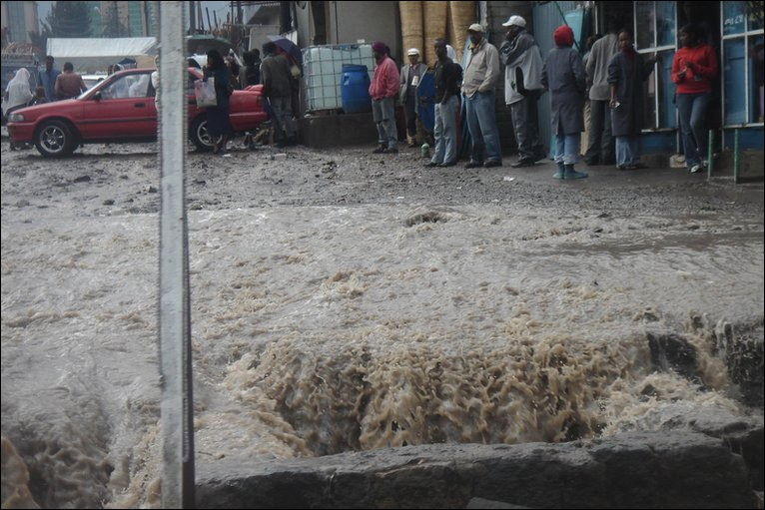
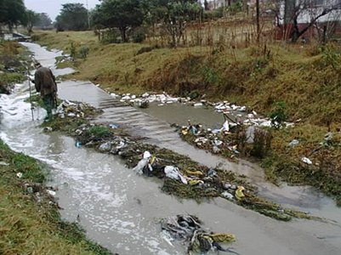
Why it is necessary to drain off storm water from an area?

Slide 15
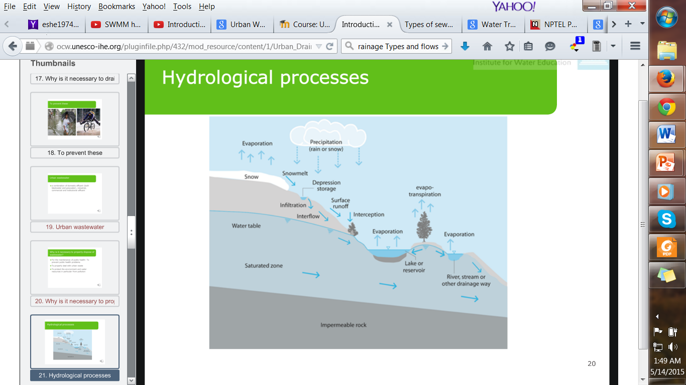
Hydrological processes

Slide 16
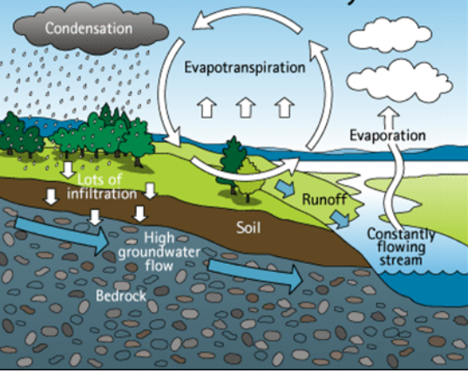
The natural water cycle

Slide 17
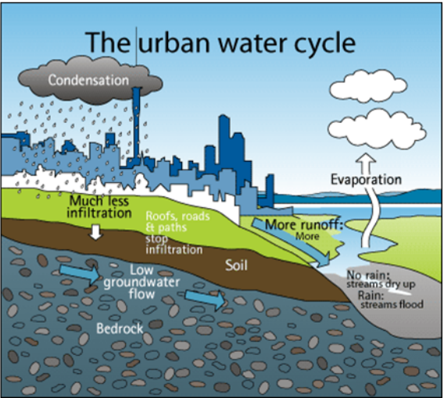
The urban water cycle
Increased water supply for consumptive use
Release of wastewater
Increased imperviousness
Reduced interception
Faster conveyance system

Slide 18
Impacts of urbanization
Urban areas
  High population density, more commercial activities
  larger and concentrated customer base
    Access to all services
    More opportunities

Slide 19
Impacts of urbanization on hydrology
In a natural setting:
  vegetation intercepts the precipitation
  the ground’s surface is often pervious, water percolates down into the soil

Slide 20
Impacts of urbanization on hydrology
In developed areas:
  Removal of vegetation – reduce interception
  Infrastructure (asphalt roads, concrete structures) – increase impervious area and prevent water from infiltrating into the soil.
  Runoff coefficient increases
More storm water runoff

Slide 21
Impacts of urbanization on hydrology
In developed areas:
  supply of large volumes of pipe water to generate more drainage water/ wastewater
  efficient and faster hydraulic conveyance systems
  increase of discharging pollutants to natural water bodies
More storm water runoff
Poor water quality
Urbanization

Slide 22
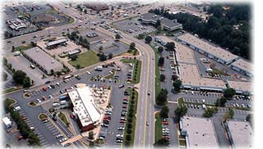
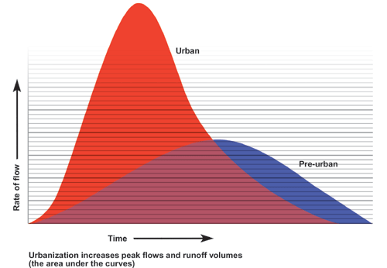
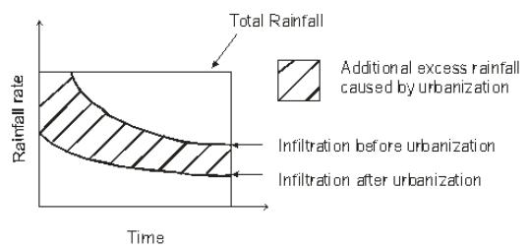
Effect of urbanization on volume and rate of surface water runoff

Slide 23
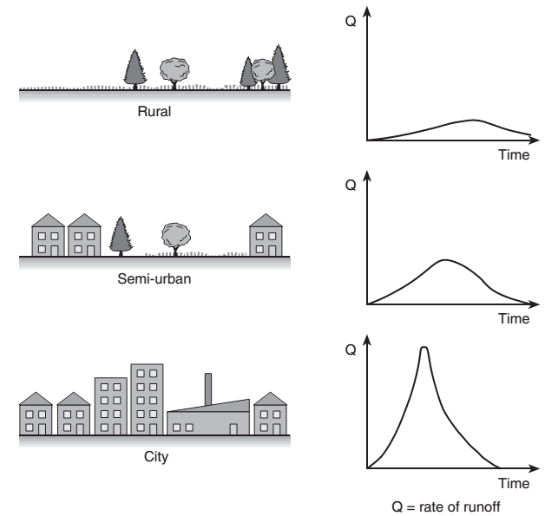
Effects of Urbanization
Fig: Effect of urbanization on peak rate of runoff

Slide 24
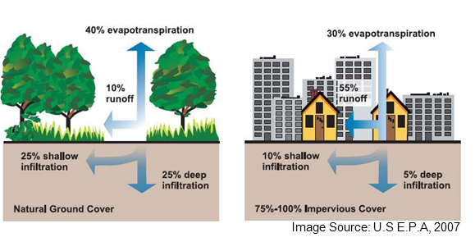
Effects of Urbanization
Fig: Effect of urbanization on natural water cycle

Slide 25
Impacts of urbanization on hydrology
Increased peak discharge of runoff
Increased volume of runoff
Reduced time of concentration
Reduced base flow from the catchment
Increased wastewater flow/drainage flow

Slide 26
Impacts of urbanization on hydrology
Increased frequency and severity of offsite downstream flooding
Reduced stream flow and lower water table levels during dry weather
Loss of wetlands
Increase in flow velocity
  increased land erosion
  increased stream channel erosion

Slide 27
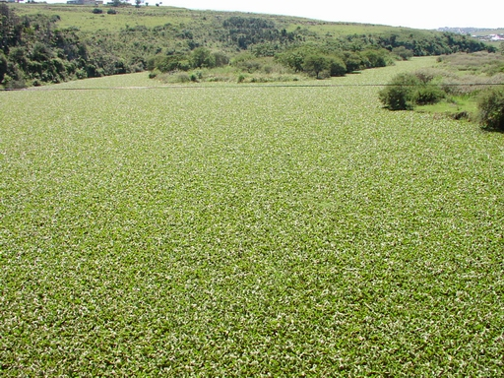
Impacts of urbanization on hydrology
Pollution significantly degrade water quality and aquatic habitat.
Urbanization increases the amount of pollutants in storm runoff
Pollutants and suspended matter in the storm change the nature of the substrate in receiving body.
Habitats of aquatic life are threatened, biodiversity is affected.

Slide 28
Mitigation of adverse impacts of urbanization
Requires a multi-disciplinary approach through:
  Structural measures
  Non-structural measures
The civil engineering components fall mainly to the structural measures
Non-structural measures do not involve constructions
Preventive actions for hydrological impacts are always simpler and cost effective compared to corrective actions.

Slide 29
Mitigation of adverse impacts of urbanization
Non structural measures
Conducting awareness building on development projects
Introduction of EIA for all development activities
Introduction of legislations
Preparedness for facing floods

Slide 30
Non structural measures
Provisions for floodplain zoning and regulation
  to regulate land use changes
  some areas are left out for flood control
Introduction of legislations for
  imposing mandatory storm water retention or detention facility within the premises.
  Building codes to include storm water storage facilities
Provisions for flood-proofing of buildings
  Buildings are required to adopt flood proofing techniques to coop with floods

Slide 31
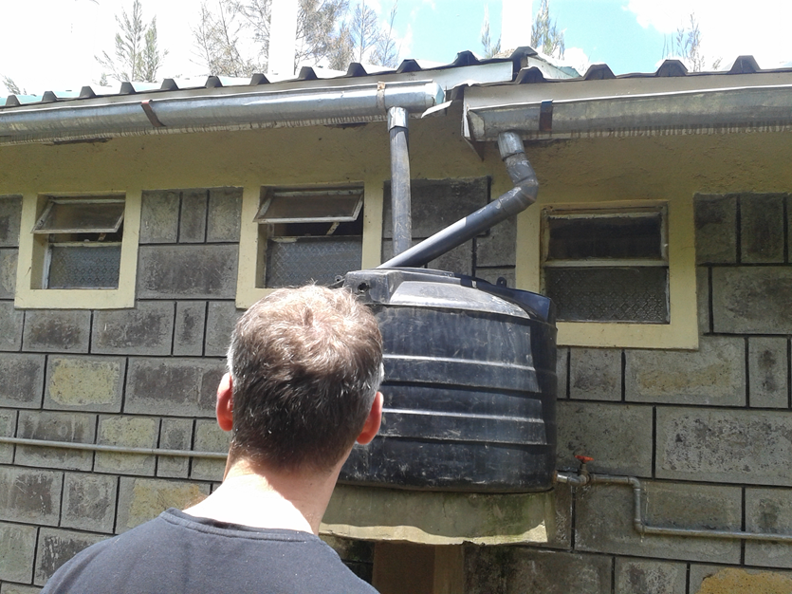
Non structural measures
Legislations
  To control water pollution by imposing quality standards for wastewater and solid waste disposals in urban environments
  To improve the quality at the premises itself by owners before releasing to public facilities such as storm water drains
storm water storage facilities

Slide 32
Structural measures
The traditional “efficient conveyance” approach is shifted gradually towards the “water storing” approach, focusing on detention, retention and recharge
  To increase infiltration for minimizing runoff generation

Slide 33
Structural measures
Flow detention and retardation structures
Storage type
  detention ponds
  retarding basins
  off-site storage structures
Infiltration type
  pervious pavements
  infiltration trenches
  Infiltration ponds and inlets

Slide 34
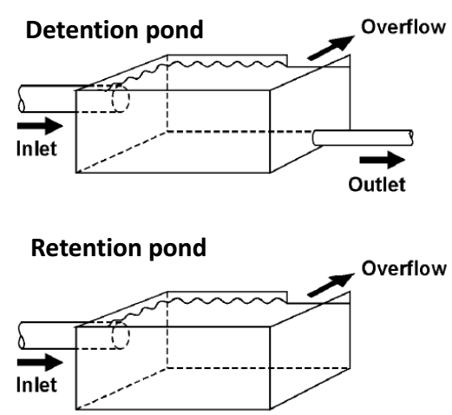
Detention ponds & Retention ponds
Dry ponds
drains after the storm peak flow has passed
Wet ponds

Slide 35
Retention ponds
Retention pond is a reservoir to provide a residence time
  to retain water and regulate outflow
  to settle down pollutants and sediments
Capacity is based on the runoff generated from the area
A dead storage is provided to trap heavy metal pollutants and sediments
Sluices and spillways are provided to discharge the excess water

Slide 36
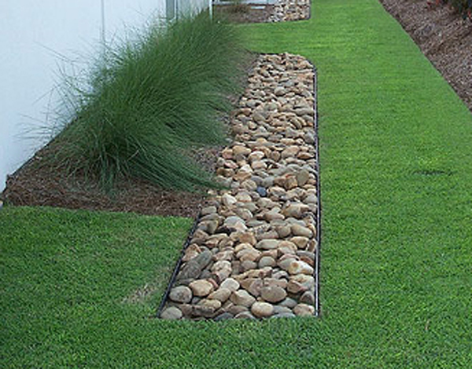
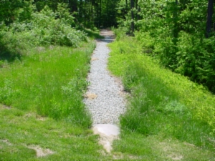
Infiltration trenches
A trench is excavated and filled with crushed stone
  to enhance the infiltration
Top of the trench is covered by a fabric

Slide 37
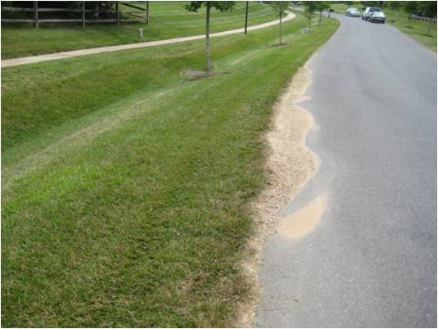
Grass filter strips
These are stripes of grassed soil surfaces introduced between the urban impervious surfaces and the storm drains
  to slow down and partially infiltrate the runoff

Slide 38
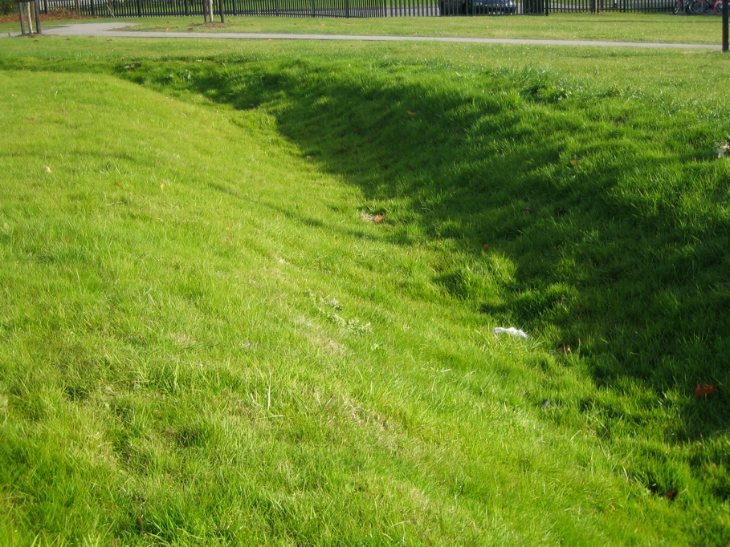
Grass swales
These are depressions in the grassed terrain designed to function as small unlined channels

Slide 39
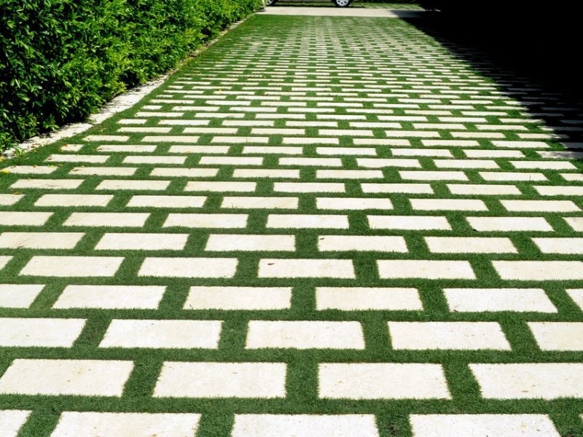
Pervious pavements
Pervious pavements are permeable surfaces where the runoff can pass and infiltrate into the ground.
Pervious pavements facilitate
  peak flow reduction
  groundwater recharge
  pollution filtering
Types:
  porous asphalt pavements
  porous concrete pavements
  garden blocks

Slide 40
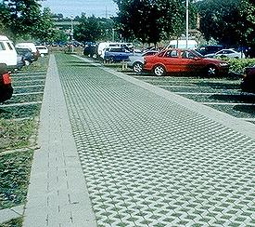
Pervious pavements
Porous asphalt pavements are popularly used in urban areas in
  Roads
  Parking lots
Porous concrete pavements are used in
  open walkways
  parking areas
Garden blocks are used in
  pavements in gardens that are only used for walking

Slide 41
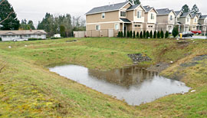
Infiltration ponds
Infiltration ponds are similar to detention ponds but they are specifically provided to infiltrate the routed storm water

Slide 42
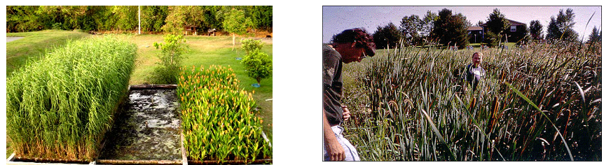
Wetlands
Wetlands are shallow ponds with growing aquatic plants constructed across streams at depressions for removal of pollutants in water
They provide a detention time for the water to settle pollutants/sediments and for the aquatic plants to uptake pollutants.

Slide 43
Storm water drainage approaches
Two fundamentally different types of storm water drainage approaches:
  Conventional or traditional (conveyance-oriented) approach
  Storage-oriented (natural system) approach

Slide 44
Conveyance-oriented Approach
Provide for the collection of storm water followed by the immediate and rapid conveyance of the storm water from the collection area to minimize damage and disruption within the collection area
  Is conveyance (transfer) oriented
  Is based on reactive-curative philosophy (deals with consequences)
  Leads to many negative environmental impacts

Slide 45
Storage-oriented Approach
Provide for temporary storage of storm water at or near the point of origin, with subsequent slow release to downstream storm sewers or channels.
The principal elements are one or more storage facilities with conveyance facilities, such as culverts, storm sewers, inlets and outlet to transport storm water to storage facilities and gradually convey flow from those facilities

Slide 46
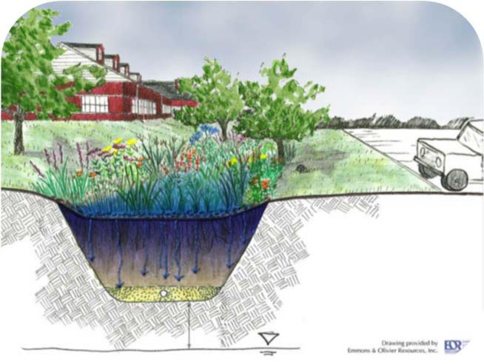
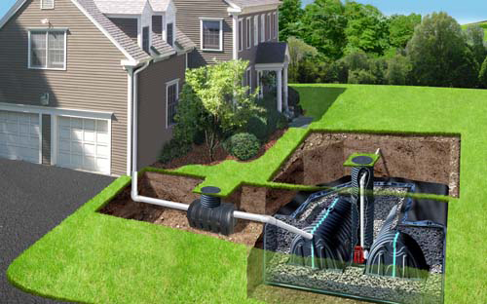
Storage-oriented Approach
Deals with the causes rather than the consequences – to avoid storm water related problems
Includes approaches that deal with the causes
  Natural drainage systems approach
  Source control and distributed systems approach
  Rainwater management approach
Rain Gardens
Green Roofs
Rain Water Harvesting

Slide 47
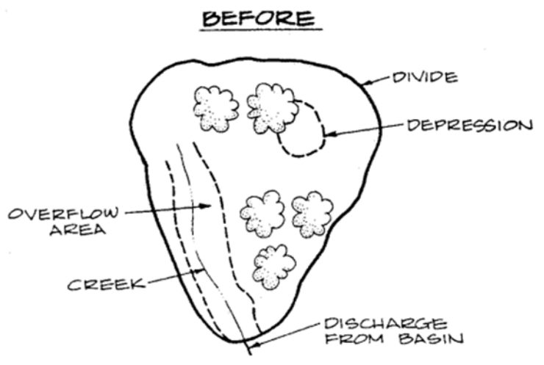
Storm water drainage approaches

Slide 48
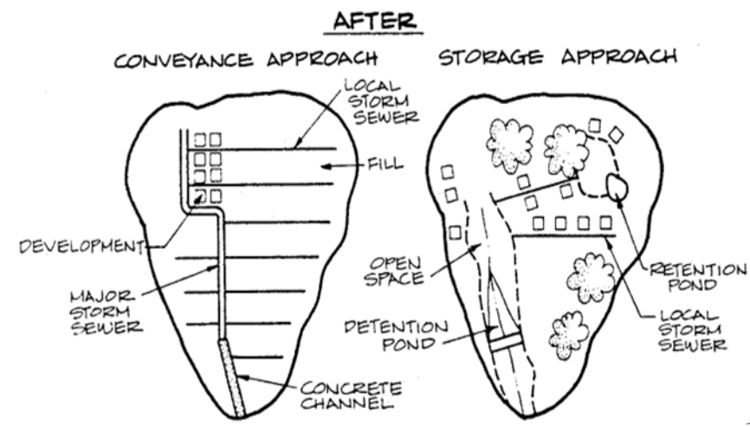
Storm water drainage approaches

Slide 49
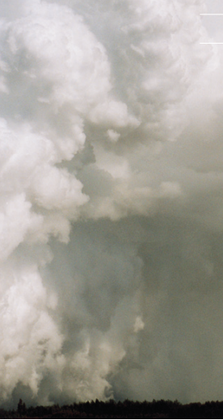
Chapter 3
Rainfall Analysis
and
Quantity of Storm Water
How much runoff flow occurs in an urban watershed outlet in response to a given amount of rainfall?

Slide 50
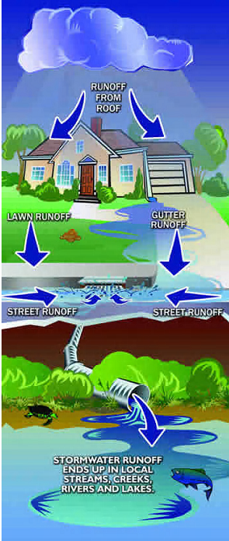
Rainfall – Runoff Processes
Questions addressed in the study of rainfall – runoff processes:
  Where water goes?
  When it rains?
  How long does water reside in a watershed?
  What pathway does water take to the storm sewer or drain?

Slide 51
Rainfall – Runoff Processes
Answering the question of how much runoff is generated from rainfall requires:
  partitioning water inputs at the earth surface into:
    components that infiltrate and
    components that flow overland and directly enter drain/sewer
The pathways followed by infiltrated water need to be understood.
  Infiltrated water can follow subsurface pathways that take it to the drain relatively quickly, it is called interflow or subsurface stormflow.

Slide 52
Rainfall – Runoff Processes
  Infiltrated water can also percolate to deep groundwater, which may sustain the steady flow in streams over much longer time scales that is called baseflow.
  Infiltrated water can also remain in the soil to later evaporate or be transpired back to the atmosphere.
Understanding and modeling the rainfall – runoff process is therefore important in designing the urban storm drainage system.
The figure below illustrates schematically many of the processes involved in the generation of runoff.

Slide 53
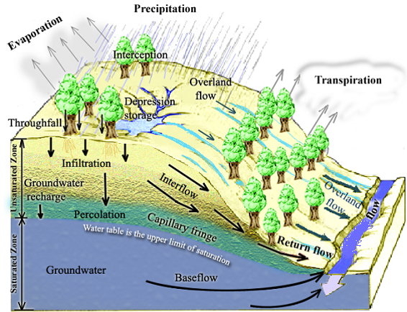
Rainfall – Runoff Processes
Figure: Physical processes involved in runoff generation

Slide 54
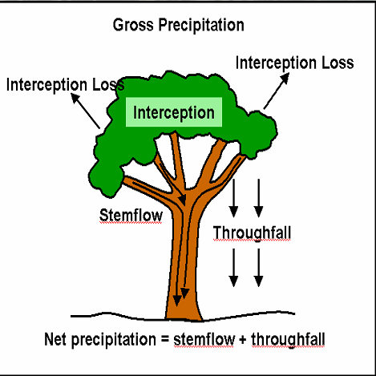
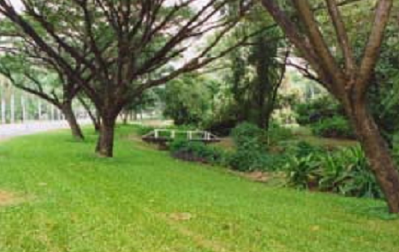
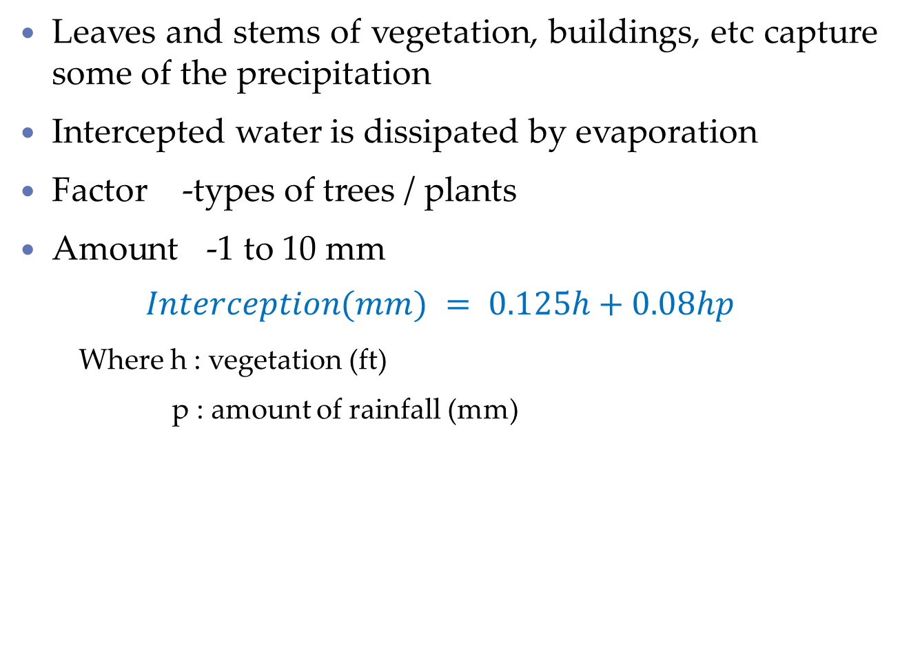
Interception
Leaves and stems of vegetation, buildings, etc capture some of the precipitation
Intercepted water is dissipated by evaporation
Factor -types of trees / plants
Amount -1 to 10 mm
$$Interception(mm) = 0.125h+0.08hp$$
    Where h : vegetation (ft)
    p : amount of rainfall (mm)

Slide 55
Evapotranspiration
Evaporation from land surface:
  includes direct evaporative loss from:
    the soil surface
    the depression storages
    the intercepted water
Transpiration from vegetation
Depends on heat energy, wind, moisture availability
Short time --- neglect EVP
Long time --- include EVP

Slide 56
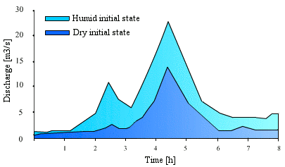
Infiltration
The process of penetrating of water from the ground surface into the soil.
Infiltration rate depends on
  condition of soil surface (slope, bare, low, moderate, high)
  existing land cover
  properties of soil beneath
    porosity, hydraulic conductivity and existing moisture content of the soil
  rainfall intensity and duration
Infiltration vary with time and space
Influence of initial humidity conditions on the hydrograph's response of a catchment

Slide 57
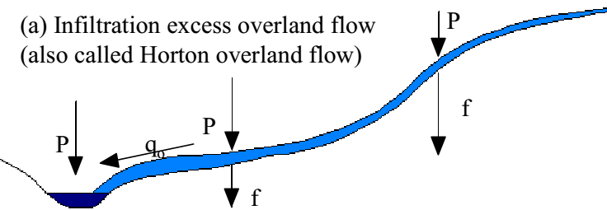
Infiltration
Rainfall intensity (I) occurs on a plain sloping ground
Infiltration rate (f)
Runoff = the excess precipitation over infiltration
= I - f
Infiltration excess overland flow is particularly obvious on paved urban areas.

Slide 58
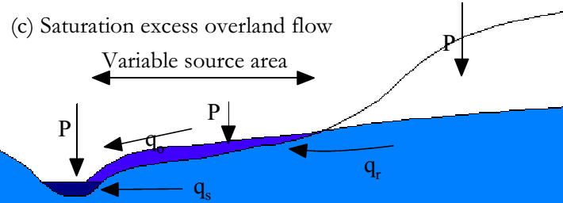
Infiltration
In most humid regions infiltration capacities are high because:
  vegetation protects the soil from rain-packing and dispersal
  the supply of humus & activity of micro fauna create an open soil structure
Rainfall intensities generally do not exceed infiltration capacities and infiltration excess runoff is rare.
Overland flow can occur, when the soil profile is saturated.
  Saturation excess OF

Slide 59
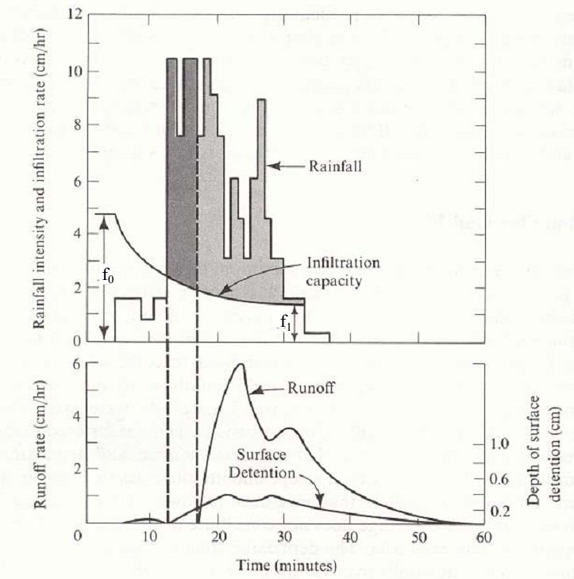
Infiltration
The shaded areas:
  precipitation falling at a rate exceeding the infiltration rate
The dark grey area:
  rainfall that enters depression storage, which is filled before runoff occurs
The light grey shading:
  rainfall that becomes overland flow

Slide 60
Surface runoff
excess over infiltration
releases from houses, industries and irrigation
discharge from springs
secretion (or exfiltration) from saturated and unsaturated soil as base flow

Slide 61
Factors affecting runoff
The runoff rate and its volume from an area, mainly influenced by following two factors:
  climatic factors
  physiographic factors
Climatic factors:
  form of precipitation (rainfall, snow or hails)
  rainfall intensity (high intensities rainfall yield higher runoff)
  duration of rainfall
    infiltration rate of the soil goes on decreasing with the duration of rainfall
  rainfall distribution
  direction of the prevailing wind

Slide 62
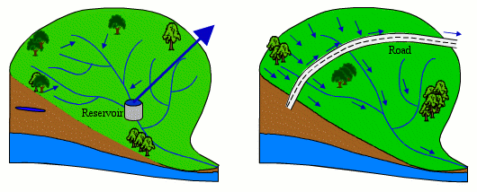
Factors affecting runoff
Physiographic factors:
  different characteristics of watershed and channel:
    size of watershed
    shape of watershed
    slope of watershed
    land use
    soil moisture
    soil type
    topographic characteristic
    type and degree of imperviousness

Slide 63
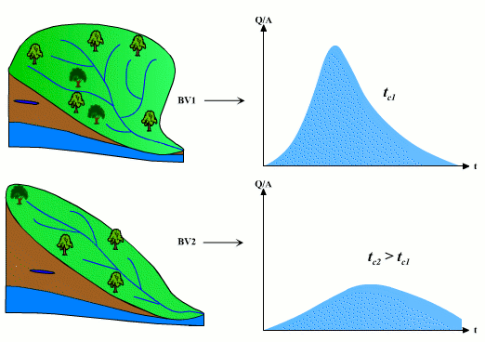
Factors affecting runoff
Physiographic factors:
  The influence of watershed shape on the hydrograph
A long shape watershed generates, for the same rainfall, a lower outlet flow, as the concentration time is higher.

Slide 64
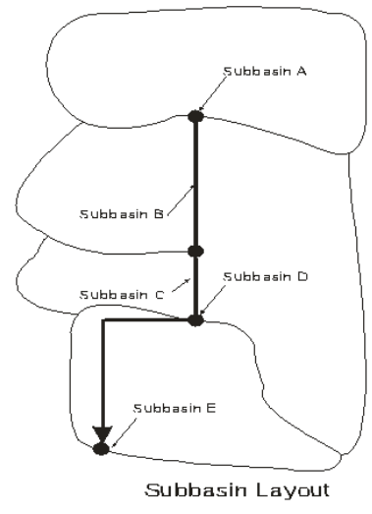
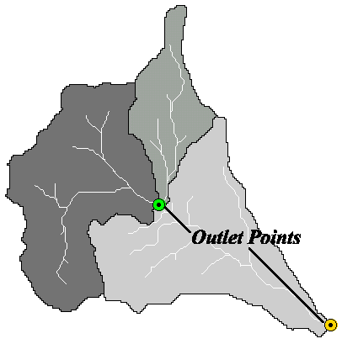
Factors affecting runoff
The catchment area to be drained is required to be defined based on the topography of the area.
  Urban catchments are usually modeled not as a single catchment but as collection of sub-catchments.

Slide 65
Effective rainfall (Runoff)
$$R_{eff}\left(t\right)=R\left(t\right)−Q_{E}\left(t\right)−Q_{I1}\left(t\right)−Q_{I2}(t)$$
  Where:
  R(t) = Actual precipitation at time t,
  Q_{E} (t) = Evaporation loss at time t,
  Q_{I1} (t) = Initial loss at time t,
  Q_{I2} (t) = Infiltration loss at time t,

Slide 66
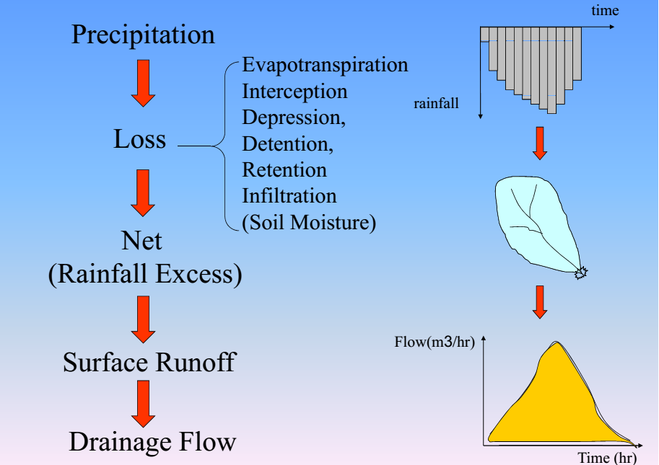
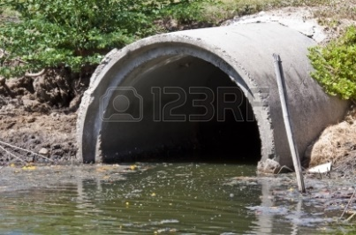

Slide 67
Rainfall Analysis
Important parameters for design of storm water drainage in a catchment area:
  rainfall intensity
  rainfall duration
  rainfall depth
  spatial variation
  recurrence interval of rainfall
Intensity-Duration-Frequency (IDF) curves
  presents rainfall characteristics at location by statistical analysis.
  provide average rainfall intensities corresponding to a particular return period for different durations.

Slide 68
Rainfall Variability
Temporal Variability

Slide 69
Rainfall Variability
Temporal Variability
Annual rainfall variation
h (mm)
1750
1500
1250
1000
750
500
1910
1920
1930
1940
1950
1960
1970
1980
1990
2000
2010
years

Slide 70
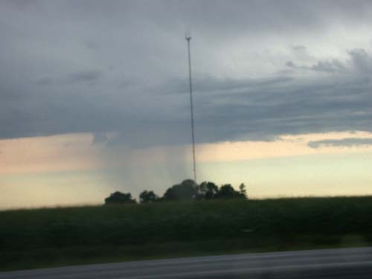
Rainfall Variability
Spatial Variability

Slide 71
Rainfall analysis
  Rain data expressed as:
    depth in mm or
    intensity in mm/h
  Rainfall depth can be related statistically to:
    duration and
    frequency
  Rainfall duration refers to the time period over which the rain falls
  Frequency or probability of the rainfall usually expressed as a return period

Slide 72
Rainfall analysis
Frequency of rainfall (f)
Design storm frequency by zoning district
Zoning district/Land use | Design storm frequency, year
 | Minor* | Major
Residential | 2 | 100
General Commercial | 5 | 100
Industrial/Central Business | 10 | 100
Parks, Open Public Land | 2 | 100
*Where multiple zoning districts or land uses apply the greater minor design storm shall be used.

Slide 73
Rainfall analysis
Frequency of rainfall (f)
Design storm frequency by street classification
Street classification | Design storm frequency, year
 | Minor* | Major
Local | 2 | 100
Collector | 5 | 100
Arterial | 10 | 100
*The 50-year design storm shall be used for depressed road crossings.
  Where the zoning district and the street classification yield different minor storm frequencies, the greater minor design storm shall govern.
  Drainage systems shall also be evaluated for the Major storm to identify potential flood hazards.

Slide 74
IDF analysis_Steps
  IDF relationships
    A convenient form of rainfall information
    For a particular return period, rainfall intensity and duration are inversely related
    IDF curves can be developed using frequency analysis
  Steps for IDF analysis are:
    gathering time series records of different duration. (eg. 5, 10, 15, 20, 30, 60, 90, and 120 min)
    Extract annual extremes from the record of each duration
    Fit the annual extreme data to a probability distribution in order to estimate rainfall depth for different return periods

Slide 75
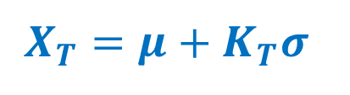
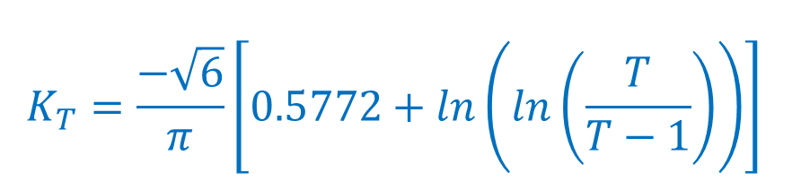
IDF analysis_Steps
  where
    X_{T} - the magnitude of the T-year event,
    µ , σ - mean and standard dev of the of the annual maximum series
    K_{T} - frequency factor depending on the return period T.
    Note that the frequency factor is distribution-specific
    For example: K_{T} for Gumbel’s extreme value type-I distribution is given by:
The rainfall depth is calculated for a given return period as:
  $$X_{T}=μ+K_{T}σ$$
  $$K_{T}=\frac{−\sqrt{6}}{π}\left[0.5772+ln\left(ln\left(\frac{T}{T−1}\right)\right)\right]$$

Slide 76
IDF analysis_Steps
Annual maximum series for different durations
Year | 5 min | 10min | 15 min | 30 min | 60 min | 90 min | 120 min
1
2
3
4
.
.
.
µ
σ

Slide 77
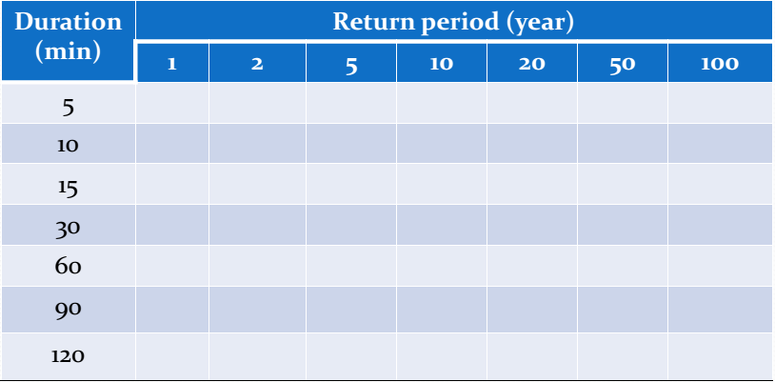
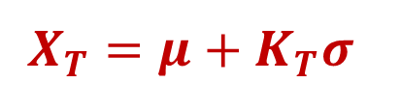

IDF analysis_Steps
IDF
  $$X_{T}=μ+K_{T}σ$$
$$\overline{I_{t}}(D)=\frac{X_{T}}{D}$$

Slide 78
IDF analysis_Example
Max. rainfall depth (mm) for different durations
Year | 1H | 2H | 6H | 12H | 24H
1969 | 44.5 | 61.6 | 104.1 | 112.3 | 115.9
1970 | 37 | 48.2 | 62.5 | 69.6 | 92.7
1971 | 41 | 52.9 | 81.4 | 86.9 | 98.7
1972 | 30 | 40 | 53.9 | 57.8 | 65.2
1973 | 40.5 | 53.9 | 55.5 | 72.4 | 89.8
1974 | 52.4 | 62.4 | 83.2 | 93.4 | 152.5
1975 | 59.6 | 94 | 95.1 | 95.1 | 95.3
1976 | 22.1 | 42.9 | 61.6 | 64.5 | 71.7
1977 | 42.2 | 44.5 | 47.5 | 60 | 61.9
1978 | 35.5 | 36.8 | 52.1 | 54.2 | 57.5
1979 | 59.5 | 117 | 132.5 | 135.6 | 135.6
1980 | 48.2 | 57 | 82 | 86.8 | 89.1
1981 | 41.7 | 58.6 | 64.5 | 65.1 | 68.5
1982 | 37.3 | 43.8 | 50.5 | 76.2 | 77.2
1983 | 37 | 60.4 | 70.5 | 72 | 75.2
1984 | 60.2 | 74.1 | 76.6 | 121.9 | 122.4
1986 | 65.2 | 73.7 | 97.9 | 103.9 | 104.2
1987 | 47 | 55.9 | 64.8 | 65.6 | 67.5
1988 | 148.8 | 210.8 | 377.6 | 432.8 | 448.7
1989 | 41.7 | 47 | 51.7 | 53.7 | 78.1
1990 | 40.9 | 71.9 | 79.7 | 81.5 | 81.6
1991 | 41.1 | 49.3 | 63.6 | 93.2 | 147
1992 | 31.4 | 56.4 | 76 | 81.6 | 83.1
1993 | 34.3 | 36.7 | 52.8 | 68.8 | 70.5
1994 | 23.2 | 38.7 | 41.9 | 43.4 | 50.8
1995 | 44.2 | 62.2 | 72 | 72.2 | 72.4
1996 | 57 | 74.8 | 85.8 | 86.5 | 90.4
1997 | 50 | 71.1 | 145.9 | 182.3 | 191.3
1998 | 72.1 | 94.6 | 111.9 | 120.5 | 120.5
1999 | 59.3 | 62.9 | 82.3 | 90.7 | 90.9
2000 | 62.3 | 78.3 | 84.3 | 84.3 | 97.2
2001 | 46.8 | 70 | 95.9 | 95.9 | 100.8
2003 | 53.2 | 86.5 | 106.1 | 106.2 | 106.8

Slide 79

IDF analysis_Example
Mean | µ | 48.70 | 66.33 | 86.78 | 96.57 | 105.18
Std. Dev. | s | 21.53 | 31.79 | 57.51 | 66.25 | 68.60
  $$K_{T}=\frac{−\sqrt{6}}{π}\left[0.5772+ln\left(ln\left(\frac{T}{T−1}\right)\right)\right]$$
T (years) | 2 | 5 | 10 | 25 | 50 | 100
K_{T} | -0.16 | 0.72 | 1.30 | 2.04 | 2.59 | 3.14
Duration (hr) | T (years)
 | 2 | 5 | 10 | 25 | 50 | 100
1 | 45.17 | 64.19 | 76.78 | 92.68 | 104.49 | 116.20
2 | 61.11 | 89.19 | 107.78 | 131.27 | 148.69 | 165.99
6 | 77.34 | 128.14 | 161.77 | 204.27 | 235.80 | 267.10
12 | 85.69 | 144.22 | 182.96 | 231.92 | 268.24 | 304.29
24 | 93.92 | 154.52 | 194.64 | 245.33 | 282.94 | 320.27

Slide 80
IDF analysis_Example

Slide 81
IDF analysis_Example
The rainfall intensity (mm/hr) for different durations
Year | 1H | 2H | 6H | 12H | 24H
1969 | 44.5 | 30.8 | 17.35 | 9.36 | 4.83
1970 | 37 | 24.1 | 10.42 | 5.80 | 3.86
1971 | 41 | 26.45 | 13.57 | 7.24 | 4.11
1972 | 30 | 20 | 8.98 | 4.82 | 2.72
1973 | 40.5 | 26.95 | 9.25 | 6.03 | 3.74
1974 | 52.4 | 31.2 | 13.87 | 7.78 | 6.35
1975 | 59.6 | 47 | 15.85 | 7.93 | 3.97
1976 | 22.1 | 21.45 | 10.27 | 5.38 | 2.99
1977 | 42.2 | 22.25 | 7.92 | 5.00 | 2.58
1978 | 35.5 | 18.4 | 8.68 | 4.52 | 2.40
1979 | 59.5 | 58.5 | 22.08 | 11.30 | 5.65
1980 | 48.2 | 28.5 | 13.67 | 7.23 | 3.71
1981 | 41.7 | 29.3 | 10.75 | 5.43 | 2.85
1982 | 37.3 | 21.9 | 8.42 | 6.35 | 3.22
1983 | 37 | 30.2 | 11.75 | 6.00 | 3.13
1984 | 60.2 | 37.05 | 12.77 | 10.16 | 5.10
1986 | 65.2 | 36.85 | 16.32 | 8.66 | 4.34
1987 | 47 | 27.95 | 10.80 | 5.47 | 2.81
1988 | 148.8 | 105.4 | 62.93 | 36.07 | 18.70
1989 | 41.7 | 23.5 | 8.62 | 4.48 | 3.25
1990 | 40.9 | 35.95 | 13.28 | 6.79 | 3.40
1991 | 41.1 | 24.65 | 10.60 | 7.77 | 6.13
1992 | 31.4 | 28.2 | 12.67 | 6.80 | 3.46
1993 | 34.3 | 18.35 | 8.80 | 5.73 | 2.94
1994 | 23.2 | 19.35 | 6.98 | 3.62 | 2.12
1995 | 44.2 | 31.1 | 12.00 | 6.02 | 3.02
1996 | 57 | 37.4 | 14.30 | 7.21 | 3.77
1997 | 50 | 35.55 | 24.32 | 15.19 | 7.97
1998 | 72.1 | 47.3 | 18.65 | 10.04 | 5.02
1999 | 59.3 | 31.45 | 13.72 | 7.56 | 3.79
2000 | 62.3 | 39.15 | 14.05 | 7.03 | 4.05
2001 | 46.8 | 35 | 15.98 | 7.99 | 4.20
2003 | 53.2 | 43.25 | 17.68 | 8.85 | 4.45

Slide 82
IDF analysis_Example
Mean | µ | 48.70 | 66.33 | 86.78 | 96.57 | 105.18
Std. Dev. | s | 21.53 | 31.79 | 57.51 | 66.25 | 68.60
  $$K_{T}=\frac{−\sqrt{6}}{π}\left[0.5772+ln\left(ln\left(\frac{T}{T−1}\right)\right)\right]$$
T (years) | 2 | 5 | 10 | 25 | 50 | 100
K_{T} | -0.16 | 0.72 | 1.30 | 2.04 | 2.59 | 3.14
Duration (hr) | T (years)
 | 2 | 5 | 10 | 25 | 50 | 100
1 | 45.17 | 64.19 | 76.78 | 92.68 | 104.49 | 116.20
2 | 61.11 | 89.19 | 107.78 | 131.27 | 148.69 | 165.99
6 | 77.34 | 128.14 | 161.77 | 204.27 | 235.80 | 267.10
12 | 85.69 | 144.22 | 182.96 | 231.92 | 268.24 | 304.29
24 | 93.92 | 154.52 | 194.64 | 245.33 | 282.94 | 320.27

Slide 83
IDF analysis_Example

Slide 84

IDF analysis_Steps
In a time duration of 90 minutes, a location could experience a peak 2 in/hr storm once every 20 years
The 20-yr 90-min design storm for the location would have a depth of P = 3 in

Slide 85

IDF analysis_Steps
A 20-yr 30-min design storm would have an intensity of 4.6 in/hr but with a depth of only 2.3 in.
Although the latter storm produces less depth, its high intensity could be the governing factor in determining the size of drainage works.
The probability of occurrence of both storms would be the same
Because the rainfall intensity is an important determinant of the hydrologic response, it is important to specify both the depth and duration (or intensity and duration) and not just the total volume (i.e., depth).

Slide 86


IDF curves
IDF curves usually represented by an empirical formula which has one of the following different forms
  Where
    i = intensity in mm/hr
    T = return period in years
    t_{d} = rainfall duration in minutes
    a, m and e are coefficients representing local condition
$$i=\frac{aT^{m}}{(t_{d}^{e}+c)}$$
$$i=\frac{aT^{m}}{{(t_{d}^{}+c)}^{e}}$$

Slide 87


Hydraulic Design – Runoff
Runoff estimation for hydraulic sizing of storm water runoff facilities such as
  pipe systems
  storm inlets and culverts
  small open channels
  detention facilities

Slide 88

Hydraulic Design – Runoff
Many different approaches
  Statistical analysis of the flood records
  Regression equations
  Rational method
  Hydrograph method

Slide 89
Hydraulic Design – Runoff
Statistical analysis of the flood records
  empirical method
  calibrates a probability model with peak annual discharge observations
  relates design flow magnitude to frequency directly
  does not consider rainfall or catchment properties or processes
  useful where records of more than 20 years runoff data are available at or on the same location near the drainage facility

Slide 90
Hydraulic Design – Runoff
Regression equations
  empirical method
  use equations previously developed through statistical analysis to predict the peak discharge
  the equations relate peak discharges to various watershed characteristics, including area, mean annual precipitation, and slope (Q_{p} = f(A, P, S …)
  useful if flood records are not available at or near the project site, or other methods are judged inappropriate

Slide 91
Hydraulic Design – Runoff
Rational method
  simple conceptual method
  estimates peak runoff rate for a selected frequency
  appropriate for urban and rural catchments less than 80 hectares in which natural or man-made storage is minor
  relies on an assumption that the design flow of a specified frequency is caused by rainfall of the same frequency
  best suited to the design of urban storm drain systems

Slide 92
Hydraulic Design – Runoff
  Hydrograph method
  conceptual method
  relies on a mathematical representation of the critical processes by which rainfall on a catchment is transformed to runoff
  used with a design rainfall hyetograph, which specifies the time distribution of rainfall over a catchment
  computes a runoff hydrograph: the peak flow, time of peak, and corresponding volume can be found

Slide 93

Rational method
provides peak discharge value not a time series of flow (hydrograph)
relates the peak discharge (Q, m³/sec) to the drainage area (A, ha), the rainfall intensity (I, mm/hr), and the runoff coefficient (C)
$Q=\frac{CIA}{360}$

Slide 94
Rational method – runoff coefficient
ratio of runoff to rainfall
difficult to estimate b/c it represents the interaction of many complex factors, including
  the storage of water in surface depressions
  infiltration
  antecedent moisture
  ground cover and slopes
  soil types
vary with respect to prior wetting and seasonal conditions
average values are used for simplicity
where a drainage area is composed of subareas with different runoff coefficients, a composite coefficient is used

Slide 95
Rational method – Rainfall Intensity
A function of
  geographic location
  return period
  storm duration
Rainfall intensity at a duration equal to the time of concentration (t_{c}) is used to calculate the peak flow
The rainfall intensity can be selected from the appropriate IDF curves

Slide 96
Rational method – Area
the drainage surface area in hectares, measured in a horizontal plane, measured from plans or maps using a planimeter or GIS
includes all land enclosed by the surrounding drainage divides

Slide 97

Rational method – Time of Concentration (t_{c})
the time it takes for runoff to travel from the most hydraulically distant point in the catchment to the outlet
taken as the sum of the overland flow time (t_{o}) ("time to entry" or "inlet time"), and the time of travel (t_{d}) in sewers or the main channel
$$t_{c}=t_{o}+t_{d}$$
must be estimated along all the possible flow paths and the maximum is used

Slide 98


Rational method – Time of Concentration
$t_{c1}$ = t₀₁ + t_{d1,2} + t_{d2,3}+ t_{d3,7}

Slide 99


Rational method – Time of Concentration
$t_{c2}$ = t₀₂ + t_{d2,3} + t_{d3,7}

Slide 100


Rational method – Time of Concentration
$t_{c5}$ = t₀₅ + t_{d5,4} + t_{d4,3}+ t_{d3,7}

Slide 101


Rational method – Time of Concentration
$t_{c4}$ = t₀₄ + t_{d4,3} + t_{d3,7}

Slide 102


Rational method – Time of Concentration
$t_{c6}$= t₀₆ + t_{d6,7}

Slide 103


Rational method – Time of Concentration
$t_{c7}$= t₀₇

Slide 104
Rational method – Runoff coefficient (c)
Description of Area | Runoff Coefficients | Recommended Value*
Business
Downtown | 0.7 - 0.95 | 0.85
Neighborhood | 0.5 - 0.7 | 0.6
Residential
Single-family | 0.3 - 0.5 | 0.4
Multiunits, detached | 0.4 - 0.6 | 0.5
Multiunits, attached | 0.6 - 0.75 | 0.7
Residential (suburban) | 0.25 - 0.4 | 0.35
Apartment | 0.5 - 0.7 | 0.6
Industrial
Light | 0.5 - 0.8 | 0.65
Heavy | 0.6 - 0.9 | 0.75
Parks, cemeteries | 0.1 - 0.25 | 0.2
Playgrounds | 0.2 - 0.35 | 0.3
Railroad yard | 0.2 - 0.35 | 0.3
Roof | 0.75 – 0.95 | 0.85
Pavement
Asphaltic and concrete | 0.7 – 0.95 | 0.85
Brick | 0.75 – 0.85 | 0.8
applicable for storms of 5- to 10-year frequencies

Slide 105
Rational method – Time of Concentration
Inlet time (t_{o})
Table: Manning roughness values for overland flow
Surface Type | n
Asphalt/concrete | 0.010 - 0.012
Bare sand | 0.010 - 0.060
Bare clay/loam | 0.012 - 0.033
Gravelled surface | 0.012 - 0.030
Short grass | 0.100 - 0.200
Lawns | 0.200 - 0.300
Pasture | 0.300 - 0.400
Dense shrubbery | 0.4

Slide 106

Rational method – Time of Concentration
Inlet time (t_{o})
  for small fully-sewered areas, some drainage authorities specify to as a constant typically ranging from 5 to 15 min.
  In more complex situations, it is recommended to use the kinematic wave formula
  $$t_{o}=6.9L^{0.6}n^{0.6}I^{0.4}S^{−0.3}$$
  Where:
  t_{o} - inlet time in min
  L - the travelled length (m)
  n - the Manning's roughness coefficient
  I - the rainfall intensity (mm/hr)
  S - the slope of the catchment (m/m)

Slide 107

Rational method – Time of Concentration
Inlet time (t_{o})_ Nomograph
Figure: Nomograph for estimating overland sheet flow times. Modified from Miller (1951).

Slide 108
Rational method – Assumption
The rate of runoff resulting from any constant rainfall intensity is maximum when the duration of rainfall equals the t_{c}
The frequency of peak discharge is the same as the frequency of the rainfall intensity for the given t_{c}
The rainfall intensity is uniformly distributed over the entire drainage area
The fraction (C) of rainfall that becomes runoff is independent of rainfall intensity or volume
The effects of channel storage is neglected

Slide 109
Rational method – Limitations
the assumption of constant rainfall intensities for large catchments is not valid
frequencies of peak discharges depend on
  rainfall frequencies
  antecedent moisture conditions in the catchment
  the response characteristics of the drainage system
rainfall intensity varies spatially and temporally during a storm
the constant runoff coefficient assumption is reasonable only for impervious areas, such as streets, rooftops, and parking lots

Slide 110
Rational method – Limitations
For pervious areas, the fraction of runoff (C) varies with
  rainfall intensity
  accumulated volume of rainfall
  antecedent moisture conditions
its inability to accommodate the presence of storage in the drainage area
May not be reliable in estimating runoff in areas with steep slopes (> 5%)
What!
Could bring errors in peak discharge ranged from an underestimation of 50.4 % to an overestimation of 767 %.

Slide 111
Rational method – Application
Applicable in estimating storm water runoff peak flows for hydraulic designs on
  very small catchments and small highly impervious areas
  drainage inlets, storm drain pipes
  design of gutters
  culverts and small ditches

Slide 112

Modified Rational Method
For higher intensity storms infiltration and other losses have a proportionally smaller effect on runoff
The runoff coefficient are usual applicable for 10 year or less recurrence intervals
Rational method is modified to account for reduction of infiltration and other loses during high intensity storms
$$Q=\frac{C_{f}∗CIA}{360}$$
C_{f} - Runoff coefficient adjustment factor

Slide 113
Modified Rational Method
Table: Runoff coefficient adjustment factors, C_{f}
Recurrence interval | C_{f}
10 years or less | 1.0
25 years | 1.1
50 years | 1.2
100 years | 1.25

Slide 114

Rational Method_ Example
A
B
A = Drainage sub-area number
B = Area in hectares
C = Runoff coefficient
C
E
D = Manhole number
E = Ground level
F = Invert level upstream sewer
G = Invert level downstream sewer
D
F
G
Calculate the peak flow at each manhole.
Assume the velocity of flow at peak through the pipe is 1.2m/s
Take storm frequency of 5 years.
Inlet time of 8 min

Slide 115
Hydrograph methods
Rational method provides only peak flow and not a hydrograph
Hydrograph methods overcome this limitation
Hydrograph methods used
  when catchments are large
  where storage influences the time distribution of flow
  where storage is a part of the design problem

Slide 116
Hydrograph method
  When hydrographs are to be computed, special effort is required to obtain adequate rainfall data
  This is because urban areas respond quickly to rainfall transients, in contrast to natural catchments, which dampen out the short-term fluctuations.
  Thus rainfall data should be available at 5-min increments or shorter to predict the runoff hydrograph adequately

Slide 117
Time–area Method
Area is treated as a constant in the Rational Method
the contributing area is not constant
  during the beginning of rainfall the area builds up with time
representing the progressive area contributions within a catchment in set time increments
uses the time–area diagram to produce a flow hydrograph
allows straightforward use of time-varying rainfall–the design storm
The cumulative time-area curve is formed by summing the incremental areas and the corresponding travel times

Slide 118
Time–area Method
Assumption: time–area plot for each individual pipe sub-catchment is linear
each pipe is designed considering the flow not only form local sub-catchment but also with the ‘concentrating’ flows from upstream pipes
The combined time–area diagram for each pipe can be produced using the principle of linear superposition

Slide 119


The Time Area Method
$$Q_{t}=R_{t}A_{1}+R_{t−1}A_{2}+{\text{R}}_{t−2}A_{3} \text{+}…+R_{1}A_{j}$$
Where:
Q_{t} = hydrograph ordinate at time t
R_{i} = excess rainfall ordinate at time t
A_{j} = time/area curve ordinate at time j
Assumes outflow hydrograph results from uniform velocity flow to the outlet, ignoring any storage.

Slide 120

Time–area Method

Slide 121

Time Area Method _ Example
Find the storm hydrograph for the following data using time area method. Given rainfall excess ordinate at time is 0.5 in/hr for 5 hours.
Basin Name | A | B | C | D
Basin Area | 100 | 200 | 300 | 100
Time to gauge G (hr) | 1 | 2 | 3 | 4

Slide 122

Time Area Method _ Example
Solution
Time (hr) | Hydrograph Ordinate (R1:Rn) | Basin No. | Time to gage | Basin area A1:An | R1:An | R2:An | R3:An | R4:An | R5:An | Storm hydrograph
0 |  |  |  |  |  |  |  |  |  | 0
1 | 0.5 | A | 1 | 100 | 50 | 0 | 0 | 0 | 0 | 50
2 | 0.5 | B | 2 | 200 | 100 | 50 | 0 | 0 | 0 | 150
3 | 0.5 | C | 3 | 300 | 150 | 100 | 50 | 0 | 0 | 300
4 | 0.5 | D | 4 | 100 | 50 | 150 | 100 | 50 | 0 | 350
5 | 0.5 |  |  |  | 0 | 50 | 150 | 100 | 50 | 350
6 |  |  |  |  | 0 | 0 | 50 | 150 | 100 | 300
7 |  |  |  |  | 0 | 0 | 0 | 50 | 150 | 200
8 |  |  |  |  | 0 | 0 | 0 | 0 | 50 | 50
9

Slide 123

Comparison of runoff computed by the
Rational Method and the Time Area Method
Time series discharge

Slide 124

Chapter 4
Hydraulics of Storm Sewer and Drain

Slide 125

Hydraulic Design
The prime functional goals of storm sewers drains are:
  to carry maximum flows without significant surcharge & flooding
  to achieve adequate self-cleansing during low flow periods
The diameter and gradient of a sewer must be chosen to meet two basic criteria.
  the pipe must be able to accommodate the calculated peak flow rate
  the velocity of flow must be sufficiently high to keep the sewer clean and free of grit and other solids.

Slide 126
Hydraulic Design
Accurate low-flow projections and sound hydraulic principles should be used to design sewers for adequate self-cleansing:
  to minimize solids deposition
  to avoid longer-term solid build up
Each reach in a sewer must have sufficient size and slope:
  to carry its design capacity flow rates
  to be self-cleansing
  not to violate the minimum and maximum sewer depth

Slide 127
Hydraulic Design
The slope calculated at full flow condition has to be checked whether a steeper slope is required for self-cleansing or not.
The slope to be used for the pipe reach might have been determined by:
  slope needed for peak flow capacity
  slope needed for self-cleansing
  slope to satisfy the minimum depth needs
The largest slope of the three slopes is the design slope.

Slide 128
Types of Flow
Open-channel flow: atm pressure exists at the surface of flow
Pressure flow: the gauge pressure at the conduit crown is > zero
Flows in sewers vary both spatially and temporally:
  unsteady flow - at any point
  spatially varied flow - from location to location
However, these variations are of negligible importance in the design of open-channel sewer conduits:
  as long as capacity and self-cleansing are addressed for each reach in the system
The traditional and usually accepted approach to achieving adequate capacity and self-cleansing design is:
  to assume 1D, incompressible, steady, uniform flow

Slide 129



Equations for Storm Flow
Continuity Principle
  For steady flow (constant over time) with no storage changes along a section, inflow equals outflow.
1
1
2
2
Full-flow pipe
Partially full-flow pipe
$$Q=V_{1}A_{1}=V_{2}A_{2}…=V_{n}A_{n}$$

Slide 130




Equations for Storm Flow
Energy Equation
  The expression most commonly applied expresses energy on a unit-weight basis, the change in energy between two points 1 and 2 is given by:
1
2
2
1
Pressurized pipe
$$\frac{p_{1}}{γ}+Z_{1}+\frac{V_{1}^{2}}{2g}=\frac{p_{2}}{γ}+Z_{2}+\frac{V_{2}^{2}}{2g}+h_{L}$$
$$Z_{1}+d_{1}cosθ+\frac{V_{1}^{2}}{2g}=Z_{2}+d_{2}cosθ+\frac{V_{2}^{2}}{2g}+h_{L}$$

Slide 131


Equations for Storm Flow
Energy Losses
  Conceptually, friction losses are simply the energy converted to heat (lost) due to viscous shear friction along the conduit walls.
  As steady, uniform flow is normally assumed for hydraulic design, the loss rate is just the pipe slope.
  For uniform open-channel flow:
    The average shear stress exerted on the channel by the flowing water, τ_{o}, can be expressed as
$$S=S_{o}=S_{W}$$
$$τ_{o}=γRS_{o}$$
Tractive force equation
R = hydraulic radius

Slide 132

Equations for Storm Flow
Energy Loss Equations
  Various empirical equations have been developed over the years to relate slope (energy loss) to conduit/channel size and material and average velocity.
  The Manning Equation
  The Manning equation is widely used and is one of the best open-channel hydraulics equations.
$$Q=\frac{1}{N}AR^{2/3}S^{1/2}$$
S = slope of the energy line = S_{o} (for uniform flow (m/m))
n = Manning’s roughness coefficient

Slide 133
Equations for Storm Flow
  The Manning Equation
  Although the n value is commonly perceived as just a function of conduit roughness, it is actually a function of several other factors (Yen, 1992).
  The perception of n being just a function of the conduit roughness is acceptable:
    in cases where it is sufficient to have velocity and flow rate accurate to within perhaps 20% or so of true values. (Table)
  If greater accuracy in the Manning n estimate (and hence the discharge) is desired, then other factors have to be considered.

Slide 134
Equations for Storm Flow
  The Manning Equation
Table. Typical values for Manning equation n
Conduit Material | Manning n
Closed Conduits
Asbestos-cement pipe | 0.11 – 0.015
Brick | 0.13 – 0.017
Cast iron pipe | 0.011 – 0.015
Cement and seal-coated | 0.011 – 0.015
Concrete
Smooth forms | 0.012 – 0.014
Rough forms | 0.015 – 0.017
Concrete pipe | 0.011 – 0.015
Corrugated Metal Pipe, Plain | 0.022 – 0.026
Corrugated Metal Pipe, Paved invert | 0.018 – 0.022
Plastic pipe (smooth) | 0.011 – 0.015

Slide 135
Equations for Storm Flow
  Manning’s n Variation
  At a minimum, designers need to be aware of the following factors that affect the value of Manning’s n:
  Wall roughness
    n for a rough concrete pipe with ε = 1.5 mm would be 20 - 25% higher than smooth pipe with ε = 0.03 mm.
    Diameter
    Experimental and field data indicate that n does increase with increasing diameter (Tullis, 1986; Schmidt, 1959)
    Viscosity
    the effect is negligible for the range of water temperatures normally found in sewers (10°C to 23°C)

Slide 136
Equations for Storm Flow
  Manning’s n Variation
  Velocity
    For hydraulically smooth flow at all diameters, the calculated Manning’s n decreases as the velocity increases.
    Experimental data indicate that n decreases with increasing velocity (Tullis, 1986).
    Manning’s n variation with depth of flow
    Negligible variation with decreasing depth of flow until about 10 % partial depth, where n begins to increase significantly as the hydraulic radius rapidly decreases

Slide 137
Equations for Storm Flow
  Manning’s n Variation
    Age and alignment
    gradually increases over time depending on design, construction, installation practices, system O&M, and environmental conditions
    Deposition
    deposits of sediment, debris, grease, and other materials can increase the value of n

Slide 138


Equations for Storm Flow
  The Darcy-Weisbach Equation
    The equation for full-pipe flow:
$$h_{L}=\frac{fL}{D}\frac{V^{2}}{2g}$$
$$S=\frac{h_{L}}{L}=\frac{f}{D}\frac{V^{2}}{2g}$$
f - the friction coefficient
f = func(R_{e}, ε/D)
Traditionally, f values are determined from the Moody diagram or the Colebrook-White formula (Colebrook 1939)

Slide 139



Equations for Storm Flow
  The Darcy-Weisbach Equation
    Colebrook-White formula is implicit in terms of f, many explicit relationships have been proposed.
      Swamee-Jain (1976) equation
$$\frac{1}{\sqrt{f}}=−2.0log\left[\frac{ε}{14.83R}+\frac{2.52}{4R_{e}\sqrt{f}}\right]$$
Colebrook-White equation
Re > 4000
= effective absolute roughness
= equivalent sand grain roughness
$$R_{e}=\frac{ρDV}{μ}$$
$$f=\frac{1.325}{{\left[log\left(\frac{ε}{3.7D}+\frac{5.74}{R_{e}^{0.9}}\right)\right]}^{2}}$$
For open-channel flow, D is replaced with 4R.

Slide 140

Equations for Storm Flow
  Calculating n with the Darcy-Weisbach Equation
    It is informative to observe the variation in Manning’s n as determined by the Darcy-Weisbach equation.
    Setting S = h_{L}/L in the Manning equation and D = 4R (for circular pipes) in the Darcy-Weisbach equation gives:
$$n=0.1129R^{1/6}f^{1/2}$$
The relationship indicates dependence of n on hydraulic radius and f (diameter, velocity, viscosity, and pipe roughness)

Slide 141
Equations for Storm Flow
  Calculating n with the Darcy-Weisbach Equation
Table: Suggested values of Manning n for sewer design calculations
 | Pipe diameters (inches)
Condition | 6 | 8 | 10 | 12 | 15 | 18 | 24 | 30 | 36
Extra care | 0.0092 | 0.0093 | 0.0095 | 0.0096 | 0.0097 | 0.0098 | 0.0100 | 0.0102 | 0.0103
Typical | 0.0106 | 0.0107 | 0.0109 | 0.011 | 0.0112 | 0.0113 | 0.0115 | 0.0117 | 0.0118
Substandard | 0.0120 | 0.0121 | 0.0125 | 0.0125 | 0.0126 | 0.0127 | 0.013 | 0.0133 | 0.0134
Extra care values are calculated from the Darcy-Weisbach equation for 15 °C, 0.61 mps velocity, ε = 0.03 mm.
The extra-care values correspond to clean water flowing in a clean, well-aligned pipe.
  It seems reasonable to increase them by about 15 percent to allow for good—but less than ideal—conditions in the pipe.
The type of pipe, the care taken during construction and in making connections, and cleaning maintenance determine whether extracare, typical, or substandard conditions actually exist in a sewer pipe over its lifetime.

Slide 142

Equations for Storm Flow
  Variation of n with Depth
    Experiments conducted to determine the effect of variation of depth of flow on ‘n’ have shown that:
      n is greater in partially filled round sewer pipe than in a full pipe
    An empirical relationship for ‘n’ as a function of depth of flow is given by:
$$\frac{n}{n_{f}}=1+2.75\frac{d}{D}−8.55{\left(\frac{d}{D}\right)}^{2}+10{\left(\frac{d}{D}\right)}^{3}−4.22{\left(\frac{d}{D}\right)}^{4}$$
where: n = Manning’s n for a partially full pipe
n_{f} = N = Manning’s n for a full pipe
d = depth of flow (m)
The practice of varying ‘n’ with depth of flow is not recommended, but it makes little difference in actual design.

Slide 143

Equations for Storm Flow
  Partial Depth Calculations
    Fluid flow equations are used for conduits of all shapes flowing either full or partly full.
    For conduits with complex cross sections, equations, tables, or graphs must be available that give relationships between size and depth of flow and the area and hydraulic radius.
    For a circular shape sewer
the equations relating the pertinent variables are given below:
D – internal diameter
d – depth of flow
a – flow area
a

Slide 144


Equations for Storm Flow
  Partial Depth Calculations
Hydraulic elements
$$θ=2\cos^{−1}\left(1−2\frac{d}{D}\right)$$
$$\frac{d}{D}=\frac{1}{2}\left(1−cos\frac{θ}{2}\right)$$
$$\frac{a}{A}=\left[\frac{θ}{360°}−\frac{sinθ}{2π}\right]$$
$$\frac{p}{P}=\frac{θ}{360°}$$
$$\frac{r}{R}=\left[1−\frac{360°sinθ}{2πθ}\right]$$
$$\frac{v}{V}=\frac{N}{n}{\left(\frac{r}{R}\right)}^{2/3}$$
$$\frac{q}{Q}=\frac{θ}{360°}{\left[1−\frac{360°sinθ}{2πθ}\right]}^{5/3}$$
$$=\frac{N}{n}\left(\frac{a}{A}\right){\left(\frac{r}{R}\right)}^{2/3}$$

Slide 145
Equations for Storm Flow
Table: Hydraulic elements of circular sewer running partially full
 |  |  |  | n = N |  | For variable n
d/D | a/A | p/P | r/R | v/V | q/Q | v/V | q/Q | n/N
1.0 | 1.000 | 1.000 | 1.000 | 1.000 | 1.000 | 1.000 | 1.000 | 1.000
0.9 | 0.949 | 0.795 | 1.194 | 1.125 | 1.068 | 1.058 | 1.004 | 1.064
0.8 | 0.858 | 0.705 | 1.217 | 1.140 | 0.978 | 1.003 | 0.861 | 1.136
0.7 | 0.748 | 0.631 | 1.185 | 1.120 | 0.838 | 0.952 | 0.712 | 1.176
0.6 | 0.626 | 0.564 | 1.110 | 1.072 | 0.671 | 0.890 | 0.557 | 1.205
0.5 | 0.500 | 0.500 | 1.000 | 1.000 | 0.500 | 0.810 | 0.405 | 1.235
0.4 | 0.373 | 0.436 | 0.856 | 0.901 | 0.336 | 0.712 | 0.266 | 1.266
0.3 | 0.252 | 0.369 | 0.683 | 0.776 | 0.195 | 0.605 | 0.152 | 1.282
0.2 | 0.143 | 0.295 | 0.485 | 0.617 | 0.088 | 0.487 | 0.070 | 1.266
0.1 | 0.052 | 0.205 | 0.254 | 0.401 | 0.021 | 0.329 | 0.017 | 1.220
0.0 | 0.000 | 0.000 | 0.000 | 0.000 | 0.000 | 0.000 | 0.000 | 1.000

Slide 146

Equations for Storm Flow
Hydraulic elements as ratio to full conduit
Figure: Hydraulic elements plot for circular conduits

Slide 147
Equations for Storm Flow
  Minor Losses in Junction Structures
    occurs when there are local flow restrictions and/or disturbances at:
      manholes and lateral inlets
      flow measurement sections
      similar pipe appurtenances
    The total head loss along a pipe is the sum of the frictional and minor losses.
    Bends and valves are rare in gravity sewer systems:
      most of the minor losses are attributed to manholes

Slide 148

Equations for Storm Flow
  Minor Losses in Junction Structures
    Traditionally, the minor head loss is expressed as:
      the product of a minor loss coefficient and the absolute difference between the velocity heads upstream and downstream of the appurtenance.
    Eergy-loss method
      Used for all inlet-pipe invert elevations lie below the elevation of the predicted depth of water surface in the structure.
      Head loss through the structure can be computed with
$$h_{L}=k\frac{V_{o}^{2}}{2g}$$
Where V_{o} = velocity in the outlet pipe
k = adjusted minor loss coefficient

Slide 149

Equations for Storm Flow
  Minimum velocity required to move sediment
  Camp Formula
  Used to calculate the minimum velocity required to move sediment in a sewer pipe. Camp (1946).
  Applying the Manning equation with results of studies by Shields (1936) on sediment transport yields:
$$V_{min}=\frac{1}{n}r^{1/6}{\left[B(\text{s}\text{ − 1)}d\right]}^{1/2}$$
V_{min} = minimum velocity (m/s)
r = hydraulic radius for partial full pipe (m)
s = specific gravity
d = particle diameter (m)
B is a constant = 0.04 to start motion of a clean granular particle
= 0.8 for adequate self-cleansing of a cohesive material

Slide 150

Equations for Storm Flow
  Minimum velocity required to move sediment
  Yao’s Method
  To determine minimum velocity based on shear stress.
  For sewers less than half full (d< 0.5D), the minimum velocity is:
$$V_{min}=0.935\frac{D^{1/6}}{n} {\left(\frac{τ_{o}}{ρ}\right)}^{1/2}d^{1/6}(1−0.08d)$$
V_{min} = minimum velocity (m/s)
n = Manning’s n
τ_{o} = minimum shear stress (Pa)
d = depth of flow (m)
Yao recommends using critical shear stress:
  For sanitary sewers 0.1 - 0.2 Pa
  For combined sewers 0.3 - 0.4 Pa (may have larger solids)

Slide 151
Equations for Storm Flow
  Self-cleansing in Storm Sewers
  Traditional Approach to Self-Cleansing
  Traditionally, an experience-based criterion of 0.61 mps for full pipe flow was adopted and incorporated into most codes and guidelines as the minimum velocity requirement for self-cleansing.
    overdesign (steeper slopes than needed) of small-diameter pipes
    underdesign (flatter slopes than needed) of larger pipes
  A problem exists with traditional criteria as velocity magnitude alone is a poor indicator of self-cleansing power.

Slide 152

Equations for Storm Flow
  Tractive Force Approach to Self-Cleansing
  Minimum boundary shear stress
  Proper application of the tractive force method strongly depends on:
    selection of an appropriate design sediment particle and
    good, realistic estimates of design minimum flow rates, Q_{min}, for each reach designed
      Qmin- the largest one-hour flowrate during the lowest flow week over the design life of the storm sewer pipe being designed.
  The average shear stress exerted by the flowing fluid on a conduit can be expressed as:
$$τ_{o}=γRS$$

Slide 153





Equations for Storm Flow
  Tractive Force Approach to Self-Cleansing
$$τ_{o}=\frac{Wsinθ}{pL}$$
p = wetted perimeter (m)
L = length of pipe (m)
a = area of fluid section (m²)
$$τ_{o}=ρgRsinθ$$
$$W=ρgaL$$
When θ is small,
$$τ_{o}=γRS$$

Slide 154

Equations for Storm Flow
  Magnitude of Tractive Forces Required
  Raths and McCauley
$τ_{c}=\text{0.867}d^{0.277}$(pa)
d - nominal diameter (mm) for a discrete mineral particle having a specific gravity of 2.7

Slide 155
Equations for Storm Flow
Table: Self-cleansing velocities based on the nature of transported material
S.no. | Nature of material | Self-cleansing velocity (m/sec)
1 | Angular stones | 1
2 | Round pebbles (12mm to 25mm dia) | 0.5 – 0.6
3 | Fine gravel | 0.3
4 | Coarse sand | 0.2
5 | Fine sand and clay | 0.15
6 | lane clay and silt | 0.075
Table: Self-cleansing velocities based on sewer diameter
S.no | Diameter of sewer (cm) | Self-cleansing velocity (m/sec)
1 | 15 - 25 | 1
2 | 30 - 60 | 0.75
3 | Above 60 | 0.6

Slide 156
Equations for Storm Flow
Table : Non-scouring limiting velocities in sewers and drains
S. No. | Sewer material | Non-scouring velocity (m/s)
1 | Vitrified and glazed bricks | 4.5 – 5.0
2 | Cast Iron sewer pipes | 3.5 – 4.5
3 | Stone ware sewers | 3.0 – 4.5
4 | Cement concrete sewers | 2.5 – 3.0
5 | Ordinary brick-lined sewers | 1.5 – 2.5
6 | Earth channels | 0.6 – 1.2

Slide 157

Chapter 5
Storm Sewer and Drain Appurtenances

Slide 158
SS APPURTENANCES
Sewer system require various types of appurtenances for their proper functioning and maintenances.
If storm sewer system will not be maintained properly, ashes, sand, grits and other matters will clog the sewer line.
Therefore, for the proper operation and maintenance of storm sewer system, various devices are essential:
  Manholes
  Drop manholes
  Street inlets
  Catch basin
Retention pond
Detention pond

Slide 159

Storm Sewer Systems
Inlets
Lift Station
Lift Station
Conduits

Slide 160


Manholes
  Manholes are masonry or RCC chambers constructed at suitable intervals along the sewer lines for providing access to them.
  The manholes help:
    in joining sewer pipes
    in sewer inspection, cleaning & maintenance
    If the manhole covers are perforated, they may also assist in ventilating the sewer

Slide 161

Manholes
Location and Spacing of Manholes:
  The manholes are generally provided at every:
    bend
    junction (intersections)
    change of gradient
    change of sewer diameter
  The sewer line between two manholes is laid straight with even gradient.
  Even when the sewer line runs straight, the manholes are provided at regular intervals.
  The spacing between the manholes depends mainly upon the size of the sewer line.

Slide 162
Manholes
  The manhole spacing, generally adopted, on straight sewer reaches, is given below:
Size of the Sewer | Recommended spacing of manholes on straight reaches of sewer lines
up to 0.3m | 45m
up to 0.6m | 75m
up to 0.9m | 90m
up to 1.2m | 120m
up to 1.5m | 250m
Greater than 1.5m | 300m

Slide 163
Classification of Manholes
Depending upon their depth, the manholes may be:
Shallow manhole: inspection chamber
  is about 0.7 to 0.9 m in depth
  is constructed at the start of a branch sewer or at places which are not subjected to heavy traffic.
Normal or medium manhole:
  is about 1.5 m in depth and is constructed either square (1m * 1m) or rectangular (1.2m * 1m) in cross-section.
  its section is not changed with depth, as is done in a deep manhole.
  is provided with a heavy cover at its top.
Deep manhole:
  is having depth more than 1.5 m
  is provided with a heavy cover at its top.

Slide 164

Figure: Deep manhole

Slide 165
Component Parts of a Manhole
Access Shaft
  The upper portion of a deep manhole
  Its minimum size for a rectangular manhole is about 0.75 * 0.6m; and for a circular manhole, the minimum diameter is about 0.6 to 0.75m.
Working chamber
  the lower portion of the manhole,
  it provides a working space for inspecting and cleaning-operations.
  Its minimum size for a rectangular manhole is about 1.2m*0.9 m; and for a circular manhole, the minimum dia. is about 1.2m.
  The height is generally be not less than 1.8 m or so.

Slide 166
Component Parts of a Manhole
The Benching
  the bottom or invert portion of manhole.
  The bottom portion of the manhole is constructed in cement concrete.
  A semicircular or a V-shaped channel is generally constructed, and the sides are made to slope towards it
The side walls
  The side walls of the manhole are made of brick or stone masonry or RCC.
  The brick masonry walls are simple to construct, and are common adopted.
  The minimum thickness of the brick walls should be 22.5cm

Slide 167

Component Parts of a Manhole
Steps or Ladders
  Generally provided for descending into the manhole.
  For deeper manholes, ladders are provided in place of steps.
  The ladder will give a high sense of security to the labourers descending into the manhole.
Cover and Frame
  The manhole is provided with a cast iron cover and, a cast iron frame at its top.
  The thickness of the frame is about 20 to 25cm, and its base is about 10cm wide.
  The manhole cover may be rectangular or circular;
  The size of a rectangular cover is about 0.6m*0.45m, and that of a circular cover being 0.5 to 0.6m in diameter.

Slide 168


Manholes
Manhole Frames and Covers

Slide 169
Drop Manholes
When a branch sewer enters a manhole by more than 0.5 to 0.6m above the main sewer,
  the sewage is generally not allowed to fall directly into the manhole, but is brought into it through a down pipe taken from the branch sewer to the bottom of the manhole
If the drop is only a few meters the down pipe can be kept sloping (at 45° to the ground), and if the drop is more, a vertical pipe is found to be economical.
The manhole, in which a vertical pipe is used, is called a drop manhole; whereas, the one using an inclined pipe is called a ramp .

Slide 170

Drop Manholes
> 0.5m

Slide 171


Street Gutters and Inlets
Gutter: is a triangle open channel along the curb stone of streets which carry the storm water along streets to inlets.
Inlets: are structures constructed in the street along the curb stone or across the street to allow water to inter from the gutter to the underground storm collection system.
  located along road sides on straight roads at an interval of 30m to 60m or so.
Gutter

Slide 172

Street Gutters and Inlets
Spread width
Combination Inlet
  Curb + Grate
Carryover
  Flow that passes beyond the inlet (none in this picture – complete capture)

Slide 173


Street Gutters and Inlets
Storm water curb inlet
Storm water inlet

Slide 174


Streets and flow in streets
Curb-and-gutter sections
Curb
Inlet (Curb Opening + Grate)
Gutter
Transverse (cross) slope
Longitudinal Slope, S₀

Slide 175




Gutters and Inlets
Gutter capacity:
The gutter capacity of carrying storm water is calculated using the modified Manning’s equation:
$$Q=K∗\frac{z}{n}∗S^{1/2}Y^{8/3}$$
Where:
Q = Gutter flow
z = Reciprocal of the cross slope of the gutter (S_{x})
n = Roughness coefficient
S = Gutter slope (longitude )
Y = water depth at the curb
K = constant = 0.38 (for SI units)
W = T = ponded width (m)
$$z=\frac{1}{S_{x}}=\frac{T}{Y}$$
$$Y={\left(\frac{QnS_{x}}{{KS}^{1/2}}\right)}^{3/8}$$

Slide 176

Example
What’s the maximum discharge which can be carried by a gutter in a street that has the following characteristics?
Street longitude slope = 1%
n = 0.018
Cross slope = 4%
Curb height = 15cm
Street width = 10m, (3.5 should be clear)

Slide 177



Example
Solution
The gutter flow will be limited either by the spread (3.5 clear width ) or the curb height.
$$Z=1/0.04= 25$$
$$W=(10−3.5)/2= 3.25 = ZY$$
$$Y=\frac{W}{Z}=\frac{3.25}{25}= 0.13 m$$
$$Q=K∗\frac{z}{n}∗S^{1/2}Y^{8/3}$$
$$Q=0.38∗\frac{25}{0.018}∗{0.01}^{1/2}{0.13}^{8/3}$$
= 0.23 $m^{3}/s$

Slide 178



Street Inlets
Street Inlets: are classified according to location into two types:
  Inlets in sumps
  Inlets on grade
Inlets are also classified according to their design into three types:
  Curb inlets
  Grating inlets
  Combined (Grating + Curb)
b
a
c

Slide 179



Street Inlets
A. Curb Inlets In Sumps
Curb inlets in sumps are located at low points in the street where water which is not removed by the inlet will accumulate rather than pass by.
The capacity of curb inlets in sumps is given by the following formula:
$Q=Ky^{3/2}L$ (m³/s)
Where:
K = constant, 1.66 (for SI units)
y = water depth at the curb, m
L = length of the curb opening, m
The value of Q is reduced by 10% to allow for clogging

Slide 180



Street Inlets
B. Grate Inlets in Sumps
The capacity of grate inlets in sumps is given by the following formula:
$Q=KAy^{3/2}$ (m³/s)
Where:
K = constant, 2.96 (for SI units)
y = water depth at the curb, m
A = Open area of grate, m²
The value of Q is reduced by 25% to allow for clogging
Inlets in sumps should be design to drain the entire flow which will reach them since no flow will pass by to other inlets.

Slide 181
Street Inlets
C. Inlets on Grade
  Inlets on grade are either with depression or without depression
  They may be curb inlets, grating inlets or combined
  They are usually designed to permits (5 to 25%) of the upstream flow to pass.
    This results in a less expensive design than would result if the street were dewatered completely.

Slide 182




Street Inlets
C. Inlets on Grade
Curb Inlet on Grade
  The capacity of the curb inlets on grade is given by the following formula:
$$\frac{Q_{a}}{L_{a}}=\frac{K}{Y}\left\{{(a+Y)}^{5/2}−a^{5/2}\right\}$$
Q_{a}/L_{a} = flow intercepted by unit length of the curb opening (m³/s.m)
Y = depth at curb above normal gutter grade
a = depression of gutter at inlet below normal gutter grade
K = constant depend on units, SI (0.39)
Y

Slide 183


Street Inlets
If L < La the interception capacity can be estimated using the Figure (RS), multiplying the resulting discharge ratios by the total discharge.

Slide 184


Street Inlets
Ratio of intercepted flow to total flow for inlets on grade

Slide 185



Street Inlets
C. Inlets on Grade
Grating Inlet on Grade
  The capacity of grating inlets on grade is the same as that for grating in sump.
$$Q=KAY^{1/2}$$
Without depression
$$Q=KA{(Y+a)}^{1/2}$$
With depression
The calculation values from the equations can be reduced by 25% or more to allow for clogging.

Slide 186


Example (curb inlet on grade)
A gutter with z = 20, n = 0.015 and a slope of 1 % caring a flow of 0.25 m³/s, curb depression (a = 60 mm). Find the required inlet length to intercept the entire flow and the capacity of a 3 m long curb inlet.
  Solution:
  The depth of flow in the gutter is given by the formula:
$$Y={\left(\frac{Q∗n}{{zKS}^{1/2}}\right)}^{3/8}={\left(\frac{0.25∗0.015}{{20∗0.38∗0.01}^{1/2}}\right)}^{3/8}=0.137m$$
$$\frac{Q_{a}}{L_{a}}=\frac{K}{Y}\left\{{(a+Y)}^{5/2}−a^{5/2}\right\}=\frac{0.38}{0.137}\left\{{(0.06+0.137)}^{5/2}−{0.06}^{5/2}\right\}$$
= 0.0465 m³/s.m

Slide 187


Example (curb inlet on grade)
The inlet length for complete interception:
$$L_{a} = \frac{0.25}{0.0465} = 5.38 m$$
Assume, only 75% of the upstream flow will be intercepted, calculate the length of curb inlet needed.
$$\frac{Q}{Q_{a}}=0.75$$
$$\frac{a}{y}=\frac{0.06}{0.137}=0.44$$
From the figure of “Ratio of intercepted flow to total flow for inlets on grade”
$\frac{L}{L_{a}}=0.56$
$$L= 0.56∗5.38 = 3 m$$
$$Q=0.75∗0.25=0.1875 m^{3}/s$$

Slide 188

Inlet placement to reduce width
Inlets are placed in low points
Consider intersections
Acceptable ponding widths

Slide 189

Inlet placement to reduce width
Ponding width

Slide 190

Inlet placement to reduce width
Partial capture with carryover

Slide 191
Allowable Ponded Width
Typical Transportation Guidelines
  Limit ponding to one-half the width of the outer lane for the main lanes of interstate highways
  Limit ponding to the width of the outer lane for major highways, which are highways with two or more lanes in each direction, and frontage roads
  Limit ponding to a width and depth that will allow the safe passage of one lane of traffic for minor highways

Slide 192

Spacing between street inlets
Spacing between inlets depends on the capacity of the street gutter as given in the equation:
So maximum capacity occurs when:
Y is just smaller than the height of curb stone so the water will not flood over the shoulders of the street
The storm water does not spread more than the minimum clear distance of the street.
Thus the maximum distance between inlets is that distance at which the street gutter reach it’s maximum capacity
$$Q=K∗\frac{z}{n}∗S^{1/2}Y^{8/3}$$

Slide 193

Example
It is estimated for the catchments area in the figure that the storm water run-off is Q_{s} = 5 l/s.m on each side. The street has the following characteristics:
  Longitudinal slope S = 3%
  Cross slope 3% = 1/z, z = 33.33
  N = 0.015
  Curb stone height = 25 cm
  Width of the street = 10m
  The minimum required clear distance = 4 m
Find the maximum spacing between inlets.

Slide 194



Example
Solution:
$$Ymax =T∗S_{x}=3∗\frac{3}{100} = 0.09 m$$
Q_{max} of gutter is,
$$Q_{max}=0.38∗\frac{33.33}{0.015}∗{0.03}^{\frac{1}{2}}∗{0.09}^{\frac{8}{3}}=0.238 m^{3}/s$$
$$The maximum spacing=\frac{Qmax (gutter)}{Qs}=\frac{0.238}{0.005}=47.6 m$$

Slide 195


Catch Basins
  Catch basins are street inlets provided with additional small settling basins.
  Grit, sand, debris, etc., do settle in these basins, and their entry into the storm sewer is thus prevented.
  They are also used in combined sewer watersheds to capture floatables and settle some solids.

Slide 196

Catch Basins
Standard frame and grate
Sump (min depth = 1.2m)

Slide 197


Catch Basins
  Catch basins act as pretreatment for other treatment practices by capturing large sediments.
  The performance of catch basins at removing sediment and other pollutants depends on:
    the design of the catch basin (e.g., the size of the sump)
    routine maintenance to retain the storage available in the sump to capture sediment

Slide 198
Catch Basins_ Limitations
  Major limitations:
    Even carefully designed catch basins cannot remove pollutants
    Catch basins cannot effectively remove soluble pollutants or fine particles.
    Unless frequently maintained, catch basins can become a source of pollutants through resuspension.

Slide 199
Catch Basins_ Design Considerations
  The performance of catch basins is related to the volume in the sump (i.e., the storage in the catch basin below the outlet).
  An “optimal” catch basin sizing criteria, which relates all catch basin dimensions to the diameter of the outlet pipe (D). Dimensions are:
    Catch basin diameter: 4D
    Catch basin overall depth: 6.5D
    Depth to top of outlet pipe: 1.5D
    Sump depth: At least 4D
      The depth should be increased if cleaning is infrequent or if the draining area has high sediment loads.

Slide 200

Catch Basins_ Design Considerations
Figure: Optimal catch basin dimensions

Slide 201
Catch Basins_ Design Considerations
  Catch basins can also be sized to accommodate the volume of sediment that enters the system.
  Pitt et al. (1997) proposed a sizing criteria based on the concentration of sediment in storm water runoff.
    The catch basin sump is sized, with a factor of safety, to accommodate the annual sediment load to the catch basin. (between sump clean-outs)
    This method is preferable where:
      high sediment loads are anticipated
      optimal design described above is suspected to provide little treatment.

Slide 202

Chapter 6
Construction of Storm Sewer Pipes

Slide 203
Forces Acting on Sewer Pipes
The structural design of the sewer pipes should be such as to enable them to withstand the various forces likely to come on them.
The following forces generally come into play in the sewer pipes:
  Internal pressure of storm water
  Pressure due to external loads
  Temperature stresses
  Flexural stresses

Slide 204

Sewer Materials
The following factors are to be carefully considered while making selection for the materials of sewer.
  Resistance to corrosion
  Resistance to abrasion
  Strength and durability
  Light weight
  Imperviousness
  The economy and cost
  Hydraulically efficient (Smooth )

Slide 205

Sewer Materials
The following are the various materials, which are used for sewers.
  Asbestos cement sewers
  Cast-Iron sewers
  Cement concrete sewers
  Stoneware sewers
  Brick sewers
  Corrugated iron sewers
  Plastic sewers
  Steel sewers
  Wood sewers

Slide 206

Asbestos Cement Pipes
are made from a mixture of asbestos fibers (10 – 18%), cement and silica.
are available up to sizes of 900mm and 3 to 4m in length.
Advantages:
Easy to cut and join.
Durable and good resistance to corrosion.
The inside surface is smooth.
Light in weight and hence easy to handle.

Slide 207
Asbestos Cement Pipes
Disadvantages:
Brittle and cannot stand impact forces during handling operations.
The structural strength is poor and hence cannot be laid to resist heavy external loads.
They are susceptible to corrosion by sulphuric acid from H2S gas generated in sanitary waste water or by some industrial chemicals.

Slide 208


Cement Concrete Sewers
The cement concrete sewers may be plain or reinforced.
The plain cement concrete sewers are used up to the diameter of 600mm and beyond 600mm reinforcement is provided.
Advantages:
These are strong and impervious.
Larger diameter can be made.
Inner surface of sewer is smooth.
For attack of chemical & erosive actions the inner surface should be lined with vitrified clay.

Slide 209
Cement Concrete Sewers
Disadvantages:
They easily get corroded and pitted by the action of sulphuric acid produced from H2S gas.
They are also susceptible to erosion by storm water containing too much silt and grit
Heavy weight, transportation and handling is difficult.
Joints should be carefully filled.

Slide 210

Protection methods of cement concrete
The concrete sewers can be protected from erosion actions by lining their interiors with vitrified clay linings.
Between adjacent blocks are filled either with rich cement mortar or with bituminous compounds.

Slide 211
Protection methods of cement concrete
Other methods of protecting concrete sewers from hydrogen sulphide corrosion are:
  Prohibiting the entry of wastes containing sulphides
  Reducing the sulphate contents by pre-treating the sewage.
  Aerating and chlorinating the sewage.
  By adequately ventilating the sewers.
  By making the sewers to run partially full.

Slide 212

Stoneware Sewers
The stoneware sewers are also known as the vitrified clay sewers or salt-glazed sewers
They are prepared from various clays and shapes in required proportion, allowed to dry and then burnt in a kiln.
A small quantity of salt is added to kiln get glass like glaze on the surface of pipes.

Slide 213

Stoneware Sewers
Advantages:
  Strong enough to take backfilling and traffic
  Smooth and impervious
  The overall performance is very good
  Cheap and easily available
  Durable & better resistance to corrosion & erosion
  Capable of withstand hydraulic pressure up to 0.15 N/mm² and bear a load of soil of about 4.5m depth

Slide 214
Stoneware Sewers
Disadvantages:
  These are brittle in nature and may damage in handling or transport.
  These are not strong enough to allow storm water under pressure. Because they are weak in tension.
  These are difficult to handle or transport because of heavy weight.

Slide 215

Cast Iron Sewers
The cast sewers possess high strength and they are durable.
These are available in sizes from 150mm to 750mm diameter.
These sewers can resists the action of acids in sewage if the inner surface is coated with paint or cement concrete.

Slide 216
Cast Iron Sewers
The cast-Iron sewers are used for following special purpose
  Danger of contamination against leakages. (100% leak proof)
  Heavy external loads under railway lane, foundation.
  Under high pressure.
  The places subjected to considerable differences in temperature.
  Where the ground is likely to subject to heavy movements and vibrations.
  Where wet ground required to reduce infiltration.

Slide 217
Cast Iron Sewers
Disadvantages:
  Cost is high
  Transportation and handling is difficult
  They can’t withstand the corrosive action of gases and other acids present in sewage; and hence generally lined from inside with cement concrete, or painted with coal tar, etc.

Slide 218

Sewer Construction Procedure
The construction of sewer consists of the following works:
  Marking center lines of sewers
  Excavation of trenches
  Checking the gradient
  Preparation of bedding
  Laying of sewers
  Jointing
  Testing (leakage and straightness)
  Backfilling

Slide 219
Marking Center Line of Sewer
The center line of a sewers are marked on the streets and roads from the plans starting from the lowest point or outfall of the main proceeding upwards.
For checking the levels of sewer pipes and their alignment temporary benchmarks are established at 200 - 300m intervals.
The reduced level (RL) of these benchmarks should be calculated with respect to G.T.S benchmarks.
On the center line position of sewer appurtenances are also marked
  It is a common practice to first locate manhole points.
A G.T.S. (Great Trigonometrical Survey) benchmark is a permanently fixed reference survey station, having known elevation wrt a standard datum (msl).

Slide 220



Excavation Trenches
After marking the layout of the sewer lines on the ground, the first step is the removal of pavement
Pick axes, spade or pneumatic drills can be used in case of removing concrete pavements.
After removing pavements, the excavation of trenches is done manually or machinery.

Slide 221
Excavation Trenches
The width of excavation at any level will depend upon the width of the trench at the bottom, and the additions due to side slopes and due to timbering etc.
The trench is excavated between two manholes, and the sewer is laid between them.
The width of sewer line is 15cm more than external diameter of sewer for easiness in lowering and adjusting the sewer pipe.

Slide 222

Preparation of Bedding
When a sewer has to be laid in a soil underground strata or in a reclaimed land, the trench shall be excavated deeper than what is ordinarily required trench bottom or rock.
In the case of very bad soil the trench bottom shall be filled in with cement concrete of appropriate grade.
Bedding protects the sewer from breakage or penetration by sharp objects.

Slide 223

Preparation of Bedding
In areas subject to subsidence, the sewer pipe shall be laid on a timber platform or concrete cradle supported on piles.
In the case of cast-in-site sewers and R.C.C section with reinforcement, bearing capacity is encountered and soil stabilization shall be done either by rubber, concrete or wooden crib.
concrete cradle

Slide 224


sand, silt, gravel, clay, loam, peat, ash, shale,
rock, boulders, slag, chalk, slate

Slide 225

Excavation of Trench for laying sewers
After the bedding concrete has been laid in the required alignment and levels, the sewer pipes are lowered down into the trench.

Slide 226


Slide 227


Slide 228






Jointing of Sewers
The Cast Iron pipes:
  shall be examined for line and level and the space left in the socket shall be filled in by pouring molten pig-lead of best-quality.
For concrete pipes:
  the collars or rubber ring shall be placed symmetrically over the end of two pipes
  the space between the inside of the collar and the outside of the pipe shall be filled with hemp yarn soaked in Mortar or cement slurry.
hemp yarn

Slide 229



Jointing of Sewers
For stoneware:
  All the joints shall be filled with tarred gasket in one length for each joint and sufficiently long to entirely surround the spigot end of the pipe.
tarred gasket
spigot

Slide 230

Testing of Sewers
The sewer after being laid and jointed are tested for watertight joints and for correct straight alignment.
Water Test: for leakage
  Each section of the sewer is tested for water tightness preferably between the manholes.
  Testing of sewers done by plugging the lower end of the sewer and fill water in the manhole in the upper end.
  The depth of the water in the manhole is maintained to the testing head of about 1.5m.
  The sewer line is watched by moving along the trench.

Slide 231
Testing of Sewers
Test for straightness of alignment and obstruction:
The straightness of the sewer pipe can be tested by placing a mirror at one end of the sewer line and a lamp at the other end.
If the pipe line is straight, the full circle of light will be observed.
However, if the pipe line is not straight, this would be apparent, and the mirror will also indicate any obstruction in the pipe barrel

Slide 232
Back-filling of Trenches
  The trenches are back filled with excavated soil after removal of pebbles and stone-pieces by ramming the soil in layers using with water.
  When the height reaches to 60cm above the crown of the pipe, back filling is stopped for at least one weak for weathering.
  After a week, again backfilling is started in layers and the trench is filled 15cm above the ground level.
  During the course of time the back filled soil gets compacted and the filled soil comes to the ground level.

Slide 233
<<Say for your self I can do rather than saying I can’t >>

