Slide 1
Chapter 5: Elements of maintenance
Broadly speaking, the elements of maintenance technology can be classified as Attendance (operation), servicing and repair.
5.1. Attendance (Operation)
Attendance is the right way of avoiding mal - operation which influences the damages and indirectly the maintenance.

Slide 2
......cont’d
The fundamentals for the use of any technical means of production are:-
•Proper use of operating instruction provided in operators manuals;
•Proper use of service instructions given in service instructions; and
•Following proper maintenance procedures and instructions as outlined in maintenance manuals.

Slide 3
........cont’d
Qualification of operators, maintenance personnel and managements are necessary .
Proper attendance avoids subjective damages and minimizes objective damages.

Slide 4
5.2. Service
Servicing of a machine is important in decelerating wear or damage of machine parts. Important measures to be taken in servicing are:-
Cleaning,
lubricating and
Adjusting.
5.2.1. Cleaning
Penetration of dust, dirt deposited, etc. accelerate the wear processes and corrosion of machine components.
Hence cleaning makes the preliminary maintenance element.
Cleaning should be done in short time intervals and the means used for cleaning should not be corrosive and should not damage paints, working surfaces, etc.

Slide 5
.....cont’d
For cleaning purposes detergents can be used, but compatibility with the working environment should be given due attention.
Accessories like water jet, steam jet or compressed air can be used to assist cleaning of machinery.

Slide 6
5.2.2 lubricating
A lubricant has the task of reducing friction between mating surfaces with relative motion,
Rules for lubricating include:-
- Use the right lubricant and the specified amount
- Complete replacement of lubricant
- Avoiding contaminants at the point of lubrication

Slide 7
......cont’d
•In applying lubricants, taking good care of filters is great importance.
•The task of filters is to separate wear products and contaminants from the lubricant to reduce wear process.
Different types of oil filters, air filters, restrainers can be used.

Slide 8
5.3. Repairs
Repair is the totality of measures of restoration with the aim of determined final state, or quality, or condition of equipment.
Classification of repair activities is based on various consideration.
These considerations are:-
– Time related breakdown
– Number of elements involved in the repair task
– Nature of repair activity
– Territorial, or
– Labor involved

Slide 9
The classification of repair activities are outlined in the chart below:-
Kinds of repair
Time related to breakdown
Preventive
corrective
Number of elements of a system involved
Individual
One element
Complex
Several elements

Slide 10
Medium repair
(One or several elements)
General overhaul (Nearly all elements)
Number of elements of a system involved
Minimum repair
Emergency repair
Exchange repair
Assembling of already
Repaired elements
Single repair
Repair in series
?
?
?
Decentralized
Centralized
Territorial
Manual
Industrial
Division and type of labor involved

Slide 11
Chapter 6: Maintenance strategies/ systems/ types decision making
Almost every business/industry has some sort of maintenance program for its physical assets,
Maintenance strategies
Systematic approach for identifying effective PM tasks for items in accordance with a set of specific procedure,
Aims to sustain or extend useful life by controlling degradation to an acceptable level
Actions performed periodically prior to function frailer to achieve desired safety or reliability

Slide 12
Why Maintenance strategies???
Reducing asset failure ,
Reducing Downtime ,
Minimizing repair cost ,
Extending asset life ,

Slide 13
Cont. ..
Maintenance strategies or methodologies have been developed, mainly basing on;
Time for doing maintenance,
Frequency of maintenance,
Quality of maintenance,
Complexity, and sophistication of equipment's , and
value of total assets etc.

Slide 14
6.1 Basis of selecting maintenance strategies
Maintenance strategies/ types/ systems are methodologies and software programs which balance maintenance costs against the impact of plant failure.
By optimizing equipment maintenance strategies against both targets, availability and the penalty of failure, you can optimize your asset life-cycle costs.

Slide 15
6.2 Reasons for evaluating and selecting maintenance strategies
Which set of tasks that should be performed and their frequency,
Maybe need of different mix of tasks is needed to maintain reliability,
Maybe with minimum number of staff it is not possible to perform all tasks related to maintenance and only the most effective tasks are selected.

Slide 16
Cont..
The plant operators may want to reduce maintenance expenditures without elevating risk ,
The resulting strategy must strike a balance between maintenance cost and plant reliability,
This evaluation develops tools and techniques for determining the best mix of maintenance tasks.

Slide 17
Cont..
An element of the maintenance strategy is to prioritizing maintenance tasks,
Any good maintenance strategy must have an integrated information system for interacting with all concerned areas such as shown below.

Slide 18
Integrated information systems for maintenance strategy
Work procedure (maintenance & operation)
driving
Problems defects & fault reports
Purchasing
Work schedules, job orders
Maintenance strategy
Or program
Inventing
Work history
Finance
Assets
Contractors & other externals

Slide 19
6.3 types of maintenance
Selection of maintenance systems/strategies has to be made depending on:-
The need,
Complexity,
reliability needed ,and
considering techno- economics
Most of the commonly used strategies can be grouped as shown:-

Slide 20
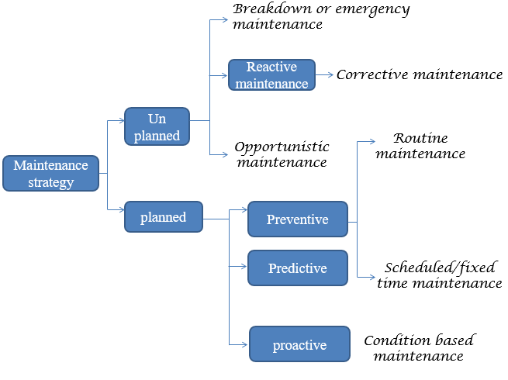
Cont..

Slide 21
6.3.1 Breakdown or emergency maintenance
In such maintenance, repair is done after failure has already occurred,
• Only when the equipment fails to perform designated functions or comes to break, any maintenance or repair job is taken.

Slide 22
Cont..
It may work well in a small factory/plant, where
Number of equipment are few,
Equipment are simple and repair does not call for experts or special tools/ tackles,
When sudden stoppage/ failure of the equipment will not cause severe financial loss , and
In terms of delivery commitment or further damage to other components,
When sudden failure will not cause any severe safety or environmental hazards.

Slide 23
6.3.2 Corrective maintenance
Corrective maintenance means action for correcting or restoring a failed unit (or unit going to fail),
Its scope is very vast and may include different types of actions, such as
From small actions like typical adjustments and minor repairs to minor redesign of equipment,
It is mostly unplanned action, but may include few planned/ scheduled actions.

Slide 24
Actions in corrective maintenance may be subdivided, according to priority
Emergency work, high priority, generally offline, i.e. after stopping the equipment. Giving normally less than 24 hours notice to take up the job,
Deferred works-jobs of lower order priority; generally off-line, to eliminate / reduce repetitive break downs, and
Specific reconditioning or redesign jobs, generally small or medium in volumes.

