Slide 1
Chapter One
Physical and Data Link Layer Overview

Slide 2
Introduction
Basically, a protocol is an agreement between the communicating peers on how communication is to proceed

Slide 3
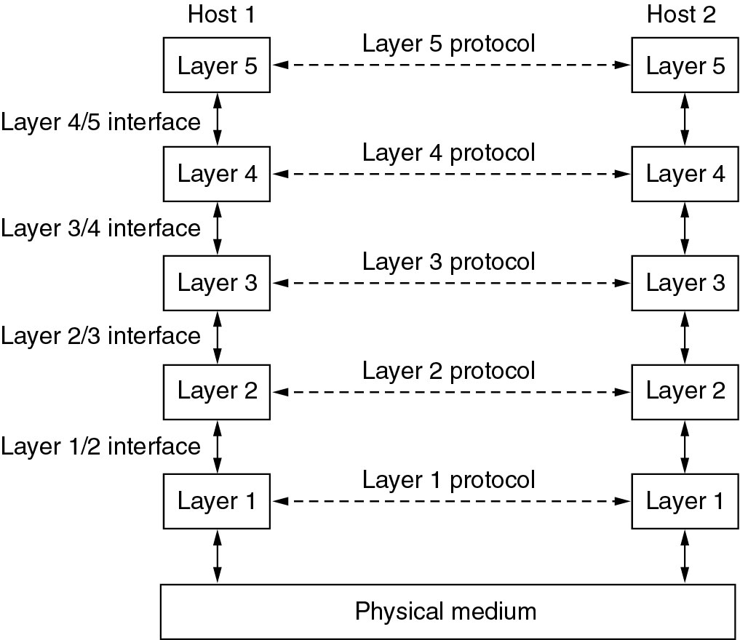
The Layering Principle

Slide 4
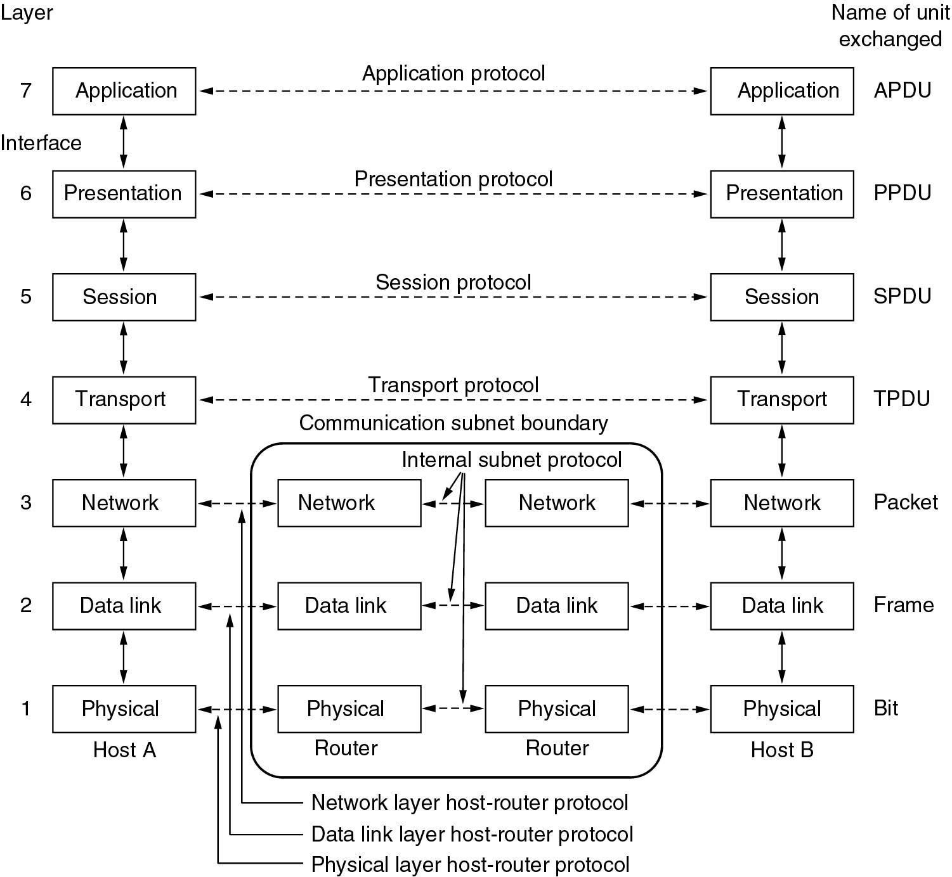
The OSI Reference Model

Slide 5
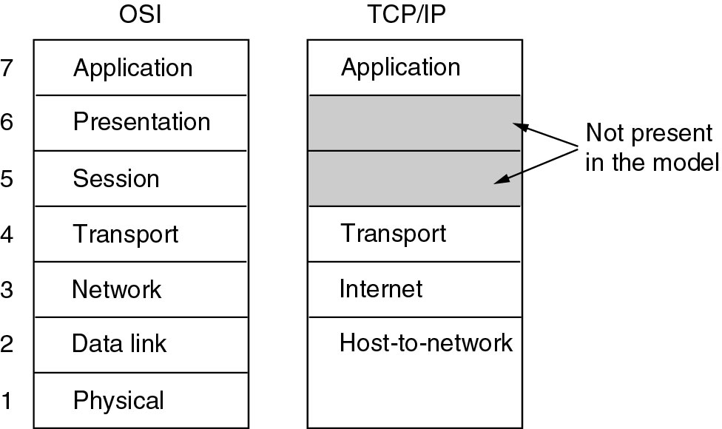
The TCP/IP Reference Model(1)

Slide 6
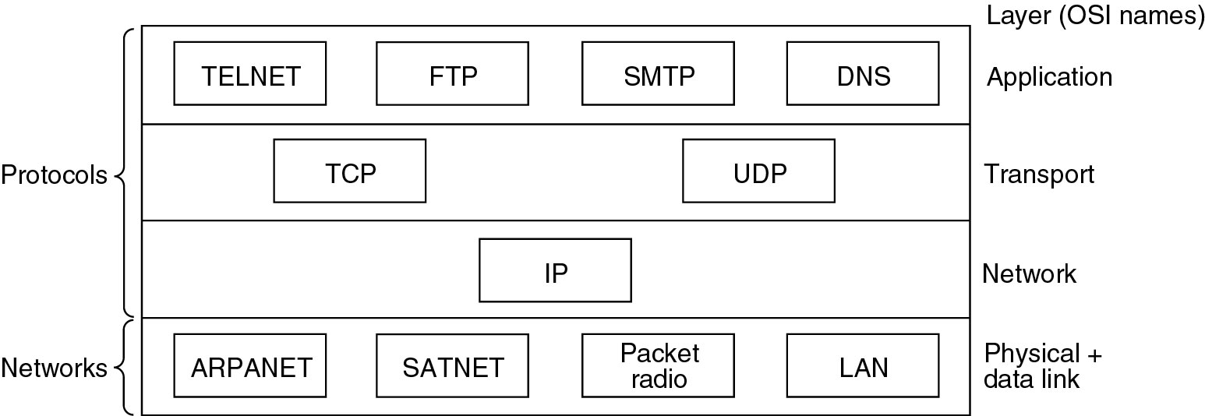
The TCP/IP Reference Model(2)
Protocols and networks in the TCP/IP model initially

Slide 7
Link Layer Services
Framing, link access:
encapsulate datagram into frame, adding header, trailer channel access if shared medium “MAC” addresses used in frame headers to identify source, dest different from IP address
Reliable delivery between adjacent nodes
Also done in transport layer
seldom used on low bit-error link (fiber, some twisted pair)
wireless links: high error rates

Slide 8
Link Layer Services...
Flow control
pacing between adjacent sending and receiving nodes
Error detection
errors caused by signal attenuation, noise
receiver detects presence of errors
signals sender for retransmission or drops frame
Error correction
receiver identifies and corrects bit error(s) without
resorting to retransmission
Half-duplex and Full-duplex
with half duplex, nodes at both ends of link can transmit,
but not at same time

Slide 9
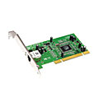
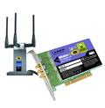
Where is the Link Layer Implemented?
In each and every host
Link layer implemented in “adaptor” (aka network interface card NIC) or on a chip
Ethernet card, 802.11 card; Ethernet chipset
Implements link, physical layer
Attaches into host’s system buses
Combination of hardware, software, firmware
application
transport
network
link
cpu
memory
link
physical
host
bus
(e.g., PCI)
controller
physical
transmission
network adapter
card
Notes:
9

Slide 10
Adaptors Communicating
datagram
datagram
controller
controller
sending host
receiving host
datagram
frame
Sending side
Encapsulates datagram in frame
Adds error checking bits, rdt, flow control, etc
Receiving side
Looks for errors, rdt, flow control, etc
Extracts datagram, passes to upper layer at receiving side
Notes:
10

Slide 11
Multiple Access Links, Protocols
Two types of Links
Point-to-point
PPP for dial-up access
Point-to-point link between Ethernet switch, host
Broadcast (Shared Wire or Medium)
Old-fashioned Ethernet
802.11 wireless LAN
shared wire (e.g.,
cabled Ethernet)
shared RF
(e.g., 802.11 WiFi)
shared RF
(satellite)
Notes:
11

Slide 12
Multiple Access Protocols
Single shared broadcast channel
Two or more simultaneous transmissions by nodes: interference
Collision if node receives two or more signals at the same time
Multiple Access Protocol
Distributed algorithm that determines how nodes share channel, i.e., determine when node can transmit
Communication about channel sharing must use channel itself
no out-of-band channel for coordination
Notes:
12

Slide 13
MAC Protocols: Taxonomy
Three broad classes:
Channel Partitioning
Divide channel into smaller “pieces” (time slots, frequency, code)
Allocate piece to node for exclusive use
Random Access
Channel not divided, allow collisions
Recover from collisions
Taking Turns
Nodes take turns, but nodes with more to send can take longer turns
Notes:
13

Slide 14
Channel partitioning MAC protocols: TDMA
TDMA: Time Division Multiple Access
Access to channel in "rounds"
Each station gets fixed length slot (length = pkt trans time) in each round
Unused slots go idle
Example: 6-station LAN, 1,3,4 have pkt, slots 2,5,6 idle
6-slot
frame
6-slot
frame
1
3
4
1
3
4
Notes:
14

Slide 15
Channel Partitioning MAC protocols: FDMA
FDMA: Frequency Division Multiple Access
Channel spectrum divided into frequency bands
Each station assigned fixed frequency band
Unused transmission time in frequency bands go idle
Example: 6-station LAN, 1,3,4 have pkt, frequency bands 2,5,6 idle
time
frequency bands
FDM cable
Notes:
15

Slide 16
Random Access Protocols
When node has packet to send
Transmit at full channel data rate R
No a priori coordination among nodes
Two or more transmitting nodes ➜ Collision
Random access MAC protocol specifies
How to detect collisions
How to recover from collisions (e.g., via delayed retransmissions)
Examples of random access MAC protocols
Slotted ALOHA
ALOHA
CSMA, CSMA/CD, CSMA/CA
Notes:
16

Slide 17
CSMA/CD
CSMA/CD: Carrier Sense Multiple Access/ Collision Detection
CSMA/CD
Collisions detected within short time
Colliding transmissions aborted
Collision Detection
Easy in wired LANs: measure signal strengths, compare transmitted, received signals
Difficult in wireless LANs: received signal strength overwhelmed by local transmission strength
Notes:
17

Slide 18
Ethernet CSMA/CD Algorithm
1.NIC receives datagram from network layer, creates frame
2. If NIC senses channel idle, starts frame transmission. If NIC senses channel busy, waits until channel idle, then transmits
3. If NIC transmits entire frame without detecting another transmission, NIC is done with frame
4. If NIC detects another transmission while transmitting, aborts and sends jam signal
5. After aborting, NIC enters binary (exponential) backoff:
After mth collision, NIC chooses K at random from {0,1,2, …, 2^{m}-1}. NIC waits K·512 bit times, returns to Step 2
Longer backoff interval with more collisions
Notes:
18

Slide 19
MAC Addresses and ARP
32-bit IP address:
Network-layer address for interface
Used for layer 3 (network layer) forwarding
MAC (or LAN or physical or Ethernet) address
Function: used ‘locally” to get frame from one interface to another physically-connected interface (same network, in IP-addressing sense)
48 bit MAC address (for most LANs) burned in NIC ROM, also sometimes software settable
e.g.: 1A-2F-BB-76-09-AD
hexadecimal (base 16) notation
(each “number” represents 4 bits)
Notes:
19

Slide 20
LAN Addresses and ARP
Each adapter on LAN has unique LAN address
1A-2F-BB-76-09-AD
LAN
(wired or
wireless)
adapter
71-65-F7-2B-08-53
58-23-D7-FA-20-B0
0C-C4-11-6F-E3-98
Notes:
20

Slide 21
ARP: Address Resolution Protocol
Question: how to determine
interface’s MAC address, knowing its IP address?
ARP table: each IP node (host, router) on LAN has table
IP/MAC address mappings for some LAN nodes:
< IP address; MAC address; TTL>
TTL (Time To Live): time after which address mapping will be forgotten (typically 20 min)
137.196.7.78
1A-2F-BB-76-09-AD
137.196.7.23
137.196.7.14
LAN
71-65-F7-2B-08-53
58-23-D7-FA-20-B0
0C-C4-11-6F-E3-98
137.196.7.88
Notes:
21

Slide 22
ARP Protocol: Same LAN
A wants to send datagram to B
B’s MAC address not in A’s ARP table.
A broadcasts ARP query packet, containing B's IP address
Dest MAC address = FF-FF-FF-FF-FF-FF
All nodes on LAN receive ARP query
B receives ARP packet, replies to A with its (B's) MAC address
Frame sent to A’s MAC address (unicast)
A caches (saves) IP-to-MAC address pair in its ARP table until information becomes old (times out)
Soft state: information that times out (goes away) unless refreshed
ARP is “plug-and-play”:
Nodes create their ARP tables without intervention from net administrator
Notes:
22

Slide 23
Addressing: Routing to Another LAN
Send datagram from A to B via R
Focus on addressing – at IP (datagram) and MAC layer (frame)
Assume A knows B’s IP address
Assume A knows IP address of first hop router, R
Assume A knows R’s MAC address
A
B
R
111.111.111.111
222.222.222.222
74-29-9C-E8-FF-55
49-BD-D2-C7-56-2A
222.222.222.220
1A-23-F9-CD-06-9B
111.111.111.112
111.111.111.110
222.222.222.221
CC-49-DE-D0-AB-7D
E6-E9-00-17-BB-4B
88-B2-2F-54-1A-0F
Notes:
23

Slide 24
Addressing: Routing to Another LAN
A creates IP datagram with IP source A, destination B
A creates link-layer frame with R's MAC address as dest, frame contains A-to-B IP datagram
MAC src: 74-29-9C-E8-FF-55
MAC dest: E6-E9-00-17-BB-4B
IP
Eth
Phy
IP src: 111.111.111.111
IP dest: 222.222.222.222
A
B
R
111.111.111.111
222.222.222.222
74-29-9C-E8-FF-55
49-BD-D2-C7-56-2A
222.222.222.220
1A-23-F9-CD-06-9B
111.111.111.112
111.111.111.110
222.222.222.221
CC-49-DE-D0-AB-7D
E6-E9-00-17-BB-4B
88-B2-2F-54-1A-0F
Notes:
24

Slide 25
Addressing: Routing to Another LAN
Frame sent from A to R
Frame received at R, datagram removed, passed up to IP
MAC src: 74-29-9C-E8-FF-55
MAC dest: E6-E9-00-17-BB-4B
IP src: 111.111.111.111
IP dest: 222.222.222.222
IP
Eth
Phy
IP src: 111.111.111.111
IP dest: 222.222.222.222
IP
Eth
Phy
A
B
R
111.111.111.111
222.222.222.222
74-29-9C-E8-FF-55
49-BD-D2-C7-56-2A
222.222.222.220
1A-23-F9-CD-06-9B
111.111.111.112
111.111.111.110
222.222.222.221
CC-49-DE-D0-AB-7D
E6-E9-00-17-BB-4B
88-B2-2F-54-1A-0F
Notes:
25

Slide 26
Addressing: Routing to Another LAN
R forwards datagram with IP source A, destination B
R creates link-layer frame with B's MAC address as dest, frame contains A-to-B IP datagram
MAC src: 1A-23-F9-CD-06-9B
MAC dest: 49-BD-D2-C7-56-2A
IP
Eth
Phy
IP
Eth
Phy
IP src: 111.111.111.111
IP dest: 222.222.222.222
A
B
R
111.111.111.111
222.222.222.222
74-29-9C-E8-FF-55
49-BD-D2-C7-56-2A
222.222.222.220
1A-23-F9-CD-06-9B
111.111.111.112
111.111.111.110
222.222.222.221
CC-49-DE-D0-AB-7D
E6-E9-00-17-BB-4B
88-B2-2F-54-1A-0F
Notes:
26

Slide 27
Addressing: Routing to Another LAN
R forwards datagram with IP source A, destination B
R creates link-layer frame with B's MAC address as dest, frame contains A-to-B IP datagram
MAC src: 1A-23-F9-CD-06-9B
MAC dest: 49-BD-D2-C7-56-2A
IP
Eth
Phy
IP
Eth
Phy
IP src: 111.111.111.111
IP dest: 222.222.222.222
A
B
R
111.111.111.111
222.222.222.222
74-29-9C-E8-FF-55
49-BD-D2-C7-56-2A
222.222.222.220
1A-23-F9-CD-06-9B
111.111.111.112
111.111.111.110
222.222.222.221
CC-49-DE-D0-AB-7D
E6-E9-00-17-BB-4B
88-B2-2F-54-1A-0F
Notes:
27

Slide 28
Addressing: Routing to Another LAN
R forwards datagram with IP source A, destination B
R creates link-layer frame with B's MAC address as dest, frame contains A-to-B IP datagram
MAC src: 1A-23-F9-CD-06-9B
MAC dest: 49-BD-D2-C7-56-2A
IP src: 111.111.111.111
IP dest: 222.222.222.222
IP
Eth
Phy
A
B
R
111.111.111.111
222.222.222.222
74-29-9C-E8-FF-55
49-BD-D2-C7-56-2A
222.222.222.220
1A-23-F9-CD-06-9B
111.111.111.112
111.111.111.110
222.222.222.221
CC-49-DE-D0-AB-7D
E6-E9-00-17-BB-4B
88-B2-2F-54-1A-0F
Notes:
28

Slide 29
802.3 Ethernet Standards: Link & Physical Layers
Many different Ethernet standards
Common MAC protocol and frame format
Different speeds: 2 Mbps, 10 Mbps, 100 Mbps, 1Gbps, 10G bps
Different physical layer media: copper, fiber, cable
application
transport
network
link
physical
MAC protocol
and frame format
100BASE-TX
100BASE-T2
100BASE-FX
100BASE-T4
100BASE-SX
100BASE-BX
copper (twister
pair) physical layer
fiber physical layer
Notes:
29

Slide 30
Ethernet Switch
Link-layer device: takes an active role
Examine incoming frame’s MAC address, selectively forward frame to one-or-more outgoing links when frame is to be forwarded on segment, uses CSMA/CD to access segment
Transparent
hosts are unaware of presence of switches
Plug-and-play, self-learning
switches do not need to be configured
Notes:
30

Slide 31
Switch: Multiple Simultaneous Transmissions
Hosts have dedicated, direct connection to switch
Switches buffer packets
Ethernet protocol used on each incoming link, but no collisions; full duplex
Each link is its own collision domain
Switching: A-to-A’ and B-to-B’ can transmit simultaneously, without collisions
A
C’
B
6
1
2
5
4
3
B’
C
A’
switch with six interfaces
(1,2,3,4,5,6)
Notes:
31

Slide 32
Switch Forwarding Table
Q: how does switch know A’ reachable via interface 4, B’ reachable via interface 5?
A
C’
B
A: each switch has a switch table, each entry:
(MAC address of host, interface to reach host, time stamp)
looks like a routing table
6
1
2
5
4
3
B’
C
A’
Q: How are entries created, maintained
in switch table?
Something like a routing protocol?
switch with six interfaces
(1,2,3,4,5,6)
Notes:
32

Slide 33
Switch: Self-Learning
Source: A
Dest: A’
Switch learns which hosts can be reached through which interfaces
When frame received, switch “learns” location of sender: incoming LAN segment
Records sender/location pair in switch table
A
A A’
C’
B
6
1
2
5
4
3
B’
C
A’
MAC addr interface TTL
A
1
60
Switch table
(initially empty)
Notes:
33

Slide 34
Switch: Frame Filtering/Forwarding
when frame received at switch:
1. record incoming link, MAC address of sending host
2. index switch table using MAC destination address
3. if entry found for destination then {
if destination on segment from which frame arrived then drop frame
else forward frame on interface indicated by entry
}
else flood /* forward on all interfaces except arriving
interface */
Notes:
34

Slide 35
Self-learning, Forwarding: Example
Source: A
Dest: A’
A
A A’
Frame destination, A’, locaton unknown:
flood
C’
B
Destination A location known:
6
1
2
A A’
A A’
A A’
A A’
selectively send
on just one link
A A’
5
4
3
B’
C
A’ A
A’
MAC addr interface TTL
A
1
60
Switch Table
(initially empty)
A’
4
60
Notes:
35

Slide 36
Interconnecting Switches
Switches can be connected together
S₄
S₁
S₃
A
S₂
F
I
B
C
D
E
G
H
Q: sending from A to G - how does S₁ know to forward frame destined to F via S₄ and S₃?
A: self learning (works exactly the same as in single-switch case)
Notes:
36

Slide 37
Self-learning Multi-switch Example
Suppose C sends frame to I, I responds to C
S₄
S₁
S₃
A
S₂
F
I
B
C
D
E
G
H
Q: show switch tables and packet forwarding in S₁, S₂, S₃, S₄
Notes:
37

Slide 38
Institutional Network
Mail Server
To external
network
Router
Web Server
IP Subnet
Notes:
38

Slide 39
Switches vs. Routers
application
transport
network
link
physical
Routers: network-layer devices (examine network-layer headers)
Switches: link-layer devices (examine link-layer headers)
Both have forwarding tables:
Routers: compute tables using routing algorithms, IP addresses
Switches: learn forwarding table using flooding, learning, MAC addresses
datagram
frame
link
physical
frame
switch
network
link
physical
datagram
frame
application
transport
network
link
physical
Notes:
39

Slide 40
VLANs: Motivation
Consider:
CS user moves office to EE, but wants connect to CS switch?
Single broadcast domain:
All layer-2 broadcast traffic (ARP, DHCP, unknown location of destination MAC address) must cross entire LAN
Security/privacy, efficiency issues
Computer
Science
Computer
Engineering
Electrical
Engineering

Slide 41
VLANs
Port-based VLAN: switch ports grouped (by switch management software) so that single physical switch ……
Virtual Local
Area Network
1
7
9
15
2
8
10
16
Switch(es) supporting VLAN capabilities can be configured to define multiple virtual LANS over single physical LAN infrastructure
…
…
Electrical Engineering
(VLAN ports 1-8)
Computer Science
(VLAN ports 9-15)
… Operates as Multiple virtual switches
1
7
9
15
2
8
10
16
…
…
Electrical Engineering
(VLAN ports 1-8)
Computer Science
(VLAN ports 9-16)

Slide 42
Port-based VLAN
Router
Traffic Isolation: frames to/from ports 1-8 can only reach ports 1-8
Can also define VLAN based on MAC addresses of endpoints, rather than switch port
1
7
9
15
2
8
10
16
Dynamic Membership: ports can be dynamically assigned among VLANs
…
…
Electrical Engineering
(VLAN ports 1-8)
Computer Science
(VLAN ports 9-15)
Forwarding between VLANS: done via routing (just as with separate switches)

Slide 43
VLANS Spanning Multiple Switches
1
7
9
15
1
3
5
7
2
8
10
16
2
4
6
8
…
…
Electrical Engineering
(VLAN ports 1-8)
Computer Science
(VLAN ports 9-15)
Ports 2,3,5 belong to EE VLAN
Ports 4,6,7,8 belong to CS VLAN
Trunk Port: carries frames between VLANS defined over multiple physical switches
Frames forwarded within VLAN between switches can’t be vanilla 802.1 frames (must carry VLAN ID info)
802.1q protocol adds/removed additional header fields for frames forwarded between trunk ports

Slide 44
802.1Q VLAN Frame Format
type
preamble
dest.
address
source
address
data (payload)
CRC
802.1 Frame
type
data (payload)
CRC
802.1Q Frame
2-byte Tag Protocol Identifier
(value: 81-00)
Recomputed
CRC
Tag Control Information (12 bit VLAN ID field,
3 bit priority field like IP TOS)

Slide 45
Multiprotocol Label Switching (MPLS)
Initial Goal: high-speed IP forwarding using fixed length label (instead of IP address)
Fast lookup using fixed length identifier (rather than shortest prefix matching)
Borrowing ideas from Virtual Circuit (VC) approach
But IP datagram still keeps IP address
PPP or Ethernet
header
IP header
remainder of link-layer frame
MPLS header
label
Exp
S
TTL
20
3
1
5
Notes:
45

Slide 46
MPLS Capable Routers
A.K.A. label-switched router
Forward packets to outgoing interface based only on label value (don’t inspect IP address)
MPLS forwarding table distinct from IP forwarding tables
Flexibility: MPLS forwarding decisions can differ from those of IP
Use destination and source addresses to route flows to same destination differently (traffic engineering)
Re-route flows quickly if link fails: pre-computed backup paths (useful for VoIP)
Notes:
46

Slide 47
MPLS versus IP Paths
R6
D
R4
R3
R5
A
R2
IP routing: path to destination determined by destination address alone
IP router
Notes:
47

Slide 48
MPLS versus IP Paths
entry router (R4) can use different MPLS routes to A based, e.g., on source address
R6
D
R4
R3
R5
A
R2
IP routing: path to destination determined by destination address alone
IP-only
router
MPLS routing: path to destination can be based on source and dest. address
Fast reroute: precompute backup routes in case of link failure
MPLS and
IP router
Notes:
48

Slide 49
MPLS Signaling
modify OSPF, IS-IS link-state flooding protocols to carry info used by MPLS routing,
e.g., link bandwidth, amount of “reserved” link bandwidth
entry MPLS router uses RSVP-TE signaling protocol to set up MPLS forwarding at downstream routers
R6
RSVP-TE
D
R4
R5
Modified
link state
flooding
A
Notes:
49

Slide 50
MPLS Forwarding Tables
in out out
label label dest interface
10 A 0
in out out
label label dest interface
12 D 0
8 A 1
10 6 A 1
12 9 D 0
R6
0
0
D
1
1
R4
R3
R5
0
0
A
R2
in out out
label label dest interface
R1
in out out
label label dest interface
6 - A 0
8 6 A 0
Notes:
50

Slide 51
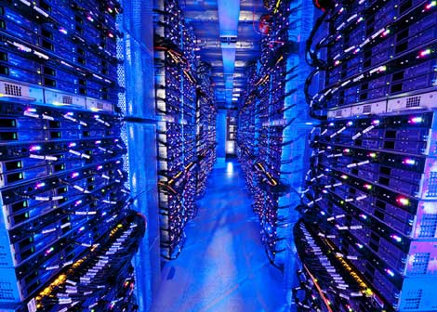
Data Center Networks
10’s to 100’s of thousands of hosts, often closely coupled, in close proximity:
e-business (e.g. Amazon)
Content-servers (e.g., YouTube, Akamai, Apple, Microsoft)
Search engines, data mining (e.g., Google)
Challenges:
Multiple applications, each serving massive numbers of clients
Managing/balancing load, avoiding processing, networking, data bottlenecks
Inside a 40-ft Microsoft container,
Chicago data center
Notes:
51

Slide 52
Data Center Networks
Load balancer: application-layer routing
receives external client requests
directs workload within data center
returns results to external client (hiding data center internals from client)
Internet
Load
balancer
Border router
Access router
Load
balancer
B
Tier-1 switches
A
C
Tier-2 switches
TOR switches
Server racks
1
2
3
4
5
6
7
8

Slide 53
Data Center Networks
Rich interconnection among switches, racks:
Increased throughput between racks (multiple routing paths possible)
Increased reliability via redundancy
Tier-1 switches
Tier-2 switches
TOR switches
Server racks
1
2
3
4
5
6
7
8

