Slide 1
Chapter Eight
SQL Injection

Slide 2
Agenda
Command injection vulnerability - untrusted input inserted into query or command
Attack string alters intended semantics of command
Ex: SQL Injection - unsanitized data used in query to back-end database (DB)
SQL Injection Examples & Solutions
Type 1: compromises user data
Type 2: modifies critical data
Whitelisting over Blacklisting
Escaping

Slide 3
SQL Injection Impact in the Real World
CardSystems, credit card payment processing
Ruined by SQL Injection attack in June 2005
263,000 credit card #s stolen from its DB
Awareness Increasing: # of reported SQL injection vulnerabilities tripled from 2004 to 2005

Slide 4
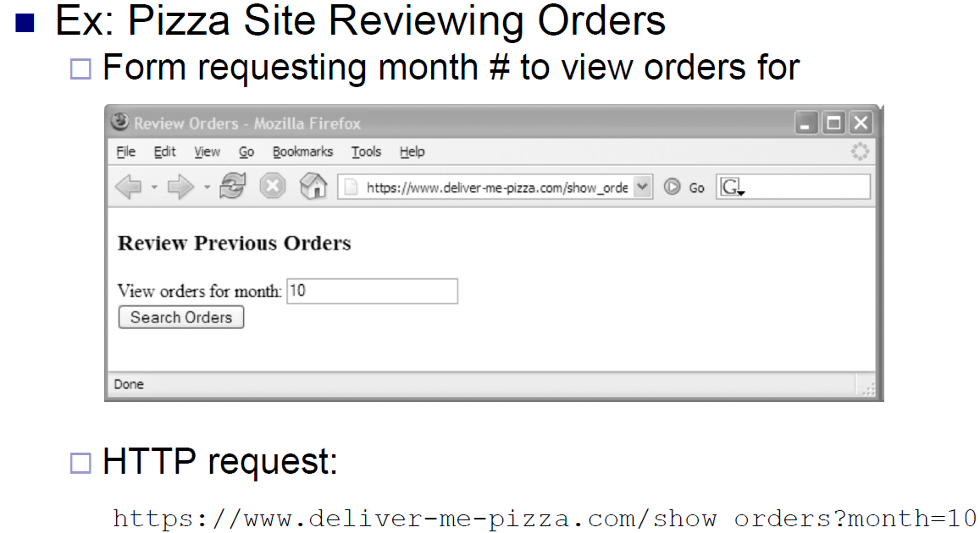
7.1. Attack Scenario (1)

Slide 5
7.1. Attack Scenario (2)

Slide 6
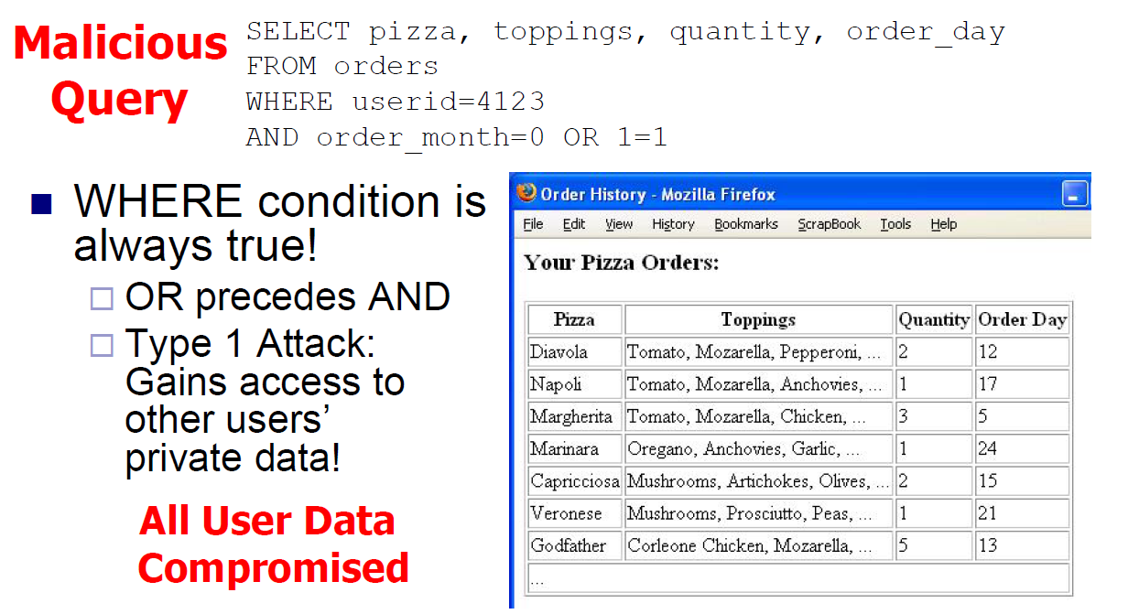
7.1. Attack Scenario (3)

Slide 7
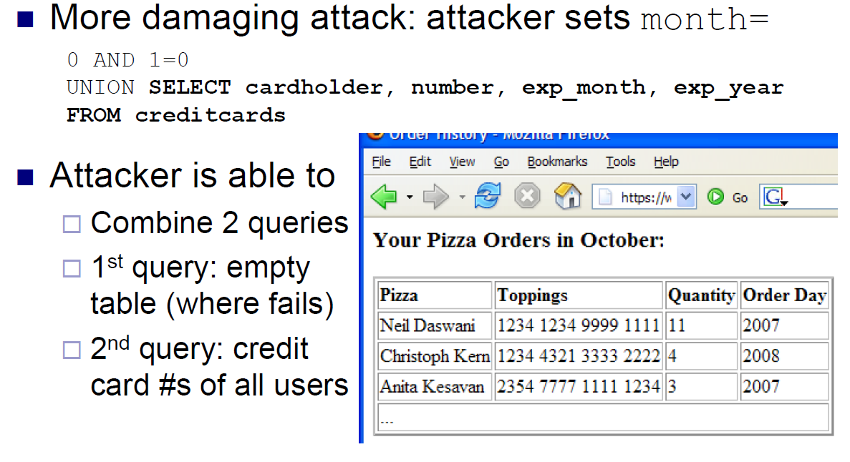
7.1. Attack Scenario (4)

Slide 8
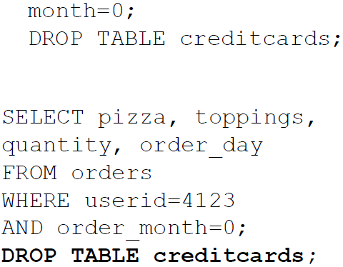
7.1. Attack Scenario (4)
Even worse, attacker sets
Then DB executes
Type 2 Attack:
Removes creditcards from
schema!
Future orders fail: DoS!
Problematic Statements:
Modifiers: INSERT INTO admin_users VALUES ('hacker',...)
Administrative: shut down DB, control OS…

Slide 9
7.1. Attack Scenario (5)

Slide 10
7.2. Solutions
Whitelisting over Blacklisting
Input Validation & Escaping
Mitigate Impact

Slide 11
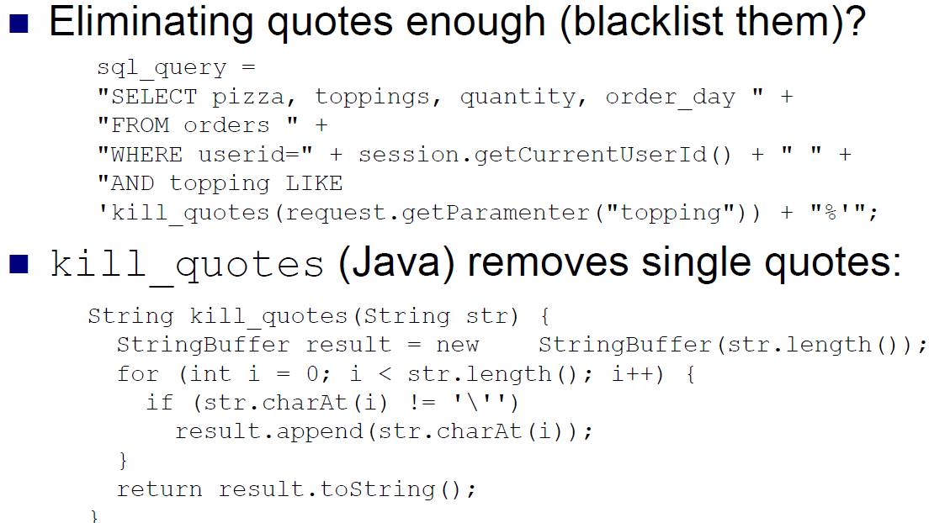
7.2.1. Why Blacklisting Does Not Work

Slide 12
7.2.1. Pitfalls of Blacklisting
Filter quotes, semicolons, whitespace, and…?
Could always miss a dangerous character
Blacklisting not comprehensive solution
Ex: kill_quotes() can’t prevent attacks against numeric parameters
May conflict with functional requirements
How to store O’Brien in DB if quotes blacklisted?

Slide 13
7.2.2. Whitelisting-Based Input Validation
Whitelisting – only allow input within well-defined set of safe values
set implicitly defined through regular expressions
RegExp – pattern to match strings against
Ex: month parameter: non-negative integer
RegExp: ^[0-9]*$ - 0 or more digits, safe subset
The ^, $ match beginning and end of string
[0-9] matches a digit, * specifies 0 or more

Slide 14
7.2.3. Escaping

Slide 15
7.2.4. Second-Order SQL Injection
Second-Order SQL Injection: data stored in database is later used to conduct SQL injection
For example, what is you define your username
uname=admin'-- !?
UPDATE USERS SET passwd='cracked' WHERE uname='admin' --‘
Attacker changes admin’s password to cracked
Has full access to admin account
Username avoids collision with real admin
-- comments out trailing quote

Slide 16
7.2.6. Mitigating the Impact of SQL Injection Attacks
Prevent Schema & Information Leaks
Limit Privileges
Encrypt Sensitive Data stored in Database
Apply Input Validation

Slide 17
7.2.6. Prevent Schema & Information Leaks
Knowing database schema makes attacker’s job Easier
Blind SQL Injection: attacker attempts to interrogate system to figure out schema
Prevent leakages of schema information
Don’t display detailed error messages and stack traces to external users

Slide 18
7.2.6. Limiting Privileges
Apply Principle of Least Privilege! Limit
Read access, tables/views user can query
Commands (are updates/inserts ok?)
No more privileges than typical user needs
Ex: could prevent attacker from executing INSERT and DROP statements
But could still be able do SELECT attacks and compromise user data
Not a complete fix, but less damage

Slide 19
7.2.6. Encrypting Sensitive Data
Encrypt data stored in the database
second line of defense
w/o key, attacker can’t read sensitive info
Key management precautions: don’t store key in DB, attacker just SQL injects again to get it
Some databases allow automatic encryption, but these still return plaintext queries!

Slide 20
7.2.6. Applying Input Validation
Validation of query parameters not enough
Validate all input early at entry point into code
Reject overly long input (could prevent unknown buffer overflow exploit in SQL parser)
Redundancy helps protect systems
E.g. if programmer forgets to apply validation for query input
Two lines of defense

