Slide 1
Debre Markos University
Department of Public Health
For post graduate Students
Health service management
By: Nurilign Abebe (Asst Prof of public health)

Slide 2
Course Objective:
After completion of this course the learners will be able to:
Apply knowledge and skill in the main management functions, duties and responsibilities of managers/leaders.
Be aware of the basics in health sector strategic planning.
Identify key models for health management, problem solving and decision-making.
Identify the key elements of organizational structure
Manage resources efficiently
Use an evidence-based approach in determining stafﬁng needs
Select appropriate stafﬁng policies for a given situation

Slide 3
Contents
Chapter I: Introduction
Chapter II: Management functions
Chapter III: Resources Management
Chapter IV: Decision Making and Problem-Solving Approach
Chapter V: Quality issues in health care delivery
Chapter VI: Health Delivery System in Ethiopia

Slide 4
Objectives
Define management
Rational of the course
Historical development of management
Difference between manager and leader
Managerial skills and roles
Coping, managing and leading

Slide 5
management has got several definitions
• Getting things done through other people.
• The process of reaching organizational goals by working with and through people and other resources
• The efficient use of resources and getting people working harmoniously together in order to achieve organizational objectives

Slide 6
• The process composed of interrelated social and technical functions & activities, occurring in a formal organizational setting for the purpose of accomplishing predetermined objectives through the use of human and other resources.
• The process of planning, organizing, leading/directing and controlling the efforts of organizational members and using all available organizational resources to reach predetermined objectives
“a process of planning, organizing, directing, and controlling organizational behaviors to accomplish a mission through the division of labor”

Slide 7
The last definition incorporates several important ideas
• First, management is a process—an ongoing flow of activities—rather than something that can be accomplished once and for all.
• Second, managerial activities affect the behaviors of an organization’s members and the organization itself.
• Third, to accomplish a firm’s mission requires organization.
If the mission could be accomplished by individuals working alone, neither the firm nor its management would be necessary.
• Fourth, the process of management can be further divided into the four functions: planning, organizing, directing, and controlling.

Slide 8
Rationale for this course
Poor health indicators
Dysfunctional health systems
Poor retention of health workforce
Poor management of equipment & materials

Slide 9
Rationale for this course….
Millions of people are displaced today as a result of conflict, natural or manmade disasters.
In such situations, local health systems become rapidly over-whelmed and multiple agencies often move in to assistance.
This leads to the paradoxical situation in which leadership is weaker than usual because it has been disrupted or divided, but the need for leadership is even greater.

Slide 10
Rationale for this course….

Slide 11
Rationale for this course….
To achieve necessary improvements in healthcare quality, there is a need to improve management skills of health facility management teams by focusing on evidence based practice, behavioral change and internalization of the culture of continuous quality improvement.
The situations are aggravated by challenging situations like inefficient and ineffective utilization of financial resources, shifting burden of disease, decentralization & devolution, more importantly by inadequacies on the key Leadership, Management, & Governance skills.

Slide 12
History of management

Slide 13
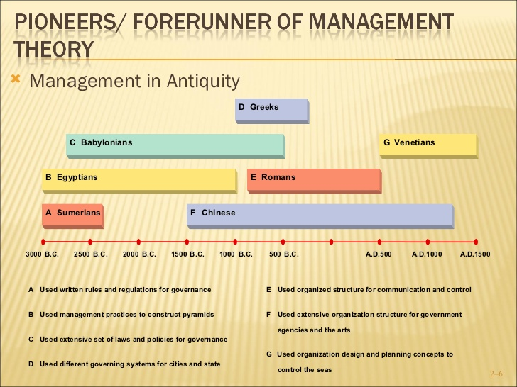

Slide 14
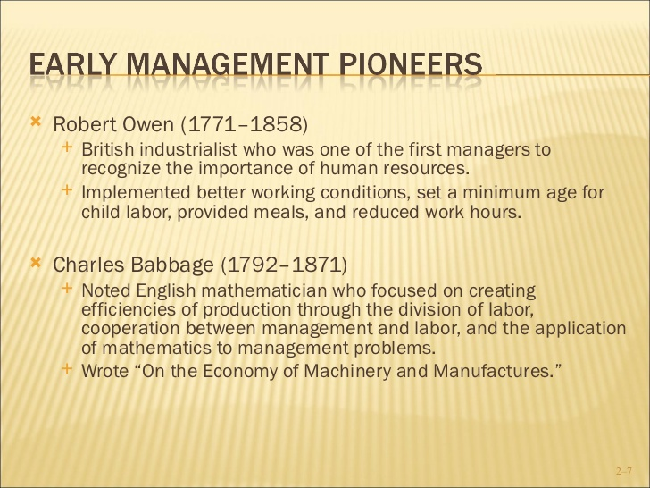

Slide 15
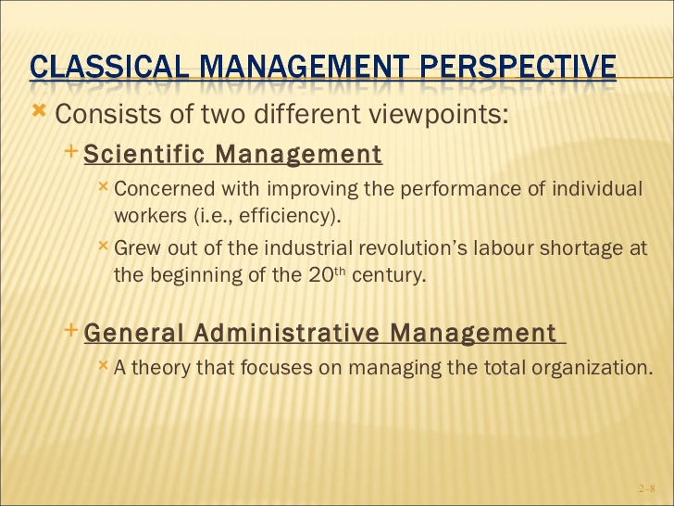

Slide 16
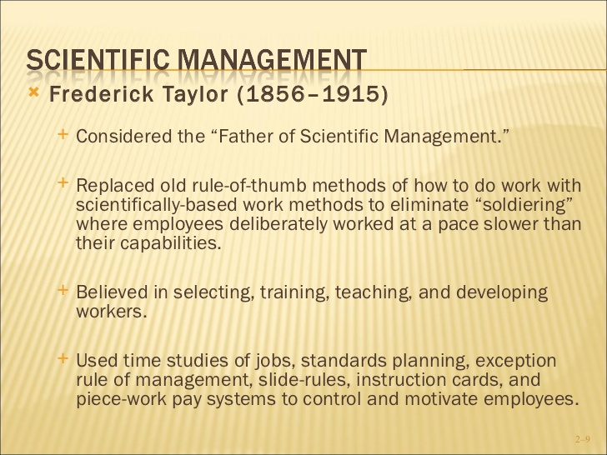

Slide 17
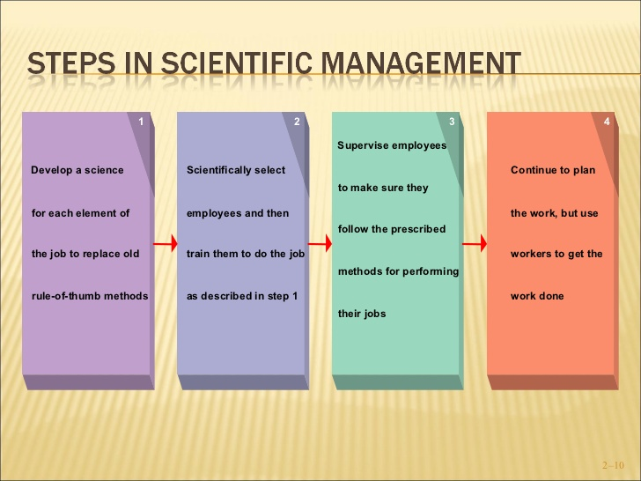

Slide 18
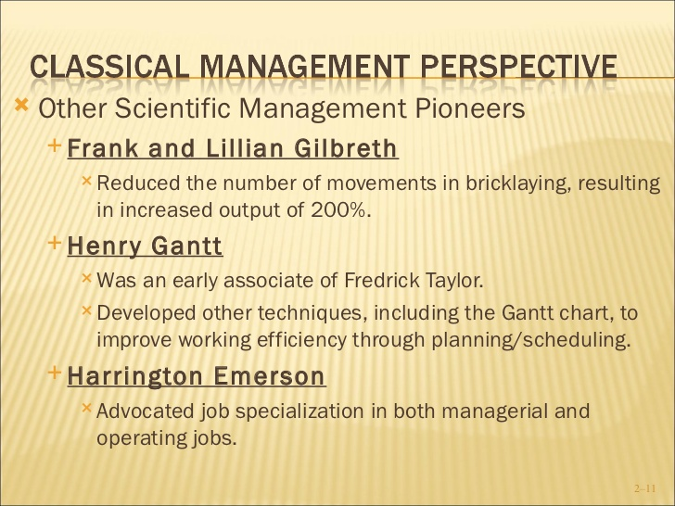

Slide 19
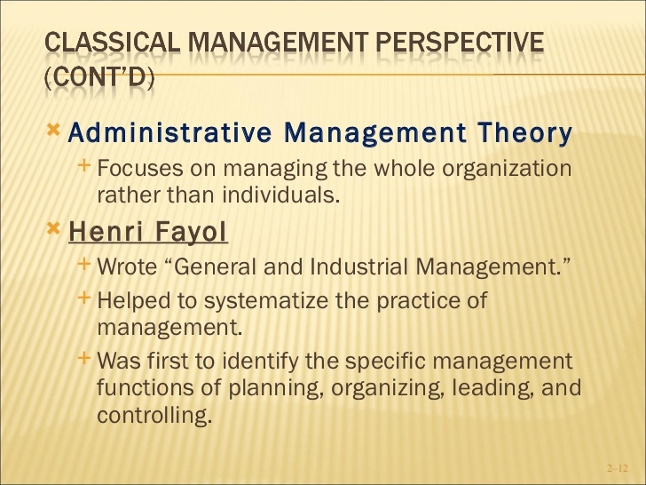

Slide 20
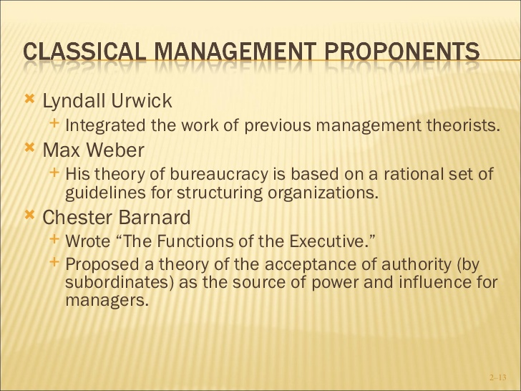

Slide 21
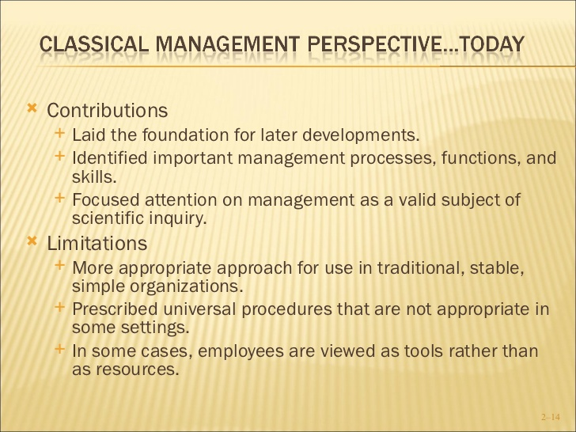

Slide 22
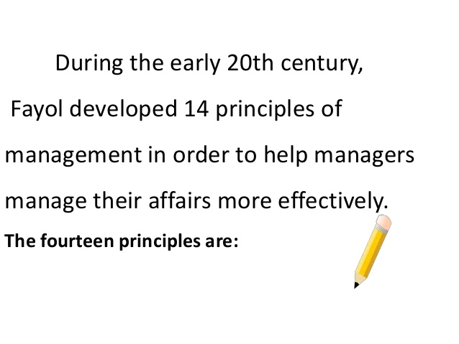

Slide 23
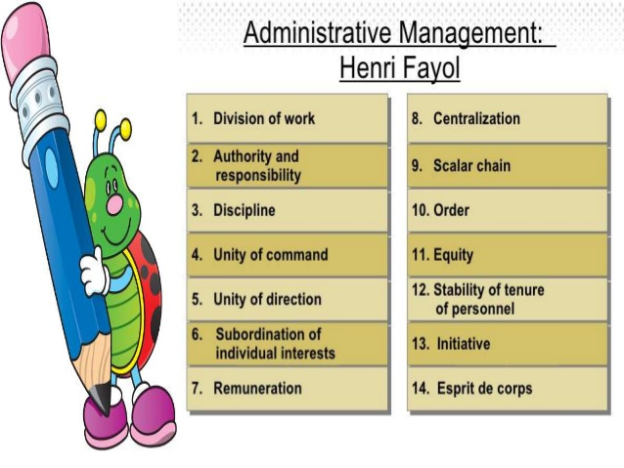

Slide 24
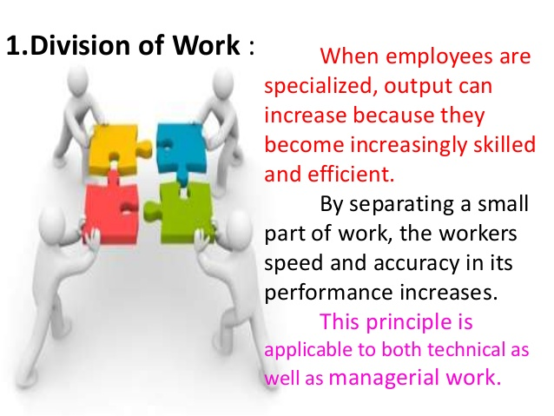

Slide 25
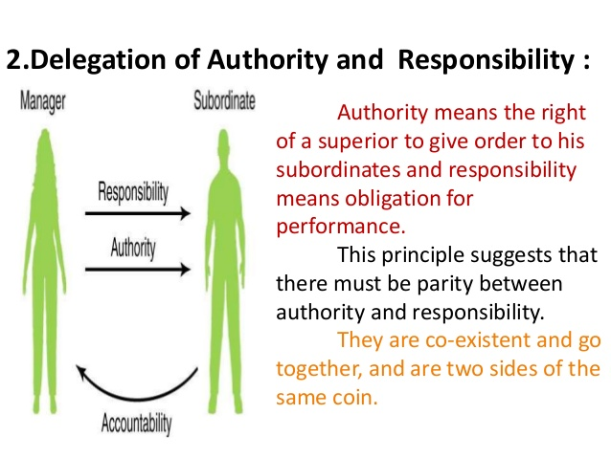

Slide 26
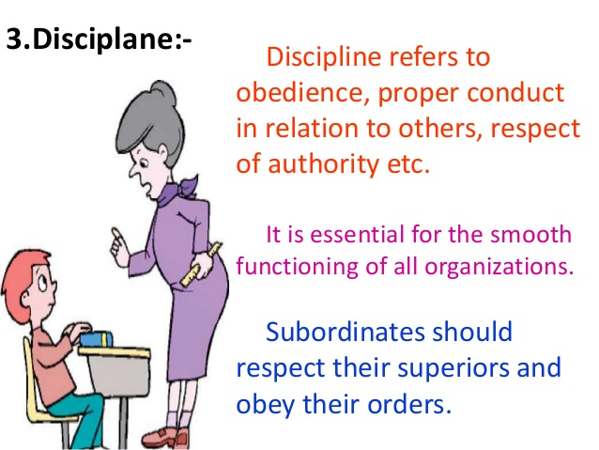

Slide 27
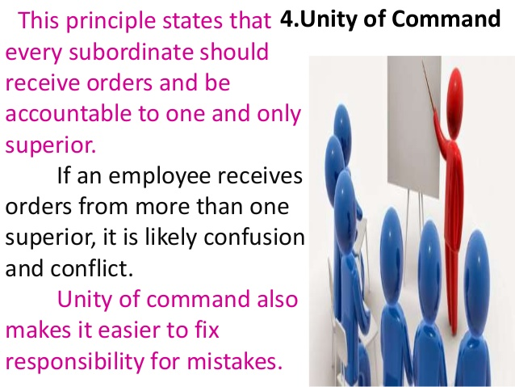

Slide 28
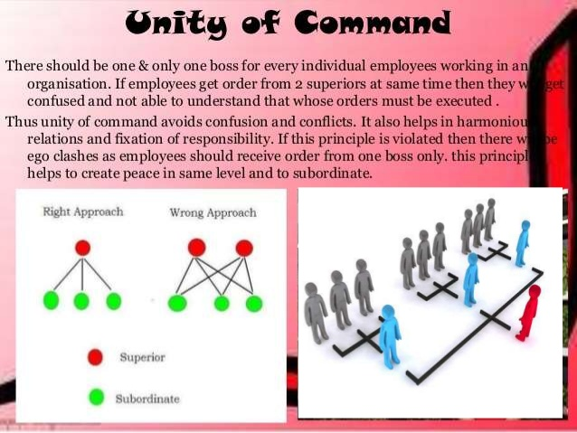

Slide 29
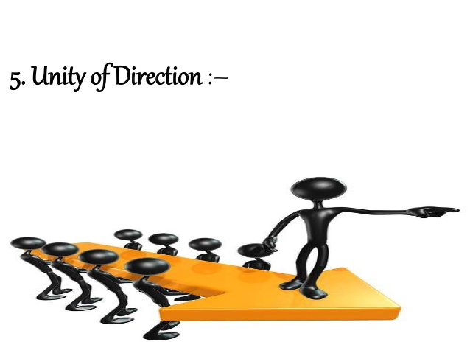

Slide 30
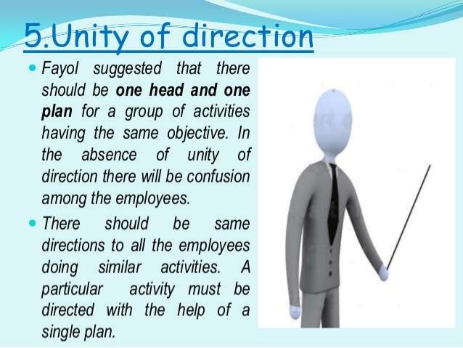

Slide 31
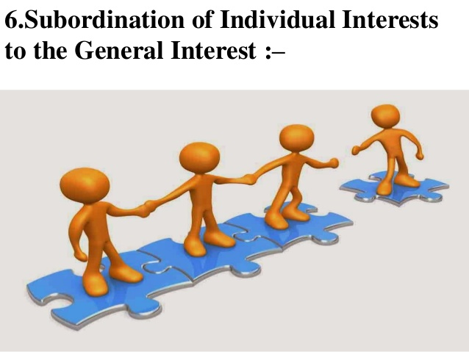

Slide 32
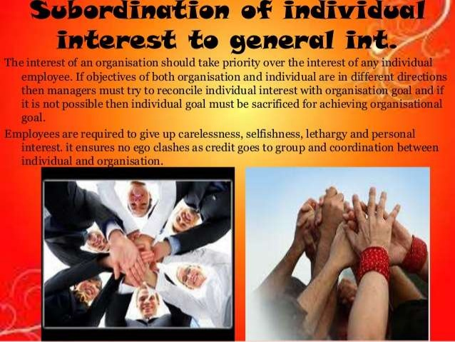

Slide 33
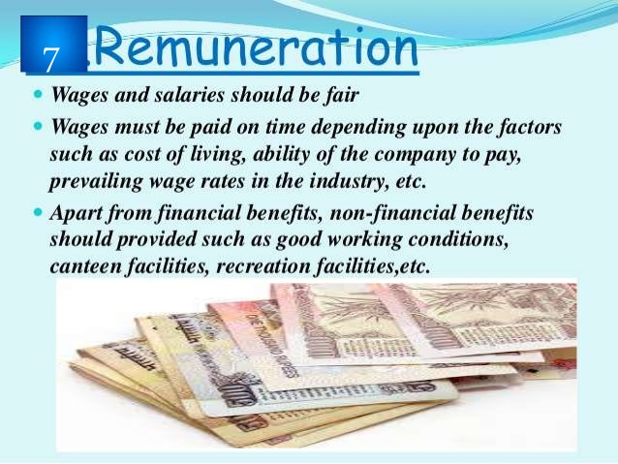

Slide 34
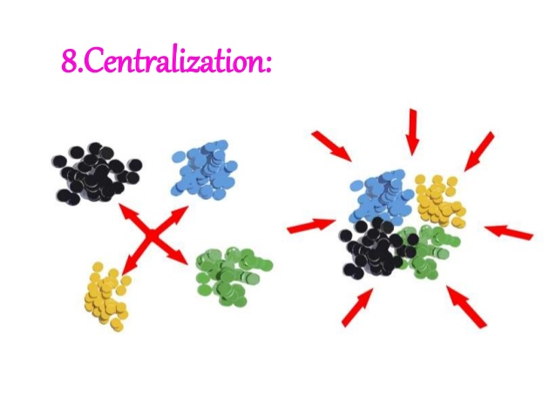

Slide 35
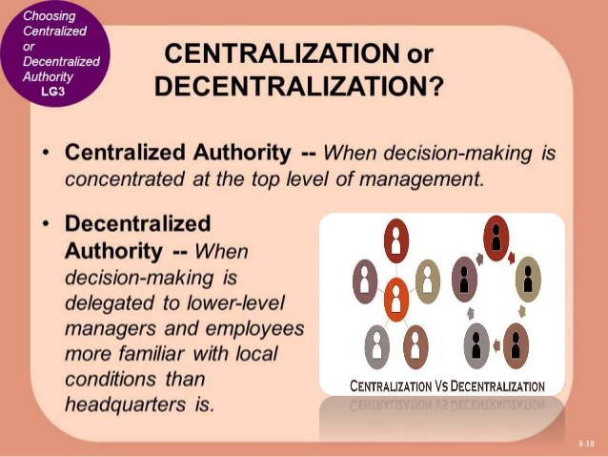

Slide 36
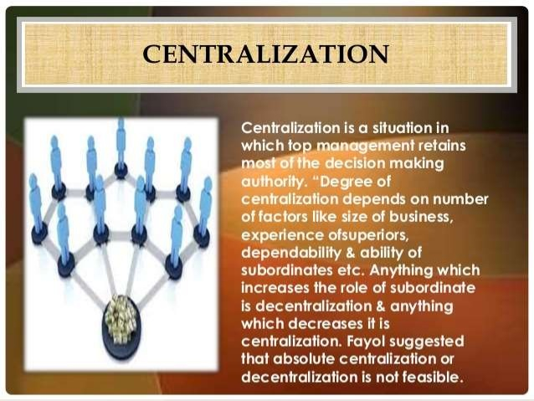

Slide 37
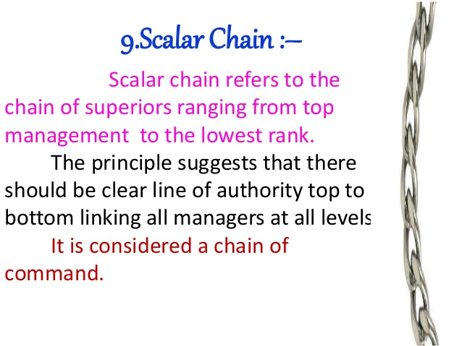

Slide 38
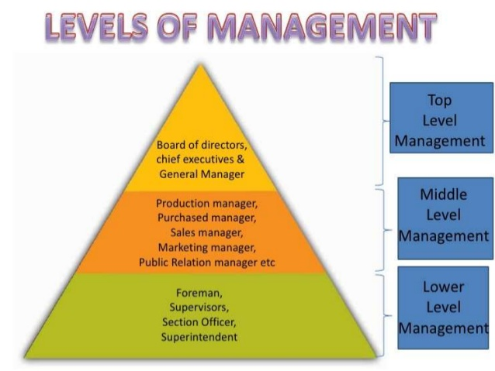

Slide 39
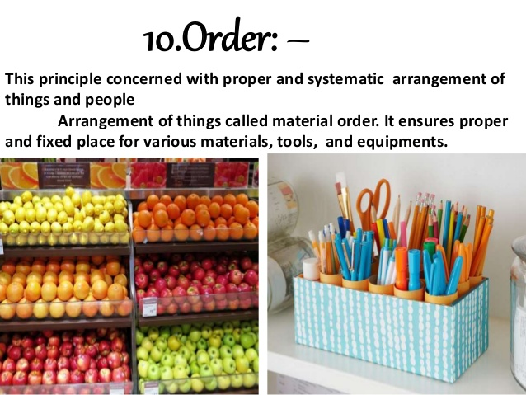

Slide 40
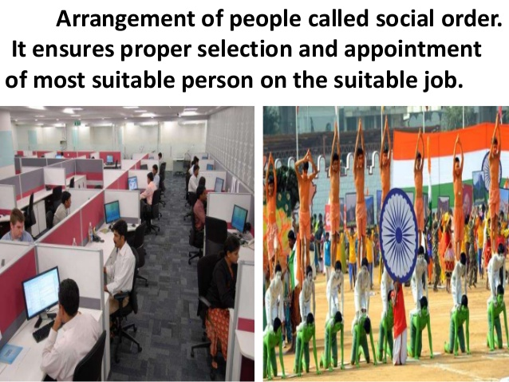

Slide 41
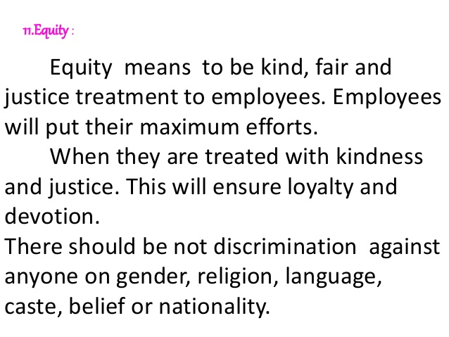

Slide 42


Slide 43
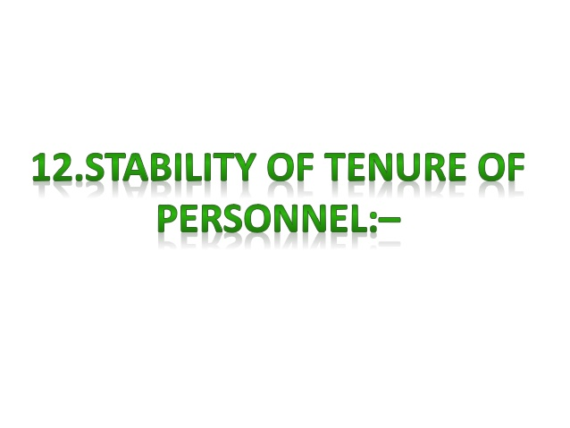

Slide 44
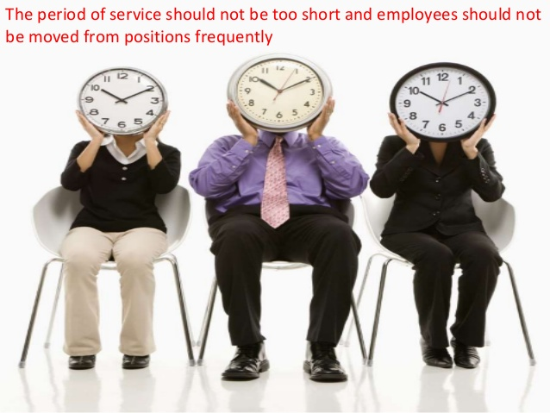

Slide 45
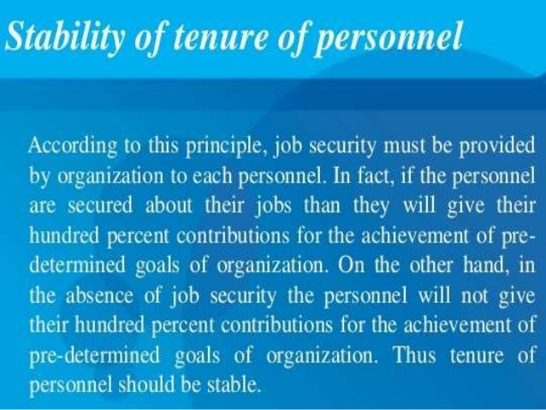

Slide 46


Slide 47
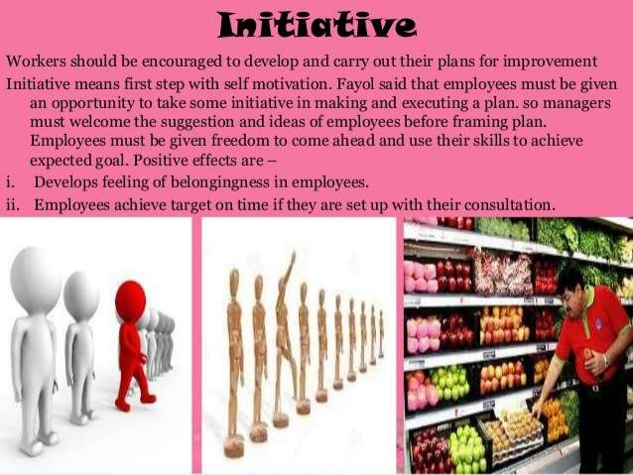

Slide 48
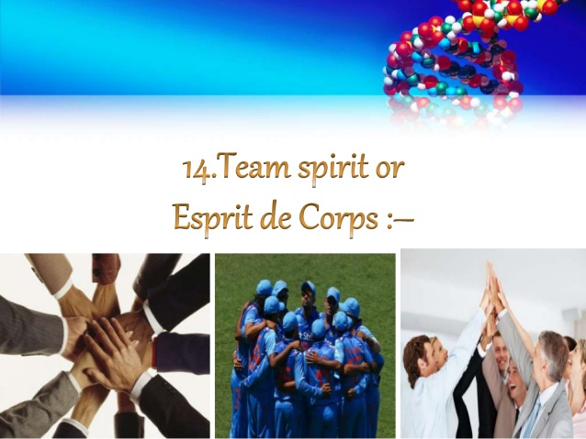

Slide 49
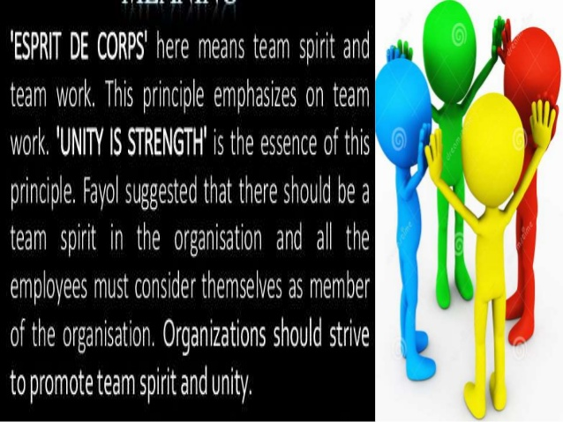

Slide 50
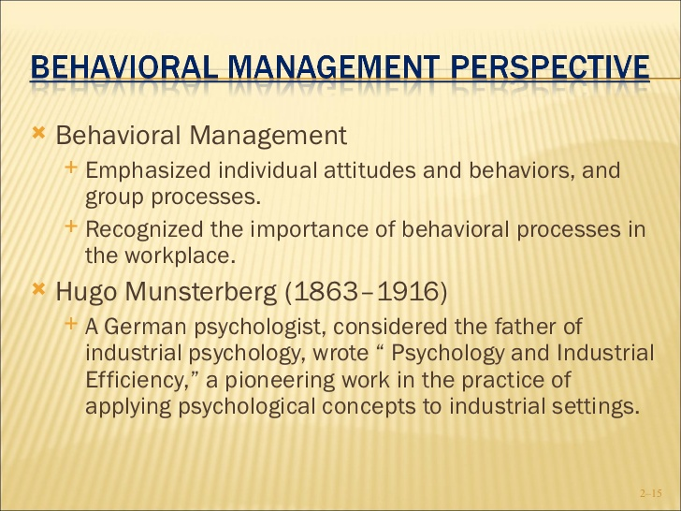

Slide 51
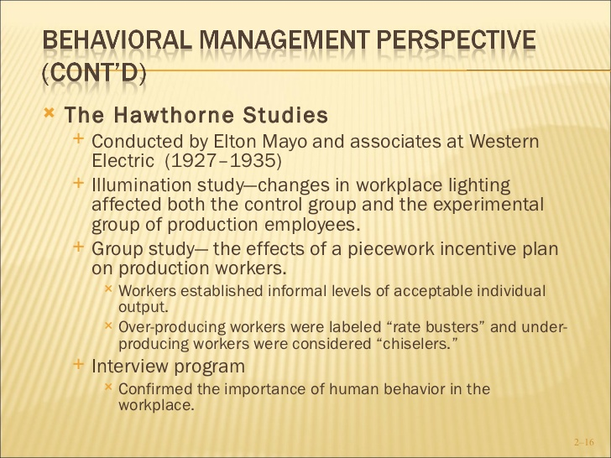

Slide 52
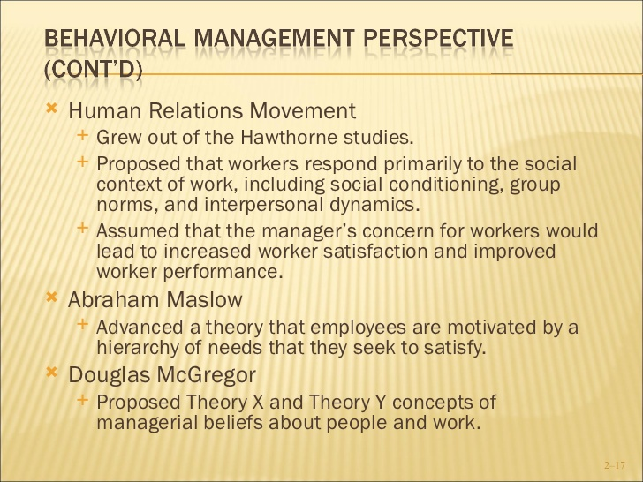

Slide 53
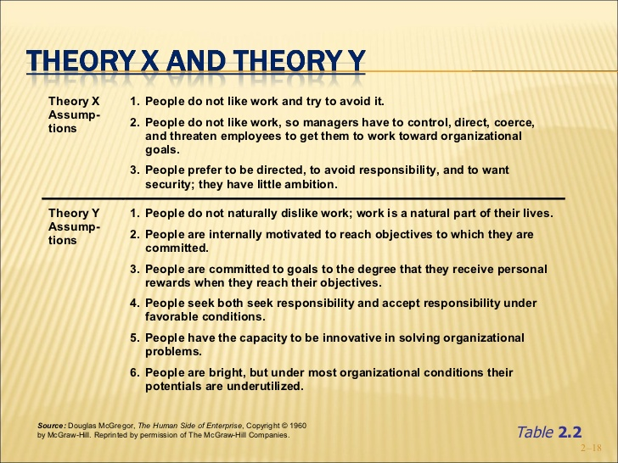

Slide 54
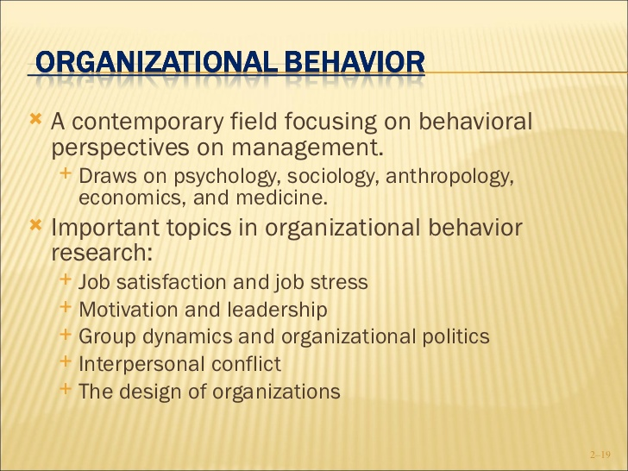

Slide 55
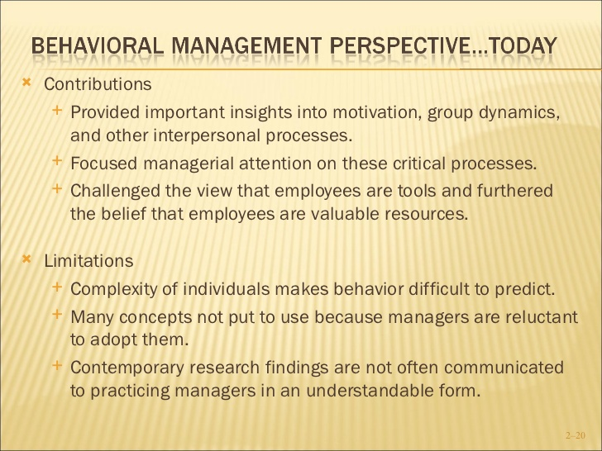

Slide 56
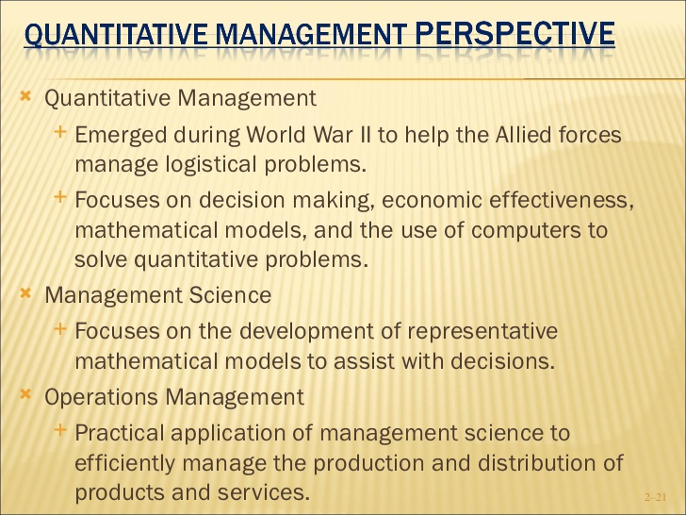

Slide 57
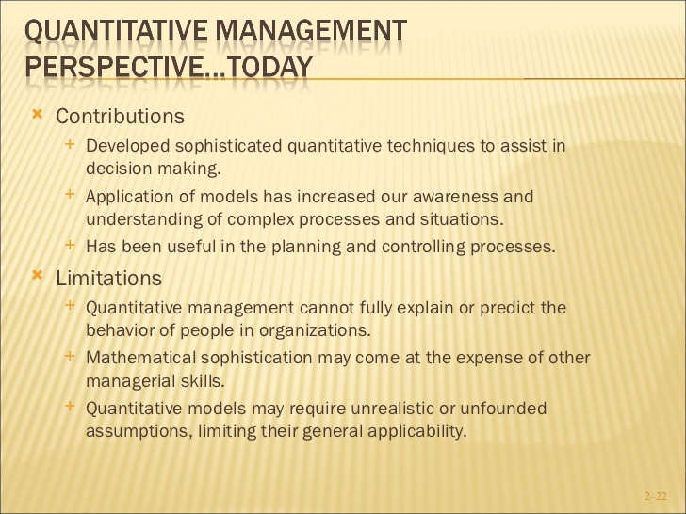

Slide 58
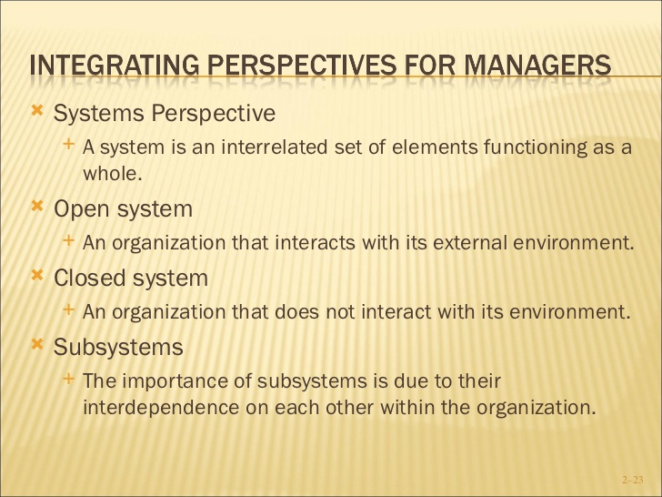

Slide 59
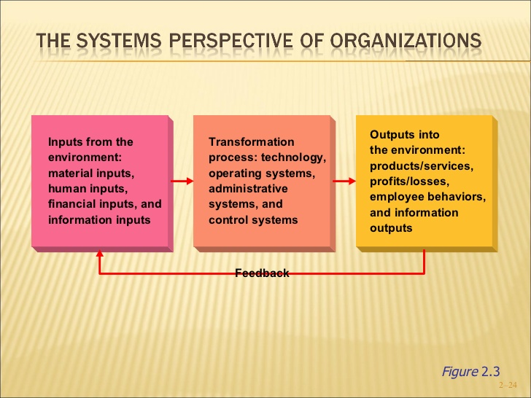

Slide 60
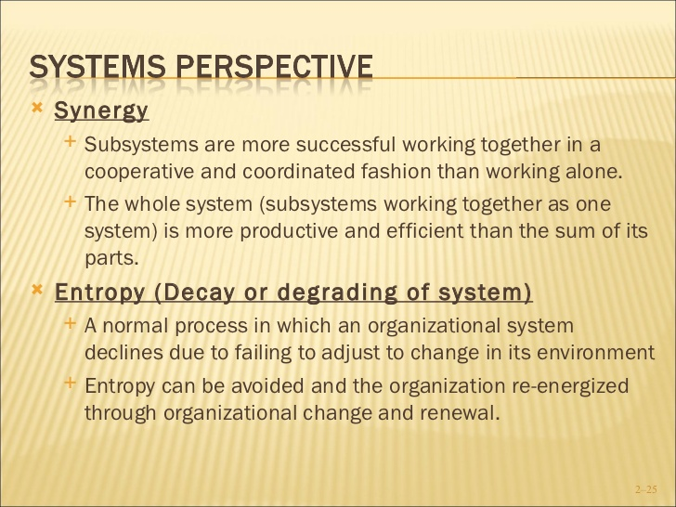

Slide 61
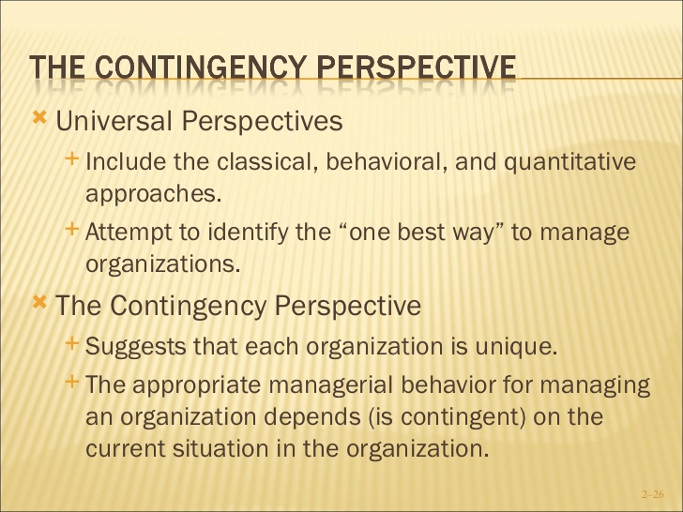

Slide 62
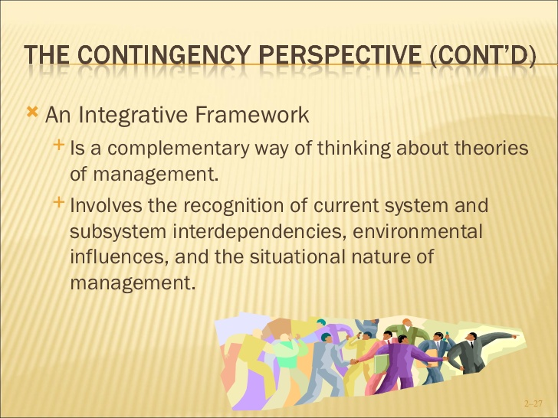

Slide 63
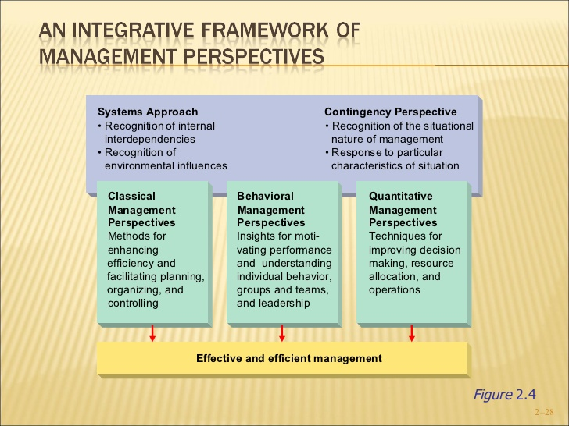

Slide 64
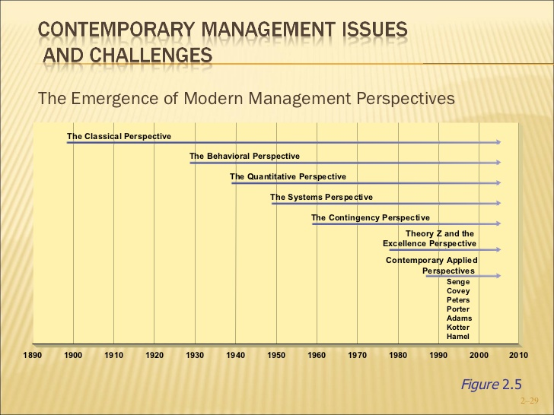

Slide 65


Slide 66
Leadership theories

Slide 67
Theories of Leadership
1. Trait Theories –What Type of Person Makes a Good Leader?
Trait theories argue that effective leaders share a number of common personality characteristics, or "traits.“
Early trait theories said that leadership is an innate, instinctive quality that you do or don't have.

Slide 68
Trait Theories…
Trait theories help us identify traits and qualities (for example, integrity, empathy, assertiveness, good decision-making skills, and likability) that are helpful when leading others.
However, none of these traits, nor any specific combination of them, will guarantee success as a leader.
Traits are external behaviors that emerge from the things going on within our minds – and it's these internal beliefs and processes that are important for effective leadership.

Slide 69
2. Behavioral Theories –What Does a Good Leader Do?
Behavioral theories focus on how leaders behave.
For instance, do leaders dictate what needs to be done and expect cooperation? Or do they involve their teams in decision-making to encourage acceptance and support.
In the 1930s, Kurt Lewin developed a framework based on a leader's behavior.

Slide 70
He argued that there are three types of leaders:
Autocratic leaders make decisions without consulting their teams.
This style of leadership is considered appropriate when decisions need to be made quickly, when there's no need for input, and when team agreement isn't necessary for a successful outcome.
2. Democratic leaders allow the team to provide input before making a decision, although the degree of input can vary from leader to leader.
This style is important when team agreement matters, but it can be difficult to manage when there are lots of different perspectives and ideas.

Slide 71
3. Laissez-faire leaders don't interfere; they allow people within the team to make many of the decisions.
This works well when the team is highly capable, is motivated, and doesn't need close supervision. However, this behavior can arise because the leader is lazy or distracted; and this is where this style of leadership can fail.
Clearly, how leaders behave affects their performance.
Researchers have realized, though, that many of these leadership behaviors are appropriate at different times.
The best leaders are those who can use many different behavioral styles, and choose the right style for each situation.

Slide 72
3 Contingency Theories
How Does the Situation Influence Good Leadership?
The realization that there is no one correct type of leader led to theories that the best leadership style depends on the situation.
These theories try to predict which style is best in which circumstance.
For instance, when you need to make quick decisions, which style is best?
When you need the full support of your team, is there a more effective way to lead?
a leader be more people-oriented or task-oriented?
These are all questions that contingency leadership theories try to address.

Slide 73
4. Power and Influence Theories
What is the Source of the Leader's Power?
Power and influence theories of leadership take an entirely different approach – these are based on the different ways that leaders use power and influence to get things done, and they look at the leadership styles that emerge as a result.

Slide 74
5. Systems Theory
Systems theory has brought a new perspective for managers to interpret patterns and events in the workplace.
They recognize the various parts of the organization, and, in particular, the interrelations of the parts, e.g., the coordination of central administration with its programs, engineering with manufacturing, supervisors with workers, etc.

Slide 75
6. Chaos Theory
A new theory, chaos theory, recognizes that events indeed are rarely controlled.
Many chaos theorists (as do systems theorists) refer to biological systems when explaining their theory.
They suggest that systems naturally go to more complexity, and as they do so, these systems become more volatile (or susceptible to cataclysmic events) and must expend more energy to maintain that complexity.
As they expend more energy, they seek more structure to maintain stability

Slide 76
7. Contemporary Theories of Leadership
Models of leadership behavior have become more complex in order to fit the reality that those in leadership roles often respond to a situation with a set of behaviors rather than a single response.
An influential model of leadership style in contemporary theories is that of transformational leadership.

Slide 77
transformational leaders:
influence through a vision,
motivating through inspiration,
stimulating the intellect of subordinates,
individualized consideration.
Theories of transformational leadership argue it is effective because it changes the attitudes, values, and behaviors of staff in ways that align with organizational goals.

Slide 78
Servant-Leadership:
The servant-leader is servant first.
It begins with the natural feeling that one wants to serve.
Then conscious choice brings one to aspire to lead.
Servant-leadership emphasizes increased service to others, a holistic approach to work, building a sense of community, and the sharing of power in decision making.

Slide 79
Who is a servant-leader?
The servant-leader is servant first.
The best test is: do those served grow as persons; do they, while being served, become healthier, wiser, freer, more autonomous, more likely themselves to become servants? And, what is the effect on the least privileged in society? Will they benefit, or at least not be further deprived? (Robert K. Greenleaf, Servant Leadership, 1977/2002)

Slide 80
Levels of Management (1)
Top/Strategic
Level
Middle/Tactical/
Administrative Level
Lower/Operational/
Supervisory Level

Slide 81
Levels of management (2)
A
B
D
E
C
F
Strategic
Technical
Operational

Slide 82
Management Levels
Operational Manager:
  make decisions that are concerned with the day to day management of the hospital and enforce rules.
  They are the supervisors.
  They are responsible for non management staff.
Tactical Managers:
  are responsible for implementing the overall strategies and policies defined by the top management.
  Head major departments
Strategic Managers:
  Are at the top of the organizational hierarchy
  Responsible for the whole organization.
  Set goals, define strategies, monitor and interpret the external environment.

Slide 83
Major Functions at the Strategic Level of Management
Formulation of corporate vision, mission, goals & objectives
Corporate policy formulation
Strategic planning
Resource mobilisation
Corporate evaluation
Etc.

Slide 84
Major Functions at the Tactical Level of Management
Corporate policy translation, regional policy formulation
Regional planning & definition of tactics
Structuring of authority
Structuring of responsibility
Coordination of activities
Control & supervision of activities
Regional evaluation
Etc

Slide 85
Major Functions at the Operational Level of Management
Policy implementation
Operational planning
Implementation of service operations & delivery of service outputs
Utilisation of resources
Activity scheduling
Inventory control
Monitoring of performance
Etc

Slide 86
Major Skills of the Effective Manager
1. Technical –
1. Financial Management and Accounting
2. Human Resources Management
3. Maternal Resources Management
4. Operations (Planning, Implementation,
M&E, Report Writing and Presentation)
2. Personal & Interpersonal Skills
3. Teambuilding Skills
4. Organizational and Societal Skills
5. Cultural and Cross Cultural Skills

Slide 87
Summary of Skills of the Effective Manager
Human skills: the ability to work effectively with people, to build cooperative effort & stimulate teamwork. Requires a deep perception of self, peers, subordinates & superiors, emotional intelligence, critical thinking as well as sociological, psychological & anthropological knowledge & intelligence.
Technical skills: knowledge, understanding & practical proficiency in the technical aspects of management.
Conceptual Skills: ability to visualize the organization as a whole, the interaction between it’s constituent parts as well as the impact & the relationship of the organisation with it’s external environment against the background of the organisation’s mission & vision.

Slide 88
Managerial Skills and Management Level
Degree Of Skill Requirements
Top Mgt
Conceptual Skills
Middle Mgt
Technical Skill
Human Skill
First Line Mgt

Slide 89
Managerial Roles
Decisional role
Entrepreneur
Disturbance handler
Resource allocator
Negotiator
Interpersonal roles
Figurehead
Leader
Liaison
Informational role
Monitor
Disseminator
Spokesperson

Slide 90
Effective Leadership
The ability to inspire and influence people to work with a sustained zeal towards the achievement of group goals
Requires
The design of a work environment which will harmonize individual needs with organizational demands, leading to the creation of a purposeful, willing, harmonious work team – effective leadership
The ability to inspire & motivate

Slide 91
Effective leadership
Create followership
Build teams
Involves everyone
Innovative/creative – “think outside the box”
Introduces positive change and make gigantic leaps
Listen with understanding and open to new ideas and insights
Lead by example

Slide 92
Manager versus Leader
(Source: Yalokwu, 2002)
Manager | Leader
Administers | Innovates
Copies | Is original
Maintains | Develops
Focuses on systems and structure | Focuses on the people
Relies on control | Inspires trust
Asks how and when | Asks what and why
Imitates | The horizon originates
Accepts the status quo | Challenges the status quo
Seeks praise from others as a classic deliverer | Is his or her own person
Wants to be seen | Wants his achievement to be noticed not himself

Slide 93
What is coping, management and leadership?
Coping, management and leadership are parts of a continuum that describes how we respond to events, change and challenges.

Slide 94
Leadership-Management Continuum
Leadership
Coping
Management

Slide 95
Coping
Reactive response to problems as they occur.
Basically “problem-solving”.
People do not think ahead and simply try to “cope” with problematic situations.

Slide 96
Coping is dominant
Leadership
Management
Coping

Slide 97
Leadership and Management should complement each other
Leadership
Coping
Management

Slide 98
What happens to an organization when leadership is strong? (advantage)
more creative
people look at organization- as-living- organism model
people cultivate change towards a shared vision through nurturing of values and relationships

Slide 99
Leadership is dominant
Coping
Leadership
Management

Slide 100
What happens when leadership becomes too dominant? (Disadvantage)
1. Confusion and chaos
2. Fear of the unknown
3. Frustrations
4. Tension and stress

Slide 101
We should complement leadership with effective management
Without effective management, dominant leadership can result in:
chaos,
backlash of drastic changes,
burnout, etc.

Slide 102
Coping is dominant when organizational behavior is:
Mostly reactive
Often in “crisis management” mode
Running to keep in place
Focused on short term rather than pursuing a clear vision for the future.

Slide 103
What happens when coping is too dominant?
1. Panic reactions
2. Confusion and chaos
3. Waste of time, human and other resources
4. Error chains
5. Problems multiply

Slide 104
Management is dominant
Leadership
Coping
Management

Slide 105
Management is dominant when:
Rules become more complex and rigid
Managers see organizations as “machines”
Managers “direct” change through a linear plan and “fixing” mode

Slide 106
What happens when management becomes too dominant?
1. Problems grow because rigid rules dampen/reduce creativity
2. “Control” organizational climate
3. Bureaucratization

