Slide 1
Unit - 1 History & Physical examination of Neonates

Slide 2
Definition of Terms
Neonatology: the branch of medicine that deals with the care and development of newborn babies and the treatment of their diseases.
Neonatal period: is the time from birth to 28th day of life
Peri natal period: is the time around 28th week of gestation to around 4 weeks after birth
Preterm delivery : occurs less than 37 completed wks from the first day of the last menstrual period
Post –term delivery : delivery occurs 42 wks or more from the first day of the last menstrual period

Slide 3
Neonatalogy…..
Children are anatomically and physiologically different from adults
Children display great variations in physical, cognitive and social development compared with adults

Slide 4
Assessment of the new born
In the absence of any immediate problems, essential newborn care begins with a thorough general clinical assessment
Any problems identified during the initial assessment will need specific management

Slide 5
1. Neonatal History Taking
Maternal history:
Age
Blood type
Transfusions
Blood group sensitizations
Chronic maternal illness(DM, HTN, Renal… )
STI (HIV/AIDS, herpes…)
Infertility, IVF/ in vitro fertilization/ fertilization in artificial environment rather than inside a living organism
Recent infections or exposures
Notes:
IVF/ in vitro fertilization/ fertilization in artificial environment rather than inside a living organism

Slide 6
Neonatal….
Previous pregnancies: problems and outcomes:
Abortions
Fetal end
Neonatal deaths
Prematurity
Post maturity
Malformations
Respiratory distress syndrome
Jaundice
Apnea

Slide 7
Neonatal….
Drug history:
Medications
Drug abuse
Alcohol
Tobacco

Slide 8
Neonatal….
Current pregnancy:
Gestational age
Quickening (normally 16-18 wks)
Fetal heart heard with fetoscope (normally 18-20 wks)
Results of any fetal testing ( amniocentesis, U/S, fetal monitoring, fetal lung maturity, prenatal infection screening [hepatitis, group B streptococci, syphilis, etc.])

Slide 9
Neonatal…..
Preeclampsia
Bleeding
Trauma
Infection
Surgery

Slide 10
Neonatal…..
Polyhydramnios
Oligohydramnios
Labor suppressant
Antibiotics

Slide 11
Neonatal….
Labour and delivery:
Presentation
Onset of labor
Rupture of membranes
Duration of labor
Fever

Slide 12
Neonatal….
Fetal monitoring
Amniotic fluid (blood, meconium, volume)
Analgesic
Anesthesia
Maternal oxygenation and perfusion
Mode of delivery
Placental examination

Slide 13
Neonatal ……
Infant’s condition at birth:
Initial delivery room assessment (shock, asphyxia, trauma, anomalies, temperature, infection)
APGAR scores
Resuscitation

Slide 14
2. Neonatal physical examination
Initial evaluation after birth :carried out in a warm room.
After 24 hrs if baby is stable
After 48 hrs if not discharged early

Slide 15
P/E…..
The examination includes:
APGAR score
General appearance : baby need to be naked
Vital signs
Anthropometry measurement &
Head to toe examination

Slide 16
APGAR score
Apgar score - is a score used to assess a newborns condition after birth.
Apgar score=
A: appearance(skin color)
P: pulse(heart rate)
G: grimace (reflex response)= a reaction to something
A: activity(muscular tone)
R: respiration

Slide 17
APGAR score
SIGN | 0 | 1 | 2
Appearance /color | Blue, pale | Body pink, extremities blue | Completely pink
Pulse /heart rate | Absent | Below 100 | Over 100
Grimace / Response to catheter in nostril (tested after oropharynx is clear) | No response | Grimace | Cough or sneeze
Activity / Muscle tone | Limp | Some flexion of extremities | Active motion
Respiratory effort | Absent | Slow, irregular | Good, crying

Slide 18
APGAR Interpretation
7-10…… well adjusted/normal
5-6……. mild asphyxia
3-4……… moderate asphyxia
< 3………. severe asphyxia

Slide 19
Neonatal P/E….
General examination:
Skin
Gestational changes:
Lanugo hair (32-35wks)……fine hair
Vernix caseosa (35-37wks)….cheesy white covering. Not remove during drying b/c it protects from hypothermia & infection.

Slide 20
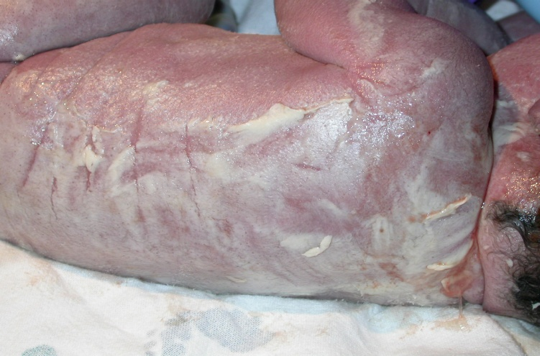
What are these?

Slide 21
Neonatal P/E….
Color:
Cyanosis & Acrocyanosis
Plethora
Pallor : may be due to anemia, asphyxia, shock, or edema
Ecchymoses
Jaundice
Rashes
Mongolian spots
Notes:
Acrocyanosis = peripheral cyanosis i.e. cynosis of fingers and toes
Bruise (Ecchymoses): bleeding from broken blood vessels into surrounding tissue

Slide 22
Skin color…..
Pallor: associated with low hemoglobin
Cyanosis: associated with hypoxemia
Plethora: associated with polycythemia
Jaundice: associated with elevated bilirubin

Slide 23
What are these?
Notes:
The first one is plethora and the second is pallor

Slide 24
What are these?
Notes:
The 1st is acrocyanosis and the 2nd is jaundice
Jaundice progresses in a head to toe direction . Blanch skin with finger to reveal underlying skin (e.g. start at forehead → chest → legs and arms → palms and soles)

Slide 25
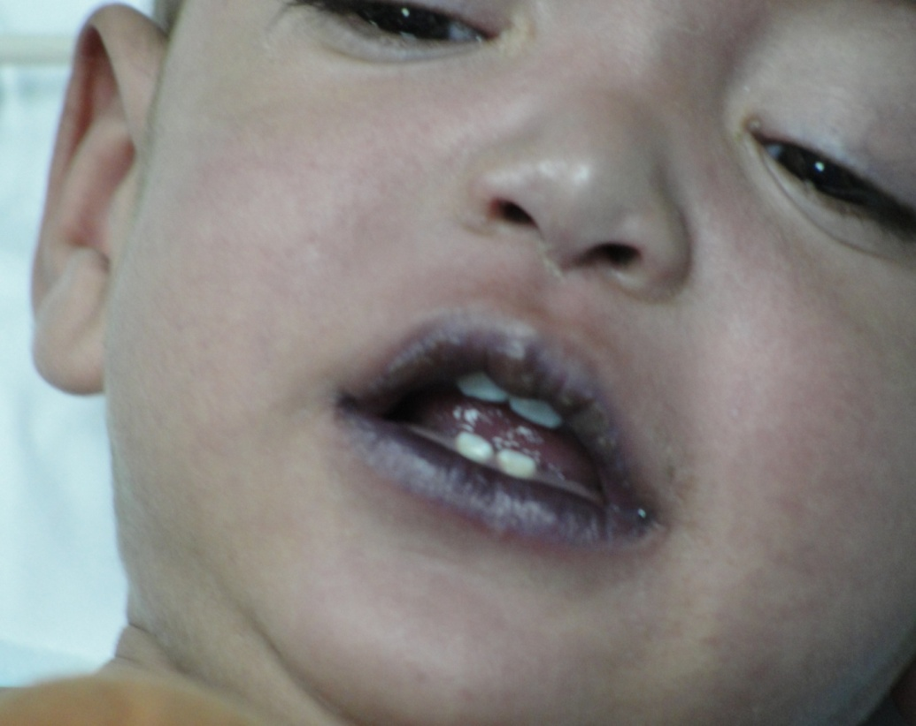
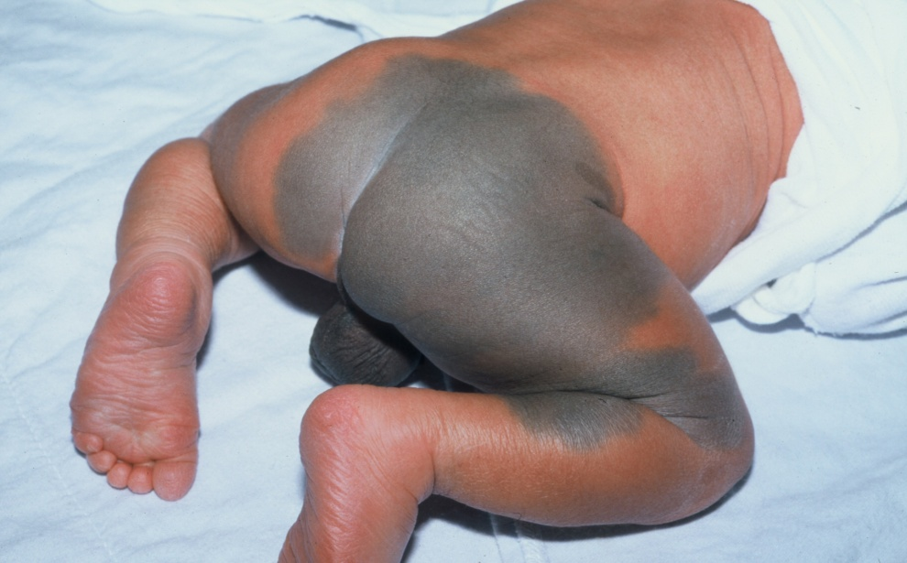
What are these?
Notes:
The Right is central cyanosis and the left one is mongolian spot
mongolian spot is Well demarcated symmetric bluish gray to deep brown to black skin markings. Common among people of Asian, East Indian, African, and Latino heritage. Often on the base of the spine, on the buttocks and back. Generally fade in a few years and disappear by puberty

Slide 26
Vital signs
Temperature (36.5 to 37. 5°C ).
Pulse ( 120 to 160 beat/min )
Respiration ( 30 to 60 breath/min)
Q. The relation between rectal and axillary temperature?
Notes:
Rectal temprature is > axillary temperature by 0.50C

Slide 27
Anthropometric Measurement
Weight:
Weight = 2.5 – 4 kg
Wt loss 5% -10% by 3-4 days after birth
Wt gain by 10th days of life
Gain ¾ kg by the end of the 1st month
Q. Why loose 5 % to 10 % of weight by 3-4 days after birth?
Notes:
Because of loss of fluids and maternal hormones

Slide 28
CONTD…
Height:
Normal range (47.5- 53.75 cm)
Boys average Ht = 50 cm
Girls average Ht = 49 cm
Q. What is the difference between length and height?
Notes:
Length used for <2yrs age but height used for >2 yrs

Slide 29
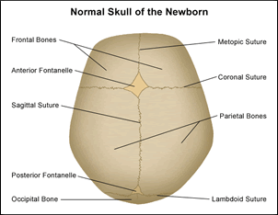
CONTD…
Head circumference:
33-35 cm
Head is ¼ of total body length
Two fontanels (anterior & posterior)

Slide 30
Anthropometric…
Anterior fontanel:
Diamond in shape
The junction of the sagital, coronal and frontal sutures
Between 2 frontal & 2 parietal bones
3-4 cm in length and 2-3 cm width
It closes at 12-18 months of age

Slide 31
Anthropometric…
Posterior fontanel:
Triangular in shape
Located between occipital & 2 parietal bones
Closes by the end of the 1st six months of age

Slide 32
Anthropometric…
Chest circumference:
It is 30.5 to 33cm
Usually 2–3cm less than head circumference

Slide 33
Neonatal P/E…..
Head:
Scalp hair, head shape, size
Microcephaly
Macrocephaly
Cranial sutures(molding vs craniosynostosis)
Fontanelle (closure, bulging, sunken…)
Caput succedaneum, subgaleal hemorrhage , Cephalohematomas
Notes:
Molding is overriden of cranial bones. This is normal finding at delivery but it will resolve with in few days after delivery
Craniosynostosis…premature fusion/closure of cranial sutures. May be due closure of sutures/primary or failure of brain to grow/secondary

Slide 34
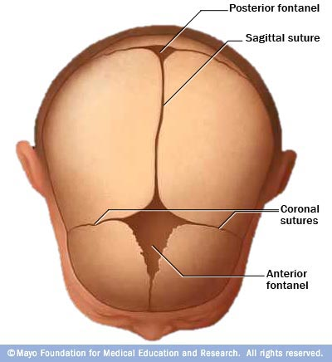
Fontanels and sutures

Slide 35
Fontanels and sutures ….
Fontanels ”soft spots”
Anterior fontanel
1-5 cm at birth
Closes by 12- 18 m
At rest: should be level
Posterior fontanel
0.5 cm at birth
Closes until 6 months
Sutures
Gap between bony plates
Normal sutures are approximated and mobile
May split up to 1 cm
Suture lines allow bones to shift during birthing process
Notes:
Fontanels are areas where at least three bony plates of the skull meet. Fontanels should not bulge or be sunken
Wide sutures may indicated increased intracranial pressure
Anterior fontanelle will bulge when infant cries

Slide 36
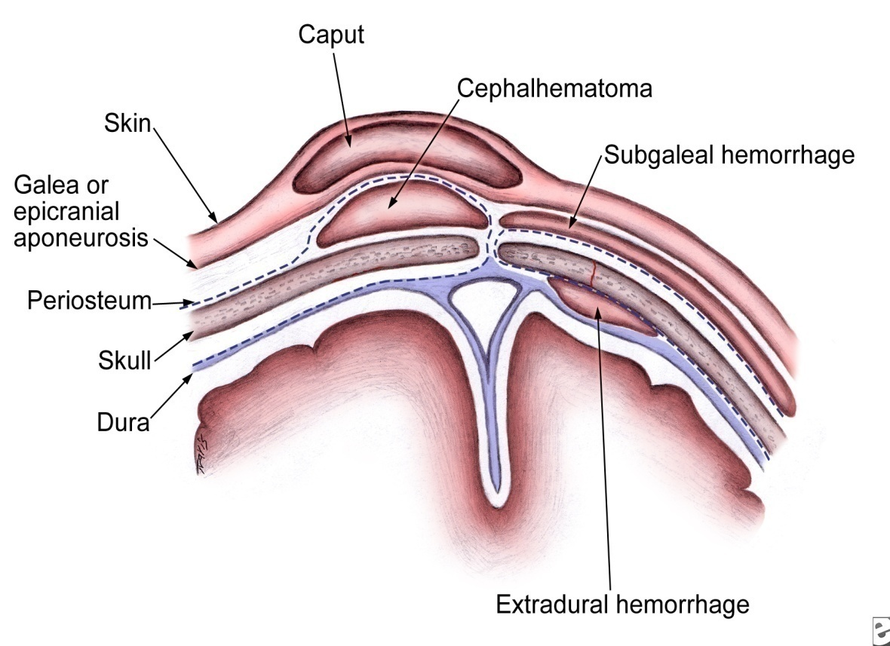
Extracranial Hemorrhages
Caput succedaneum
Cephalohematoma
Subgaleal hemorrhage
Notes:
Highlight the location of the bleeding

Slide 37
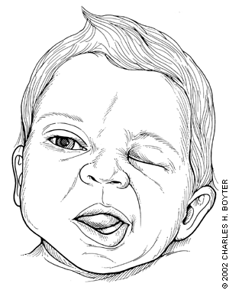
Neonatal P/E…..
Face
Dysmorphic syndrome
Facial paralysis
Eye
White pupillary reflex (Leukocoria or Cat’s eye reflex)
Conjunctivitis
Ear
Low set ears
Malformed ears

Slide 38
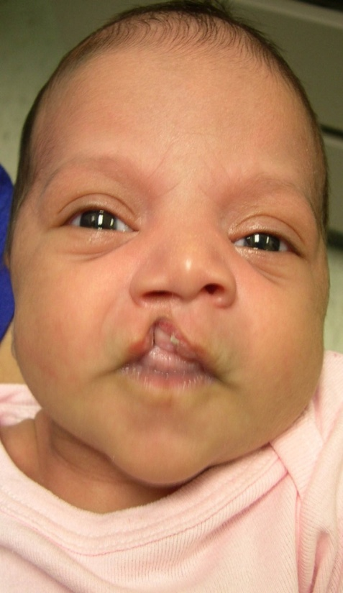
Neonatal P/E…..
Nose
Most newborn infants are mouth breathers
Obstructive lesions/ Choanal Atresia
Mouth
Cleft lip, cleft palate
Natal teeth
Neck
For any neck mass
Notes:
Cleft Palate
Repair is usually before age 1 year for normal speech
Mouth breathers b/c their mouth is wider than nose
Choanal Atresia= bi/unilateral atresia of nose c pharynx & not pass 3-4 cm catheter, w/n suck they cry due to lack of o2 then w/n cry get air and become calm

Slide 39
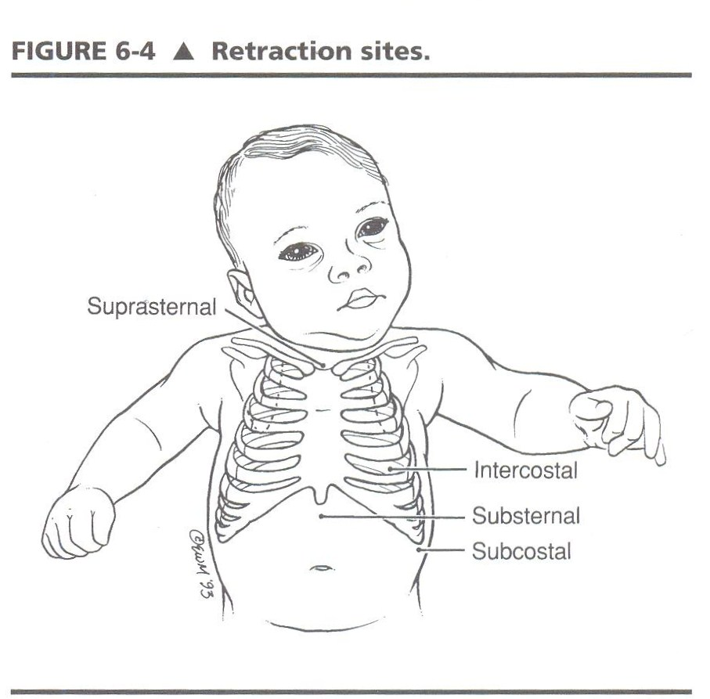
Neonatal P/E…..
Chest
Any abnormality?
Retraction?
Lung
Inspection, palpation &
auscultation

Slide 40
Neonatal P/E….
CVS:
HR :normal 120-160
Bradycardia
Tachycardia
Murmurs
Listen at
Aortic area
Pulmonic area
Tricuspid area
Mitral area
Notes:
The valve areas are not over the actual anatomic locations of the valves but are the sites on the chest wall where sounds produced by the valves are best heard. The sound radiates with the direction of blood flow.
Aortic area: right second intercostal space
Pulmonic area: left second intercostal space
Triscuspid area: fifth intercostal space, sternal border
Mitral area: fifth left intercostal space, midclavicular line

Slide 41
Neonatal P/E….
Abdomen
Inspection
Distended Vs scaphoid
Umbilical hernia
Omphalocele
Gastroschisis
Liver and Spleen
For any mass
Notes:
Gastroschisis…..Herniation of abdominal contents through abdominal defect located to right of umbilicus
Omphalocele……Herniation of umbilicus through which abdominal contents protrude

Slide 42
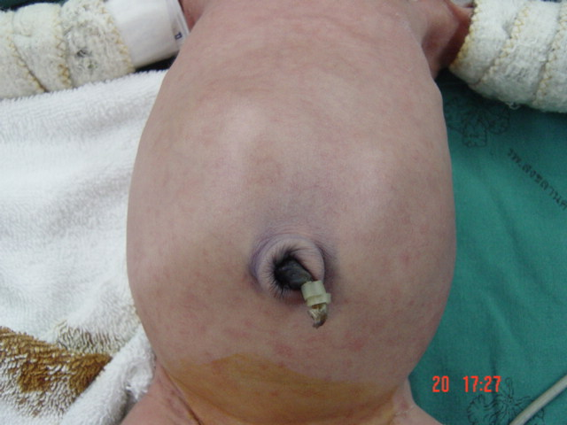
What are these?
Notes:
Left one is scaphoid and the right one is distended

Slide 43
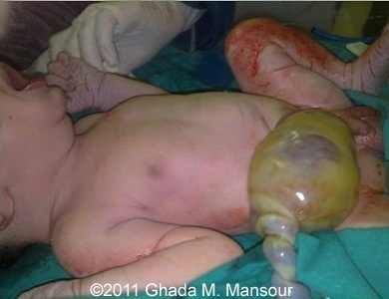
Are these normal?

Slide 44
Neonatal P/E…..
External genitalia
Labia majora and minora
Penis: length 3 to 4 cm
Penile hypospadias vs Epispadias
Undescended testes
Hydroceles
Imperforated anus
Notes:
Meconium passed within 48 hours of birth

Slide 45
Neonatal P/E…..
Spine
Spinal bifida occulta
Meningocele
Myelomeningocele
Limbs
For any sign of trauma
Barlow vs Ortolani for CHD
Polydactyly, syndactyly , clenched hand
Notes:
Spina Bifida Occulta
Spinal bifida…No abnormality of meninges, spinal cord or nerve roots
Meningocele….. Meninges herniate through posterior vertebral arches, Spinal cord and nerve roots are not involved
Myelomeningocele….Meninges, spinal cord and nerve roots are involved

Slide 46
Neonatal P/E…..
Neurologic examination
State of consciousness
TONE : Hypotonic vs Hypertonic
Reflexes
Notes:
Barlow test: test to dislocate an unstable hip
Ortolani test: test to reduce a recently dislocated hip

Slide 47
Neonatal P/E…..
Reflexes:
Primitive reflexes
Sucking reflex
Moro reflex
Rooting reflex
Grasp reflex
Stepping
Tonic neck

Slide 48
Reflexes:
Moro reflex
place the infant in semi-upright position.
The head is momentarily allowed to fall backward, with immediate re-support.
Symmetrically abducts & extends the arms & flexes the thumbs, followed by flexion & adduction of the upper extremities.

Slide 49
Reflexes…
An asymmetric response may signify:
fractured clavicle
brachial plexus injury or
hemiparesis
Absence of the Moro reflex in a term newborn suggests significant dysfunction of the CNS.

Slide 50
Reflexes…
The grasp response
elicited by placing a finger or object in the open palm of each hand.
Normal infants grasp the object, & with attempted removal, the grip is reinforced.

Slide 51
Reflexes…
The tonic neck reflex
manually turning the head to one side while supine.
Extension of the arm occurs on that side & flexion in the contralateral.
An obligatory tonic neck response, by which the infant remains “locked” in the fencer's position,
always abnormal & implies a CNS disorder.

Slide 53
Classification of Newborn
Birth weight classification:
Extremely low birth weight… <1000 grams
Very low birth weight…..<1500gm
Low birth weight……1500-<2500gm
Normal weight …….≥ 2500gm

Slide 54
Low birth weight…
Causes:
Premature birth: (< 37 weeks). The earlier a baby is born, the less it is likely to weigh.
Fetal growth restriction: (growth-restricted= small-for-gestational age or small-for-date)

Slide 55
low birth weight……
What is common?
Overall wasted appearance
Poor skin turgor
Have a large head (since the rest body is small)
Hair is dull and lusterless (not shiny)
Ineffective breathing patterns
Ineffective thermoregulation

Slide 56
low birth weight……
What to do?
Initiating and maintaining respiration
Fluid and electrolyte balance
Temperature regulation
Establishing adequate nutritional intake
Preventing infection
Establishing parent –infant bonding

Slide 57
Classification ……
Gestational age classification:
Very preterm……<32 weeks
Preterm…….32-37 weeks
Term …..37-42 weeks
Post term … ≥ 42 weeks

Slide 58
Pre term babies …….
Risk factors:
Maternal: medical conditions (pre eclampsia), drug, uterine and cervical structure, age, genetics …
During pregnancy: placenta (function, previa, abruption), PROM, interval of pregnancy (short), amniotic fluid (poly/olig)…
Fetal: Multiple gestation, uterine environment(anomalies…)

Slide 59
Intrauterine growth curve(A&W)
AGA: weight between 10th - 90th percentiles. = normal
LGA: weight > 90th percentile = accelerated grown rate
SGA: weight < 10th percentile = IUGR

Slide 60
Pre term babies …….
Thin extremities with very little muscle /subcutaneous fat
Birth weight is usually less than 2500 grams
Length ≤ 47cm, little scalp hair
Thin, translucent and wrinkled skin
Visible abdominal and scalp veins

Slide 61
Pre term babies …….
Excessive lanugos over the extremities, back and shoulders
Un descended testes/ prominent labia and clitoris
Absent / weak typical newborn reflexes
Weak cry and weak body tone

Slide 62
Pre term babies …….
What to do?
Special care (NICU)
Temperature Control
Oxygen
Intravenous Fluids
Medications
Feedings (NG tube)
Skin to skin contact (Kangaroo mother care)

Slide 63
Birth weight and GA classification ……

Slide 64
Care of normal new born/Immediate new born care
Deliver baby onto mother’s abdomen or a dry warm surface close to the mother
Dry baby’s body with dry towel. Wrap with another dry warm cloth and cover head
Tie and cut the cord
Assess breathing and color; if not breathing, gasping or < 30 b/m then resuscitate

Slide 65
Essential Newborn Care(ENC)
Dry the baby with dry & warm towel & cover with another dry towel
Assess breathing
Cord care
Skin to skin contact (Prevent hypothermia)
Initiate breast feeding within the 1st hour
Notes:
Vitamin K…..1mg for graeter than or equal to 34 weeks and 0.5 mg for <34 weeks gestation
Eye ointment….from medial to lateral

Slide 66
ENC…
6. Apply Tetracycline eye ointment once on both eyes
7. Apply Chlorohexidine on the cord
8. Give Vitamin K,1mg IM on anterior mid lateral thigh
9. Place identification band
10. Weighing baby
11. Recording
Notes:
Vitamin K…..1mg for graeter than or equal to 34 weeks and 0.5 mg for <34 weeks gestation
Eye ointment….from medial to lateral , Newborns are deficient in vitamin K for first 5 to 8 days of life because of lack of intestinal flora necessary to absorb vitamin K

Slide 67
ENC…
Help with correct position, attachment and suck
Immunization and medication
Polio zero and BCG at birth
Bathing after 24 hr

Slide 68
New Born Resuscitation
The transition from fetus to neonate represents a series of rapid physiologic changes
Majority of newborn infants make a successful transition to extrauterine life
Some of infants will need some intervention
Few will require extensive resuscitative measures at birth

Slide 69
Resuscitation……
Birth asphyxia is the failure to initiate and sustain breathing at birth
Variety of conditions can predispose to asphyxia
However, asphyxia is not always predictable
The worry is the permanent brain damage that birth asphyxia can cause
Management is using A B C of resuscitation

Slide 70
Resuscitation……
Resuscitation may be required for some new borns born to mothers with:
Chronic illness
Previous fetal or neonatal death
Pre-eclampsia
Multiple pregnancies
Preterm delivery

Slide 71
Resuscitation……
Abnormal presentation of the fetus
Infants with a prolapsed cord
After prolonged labour
Rupture of membranes or meconium-stained liquor

Slide 72
Newborns are different
Newborn lungs are full of amniotic fluid
Inflation breaths: expand the chest to clear amniotic fluid and oxygenate the lung
Chest compressions: more oxygenated blood to coronary arteries kick to start the heart pumping

Slide 73
Purpose of Resuscitation
Reverse asphyxia before irreversible damage has occurred

Slide 74
Steps
A - establish open airway
Position … neck in a neutral to slightly extended position
Suction…… mouth then nose
B - initiate breathing
Tactile stimulation
PPV/positive pressure ventilation
O2…if central cyanosis
C - maintain circulation
Chest compressions
D - drugs
Notes:
Taking an APGAR score is not a prerequisite for resuscitation
The need for resuscitation must be recognized before the end of the first minute of life which is when the first APGAR score is taken
The mouth is suctioned first and then the nares to decrease the risk for aspiration

Slide 75
Resuscitation……

Slide 76
Resuscitation……
Chest compression:
Are required only if the heart rate remains <60 b/minute despite chest expansion with inflation breaths
3 chest compression:1 ventilation
Two methods
Thumb technique – better method
Two-finger technique

Slide 77
Chest compression…..
Thumb technique
Both hands encircle the infant's chest with the thumbs on the sternum and the fingers under the infant

Slide 78
Chest compression…..
Two-finger technique
The tips of the first two fingers, or the middle and ring finger are placed in a perpendicular position over the sternum

Slide 79
Rooming in
Practice of nursing babies with their mothers rather than keeping them in a separate nursery:
Promotes bonding
Makes exclusive breastfeeding easy
Early exposure of baby to maternal bacterial flora
Reduces risk of nosocomial infections
Mother is able to keep a close watch on her infant
Encouraged to report any concerns that she has

Slide 80
Breast feeding values
Nutritional
Immunological/immunity
Psycho social
Economical
Reproductive
Physiological (e.g. uterine contraction)….
Notes:
Colostrum…the first milk.. helps to expel meconium and to prevent jaundice, it is the first vaccine

Slide 81
Breast feeding ….
Good positioning:
The newborns head and body straight
Baby face the breast…baby’s nose opposite to nipple
New born body close to her body
Whole body is supported

Slide 82
Breast feeding ….
Good attachment:
Mouth opens wide
Chin of baby touched the mother’s breast
More areola seen above baby’s mouth than below
Lower lip of baby turned out ward

Slide 83
Exclusive Breastfeeding
Giving an infant only breast milk, with the exception of drops or syrups consisting of vitamins, mineral supplements, or drugs
No food or drink other than breast milk—not even water
Exclusive breastfeeding for 6 months
Introduce nutritionally adequate and safe complementary foods after the infant reaches 6 months of age
Continuing to breastfeed for 2 years or beyond

Slide 84
Exclusive……

Slide 85
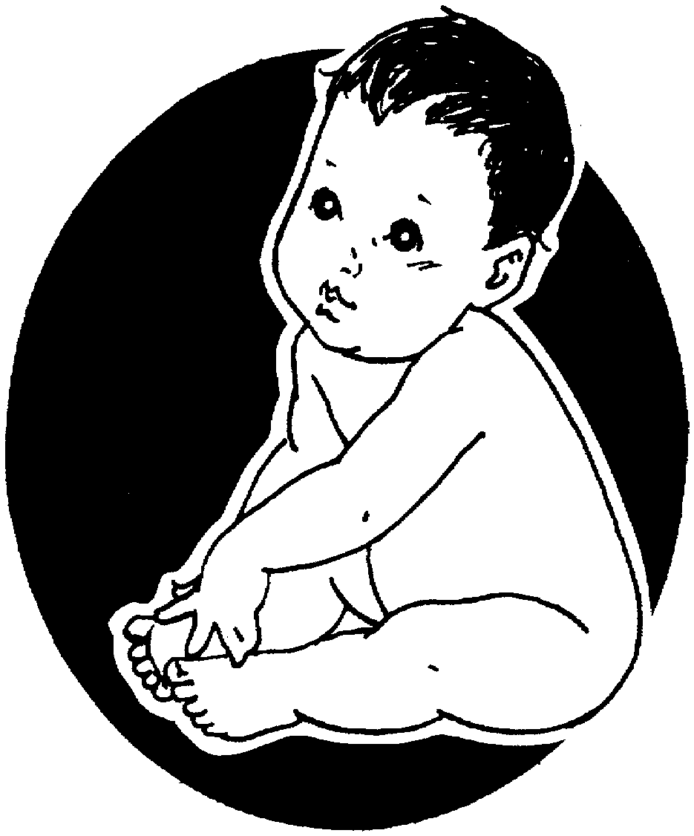
Benefits to the Baby
Perfect nutrition
Higher IQ
Emotional bonding
Prevents infections, chronic diseases
Easily digested
Complete food for the first six months

Slide 86
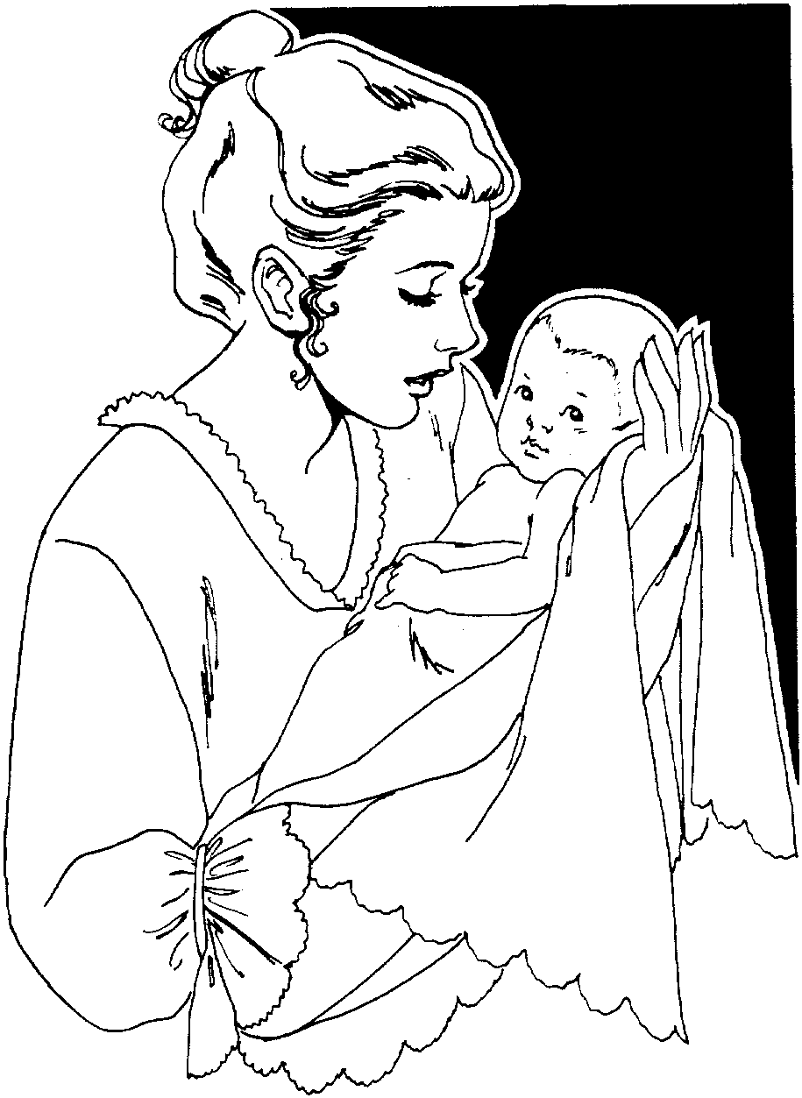
Benefits to the Mother
Reduces post delivery bleeding and anemia
Helps delay next pregnancy
Protective effect against breast and ovarian cancer
Helps to loose weight
Emotional bonding
Needs no preparation
Economical

Slide 87
Breastfeed on demand
8-12 times or more in 24 hours (q 2 hr)
Breastfeed at night
No restrictions on length of breastfeeds
No restrictions on frequency of breastfeeds
MORE SUCKLING MORE MILK

Slide 88
HIV/AIDS and Breast Feeding
Mothers should be counseled and provided with appropriate information (advantage and disadvantage of BF) in order to make informed choices
When AFASS criteria is fulfilled, avoidance of all BF is recommended
When AFASS criteria is not fulfilled, EBF, expressed milk and EBF by wet nurse
Notes:
AFASS……. Affordable, Feasible, Acceptable, Sustainable and Safe

Slide 89
Complementary/supplementary Feeding
Should be energy-rich, nutrient-rich, and affordable
Introducing complementary feeding at 6 months
Continuing breast feeding until 24 months
food quantity and frequency as the child grows
Frequent and active feeding during and after illness
Practicing good hygiene and proper handling of foods

Slide 90
Weaning
Weaning is complete cessation of any breast feeding
Is gradual change
Energy density should exceed that of breast milk

Slide 91
Important!!!
Initiate BF as early as possible within one hour of birth
Do not give the baby any prelacteal feeds
Not use bottles & artificial teats
BF on demand at least 8-12 times in a day
Breastfeed in a correct position
Build mother’s confidence to sustain good milk supply and alleviate feeling of not enough milk.
Notes:
artificial teats = ye ingera enat=pacifier

Slide 92
Thank You!!!

