Slide 1
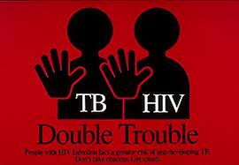
TUBERCULOSIS IN HIV POSITIVE CHILDREN

Slide 2
Objectives
At the end of this session, you are expected to ;
Discuss the relation between TB and HIV/AIDS
Discuss the impact of HIV on TB and vice versa
Identify methods to diagnose TB in HIV patients.
Discuss TB treatment in HIV infected children

Slide 3
Introduction
Tuberculosis (TB) is a potentially fatal contagious disease that can affect almost any part of the body but is mainly an infection of the lungs.
It is caused by a bacterial microorganism
- tubercle bacillus or Mycobacterium tuberculosis
AIDS patients are much more likely to develop tuberculosis.

Slide 4
Mother-to-child transmission of OI is an important mode of acquisition (vertical)
HIV-infected women co-infected with OI more likely to transmit (e.g., CMV, HCV)
HIV-infected women or HIV-infected family members are sources of horizontal transmission (eg, tuberculosis)

Slide 5
TB: A Growing Concern for PLWHA
Approximately 1/3 of the world population is infected with TB
Globally, 1/3 of PLWHA are co-infected with TB
TB is one of the leading causes of death in people with HIV, particularly in low-income countries
HIV
HIV & TB
TB
Notes:
5
Module 8B Version 9.2008
Interim Caribbean Guidelines for the Prevention, Treatment, Care, and Control of Tuberculosis

Slide 6
The Effects of TB on HIV Progression
TB increases HIV progression
Dually infected persons often have very high HIV viral loads
Immuno-suppression progresses more quickly, and survival may be shorter despite successful treatment of TB
Management is challenging due to pill burden, increase ADR, drug interaction
Notes:
6
Module 8B Version 9.2008
Interim Caribbean Guidelines for the Prevention, Treatment, Care, and Control of Tuberculosis

Slide 7
The Effects of Immune Suppression on TB Progression
HIV+ person has a greater risk of reactivation of latent TB infection (LTBI)
Increase TB suspect and TB patients
Alter the diagnosis of TB ( false negative)
HIV+ person has a high risk of becoming sick again after treatment
HIV+ person with LTBI has a 5-10% annual risk of developing active TB versus 50% lifetime risk .
Notes:
7
FALSE negative because the immune system that cause reaction with the test is not working properly.
Module 8B Version 9.2008
Interim Caribbean Guidelines for the Prevention, Treatment, Care, and Control of Tuberculosis

Slide 8
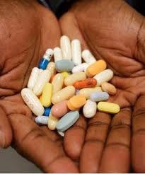
The Effects of HAART on TB Progression
Highly Active Anti-retroviral Therapy (HAART) alone can reduce the risk of latent TB infection progression to active TB disease by as much as 80%–92%
Notes:
8
Module 8B Version 9.2008
Interim Caribbean Guidelines for the Prevention, Treatment, Care, and Control of Tuberculosis

Slide 9
Epidemiology
HIV infection increase the risk of TB by 20-25x folds
Have a 6 times greater risk of dying from TB than HIV uninfected children
In South Africa, as many as 48% of children with TB were co-infected with HIV
In Ethiopia, 15% of active TB children admitted to black lion were co infected with HIV in 2012
Extra pulmonary and miliary TB more common in children <4 years old

Slide 10
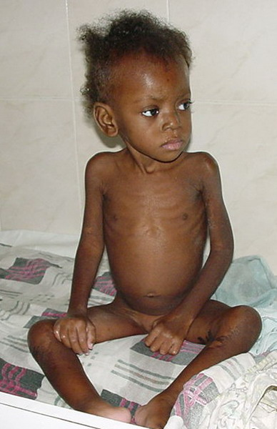
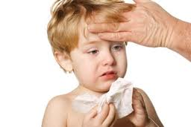
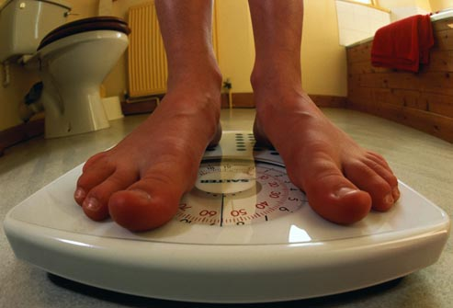
Clinical Manifestations
Clinical presentation of TB similar in HIV-positive and HIV-negative children
Non specific symptoms: fever, weight loss, failure to thrive, anorexia and decreased activity level less often
TB may present as acute pneumonia.
Non productive cough and mild dyspnea are most common symptoms

Slide 11
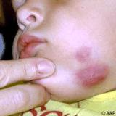
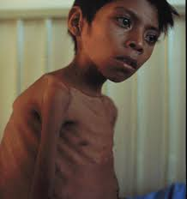
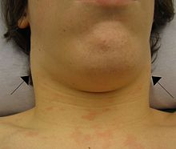
Clinical Manifestations
Pulmonary TB most likely appears as infiltrate with hilaer adenopathy
Some infants and young children with bronchial obstruction have localized wheeze .
Extra pulmonary: marrow, lymph node, bone, pleura, pericardium, peritoneal (Read about extra pulmonary TB)
Notes:
Hilar adenopathy=is bilateral enlargement of the lymph node of pulmonary hila.

Slide 12
Diagnosis

Slide 13
The diagnosis of TB in HIV children is challenging because of some reason
TB clinical features may be present due to other diseases
High rate of acute and chronic lung disease other than TB
Overlap of radiographic finding in TB and other HIV related lung disease like LIP
Presence of more than one cause of lung disease that mask response to therapy

Slide 14
Screening
All children should be screened for TB at first presentation to HIV clinic
Further symptom based screening should be performed at each clinical review with appropriate investigations if concerns.
Following any exposure to an infectious case of TB, all children should be screened for active disease as above.
All children diagnosed with TB should have an HIV test.

Slide 15
Diagnosis of Active TB disease
Careful history including history of TB contact
Careful history of symptoms consistent with TB
Clinical examination including growth assessment
Bacteriological confirmation whenever possible( smear microscopy , gene Xpert)
Tuberculin skin test (less sensitive )
Chest x-ray
Other forms of imaging for disseminated TB
Notes:
Tuberculin skin test (less sensitive due to false negative when immunity is suppressed)

Slide 16
TB suspected on the basis of typical & current symptoms
Sputum smear
Or gene expert –ve smear/ gene expert positive
Consider TB contact treat for TB
History
Contact smear +ve /
Not known Contact smear positive
Physical sign and chest
X-RAY suggest other Physical sign and chest X-RAY
suggestive of PTB
Treat other condition
Notes:
Chest x ray ; The following abnormalities on CXR are suggestive of TB:
• Enlarged hilar lymph nodes and opacification in the lung tissue
• Miliary mottling in lung tissue
• Cavitation (common with older children)Pleural or pericardial effusion

Slide 17
    Management of TB/HIV
    Co-Infection in Children

Slide 18
Management of TB-HIV co-infection require;
Selection of antiretroviral drugs with minimal drug interactions where possible
Dose adjustment
Careful monitoring of therapeutic drug levels and for overlapping toxicity

Slide 19
Treatment of TB/HIV Co-infection in Children
A)Anti-TB Medication
Treatment principles similar in HIV-positive and HIV-negative children
For drug susceptible TB
2RHZE/4RH….for all PTB cases and most extra pulmonary TB
2RHZE/10RH….for TB meningitis , and TB involving vertebra and osteoarticular space
All HIV children on Isoniazide based regimens should receive pyridoxine.

Slide 20
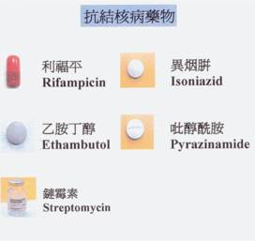

Treatment
Initial treatment (induction phase)
4 drugs: isoniazid, rifampin, pyrazinamide, plus either ethambutol or streptomycin
Use ethionamide as alternative to ethambutol for CNS disease

Slide 21
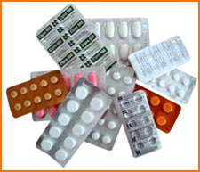
Treatment
Secondary drugs
Ethionamide: 15-20 mg/kg orally divided into 2 or 3 doses daily
Streptomycin: 20-40 mg/kg daily intramuscularly (maximum dosage 1 g daily)
Alternatives: kanamycin, amikacin, capreomycin, quinolones, cycloserine, paraaminosalicylic acid
Steroids may be indicated for TB meningitis

Slide 22
Nationally Available Pediatric Formulations
Rifampicin + Isoniazid(RH): 60mg + 30mg tab/dispersible
Rifampicin + Isoniazid(RH): 60mg + 60mg tab/dispersible
Rifampicin + Isoniazid(RH) + Pyrazinamide: 60mg + 30mg + 150mg tab/dispersible
Pediatric drugs as loose form:
Ethambutol: 100mg tab

Slide 23
Read the side effect as well as contra indication of each Anti – TB drugs
????????

Slide 24
Treatment of TB/HIV Co-infection in Children
B) Cotrimoxazole Preventive Therapy
All children with tuberculosis have to be provided with prophylactic cotrimoxazole.
It prolongs survival and decreases the incidence of respiratory tract illnesses, diarrheal illnesses and hospital admissions

Slide 25
Treatment of TB/HIV Co-infection in Children
C). Antiretroviral Therapy
Start ART as soon as tolerated in the first 2- 8 weeks of TB therapy if the child was not previously on ART
If the child was on ART before diagnosis of TB, the child are recommended to take treatment of TB with little modification of ART dose and regimen
Close monitoring for clinically significant drug interaction.

Slide 26
ART regimen for TB patients in pediatric age that are recommended by WHO
Recommended regimen for children and infants initiating ART while on TB treatment
Younger than 3 years
Two NRTIs+NEV, ensuring the dose of NEV is 200mg/m2 or
Triple NRTI(AZT+3TC+ABC)
3 years and above
Two NRTIs + EFV or
Triple NRTI(AZT + 3TC+ ABC)

Slide 27
B. Recommended regimen for children and infants initiating TB treatment while receiving ART
Child on standard NNRTI based regimen (2 NRTIs + EFV or NEV
Younger than 3 year
Continue NEV, ensuring that dose is 200mg/m2 or triple NRTIs( AZT+ 3TC+ABC)
3 years and above
If the child is receiving EFV, continue the same regimen
If on NEV, substitute with EFV or triple NRTIs ( AZT + 3TC + ABC)

Slide 28
Child on standard PI based regimen
Younger than 3 year
Triple NRTIs ( AZT + 3TC + ABC) or substitute LPV/r by NEV, ensuring dose of NEV is 200mg/m2
3 years and older
If the child has no hx of failure to NNRTIs , substitute with EFV or triple NRTIs or continue LPV/r, consider adding RTV to achieve the full therapeutic dose
If the child has hx of failure of NNRTIs based regimen, shift to triple NRTIs

Slide 29
Treatment of TB/HIV Co-infection in Children
D). INH prophylaxis in infants and children (IPT)
IPT should be administered after excluding active TB.
All HIV-infected infants and children exposed to TB through household contacts, but with no evidence of active disease, should begin IPT.
Isoniazaide daily for 6 months or IR daily for 3 months

Slide 30
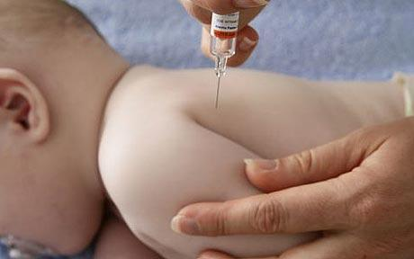
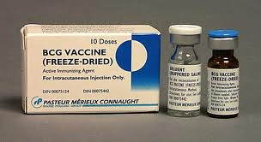
BCG vaccination in HIV infected infants
BCG vaccination is contraindicated in HIV infected infants.

