Slide 1
FOOD ANALYSIS AND ANALYTICAL TECHNIQUES
By:
Yonas Tsega

Slide 2
Chapter 4.
Evaluating Analytical Data
Analytical data- a collection of data used to support decision making
Often contrasted with operational data…how??
is historical data stored in read-only database i.e optimized for data analysis;…types?

Slide 3
Quantitative Analytical Methods
Gravimetric methods: determine the mass of the analyte or some compound chemically related to it.
Volumetric method: the volume of a solution containing sufficient reagent to re­act completely with the analyte is measured.
Electro-analytical methods: measurement of such electrical properties as voltage, current, resistance, and quantity of electrical charge.

Slide 4
Measures of Central Tendency
A single value describes a set of data by identifying the central position within that set of data.
sometimes called measures of central location
classed as summary statistics
Mean, median and mode

Slide 5

Mean (Arithmetic)
Mean (or average) -- the most popular and well known measure of central tendency
Used with both discrete and continuous data
Sum of scores divided by the number of people.
Population mean is (mu) and sample mean is (X-bar).
…...……. (1)
………………(2)

Slide 6
The Mean (Arithmetic Average)
It is the Arithmetic Average of data values:
The Most Common Measure of Central Tendency
Affected by Extreme Values (Outliers)
Sample Mean
0 1 2 3 4 5 6 7 8 9 10
0 1 2 3 4 5 6 7 8 9 10 12 14
Mean = 5
Mean = 6

Slide 7
Practice: Finding a Sample Mean
The transport prices (in Birr) for a sample of round-trip from D/Markos, Bahir dar to Gondar, Addis Ababa are listed. What is the mean price of the trip?
872 432 397 427 388 782 397

Slide 8
Solution: Finding a Sample Mean
872 432 397 427 388 782 397
The sum of the trip prices is
Σx = 872 + 432 + 397 + 427 + 388 + 782 + 397 = 3695
To find the mean price, divide the sum of the prices by the number of prices in the sample
The mean price of the flights is about 527.90. birr

Slide 9
Practice…find the Mean????
Example 2
The Analyst recorded the values of the experiment with repeated measures.
Result Frequency
0 8
1 10
2 12
3 3
4 5
5 2

Slide 10
SOLUTION….
Result Frequency Result × Frequency
0 8 0 × 8 = 0
1 10 1 × 10 = 10
2 12 2 × 12 = 24
3 3 3 × 3 = 9
4 5 4 × 5 = 20
5 2 5 × 2 = 10
Totals 40 (total expt.) 73 (total Result)
Mean = = 73
40
= 1.825

Slide 11
Mean - Grouped Data
When data already grouped in frequency distribution
Σf_{i} (n)= sum. of freq.
f_{i} = freq in the i^{th} cell
n = no. of cells/class
x_{i} = mid point in i^{th} cell

Slide 12
Mean - Grouped Data
Cell (i) | Class boundary | Mid Point (xi) | Freq (fi) | Fixi | Σfi | Σfixi
1 | 1 – 20 | 10 | 2 | 20 | 2
2 | 21 – 40 | 30 | 10 | 300 | 12
3 | 41 - 60 | 50 | 20 | 1000 | 32
4 | 61 – 80 | 70 | 12 | 840 | 44
5 | 81 -100 | 90 | 6 | 540 | 50
 | Totals |  |  | 2700
= 2700/50 = 54

Slide 13
The Median
Important Measure of Central Tendency
In an ordered array, the median is the
“middle” number.
  If n is odd, the median is the middle number.
  If n is even, the median is the average of the 2
  middle numbers.
Not Affected by Extreme Values
0 1 2 3 4 5 6 7 8 9 10
0 1 2 3 4 5 6 7 8 9 10 12 14
Median = 5
Median = 5

Slide 14
Median
Score that separates top 50% from bottom 50%
Even number of scores, median is half way between two middle scores.
  1 2 3 4 | 5 6 7 8 – Median is 4.5
Odd number of scores, median is the middle number
  1 2 3 4 5 6 7 – Median is 4

Slide 15
Median
The value that lies in the middle of the data when the data set is ordered.
Measures the center of an ordered data set by dividing it into two equal parts.
If the data set has an
  odd number of entries: median is the middle data entry.
  even number of entries: median is the mean of the two middle data entries.

Slide 16
Example….1
Find the Median..?
Let, 65 55 89 56 35 14 56 55 87 45 92
Solution:
We first need to rearrange that data into order of magnitude (smallest first):
14 35 45 55 55 56 56 65 87 89 92
It is the middle mark because there are 5 scores before it and 5 scores after it.

Slide 17
Practice…find the Median????
Example 2
The Analyst recorded the values of the experiment with repeated measures.
Result Frequency
0 8
1 10
2 12
3 3
4 5
5 2

Slide 18
Solution: Finding the Median
872 432 397 427 388 782 397
First order the data.
  388 397 397 427 432 782 872
There are seven entries (an odd number), the median is the middle, or fourth, data entry.
The median price of the flights is 427 Birr.

Slide 19
Practice…Example 3
Twelve Students in a class take a test, some scored good result and some in not scored so good result.
Here are their scores.
2 3 6 10 12 12 14 15 15 15 24 25
What is the median number of scores???
ANSWER:-----------

Slide 20
Measure of Central Tendency: Mode
Mode
The data entry that occurs with the greatest frequency.
A data set can have one mode, more than one mode, or no mode.
If no entry is repeated the data set has no mode.
If two entries occur with the same greatest frequency, each entry is a mode (bimodal).

Slide 21
The Mode
A Measure of Central Tendency
Value that Occurs Most Often
Not Affected by Extreme Values
There May Not be a Mode
There May be Several Modes
Used for Either Numerical or Categorical Data
0 1 2 3 4 5 6
0 1 2 3 4 5 6 7 8 9 10 11 12 13 14
No Mode
Mode = 9

Slide 22
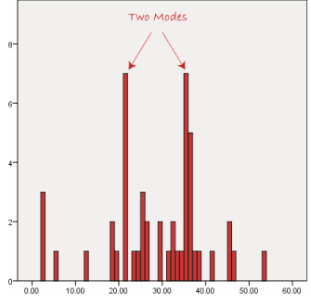
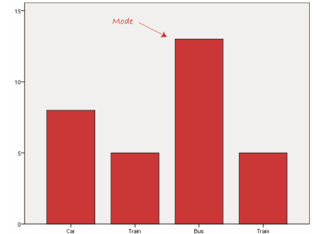
On a histogram it represents the highest bar in a bar chart or histogram.

Slide 23
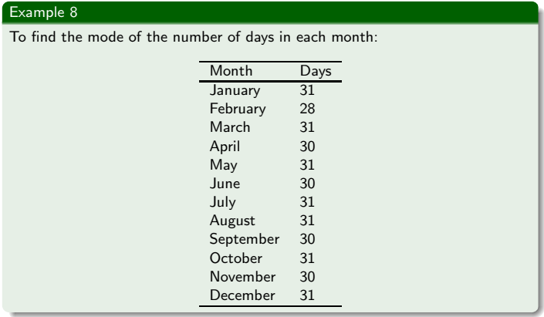

Slide 24
Some data sets may have more than one mode:
1, 3, 3, 4, 4, 5 for example, has two most frequently occurring numbers (3 and 4) this is known as a bimodal set.
Some data sets may have more than one mode:
1, 3, 3, 4, 4, 5 for example, has two most frequently occurring numbers (3 and 4) this is known as a bimodal set. Data sets with more than two modes are referred to as multimodal data sets. ???

Slide 25
Comparison of mean, median and mode
Mode
  Good for nominal variables
  Good if you need to know most frequent observation
  Quick and easy
Median
  Good for “bad” distributions
  Good for distributions with arbitrary ceiling or floor

Slide 26
Comparison of mean, median & mode
Mean
  Used for inference as well as description; best estimator of the parameter
  Based on all data in the distribution
  Generally preferred except for “bad” distribution. Most commonly used statistic for central tendency.

Slide 27
Best Guess interpretations
Mean – average of signed error will be zero.
Mode – will be absolutely right with greatest frequency
Median – smallest absolute error

Slide 28
Check yourself …???
What is central tendency?
Mode
Median
Mean

Slide 29
CURVE FITTING
The process of constructing a curve, or mathematical function,
best fit to a series of data points
examines the relationship between predictors and a response variable, with the goal of defining a "best fit" model of the relationship.

Slide 30
Steps:

Slide 31
Example
"x" Hours of Sunshine | "y" Ice Creams Sold
2 | 4
3 | 5
5 | 7
7 | 10
9 | 15
Let us find the best m (slope) and b (y-intercept) that suits that data
y = mx + b

Slide 32
Step 1: For each (x,y) calculate x2 and xy:

Slide 33
Step 2: Sum x, y, x2 and xy (gives us Σx, Σy, Σx2 and Σxy):

Slide 34
Step 3: Calculate Slope m:
m = N Σ(xy) − Σx Σy N Σ(x2) − (Σx)2
= 5 x 263 − 26 x 41 5 x 168 − 262
= 1315 − 1066 840 − 676
= 249 164 = 1.5183...
Step 4: Calculate Intercept b:
b = Σy − m Σx N
= 41 − 1.5183 x 26 5
= 0.3049...

Slide 35
Step 5: Assemble the equation of a line:
y = mx + b
y = 1.518x + 0.305
Let's see how it works out:

Slide 36
Here are the (x,y) points and the line y = 1.518x + 0.305 on a graph:
Nice fit!
The weather forecast which says "we expect 8 hours of sun tomorrow", so use the above equation to estimate that will sell
y = 1.518 x 8 + 0.305 = 12.45 Ice Creams
Make fresh waffle cone mixture for 14 ice creams just in case.

Slide 37
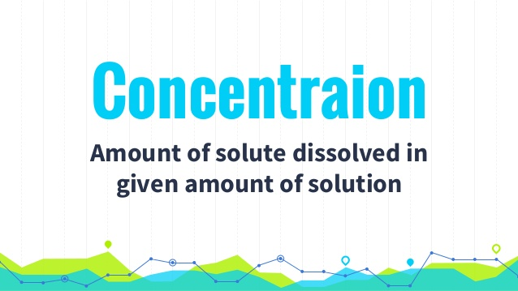

Slide 38
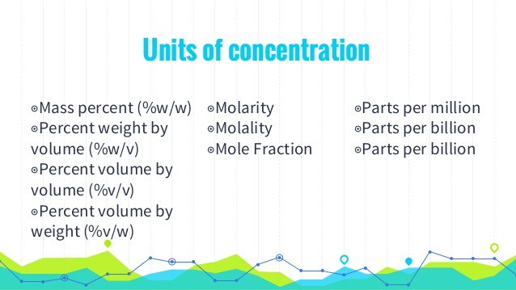

Slide 39
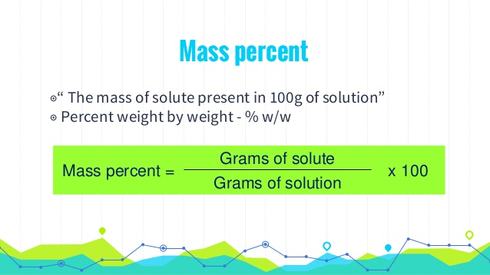

Slide 40
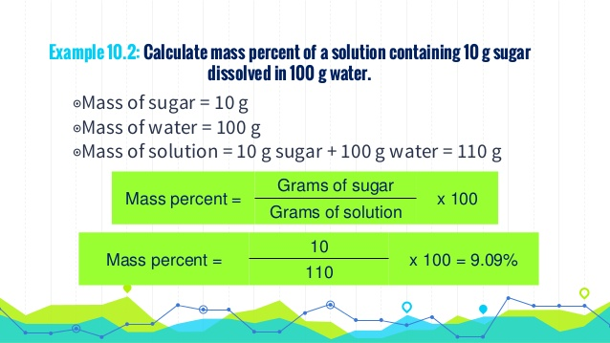

Slide 41
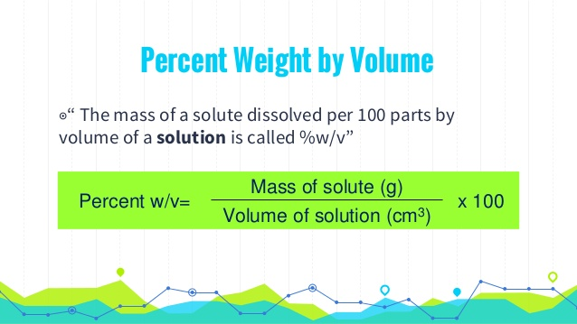

Slide 42
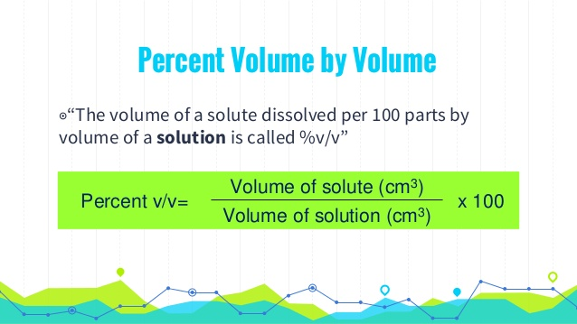

Slide 43
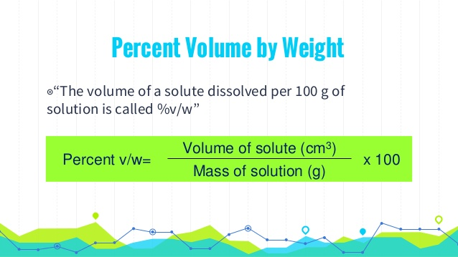

Slide 44
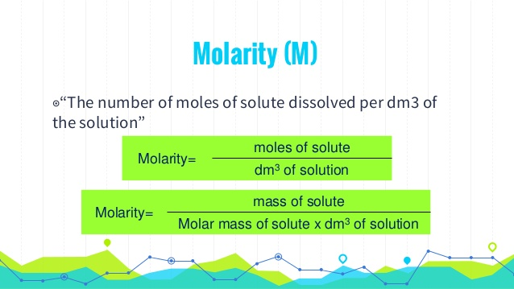

Slide 45
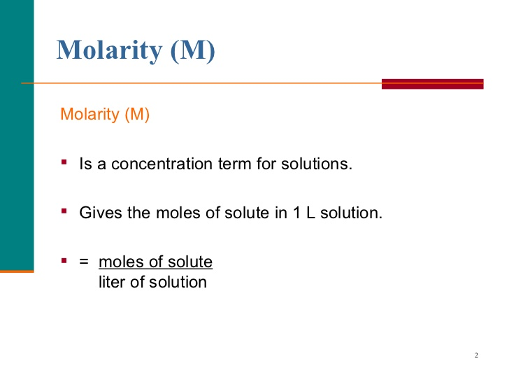

Slide 46
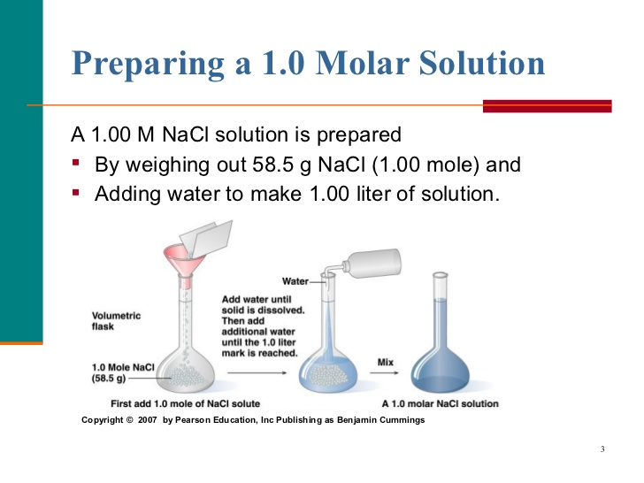

Slide 47
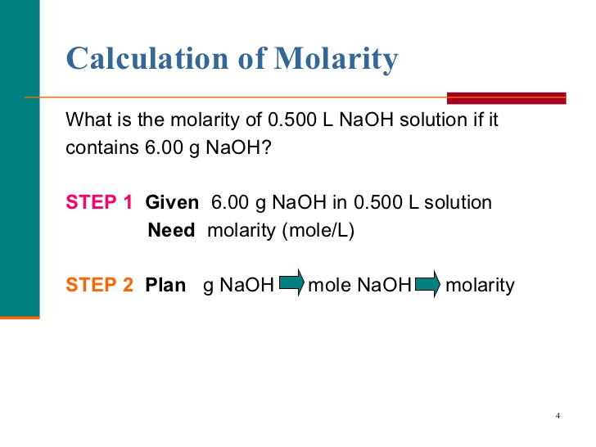

Slide 48
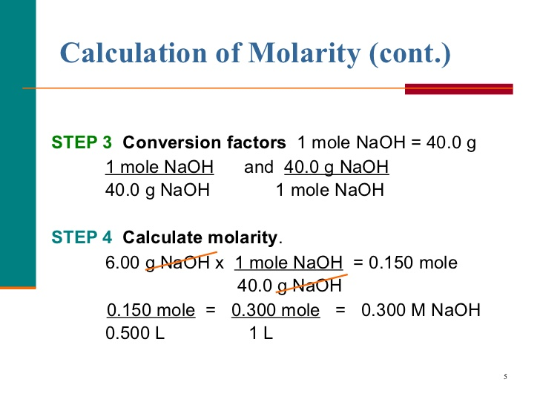

Slide 49
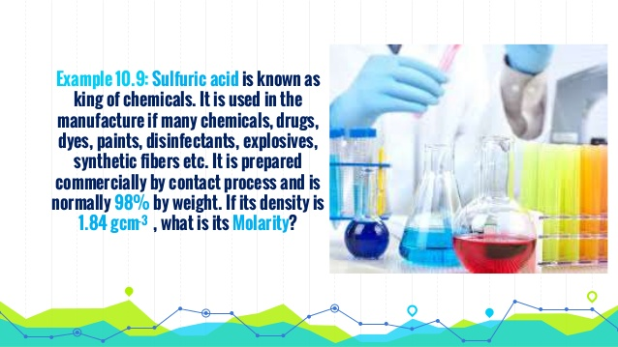

Slide 50
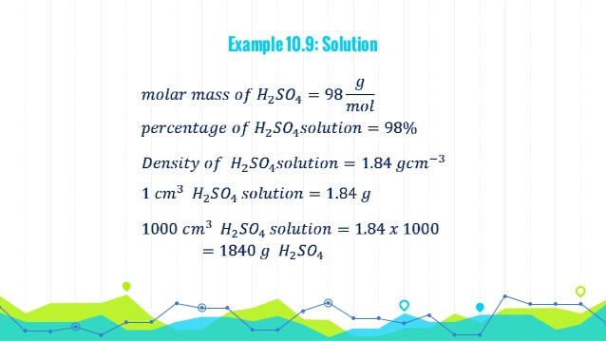

Slide 51
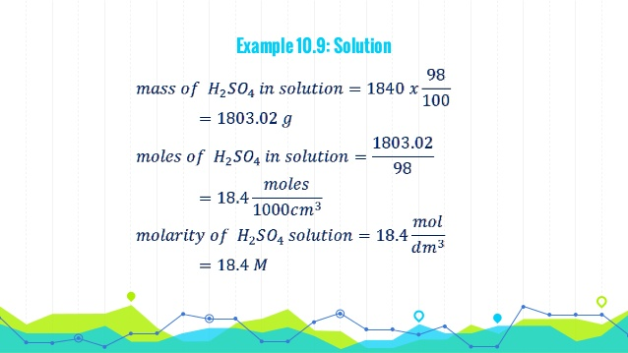

Slide 52
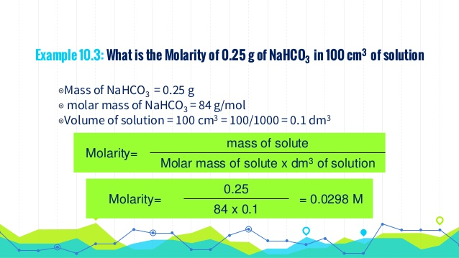

Slide 53
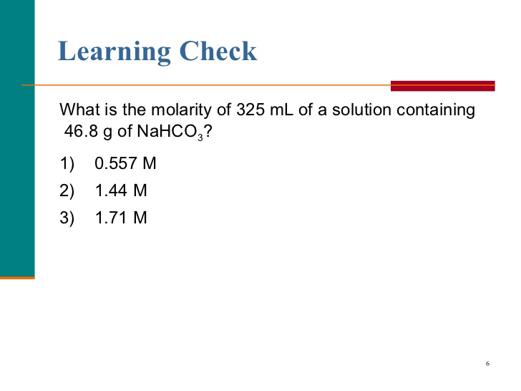

Slide 54
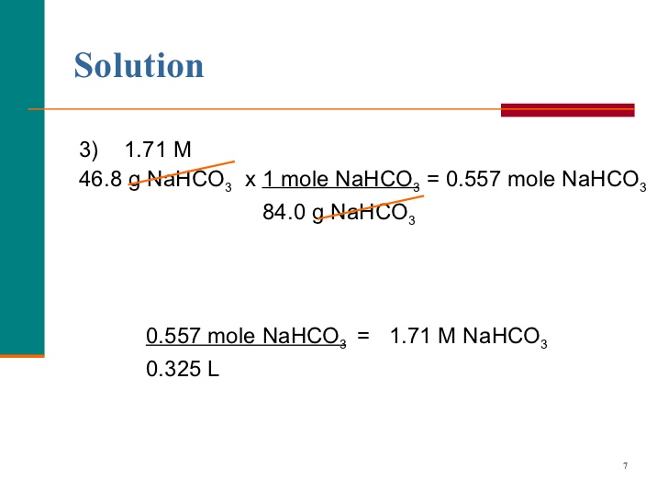

Slide 55
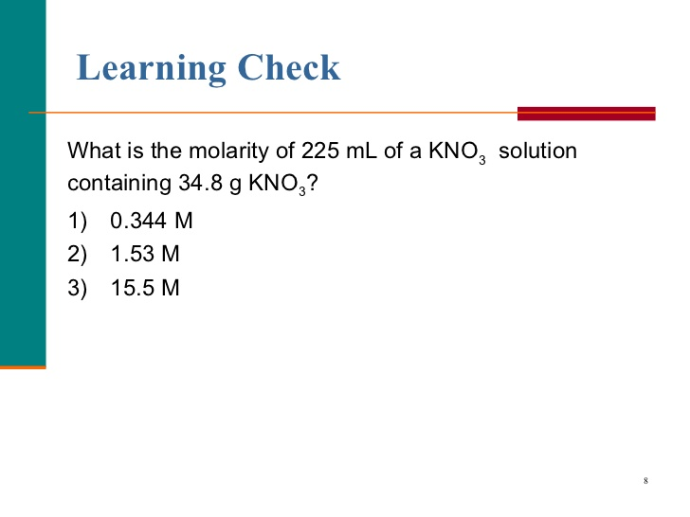

Slide 56
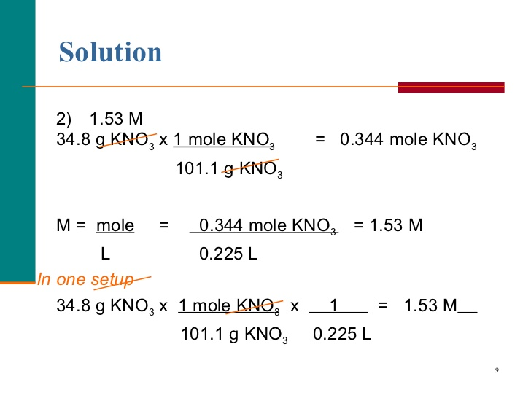

Slide 57
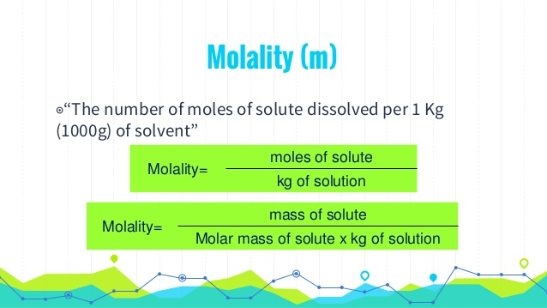

Slide 58
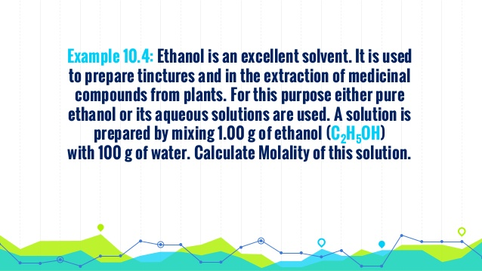

Slide 59
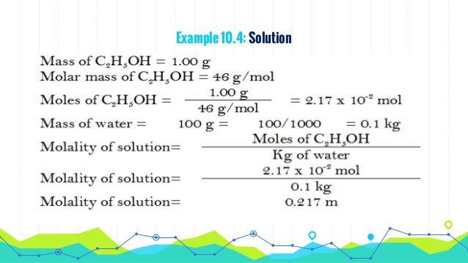

Slide 60
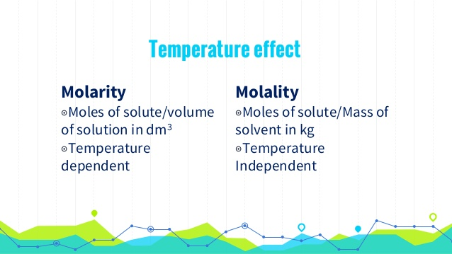

Slide 61
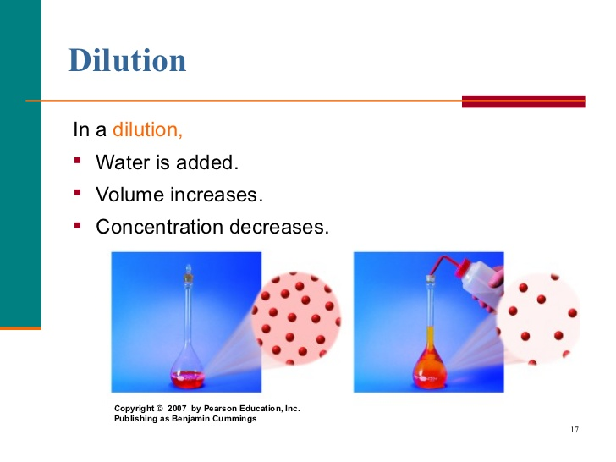

Slide 62
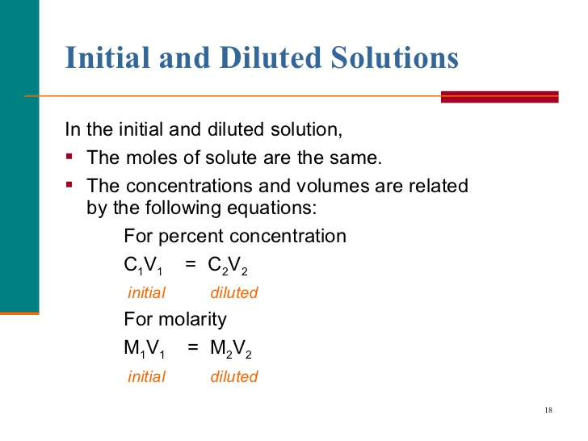

Slide 63
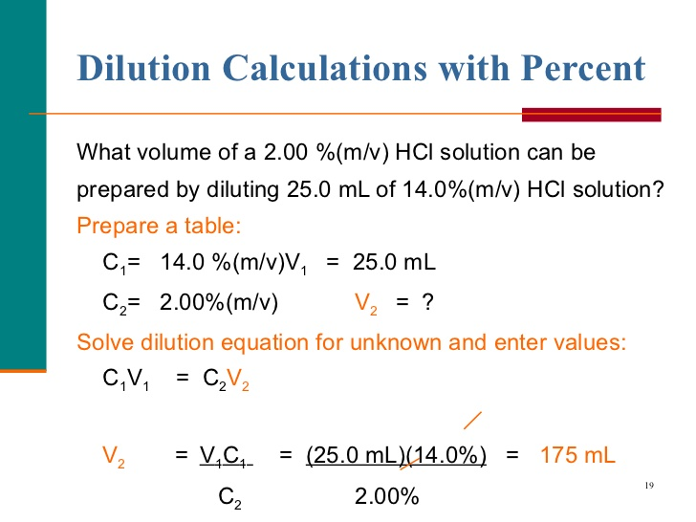

Slide 64
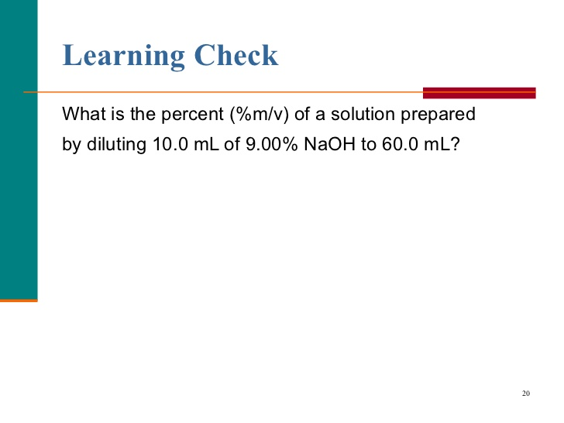

Slide 65
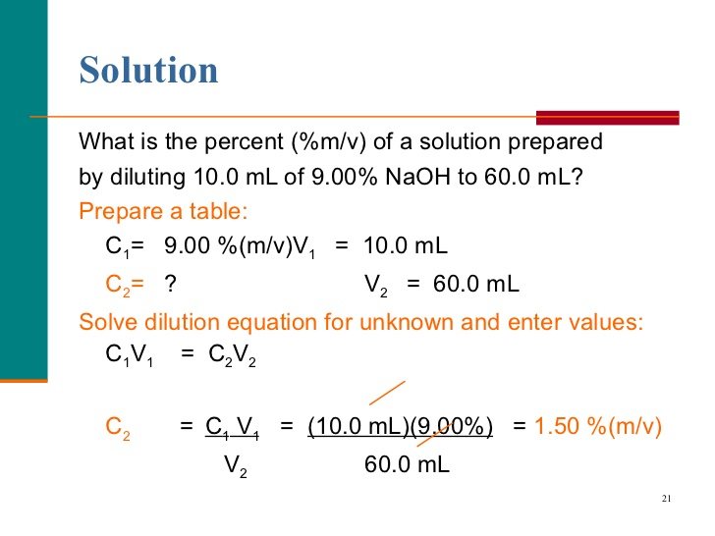

Slide 66
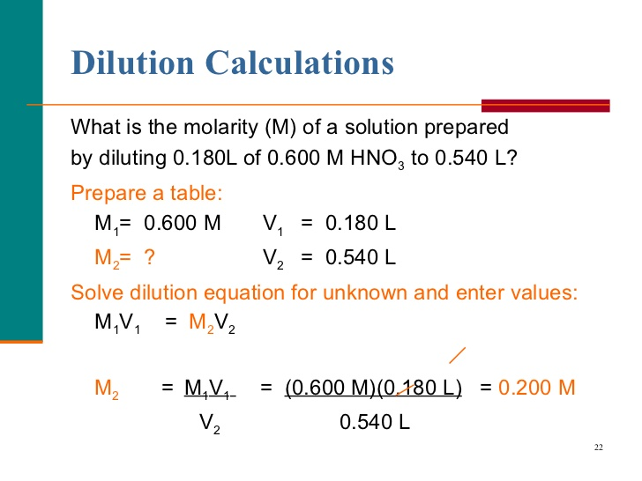

Slide 67
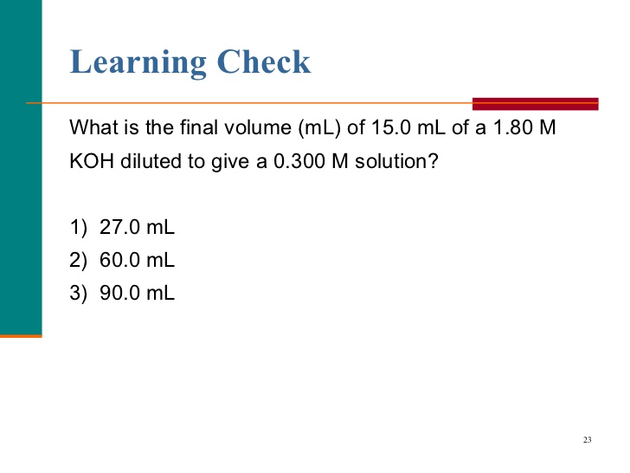

Slide 68
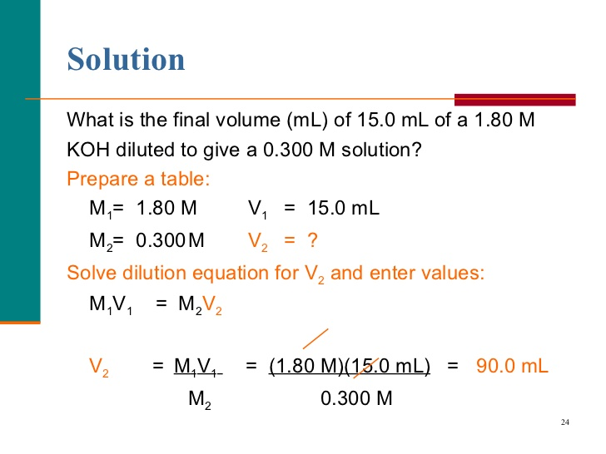

Slide 69
Chapter.5
Food Composition database
FCDB sometimes - Food Composition Tables FCT
Collections of data on the nutritional content of foods.
quantitative analyses…???
multiple uses
sometimes available online…..

Slide 70
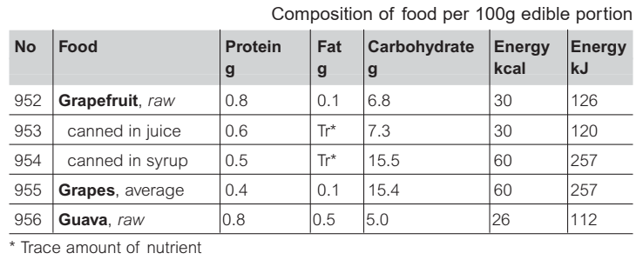

Slide 71
uses FCDBs
assessment of energy and nutrient intake
effect of diet on health and disease outcomes
development of dietary guidelines
plan the food ration requirements
food industry
comparison

Slide 72
Clinical practice
to assess overall dietary balance
to obtain a quantitative estimate of energy and/or specific nutrient intakes
to identify nutritional deficiencies or excesses
to assess the risk of malnutrition
to monitor compliance with dietary advice.

Slide 73
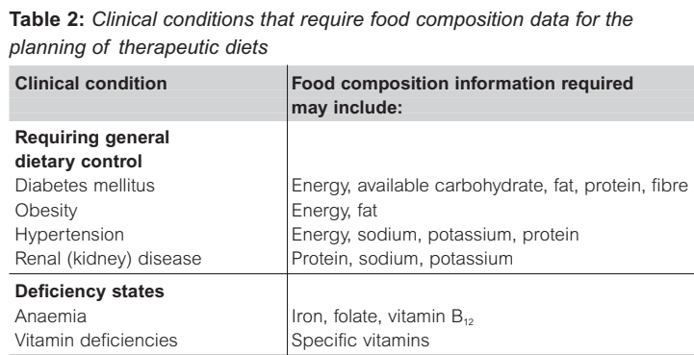
cont…

Slide 74
Fortification with folic acid
development of public health policy
recognised--pregnant women
(NTDs) , such as spina bifida
PLANNING OF INSTITUTIONAL DIETS
links between diet and health
Provided with the way in:
Hospitals
Military
Day-care centers…etc

Slide 75
Strength Vs. weakness –FCDBs.
nutrition labeling, policy making
types of food available and consumed
paired with dietary consumption data
Adequate training on FCD use – comprehend
Differences in the development of FCDBs

Slide 76
Limitations- FCDBs.
poorly understood by users
variability in their composition…???
product formulations are constantly changing

Slide 77
Sources of FCD
○ Scientific literature,
○ Contract lab analysis,
○ Food industry (labeling data)
○ US/non-US databases
○ Calculated from ingredients
○ Estimated based on similar foods

Slide 78
CHAPTER…….6.
Nutrient bioavailability
Bioavailability??
- the proportion of the nutrient- digested, absorbed and metabolized through normal pathways- body function
Understanding nutrient bioavailability:
optimize diets and;
set appropriate nutrient recommendations.

Slide 79
Factors:
External:
food matrix
chemical form of the nutrient
Internal factors:
age, nutrient status and
life stage (e.g. pregnancy)

Slide 80
The bioavailability of macronutrients- CHO, proteins, fats- – is usually very high at
micronutrients, vary widely in the extent they are absorbed and utilized.

