Slide 1
Debre Markos University
College of Health Sciences
Department of Public Health
Lecture on Introduction to Epidemiology
Belayneh Mengist (BSc in PH, MPH in Epidemiology)
Email: belaynehmengist2008@gmail.com

Slide 2
Objectives
After completing this session, the learner will be
able to:
Define epidemiology and describe its components
Understand history and scope of Epidemiology
Distinguish b/n analytic and descriptive Epidemiology
Describe the basic assumptions and uses of Epidemiology
  Describe epidemiological approach in disease causation

Slide 3
Definitions
Health: A state of complete physical, mental and social well-being and not merely the absence of disease or infirmity (WHO,1948)
Disease: A physiological or psychological dysfunction
Illness: A subjective state of not being well
Sickness: A state of social dysfunction

Slide 4
Definitions…
Public health-The science & art of
Preventing disease,
prolonging life,
promoting health & efficiency
through organized community effort (Winslow, 1920)
Clinical medicine- medical care of individuals. Typically these are sick people who have presented for help.

Slide 5
Core functions of public health
Assessment- of health need, by conducting surveillance and specific studies
Leadership - program design, resource allocation and social mobilization
Provision of services- assure availability of quality and comprehensive health services through accessible outlets

Slide 6
Definitions…
Epidemiology
“The basic science of public Health”
Epidemiology is the study of the frequency, distribution and Determinants of diseases and other health related states or events in specified populations and the application of this study to the promotion of health and to the prevention and control of health problems.

Slide 7
Key words in the definition are:
Study: Epidemiology is a scientific discipline.
Frequency
  Reminds us that epidemiology is a quantitative science
Population
  Human population - though epidemiology is concerned with population

Slide 8
“Distribution”
Person (Who)
Young Vs Old
Female Vs Male
Rich Vs Poor
“Place (Where)”
Lowland Vs High land
Urban Vs Rural
Time - When: Seasonal Variations, Long term variations

Slide 9
Determinants
-How: mechanism
- Mode of transmission
Why: cause
- Genetic Vs environmental
- Social and cultural conditions

Slide 10
Scope of Epidemiology
Epidemics
Non-communicable diseases
epidemiologic methods are being applied to:
– Infectious and non infectious diseases
– Injuries and accidents
– Nutritional deficiencies
– Mental disorders
– Maternal and child health
– Congenital anomalies, – Cancer
– Occupational health &Environmental health
– Health behaviors
All disease conditions and related events

Slide 11
Uses of Epidemiology
Monitoring the Public Health
Studying the natural history of disease
Looking for causes of disease, death and disability – etiological agents
Evaluating interventions & health service
Planning health services
Decision making in clinical medicine

Slide 12
Historical Perspective of Epidemiology
Hippocrates - 5th century
Association b/n external environment and personal characteristics and health
Whoever wishes to investigate medicine:
Season of the year
The wind
The water
The earth
Drinking and eating pattern of the people
Exercise and labor

Slide 13
Historical perspective…
John Graunt - 1662
– “The nature and political observation made up on the bills of mortality”
– Analyzed births and deaths in London
• Excess of males born
• Infant mortality is very high
• Seasonal variation for mortality
• Assess the impact of plague

Slide 14
Lind -1747
Used an "experimental" approach to prove the cause of scurvy by showing it could be treated effectively with fresh fruit.
1st clinical trial

Slide 15
William Farr - 1839
Examined mortality & occupation &marital status
Defined: population at risk
Choosing appropriate comparison group
Other factors
o Age,
o Duration of exposure,
o General health status
-Set up a system for routine summaries of causes of death

Slide 16
William……
He said :
‘No variation in the health of the states of Europe is the result of chance.
It is the direct result of the physical and political conditions in which nations live.’
He stressed the need for economic, env’tal & social reform to improve health.

Slide 17
John Snow - 1853
–became famous for his investigations of the cholera epidemics in London.
he decided to remove the pump handle from a water pump which he saw as responsible for local
residents getting infected with cholera

Slide 18
History..
Bradford Hill- 1937
Criteria for establishing causation.
1950's-1970's: successes in:
- fluoride, - tobacco
- blood pressure and stroke
- CHD risk factors,
- toxic shock syndrome
- Legionnaire's disease,
- endometrial cancer and exogenous estrogens.

Slide 19
Evolution of modern Epidemiology
Milestones have been broadly divided into stages:
Sanitary statistics
Infectious disease epidemiology
Chronic disease epidemiology
Multi-level causality

Slide 20
Evolution in epidemiology
(21st Century): focus on risk-factors as well as causal pathways at the societal level and with pathogenesis at the molecular level.
.
(Modern Epidemiology): focus on risk-factor at individual level
-infectious diseases era
focus on environment; the theory that all disease was due to bad air – contaminations (miasma

Slide 21
Fundamental Assumptions in Epidemiology
1. Human disease does not occur at random
=Disease is not randomly distributed throughout a population
2. Human disease has causal & preventive factors that can be identified through systematic investigation
Epidemiology uses systematic approach to study the d/c in disease distribution in subgroups
Allows for study of causal and preventive factors

Slide 22
Major approaches in Epidemiology
Descriptive epidemiology
Analytic epidemiology

Slide 23
Descriptive epidemiology
One of the basic types of epidemiology which is concerned with describing:
the frequency and distribution of diseases and other health related conditions by:
time,
place, and
person.

Slide 24
Major characteristics in Descriptive Epidemiology
Person, place and time.
To describe occurrence of a disease fully, the following questions must be answered.
Who is affected?
Where? and
When do the cases occur?
How many?

Slide 25
Person
People can be categorized with respect to many variables.
Age
Sex
Ethnic group and Race
Other personal variables

Slide 26
Place
Natural barriers
Environmental or climatic conditions, such as temperature, humidity, rainfall, altitude, mineral content of soil, or water supply.
helpful to see the nature and etiology of diseases.
Political boundaries.
- intended for planning and allocation of resources
Urban-rural differences in disease occurrence in terms of migration, style of living and differential environmental exposures is also helpful

Slide 27
Time
There are three major kinds of changes in disease occurrence over time.
1. Secular Trends.
Years or decades. E.g. AIDS, Lung Ca
2. Periodic or cyclic changes. This refers to recurrent alterations in the frequency of diseases. Cycles may be annual or have some other periodicity. E.g. Malaria, meningitis
3. Sporadic –at irregular & unpredictable intervals.

Slide 28
Time…
Secular trend can be due to one or more of factors
1. Change in Diagnostic technique
2. Change in accuracy of enumerating the population at risk
3. Change in age distribution of the population
4. Change of survival from a disease
5. Change in actual incidence of the disease

Slide 29
Analytic Epidemiology
Involves explicit comparison of groups of individuals to identify determinants of health and diseases.
-Testing of hypotheses, w/c in turn may arise from
Case reports
Case series
Laboratory studies
Descriptive epidemiologic studies
Other analytic studies

Slide 30
Major approaches in Epidemiology…
Descriptive and analytic classification is more of a continuum than a dichotomy.
Many studies have both descriptive & analytic aspects.
data collected in one mode may end up being used in the other as well.
Whether a particular study is primarily “descriptive” or “analytic” may be a matter of the investigator’s “stance” in relationship to the study question & data collection.

Slide 31
Features of Epidemiology
Studies are conducted on human population
-Ethics*…….observational studies*
Examines Patterns of events in groups of people
Can establish cause and effect relationship without the knowledge of biologic mechanism
-Smoking and lung cancer
Covers a wide range of conditions
-From infectious to non-infectious
-From simple survey to complex drug trials

Slide 32
Infectious Disease Epidemiology
Definition: The study of circumstances under which both infection and disease occur in a population and the factors which influence their frequency, spread and distribution of infectious diseases.
Is an illness due to a specific infectious agent or its toxic products that arises through transmission of that agent or its products from an infected person, animal or reservoir to a susceptible host, either directly or indirectly through d/t mechanisms.

Slide 33
What is Infectious Disease Epidemiology?
Epidemiology
Deals with population
Risk case
Identifies causes
Infectious Disease Epidemiology
– Two or more populations
– A case is a risk factor
– The cause often known

Slide 34
What is infectious disease epidemiology?
Two or more populations
Humans
Infectious agents
– Helminthes, bacteria, fungi, protozoa, virus, prions
Vector
Mosquito (protozoa-malaria), snails (helminths schistosomiasis)
– Blackfly (microfilaria-onchocerciasis)
Animals
– Dogs and sheep/goats – Echinococcus
– Mice and ticks – Borrelia

Slide 35
What is infectious disease epidemiology?
A case is a risk factor
Infection in one person can be transmitted
to others

Slide 36
What is infectious disease epidemiology?
The cause often known
– An infectious agent is a necessary cause
What is infectious dx epidemiology then used for?
Identification of causes of new, emerging infections.
Surveillance of infectious disease
Identification of source of outbreaks
Studies of routes of transmission and natural history of infections
Identification of new interventions

Slide 37
Transmission
Cases
Index – the first case identified
Primary – the case that brings the infection into a population
Secondary – infected by a primary case
Tertiary – infected by a secondary case
o Susceptible
o Immune
o Sub-clinical
o Clinical

Slide 38
Natural History of Diseases
refers to the progression of a disease process in an individual over time, in the absence of intervention.

Slide 39
.
Broad classification of Diseases
 | Acute | Chronic
Infectious | .?? | ??
Non-infectious | ?? | ??
.

Slide 40
Trends in Epidemiology
Infectious Diseases
Improved SES
Improved control activities
Emerging- HIV/AIDS
Re-emerging – TB, Malaria
Non-infectious diseases

Slide 41
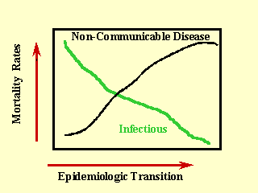

Slide 42
The Spectrum of Illness from Communicable Disease
Unapparent infection
Mild Disease
Severe Disease
Death
No signs or symptoms
Clinical illness with signs and symptoms

Slide 43
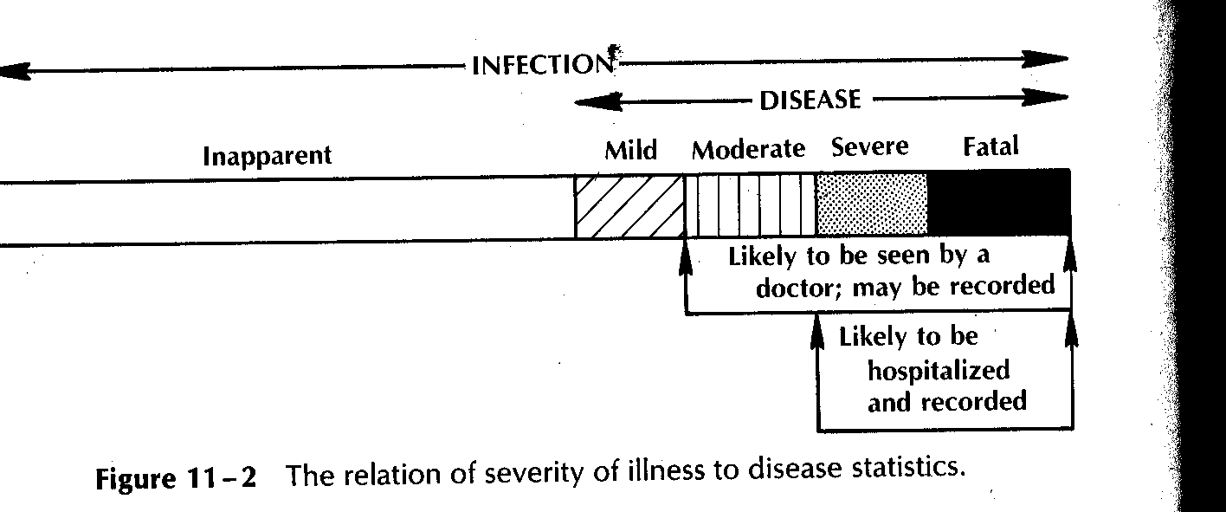
Severity of Illness and disease Statistics

Slide 44
Principles of Disease Causation and Models
Disease Causation
Cause of a disease is an event, condition, or characteristic that preceded the disease event & without w/c the disease event either would not have occurred at all, or would not have occurred until some later time.
The cause of any effect must consist of a constellation of components that act in concert.

Slide 45
Principle of Causation
Two principles of disease causation:
1. The single germ theory and
2. The ecological approach

Slide 46
The Germ theory
Luis Pasteur isolated microorganism.
This discovery led to Koch's postulate in 1877.
It was a set rule for the determination of causation.
Koch's Postulate states that:
The organism must be present in every case.
The organism must be isolated and grown in culture.
The organism must, when inoculated into a susceptible animal, cause the specific disease.
The organism must then be recovered from the animal.

Slide 47
The Ecological approach
Disease (dx) cannot be attributed to the operation of any one factor
The requirement that more than one factor be present for dx to develop is referred to as multiple causation or multifactorial etiology

Slide 48
Ecological approach cont…
In ecological view, an agent is considered to be necessary but not sufficient cause of disease b/c the conditions of the host and environment must also be optimal for a disease to develop.
Example: Mycobacterium tubercle bacilli is a necessary but not sufficient cause for TB

Slide 49
Ecological approach cont…
I. The Agent
A. Nutritive element
Excessive Cholesterol
Deficiency Vitamin, Protein
B. Chemical Agents, Poison, Carbon monoxide (CO)
C. Physical Agents, Radiation
D. Infectious Agents
Metazoa-Hookworm, Schistosomiasis
Protozoa- Amoeba,
Bacteria- M.Tb,
Fungus-Candidiasis,
Virus- Measles

Slide 50
Ecological approach cont…
II. Host Factors: Influence exposure, susceptibility or response to agents.
Genetic
  Age, Sex
Physiologic state
  Pregnancy
  Puberty
  stress
Immunologic condition
  Active immunity: Prior infection, immunization
  Passive immunity: Gamma globulin
Human behavior
  Hygiene, Diet handling

Slide 51
Ecological approach con’t…
III. Environmental Factors: Influence the existence of the agent, exposure, or susceptibility to agent.
A. Biological environment
  Infectious agents
  Reservoirs (man, animal, soil)
  Vectors (flies, mosquitoes)
B. Social environment
  Socioeconomic & political organizations affect level of medical care.
C. Physical environment
  Heat, Light, Water, Air -Industrial wastes
  Chemical agents of all kinds -Indoor air pollution

Slide 52
Ecological approach cont…
It is the interaction of the above factors (agent, host, and environment) which determines whether or not a disease develops, and this can be illustrated using different models.

Slide 53
Disease Models
How do diseases develop?
Epidemiology helps researchers to visualize disease and injury etiology through models.

Slide 54
Traditional model of infectious disease causation

Slide 55
Epidemiologic triangle cont…
The host, agent, and environment can coexist harmoniously.
Disease and injury occur only when there is interaction or altered equilibrium b/n them.
An agent, in combination with env’tal factors, can act on susceptible host to cause disease
Disruption of any link among these three factors can also prevent disease.

Slide 56
The web of causation
The process that generates disease or leads to injury is much more complex.
This complexity is better portrayed in web of causation model
The web of causation was developed especially to enhance understanding of chronic dx, such as cardiovascular dx.
an also be applied to the study of injury, communicable dx.
Web of causation de-emphasizes the role of the agent and highlights other factors that encourage the onset of dx.

Slide 57
Web of Causation
phenotype
social organization
behaviour
microbes
Disease
genes
environment
Unknown factors
workplace

Slide 58
Web of Causation - CHD
Stress
Genetic susceptibility
Medications
Smoking
Lipids
Disease
Gender
Physical activity
Unknown factors
Inflammation
Blood pressure

Slide 59
The Wheel
The wheel consists of a hub (the host or human), which has genetic makeup as its core.
Surrounding the host is the env’t, schematically divided into biological/social/ physical.
relative sizes of the d/t components of the wheel depend upon specific dx under consideration.
For hereditary dx, the genetic core would be relatively large.
In contrast to the web of causation, the wheel model does encourage separate delineation of host and environmental factors.

Slide 60
The Wheel of Causation
Biological Environment
Social Environment
Host (human)
Genetic Core
Physical Environment

Slide 61
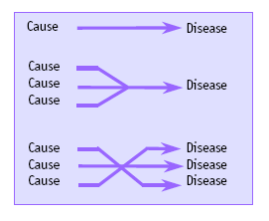
Multiple causation of Disease

Slide 62
Necessary Vs Sufficient Cause
NECESSARY CAUSE: A causal factor whose presence is required for the occurrence of the disease.
SUFFICIENT CAUSE. A causal factor or collection of factors whose presence is always followed by the occurrence of the disease.

Slide 63
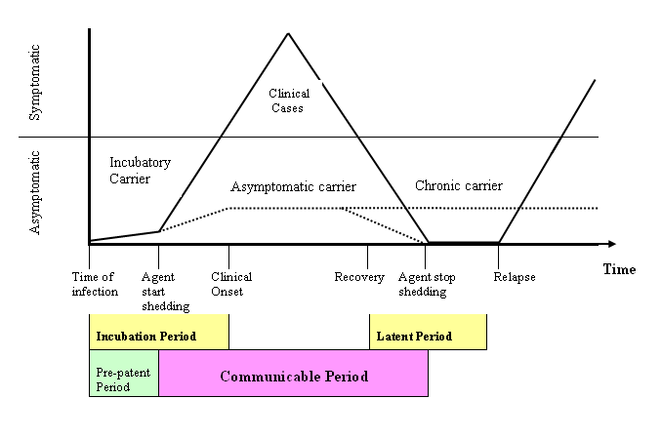
,
Time Course of a Disease in Relation to Its Clinical Expression and Communicability

Slide 64

Iceberg

Slide 65
Outcomes at Each Stage of Infection
Exposure
Infection
Disease
Disease Outcome
Infectiousness
(Infection rate)
Pathogenesis
(Clinical to sub-clinical ratio)
Virulence
(Case-fatality rate,
Hospitalization rate)

Slide 66
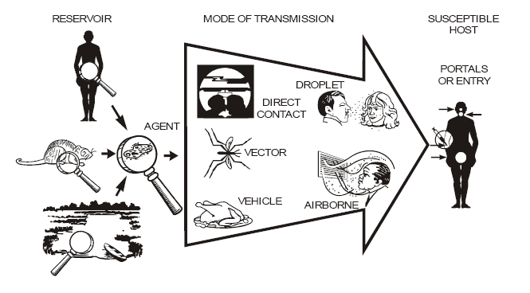
Chain of Infection
Components of Chain of Infection
1. Causative Agent
2. Reservoir host
3. Portal of exit
4. Mode of transmission
5. Portal of entry
6. Susceptible host.

Slide 67
.
Chain of Infection
Horton & Parker: Informed Infection Control Practice (www)
.

Slide 68
Some aspects of person-to-person spread of disease
Three important aspects of person-to-person spread of dx are
generation time,
herd immunity, and
secondary attack rates

Slide 69
Disease Transmission from Infectious host to susceptible host
Infectious
Host
Susceptible
Host
Contact
Transmission depends on:
  -infectious host
  -susceptible host
  -contact definition
  -infectious agent

Slide 70
Generation time
With person-to-person spread, the interval b/n cases is determined by generation time
is the time b/n the receipt of infection by a host and maximal communicability of that host.
In general the generation time is roughly equivalent to the incubation period
However, the 2 terms are not identical.

Slide 71
Generation time cont…
The time of maximal communicability may precede or follow the end of the incubation period.
Incubation period can only be applied to infections that result in manifest disease
Since infectious agents can be spread by persons with unapparent infection as well as clinically manifest cases, the concept of generation time is essential in studies of the dynamics of transmission of infection.

Slide 72
Secondary Attack Rate (SAR)
SAR = | No. of persons exposed (have contact with a known case) who develop disease | X 10^{n}
 | Total no. of susceptible exposed person
A secondary attack rate is a measure of the frequency of new cases of a disease among the contacts of known cases.

Slide 73
Secondary attack rates cont…
The index case is excluded from both numerator and denominator as are co-primaries, cases that are related to the index case so closely in time that they are considered to belong to same generation of cases.
Primary case – is the individual who introduces the dx into the family or group under study, not necessarily the 1st diagnosed case in a family or group.
The first step in assessing SAR is to define for the disease under study the time interval after the index case that would include the secondary cases.

Slide 74
Secondary attack rates cont…
The presumed beginning of infectiousness of the index case is defined as time 0 for each household.
Secondary cases are those with time of onset b/n the end of minimum incubation period (E₁) relative to the beginning of the index case (t=0) and the end of maximum incubation period (E₂) relative to the time of the maximum infectious period of the primary case, t=I.

Slide 75
Secondary attack rates cont…
Co-primary case: a case recorded onset time less than one minimum incubation period, E1, after that of the index case was presumably not infected by them
Tertiary and higher cases are those occurring after the maximum allowable time interval for the secondary cases.
Tertiary case infected by a secondary case

Slide 76
Time periods for estimating the household secondary attack rate.
Onset of primary case
Maximum infectious period
Maximum incubation period
Definition
of time intervals
Minimum
incubation period
Time
secondary cases
Primary
case
Co-Primary
case
Secondary
case
Secondary
case
Tertiary
case
1
2
3
4
5
Onset of
Cases in
Household
Time

Slide 77
Herd immunity
is the resistance of a community (group) to invasion and spread of an infectious agent, based on the immunity of a high proportion of individuals in the community.
The high proportion of immunes prevents transmission by highly decreasing the probability of contact b/n reservoirs and susceptible hosts.

Slide 78

Herd Immunity
Group immunity that limits the spread of disease.
Best operates when:
Single reservoir is involved
Mode of transmission is direct
there is total immunity
No shedding of agent by immune host
Uniform distribution of immunes
No over crowding

Slide 79
Levels of Disease Occurrence
Expected Levels
  Endemic
  Hyper-endemic
  Sporadic
Excess occurrence
  Epidemic/Outbreak
  Pandemic

Slide 80
Levels of disease occurrence
Number of cases
Epidemic/Outbreak
Hyper-endemic
Endemic
Time

Slide 81
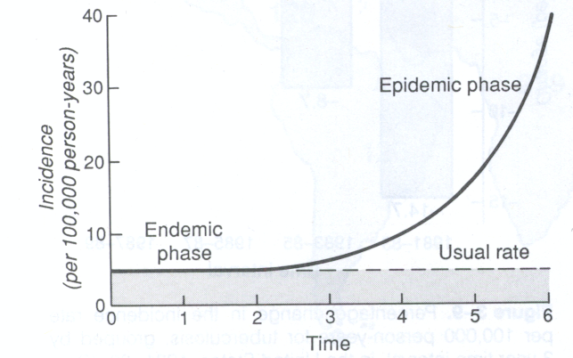
Epidemic development over time

Slide 82
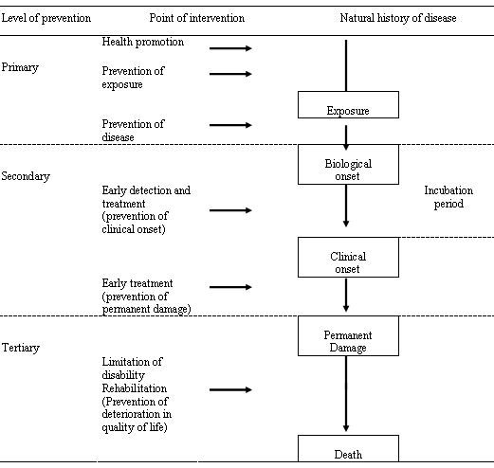
Levels of prevention & Natural History of Disease

Slide 83
Levels of Disease Prevention
Level of Prevention | Stage of disease | Target
Primordial | Existence of underlying condition leading to causation | Total population and selected groups
Primary | Specific causal factors exist | Total population, selected groups and health individuals
Secondary | Early stage of disease | Patients
Tertiary | Late stage of dx (treatment & rehabilitation) | Patients

Slide 84
Advantages and Disadvantages of strategies for primary prevention
 | Population-based | High-risk group
Advantages | Radical Identification of high-risk groups not necessary | Appropriate to individual Subject motivation high Health professionals motivation high Favorable benefit-to-risk ratio
Disadvantages | Small benefits to individuals Poor motivation of subjects Poor motivation of Health professionals Benefit-to-risk ratio can be low | Identifying high risk group is difficult Temporary effect Limited effect

Slide 85
Method for prevention and control of infectious diseases
1. Increasing host resistance
2. Breaking the chain of transmission of infection
3. Inactivating the infectious agents

Slide 86
Method for prevention and control of infectious diseases
1. Increasing host resistance
  Use of vaccines
  Improvement in general health
  - proper nutrition, exercise

Slide 87
Method for prevention and control of infectious diseases
2. Breaking the chain of transmission of infection
Rapid case detection and treatment
Isolation of infectious cases and quarantine of their contacts
Chemo-prophylaxis before or after exposure to an infectious diseases
Control of animals and other biological vectors
Environmental control of air, dust, which may harbor infectious agents
Use of aseptic techniques in management of patients their excretion and secretions
Control of general sanitation- food, water, sewage
Personal measures for avoiding exposure as limiting spread of infectious diseases

Slide 88
Method for prevention and control of infectious diseases
3. Inactivating the infectious agents
Use of physical agents:
    Heat, Cold , Radiation
Use of chemical methods:
    Chlorination of water supplier and sewage effluents

Slide 89
Epidemiological Measures
Measures of frequency
and
Disease Occurrence

Slide 90
Objectives
After completing this chapter, the student will be
able to:
1. Describe advantages of measuring frequency
2. How diseases afflict individuals over time including disease events and states
3. Describe nature and components of epidemiologic transition
4. Calculate& interpret direct & indirect adjusted rates.
5. Determine prevalence & incidence from a given data
6. Calculate measures of association

Slide 91
Why We Measure Disease Frequency ?
Fundamental to epidemiology:
__distribution of dx &to make comparisons.
__Monitoring the health status of the population
__ planning health services.

Slide 92
How do diseases evolve in individuals over time?
Disease states:
o Many diseases afflict an individual over time.
o Some are recurrent – person is diseased for a while, then recovers, but may experience the disease again
Examples:
Malaria
Tuberculosis
Urinary tract infection

Slide 93
How do diseases evolve …
Disease states:
– Some are non-recurrent – an individual can develop the disease at most once
E.g.: hepatitis A
Diseases may be irreversible
Example: HIV,

Slide 94
How do diseases evolve …
At any given time, an individual can be in one of three states:
1. Diseased: Currently afflicted.
2. Susceptible: not currently afflicted, but capable of developing the disease in the next moment of time.
3. Immune: not currently afflicted, & incapable of developing the disease in the next moment (and possibly longer).

Slide 95
How disease evolve…
Over time, individuals may move from one state to another:
Moving from immune to diseased is always impossible, by definition.
Depending on the disease, some other transitions shown may also be impossible, leading to a simpler model.
disease
Susceptible
Immune

Slide 96
How disease evolve….
General Model: Examples:
– Uterine cancer – men are immune.
– Benign prostatic hypertrophy – women are immune.
– Measles – those who become ill (or immunized) develop protective antibodies.
– Polio – oral vaccines confer immunity.
– “At-risk”
• Susceptible individuals are termed “at-risk” (there may be wide variability in risk among them, however).
• Immune and diseased ……… “not at-risk”
– they have no chance of developing the disease in the next moment of time.

Slide 97
How disease evolve…
Example #1: HIV – nobody is immune, and recovery does not occur.
Susceptible Disease
Example #2: Measles – afflicted individuals recover with lifelong immunity, or susceptible individuals may be immunized with vaccine.
Disease
Susceptible
Immune

Slide 98
How dx evolve…
Example #3: Diphtheria – afflicted individuals develop immunity, but it wears off over time. Vaccination is also possible.
Disease
Susceptible
Immune

Slide 99
Tools in Measures of frequency
Counts
Ratio
Proportion
Rate

Slide 100
1. Counts
Common descriptive measure
First step in calculating rates
Essential for service delivery, planning
It is simple counting of cases of a disease

Slide 101
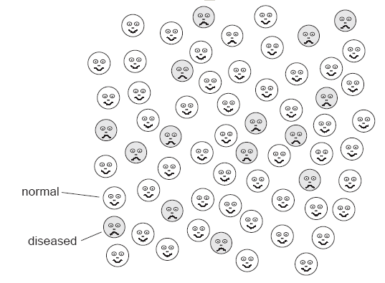
Simple count

Slide 102
Number of Ebola hemorrahagic fever cases by age and sex, Zaire, 1976
Age (years)
Male
Female
Total
< 1
10
14
24
1 - 14
18
25
43
15 - 29
33
60
93
30 - 49
57
52
109
50+
23
26
49
Total
141
177
318
Notes:
Here is a table showing the distribution of cases of Ebola hemorrhagic fever during the original outbreak in 1976. Which age group had the most cases? That is, if you were in charge of planning for a temporary hospital, would you want more adult beds or more cribs for infants?

Slide 103
2. Ratio
A ratio is the relative size of two quantities
It quantifies the magnitude of occurrence of something in relation to another.
One character divided by another
Example: sex ratio
Notes:
A ratio is the relative size of two quantities, calculated by dividing one quantity into another in which there is no specific relationship between the numerator and denominator. The two quantities could be related or totally independent.

Slide 104
Cont….
No specific relationship is necessary between the numerator and denominator (numerator NOT necessarily included in the denominator)
Either the numerator or denominator is set to 1.
n:y or n/n: y/n or 1 to y/n

Slide 105
Example
# beds per doctor
  120 beds/10 doctors
  120/10 : 10/10
  12 beds for a doctor
# students per facilitator
# inhabitants per latrine
Sex ratio: Male / Female
Odds ratio
Rate ratio
Maternal mortality rate

Slide 106
3. Proportion
It is comparison of a part to the whole population
Numerator MUST BE INCLUDED in the denominator
Its result ranges b/n 0 & 1 or (0–100%)
Percentage = Proportion x 100
Notes:
A proportion is one number divided by another number in which those who are included in the numerator must also be included in the denominator. A proportion ranges from 0-1, but this measure can also be expressed as a percentage ranging from 0-100%.

Slide 107
Example
Population
3500 women
6500 men
Proportion of men
= 6500 / (3500 + 6500) = 0.65 or 65 %
Male to female ratio
= 6500 / 6500 = 1.00 to
3500/6500 = 0.54
1 male for 0.54 females

Slide 108
Proportion — Summary
Common descriptive measure
Numerator must be included in the denominator
Can be expressed as a fraction, decimal, or percentage

Slide 109
4. Rate
Rate: measures the occurrence of an event in a population over time. The time component is important in the definition.
  Cervical cancer cases in menopausal women in 2000
  Total number of menopausal women in 2000
It is similar to proportion
But it also adds time dimension

Slide 110
Cont…
Numerator
  number of EVENTS observed in a given time
Observed in 2006
2. Denominator
  Population in which the events occur
  (Population at risk)
  - includes time dimension
Population in 2006

Slide 111
Cont….
Observed in 2006
2
----- = 0.02 / year
100

Slide 112
Example
Mortality rate of tetanus in X country in 2005
  Tetanus deaths: 1050
  Population in 2005: 70 million
  Mortality rate = 1.5/ 100,000 people/ year
Rate may be expressed in any power of 10 (10⁰, 10¹, 10², 10³, 10^{n})
100, 1,000, 10,000, 100,000

Slide 113
Summary
All rates are proportions!
All rates are ratios too!
All proportions are ratios!
But all proportions are not rates!
All ratios are not proportions!

Slide 114
2. Measures of disease occurence
Two types of measures :
1. Prevalence
  Which measures a population’s disease status
  (two forms)
    Point Prevalence 2. Period prevalence
2. Incidence
  Assesses frequency of disease onset (two forms)
    Cumulative incidence/ incidence proportion
    Incidence density or incidence rate

Slide 115
1. Prevalence
Number of cases of a disease at a specific time
Mid-year population at risk at that time
It is proportion of a population affected by a disease
at a given time.
It is expressed as a percentage
HIV/AIDS in X city in 1999:
  Population 210,000
  Cases 3,200
  Prevalence 1.5%

Slide 116
1. Point Prevalence
It is proportion of a population that is affected by disease at a given point in time
The amount of disease in a population usually changes constantly
Thus, may not be useful for assessment of diseases with short generation period
Notes:
The amount of disease in a population is constantly changing. For a stop action look at a single point in time you can use point prevalence.
If you want to know how much disease is present over a longer period of time can use period prevalence.

Slide 117
2. Period prevalence
If we want to know how much disease is present over a longer period of time, period prevalence would be preferred.
Number of cases of a disease at a specific time
Mid-year population at risk at that time
total population
at starting
total population
at the end
+
Mid-year population =
2
Notes:
The amount of disease in a population is constantly changing. For a stop action look at a single point in time you can use point prevalence.
If you want to know how much disease is present over a longer period of time can use period prevalence.

Slide 118
Example
A total of 100 people were at risk of disease x, which has no life time immunity.
t₁
t₂
What is the prevalence of disease X during time t₁?
Notes:
The amount of disease in a population is constantly changing. For a stop action look at a single point in time you can use point prevalence.
If you want to know how much disease is present over a longer period of time can use period prevalence.

Slide 119
Example
A total of 100 people were at risk of disease x, which has no life time immunity.
t₁
t₂
What is the prevalence of disease X during time
between t₁ and t₂?
Notes:
The amount of disease in a population is constantly changing. For a stop action look at a single point in time you can use point prevalence.
If you want to know how much disease is present over a longer period of time can use period prevalence.

Slide 120
2. Incidence
The number of new events of a disease in a defined population at risk within a specified period of time.
Two forms,
    Cumulative incidence
    Incidence density
Number of NEW cases of disease during a specific period
Population at risk during such period

Slide 121
a. Cumulative Incidence
It assumes that the entire population is at risk and is followed up for specified time of period
x
Risk
x
CI = 3/12 per year
= 0.25 per year
x
x disease onset
Month 0
Month12

Slide 122
b. Incidence density (rate)
Number of NEW cases of disease during a period
Total person-time of observation
Rate
Instantaneous concept of rate (= speed)
Denominator:
- the sum of each individual’s time at risk (or free from disease) is counted

Slide 123
Incidence (density) rate
Incidence rate must take into account
  Number of individuals who become ill in a population
  Time periods experienced by member of the population during which the events occur

Slide 124
Person- time
It is sum of length of time period passed free of illness (at risk) by each individual member of study
It accounts for the amount of exposure time of members
It is a good measure in a dynamic cohort
Dynamic cohort is a cohort of people leaving and entering a study at different time of period

Slide 125
Dynamic (open) cohort study
Birth
In-migrants
Death
Out-migrants
E. g. Butajira Rural Health Program

Slide 126
90 91 92 93 94 95 96 97 98 99 00 Time at risk
A
B
C
D
E
6.0
6.0
10.0
8.5
5.0
x
x
Total years at risk 35.5
-- time followed
x disease onset
ID = 2 / 35.5 person- years
= 0.056 person-year

Slide 127
Example
1000 HIV negative persons were tested one year later and 50 were found HIV positive.
What is the incidence rate of HIV infection?
What is the incidence density of HIV infection?
  .
Notes:
Let's do another example. Suppose we have a group of 1000 persons whom we test and find HIV-negative. A year later we test this cohort again and find that 50 are now HIV‑positive.
QUESTION: What is the incidence rate, or cumulative incidence, of seroconversion to HIV positivity?
ANSWER: The answer would be 50 cases per 1,000 population at risk, or 5% in this year.
QUESTION: Now what is the incidence density of seroconversion to HIV positivity?
ANSWER: We cannot determine incidence density in this situation, since we do not know at what time during the year the 50 HIV‑infected persons became so and thus stopped being at risk for becoming infected again.

Slide 128
Example
1000 HIV negative persons were tested one year later and 50 were found HIV positive.
What is the incidence of HIV infection?
  50 cases per 1000 population at risk or 5% in this year
What is the incidence density of HIV infection?
  Do not know the time of infection, thus the time they stopped being at risk of becoming infected.
Notes:
Let's do another example. Suppose we have a group of 1000 persons whom we test and find HIV-negative. A year later we test this cohort again and find that 50 are now HIV‑positive.
QUESTION: What is the incidence rate, or cumulative incidence, of seroconversion to HIV positivity?
ANSWER: The answer would be 50 cases per 1,000 population at risk, or 5% in this year.
QUESTION: Now what is the incidence density of seroconversion to HIV positivity?
ANSWER: We cannot determine incidence density in this situation, since we do not know at what time during the year the 50 HIV‑infected persons became so and thus stopped being at risk for becoming infected again.

Slide 129
Estimating Incidence Density
Assume disease is acquired on the mid-point of the interval between the last disease-free visit and the first visit when disease is diagnosed.
What is the incidence density of HIV infection?
Notes:
In such situations, one often assumes they all became infected on the midpoint day of the year, as that is likely to be the "average" day of infection if the members of the group became infected at random times during the year.
QUESTION: Using the mid-point assumption, what would be the incidence density of HIV infection in this cohort?
ANSWER: The numerator of the incidence density would be the 50 cases of new infection. To calculate the denominator, first take the 950 persons who did not become infected, who would contribute a total of 950 person-years to the incidence density denominator.
Next, take the HIV seroconverters, who are all assumed to have become infected on July 1. They were each at risk for half the year while they remained uninfected, so 50 persons times 1/2 year each equals 25 person-years. So the incidence density would be 50 cases per a total of 975 (950 + 25) person-years. This converts to an incidence density of .05 case per person-year, or 5.1 cases per 100 person-years.

Slide 130
Estimating Incidence Density
Assume disease is acquired on the mid-point of the interval between the last disease-free visit and the first visit when disease diagnosed.
What is the incidence density of HIV infection?
950 persons not infected = 950 person-years
50 persons at risk for ½ year = 50 x ½ = 25 person-years
50 new cases/975 person-years = 0.051 case per person-year, or 5.1 cases per 100 person-years.
Notes:
In such situations, one often assumes they all became infected on the midpoint day of the year, as that is likely to be the "average" day of infection if the members of the group became infected at random times during the year.
QUESTION: Using the mid-point assumption, what would be the incidence density of HIV infection in this cohort?
ANSWER: The numerator of the incidence density would be the 50 cases of new infection. To calculate the denominator, first take the 950 persons who did not become infected, who would contribute a total of 950 person-years to the incidence density denominator.
Next, take the HIV seroconverters, who are all assumed to have become infected on July 1. They were each at risk for half the year while they remained uninfected, so 50 persons times 1/2 year each equals 25 person-years. So the incidence density would be 50 cases per a total of 975 (950 + 25) person-years. This converts to an incidence density of .05 case per person-year, or 5.1 cases per 100 person-years.

Slide 131
Comparing Incidence and Prevalence
Incidence
New cases or events over period of time
Useful to study factors causing disease,
Useful in “risk” estimation
Prevalence
All cases at point/period of time
Useful for measuring size of problem
For planning

Slide 132
Relationship of Incidence to Prevalence
Prevalence depends on both incidence rate and duration of disease
Prevalence = Incidence X Duration
Because prevalence is affected by factors such as migration and duration,
➔ incidence is preferred for studying etiology.
Notes:
Illnesses that you either die from quickly or recover from quickly, therefore a short duration will have a lower prevalence regardless of their incidence.
Illnesses that have a long duration due to low mortality and inability to cure will have a high prevalence even with a low incidence. Examples could include hypertension or adult onset diabetes.
Other examples; Consider putting the page 87 example on board.
Consider water example inflow is migration and incidence, outflow is death, cure, emigration.

Slide 133
Relationship between Incidence, Prevalence and Disease Duration
Incidence
Deaths,
Cure,
Lost to follow up
Prevalence
Notes:
Let us discuss the relationship between prevalence and incidence, and the differences between the two measures. This barrel of water illustrates the relationship. The level of water in the barrel represents the prevalence of, say, Disinfected persons. This level is a function of the rate at which new infections pour into the barrel, representing incidence, as well as the rate at which water leaves the barrel, representing losses to the population due to mortality or moving out of the community.
If no deaths occurred, then the water level, representing the prevalence, would increase over time at the rate of the entry of the incoming water representing new infections. On the other hand, if there were no new cases and water stopped entering the barrel (or new cases of HIV stopped occurring), prevalence would decline as water left the beaker.
If the inflow and outflow to the barrel are balanced, even if at very high levels, then a stable level of water would occur. In such a situation, a stable prevalence rate could mask a very high incidence rate.
Since epidemiologists and public health officials are concerned about preventing new infections, incidence is generally a better measure to use to monitor how rapidly a disease is spreading. The problem with incidence, of course, is that it requires one to follow cohorts of specific individuals through time to measure new onset of disease. In most cases this is very expensive and not practical.

Slide 134
Factors influencing Prevalence
Increased By
By longer duration of the disease
Prolongation of life of patients without cure
Increase in new cases (increase in incidence)
In-migration of cases
Out-migration of healthy people
In-migration of susceptible people
Improved diagnostic facilities (better reporting)
Decreased By
Shorter duration of the disease
High case fatality
Decrease in new cases (decrease in incidence)
In-migration of health people
Out-migration of cases
Out-migration of susceptible people
Improved cure rate of cases)

Slide 135
Special types of Incidence
Type | Numerator | Denominator
Morbidity rate | # cases | Population at risk
Mortality rate | # deaths | Population at risk
Case-fatality rate | # deaths from a disease | Total cases of that disease
Attack rate | # cases during “epidemic” period | Population at risk
Notes:
With both incidence and prevalence, the numerators and denominators can be altered to give specialized types of measures suitable for use in particular circumstances. Several specialized incidence rates that you will be hearing and using in epidemiology are morbidity rate, mortality rate, case-fatality rate, and attack rate.
The morbidity rate for a particular disease is the incidence of cases, that is, new cases of that disease, both non-fatal and fatal, in the population at risk during the specified period of time. In reporting morbidity rates, we often use the total population for the denominator, even if that is not really the precise population at risk. For example, we might say that the measles morbidity rate for 1993 in country X was 26 cases per 100,000 population. Technically, people who have already had measles are no longer at risk for it, but for convenience we still might use the total population in expressing a measles morbidity rate, since no one know the number of non-immune persons who might be the more specific "population at risk".
The mortality rate for a disease is the incidence of deaths in a population at risk due to that disease during a certain time period, and it is calculated similarly to the morbidity rate. A total mortality rate would reflect all causes of deaths. The population at risk is often the total population, but not always. For example, the mortality rate for prostate cancer and for breast cancer are often expressed with denominators of the populations of either men or women, respectively, since these diseases only occur in one sex or the other.
The case-fatality rate is a measure of how deadly a disease is. It is calculated from the number of deaths from a disease divided by all cases of that disease. It is really a ratio so you can also refer to the death to case ration.
Another type of incidence rate used frequently in epidemic investigations is the attack rate. The attack rate is the cumulative incidence of a disease among a particular population at risk during a specific epidemic period. For example, if all 36 students in this class attend the course picnic, and 12 of you get sick with food poisoning

Slide 136
Attack Rate
Cumulative incidence during an outbreak
  Usually expressed for the entire epidemic period, from the first to the last case
Ex: Outbreak of cholera in country X
in March 1999
  Number of cases = 490
  Population at risk = 18,600
  Attack rate = 2.6%

Slide 137
Attack Rate
Number of new cases of a specified disease reported during an epidemic period of time
Population at risk during the same time interval
Secondary Attack Rate
Number of new cases of a specified disease among contacts of known cases
Size of contact population at risk

Slide 138
Mortality rates
When the event under study is death rather than the occurrence of disease, we usually use the term mortality (rate) rather than cumulative incidence.
Crude Death Rate (CDR)
Cause-specific Death Rate
Neonatal Mortality Rate
Perinatal Mortality Rate (PMR)
Infant Mortality Rate (IMR)
Child Mortality Rate (CMR)
Maternal Mortality Rate (MMR)

Slide 139
Crude Death Rate
The crude death rate is the mortality rate from all causes of death for the population. Numerator is all deaths.
Cause-specific Death Rate
The mortality rate from a specified cause for a population. The numerator is the number of deaths attributed to a specific cause.
The denominator for both is the size of the population at the midpoint of the time period.

Slide 140
Infant Mortality Rate
One of the most commonly used measures for comparing health services among nations.
Number of deaths among children under 1 year of age reported during a time period (usually a calendar year)
Number of live births reported during the same period
Usually expressed per 1000 live births.
➔ Poor social, economic and health condition of a nation
Notes:
The question we are answering is “Of the children born alive, how many died before their first birthday?”
The infant mortality rate is also not technically a proper rate, since some of the infants dying this year were actually born in the previous year and are not contained in the denominator of this year's live births. We sometimes use the term index to distinguish such ratios as the maternal and infant mortality rates from true rates.
This is an important indicator as a high rate eg 120/1000 reflects poor social, economic and health conditions.
In Zimbabwe this rate, the IMR was reported to be 100-120 per 1000 live births in 1980, 84-94 in 1984, and 54 in 1988. However, the most recent report from 1999 finds the rate at 65 per 100 live births. In developed countries the rate is usually 10-20 or less.

Slide 141
Other Infant and Child Mortality Rates
Perinatal Mortality Rate:
Number of stillbirths 28 weeks or more and infant deaths under 7 days in a year
Number of live and still births 28 weeks or more in the same year
Expressed as per 1000 live and still births of 28 weeks or more
Neonatal Mortality Rate:
Number of deaths among children under 28 days of age in a year
Number of live births in the same year
Usually expressed per 1000 live births.
➔ Obstetric care (quality and accessibility of maternal service)
Notes:
There are other measures to look at the different times of infancy and childhood.
The PMR of perinatal mortality rate is a measure of the care the mother received in pregnancy (obstetric care) and the newborn baby gets immediately after birth. It can say something about the quality and accessibility of maternity services.
The Neonatal mortality rate, tells us the probability of dying in the first month of life.

Slide 142
Cont….
Child Mortality Rate:
Number of deaths in children aged 1-4 years in a year
Number of children aged 1-4 in the same year
Under-five Mortality Rate:
Number of deaths of children under 5 years in a year
Number of live births in the same year
As the group in the numerator differs from that in the denominator for U5MR, this is actually an index rather than a rate.
Reflects Economic and social conditions to health service
(malnutrition, infectious disease like diarrhea, ARI, measles)
Notes:
Child mortality rate is another important indicator because it measures the deaths among children over 1 year but less than 5 years. These children are at risk of malnutrition and illnesses such as diarrhea, measles, pneumonia, that may reflect economic and social conditions as well as access to health services. In Ethiopia this was estimated to be around 95/ 1000 LB in 2005 EDHS
The under 5 mortality takes into account the previous data and provides the probability of dying between birth and the fifth birthday. As for all the previous measures except CMR it is based on the number of live births.

Slide 143
Maternal Mortality Rate
Number of deaths from pregnancy/ childbirth in a year
Number of live births in the same year
Actually a ratio used to measure mortality associated with pregnancy
Per 10,000 or 100,000
➔Obstetric care, social, economic condition of a nation
Notes:
The maternal mortality rate is really a ratio used to measure mortality associated with pregnancy. The numerator is the number of deaths assigned to causes related to pregnancy during a given time period. The denominator is the number of live births in the same period. Because maternal mortality is much less common than infant mortality the rate is usually expressed per 10,000 or 100,000 live births.
For example, the maternal mortality rate is the number of deaths to women from causes related to pregnancy, childbirth, and the perinatal period, divided by the number of live births, times a constant of 10,000. We use the number of live births, since that is a relatively easy number to come by, whereas the true population at risk would be all pregnant women, including those who never end up giving birth. This reflects the quality of obstetric care as well as social and economic conditions for women. In the 2000 DHS this was estimated at 783 per 100,000 live births. In the 2005 DHS it was estimated at 695 per 100,000 live births. This is in contrast to less than 10 in most developed countries.

Slide 144
Death-to-case ratio
# of deaths of particular disease during specified period
# of new cases of the disease identified during the same period
Note: Cases in numerator may not be represented in the denominator therefore this is a ratio, but not a proportion.

Slide 145
Proportionate mortality
Deaths due to a particular cause X 100
Deaths from all causes

Slide 146
Case fatality rate:
Proportion of persons with a particular condition who die from that condition.
Case fatality rate
Number of deaths due to Disease X
Number of cases due to Disease X
Case fatality rate is a proportion that requires deaths in the numerator to be limited to cases in the denominator.

Slide 147
An Asian country with a population of six million people, there were 60,000 deaths during the year ending December 31, 2007. These included 30,000 deaths occurring in 100,000 people who were sick with cholera.
Mortality rate from cholera in 2007 ?
Case fatality rate from cholera in 2007?

Slide 148
Epidemiological Measure of association
Session Objectives
By the end of session students should be able to:
Compute & Interpret Relative risk (RR) & Odds ratio (OR) as a measure of association b/n exposure and Disease
Compute & Interpret Attributable risk & Population attributable risk
Discuss when OR approximates RR

Slide 149
Measures of association
To test presence or absence of association
( to test whether the association is significant or not )
    Z test , t-test
    Chi square test
2. Strength of association
    OR (in case control & cross sectional studies
    RR (in experimental and cohort studies)

Slide 150
Epidemiological Measure of association
Association
A statistical relationship b/n two or more variables
Risk
Probability of the occurrence of some event(dx) in time
Absolute risk Vs relative risk

Slide 151
Association between exposure & Disease
Question:
Is there an excess risk associated with a given exposure?
Objective:
To determine whether certain exposure is associated with a given disease
Methodology:
Use one of the epidemiologic study designs
Cohort
Case-control

Slide 152
Epidemiological Measure of association
Statistical relationship between two or more events, characteristics, or other variables
􀂇 Statistical relationship between exposure and disease
􀂇 Association is not causation!

Slide 153
Measure of association
Risk Factor
􀂇 A factor (exposure) found to be associated with a health condition
􀂇 an attribute or exposure that increases the probability of occurrence of disease
􀂱 behaviour
􀂱 genetic
􀂱 environmental
􀂱 social
-- time -- person -- plac

Slide 154
Epidemiological Measure of association
2 x 2 Tables in Epidemiology
Used to summarize frequencies of disease and exposure and used for calculation of association
 | Diseased | Not diseased | Total
Exposed | a | b | a+b
Not exposed | c | d | c+d
 | a+c | b+d | a+b+c+d

Slide 155
2 x 2 Tables: Contents of Cells
a = number of individuals who are exposed and have the disease
b = number who are exposed and do not have the disease
c = number who are not exposed and have the disease
d = number who are both non-exposed and non-diseased

Slide 156
A. Relative Risk (RR) or Risk Ratio
RR shows magnitude of association b/n exposure & dx.
Indicates the likelihood of developing the disease in exposed group relative to those who are not exposed.
RR can also be used to compare risks of death, injury, and other possible outcomes of the exposure.
The basic steps in the calculation of a relative risk
1.Incidence rates among the exposed Ie= (a/a+b)
2.Incidence rates among the non-exposed Io= (c/c+d )
RR= (a/a+b)/ (c/c+d)= Ie/Io

Slide 157
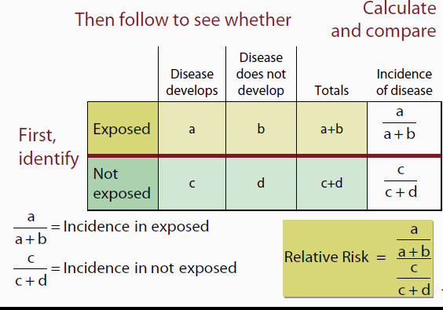

Slide 158
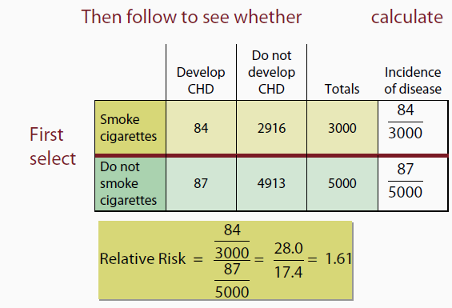
..

Slide 159
RR
Question:
Is the risk of developing Coronary Heart Disease higher in exposed subjects compared to the unexposed subjects?
Based on this evidence;
Answer: Yes risk is high for exposed group

Slide 160
Interpretation
The dx or health related out come is RR times more likely to occur among the exposed to the suspected risk factor than among those with no such exposure.
The larger the Value of RR, the stronger the association b/n the dx in question and exposure to the risk factor.
Values if RR close to 1 indicates that the disease and exposure to the risk factor are unrelated.

Slide 161
RR=1.0 {No association between exposure and disease incidence rates. Rates are identical between groups.}
•RR> 1.0 {Positive association (increased risk) exposed group has higher incidence than non-exposed group}
•RR < 1.0 {Negative association (protective effect) non-exposed group has higher incidence than exposed group}
In general the strength of association can be considered:
High - if the RR is 3.0 or more.
Moderate – if the RR is from 1.5 to 2.9
Weak – if the RR is from 1.2 to 1.4

Slide 162
Example
Table 4: Calculation of RRs from a cohort study of postmenopausal hormone use and CHD with several exposure categories
CHD Person-years
Postmenopausal
hormone use
Ever use 30 54,308.7
Past use 19 24,386.7
Current use 11 29,922.0
Never use 60 51,477.5
Ever Vs never use: RR= 0.5
Past Vs never use: RR=0.7
Current Vs never use: RR=0.3

Slide 163
B. Odds Ratio (OR)
In case control studies, it is usually not possible to calculate the rate of development of disease in the exposed and non-exposed group.
Hence, it is difficult to calculate the RR.
The RR can be estimated, however, by calculating the ratio of the odds of exposure among the cases to that among the controls i.e the OR.

Slide 164
Odds: not a proportion, but the ratio of the # of ways an event can occur relative to the # of ways an event can not occur.
Odds = P(event occurs) = p / ( 1 - p)
1 - P(event occurs)
2. Odds Ratio: Odds of case being exposed
Odds of control being exposed

Slide 165
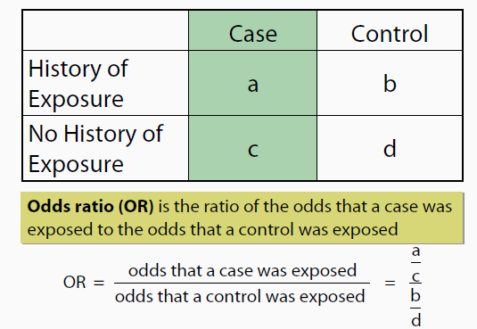

Slide 166
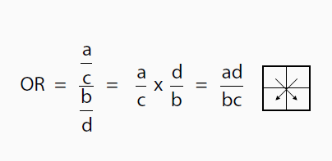
OR is :- A measure of association which quantifies the relationship between an exposure and health outcome from a comparative study; also known as the cross-product ratio.

Slide 167
Example: Is Use of Artificial Sweeteners associated with Bladder Cancer?
Cases Controls
Ever Used 1,293 2,455
Never Used 1,707 3,321
Total 3,000 5,776
ODDS RATIO = 1,293 * 3,321 = 1.025
2,455 * 1,707
The odds that those with bladder cancer had used artificial sweeteners' is 1.025 times greater than those who do not have bladder cancer.

Slide 168
Interpretation of the Odds Ratio…
OR = 1 then exposure NOT related to disease
OR >1 then exposure POSITIVELY related to disease
OR <1 then exposure NEGATIVELY related to disease

Slide 169
Interpretation
The odds of having the disease in question are OR times greater among those exposed to the suspected risk factor than among those with no such exposure.
For rare diseases (with prevalence rate <10%) OR approximates RR.

Slide 170
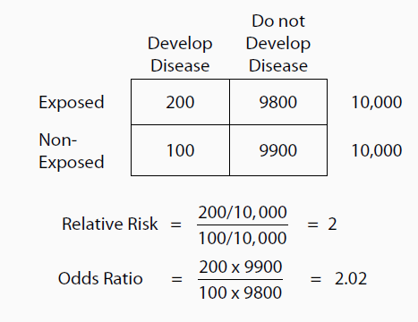
example

Slide 171
Interpreting a Relative Risk or Odds Ratio
Odds Ratio/RR | 95% confidence interval include 1 | Interpretation
1 | Yes | No association
>1 | no | +ve association b/n exposure and outcome at the 5% significance level (the odds of exposure is greater in cases than in controls)
<1 | no | -ve association b/n exposure and outcome at the 5% significance level (the odds of exposure is smaller in cases than controls)
If | 95% confidence interval does include 1 | Association of exposure and outcome is not proved by the study at the 5% significance level

Slide 172
Questions answered
Is the exposure associated with the outcome?
What proportion of the subjects developed the outcome?
Does the risk increase as the level of the exposure increase? (Is there a dose response)

Slide 173
Odds Ratio as estimator of Relative Risk
OR is a valid estimator of RR if:
Cases are incident & drawn from a known & defined population
Controls are drawn from the same defined population & would have been in the case group if they had the dx;
Controls are selected in an unbiased way the dx is rare ( *Rare disease =CI < 0.1)
*Prevalence of exposure among studied controls is similar to that of non-diseased population from cases were drawn.

Slide 174
C. Attributable Risk (AR) (Risk Difference (RD)
AR is a measure of association that provides information about absolute effect or the excess risk of disease of the exposure or the excess risk of disease in those exposed compared with not exposed.
AR is used to quantify the risk of disease in the exposed group that can be considered attributable to the exposure
by removing the risk of disease that would have occurred anyway due to other causes.

Slide 175
AR…
AR is the portion of the incidence of a disease in exposed that is due to the exposure under study.
It is the incidence of a dx in the exposed that would be eliminated if exposure were eliminated.
AR = I_{e} - I_{o}
In a cohort study, AR is calculated as the difference of cumulative incidences (risk difference) or incidence density (rate difference) depending on the study design

Slide 176
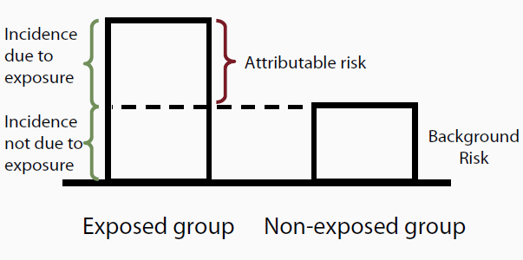

Slide 177
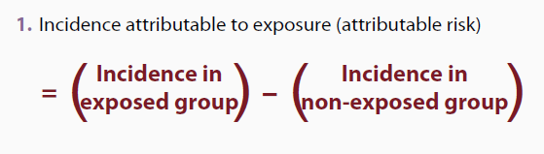

Slide 178
This table shows data from a cohort study of oral contraceptive (OC) use and bacteria among women aged 16-49 years
OCP No ocp | bacturia No bacturia
 | 27 | 455 | 482
 | 77 | 1831 | 1908
 | 104 | 2284 | 2390

Slide 179
AR = 27/482 _ 77/1908
=0.0156
=1560 per 100,000 OC users
Interpretation:
The excess occurrence of bacteria among OC users attributable to their OC use is 1566 per 100,000 OC users

Slide 180
Interpretation of the AR
interpretation of the AR is dependent on assumption that a cause-effect r/s exists b/n exposure & disease
AR=0 - no association And AR > 0 indicates
the number of cases of the dx among the exposed that can be attributable to the exposure itself, or
alternatively, the number of cases of the disease among the exposed that could be eliminated if the exposure were eliminated
Thus, the AR can be useful as a measure of the public health impact of a particular exposure

Slide 181
Attributable Risk (AR) more examples
AR = I_{exposed} – I_{nonexposed} = “Risk Difference”
Develop CHD
I_{SM} = 84 / 3000
= 0.028 = 28.0 / 1000
I_{NS} = 87 / 5000
= 0.0174 = 17.4 / 1000
(background risk)
Smoke | Yes | No
Yes | 84 | 2916 | 3000
No | 87 | 4913 | 5000
AR = (28.0 – 17.4) / 1000 = 10.6 / 1000

Slide 182
Attributable Risk (AR)
AR = (28.0 – 17.4) / 1000 = 10.6 / 1000
Among SMOKERS, 10.6 of the 28/1000 incident cases of CHD are attributed to the fact that these people smoke …
Among SMOKERS, 10.6 of the 28/1000 incident cases of CHD that occur could be prevented if smoking were eliminated.

Slide 183
Possible Outcomes in studying the r/s b/n disease and exposure
1. No association between exposure and disease
AR= 0 RR/OR = 1
2. Positive association b/n exposure & the disease (i.e., more exposure, more disease)
AR> 0 RR/OR> 1
3. Negative association b/n the exposure & the disease (i.e., more exposure, less disease)
AR< 0 (negative) RR/OR< 1 (a fraction)
* Association is dependent on your definition of exposure.

Slide 184
Presence of Association
.
Relative risk ≠ 1
Odds Ratio ≠ 1
Attributable risk ≠ 0
∝
1
0

Slide 185
Attributable Risk Percent (AR%) or Attributable-rate percent, or Attributable Proportion, or Etiologic fraction
Estimates the proportion of the dx among the exposed that is attributable to the exposure, or
proportion of the dx in the exposed group that could be prevented by eliminating the exposure
AR % = (Ie - Io) X 100
Ie

Slide 186
AR%...
AR% estimate the proportion of the disease among the exposed that is attributable to the exposure, or
AR% is the percent of the incidence of a disease in the exposed that is due to the exposure.
It is the percent of the incidence of a disease in the exposed that would be eliminated if exposure were eliminated.
the proportion of the disease in that group that could be prevented by eliminating the exposure

Slide 187
Attributable Risk Percent (AR%)
AR% = (I_{exposed} – I_{nonexposed}) / I_{exposed} = “Etiologic fraction”
Develop CHD
I_{SM} = 84 / 3000
= 0.028 = 28.0 / 1000
I_{NS} = 87 / 5000
= 0.0174 = 17.4 / 1000
(background risk)
Smoke | Yes | No
Yes | 84 | 2916 | 3000
No | 87 | 4913 | 5000
AR% = (28.0 – 17.4) / 28.0 = 37.9%

Slide 188
Attributable Risk Percent (AR%)
AR% = (28.0 – 17.4) / 28.0 = 37.9%
Among SMOKERS, 38% of the morbidity from CHD may be attributed to smoking…
Among SMOKERS, 38% of the morbidity from CHD could be prevented if smoking were eliminated.

Slide 189
Preventive fraction
If the exposure is preventive, so that Ie is less than Io, the AR is meaningless.
However, an analogous measure, the Preventive Fraction (PF), can be defined
In a situation in which exposure to a given factor is believed to protect against a disease (or other outcome), the prevented fraction is the proportion of the hypothetical total load of disease (in the population) that has been prevented by exposure to the factor.
PF = Io – Ie
Io

Slide 190
Population Attributable Risk (PAR)
Among the EXPOSED and NONEXPOSED (e.g. total population):How much of dx that occurs can be attributed to a certain exposure?
This of interest to policy makers and those responsible for funding prevention programs.
PH planners want to be able to anticipate the effect of eliminating the exposure on the population as a whole, rather than just on the exposed part of the population.
Example:
We want to estimate how much of the burden of diabetes among Ethiopians is attributed to obesity.

Slide 191
Population Attributable rate (Risk)…
Estimates the proportion of disease occurring in the total population attributable to the exposure
PAR is the portion of the incidence of a disease in the population (exposed and non exposed) that is due to exposure.
It is the incidence of a disease in the population that would be eliminated if exposure were eliminated

Slide 192
PAR…
It helps to determine which exposures have the most relevance to the health of a community
What is the excess risk among the general population that is due to exposure of interest?
PAR = IT - Io

Slide 193
Population Attributable Risk (PAR)
PAR = I_{total} – I_{nonexposed}
Diabetes
I_{T} = 1100 / 10000
= 0.11 = 110 / 1000
I_{NE} = 250 / 5500
= 0.0455 = 45.5 / 1000
(background risk)
Weight | Yes | No
Obese | 850 | 3650 | 4500
Slim | 250 | 5250 | 5500
1100 | 8900 | 10000
PAR = (110 – 45.5) / 1000 = 64.5 / 1000

Slide 194
Population Attributable Risk (PAR)
PAR = (110 – 45.5) / 1000 = 64.5 / 1000
In the general pop, 64.5 of the 110/1000 incident cases of diabetes are attributed to obesity …
In the general population, 64.5 of the 110/1000 incident cases of diabetes that occur could be prevented with sufficient weight loss.

Slide 195
Population Attributable Risk Percent
It answers:
What proportion of cases is attributed to the actual exposure among the general population?
expresses proportion of dx in the study population that is attributable to the exposure &thus could be eliminated if the exposure were eliminated.
PAR% is the % of the incidence of a dx in the pop. (exposed and non-exposed) that is due to exposure.

Slide 196
PAR%...
It is the percent of the incidence of a dx in the population that would be eliminated if exposure were eliminated.
PAR% = PAR X 100
IT
= IT-I0
IT

Slide 197
Population Attributable Risk Percent
PAR% = (I_{total} – I_{nonexposed}) / I_{total}
I_{T} = 1100 / 10000
= 0.11 = 110 / 1000
I_{NE} = 250 / 5500
= 0.0455 = 45.5 / 1000
(background risk)
Diabetes
Weight | Yes | No
Obese | 850 | 3650 | 4500
Slim | 250 | 5250 | 5500
1100 | 8900 | 10000
PAR% = (110 – 45.5) / 110 = 58.6%

Slide 198
Population Attributable Risk Percent
PAR% = (110 – 45.5) / 110 = 58.6%
In the populaiton, 59% of the cases of diabetes may be attributed to obesity in the population…
In the population, 59% of the cases of diabetes could be prevented if Tampa residents lost sufficient weight.

