Slide 1
Maternal, Infant & Child Nutrition (HNFS 2104)
Yidersail Hune ( BSc, MSc in Applied Human Nutrition)
Debremarkos university College of health science, department of human nutrition and food science
May 29 /2020

Slide 2
Course Description
The course is designed to acquaint students with knowledge of integrated and holistic approach to promote better nutrition; nutrition and physiological interrelationship during pregnancy, lactation, infancy, child hood

Slide 3
Course All Over Objectives
Students will be able to :
Understand healthy maternal, infant and child feeding practices
Understand the factors that may affect nutritional status and development in children
Review the issues associated with pre-conceptual nutrition???,nutrition during pregnancy and infant nutrition using current expert recommendations and recent research.
Examine a maternal or infant nutrition issue in depth
Identify the major underlying causes of malnutrition
Understand impact of malnutrition
Impart optimal infant and child feeding practices
Identifies strategies and services to prevent and minimize maternal and child mortality

Slide 4
Topics will be covered
Introduction
Nutrition during pregnancy and lactation
Nutrition during infancy
Nutrition of pre-school children
Nutrition in school aged children
Essential nutrition action (ENA)
Harmful traditional practices
Assessment of nutritional status –reading assignment

Slide 5
Teaching & Learning and Assessment Methods:
  Lectures
  Group discussions
  Tutorials (optional
  Seminars(optional)
  Assignments
Assessment/ Evaluation:
  Continuous assessment( assignment, quiz, test, presentation and class activity)
  Final written examination

Slide 6
References
1.Judith E.Brown.Nutrition through the life cycle
2.Understanding nutrition,11th edition
3.Different guidelines

Slide 7
Introduction
Objectives
At the end of this lesson you will be able to:
Describe the reasons why study maternal, infant and child nutrition
Mention the life cycle approach to nutrition
The magnitude of maternal and child nutrition in sub Saharan Africa

Slide 8
Introduction
Contents:
Why study maternal, infant and child nutrition
The life cycle approach to nutrition
The issue of maternal and child nutrition in sub Saharan Africa

Slide 9
Why study maternal, infant and child nutrition
Many aspects of nutritional status, such as dietary intake, supplement use, and weight change, influence the course and outcome of pregnancy.
The fetus is not a parasite; it depends on the mother’s nutrient intake to meet its nutritional needs.
Periods of rapid growth and development of fetal organs and tissues occur during specific times throughout pregnancy.

Slide 10
Cont.…
Essential nutrients must be available in required amounts during these times for fetal growth and development to proceed optimally.
The risk of heart disease, diabetes, hypertension, and other health problems during adulthood may be influenced by maternal nutrition during pregnancy.

Slide 11
Cont.…
Reduction in infant & child mortality, but surviving children are not healthy.
Relative decrease in rate of malnutrition, but the absolute numbers of children are increasing every year in millions
The prevalence of LBW is increasing & no improvement has been made
In LIC women die from pregnancy related complications

Slide 12
Cont.…
Magnitude of the Problem
  450 million women are stunted most in Africa.
  Worldwide anaemia = 59% of pregnant & 47% of all women
  Over 2 m women-blind due to VAD
  250 m women-at risk of IDD
  Globally, about 178 million children are stunted.
  90% live in 36 countries including Ethiopia (Black, 2008).

Slide 13
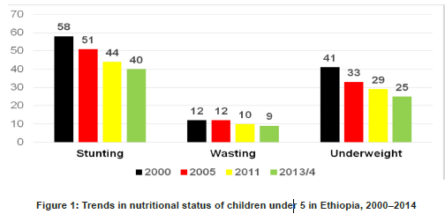
Cont.….
Under-nutrition accounting for 50 % of all childhood deaths in Ethiopia.
Can be minimized:

Slide 14
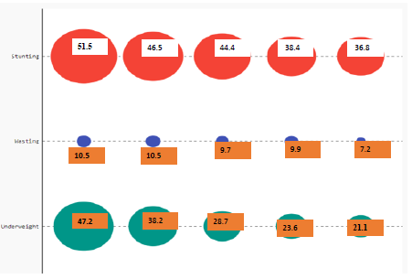
Cont.… according to mini EDHS/2019

Slide 15
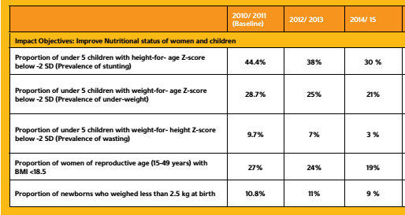
Cont.…

Slide 16
Cont.…
2020 TARGETS(Ethiopia)
Reduce the prevalence of anemia in adolescent girls from 30% to 15%.
Reduce the prevalence of anemia among women of reproductive age (15-49 years) from 19.3% to 12%.
Reduce the prevalence of anemia among pregnant women from 22% to 14%.
Reduce the proportion of women of reproductive age with BMI <18.5% from 27% to 16%.
Reduce the proportion of newborns with low birth weight (less than 2.5kg at birth) from 11% to 5%.

Slide 17
Cont.…
Reduce stunting prevalence among under-five children from 40% to 26%. ???
Reduce the prevalence of underweight among under-five children from 25% to 13%.
Reduce the prevalence of wasting among under-five children from 9% to 4.9%.
Reduce the prevalence of low birth weight (less than 2.5kg at birth) from 11% to 5%.
Reduce the prevalence of anemia in under-five children from 39% to 24%.
Increase the proportion of children 6-23 months with minimum dietary diversity score from 5% to 40%.

Slide 18
Cont.…
Maternal, infant and child nutrition is a parts of SDGs.
Parts of “sekota” declaration in Ethiopia.
Commitment to end child under nutrition in Ethiopia by 2030
  Zero stunting in children under 2 years old
  100% access to adequate food all year round

Slide 19
Cont.…
Generational effect
Under nutrition has life-span & generation-span result
Under nutrition often starts in-utero due to maternal under nutrition & extend throughout the life cycle
A foetus with IUGR is unlikely to catch up at the later life
Most growth failure occurs from before birth until 2-3 yrs.
A child who is stunted at two years of age is likely to remain stunted throughout life

Slide 20
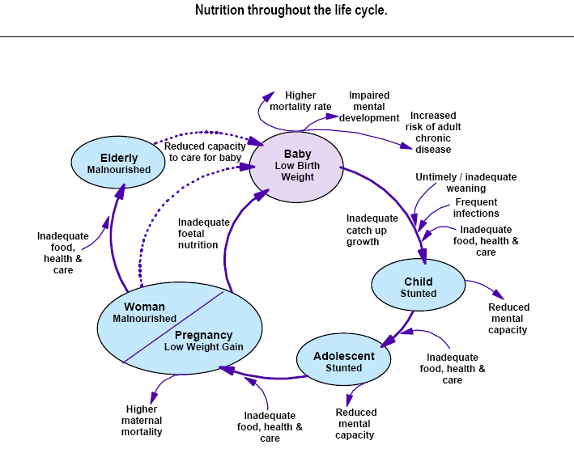
Cont.…
Nutrition throughout the life cycle????

Slide 21
Cont.…
The causes of malnutrition are interconnected
Sever Consequences
Increases morbidity in children
20 to 25% of the global burden of disease in children
Increased mortality
45 to 65% of child deaths due to mild to severe malnutrition
~54% of deaths of children under 5 years in developing countries were accompanied by low Weight for age

Slide 22
Cont.…
Uncatchable – difficult to compensate
Findings from different study showed that:
Children of poor families adopted to a wealthy families in infancy were shorter adults than their peers who were not stunted at the time of adoption
The improved early childhood growth in them hastened menarche & shortened the period of rapid premenarcheal growth.

Slide 23
Cont.…
(FOAD) fetal origin of adulthood disorders
Malnutrition during fetal life and low birth weight
NCCDs
Short “window of opportunity” for improving critical nutrition

Slide 24

Cont.…
A smart investment
Nutrition investments
can break the cycle of poverty
increase a country’s GDP by at least 2 to 3% annually.
Investing $1 in nutrition can result in
  a $30 return in increased health, schooling and economic productivity.

Slide 25
Cont.….
Experts agree
The Copenhagen Consensus 2012 Expert Panel of world renowned economists identified the smartest ways to allocate money to respond to ten of the world’s biggest challenges.
They agreed that fighting malnutrition should be the top priority for policy-makers & philanthropists.
Notes:
Challenges were :
Armed Conflict
Biodiversity
Chronic Disease
Climate Change
Education
Hunger and Malnutrition
Infectious Disease
Natural Disasters
Population Growth
Water and Sanitation

Slide 26
The life cycle approach to nutrition
Child growth failure
Low birth
weight babies
Early
pregnancy
Low weight &
height in teens
Small adult women
ACC/SCN, 1992

Slide 27
The issue of maternal and child nutrition in sub Saharan Africa
In Ethiopia:
One-quarter of women age 15-49 in Ethiopia are anaemic
Only 58% of infants are exclusively breastfed for the first 6 months.
anemia on children age 6-59 months were 57%
Stunting in children 38%
Wasting 10% and underweight =24%
22% of women are thin (body mass index or BMI < 18.5)
8% of women are overweight or obese
5% pregnant women took iron supplements for 90+ days as recommended.

Slide 28
Cont.…
Percent of children age 6-23 months
Notes:
For breastfed children, 13% of breastfed children had an adequately diverse diet and had been given foods from the appropriate number of food groups, while 45% had been fed the minimum number of times appropriate for their age. The feeding practices of only 8% of children age 6-23 months meet the minimum standards for all three IYCF feeding practices.
For non-breastfed children, 20% had a diverse diet, 49% were fed the minimum number of times, and 4% met the minimum standards for all 3 IYCF feeding practices. For all children, 14% had a diverse diet, 45% ate the appropriate number of times, and 7% met the minimum standards for all 3 IYCF feeding practices.

Slide 29
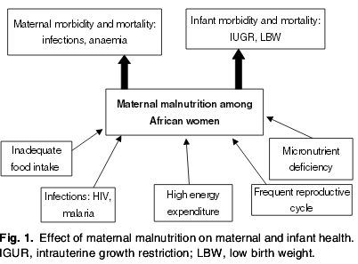
Cont.…

Slide 30
THANK YOU
if you have any Questions????? You can ask by using this email address yidhune2009@gmail.com

Slide 31
Nutrition during pregnancy and lactation
Physiological adjustments during pregnancy
Factors that influence maternal and infant outcomes
Energy and nutrient needs during pregnancy and lactation
Weight gain during pregnancy
Effect of maternal malnutrition on fetus

Slide 32

Nutrition during pregnancy
“Good nutritional status maintained before and throughout pregnancy decreases the risk of birth defects, suboptimal fetal growth and development, and chronic health problems later in life.”(Position of the American Dietetic Association)
Notes:
Missed menstrual period
Excessive tenderness in her breasts
Fatigue
Change in appetite
Morning Sickness
May have spotting or light, irregular menstrual flow
Urine Test: This is a quick simple test that test for the hormone HCG within the females urine. HCG is released by a women when the egg attaches to the lining of the Uterus. HCG is only released when a female is pregnant. (EPT = Early Pregnancy Test)

Slide 33
Nutrition during pregnancy
Nutrient requirements during pregnancy are not static.
They vary during the course of pregnancy depending on:
      prepregnancy nutrient stores
      body size and composition
      physical activity levels
      stage of pregnancy
      and health status
Healthful diets established during pregnancy can last well beyond pregnancy and benefit health for life.

Slide 34
Cont.…
Studies showed that diet quality during pregnancy, assessed using diet histories, was strongly related to newborn health status.
Newborns having optimal physical condition were found to be much more common among women consuming high-quality diets
Whereas those with the poorest physical condition were born to women with the poorest-quality diets.

Slide 35
Cont.…
High-quality pregnancy diets by themselves were responsible for robust newborn health,
prenatal diet quality may strongly influence pregnancy outcome.
The 9 months of pregnancy represent the most intense period of growth and development humans ever experience.

Slide 36
Cont.…
How well these processes go depends on many factors, most of which are modifiable.
Of the factors affecting fetal growth and development that are within our control to change, nutritional status stands out.
At no other time in life are the benefits of optimal nutritional status more obvious than during pregnancy.

Slide 37
The Status of Pregnancy Outcomes
The status of reproductive outcomes assessed through examination of a particular set of vital statistics data called natality statistics.
Natality statistics summarize important information about the occurrence of pregnancy complications and harmful behaviors.
In addition to infant mortality (death) and morbidity (illness) rates within a specific population.
These data are used to identify problems in need of resolution and to identify progress in meeting national goals for improvement in the course and outcome of pregnancy.
Notes:
natality means “related to birth”).

Slide 38
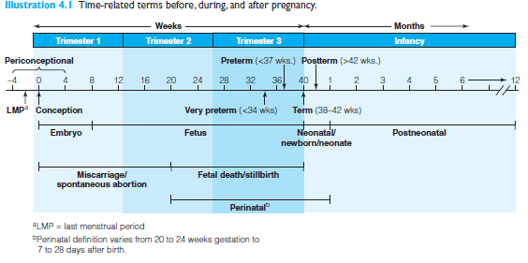
Cont.…

Slide 39
Cont.….
Infant Mortality
“Infant mortality is a mirror of a population’s physical health and socioeconomic status.”
Infant mortality reflects the general health status of a population to a considerable degree.
B/C so many of the environmental factors that affect the health of pregnant women and newborns also affect the health of the rest of the population.
Notes:
In 2016, infant mortality rate for Ethiopia was 41 deaths per 1,000 live births. Infant mortality rate of Ethiopia fell gradually from 144.2 deaths per 1,000 live births in 1967 to 41 deaths per 1,000 live births in 2016

Slide 40
Cont.…
Low Birth Weight, Preterm Delivery, and Infant Mortality
Infants born low birth weight or preterm are at substantially higher risk of dying in the first year of life than are larger and older newborns.
Deaths and illnesses associated with low-birth-weight and preterm infants can be reduced through improvements in the birth weight of newborns.

Slide 41
Physiology of Pregnancy
Conception triggers thousands of complex and sequenced biological changes that transform two united cells into a member of the next generation of human beings.
Pregnancy begins at conception; that occurs approximately 14 days before a woman’s next menstrual period is scheduled to begin.
  averages 38 weeks, or 266 days, in length.
Most commonly, 40 weeks (280 days) because it is measured from the date of the first day of the last menstrual period (LMP).

Slide 42
Cont.…
Changes in maternal physiology during pregnancy are so profound that they were previously considered abnormal and in need of correction.

Slide 43
Cont.…
Maternal physiological changes occurred to promote fetal growth and development
Affects the entire maternal physiological systems in general
These changes are generally categorized as maternal anabolic and catabolic changes
Maternal anabolic changes:
Occurs in the first half of pregnancy (0-20 weeks)
Builds mothers capacity to deliver large quantity of blood, oxygen and nutrients to the fetus in the second half of pregnancy

Slide 44
Cont.…
10% of fetal weight gain
Growth of some maternal organs occur
Increased food appetite and food intake (positive calorie balance)
Decreased exercise tolerance
Increased levels of anabolic hormones

Slide 45
Cont.…
Maternal catabolic changes:
Timed to deliver the stored nutrients
Mobilization of fat and other nutrients decreased
Decreased glycogen stores
Increased appetite and food intake decline somewhat near to term
Supports rapid fetal weight gain (90%) in the second half of pregnancy

Slide 46
Cont.…

Slide 47
Normal changes in maternal physiology during pregnancy
1.Blood Volume Expansion(1.25l)
• Blood volume increases 20%
• Plasma volume increases 50%
• Edema (occurs in 60–75% of women)
2.Hemodilution
• Concentrations of most vitamins and minerals in blood decrease

Slide 48
Cont.…
3. Blood Lipid Levels
• Increased concentrations of cholesterol, LDL
Cholesterol, triglycerides, HDL cholesterol
4. Blood Glucose Levels
• Increased insulin resistance (increased plasma levels of glucose and insulin)

Slide 49
Cont.…
5. Maternal Organ and Tissue Enlargement
• Heart, thyroid, liver, kidneys, uterus, breasts, adipose tissue
6. Circulatory System
• Increased cardiac output through increased heart rate and stroke volume (30–50%)
• Increased heart rate (16% or 6 beats/min)
• Decreased blood pressure in the first half of pregnancy (29%), followed by a return to non pregnancy levels in the second half.

Slide 50
Cont.…
7. Respiratory System
• Increased tidal volume, or the amount of air inhaled and exhaled (30–40%)
• Increased oxygen consumption (10%)
8. Food Intake
• Increased appetite and food intake; weight gain
• Taste and odor changes, modification in preference
for some foods
• Increased thirst

Slide 51
Cont.…
9. Gastrointestinal Changes
• Relaxed gastrointestinal tract muscle tone
• Increased gastric and intestinal transit time
• Nausea (70%), vomiting (40%)
• Heartburn
• Constipation
10. Kidney Changes
• Increased glomerular filtration rate (50–60%)
• Increased sodium conservation
• Increased nutrient spillage into urine; protein is con served
• Increased risk of urinary tract infection
Notes:
Constipation =due to progesterone effect

Slide 52
Cont.….
11. Immune System
• Suppressed immunity
• Increased risk of urinary and reproductive tract infection
12. Basal metabolism
• Increased basal metabolic rate in second half of pregnancy
• Increased body temperature
13. Hormones
• Placental secretions of large amounts of hormones needed to support physiological changes of pregnancy

Slide 53
Cont.…
HCG
Stimulates the corpus luteum to produce progesterone and estrogen to maintain early pregnancy.
Placenta also produce the two hormones after the first two months of pregnancy
Progesterone
Maintains the implant
Stimulates the growth of the endotulium and its secretion of nutrients
Promote lipid deposition
Breast development
Relax the smooth muscle of the blood vessels (uterine) and gastro-intestinal tract
Notes:
The corpus luteum (Latin for "yellow body"; plural corpora lutea) is a temporary endocrine structure in female ovaries and is involved in the production of relatively high levels of progesterone, moderate levels of estradiol, inhibin A and small amounts of estrogen.^{[1][2]} It is the remains of the ovarian follicle that has released a mature ovum during a previous ovulation.^{[3]} It is colored as a result of concentrating carotenoids (including lutein) from the diet and secretes a moderate amount of estrogen to inhibit further release of gonadotropin-releasing hormone (GnRH) and thus secretion of luteinizing hormone (LH) and follicle-stimulating hormone (FSH). A new corpus luteum develops with each menstrual cycle.

Slide 54
Cont.…
Estrogen
Increase lipid formation and storage
Protein synthesis
Increase uterine blood flow and breast duct development
Human chorionic somatotropin (hCS)
Increase maternal insulin resistance to maintain glucose availability for fetal use
Promotes protein synthesis
Liberation of energy from fat, special importance in second half pregnancy

Slide 55
11.CHO metabolism
Glucose is the preferred fuel source for the fetus, even though fats can be utilized for energy
Changes are made to promote the availability of glucose to the fetus
Accomplished by maternal physiological change named Maternal insulin resistance: ‘diabetogeniceffect of pregnancy’ in the third trimester of pregnancy
In the first half of pregnancy: estrogen and progesterone increases insulin production thereby conversion of glucose to glycogen and fat

Slide 56
Cont.…
Second half of pregnancy:
HCS and prolactin decreases conversion of glucose to glycogen and fat
Insulin resistance let the mother to use fats for energy production and decrease maternal utilization of glucose
The plasma triglyceride, free fatty acid, ketones are elevated in fasting

Slide 57
Cont.…
But, prolonged fasting will prone the fetus to utilize ketone bodies
Also, fetal use of ketone bodies is observed in mothers with poorly controlled Diabetes Mellitus and experiencing weight loss
Associated with impaired growth and intellectual development of the offspring

Slide 58
Reading assignment
Protein and fat metabolism during pregnancy

Slide 59
Growth and development during pregnancy
A whole new life begins at conception
Organ systems develop rapidly, and nutrition plays many supportive roles
      Placental development
      Fetal growth and development

Slide 60
Placental development
Develops from the embryo tissue in the uterus in the early days of pregnancy
The maximal rate of placental growth is timed to precede that of the fetal growth.
Functions
Hormone and enzyme production
Nutrient and gas exchange
Removal of waste products from the fetus
Generally, it performs the respiratory, absorptive, and excretory functions that the fetus's lungs, digestive system, and kidneys will provide after birth.
Notes:
The word placenta is derived from the Latin word
for cake. The placenta, with its round, disklike shape
(Illustration 4.5), looks somewhat like a cake—the more
so the more active the imagination
this is to ensure that placenta is fully prepared to for high level of functioning that will be needed as fetal weight increases most rapidly

Slide 61
Cont.…

Slide 62
Cont.…
It is a barrier to the passage of maternal red blood cell, bacteria and many large proteins
Generally, lipids and molecules with little or no charge (H2O) pass through the placenta more easily
However, excess levels of some vitamins, alcohol, drugs, and certain viruses can cross placenta

Slide 63
Cont.…
Two associated structures also form
        Amniotic sac
        And umbilical cord
These three structures play crucial roles during pregnancy and then are expelled from the uterus during childbirth
Placenta uses 30-40% of glucose delivered by maternal circulation.
If the supply is low, placenta utilizes nutrients to fulfill its requirement before reaching to fetus.
Notes:
Size and health of placenta Vs birth outcome????

Slide 64
Fetal growth and development
Fetal development begins with the fertilization of an ovum by a sperm
Three stages:
Zygote
Embryo(two to eight weeks after conception)
Fetus(eight weeks after conception to term)

Slide 65
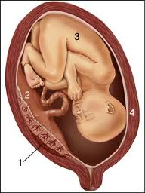
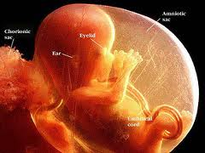
Cont.…
Placenta
Amniotic fluid

Slide 66
Cont.…
Fetal growth is the most rapid growth in human growth and development
The most intense growth occurs during the first 2-3 months following conception????
Critical period/sensitive period: fetal growth proceed along genetically determined pathways in which cells are programmed to multiply, differentiate and establish long term functional levels
Majority of organs and tissues form
Explained by Hyperplasia: an increase in cell multiplication

Slide 67
Cont.…
One way street, because it is not possible to reverse or take remedies for errors once happening
Brain is the first organ that develops along with CNS, thus in case of low energy, nutrient and oxygen availability priority is given
Neural tube, the beginning structure, develops to brain and spinal cord 3-4 weeks after conception

Slide 68
Cont.…
Successful development of the neural tube depends, in part, on the vitamin folate
If folate supply impaired during this period, permanent defects are inevitable
Any failure of the neural tube to close or to develop normally results in central nervous system disorders, such as spinal bifida and anencephaly
Heart and adrenal gland are the next…..

Slide 69
Cont.…

Slide 70
Weight gain in pregnancy
Normal weight gain in singleton pregnancy-12kg
Normal weight gain in multiple pregnancy- up to 18 kg
Rates of low birth weight are higher in women gaining
too little weight during pregnancy
Weight gained during pregnancy appear to be as important to newborn outcomes as is total weight gain.
For underweight and normal weight women, rates of gain of less than (0.25 kg) per week in the second half of pregnancy,
Notes:
Weight gain during pregnancy is an important consideration
because newborn weight and health status tend to increase as weight gain increases
Rate of Pregnancy Weight gain:
Weight gained during pregnancy appear to be as important to newborn outcomes as is total weight gain.
Low rates of gain in the first trimester of pregnancy may down-regulate fetal growth and result in reduced birth weight and thinness
For underweight and normal weight women, rates of gain of less than (0.25 kg) per week in the second half of pregnancy,

Slide 71
Cont.…
and of less than (0.37 kg) per week in the third trimester of pregnancy, double the risk of preterm delivery and SGA newborns.
For overweight and obese women, rates of gain of less than (0.25 kg) per week in the third trimester also double the risk of preterm birth.
Notes:
Rate of weight gain is generally highest around mid-pregnancy which is prior to the time the fetus gains most of its weight

Slide 72
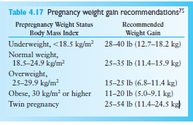
Cont.….

Slide 73
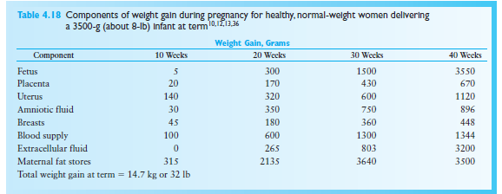
Cont.…

Slide 74
Causes of maternal malnutrition
Insufficient supply of the necessary food due to:
  lack of food production,
  unavailability of food on the market
  or lack of money to purchase the available food on the market.
Lack of knowledge about food, nutrition, safe and sanitary preparation, preservation of food, healthy life style at:
  individual,
  household,
  community
  and national levels.
Infectious disease

Slide 75
Cont.…
Available land devoted to cash crop, too little for food crops
The amount of food for human consumption varies each year in Africa.
Uneven distribution of the available food within the household and the community.
Generally:
    Basic
    Underline(intermediate)
    Immediate causes

Slide 76
Factors Affecting Maternal Nutrition
Culture and beliefs:
During periods of fasting, important nutrients are not consumed, such as animal products.
Pork may be forbidden for religious and cultural reasons.
Discrimination in feeding among family members;
    Adult males (head of the household) eat before females
    And children are given left over food.

Slide 77
Cont.…
Economy
Gender
Pregnancy and Lactation
Life and habit: Eating patterns are highly individualized and greatly determined by personal preference
Notes:
Economy: The type and amount of foods consumed during pregnancy and lactation depends upon the income of the family.
Gender: In the family and community, females are socially given lower priority and hence they are served with low quality and quantity foods

Slide 78
Consequences of maternal malnutrition
Mothers
High maternal mortality
Increased infection
Anemia
Decreased immune function
Lethargy and weakness
Low productivity
Obstructed labor

Slide 79
Cont.…
Fetal/Infant health
Increased fetal and neonatal death
Intrauterine growth retardation
Low birth weight
Preterm delivery
Decreased immune function
Birth defects
Cretinism and decreased IQ

Slide 80
Cont.…
Family and community:
Increased expenditure of resources (cost of medical/social costs)
Affects the socioeconomic condition

Slide 81
Common Problems Related to Maternal Nutrition in Pregnancy
1. Adolescent pregnancy
Risk for:
  preterm delivery,
  increased perinatal mortality
  and low birth weight.
Due to concern about body image,
  the adolescent may take inadequate energy and nutrients resulting in low weight gain.
The growth demands of her own body as well as her fetus.
The diet chosen by female adolescents
In adolescents pica, hyperemesis gravidarum, drug abuse and alcohol may be a problem.

Slide 82
Cont.…
2. Nausea, vomiting and hyperemesis gravidarum
• Usually occurs in the first trimester
• Causes discomfort and anxiety as well as weight loss, ketosis and dehydration in more severe cases.
3.Pica
The craving and eating of non-foods such as laundry starch and clay.
Notes:
• It is common in some ethnic groups.
• The etiology is unknown but cultural belief and iron deficiency anemia are thought to be contributing factors.
• Pica replaces ingested nutritious food and may bind dietary iron, leading to anemia. There is also the possibility that the ingested substance is toxic

Slide 83
Cont.…
4.. Heart burn and acid ingestion
Common complaints in pregnancy that affect intake of nutrients.
5. Constipation
Can be treated by increasing dietary fibers, fluid intake, and exercise.
6. Vegetarianism
The strict vegan lacks essential amino acids from animal proteins.
7. Food restriction
Dieting and fasting on a chronic basis can result in suboptimal fetal growth.
Bulimia and anorexia nervosa reflect extreme forms of food restriction and malnutrition
Notes:
Bulimia=eating disorder which is compulsive excessive eating disorder….over eating

Slide 84
Cont.…
8.Ingestion of caffeine-Caffeine is contained in foodstuffs like coffee, chocolate and cola beverages.
Problems – withdrawal symptoms including nausea, lethargy, malaise and headache, insomnia, acid indigestion, reflux and urinary frequency.
9.Ptyalin (Amylase) – increased production of saliva probably induced most of the times by consumption of starch.
10.HIV/AIDS and maternal nutrition
Malnutrition affects the natural progression of HIV and HIV/AIDS affects the nutritional status of a woman

Slide 85
Nutritional Requirement During Pregnancy
What extra nutrients does pregnant mothers need?

Slide 86
Nutritional Requirement During Pregnancy
In general, nutrients requirement varies during the course of pregnancies
Pregnancy nutrient stores
Body size and composition
Stage of pregnancy
Health status
Level of physical activity
Can be meet by well-balanced, healthful and adequate diet

Slide 87
Cont.…
1. Energy
All extra energy requirement plus an allowance for greater physical effort during pregnancy may amount to as much as 80,000 kcal (300 kcal/day) during the 40 weeks of gestation
Causes of higher energy requirement
To support growth of the developing
    Fetus (accounts to one-third of the energy demand),
    the uterus,
    the placenta
    and the enlarging breasts

Slide 88
Cant…
Near to the end of pregnancy the breasts start to secrete highly nutritious special secretion (colostrum) which precedes the production of mature milk
Pregnant woman normally accumulates about 4 kg of fat, for the later lactation
Also, to meet fetal and her own energy need, but only 0.5 kg spent for the fetus

Slide 89
Cont.…
The extra energy versus gestational age
Quite small during the first three months
Larger during the middle three months (240-340 kcal/day)
Greatest during the last three months (452 kcal/day)
60% of calorie should come from CHO
A minimum of 175gm of CHO should be taken to meet the fetal brain glucose need

Slide 90
Cont.…
Care must be taken to prevent excessive weight gain (>20.5kg) especially towards the end of pregnancy so as to reduce risk of:-
  Pregnancy induced hypertension
  Post-pregnancy obesity and its complication
Whole grain cereals, fruits and vegetables
30% of calorie from fat
13 mg of Linoleic acid and 1.4 mg of other essential FA
Notes:
Linoleic and alpha-linolenic acids serve as structural
components of cell membranes. The brain, retina, and
other neural tissues of the fetus are particularly rich in
these fatty acids.116 Derivatives of linoleic acid and alphalinolenic
acid serve as precursors for eicosanoids that regulate
numerous cell and organ functions.117 Two members
of the alpha-linolenic acid family of fatty acids, eicosapentaenoic
acid (EPA) and docosahexaenoic acid (DHA), play
particularly important roles in pregnancy.
EPA and DHA are highly unsaturated molecules: EPA
contains 5 double bonds between carbons, and DHA has 6.
The double bonds tend to break down upon exposure to
light, heat, or oxygen in the air. They are the components
of fish that become oxidized with time and release a
“fishy” odor.118

Slide 91
Cont.…
2. Water
On average, a mother needs 9 cups/day
Increased level of thirst is the physiological compensation
Level of physical activity and climate (hot) considered: until the urine is light colored and normal in volume

Slide 92
Cont.….
3. Calcium
About 99% of calcium in pregnant women and their fetus is located in their bones
The surplus calcium should be stored in the mother’s bones and will be used later in the pregnancy and also during lactation
There is 250–350 mg of calcium in a daily output of 800 ml of breast milk
Mother should be sure to have a plentiful calcium intake throughout the pregnancy
-1200–1500 mg calcium per day during pregnancy
-1500–2000 mg during lactation

Slide 93
Cont.…
The demand for calcium particularly increases during the third trimester of pregnancy when there is higher rate of fetal bone mineralization
If dietary deficiencies occur, maternal bone will supply the calcium to the fetus
Pregnancy and lactation are associated with increased bone turnover to meet needs.
If access for cow milk is impossible, supplements should be considered.

Slide 94
Cont.…
Dietary recommendation for calcium
A diet rich in calcium and vitamin D will keep calcium depletion of the mother’s bones to a minimum and will thereby help reduce later osteoporosis.
  Cows’ milk is very rich in calcium
  Avoid/ prevent foods high in phytate

Slide 95
Cont.…
4. Iron
Over the whole of pregnancy, there is a need for about 900-1000 mg of iron, which is about 3 mg of iron each day for the 280 days.
To absorb about 3 mg of iron from the intestine an intake of at least 30 mg of iron is needed.
  300 mg for the fetus and placenta
  250 mg lost at delivery
  450 mg to increase the red blood cell mass
Notes:
To absorb about 3 mg of iron from the intestine an intake of at least 30 mg of iron is needed because iron is absorbed relatively poorly????

Slide 96
Cont.…
During the second half of pregnancy, when iron needs are greatest, many women show little stores remaining in their bone marrow
Compensatory Mechanism:
Maternal absorption of iron from the gastrointestinal tract is increased by about 15%

Slide 97
Cont.…
Food sources:
It is better to obtain the iron from an iron-rich diet, usually based on meat or iron-fortified food
Supplementation of iron and folate
Food sources of vitamin-C
Reduce foods high in phytate

Slide 98


Foods abundant in iron include
  red meat (especially liver),
  whole grains,
  dark green leafy vegetables,
  shellfish and dried fruit.
Iron Supplementation
Animal products

Slide 99
Cont.…
WHO definition of
  severe anemia: Hemoglobin < 7 g/dL
  Moderate anemia (Hgb 7–11 g/dL):
Severe anemia associated with:
  Low birth weight newborns
  Premature newborns
  Perinatal mortality
  Increased maternal mortality and morbidity
Notes:
Classifications of anemia were taken from the World Health Organization (WHO). December 2000. Essential Care Practice Guide: Pregnancy, Childbirth and Newborn Care. Draft.
Severe anemia is associated with a significantly increased risk of complications in pregnancy, specifically low birth weight newborns, premature birth, perinatal mortality, and increased maternal mortality and morbidity. This increase is due to low oxygen-carrying capacity for both fetus and mother.

Slide 100
4. Folate
Strong evidence that folic acid prevents pre-conceptionally recurrent and first occurent neural tube defects
Increasing evidence that folic acid reduces risk of some other birth defects
Improves the hematologic indices in women receiving routine iron and folic acid
Recommends for US women
  400 μg/day: All women in childbearing age
  1 mg/day: Pregnant women
  4 mg/day: Women with history of neural tube defect deliveries take folic acid 1 month prior to conception and during first trimester.

Slide 101
Cont.…
Food sources
•Green leafy vegetables, dark yellow fruits and vegetables, beans, peas, nuts, liver
Eg. Deficiencies
Spinal bifida
Notes:
Folate is a methyl group (CH3) donor
and enzyme cofactor in metabolic reactions involved
in the synthesis of DNA, gene expression, and gene regulation.
Deficiency of folate impairs these processes, leading
to abnormal cell division and tissue formation.136 Folate
serves as a methyl donor in the conversion of homocysteine
to the amino acid methio nine. The conversion of homocysteine
to methionine depends primarily on three enzymes
and folate, vitamin B12, and vitamin B6 cofactors. Lack of
folate in particular, and less commonly a lack of vitamin
B12, as well as genetic abnormalities in the enzymes can
lead to an accumulation of homocysteine. This may result
in methionine shortage at a crucial stage of fetal development.

Slide 102
Cont.…
5. Iodine
-If a mother does become iodine-deficient, not only may she show abnormalities, but her baby may be born with hypothyroidism (cretinism)
Such infants are dwarfed, have a thick dry skin, a large protruding tongue and are mentally retarded
Meat, fish, eggs and some vegetables are also useful sources and iodized salt should be used for cooking
Vegetables, cassava, sorghum

Slide 103
Cont...
6.Alcohol
The child gets the same blood alcohol concentration as the mother
The Placenta can’t stop alcohol from passing over to the child
The child get’s as intoxicated as the mother
The production of brain cells is damaged when the mother drinks alcohol
Notes:
The unborn child lives in a closed system so they recycle the alcohol

Slide 104
Cont.…
leads to Fetal Alcohol Spectrum Disorder FASD
Caused by alcohol use in the prenatal period
–Most common preventable cause of mental retardation
  • First trimester- morphologic abnormalities
  • Second trimester- spontaneous abortion
  • Third trimester-poor fetal growth
– Through out- Central Nervous System/Brain Damage

Slide 105
Cont.…
Consequences of FASD
Primary Disabilities
– Brain damage
– Lowered cognitive function
– Inability to learn from consequences
– Facial dysmorphology
– Growth deficiency
Secondary Disabilities
– Disrupted school experiences
– Inappropriate sexual behaviours
– Alcohol/drug problems

Slide 106
Cont.…
7. Protein
Pregnant mother’s should increase protein intake by extra 30 gm per day (71gm/day)
Protein needed for the placenta, the enlarging uterus and the breasts amounts to about 1 kg
The total protein of a newborn baby weighs about 0.5 kg
Protein needed for extra plasma proteins and extra red blood cells in the mother’s expanded blood volume

Slide 107
Cont.….
Until 20wks essential and non-essential
If the dietary protein is inadequate, protein is transferred from the mother’s tissues
If the pregnant mother is an adolescent:
Extra 15–20 g protein per day.
Protein requirement of vegetarians (cereals and legumes)is 30% higher than non vegetarians

Slide 108
Cont.…
8. Vitamin
Essential for cell differentiation
Excess preformed vitamin A intake (>5,000-10000 IU), in the form of supplements, may increase risk of danger of vitamin A overdose during pregnancy
May damage the developing baby, especially during the first nine weeks of pregnancy, producing abnormalities of the face and head (high forehead, flat nasal bridge and malformed ear)

Slide 109
Cont.…
RDA is 800 microgram
But, what is the context of our country regarding VAD?
Other recommendations
Encourage the use of high fiber foods and plenty of fluids to avoid constipation
Caffeine intake should be limited, controversies?

Slide 110
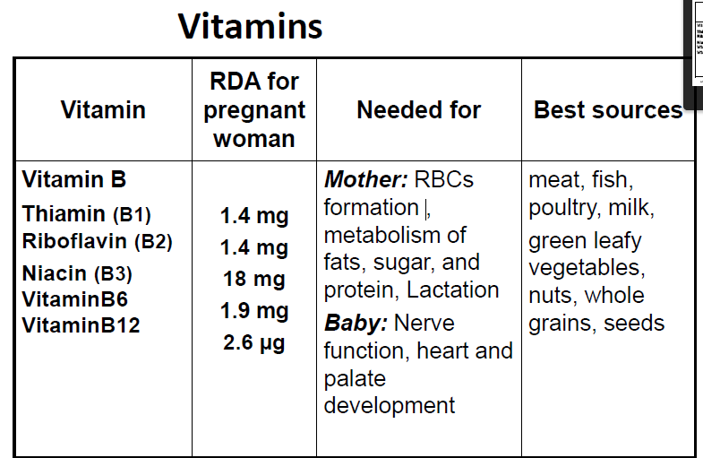
Cont.….

Slide 111
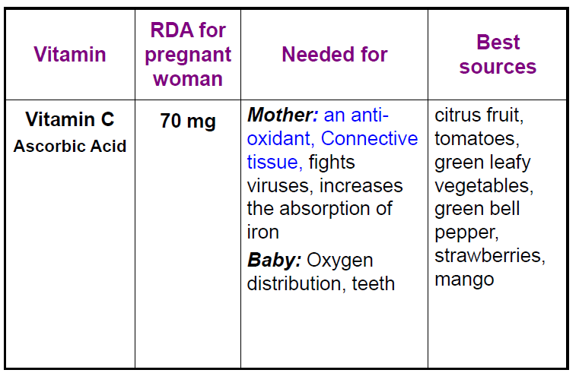
Cont.….

Slide 112
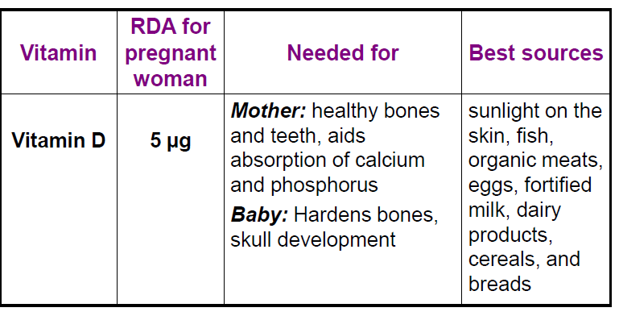
Cont.…

Slide 113
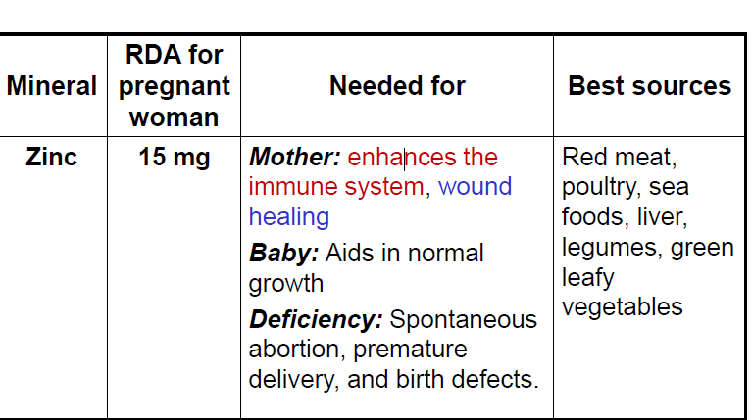
Cont.….

Slide 114
Major Issues in Maternal Nutrition
1. Inadequate weight and height
2. Micronutrient deficiencies??????

Slide 115
In Ethiopia
About 27% of reproductive age women are chronically malnourished with BMI<18.5
Adolescent girls at greater risk as compared to adults
Low pre-pregnancy BMI, short stature, is associated with poor birth outcomes and obstetric complications
Burden of anemia among women of reproductive age(15- 49years) is 17% while it is 22% among pregnant women
However,83% did not took iron supplement during pregnancy
Overweight and obesity in urban settlements :Addis Ababa

Slide 116
Maternal weight
•Two characteristics of the mother's weight influence an infant's birth weight:
–Weight prior to conception
–Weight gain during pregnancy
•Birth weight is the most reliable indicator of an infant's health
•An underweight infant is more likely to have physical and mental defects, become ill, and to die than a normal-weight infant

Slide 117
Cont.…
Women of large stature and overall good health tend to have large babies
–Is a conditioning factor on the ultimate size of the placenta in the absence of disease
–Underweight women have been shown to have lighter weight placenta and an increased risk for delivering LBW infant.

Slide 118
Cont.…
If an adult Women has a BMI less than 16 kg/m2
–There is a 50% chance that a pregnant woman with such a condition will give rise to a low birth weight child
–There is poor physical work out put as a result of poor energy stores
–There is increased risk of infection due to impaired immunity

Slide 119
Cont.…
COMPONENTS OF WEIGHT GAIN DURING PREGNANCY
•Fetus, placenta, amniotic fluid 4750gms
•Uterus and breasts 1300gms
•Blood 1250gms
•Water 1200gms
•Fat 4000gms
•Total 12,500grms

Slide 120
Cont.…

Slide 121
Cont.…
Low birth weight (LBW)
•LBW is defined as weighing less than 2,500 g at birth
•It is one of the most common statistics because it requires a single measurement, weight at birth, and no information about gestational age
•There are two main causes of LBW:
–Being born small for gestational age, or
–Being born premature

Slide 122
Cont.….
Small for gestational age
Disproportionately small for gestational age
  Weight <10thpercentile for gestational age, but not for height and head circumference
Proportionately small for gestational age
  Weight, height and head circumference<10th percentile for gestational age

Slide 123
Cont.…
Large for gestational age (LGA)
  Weight for gestational age >90 percentile or birth weight>4500gm
Due to: Maternal factors:
  pre-pregnancy obesity,
  excess weight gain during pregnancy,
  poorly controlled DM in pregnancy

Slide 124
Consequences of Low Birth Weight
Increased Mortality and Morbidity
Greater Risk of Stunting
Poor Neuro-developmental Outcomes
Reduced Strength and Work Capacity
Increased Risk of Chronic Diseases
Notes:
Poor Neuro-developmental Outcomes
•LBW infants are more likely to experience developmental deficits
•Under-nutrition that affects head circumference before 26 weeks of pregnancy has a greater impact on neurological function than does under nutrition later in pregnancy
Reduced Strength and Work Capacity
▪In the Guatemala longitudinal study, males and females at an average of 15 years of age, who were born IUGR, performed significantly more poorly on tests of strength, compared to those born weighing at least 2,500 g

Slide 125
Nutritional assessment during pregnancy
Assessment using weight gain
Assessment using MUAC
Dietary history
Physical examination
Laboratories
.
Notes:
The weight recommended weight gain is based on pre-pregnancy BMI, women who were
underweight, overweight, or obese should receive counseling regarding appropriate diet for
adequate weight gain during pregnancy.
Ideal Weight gain during pregnancy based on BMI status (FAO/WHO/UNU 2001)
BMI < 19.8 12.5-18kg
BMI 19.8 to 26.0 11.5-16kg
BMI > 26.0 to 29.0 7-11.5kg
A woman at pre-conception is considered underweight when the MUAC reading is < 21cm. Apregnant or lactating woman whose MUAC is less than 23 cm are considered to be underweight

Slide 126
Nutrition in lactation
By: Habtamu T.

Slide 127
lactation
Lactation is a period when a woman produces breast milk.
After birth, circulatory levels of estrogen and progesterone are decreased while prolactin levels remains elevated.
Initiation of lactogenesis is hormone related, however, stimulation by infant suckling or other means must be provided within the first few days for the continuation of the process.

Slide 128
Colostrum
Colostrum is the earliest form of breast milk
It is yellowish and relatively viscous solution consisting of a variety of dissolved or suspended substances such as electrolytes and immune factors.
Is lower in fat than protein as compared to BM after one month.

Slide 129
Energy demands of Lactation
Much greater than that of pregnancy.
Attributable to rapid growth of infants
Some of the energy is derived from maternal stores during pregnancy.
23% increase in energy demand over a non-pregnant , non lactating woman.

Slide 130
Lactation….
Energy intake and exercise
  Almost 500 extra calories per day
  Exercise is compatible with breastfeeding
Energy nutrients
  Recommendations increase for carbohydrates and fibers
Water
  Prevent dehydration

Slide 131
Lactation….
Vitamins and minerals
    Inadequacies reduce the quantity, not quality of breast milk
        Quality maintained at expense of maternal stores
  Prolonged inadequate intakes
    Impacts several nutrients
Supplements
  Iron with foliate

Slide 132
Lactation……
Food assistance programs
  Participants are less likely to breastfeed
  WIC incentives to encourage breastfeeding

Slide 133
Maternal Health
HIV infection and AIDS
  Transmission through breast milk
    Medications
Diabetes – type I
Postpartum amenorrhea
  Does not protect from pregnancy
Breast health
  Breast cancer

Slide 134
Practices Incompatible With Lactation
Alcohol
  Easily enters breast milk
  Infants eat less when mother consumes alcohol
Medical drugs
  Physician consultation
Illicit drugs
  Risks

Slide 135
Practices Incompatible With Lactation
Smoking
  Reduces milk volume
  Sleep less
  Passive smoking
Environmental contaminants
  DDT, and dioxin
Caffeine
  Iron bioavailability

Slide 136
Milk Synthesis and secretion
Under neuroendocrine control that varies with timing and stage of lactation
  Prolactin
  Lactogens
  Estrogen
  Thyroxine
  Growth hormone
  other
  Stimulus: infant suckling

Slide 137
…cont’d
Hormones during breastfeeding
  Prolactin levels rise with nipple stimulation
  Alveolar cells make milk in response to prolactin when the baby sucks
  Oxytocin causes the alveoli to squeeze the newly produced milk into the duct system

Slide 138
Lactation:
Latch On and sucking
Oxytocin Release
Releases Milk
Infant Empties Breast
Production Increases
Milk Production Occurs
Interference with this cycle decreases the milk supply.

Slide 139
Anatomy of the breast
Oxytocin makes them contract
Muscle cells
Milk-secreting cells
Prolactin makes them secrete milk
Ducts
Larger ducts
Nipple
Areola
Montgomery’s glands
Alveoli
Supporting tissue and fat

Slide 140
Onset of Secretion
Milk production is a complex process, involving four secretary mechanisms: exocytosis, fat synthesis and transfer, secretion of ions and water, and immunoglobulin transfer.
Following birth, placental inhibition of milk synthesis is removed and progesterone level rapidly drops.
Lactose production increases.
After 24 to 48 hours, the hormonal control is shifted to autocrine control.

Slide 141
Prolactin: Milk Production Reflex
Secreted during and after feed to produce next feed
Sensory impulses from nipples
Prolactin in blood
Baby suckling
More prolactin secreted at night
Suppresses ovulation

Slide 142
Milk ejection reflex
Oxytocin level increases 10 minutes after suckling.
It causes contraction of the myoepithelial cells
May be painful.
Warm and tingling sensation at the breast
The post pain is also be explained by this release.

Slide 143
Oxytocin reflex
Works before or during feed to make milk flow
Sensory impulses from nipples
Oxytocin in blood
Baby suckling
Makes uterus contract

Slide 144
Helping and hindering of oxytocin reflex
These help reflex
These hinder reflex
Thinks lovingly of baby
Sounds of baby
Sight of baby
Touches baby
Confidence
Worry
Stress
Pain
Doubt

Slide 145
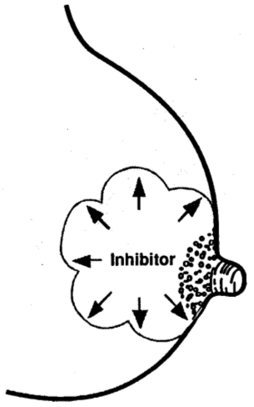
Inhibitor in breast milk
If breast remains full of milk, secretion stops
Inhibitor

Slide 146
Cont.…
Early breastfeeding failures deprive infants of the benefits
It is a natural process, but many mothers need a lot of help
Breast Pathology
  Flat/inverted nipples, breast reduction surgery that severed milk ducts
Hormonal pathology: Failure of lactogenesis, hypothyroidism
Overall health: Smoking, anemia, poor nutrition, depression
Psychosocial: Restrictive feeding schedules, mother without support
Others: Previous breastfed infant who failed to gain weight well

Slide 147
Breastfeeding Complications
Infants at risk for poor weight gain
  Premature (less than 38 weeks)
  Difficulty latching on, ineffective or un sustained sucking
  Oral anatomic abnormalities (cleft lip/palate)
  Jaundice, Cystic fibrosis, Infection, Cardiac disorders
  Neurologic problems – downs, hypo or hypertonia
  Long labor
  Sleepy, non-demanding, passive temperament
  Separation from mother early after delivery

Slide 148
Influence of diet on milk composition
Protein-energy malnutrition impacts milk volume.
Water soluble vitamins move readily from serum to milk thus dietary fluctuations are more apparent
  B12 vegan, case report of beri-beri…..
Fat soluble vitamin content not improved with supplementation
Fatty acid composition altered by maternal diet and supplementation

Slide 149
Breast milk composition and Diet
Water soluble vitamins may vary with diet.
Diets inadequate in B12 or B1have been associated with case reports of deficiency in infants.
High intakes of Vitamin C, however, does not appear to change the content of breast milk.
Supplementation of fat soluble vitamins do not appear to alter the content of breast milk.
Iron supplementation does not appear to alter the iron content of breast milk.

Slide 150
Health Benefits of Breastfeeding
COLOSTRUM
  Small amount for the immature digestive system
  ‘paints’ the digestive tract
  Low fat for easy digestion
  Contains mothers antibodies which boost infants’ immune system
  Acts as a laxative to ease passage of meconium

Slide 151
…cont’d
Less postpartum bleeding
More rapid uterine involution
Weight loss
Decreased premenopausal breast cancer rates
Decreased ovarian cancer rates
Locational amenorrhea
  Should still use progesterone only contraceptives
  Combined contraceptives dry up milk
Saves money
Saves time
Babies love it

Slide 152
Common Breastfeeding Conditions
Sore Nipples
Flat or Inverted Nipples
Engorgement
Hyperactive Letdown
Hyper lactation
Plugged Duct
Mastitis
Low Milk Supply
Notes:
Early, mild nipple discomfort is common among women initiating breastfeeding.
In most women, the discomfort is transient and usually subsides by the end of the first week
Severe nipple pain, the presence of nipple cracks or fissures, pain that persists throughout a feeding, or pain that is not improved by the end of the first week should not be considered normal
Hyperlactation
Hyperlactation occurs when the milk volume being produced
by the mother far exceeds the intake of the baby.
A hyperactive letdown may be a sign of overproduction.
Other signs include breasts that are not drained completely
Plugged Duct
An obstructed, or “plugged,” duct is a localized blockage
of milk resulting from milk stasis (milk remaining in
the ducts).3 The mother may feel a painful knot in one
breast and usually does not have a fever or other signs
of illness.

Slide 153

Thank you!!!!

Slide 154


