Slide 2
Debre Markos University
College of medicine and health science
Department Public Health
Biostatistics
Muluneh Alene (BSc. MPH in Biostatistics)
Email: mulunehadis@gmail.com

Slide 3
Sampling
Sampling involves the selection of a number of study units
from a defined study population.
Sampling frame:-list of sampling unit in the population.
Sampling unit:-is one of the possible member of the population that could be included in the sample or an element of a population that will be a person or object on which observation can be made or from which information is obtain.
Sampling error:-which are introduced due to error in selection of sample or the discrepancies between population parameters and estimate which are derived from a random sample.

Slide 4
Sampling ………
When taking a sample, we will be confronted with the
following questions:
What is the group of people from which we want to draw a
sample? (Sampling Population)
How will these people be selected? (Sampling Methods)
How many people do we need in our sample? (Sample size)

Slide 5
Sampling ………
Data or information can be collected via:
      Census
      Vital registration
      Administrative records
      Sample survey*
Sample survey (total survey design) consists of three different methodological areas which include:
      Questionnaire design
      Sampling*
      Data collection

Slide 6
Sampling ……
A sampling process can be divided into seven steps as given below:
  Defining the target population.
  Specifying the sampling frame.
  Specifying the sampling unit.
  Selection of the sampling method (including its design).
  Determination of sample size.
  Specifying the sampling plan (outlining the whole research process including how to handle non-respondents).
  Selecting the sample.

Slide 7
Reason for sampling
Sampling saves money, labor and time. The cost of the obtaining information through a sample would be a lot less than obtaining it through a census.
Sampling is the only option for the study in some specialized area. Highly trained personnel and specialized equipment are needed in medical sciences.
Observation or experimentation could be destructive in nature in quality control like testing the average duration of bulbs and testing the quality of wine, beer, and e.t.c. In such areas sampling is the only feasible option for the study.
If the population is too large to cover sampling is the only way for the study.
Results obtained from sample are more accurate as compared to that of a census result

Slide 8
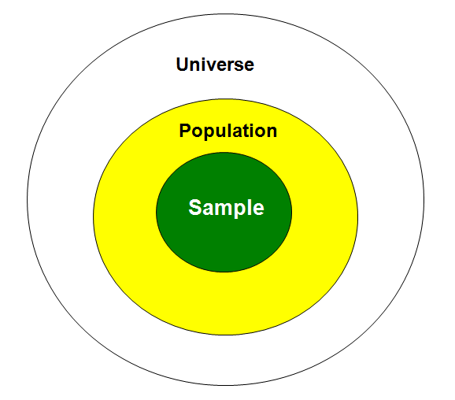
Sampling procedure:

Slide 9
Sampling ………..
Procedure by which some members of the population are selected as representatives of the entire population
POPULATION
SAMPLE

Slide 10
Types of sampling method
Probability Sampling
Non-Probability Sampling
  Types of Probability Sampling
    Simple Random Sampling
    Systematic Random Sampling
    Stratified Random Sampling
    Cluster Sampling
    Multi-Stage Sampling

Slide 11
Types of sampling………
    Simple Random Sampling: Each unit in the population has the same probability of being selected to be part of the sample:
  Construct the sampling frame
  Listing all the subjects and number them
  Decide the sample size
  Using a table of random number, lottery method or computer generation
Advantage: the selection cannot be biased
Disadvantage: need a list of individual sampling units

Slide 12
Types of sampling………
Systematic Random Sampling: Similar to the simple random sampling in design which requires a list of the population as sampling frame
  We need to define the size of the sample
  Compute the sampling ratio 1 in N and use it as the sampling interval k
  Obtaining a random start, then selecting every kth element that is bases on the desired
  Sample size (k=N/n)
Advantages: It is equivalent to the random sample but easier and faster to implement
Disadvantage: It can be biased if the list has a pattern

Slide 13
Types of Sampling………
Example Hospital Satisfaction Survey
Determine sample size (n=50)
Use hospital records to create the sampling frame (N=200)
Assign numbers
Divide N/n to determine K (200/50= 4)
Randomly select the first element
Select every K^{th} element
N
n
Notes:
Lets consider the sampling frame form the hospital records N=200
This type is similar to simple random sampling
The main difference is when selecting the elements from the sampling frame we do the following steps
Divide the population size (N) over the desired sample size (n): N/n= K the interval size
randomly select a number or element from the sampling frame
Select to include in the sample every Kth. Element from the sampling frame
Note if N/n is not an integer, you may choose to round K up.

Slide 14
Types of sampling………
Stratified Random Sampling : Population is divided into appropriate non-overlapping strata (age, sex, residence, etc.)
Sample has to reflect them
  First, identify the sub-groups or strata
  Then construct a sampling frame in each stratum
  Perform sampling in each stratum independently
Advantages: Reduction of sampling variability, gain proportional to the magnitude of differences

Slide 15
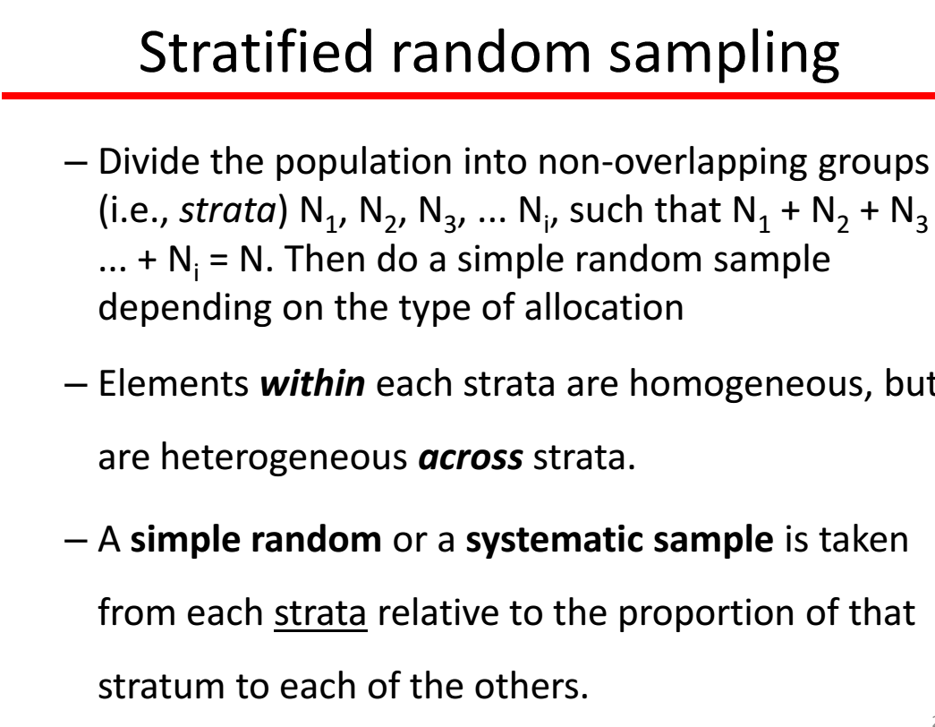
Types of sampling………

Slide 16
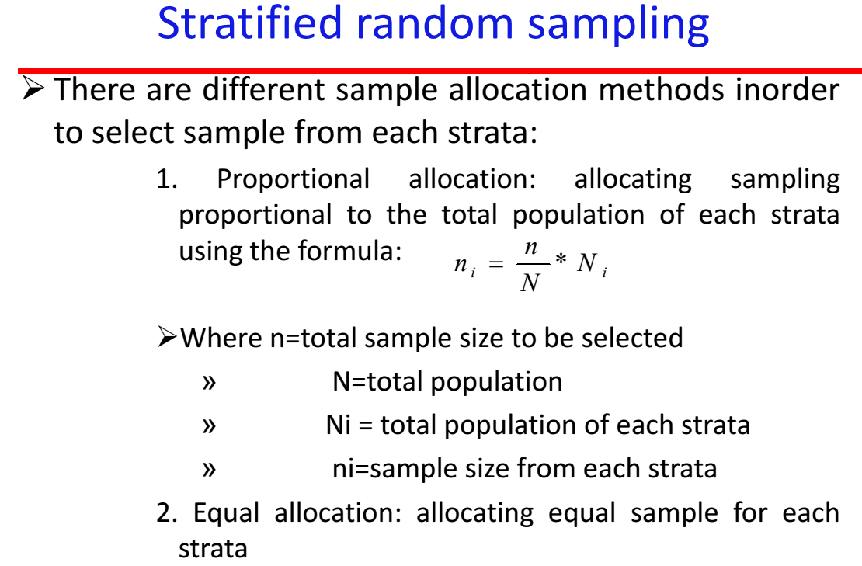
Types of Sampling………

Slide 17
Types of Sampling………
Example
Divide health care workers into 2 groups (males and females)
Create sampling frame for each group
Select a random sample from every group
Conduct the survey on male and female health care workers
X
X
X
X
X
X
X
X
X
X
Male
Female
X
X
X
X
X
X
X
X
X
X
X
X
X
X
X
X
X

Slide 18
Types of sampling………
A cluster sampling: is a simple random sample of groups of clusters of elements VS. a simple random sample of individual objects.
Clusters are geographical areas such as region, state, city, county, district
Deal with a scattered population over a large area
Reduces travelling time and cost

Slide 19
Types of sampling………
The sampling unit is not a subject, but a group (cluster) of subjects.
Define the number of clusters to be included
Divide the grand total by the number of clusters and obtain the sampling interval
Choose a random number and identify the first cluster
In each cluster select a random sample using a sampling frame of subjects (e.g. residents) or households
Advantages: reduce time and expenses
Disadvantages: design effect, when the entire population is not well mixed

Slide 20
Types of sampling………
Can involve more than one random selection process (multi-stage)
  Divide sampling frame into clusters
  Conduct random sample of clusters
  Collect data
More efficient than simple random samples

Slide 21
Types of Sampling………

Slide 22
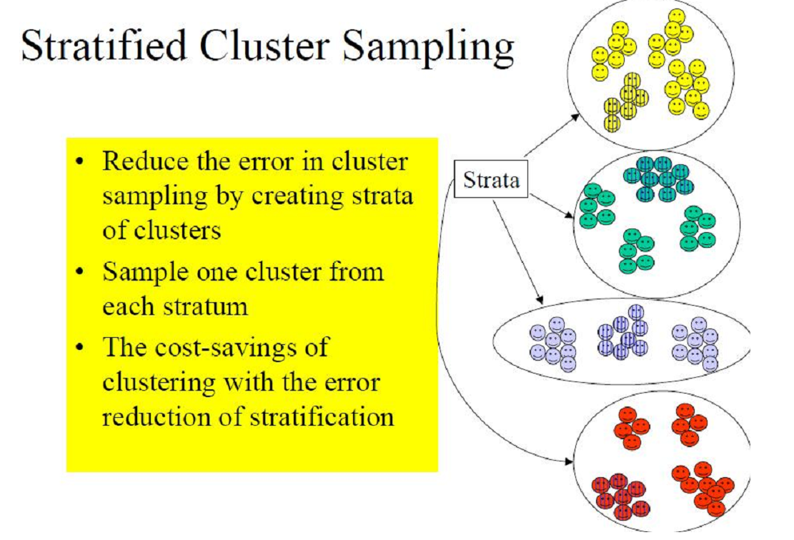
Types of Sampling………

Slide 23
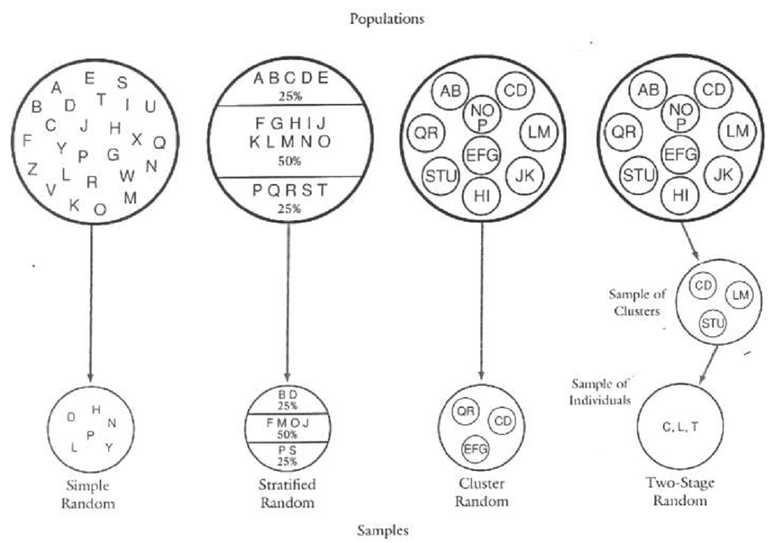
Summary for probability sampling method

Slide 24
Types of Sampling………
Non-Probability Sampling Key Points
NOT randomly drawn
Cannot generalize results beyond sample
Can identify association
Notes:
Important concepts to remember in non-probability sampling are the following:
These samples are NOT randomly drawn.
You cannot generalize results beyond the sample.
Yet, they are useful to identify associations between two of more factors

Slide 25
Types of Sampling………
Types of Non-Probability Sampling
Convenience sampling
Volunteer
Snowball
Purposive sampling
Quota surveys
Notes:
Here are some examples of non-probability sampling that we will discuss:
Convenience sampling
Volunteer
Snowball
Purposive sampling
Quota surveys

Slide 26
Types of Sampling………
Convenience Sampling
Easy-to-access subjects selected
Examples
  People shopping at a certain store
  Eating at certain restaurant
  People who pass a given street corner
  People at your workplace
Notes:
Convenience sampling is also called non-purposive, haphazard or accidental sampling.
In convenience samples, subjects are selected because it is easy to access them. For examples, someone taking a survey might stand in front of a retail store, people eating at certain restaurant (especially when investigating food born illness), and interview people entering the store. Or, an interviewer might stop people passing by on a street corner. A common convenience sample for pilot testing questionnaires is a sample of people at your workplace.

Slide 27
Types of Sampling………
Purposive Sampling
Judgment used to select subjects
May end up being more representative than random sample but no way to assess reliability
Example
  Patients who visit clinic on “typical” day
Notes:
In purposive sampling, the researcher’s judgment is used to select subjects. This type of sampling may end up being more representative than random sample but there is no way to assess the reliability of the estimates, which is a significant disadvantage.
One example of purposive sampling would be when the researcher chooses what she believes to be a “typical day” to interview people in a medical clinic, such as a Tuesday in March, instead of randomly selecting a day, which could end up being the day before or after a weekend or holiday.

Slide 28
Types of Sampling………
Volunteer Sampling
Subjects are people who volunteer their services such as: people who respond to an advertisement and participate in study or focus group meeting
May be the only choice--
When would this happen?
Volunteers for clinical trials
Notes:
Volunteer sampling
Subjects are people who volunteer their services to be in the study (for free or for incentives)
Such as People who respond to an ad and participate in study or focus group meeting
May be the only choice, (when would this happen?) Volunteers for clinical trials
Instructor: ask “when would this happen?” Answer: when enrolling participants in clinical trials. You can not coerce them to participate, you rely on them to volunteer

Slide 29
Types of Sampling………
Snowball (Referral) Sampling: Relies on referrals from initial subjects to
identify and bring in additional subjects
Especially useful when desired sample
characteristic is rare, population is inaccessible, or hard to find
Not usually representative unless almost everyone in the desired population is enrolled
Example
  Study of STD among homeless people
Notes:
Instructor: Before talking about snowball as a type of sampling. Let’s make sure that we all understand the phrase snowball.
Explain the concept of snowball, it increases in size as rolls down the hill, continuously adding to it.
Snowball Sampling
Relies on referrals from initial subjects to identify and bring in additional subjects
Especially useful when desired sample characteristic is rare, population is inaccessible, or hard to find
Not usually representative unless almost everyone in the desired population is enrolled
Such as:
Study of STD among homeless people:
Study sample is collected by identifying one homeless person with STD and then asking that person for his/her contacts whom are like the first subject are homeless and may have STD and then the contacts are asked to identify others who they know as homeless and may have STD, and so on. The sample increases in size gradually as snowball.
Other examples: might include any other sensitive, hard to document issue.

Slide 30
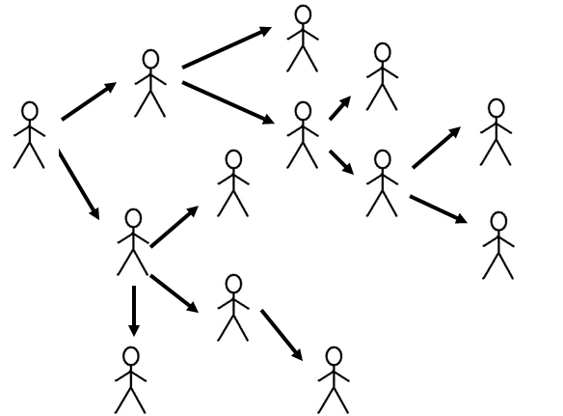
Types of Sampling………

Slide 31
Types of Sampling………
Quota Survey
Predetermined number of subjects selected in different groups
Example
  Knocking on doors down a street until 5 female heads-of-household have been interviewed
Notes:
.
Instructor: You may decide to explain the 2 types of quota sampling if you think is necessary
Quota sampling can either be proportional or non-proportional.
For example, if your study design required a sample of 60% females and 40% males, you could select a proportional sample by knocking on doors until you find 6 females and 4 males.

Slide 32
Sample size determination
There are two major classical approaches to sample size calculations in the design of quantitative studies:
(I) Using precision of estimation of an unknown Population parameter
Sample size calculations are important to ensure that estimates of parameters are obtained with required precision/accuracy or level of confidence.
Confidence Interval (CI) method is the only one method of determining sample size that allows the researcher to predetermine the accuracy of the sample

Slide 33
Sample size determination cont.…
(II) Using hypothesis testing of treatment effects /population parameters (mean, proportion, population size, correlation coefficient etc)
In studies concerned with detecting an effect, sample size
calculations are important to detect a clinically meaningful effect if exist.

Slide 34
Sample size determination cont…
Precision/confidence interval approach
Confidence Interval is a measure of the precision of an estimator
As far as probability sampling is used, sampling error (precision) can be measured by the statistical formula:
So this relationship is a good opportunity to calculate for sample size , n
Notes:
We can assess precision by: Sample Standard Deviation, population standard deviation
Using Coefficient of variation = S.D.
X
Using Kappa statistic
Using Cronbach's alpha

Slide 35
Sample size determination cont..
In order to calculate the required sample size using precision or CI approach, we need the following facts
The reasonable estimate of the key proportion or standard deviation to be studied. If you cannot guess the proportion take it as 50%
The degree of accuracy (precision) required. That is the allowed deviation from the true mean or proportion in the population as a whole. It is usually called maximum tolerable error. For proportion, it can be within the interval of 1% to 5%
The confidence level required, usually specified as 95%
The size of the population that the sample is to represent. If it is more than 10,000, the exact number is not likely to be very important; but if the population is less than 10,000, a smaller sample size may be required.

Slide 36
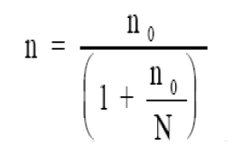
Sample size determination cont…
Estimating a single population mean or proportion for a very large population (N > 10, 000)
Hence the absolute precision denoted by d is given as
If N < 10,000 we calculate the adjusted sample size as:
Where s.e is the standard error of the estimator of the parameter of interest.
For mean estimation
d = (Z_{α/2}) s.e
d= (Z_{α/2}) σ/√n
√n = (Z_{α/2}) σ/d
n = (Z_{α/2})² σ²/d²
For proportion estimation
d = (Z_{α/2}) Se
d= (Z_{α/2}) √p(1-p)/n
√n = (Z_{α/2}) √p(1-p)/d
n = (Z_{α/2})² p(1-p)/d²
where, n_{o} and n are the initial and adjusted sample sizes respectively

Slide 37
Estimating a mean
Example -1
A health officer wishes to estimate the mean serum cholesterol in a population of men. From previous similar studies a standard deviation was 40mg/100ml in his estimate. How many subjects should be included in his study? (α = 5%, two sided)
i. If the population size is assumed to be very large, the required minimum sample size would be:
n = (1.96)²(40)²/((5)² = 245.86 ≈ 246 persons
ii. If the population size is small, say 2000, the required sample size would be 220 persons

Slide 38
Estimating a mean cont..
iii. If the investigator anticipates that 15% of the subjects will fail to comply with the intended study, the sample size required will be:
n = n_{o} + n_{o}x0.15 = 246 +246x0.15 = 283 men
Sometimes the following formula will give larger sample size
n = (1/(1- 0.15)) x n_{o}= (1/(1- 0.15)) x 246 = 290 men
That means he needs to have a contingency of 44 persons.
NB: σ² can be estimated from previous similar studies or could be obtained by conducting a small pilot study

Slide 39
Estimating a mean cont..
Example-2
A researcher wishs to estimate the average birth weight of infants within 250g around the unknown population mean at 95% confidence level. How large a sample should we select? (Assume σ=700 g)
Thirty one sample infants should be taken

Slide 40
Estimating the proportion
Example-1
A district medical officer wishes to estimate the proportion of childhood vaccination. How many children must be studied if the resulting estimate is to fall within 4% percentage points of the true proportion with 95% confidence?
Assuming no estimate of p is available, we take p = 50%
So we have, P = 0.50, d = 0.04, Z = 1.96 (95% CI)
Thus n= (1.96)²(0.5)(0.5/(0.04)² = 600.25 ≈ 601
Therefore, the study should include at least 601 subjects
The minimum sample size required for a very large population (N> 10,000) is:
n = (Z_{α/2})² P(1-P)/d²

Slide 41
Estimating proportion cont…
Example-2
The medical director of a hospital wishes to know what proportion of patients get cured of a malaria disease using the newly started drug. From another study in a different hospital, it has been reported that about 86% patients cured of malaria due to the new drug. If a 95% confidence interval is desired to estimate the proportion within 5%, how large a sample should be drawn?
We have, P = 0.86, d = 0.05, Z = 1.96 (95% CI)
n = (Z_{α/2})² P(1-P)/d² = (1.96)²(0.86x0.14)/(0.05)²
= 138.30 ≈ 139
NB If you don’t have any information about P take it as 50% and get the maximum value of PQ which is 25%

Slide 42
Estimating the proportion cont…
If the above sample (example 2) is taken from a relatively small population (say N = 3000), the required minimum sample will be obtained from the above estimate by making the following adjustment
n = 139/(1 + 139/3000) = 133

Slide 43
Comparison of two proportions/means
(ii) In order to calculate the required sample size using the second approach (hypothesis testing) we need to know the following facts:
The difference between the two sub groups’ parameters or/and the minimum clinically important difference (δ)
The confidence level required, usually specified as 95%
The value of the likelihood or the power that helps to find a statistically significant difference

Slide 44
Comparison of two …cont’d
For proportion estimation:
n (in each region/group) = [(p₁q₁ + p₂q₂) f(α, Ɓ)]/(p₁ –p₂)²
For mean estimation:
n (in each region/group) = [(S²₁ + S²₂)f(α, Ɓ)]/(μ₁ –μ₂)²
Where α = type I error (level of significant)
β = Type two error (1- β = power of the study)
Power = the probability of getting a significant result
If β = 0.1, and α = 5% we have the following:
f(α, Ɓ) = (Z_{α/2} + Z_{B})² = (1.96+ 1.28)² = 10.5 for two sided test
f(α, Ɓ) = (Z_{α} + Z_{B})² = (1.645+ 1.28)² = 8.56 for one sided test

Slide 45
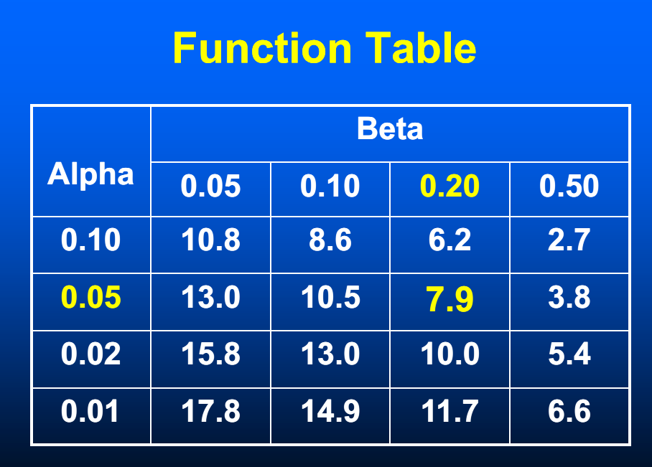
A Function table for two sided test, f(α, β)

Slide 46
Comparison of two proportions cont...
Example-1
A study is being designed to measure the effect of lowering sodium in the diet on systolic blood pressure. From a pilot study, it is observed that the standard deviation of the systolic blood pressure in a community with a high sodium diet is 12 mmHg, while that in a group with a low sodium diet is 10.3mmHg. If α = 0.05, and β = 0.10, how large a sample from each community should be selected if we want to be able to detect 2 mmHg difference in blood pressure between the two communities.
n (in each community) = [(S²₁ + S²₂)f(α, Ɓ)]/(μ₁ –μ₂)²
n = (1.28 +1.96)²(12² +10.3²)/ 2² = 657
A sample of 657 subjects from each community is required

Slide 47
Comparison of two proportions cont...
Example-2
A study is being planned to test whether a dietary supplement for pregnant women will increase the birth weight of babies. One group of women will receive the new supplement and the other group will receive the usual nutritional consultation. From a pilot study, the standard deviation in birth weight is estimated as 500g and is assumed to be the same in both groups. The hypothesis of no difference is to be tested at 5% level of significance. It is desired to have 80% power of detecting a increase of 100g
n (in each group) = [(S²₁ + S²₂)f(α, Ɓ)]/(μ₁ –μ₂)²
n = (1.645 +0.842)²(500² +500²)/ 100² = 309.28 = 310 (here since the study is one sided, we took Z_{α/2} = 1.645 instead of 1.96
A sample of 310 subjects should be included from each groups

Slide 48
Comparison of two proportions…
Example 3
The prevalence of the under weight of newborns is compared between two regions. In one region, it is estimated that about 30% of the newborns could be under weight. In other region it is probably 15%.
The required sample to show with a 90% likelihood (power), that the percentage of newborns is different in these two regions would be:
(Assume a confidence level of 95%)
n (in each community) = [(p₁q₁ + p₂q₂) f(α, Ɓ)]/(p₁ –p₂)²
n = (1.28 +1.96)²{(0.3x0.7) +(0.15x.85)}/ (0.30 – 0.15)²
= 158 newborns are required in each region

Slide 49
Using design effect
For the wise use of the limited recourse, cluster sampling is commonly used, rather than simple random sampling,
However, “respondents in the same cluster are likely to be somewhat similar to one another”
As a result, in a clustered sample “Selecting an additional member from the same cluster adds less new information than would a completely independent selection”
This situation increases the variability in cluster sampling which intern reduces its effectiveness in reducing the sample size
The loss of effectiveness by the use of cluster sampling, instead of simple random sampling, is the design effect.

Slide 50
Using design effect cont…
The design effect is basically the ratio of the actual variance, under the sampling method actually used, to the variance computed under the assumption of simple random sampling
Where deff is the design effect
is the variance when cluster sampling is used
is the variance when srs w/o replacement is used
Usually we use d_{eff} = 2, 3, 4, etc according the stages of sampling
(number of cluster sampling in multi-stage sampling)

Slide 51
Statistical inference
Statistical inference: is a method/process of making conclusion about the population based on the sample result.
Statistical inference may be divided into two major areas:-Estimation and Hypothesis test.
Statistical estimation is a procedure of using a sample statistics to estimate a population parameter.
Statistical estimation has two components:-
  point estimation and
  interval estimation.

Slide 52
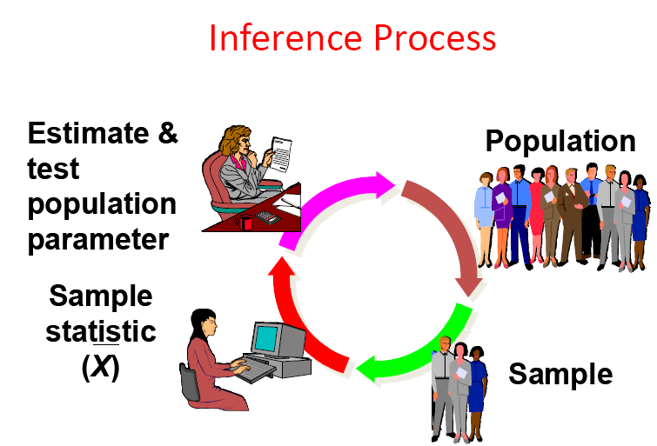
Inferential statistics

Slide 53
Sampling Distributions
Sampling distribution: The sampling distribution yields the probability of occurrence associated with each sample mean over the set of all possible sample mean.
sample
sample
sample
sample
sample
sample
Population
sample
sample
sample

Slide 54
Sampling Distributions………
If the sample statistic is the sample mean, then the distribution is the sampling distribution of sample means.
Sample 3
Sample 4
Sample 1
Sample 2
Sample 5
Sample 6
Sample 7
x̄₇
Sample 9
x̄₉
Sample 8
x̄₈
The sampling distribution consists of the values of the sample means, x̄_{1,} x̄_{2,} x̄_{3,} x̄_{4,} x̄_{5,} x̄_{6,} x̄_{7,} x̄_{8,} x̄_{9,}

Slide 55
Methods of sampling
Sampling with replacement: - it is the process of selecting items one by one replacing selected item before next selection. If we have a population of size N sample of size n then, there are N^{n} possible samples of size n.
Sampling with out replacement:- It is a process of selecting items one by with out replacing the selected items. If we have a population size N and sample size n we have N combination of n (NC_{n}) different samples of size n from the population of size of N.

Slide 56
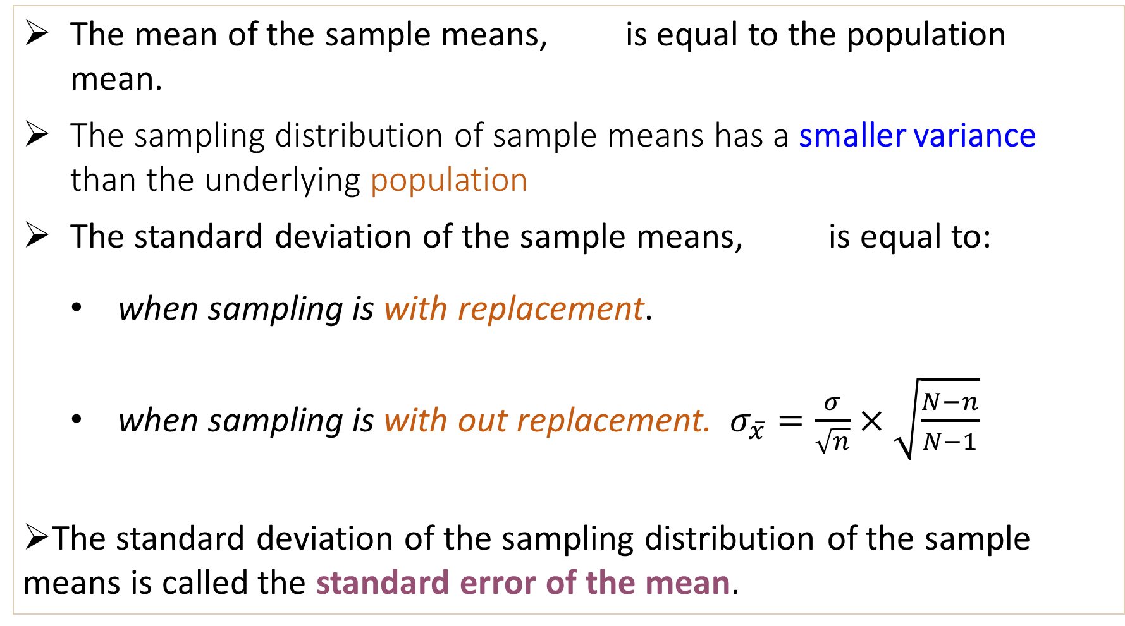
Properties of Sampling Distributions
The mean of the sample means, is equal to the population mean.
The sampling distribution of sample means has a smaller variance than the underlying population
The standard deviation of the sample means, is equal to:
  when sampling is with replacement.
  when sampling is with out replacement. $σ_{\overline{x}}=\frac{σ}{\sqrt{n}}×\sqrt{\frac{N−n}{N−1}}$
The standard deviation of the sampling distribution of the sample means is called the standard error of the mean.

Slide 57
Sampling Distribution of Sample Means
Example:
The weight in Kg of under five children have values {5, 10, 15, 20}. These values are written on slips of paper
Find the mean, variance and standard deviation of the weight of the population.
Population
5
10
15
20

Slide 58
Sampling Distribution of Sample Means Cont’d
Example continued:
Now assume that two slips are randomly selected, with replacement.
  b. List all the possible samples of size n = 2 and calculate the mean of each.
Sample
Sample mean,
Sample
Sample mean,
5, 5
5
15, 5
10
These means form the sampling distribution of the sample means.
5, 10
7.5
15, 10
12.5
5, 15
10
15, 15
15
5, 20
12.5
15, 20
17.5
10, 5
7.5
20, 5
12.5
10, 10
10
20, 10
15
10, 15
12.5
20, 15
17.5
10, 20
15
20, 20
20
Continued.

Slide 59
Sampling Distribution of Sample Means Cont’d
Example continued:
  c. Now create the probability distribution of the sample means.
Probability Distribution of Sample Means
The mean and variance of this distribution would be 12.5 and 31.25/2 respectively
5
1
0.0625
7.5
2
0.1250
10
3
0.1875
12.5
4
0.2500
15
3
0.1875
17.5
2
0.1250
20
1
0.0625

Slide 60
Sampling Distribution of Sample Means Cont’d
Example continued:
  d. Then graph the probability histogram for the sampling distribution.
P(x)
Probability Histogram of Sampling Distribution
0.25
The shape of the graph is symmetric and bell shaped.
It approximates a normal distribution.
0.20
Probability
0.15
0.10
0.05
5
7.5
10
12.5
15
17.5
20
Sample mean

Slide 61
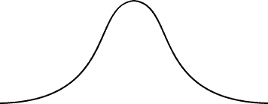

Normal distribution
Normal distribution: is the most important distribution in describing a continuous random variable and used as an approximation of other distribution.
If a sample of size n ≥ 30 is taken from a population with any type of distribution that has a mean = μ and standard deviation = σ, the sample means will have a normal distribution.
Normal curve
x
x
x
x

Slide 62
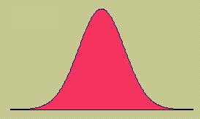
Normal distribution Cont’d
The formula that generates the normal probability distribution is:
This is a bell shaped curve with different centers and spreads depending on μ and σ
Where, σ = Population variance
µ = population mean
e =2.718…, π= 3.14…

Slide 63
Point Estimation
Point estimation: One important of statistical inference is the estimation of unknown population parameters from the corresponding sample statistics.
From a single sample, we can calculate a sample statistic to estimate a single parameter (a point estimate).
Point estimate for population mean µ is
Point estimate for population proportion is given by
where x is the total number of success (events)

Slide 64
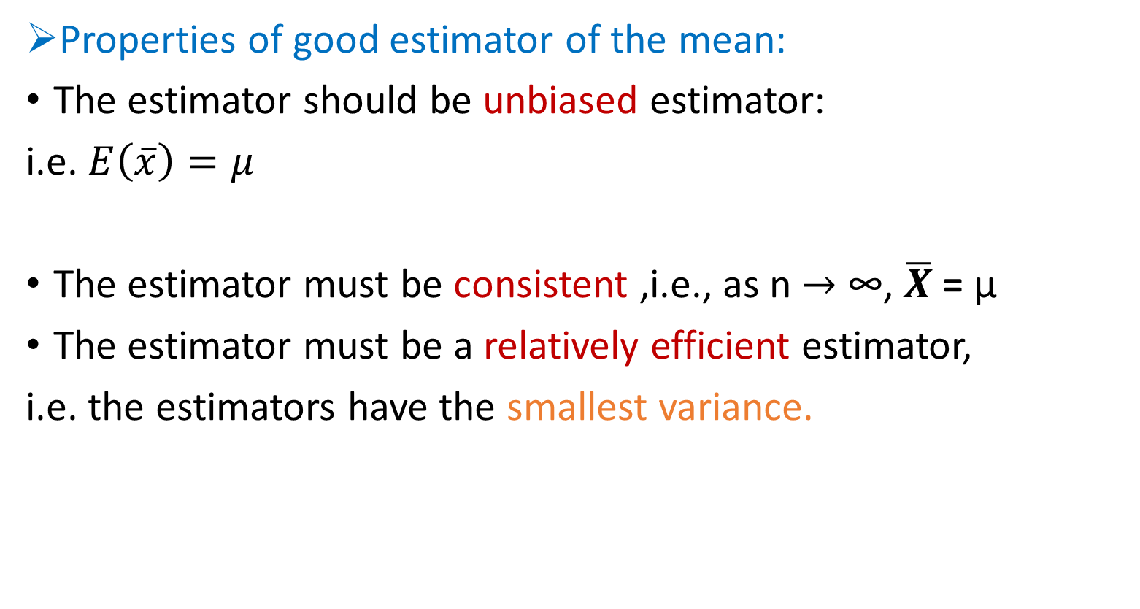
Point estimation ………
Properties of good estimator of the mean:
The estimator should be unbiased estimator:
i.e. $E\left(\overline{x}\right)=μ$
The estimator must be consistent ,i.e., as n $→$ ∞, $\overline{X}$ = µ
The estimator must be a relatively efficient estimator,
i.e. the estimators have the smallest variance.

Slide 65
Interval estimation
An interval estimate of population parameter is the range of values used to estimate the population value.
For most part, the sample estimate will be somewhat different from the population parameter due to sampling error.
There is no way of knowing how close the estimate is to the population parameter
we can accompany a point estimate by an interval estimate.

Slide 66
Interval estimation……..
Interval estimation of the Mean
Formula: Estimate ± K × Standard Error, where k is reliability coefficient
When we try to give an interval estimate for µ we need to consider several conditions on the sample size n and the population variance. That is:
  whether the sample size is large or small (n≥30 or n<30)
  where the population variance is known or not known.

Slide 67


Interval estimation……..
A (1-α) 100% confidence interval to estimate population mean μ is (if the sample is from normal distribution for any sample size large or small) and population variance is known
If σ is unknown and the sample is from normal distribution, (whether n is small) we use t-test by substituting σ with S
Of course in this last situation, if n is large and population variance is unknown we can approximate it by Z test.

Slide 68
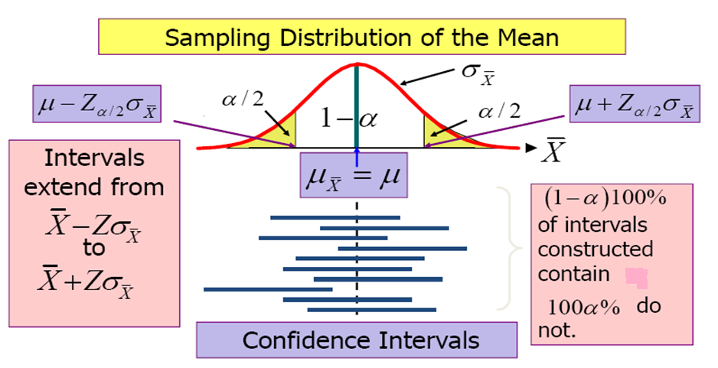
Interval estimation cont…
μ

Slide 69
Interval estimation……..
Interval estimation of the proportion
A (1-α) 100% confidence interval to estimate population proportion p is
Where is sample proportion estimate

Slide 70
Interval estimation : Example :
A random sample of 100 subjects with family history of diabetes was selected and their mean fasting blood sugar is 100mg/dl with S.D. of 0.06mg/dl.
Calculate 95% CI for mean fasting blood sugar with history of diabetes and interpret the results.

Slide 71
Solution :
Interpretation
The probability of obtaining the population mean fasting blood sugar for persons with history of diabetes within 99.998 to 100.012 is 95%.

Slide 72
Interval estimation : Example 2
The blood lead level measured in μg/dl for 88 sample individuals living in a region are given as follows;
20,21,22,22,23,23,23,24,24,24,24,25,25,25,25,25,26,26,26,26,26,27, 27,27,27,27,27,28,28,28,28,28,28,28,28,29,29,29,29,29,30,30,30,30, 30,30,30,30,30,31,31,31,31,31,31,31,32,32,32,32,32,33,33,33,33,33, 33,33,34,34,34,34,35,35,35,35,36,36,36,36,36,37,37,37,37,38,38,39
Construct the 90%, 95%, 98% confidence interval for population mean
Solution: First the sample mean and standard deviation is calculated as 29.92 and 4.52 respectively.
Then we use Z-distribution as: 29.92 + Z_{α/2}x4.52/√88
90% CI: (29.92 +1.645x4.52/9.4) =(29.13, 30.71)
95% CI: (29.92 +1.96x4.52/9.4) = (28.98, 30.86)
98% CI: (29.92 +2.33x4.52/9.4) = (28.80, 31.04)

Slide 73
Interval estimation : Example 3
Consider the problem of estimating the prevalence of Breast cancer in 45- to 54-year-old women in the Ethiopia.
Suppose that a random sample of n = 5000 women is selected from this age group and X = 500 women are found to have the disease.
A. Calculate the point estimator of the prevalence of Breast cancer for the population of women in this age range.
B. Construct a 95% CI for the population prevalence of Breast cancer for the population of women in this age range.

Slide 74
Solution :
point estimate for the prevalence of this disease is:
p̂ = 500/5000 = 0.1 = 10%
95% CI for the population prevalence of Breast cancer for the population of women in this age range:

Slide 75
Sample size determination cont…
There are two major classical approaches to sample size calculations in the design of quantitative studies:
(I) Using precision of estimation of an unknown Population parameter
Sample size calculations are important to ensure that estimates of parameters are obtained with required precision/accuracy or level of confidence.
Confidence Interval (CI) method is the only one method of determining sample size that allows the researcher to predetermine the accuracy of the sample

Slide 76
Sample size determination cont…
(II) Using hypothesis testing of treatment effects /population parameters (mean, proportion, population size, correlation coefficient etc.)
In studies concerned with detecting an effect, sample size
calculations are important to detect a clinically meaningful effect if exist.

Slide 77
Sample size determination cont…
Precision/confidence interval approach
Confidence Interval is a measure of the precision of an estimator
As far as probability sampling is used, sampling error (precision) can be measured by the statistical formula:
So this relationship is a good opportunity to calculate for sample size , n

Slide 78
Sample size determination cont…
In order to calculate the required sample size using precision or CI approach, we need the following facts
The reasonable estimate of the key proportion or standard deviation to be studied. If you cannot guess the proportion take it as 50%
The degree of accuracy (precision) required. That is the allowed deviation from the true mean or proportion in the population as a whole. It is usually called maximum tolerable error. For proportion, it can be within the interval of 1% to 5%
The confidence level required, usually specified as 95%
The size of the population that the sample is to represent. If it is more than 10,000, the exact number is not likely to be very important; but if the population is less than 10,000, a smaller sample size may be required.

Slide 79
Sample size determination cont…
Estimating a single population mean or proportion for a very large population (N > 10, 000)
Hence the absolute precision denoted by d is given as
Where s.e is the standard error of the estimator of the parameter of interest.
For mean estimation
d = (Z_{α/2}) s.e
d= (Z_{α/2}) σ/√n
√n = (Z_{α/2}) σ/d
n = (Z_{α/2})² σ²/d²
For proportion estimation
d = (Z_{α/2}) Se
d= (Z_{α/2}) √p(1-p)/n
√n = (Z_{α/2}) √p(1-p)/d
n = (Z_{α/2})² p(1-p)/d²
If N < 10,000 we calculate the adjusted sample size as:
where, n_{o} and n are the initial and adjusted sample sizes respectively

Slide 80
Estimating a mean
Example -1
A health officer wishes to estimate the mean serum cholesterol in a population of men. From previous similar studies a standard deviation was 40mg/100ml in his estimate. How many subjects should be included in his study? (α = 5%, two sided)
i. If the population size is assumed to be very large, the required minimum sample size would be:
n = (1.96)²(40)²/(5)² = 245.86 ≈ 246 persons
ii. If the population size is small, say 2000, the required sample size would be 220 persons

Slide 81
Estimating a mean cont’d
iii. If the investigator anticipates that 15% of the subjects will fail to comply with the intended study, the sample size required will be:
n = n_{o} + n_{o}x0.15 = 246 +246x0.15 = 283 men
Sometimes the following formula will give larger sample size
n = (1/(1- 0.15)) x n_{o}= (1/(1- 0.15)) x 246 = 290 men
That means he needs to have a contingency of 44 persons.
NB: σ² can be estimated from previous similar studies or could be obtained by conducting a small pilot study

Slide 82
Estimating a mean cont’d.
Example-2
A researcher wishs to estimate the average birth weight of infants within 250g around the unknown population mean at 95% confidence level. How large a sample should we select? (Assume σ=700 g)
Thirty one sample infants should be taken

Slide 83
Estimating the proportion
Example-1
A Debremarkos Referral Hospital medical director wishes to estimate the proportion of childhood vaccination. How many children must be studied if the resulting estimate is to fall within 4% percentage points of the true proportion with 95% confidence?
Assuming no estimate of p is available, we take p = 50%
So we have, P = 0.50, d = 0.04, Z = 1.96 (95% CI)
Thus n= (1.96)²(0.5)(0.5/(0.04)² = 600.25 ≈ 601
Therefore, the study should include at least 601 subjects
The minimum sample size required for a very large population (N> 10,000) is:
n = (Z_{α/2})² P(1-P)/d²

Slide 84
Estimating the proportion cont’d.
Example-2
The medical director of a hospital wishes to know what proportion of patients get cured of a malaria disease using the newly started drug. From another study in a different hospital, it has been reported that about 86% patients cured of malaria due to the new drug. If a 95% confidence interval is desired to estimate the proportion within 5%, how large a sample should be drawn?
We have, P = 0.86, d = 0.05, Z = 1.96 (95% CI)
n = (Z_{α/2})² P(1-P)/d² = (1.96)²(0.86x0.14)/(0.05)²
= 138.30 ≈ 139
NB If you don’t have any information about P take it as 50% and get the maximum value of PQ which is 25%

Slide 85
Estimating the proportion cont’d.
If the above sample (example 2) is taken from a relatively small population (say N = 3000), the required minimum sample will be obtained from the above estimate by making the following adjustment
n = 139/(1 + 139/3000) = 133

Slide 86
Comparison of two proportions/means
(ii) In order to calculate the required sample size using the second approach (hypothesis testing) we need to know the following facts:
The difference between the two sub groups’ parameters or/and the minimum clinically important difference (δ)
The confidence level required, usually specified as 95%
The value of the likelihood or the power that helps to find a statistically significant difference

Slide 87
Comparison of two proportions/means cont’d.
For proportion estimation:
n (in each region/group) = [(p₁q₁ + p₂q₂) f(α, Ɓ)]/(p₁ –p₂)²
For mean estimation:
n (in each region/group) = [(S²₁ + S²₂)f(α, Ɓ)]/(μ₁ –μ₂)²
Where α = type I error (level of significant)
β = Type two error (1- β = power of the study)
Power = the probability of getting a significant result
If β = 0.1, and α = 5% we have the following:
f(α, Ɓ) = (Z_{α/2} + Z_{B})² = (1.96+ 1.28)² = 10.5 for two sided test
f(α, Ɓ) = (Z_{α} + Z_{B})² = (1.645+ 1.28)² = 8.56 for one sided test

Slide 88
Comparison of two proportions/means cont’d.
A Function table for two sided test, f(α, β)

Slide 89
Comparison of two proportions/means cont’d.
Example-1
A study is being designed to measure the effect of lowering sodium in the diet on systolic blood pressure. From a pilot study, it is observed that the standard deviation of the systolic blood pressure in a community with a high sodium diet is 12 mmHg, while that in a group with a low sodium diet is 10.3mmHg. If α = 0.05, and β = 0.10, how large a sample from each community should be selected if we want to be able to detect 2 mmHg difference in blood pressure between the two communities.
n (in each community) = [(S²₁ + S²₂)f(α, Ɓ)]/(μ₁ –μ₂)²
n = (1.28 +1.96)²(12² +10.3²)/ 2² = 657
A sample of 657 subjects from each community is required

Slide 90
Comparison of two proportions/means cont’d.
Example-2
A study is being planned to test whether a dietary supplement for pregnant women will increase the birth weight of babies. One group of women will receive the new supplement and the other group will receive the usual nutritional consultation. From a pilot study, the standard deviation in birth weight is estimated as 500g and is assumed to be the same in both groups. The hypothesis of no difference is to be tested at 5% level of significance. It is desired to have 80% power of detecting a increase of 100g
n (in each group) = [(S²₁ + S²₂)f(α, Ɓ)]/(μ₁ –μ₂)²
n = (1.645 +0.842)²(500² +500²)/ 100² = 309.28 = 310 (here since the study is one sided, we took Z_{α/2} = 1.645 instead of 1.96
A sample of 310 subjects should be included from each groups

Slide 91
Comparison of two proportions/means cont’d.
Example 3
The prevalence of the under weight of newborns is compared between two regions. In one region, it is estimated that about 30% of the newborns could be under weight. In other region it is probably 15%.
The required sample to show with a 90% likelihood (power), that the percentage of newborns is different in these two regions would be:
(Assume a confidence level of 95%)
n (in each community) = [(p₁q₁ + p₂q₂) f(α, Ɓ)]/(p₁ –p₂)²
n = (1.28 +1.96)²{(0.3x0.7) +(0.15x.85)}/ (0.30 – 0.15)²
= 158 newborns are required in each region

Slide 92
Using design effect
For the wise use of the limited recourse, cluster sampling is commonly used, rather than simple random sampling,
However, “respondents in the same cluster are likely to be somewhat similar to one another”
As a result, in a clustered sample “Selecting an additional member from the same cluster adds less new information than would a completely independent selection”
This situation increases the variability in cluster sampling which intern reduces its effectiveness in reducing the sample size
The loss of effectiveness by the use of cluster sampling, instead of simple random sampling, is the design effect.

Slide 93
Using design effect cont’d.
The design effect is basically the ratio of the actual variance, under the sampling method actually used, to the variance computed under the assumption of simple random sampling
Where deff is the design effect
is the variance when cluster sampling is used
is the variance when srs w/o replacement is used
Usually we use d_{eff} = 2, 3, 4, etc according the stages of sampling
(number of cluster sampling in multi-stage sampling)

Slide 94
Objectives
After completing this unit, the student should be able to
Define and describe statistical inference
Define and describe Estimation and hypothesis testing
Explore the relation ship between estimation and hypothesis testing
Construct confidence interval and test hypothesis

Slide 95
Statistical inference
Statistical inference: is a method/process of making conclusion about the population based on the sample result.
Statistical inference may be divided into two major areas:-Estimation and Hypothesis test.
Statistical estimation is a procedure of using a sample statistics to estimate a population parameter.
Statistical estimation has two components:-
  point estimation and
  interval estimation.
Hypothesis is a testable statement that describes the nature of the proposed relationship between two or more variables of interest.

Slide 96
Inferential statistics

Slide 97
Point Estimation
Point estimation: One important concept in statistical inference is the estimation of unknown population parameters from the corresponding sample statistics.
From a single sample, we can calculate a sample statistic to estimate a single parameter (a point estimate).
Point estimate for population mean µ is
Point estimate for population proportion is given by
where x is the total number of success (events)

Slide 98
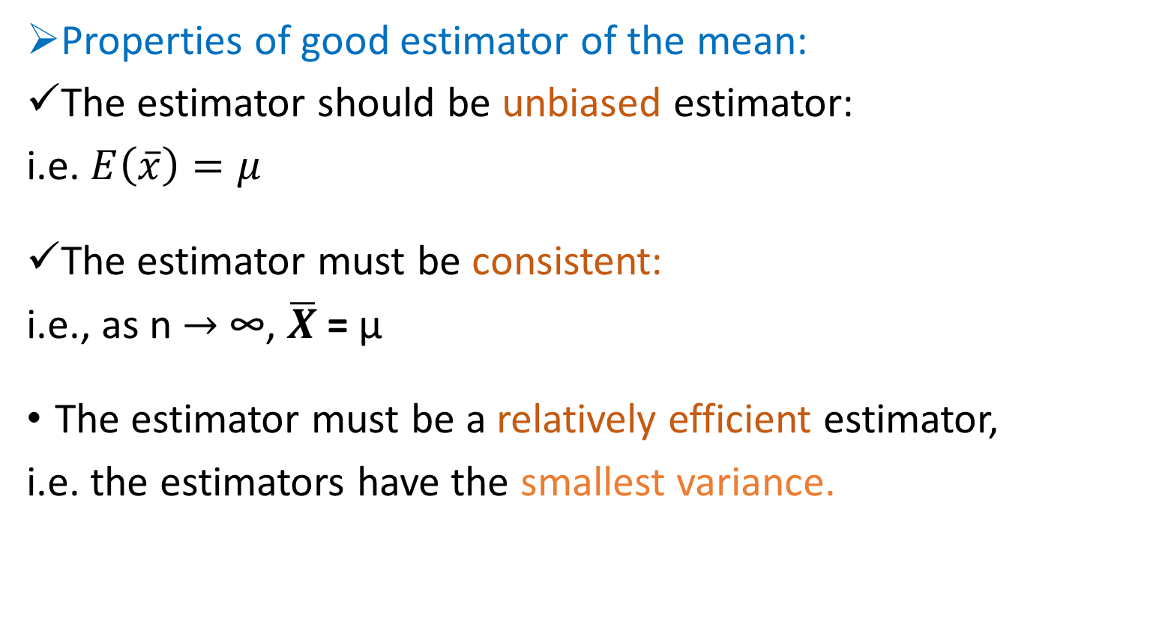
Point estimation ………
Properties of good estimator of the mean:
The estimator should be unbiased estimator:
i.e. $E\left(\overline{x}\right)=μ$
The estimator must be consistent:
i.e., as n $→$ ∞, $\overline{X}$ = µ
The estimator must be a relatively efficient estimator,
i.e. the estimators have the smallest variance.

Slide 99
Interval estimation
An interval estimate of population parameter is the range of values used to estimate the population value.
For most part, the sample estimate will be somewhat different from the population parameter due to sampling error.
There is no way of knowing how close the estimate is to the population parameter
We can accompany a point estimate by an interval estimate.

Slide 100
Interval estimation……..
Interval estimation of the Mean
Formula: Estimate ± K × Standard Error, where k is reliability coefficient
When we try to give an interval estimate for µ we need to consider several conditions on the sample size n and the population variance. That is:
  whether the sample size is large or small (n≥30 or n<30)
  where the population variance is known or not known.

Slide 101
Interval estimation……..
A (1-α) 100% confidence interval to estimate population mean μ is (if the sample is from normal distribution for any sample size large or small) and population variance is known
If σ is unknown and the sample is from normal distribution, (n is small) we use t-test by substituting σ with S
Of course in the last situation, if n is large and population variance is unknown we can approximate it by Z test.

Slide 102
Interval estimation cont…
μ

Slide 103
Interval estimation……..
Interval estimation of the proportion
A (1-α) 100% confidence interval to estimate population proportion p is
Where is sample proportion estimate

Slide 104
Interval estimation : Example :
A random sample of 100 subjects with family history of diabetes was selected and their mean fasting blood sugar is 100mg/dl with S.D. of 0.06mg/dl.
Calculate 95% CI for mean fasting blood sugar with history of diabetes and interpret the results.

Slide 105
Solution :
Interpretation
At 95% confidence level, the probability of obtaining the population mean fasting blood sugar for persons with history of diabetes is within 99.998 to 100.012.

Slide 106
Interval estimation : Example 2
The blood lead level measured in μg/dl for 88 sample individuals living in a region are given as follows;
20,21,22,22,23,23,23,24,24,24,24,25,25,25,25,25,26,26,26,26,26,27, 27,27,27,27,27,28,28,28,28,28,28,28,28,29,29,29,29,29,30,30,30,30, 30,30,30,30,30,31,31,31,31,31,31,31,32,32,32,32,32,33,33,33,33,33, 33,33,34,34,34,34,35,35,35,35,36,36,36,36,36,37,37,37,37,38,38,39
Construct the 90%, 95%, 98% confidence interval for population mean
Solution: First the sample mean and standard deviation is calculated as 29.92 and 4.52 respectively.
Then we use Z-distribution as: 29.92 + Z_{α/2}x4.52/√88
90% CI: (29.92 +1.65x4.52/9.4) =(29.13, 30.71)
95% CI: (29.92 +1.96x4.52/9.4) = (28.98, 30.86)
98% CI: (29.92 +2.33x4.52/9.4) = (28.80, 31.04)

Slide 107
Interval estimation : Example 3
Consider the problem of estimating the prevalence of Breast cancer in 45- to 54-year-old women in the Ethiopia.
Suppose that a random sample of n = 5000 women is selected from this age group and X = 500 women are found to have the disease.
A. Calculate the point estimator of the prevalence of Breast cancer for the population of women in this age range.
B. Construct a 95% CI for the population prevalence of Breast cancer for the population of women in this age range.

Slide 108
Solution :
point estimate for the prevalence of this disease is:
p̂ = 500/5000 = 0.1 = 10%
95% CI for the population prevalence of Breast cancer for the population of women in this age range:

Slide 109
Hypothesis Testing
The formal process of hypothesis testing provides us with a means of answering research questions.
Hypothesis is a testable statement that describes the nature of the proposed relationship between two or more variables of interest.
The purpose of the study is to collect data which will allow the researcher to test the hypothesis.

Slide 110
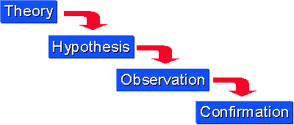
Idea of hypothesis testing

Slide 111
Null and Alternative hypotheses
Null hypothesis (H_{O}): is the statement about the value of the population parameter.
It postulates that ‘there is no association between factor and outcome’ or ‘there is no an intervention effect’.
Alternative hypothesis (H_{A}): states the ‘opposing’ view that ‘there is association between factor and outcome’ or ‘there is an intervention effect’.
Hypotheses are often stated in a null form, so as to allow them to be refuted.

Slide 112
Steps in hypothesis testing
1 Identify the null hypothesis H₀ and the alternate hypothesis H_{A}.
2 Choose α. The value should be small, usually less than 10%. It is important to consider the consequences of both types of errors.
4 Compare the observed value of the statistic to the critical value obtained for the chosen α.
3 Select the test statistic and determine its value from the sample data. This value is called the observed value of the test statistic.
5 Make a decision.

Slide 113
Types of testes

Slide 114
Types of tests

Slide 115
Test Statistics
A test statistics is a value we can compare with known distribution of what we expect when the null hypothesis is true.
The general formula of the test statistics is:
Observed _ Hypothesized
Test statistics = Value Value
Standard Error of
observed value

Slide 116
Decision Rule Based on the test statistics
If the calculated test statistics is:
  in the rejection region, then we reject H₀.
  Otherwise we fail to reject H₀ and conclude that there is not enough evidence to reject it
Fail to reject H_{o.}
Fail to reject H_{o.}
Reject H_{o.}
Reject H_{o.}
z
z
z_{cal} < z_{tab}
Z _{tab}
z_{tab}
z_{cal} > z_{tab}
0
Fail to reject H_{o.}
0
Left-Tailed Test
Right-Tailed Test
Reject H_{o.}
Reject H_{o.}
z
z_{cal} < z_{tab}
z_{tab}
0
z_{tab}
z_{cal} > z_{tab}
Two-Tailed Test

Slide 117
Types of errors
There are 2 types of errors
Most people say type I error is a more serious error; however, it should depend on the question.
Need to think about individual and population health implications and costs
Power is the probability of rejecting false null hypothesis and it is given by 1-β
Type of decision | H₀ true | H₀ false
Reject H₀ | Type I error (α) | Correct decision (1-β)
Accept H₀ | Correct decision (1-α) | Type II error (β)

Slide 118
Single Population Inference
To establish and to investigate the relationship between the sample measure and population characteristics (parameter),
Single population inference: is a rule or a procedure for determining whether or not a statement about a population parameter (mean or proportion) is true.
It is used to compare the estimate of a sample with a hypothesized population parameter to see if the sample is significantly different.

Slide 119
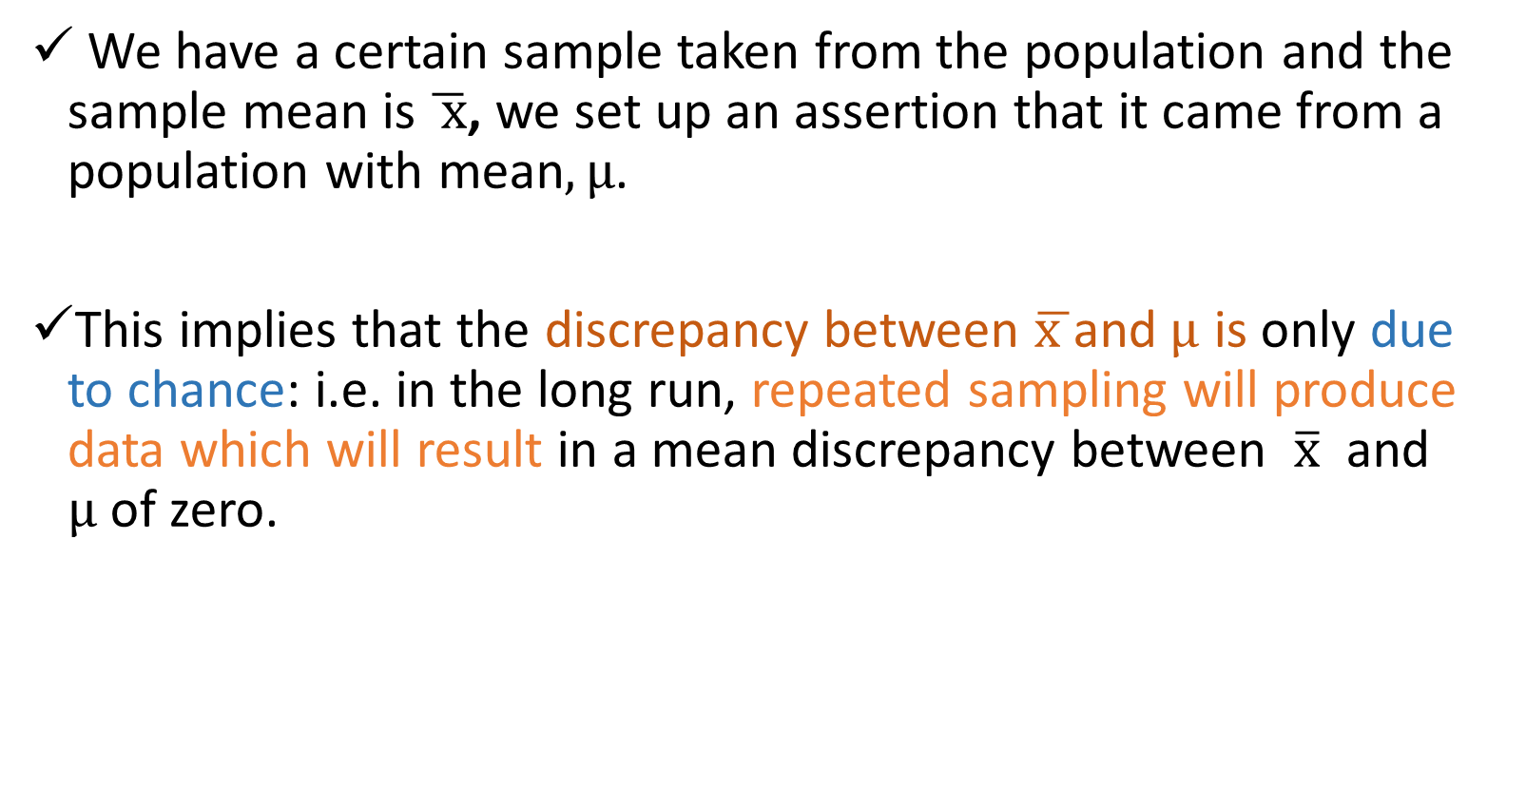
Inference for a population mean
We have a certain sample taken from the population and the sample mean is $\overline{ x}$, we set up an assertion that it came from a population with mean$,µ$.
This implies that the discrepancy between $\overline{x }$and$µ$ is only due to chance: i.e. in the long run, repeated sampling will produce data which will result in a mean discrepancy between $\overline{x}$ and $µ$of zero.

Slide 120
Inference for a population mean cont’d
  1. State the null and alternative hypothesis:
  2. State the level of significance (Assume α = 0.05 unless otherwise stated)
  3. Calculate the test statistic
Samples from normal distribution and variance is unknown as well as small sample
Samples from normal distribution and variance is known Or large sample

Slide 121

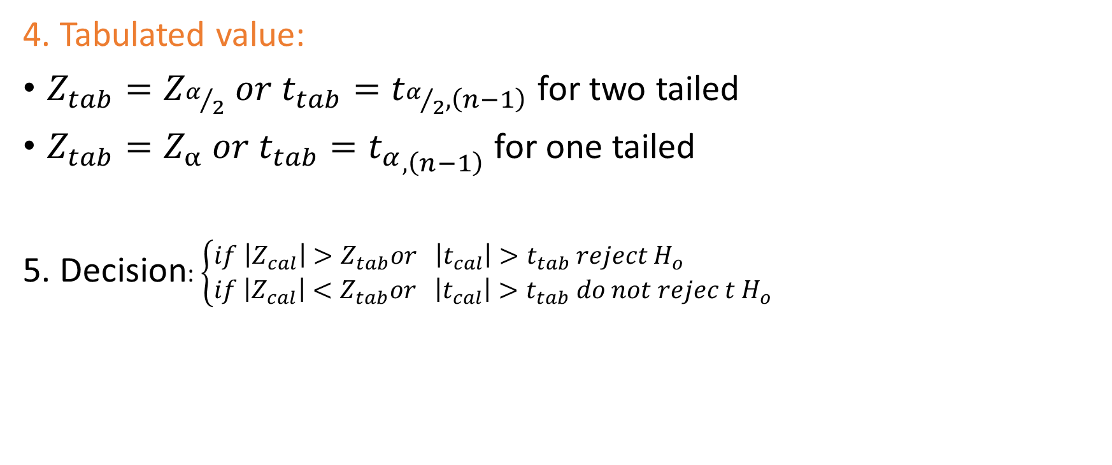

Inference for a population mean cont’d
4. Tabulated value:
$Z_{tab}=Z_{α/2} or t_{tab}=t_{α/2,\left(n−1\right)}$ for two tailed
$Z_{tab}=Z_{α} or t_{tab}={t_{α}}_{,\left(n−1\right)}$ for one tailed
5. Decision: $\left\{\begin{aligned}if \left|Z_{cal}\right|>Z_{tab}or \left|t_{cal}\right|>t_{tab} reject{ H}_{o} \\ if \left|Z_{cal}\right|<Z_{tab}or \left|t_{cal}\right|>t_{tab} do not rejec t{ H}_{o}\end{aligned}\right.$
$$\left\{\begin{aligned}if Z_{cal}<Z_{tab}or { t}_{cal}<t_{tab} reject{ H}_{o } \\ if Z_{cal}>Z_{tab}or { t}_{cal}>t_{tab} do not reject{ H}_{o} \end{aligned}\right.$$
For left tailed
$$\left\{\begin{aligned}if Z_{cal}>Z_{tab}or { t}_{cal}>t_{tab} reject{ H}_{o } \\ if Z_{cal}<Z_{tab}or { t}_{cal}<t_{tab} do not reject{ H}_{o} \end{aligned}\right.$$
For right tailed

Slide 122
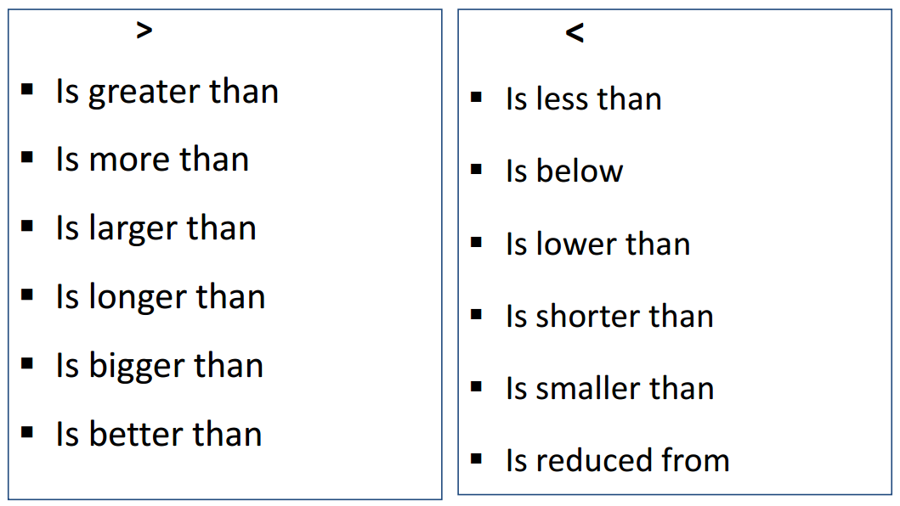
Hypothesis-Testing Common Phrases cont.

Slide 123
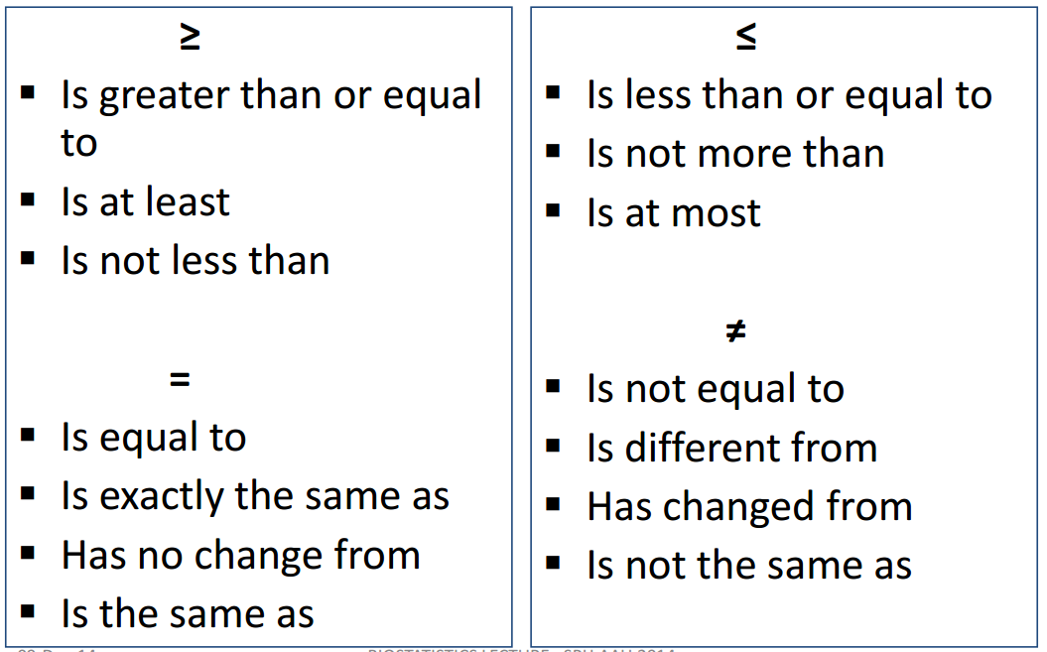
Hypothesis-Testing Common Phrases cont.

Slide 124
Example :
Researchers claim that the mean age of population having a certain disease ‘A’ is 35 years.
To prove their claim, a researcher collected information from a random sample of 20 individuals drawn from population of interest.
Population variance is known and is equal to σ² = 25 and the study found that the mean age of 20 individuals is as 32.
Test whether the mean age of population having disease ‘A’ is 35 years.

Slide 125
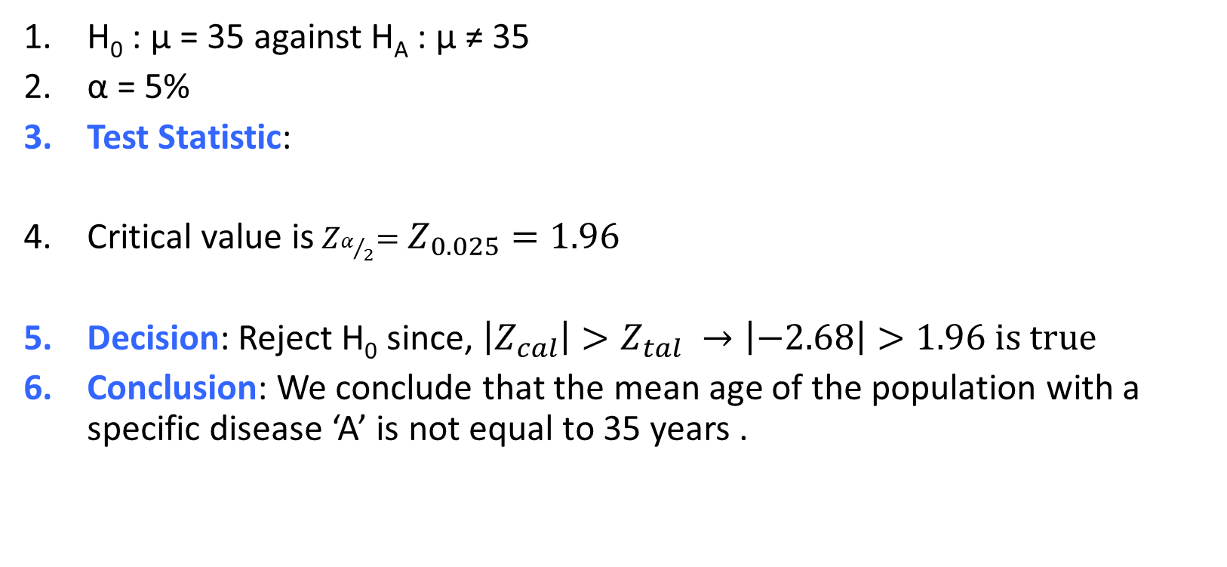
Solution :
H₀ : μ = 35 against H_{A} : μ ≠ 35
α = 5%
Test Statistic:
Critical value is${ Z}_{α/2}=Z_{0.025}=1.96$
Decision: Reject H₀ since, $\left|Z_{cal}\right|>Z_{tal} →\left|−2.68\right|>1.96 is true$
Conclusion: We conclude that the mean age of the population with a specific disease ‘A’ is not equal to 35 years .

Slide 126
Exercise
A researcher claims that the mean of the IQ for 16 students, which are normally distributed is 110 and the expected value for all population is 100 with standard deviation of 10. Test the hypothesis .

Slide 127
Inference for a population proportion
π is a value between 0 and 1
State Hypothesis
Null hypothesis:
  Proportion equals π₀
Alternative hypothesis (2-tailed):
  Proportion is different from π₀
Alternative hypothesis (1-tailed):
  Proportion is less than π₀
Alternative hypothesis (1-tailed):
  Proportion is bigger than π₀
State the level of significance
  Calculate the test statistic

Slide 128


Inference for a population proportion cont’d
4. Tabulated value:
$Z_{tab}=Z_{α/2}$for two tailed
$Z_{tab}=Z_{α}$for one tailed
5. Decision: $\left\{\begin{aligned}if \left|Z_{cal}\right|>Z_{tab} reject{ H}_{o} \\ if \left|Z_{cal}\right|<Z_{tab} do not rejec t{ H}_{o}\end{aligned}\right.$
$$\left\{\begin{aligned}if Z_{cal}<Z_{tab} reject{ H}_{o } \\ if Z_{cal}>Z_{tab} do not reject{ H}_{o} \end{aligned}\right.$$
For left tailed
$$\left\{\begin{aligned}if Z_{cal}>Z_{tab} reject{ H}_{o } \\ if Z_{cal}<Z_{tab} do not reject{ H}_{o} \end{aligned}\right.$$
For right tailed

Slide 129
Example :
A researcher wants to study prevalence of anemia among rural pregnant women's. Previous studies have shown prevalence to be 50%.
She took 100 pregnant women's from rural areas and took their hemoglobin readings and found 40% as anemic.
What would be the null hypothesis and the alternative hypothesis?
Can researcher conclude that prevalence of anemia in her study is different from previous studies?

Slide 130
Solution :
What would be the null hypothesis and the alternative hypothesis?
H₀ : π = π₀ (50%) against H_{A} : π ≠ π₀ (50%)
Can researcher conclude that prevalence of anemia in her study is different from previous studies? Yes
Decision: |-2|> 1.96, reject H0; we can conclude that in 95% confidence level, the prevalence of anemia in her study is deferent from previous studies.

Slide 131
Example :
  The superintendent of a large school district wants to know if the proportion of first graders in her district that have received their immunization shots is different from last year. Last year, 74% of the first grade children had received their immunization shots. The superintendent randomly selects 100 first grade students and 77 of them have received their immunization shots.

Slide 132
Solution :
Information given: n = 100, m = 77, hence,
State the null and alternative hypothesis:
State the level of significance: assume α = 0.05
Calculate the test statistic.

Slide 133
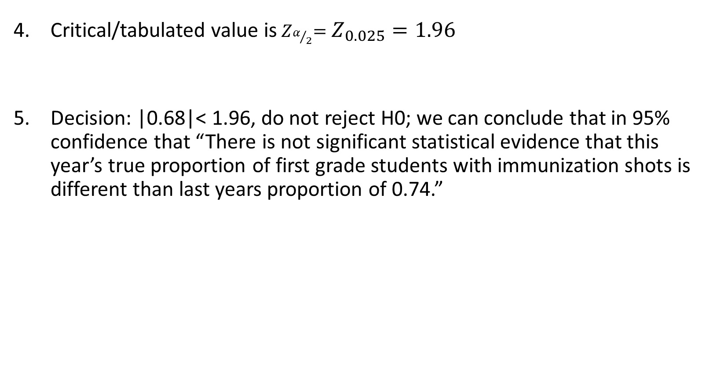
Solution …
Critical/tabulated value is${ Z}_{α/2}=Z_{0.025}=1.96$
Decision: |0.68|< 1.96, do not reject H0; we can conclude that in 95% confidence that “There is not significant statistical evidence that this year’s true proportion of first grade students with immunization shots is different than last years proportion of 0.74.”

Slide 134
Objective
After completing this unit, the student should be able to
Define and describe simple linear regression
Define and describe correlation
Construct simple linear regression model and give interpretation
Calculate correlation coefficient and give interpretation

Slide 135
Introduction to regression analysis
Regression analysis is used to:
Predict the value of a dependent variable based on the value of at least one independent variable
✓Explain the impact of changes in an independent variable on the dependent variable
Dependent variable: the variable we wish to explain. In linear regression it is always continuous variable
Independent variable: the variable used to explain the dependent variable. In linear regression it could have any measurement scale.

Slide 136
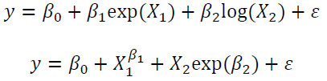
Introduction to regression analysis cont.
 In a linear models the parameters enter linearly, but the predictors do not necessarily have to be linear. For instance, consider the following two functions
 The first one is linear in the parameters, but the second one
is not.

Slide 137
Simple Linear Regression Model
Only one independent variable, x
Relationship between x and y is described by a linear function
Changes in y are assumed to be caused by changes in x

Slide 138
Simple Linear Regression Model
The population regression model:
Dependent
Variable
Population Slope Coefficient
Random Error term, or residual
Population y intercept
Independent Variable
y = β₀ + β₁x + ε
Linear component
Random Error component

Slide 139
Estimated Regression Model
The sample regression line provides an estimate of the
population regression line
Estimated
(or predicted)
y value
Estimate of the regression intercept
Estimate of the
regression slope
Independent
variable
yˆ _{i} = b₀ + b₁x
The individual random error terms e_{i}
have a mean of zero

Slide 140
Least squares method
b₀ and b₁ are obtained by finding the values of b₀ and b₁
that minimize the sum of the squared residuals
_{∑e}2
= ∑(y −yˆ)²
= ∑(y − (b
+ b x))²
0
1

Slide 141
The Least Squares Equation
After some application of calculus (derivation) and equating it to zero, we can find the following:
₌ ∑(x − x)( y − y)
b
∑(x − x)²
1
∑ xy − ^{∑ x∑ y}
b₁ =
n
b₀ = y − b₁x
_{∑ x2 −} (∑ x)
2
and
n

Slide 142
Interpretation of the Slope and the Intercept
b₀ is the estimated average value of y when the value of x is zero (provided that x is inside the data range considered).
Otherwise it shows the portion of the variability of the dependent variable left unexplained by the independent variables considered
b₁ is the estimated change in the average value of y as a result of a one-unit change in x

Slide 143
Example: Simple Linear Regression
A researcher wishes to examine the relationship between the amount of the daily average diets taken by a cohort of 20 sample children and the weight gained by them in one month (both measured in kg). The content of the food is the same for all of them.
Dependent variable (y) = weight gained in one month measured in kilogram
Independent variable (x) = average weight of diet taken per day by a child measured in Kilogram

Slide 144
Sample Data for child weight Model
Weight gained (y) | Diet (x) | Weight gained (y) | Diet (x)
0.4 | 0.65 | 0.86 | 1.1
0.46 | 0.66 | 0.89 | 1.12
0.55 | 0.63 | 0.91 | 1.20
0.56 | 0.73 | 0.93 | 1.32
0.65 | 0.78 | 0.96 | 1.33
0.67 | 0.76 | 0.98 | 1.35
0.78 | 0.72 | 1.02 | 1.42
0.79 | 0.84 | 1.04 | 1.1
0.80 | 0.87 | 1.08 | 1.5
0.83 | 0.97 | 1.11 | 1.3

Slide 145
From the data we have:
Estimation using the computational formula
Σx = 20.35, Σy = 16.27, Σxy = 17.58,
Σx² = 22.30
∑ xy − ^{∑ x∑ y}
_{b =} n
1
(∑ x)²
∑ x² −
n
_{b1 =} 17.57 − (20.35*16.27) / 20 _{= 0.643}
22.30 − 414.12 / 20
b₀ = y − b₁x = 0.8135 − 0.643*1.0175 = 0.160

Slide 146
Regression Using SPSS
Analyze/ regression/linear….
Coefficients
Model | Unstandardized Coefficients |  | Standardized Coefficients | t | Sig.
 | B | Std. Error | Beta
(Constant) | 0.160 | .077 | .900 | 2.065 | .054
foodweight | 0.643 | .073 |  | 8.772 | .000
Weight gained = 0.16 +0.643(food weight)

Slide 147
Interpretation of the parameter
Weight gained = 0.16 + 0.643(food weight)
Here, no child had had 0 kilogram of food per day, so for foods within the range of sizes observed, 0.16Kg is the portion of the weight gained not explained by food.
Whereas, b₁ = 0.643 tells us that the average weight of a child increases by 0.643, on average, for each additional one kilogram of food taken each day

Slide 148
Exercise
The following data are the age (in years) and systolic blood pressure of 20 apparently healthy adults.
Find the correlation between age and blood pressure and comment.
Find the regression equation?
What is the predicted blood pressure for a man aging 25 years?
B.P (y) | Age (x) | B.P (y) | Age (x)
128 136 146 124 143 130 124 121 126 123 | 46 53 60 20 63 43 26 19 31 23 | 120 128 141 126 134 128 136 132 140 144 | 20 43 63 26 53 31 58 46 58 70

Slide 149
Solution
x2 | xy | y | x | Serial
400 | 2400 | 120 | 20 | 1
1849 | 5504 | 128 | 43 | 2
3969 | 8883 | 141 | 63 | 3
676 | 3276 | 126 | 26 | 4
2809 | 7102 | 134 | 53 | 5
961 | 3968 | 128 | 31 | 6
3364 | 7888 | 136 | 58 | 7
2116 | 6072 | 132 | 46 | 8
3364 | 8120 | 140 | 58 | 9
4900 | 10080 | 144 | 70 | 10

Slide 150
Solution ………
x2 | xy | y | x | Serial
2116 | 5888 | 128 | 46 | 11
2809 | 7208 | 136 | 53 | 12
3600 | 8760 | 146 | 60 | 13
400 | 2480 | 124 | 20 | 14
3969 | 9009 | 143 | 63 | 15
1849 | 5590 | 130 | 43 | 16
676 | 3224 | 124 | 26 | 17
361 | 2299 | 121 | 19 | 18
961 | 3906 | 126 | 31 | 19
529 | 2829 | 123 | 23 | 20
41678 | 114486 | 2630 | 852 | Total

Slide 151
=
bo= 131.5 – (0.4547x42.6) = 112.13
=112.13 + 0.4547 x
for age 25
B.P = 112.13 + 0.4547 * 25=123.49 = 123.5 mm hg

Slide 152
Multiple Regression
Multiple regression analysis is a straightforward extension of simple regression analysis which allows more than one independent variable.

Slide 153
Correlation coefficient
Correlation analysis to measure the strength of linear relationship between two continuous variables
The population correlation coefficient ρ (rho) measures the strength of the association between the variables
The sample correlation coefficient r is an estimate of ρ and is used to measure the strength of the linear relationship in the sample observations

Slide 154
Correlation coefficient ………
Only concerned with strength of the relationship and its direction
The sign of r denotes the nature of association
  while the value of r denotes the strength of association.
  We consider the two variables equally; as a result no causal effect is implied

Slide 155
Correlation coefficient ………
If the sign is +ve this means the relation is direct (an increase in one variable is associated with an increase in the
other variable and a decrease in one variable is associated with a decrease in the other variable).
While if the sign is -ve this means an inverse or indirect relationship (which means an increase in one variable is associated with a decrease in the other).

Slide 156
Features of correlation
Unit free
Range between -1 and 1
The closer to -1, the stronger the negative linear relationship
The closer to 1, the stronger the positive linear relationship
The closer to 0, the weaker the linear relationship

Slide 157
Features of correlation ………
If r = Zero this means no association or correlation between the two variables.
If 0 < r < 0.25/ -0.25 < r < 0 = weak correlation.
If 0.25 ≤ r < 0.75/ -0.75 < r ≤ -0.25 = intermediate correlation.
If 0.75 ≤ r < 1/ -1 < r ≤ -0.75 = strong correlation.
If r = l /-1= perfect correlation.

Slide 158
Calculating the Correlation Coefficient
Sample correlation coefficient:
where:
r = Sample correlation coefficient n = Sample size
x and y are two continuous variables

Slide 159
Example:1
A sample of 6 children was selected, data about their age in years and weight in kilograms was recorded as shown in the following table . It is required to find the correlation between age and weight.
Weight (Kg) | Age (years) | serial No
12 | 7 | 1
8 | 6 | 2
12 | 8 | 3
10 | 5 | 4
11 | 6 | 5
13 | 9 | 6

Slide 160
These 2 variables are of the quantitative type, one variable (Age) is called the independent and denoted as (X) variable and the other (weight)
is called the dependent and denoted as (Y) variables to find the relation between age and weight compute the simple correlation coefficient using the following formula:

Slide 161
Y² | X² | xy | Weight (Kg) (y) | Age (years) (x) | Serial n.
144 | 49 | 84 | 12 | 7 | 1
64 | 36 | 48 | 8 | 6 | 2
144 | 64 | 96 | 12 | 8 | 3
100 | 25 | 50 | 10 | 5 | 4
121 | 36 | 66 | 11 | 6 | 5
169 | 81 | 117 | 13 | 9 | 6
∑y2= 742 | ∑x2= 291 | ∑xy= 461 | ∑y= 66 | ∑x= 41 | Total

Slide 162
r = 0.759
strong direct correlation

Slide 163
Example 2: Relationship between Anxiety and Test Scores
Anxiety (X) | Test score (Y) | X² | Y² | XY
10 | 2 | 100 | 4 | 20
8 | 3 | 64 | 9 | 24
2 | 9 | 4 | 81 | 18
1 | 7 | 1 | 49 | 7
5 | 6 | 25 | 36 | 30
6 | 5 | 36 | 25 | 30
∑X = 32 | ∑Y = 32 | ∑X² = 230 | ∑Y² = 204 | ∑XY=129

Slide 164
Calculating Correlation Coefficient
r = - 0.94
Indirect strong correlation

Slide 165


Slide 166


Thank
You

