Slide 1
Nutritional Surveillance
Contents
Food & nutrition security
Definition and types of nutrition surveillance
Basic steps in carrying out nutritional surveillance

Slide 2
Food & nutrition security
Food Security is defined as when “all people, at all times, have physical, social and economic access to sufficient, safe and nutritious food which meets their dietary needs and food preferences for an active and healthy life”. (FAO 2000)
A household is food secure if it can reliably gain access to food of a sufficient quality in quantities that allow all its members to enjoy a healthy and active life.

Slide 3
Nutrition security is defined as when secure access to food is coupled with a sanitary environment, adequate health services, and the knowledge and care needed to ensure the good health of all individuals in a household.

Slide 4
Nutritional Surveillance
Definition
It is defined as the measurement of the frequency and distribution of nutrition related diseases or problems using regularly collected and available information.
It comprises the compiling and analysis of nutrition information for decision making relative to national or regional polices or programme planning.

Slide 5
Methods of acquiring data in
Nutritional Surveillance
1. Active surveillance: - the data are collected actively by the group /individuals running the program and hence it takes time and other resources. Information collected is timely and give more reliable data.
Disadvantages
  it is expensive
  it requires skilled human power
  it is for short period of time
  it is directed towards specific disease conditions

Slide 6
2. Passive surveillance: in this type of surveillance, data are obtained from the on going programs and it does not incur too much in terms of cost, time, personnel as compared to the active surveillance,
but as information generated is to a large extent; unreliable, incomplete and inaccurate
data is not available on time
you may not get the kind of information you desire.

Slide 7
3.Sentinel site surveillance
Sentinel site surveillance involves surveillance in a limited number of sites to detect trends in the overall well-being of the population.
The sites may be specific population groups or villages that cover populations at risk.
Trends are monitored for various indicators, including nutritional status, morbidity, dietary issues, coping strategies and food security. Data can be collated and analyzed centrally (centrally-based sentinel site surveillance) or by trained members of the community(community based sentinel survillance

Slide 8
What are potential uses and who are the users of nutritional surveillance information?
Users are:
Ministry of Agriculture
Ministry of Health
Ministry of Economic Development
Food and nutrition planning
Interministerial Coordinating Committee on Food and Nutrition

Slide 9
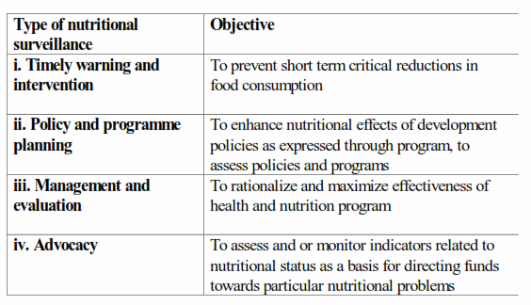
Types of nutritional surveillance

Slide 10
Use of nutritional surveillance information?
1. Timely warning and intervention
Nutritional surveillance was first established to warn governments of poor nations of imminent nutritional crises. It was in part modelled on health surveillance for important infectious diseases.
Certain infectious diseases such as plague and cholera are notifiable to WHO; countries
require that each district or province notify the national ministry of health on a weekly basis of the number of cases of notifiable diseases.

Slide 11
Cont’…
In famines or severe crises, data on famine deaths or serious famine-related malnutrition can be collected and reported.
Unlike outbreaks of serious infectious diseases, famine brings with it many cases of serious malnutrition.
Nutritional surveillance reports on indicators that would warn a government of an approaching nutrition disaster.
As listed above, production patterns, market prices, food stocks and fall in body weights are possible indicators of food crises.

Slide 12
2. Nutrition surveillance for Policy and programme planning
Many kinds of indicators, can be used by governments or local authorities for surveillance to influence policy and programme planning.
For example, anthropometric data may be collected on a regular basis to describe PEM trends over time.
The data may be analysed to discern groups of the population most severely affected.

Slide 13
Cont’…
The next step might be to decide on direct interventions (perhaps supplementary feeding or nutrition education) for the most seriously affected groups and to suggest ways in which existing policies (for example, regarding credit for small farmers to improve agricultural productivity or subsidies for staple foods for the poor in urban areas) might be modified or strengthened to influence nutritional status.

Slide 14
3. Nutritional surveillance for management and evaluation
Surveillance can be used to evaluate programmes aimed at improving nutrition and to assist in their management.
For example, data from growth monitoring over a period of five years might be used to evaluate whether an agricultural credit scheme has improved the nutritional status of children; or
Data on IDD might be used over time to evaluate whether salt iodization activities are influencing iodine nutritional status.

Slide 15
4. Nutritional surveillance for problem identification and advocacy
Conducting surveillance for advocacy mainly involves collecting data on the prevalence of PEM or micronutrient deficiencies or on related indicators and using these data to get support for action.
Support can be solicited in different ways including making the government aware of the problems found or embarrassing the government into taking action by publicizing a serious nutrition problem in the news media.

Slide 16
Summary of use of NS

Slide 17
Nutritional surveillance cycle
The following table illustrates basic steps in nutritional surveillance.
These steps involve assessment, data collection, analysis, decision-making and the enactment of interventions based on the decisions.

Slide 18
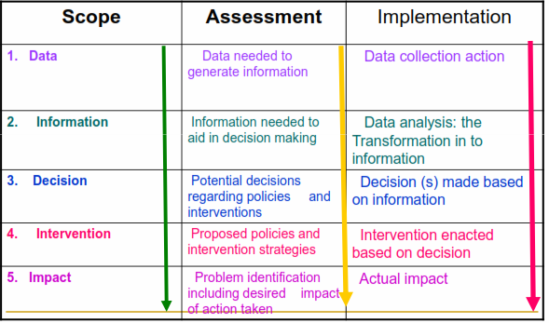
BASIC STEPS IN NUTRITIONAL SURVEILLANCE

