Slide 1
Nutritional intervention
Definition- It is a corrective measure that is undertaken to reduce correct avoid the occurrence of over all malnutrition or specific nutrient deficiency or excess.
Based on the underlying cause of the nutritional problem, the nutritional interventions can vary.

Slide 2
1. Nutrition education and promotion of horticultural activities (dietary diversification)
It promotes consumption of different varieties of foods.
Nutritional education needs to focus on the promotion of consumption of different diversities of foods.
Problems that may face this approach
The food promoted must be
- Culturally accepted
- Consumed by the vulnerable
- Target nutrients must be absorbed from the food.

Slide 3
Cont’…
- Good agricultural extension support is needed
- The program must be location specific
- High level of commitment needed
- No immediate changes in nutritional status
Advantages
Long term Sustainability
It is preventive
High community involvement
Seasonality can be offset
Good in areas of chronic malnutrition

Slide 4
Cont’…
Nutritional education should focus on
Cultural malpractices and beliefs in child feeding and weaning.
House hold mal-distribution of food (age, sex basis)
Breast feeding and its benefits
Hygiene- in storage, preparation, ….)

Slide 5
2. Dietary modification
Aimed at modifying the energy, protein, and micronutrient content of foods especially weaning foods, and other infant formulas.
e.g. – The energy and protein content of a food can be improved by fermenting or germinating adding a power flour.
Other methods employed to improve the micronutrient contents of a food include.
Enrichment- addition of a nutrient, which is originally present in the food, above the level found naturally.
Restoration- Replacement of a nutrient lost during harvest, storage or processing.

Slide 6
Cont’…
Standardization- to compensate for the natural variation of foods grown in different geographic areas in their contents of a nutrient.
Fortification- an addition of a nutrient in a food that is not naturally present in order to enhance the consumption of the target nutrient.
Supplementation- administration of nutrients in the form of tablets, capsule, or injection.

Slide 7
3. Economic approaches
A. Food-For-Work (FFW) Projects
In these projects, food is given as full or partial payment of wages to people working in land improvement or community development projects.
This strategy is very effective during food shortages, particularly when it targets the poor.
It allows able -bodied individuals to earn food rather than become reliant on food handouts.

Slide 8
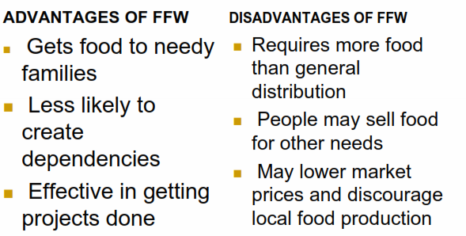
Table : Advantages and Disadvantages of Food-For-Work (FFW) Projects

Slide 9
B. Food stamps
A sort of officially stamped ticket will be given to the poor which they could use for buying food from restaurant etc and this will be paid later on by the government.
Advantage
- They are preventive.
Disadvantage
They are highly targeted to urban people.
They have high administrative cost.
The system can be abused.

Slide 10
C. Income-Generating Projects (IGP)
Relief agencies may issue small loans and training to the most affected families in order to provide them with alternative sources of income once food aid is phased out.
These projects should have a direct impact on improving food production, e.g., digging wells, raising poultry and small livestock, fishing or milling projects.

Slide 11
4. ENA (Essential Nutrition Actions)
Over past 30-40 years nutrition interventions were often…
not integrated
viewed as separate vertical programs
in competition with one another
not action oriented(non-specific)
focused only on GM/P activities

Slide 12
ENA…
In the past 10 years growing consensus is that nutrition interventions need to be…
integrated conceptually& programatically
- infant & young child feeding
- maternal nutrition
- micronutrients
based on proven impact
action oriented with clear guidance « Who should take what action when »
7 action areas

Slide 13
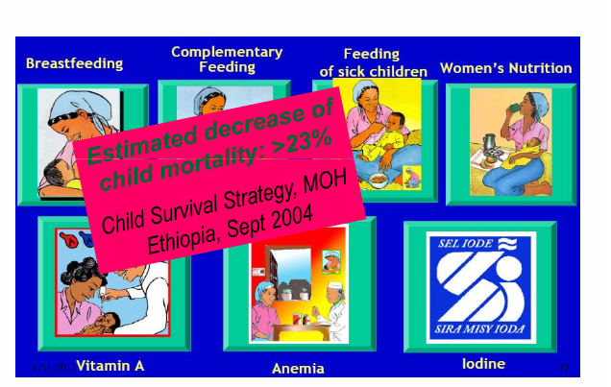

Slide 14
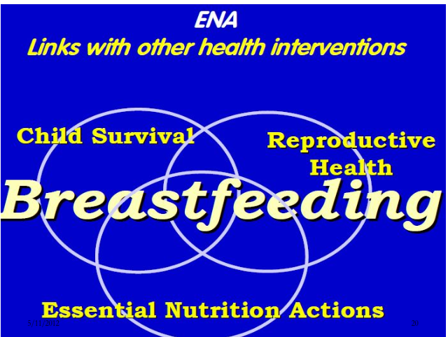

Slide 15
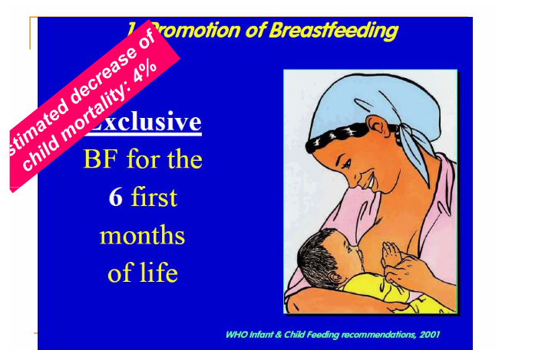

Slide 16
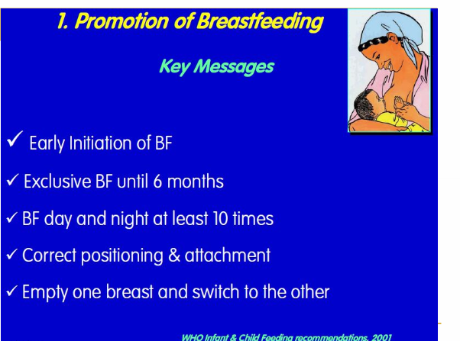

Slide 17
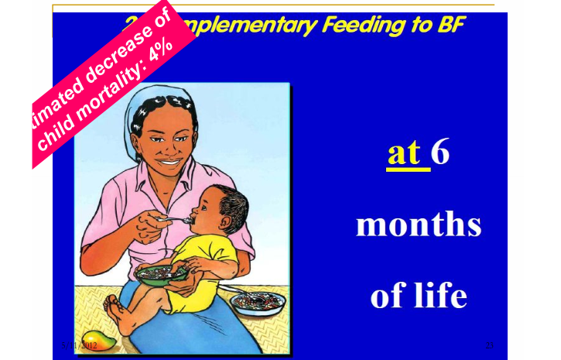

Slide 18
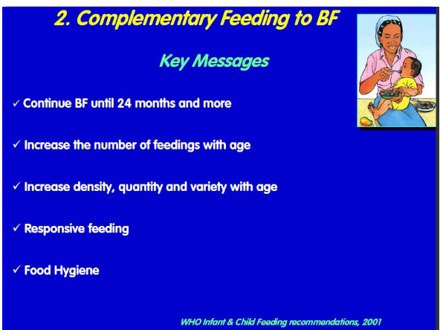

Slide 19
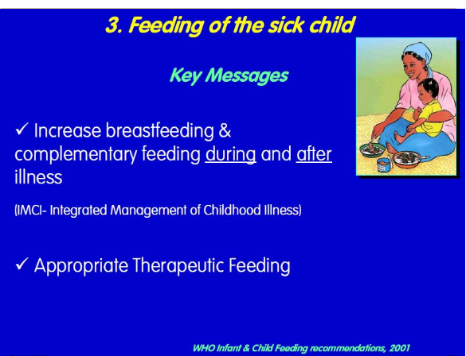

Slide 20
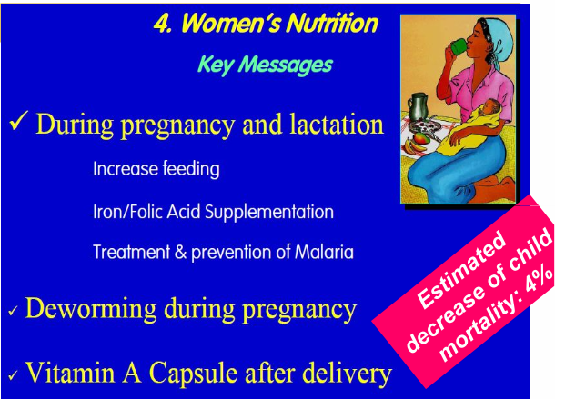

Slide 21
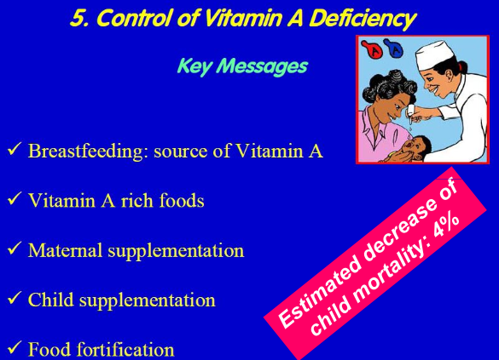

Slide 22
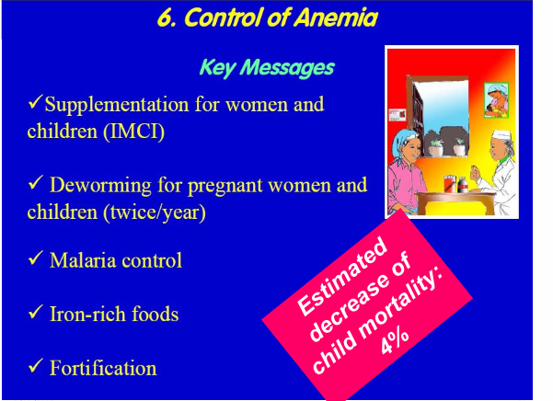

Slide 23
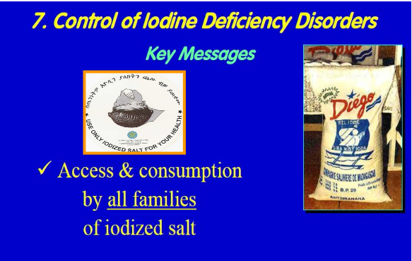

Slide 24
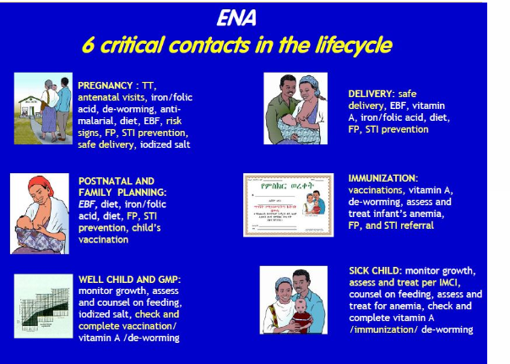

Slide 25
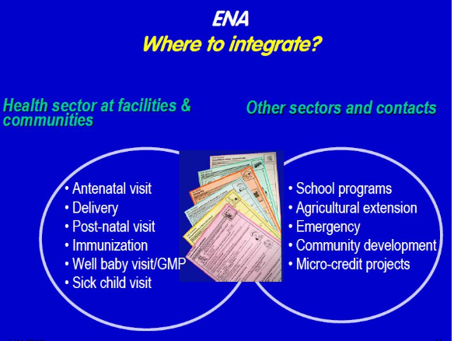

Slide 26
ENA
3 key Program Components
1. Health facility level: integrate ENA actions into existing health contacts at all health services.
2. Community--level: work with community-based organizations & networks from all sectors; and
3. Behavior change: re-inforce ENA actions through behavior change communication at all levels, including inter-personal communication, mass media and community mobilization.

Slide 27
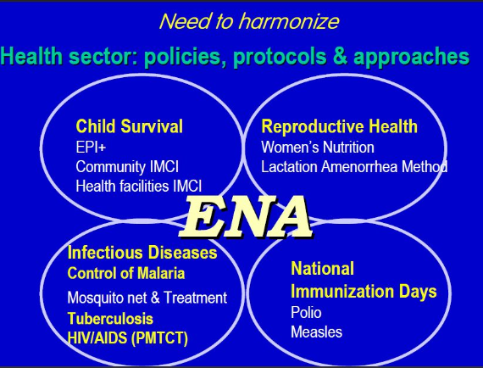

Slide 28
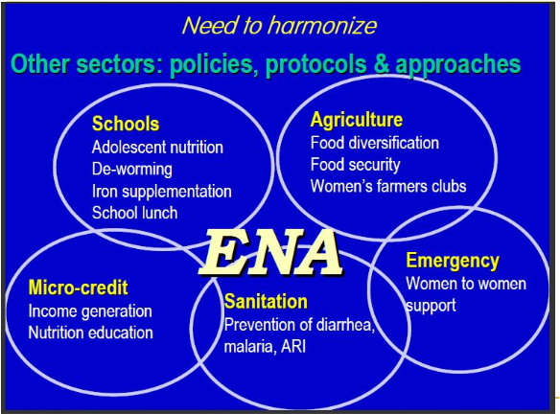

Slide 29
Infant feeding options in the context of HIV/AIDS
Group1: Pregnant women whose HIV status is unknown or who have been tested and are HIV negative:
As before…
- Exclusive breastfeeding 0 to 6 months
- Introduction of Complementary Feeding at 6 months
- Continued breastfeeding to 24months+

Slide 30
Group 2: Pregnant women who have been tested and are HIV positive:
Ideally a woman should be supported through counseling to make an informed choice on how to feed her infant to reduce risk of HIV transmission.
Provision of ARVs to reduce transmission

Slide 31
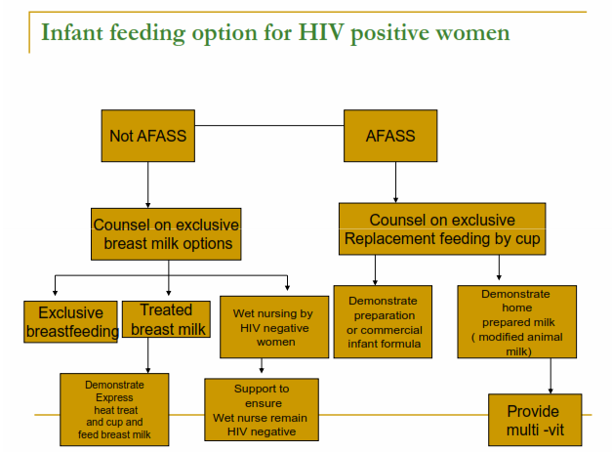

Slide 32
Infant Feeding recommendations for HIV+ women
When replacement feeding IS acceptable, feasible, affordable, sustainable and safe, avoidance of all breastfeeding by HIV-infected mothers is recommended…”
Replacement feeding from birth with breast milk substitutes (cup & spoon).
Key words are affordable and safe
Exclusive replacement feeding (never mix-feed!)

Slide 33
How Can Families Decide? -1
What is meant by ACCEPTABLE?
- There are social and cultural norms about infant feeding.
- Concerns about stigma associated women who do not breastfeed, suspicion of HIV.
What is meant by FEASIBLE?
- There are economic, behavioral, psychosocial aspects for care-giver and infant.
- Resources and skills are required

Slide 34
How Can Families Decide? -2
What is meant by AFFORDABE?
- Able to purchase adequate amount of the formula over the duration it is needed.
- Able to purchase necessary fuel, equipment.

Slide 35
How Can Families Decide? -3
What is meant by SUSTAINABLE?
- It must be practiced every day and night
- Resources must be available throughout
- It should be exclusive over first 6 months
What is meant by SAFE?
- Free from contamination
- Nutritious
- Free from stigma
- Does not spillover to general population

Slide 36
Replacement Feeding Options for HIV+ mothers
commercial infant formula
home prepared infant formula (modified, with additional nutrients)
enriched family diet with BM/V supplements after 6 months

Slide 37
What do we know about the feasibility of commercial infant formula?
High acceptance/adherence in some countries with access to clean water, health care, subsidized cost.
Stigma associated with its use widely reported in Africa
Access to safe water, health care needed
Proper instruction on safe preparation, feeding
Costs are high

Slide 38
When replacement feeding IS NOT acceptable, feasible, affordable, sustainable and safe…
Option 1: Safer breastfeeding
Option 2: Heat treating breast milk
Option 3: Wet nursing by HIV negative woman
Option 4: Early cessation of breastfeeding

Slide 39
Option 1: Safer breastfeeding
Exclusive breastfeeding…
Avoid mixed feeding, especially in early months, as irritates gut and may lead to virus transmission.
Maintain good breast health (higher transmission risk with mastitis or crack nipples…)
Mothers with full-blown AIDS should stop breastfeeding.
Cessation of breastfeeding when AFASS

Slide 40
Option 2: Heat Treating Breast milk
Express breast milk
Heat treat breast milk (bring to boil, then cool)
Cup feed breast milk
Option 3: Wet Nursing
Ensure wet-nurse is HIV negative
Exclusive breastfeeding
Maintain breast health

Slide 41
Option 4: Early Cessation of Breastfeeding
Shorten duration of exposure to HIV virus in breast milk
Stop breastfeeding as soon as replacement feeding is acceptable, feasible, affordable, sustainable, and safe
Key words are affordable and safe
Experience suggests that breastfeeding should/could be stopped at 6 months, but this is dependant on circumstance of mother and family

Slide 42
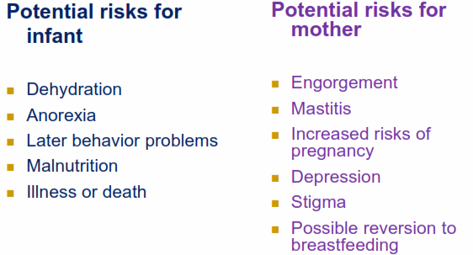
What do we know about the feasibility of early cessation of breastfeeding?

Slide 43
Cont’…
Breast milk contributes > 50% of the nutrient intake of children > 6 months in developing countries.
Replacing breast milk nutrients and energy won’t be easy

Slide 44
How to negotiate with women regarding their Nutrition
Demonstration of Negotiation
Steps of negotiation
ALIDRAA
Ask woman if she is pregnant or lactating, and about her own feeding practices.
Listen to the woman
Identify difficulty(ies) and causes of difficulty(ies)
Discuss different feasible options with the mother
Recommend and negotiate doable actions
Agree which practice will the mother try; mother repeats agreed upon practice
Appointment for follow-up

