Slide 1
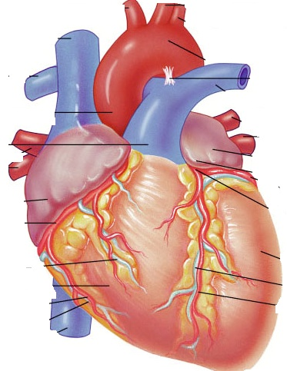
NURSING CARE OF PATIENTS WITH HEMATOLOGICAL & TISSUE PERFUSION DISORDERS
For 2nd year regular Nursing Students
By Setarg Ayenew
April, 2020
Debre Markos, Ethiopia

Slide 2
Learning objectives
After this topic the students will be able to;
  List the components of blood.
  Describe different types of hematologic & perfusion disorders
  Identify data to collect when caring for a patient with a disorder of the hematologic or lymphatic system.
  Identify laboratory and diagnostic studies that are used when evaluating the hematologic and lymphatic systems.
  Plan nursing care for patients undergoing diagnostic tests of the hematologic or lymphatic systems.
  List common therapeutic measures used for patients with hematologic and lymphatic disorders

Slide 3
Outlines
RBC disorders
  Anemia
  Polycythemia
WBC disorders
  Leukemia
  Lymphoma:
    Non-Hodgkin’s lymphoma (NHL)
    Hodgkin’s lymphoma (HL)
Platelet disorders
  Thrombocytopenia
  Thrombocythemia
Hemophilia
Shock
Malaria

Slide 4
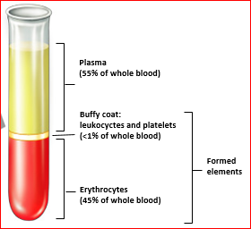
Anatomy & physiology overview
The hematologic system includes
  The bone marrow,
  Blood and its components and
  The reticuloendothelial system (RES).
Notes:
The RES is composed of special tissue macrophages (particularly spleen, lymph nodes, lungs, and liver). When released from the marrow, monocytes spend a short time in the circulation (about 24 hours) and then enter the body tissues. Within the tissues, the monocytes continue to differentiate into macrophages, which can survive for months or years. Macrophages have a variety of important functions.
They defend the body against foreign invaders (ie, bacteria and other pathogens) via phagocytosis.
They remove old or damaged cells from the circulation.
They stimulate the inflammatory process and present antigens to the immune system (see Chapter 50).
Macrophages give rise to tissue histiocytes, including Kupffer cells of the liver, peritoneal macrophages, alveolar macrophages, and other components
of the RES.
Thus, the RES is a component of many other organs within the body, particularly the spleen, lymph nodes, lungs, and liver.

Slide 5
Blood
Three primary cell types:
  erythrocytes (red blood cells [RBCs], red cells),
    Carries hemoglobin to provide oxygen to tissues; average lifespan is 120 days
  leukocytes (white blood cells [WBCs]), and
  thrombocytes (platelets).
    Fragment of megakaryocyte; provides basis for coagulation to occur; maintains hemostasis; average lifespan is 10 days
Blood makes up ∼7% to 10% of the normal body weight and amounts to 5 to 6 L of volume.
Blood serving as a link between body organs

Slide 6
Blood …
Leukocyte
Fights infection
Neutrophil
Essential in bacterial infection via phagocytosis
Monocyte
Enters tissue as macrophage; highly phagocytic, especially against fungus; immune surveillance
Eosinophil
Involved in allergic reactions (neutralizes histamine); digests foreign proteins
Basophil
Contains histamine; integral part of hypersensitivity reactions
Integral component of immune system
Lymphocyte
➔
➔
➔
➔
➔
Types of leukocytes

Slide 7
Blood …
Leukocytes …
Lymphocyte
Integral component of immune system
T lymphocyte
Responsible for cell-mediated immunity; recognizes material as “foreign” (surveillance system)
B lymphocyte
Responsible for humoral immunity; many mature into plasma cells to form antibodies
Plasma cell
Secretes immunoglobulin (Ig, antibody); most mature form of B lymphocyte

Slide 8
FUNCTIONS OF BLOOD
transport of O₂, nutrients, water, hormones, electrolytes, drugs and metabolic wastes
Contribution to regulation of temperature
Vital role in reproduction - hydraulic mechanism for penile erection
Defense mechanisms by antibodies and leucocyte
Coagulation to control bleeding
8

Slide 9
Anatomy & physiology overview …
What is Hematopoiesis?
  Hematopoiesis is a complex process of the formation and maturation of blood cells
Bone marrow is the tissue responsible for blood formation.
  It produces RBCs, WBCs, and platelets
The bone marrow first produces blood stem cells, which are immature, unspecialized (undifferentiated) cells.
These are capable of becoming any one of several types of blood cells: RBCs, WBCs, or platelets, depending on the body’s needs

Slide 10
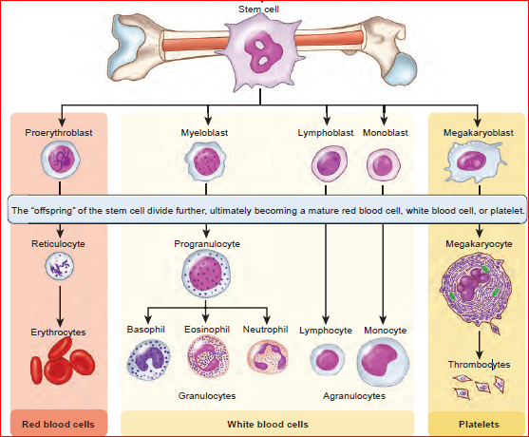

Slide 11
Assessment and Diagnostic Evaluation
Extensive laboratory tests are often required to diagnose a hematologic disorder
  Hematologic studies include
    CBC
    Blood chemistry
    Coagulation tests
  Bone Marrow Aspiration (BMA) and Biopsy

Slide 12
Hematologic studies
CBC
White blood cell count
4,500 – 11,000/mm³
Hematocrit
Male: 42 – 52%
Female: 36 – 47%
Hemoglobin
Male: 13 -8 g/dl
Female: 12 – 16g/dl
Platelets:
150,000 – 450,000/mm³
↑ed in acute infections
↓ed in immune supressesion
↑ed in chronic hypoxia or dehydration
↓ed in anemia or blood loss
↑ed in chronic hypoxia
↓ed in anemia or blood loss
↑ In Polycythemia Vera or malignancy
↓ In bone marrow suppression

Slide 13
Hematological studies …
Hematological studies |  | Normal range | Implication
RBC count | Male | 4.2 – 5.4m/mm3 | ↑ed in chronic hypoxia ↓ed in anemia or blood loss
 | Female | 4.6 – 6.1m/mm3
Reticulocytes |  | 1.5-2.5% | ↑ in hypoxia or anemia ↓ in RBC maturation defect
PT |  | 9 -12.5 seconds | Clotting factors deficiency ↓ Vit K excess
aPTT) |  | 29 40 seconds
INR |  | 0.8 – 1.1
PT: Prothrombin time
aPTT: Activated Partial thromboplastin time
INR: International Normalized Ratio

Slide 14
Hematologic assessment …
RBC indices
  Mean Cell (Corpuscular) volume (MCV)
    MCV is average size of red blood cells
    Normal range 80 – 100fL; If >100fL macrocytic, if < 80fL microcytic
  Mean Corpuscular Hemoglobin (MCH)
  Mean Corpuscular Hemoglobin Concentration(MCHC)
  RBC distribution width (RDW)
Notes:
MCV = Hct (%)*10/RBC (millions)

Slide 15
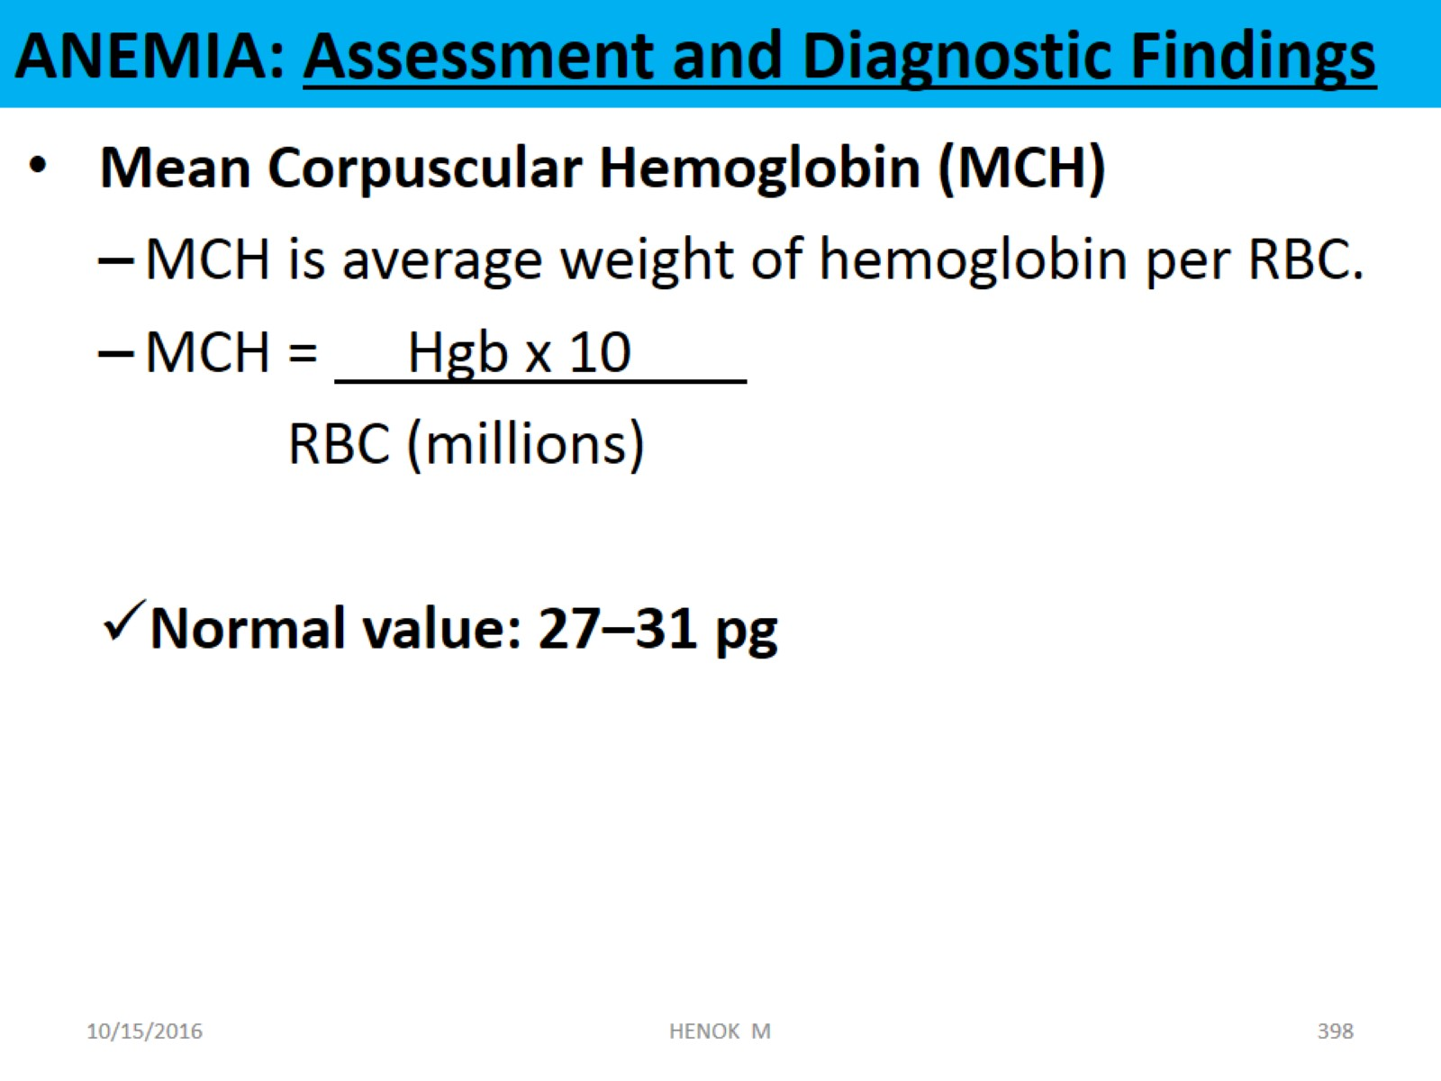
ANEMIA: Assessment and Diagnostic Findings
Hematologic assessment …
Low value is associated with anemia and iron deficiency.
High value is associated with hereditary spherocytosis.

Slide 16
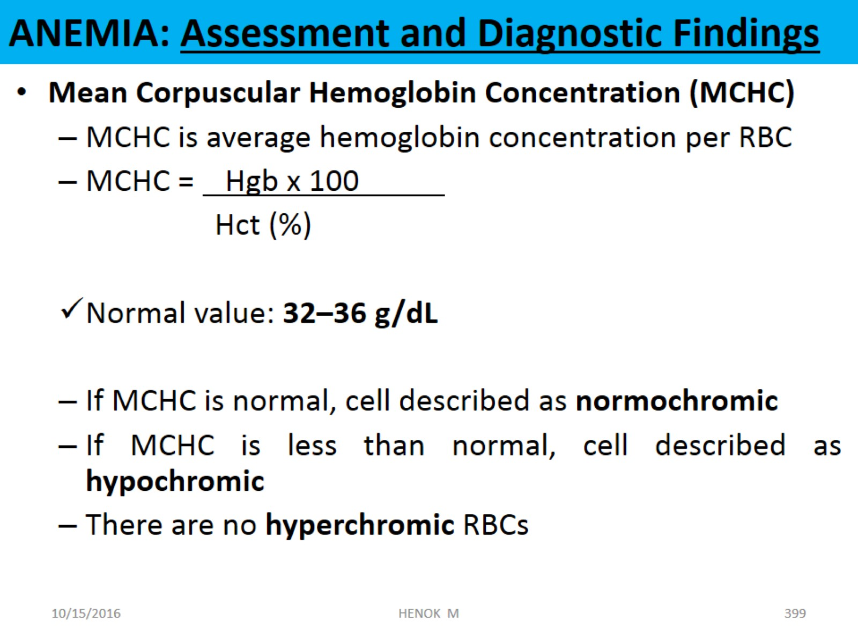
ANEMIA: Assessment and Diagnostic Findings
Hematologic assessment …

Slide 17
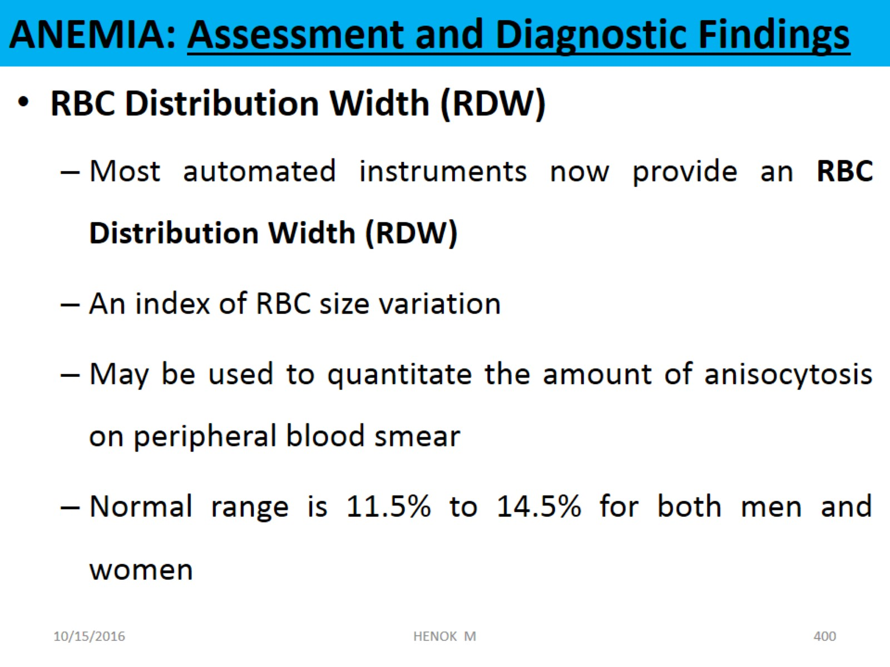
ANEMIA: Assessment and Diagnostic Findings
Hematologic assessment …
-- high values are associated with iron deficiency, vitamin B12 or folate deficiency.
Notes:
RDW- Indicates the degree of abnormal variation in the size of the RBCs.
Low values have no known cause
Used to differentiate anemias from one another and from thalassemia

Slide 18
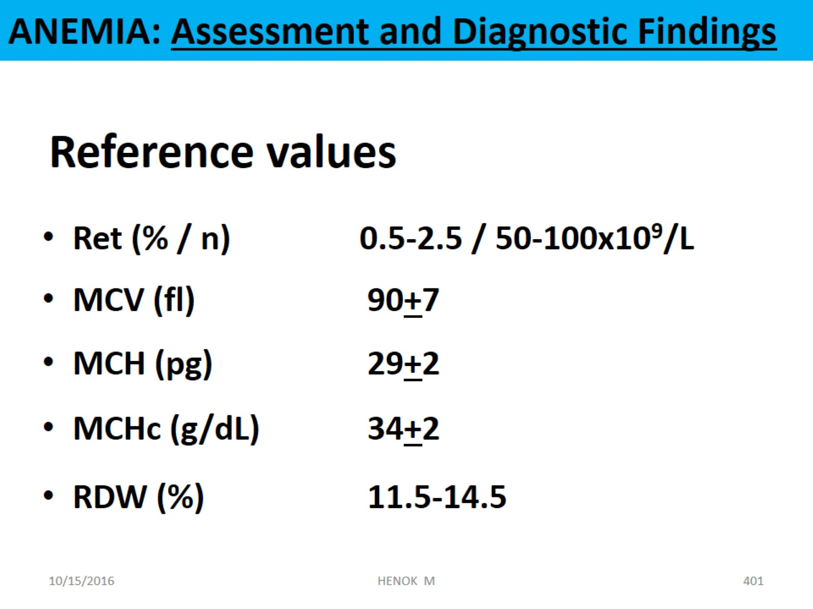
ANEMIA: Assessment and Diagnostic Findings
Hematologic assessment …

Slide 19
Self Assessment #1
Which laboratory blood test result for a client undergoing hematologic assessment does the nurse report immediately?
  Red blood cell count 1.2 million/mm3
  Platelets 185,000/mm3
  Hematocrit 36%
  INR 1.2
What are the functions of blood
Describe the process of hematopoiesis

Slide 20
HEMATOLOGIC DISORDERS
Patients with hematologic disorders have problems related to their blood.
  When red blood cells (RBCs) are affected, oxygen transport is also affected, causing symptoms related to poor oxygenation.
  When white blood cells (WBCs) are affected, the patient is unable to effectively fight infections.
  If platelets or clotting factors are affected, bleeding disorders occur.

Slide 21
Hematologic Disorders …
The common hematologic disorders include
RBC disorders
Anemia
Polycythemia
WBC disorders
Leukemia
Lymphoma
Clotting disorders
Hemophilia
Thrombocytopenia
Thrombocythemia
→IDA
→Megaloblastic anemia
→ Aplastic anemia
→Immune hemolytic anemia
→SCD
→ Thalassemia e.t.c…
Hodgkin's Lymphoma
Non Hodgkin’s Lymphoma

Slide 22
DISORDERS OF RED BLOOD CELLS
1. Anemia
Anemia is a condition in which there is abnormally low number of circulating RBCs, low hemoglobin concentration, or both.
  This results in a ↓ed amount of oxygen to body tissues.
According to WHO anemia is defined as Hb <13 g/dl in men and <12 g/dl in women.
  Classified as moderate (Hb 7-10 g/dl) or severe (Hb <7g/dl).

Slide 23
Disorders of RBCs: Anemia …
Anemia may results from blood loss, inadequate RBC production, or ↑ed RBC destruction.
Anemia is not a specific disease state but a sign of an underlying disorder.
It is by far the most common hematologic condition
Reading assignment
  Anemia of chronic diseases
  Drug induced anemia
  Reticulocytosis

Slide 24
Classifications of Anemias
Anemia may be classified in several ways
Morphologic
  Normocytic: MCV= 80-100fL
  Macrocytic: MCV > 100 fL
  Microcytic : MCV < 80 fL
Pathophysiologic approach
  Excessive blood loss (bleeding)
  Decreased RBC production (hypo proliferative)
  Increased RBC destruction (hemolytic anemia)

Slide 25
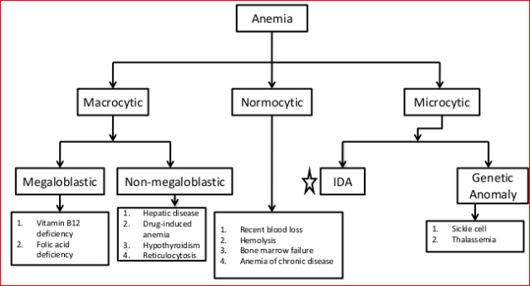
Morphological classification …

Slide 26
Etiological classification …
Anemia
Bone marrow damage
Medications (eg, CAF)
chemicals (eg, benzene)
lack of factors necessary for erythrocyte formation
eg, iron, vitamin B12, folic acid, erythropoietin
Blood loss anemia
Bleeding from GIT, epistaxis, trauma, bleeding from genitourinary tract (eg, menorrhagia)
Hemolytic anemia
Sickle cell anemia
Thalacemia
Glucose-6-phosphate dehydrogenase deficiency)
Direct injury to the erythrocyte within the circulation (eg,mechanical heart valve).
Hypo proliferative anemia
Notes:
Iron deficiency
Decreased reticulocytes, iron, ferritin, iron saturation, MCV; increased TIBC
Vitamin B12 deficiency (megaloblastic)
Decreased vitamin B12 level; increased MCV
Macrocytic-Normochromic
Folate deficiency (megaloblastic)
Decreased folate level; increased MCV
Decreased erythropoietin production (eg, from renal dysfunction)
Decreased erythropoietin level; normal MCV and MCH; increased creatinine level (likely)
Cancer/inflammation
Normal MCV, MCH; normal or decreased erythropoietin level; increased % of iron saturation, ferritin level; decreased iron, TIBC

Slide 27
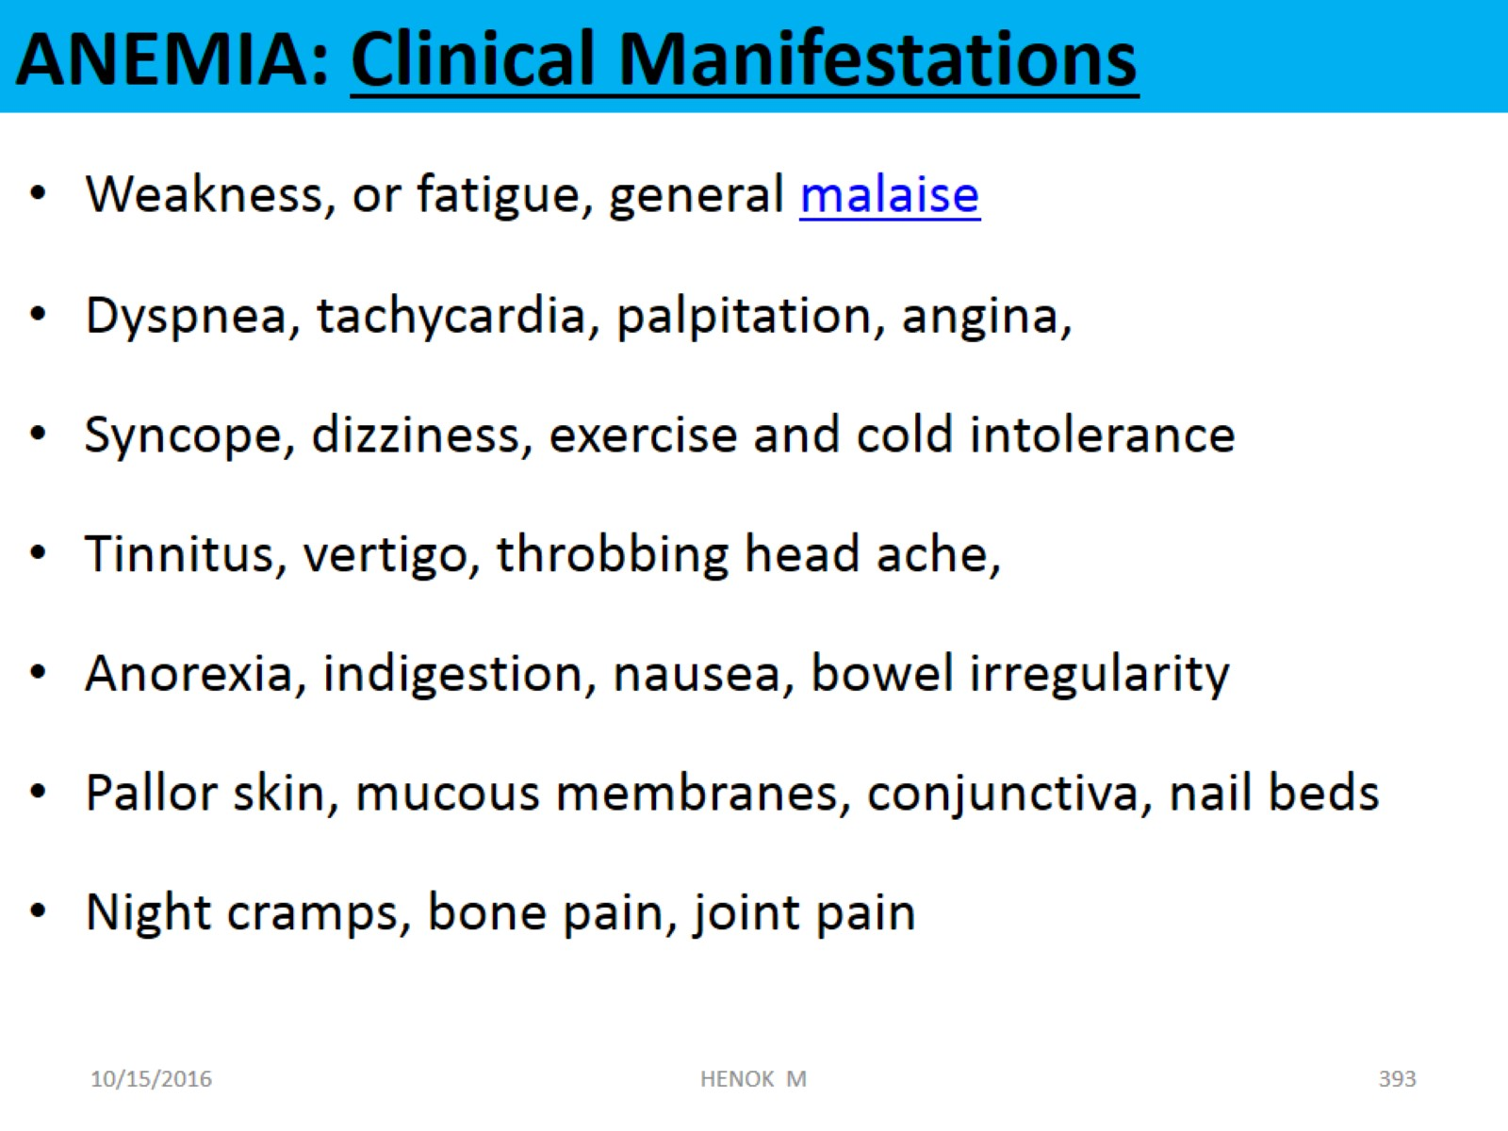
ANEMIA: Clinical Manifestations

Slide 28
Specific Anemias
Hypo proliferative Anemias
  Iron deficiency anemia (IDA)
  Megaloblastic anemia
    Vit B12 deficiency anemia
    Folic acid deficiency anemia
  Aplastic Anemia
Hemolytic Anemia
  Sickle cell anemia (SCD)
  Thalassemia
  Immune hemolytic anemia

Slide 29
1. Iron Deficiency Anemia (IDA)
IDA typically results when the intake of dietary iron is inadequate for hemoglobin synthesis
The most common type of anemia world wide
It is a major health problem in developing countries.
The incidence is more common in women than men
RBCs appear pale and are small (microcytic, Hypochromic)

Slide 30
IDA …
Etiology
Chronic blood loss: the most common cause
  GI bleeding
  excessive menstrual bleeding
  hookworm infestation
Insufficient intake of iron
Iron malabsorption: e.g. Gastrectomy, Celiac disease
Increased requirements (pregnancy, periods of rapid growth).

Slide 31
Clinical Manifestations
The symptoms and findings are related to anemia itself or to the underlying disease that causes anemia.
Tissue hypoxia: fatigue, dyspnea on exertion, pallor of skin and mucous membranes
Compensatory attempts: tachycardia, hyperventilation e.t.c
Smooth and sore tongue; brittle and ridged nails; angular cheilosis (lesions at corners of mouth), koilonychia (spoon-shaped fingernails), and pica (craving to eat unusual substances)

Slide 32
IDA: Diagnostic findings
History & physical examination
Decreased hematocrit and hemoglobin level
↓ed RBC count and microcytic morphology(↓MCV)
Reticulocyte count – usually normal (↓/↑)
↓ed serum iron & ferritin
Normal or ↑ed total iron binding capacity (TIBC)
Normal level of Vit B12
Normal folate level
Notes:
Ealy stage and mild deficiency increase in reticulocytes but in severe deficiency of iron decrease in reticulocytes

Slide 33
IDA: Diagnostic findings …
Determination of source of chronic blood loss
  upper and lower GI studies: such as sigmoidoscopy, colonoscopy …
  Stool exam for occult blood if Hx of upper GI bleeding
Note
  Decreased Ferritin and Hgb values are the most reliable and clinically useful laboratory findings
Notes:
Ealy stage and mild deficiency increase in reticulocytes but in severe deficiency of iron decrease in reticulocytes

Slide 34
Treatment of IDA
Identify underlying cause and treat it
  e.g. Diagnosis and correction of chronic blood loss.
Iron therapy
  Correct anemia and replenish stores by oral iron
  Oral ferrous sulfate preferred and least expensive; (Ferous sulfate 300mg (60 mg elemental iron) 3x/day for 4-6 months
  treatment continues until hemoglobin level is normalized

Slide 35
Treatment of IDA …
Liquid forms of iron that cause less GI distress are available: Use straw to prevent tooth discoloration
Parenteral therapy may rarely be used when patient cannot tolerate or is noncompliant with oral therapy
  sodium ferric gluconate (Ferrlecit),
  iron sucrose (Venofer), or
  iron dextran (DexFerrum).
For severe anemia – blood transfusion & Follow-up

Slide 36
Nursing management
Food sources high in iron include organ meats (eg, beef or calf’s liver, chicken), other meats, beans and leafy green vegetables
Increase the intake of vitamin C (citrus fruits & orange juices, strawberries, tomatoes, broccoli), to enhance iron absorption.
Instruct the patient to take the supplement an hour before meals because iron is best absorbed on an empty stomach

Slide 37
Nursing management …
Antacids or dairy products should not be taken with iron, because they greatly diminish its absorption
For parenteral iron preparations; use Z - track injection and avoid massaging ⇒ to minimize pain and coloring effect of drugs on the skin
Complications:
  Ischemic organ damage, such as MI or stroke.
  Anaphylaxis to parenteral iron therapy, especially with iron dextran.
Notes:
For parenteral iron preparations; Use Z - track injection and Avoid massaging ➔ to minimize pain and coloring effect of drugs

Slide 38
2. Megaloblastic Anemia
Are group of disorders caused by impaired DNA synthesis
Characterized by an abnormally large red blood cells
RBCs are easily fragile
Etiology
  Vitamin B12 deficiency:
    inadequate dietary intake
    Malabsorption
    Intrinsic Factor deficiency => pernicious anemia
  Folic acid deficiency: - inadequate dietary intake
- Pregnancy
- Alcoholism
- Drugs: anticonvulsants, OCPs

Slide 39
Clinical manifestations
Symptoms of other anemia
For vitamin B12 deficiency
  paresthesia in the extremities (particularly numbness and tingling in the feet and lower legs)
  difficulty of maintaining balance because of damage to the spinal cord, and
  lose of position sense (proprioception)

Slide 40
Assessment and Diagnostic Findings
Determination of serum folate level
RBC morphology – macrocytic
Intrinsic factor antibody test
Schilling test - the classic method of determining the cause of vitamin B12 deficiency
Notes:
The classic method of determining the cause of vitamin B12 deficiency is the Schilling test, in which the patient receives a small oral dose of radioactive vitamin B12, followed in a few hours by a large, nonradioactive parenteral dose of vitamin B12 (this aids in renal excretion of the radioactive dose). If the oral vitamin is absorbed, more than 8% is excreted in the urine within 24 hours; therefore, if no radioactivity
is present in the urine (ie, the radioactive vitamin B12 stays within the GI tract), the cause is GI malabsorption of the vitamin B12. Conversely, if radioactivity is detected in the urine, the cause of the deficiency is not ileal disease or pernicious anemia. Later, the same procedure is repeated, but this time intrinsic factor is added to the oral radioactive vitamin B12. If radioactivity is now detected in the urine (ie, the vitamin B12 was absorbed from the GI tract in the presence of intrinsic factor), the diagnosis of pernicious anemia can be made. The Schilling test is useful only if the urine collections are complete; therefore, the nurse must promote the patient’s understanding and compliance with this collection.

Slide 41
Treatment of megaloblastic anemia
Megaloblastic anemia - Vitamin B12 deficiency
  Cobalamin, 1000micrograms (1mg), IM, every day for one week, every week for four weeks and then, if the underlying disorder persists, 1mg every month for the remainder of the patient's life
Megaloblastic anemia-Folate deficiency
  Nutritional supplementation is the best
  Folic acid, 1 to 5mg P.O., daily for 1-4 months, or until complete hematologic recovery

Slide 42
3. APLASTIC ANEMIA
Aplastic anemia is a rare disease
caused by a decrease in or damage to marrow stem cells
Markedly reduced hematopoiesis
  Therefore, in addition to severe anemia, significant neutropenia and thrombocytopenia also occur.

Slide 43
Cause: Aplastic Anemia
Can be congenital or acquired
Most cases are idiopathic
Infections and pregnancy can trigger
medications, chemicals, or radiation damage. E.g
  benzene and benzene derivatives (eg, airplane glue, paint remover, dry-cleaning solutions)
  Certain antibiotics (chloramphenicol), chemotherapy ..
Notes:
medications, chemicals, or radiation damage. E.g benzene and benzene derivatives (eg, airplane glue, paint remover, dry-cleaning solutions), inorganic arsenic, glycol ethers, plutonium, and radon, have also been implicated as potential causes.

Slide 44
Clinical manifestations
The manifestations are often insidious.
Sign & symptoms of infections
symptoms of anemia (eg, fatigue, pallor, dyspnea).
Purpura (bruising) may develop later
Cervical lymphadenopathy may be seen.
Splenomegaly sometimes occur.
Retinal hemorrhages are common.

Slide 45
Diagnostic findings
Bone marrow aspiration
  A bone marrow aspirate shows an extremely hypo plastic or even aplastic (very few to no cells) marrow replaced with fat
RBC indices are normal
  Normocytic normochromic anemia

Slide 46
Treatment
Medical management
  Remove the underline cause
  Supportive - blood transfusion
  Bone marrow transplant => in severe cases
  Immunosuppressive anti thymocyte globulin (TAG)
Nursing Management
  Patients with aplastic anemia are vulnerable to problems related to erythrocyte, leukocyte, and platelet deficiencies.
  They should be assessed carefully for signs of infection and bleeding.

Slide 47
HEMOLYTIC ANEMIAS

Slide 48
1. Sickle Cell Anemia
Sickle cell anemia is a severe hemolytic anemia that results from inheritance of the sickle hemoglobin(HbS) gene.
Normal adult hemoglobin is HbA
The HbS acquires a crystal-like formation when exposed to low oxygen tension.
Notes:
These long, rigid erythrocytes can adhere to the endothelium of small vessels; when they adhere to each other, blood flow to a region or an organ may be reduced.
If ischemia or infarction results, the patient may have pain, swelling, and fever.

Slide 49
Sickle Cell Anemia …
The sickling process takes time; if the erythrocyte is again exposed to adequate amounts of oxygen (eg, when it travels through the pulmonary circulation) before the membrane becomes too rigid, it can revert to a normal shape.
For this reason, the “sickling crises” are intermittent.
Cold can aggravate the sickling process
Notes:
Cold can aggravate the sickling process, because vasoconstriction slows the blood flow.
Oxygen delivery can also be impaired by an increased blood viscosity, with or without occlusion due to adhesion of sickled cells; in this situation, the effects are seen in larger vessels, such as arterioles.

Slide 50
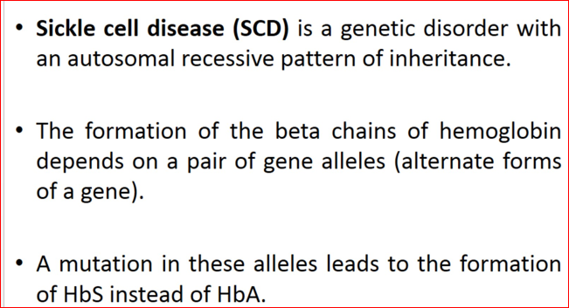
Cause

Slide 51
Risk Factors
Hypoxia
Dehydration
Infection
Venous stasis
Pregnancy
Alcohol consumption
High altitude
Emotional stress
Strenuous exercise
Acidosis
Anesthesia

Slide 52
Pathophysiology
Erythrocytes containing HbS exposed to ↓ed O₂ tension ( such as in venous blood)
Erythrocytes loses their normal shape and becomes rigid, sickle shaped and clumped together and causing the RBCs to become sticky & easily fragile
These clumped RBCs block blood flow
Leads to further tissue hypoxia (↓ O₂ tension)
More sickle shaped cells, clumping and obstruction of blood flow and ischemia
Notes:
Cold can aggravate the sickling process, because vasoconstriction slows the blood flow.
Oxygen delivery can also be impaired by an increased blood viscosity, with or without occlusion due to adhesion of sickled cells; in this situation, the effects are seen in larger vessels, such as arterioles.

Slide 53

Clinical manifestations
Short lifespan of RBCs (10 to 12 days).
Anemia is always present;
  usually Hb values are 7 to 10 g/dL.
Jaundice is characteristic
The chronic anemia is associated with tachycardia, cardiac murmurs, and often an enlarged heart (cardiomegaly).
Dysrhythmias and heart failure may occur in adults.

Slide 54
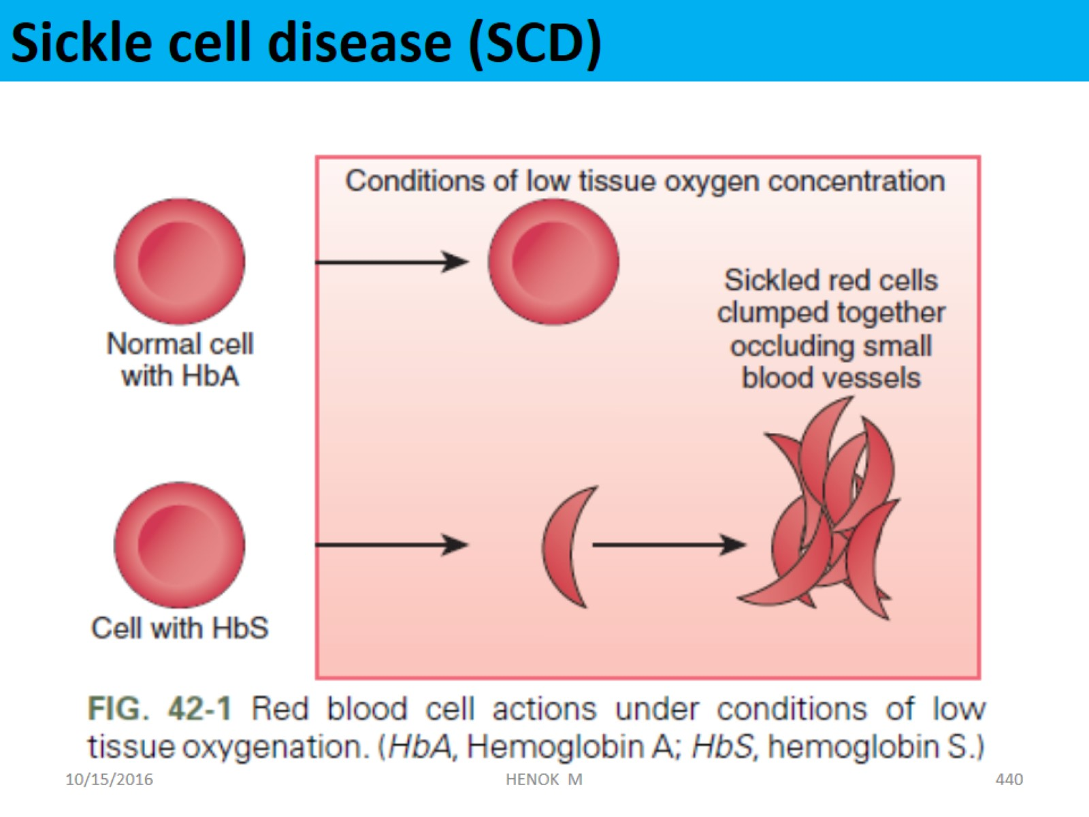
Sickle cell disease (SCD)

Slide 55
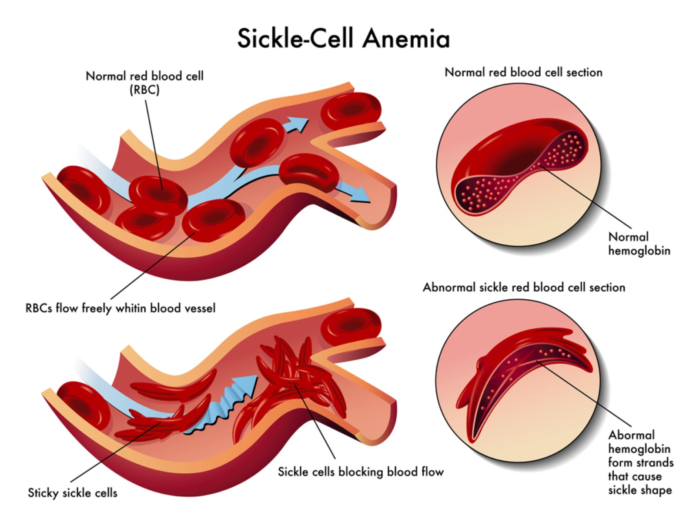

Slide 56
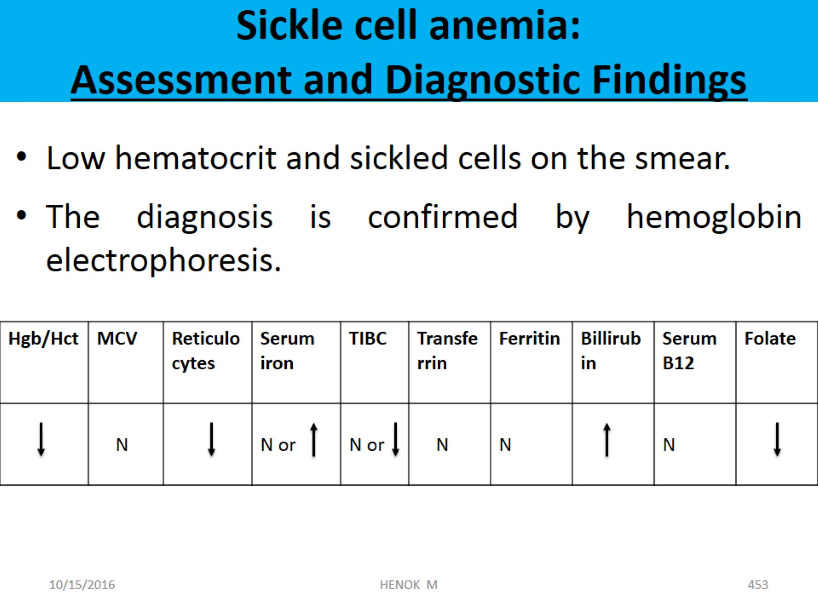
Sickle cell anemia:
Assessment and Diagnostic Findings

Slide 57
Complications
Acute chest pain syndrome
Pulmonary hypertension
Leg ulcer – blockage of micro circulations
Renal failure
CVAs
Priapism
Notes:
PRIAPISM LEADING TO IMPOTENCE. Male patients may develop sudden, painful episodes of priapism (persistent penile erection). The patient is taught to empty his bladder at the onset of the attack, exercise, and take a warm bath. If an episode persists longer than 3 hours, medical attention, which consists of IV hydration, administration of analgesic
agents, and possible penile intracavernosal aspiration, is recommended. Repeated episodes may lead to extensive vascular thrombosis, resulting in impotence.

Slide 58
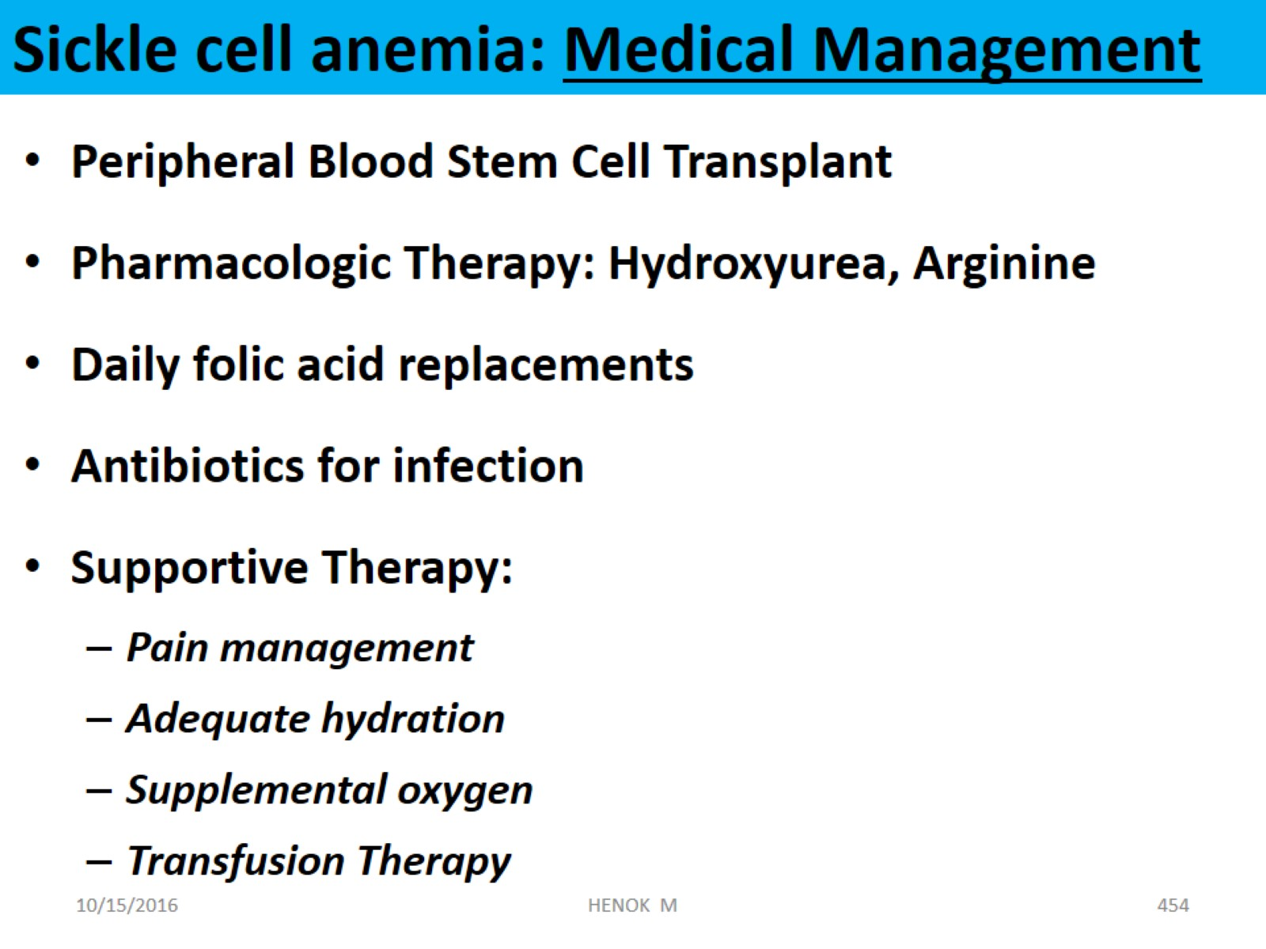
Sickle cell anemia: Medical Management

Slide 59
2. THALASSEMIA
Thalassemias are a group of hereditary anemias
Are associated with defective synthesis of hemoglobin
  either α or β chains within the hemoglobin molecule are missed or defected.
This increases the rigidity of the erythrocytes and thus the premature destruction of these cells
Notes:
The thalassemia occur worldwide, but the highest prevalence is found in people of Mediterranean, African, and Southeast Asian ancestry.

Slide 60
Thalassemia …
Thalassemia is characterized by
  hypochromia (an abnormal decrease in the hemoglobin content of erythrocytes) ➔ bull’s eye appearance
  extreme microcytosis (smaller-than-normal erythrocytes),
  destruction of blood elements (hemolysis), and
  variable degrees of anemia.

Slide 61
Thalassemia …
Bone marrow transplantation (BMT) offers a chance of cure in children
Blood transfusion when BMT is not possible

Slide 62
2. IMMUNE HEMOLYTIC ANEMIA
Hemolytic anemias can result from exposure of the erythrocyte to antibodies
It can be caused by
  Autoimmune antibodies
  Antigen antibody reactions

Slide 63
Immune Hemolytic Anemia …
Clinical features
  fatigue and dizziness.
  Splenomegaly (>80% cases) is the most common physical finding
  Hepatomegaly
  Lymphadenopathy and
  Jaundice

Slide 64
Immune Hemolytic Anemia …
Assessment and Diagnostic Findings
  Low hemoglobin level and hematocrit,
  Increase reticulocyte count
  The serum bilirubin level is elevated
  The Coombs test (also referred to as the direct antiglobulin test [DAT]), which detects antibodies on the surface of erythrocytes, shows a positive result.

Slide 65
Treatment
High dose of corticosteroids for several weeks
  decrease the macrophage’s ability to clear the antibody-coated erythrocytes.
If severe hemolysis or no remission to corticosteroids;
  Blood transfusion
  Splenectomy
Notes:
Corticosteroids decrease the macrophage’s ability to clear the antibody-coated erythrocytes.

Slide 66
POLYCYTHEMIA
It is a disease state in which the proportion of blood volume that is occupied by red blood cells increases.
It is a term used when the hematocrit is elevated (to more than 55% in males, more than 50% in females).
The hematocrit (HCT) is expressed as the percent of a blood sample occupied by intact RBCs.
The Hb concentration is its content in grams per 100 mL of whole blood.

Slide 67
Classification
Polycythemia
Absolute polycythemia = ↑ in RBCs
Primary polycythemia
Polycythemia Vera
Secondary polycythemia
Chronic hypoxemia resulting from pulmonary disease, cardiac disease, high altitude
Erythropoietin secreting tumors such as renal-cell carcinoma, liver tumors …
Relative polycythemia = ↓ in blood volume
Notes:
Secondary polycythemia
Erythropoietin secreting tumors
Renal-cell carcinoma
liver tumors
von Hippel-Lindau disease
Uterine fibroids
Hemangioblastoma
Chronic hypoxemia
Chronic pulmonary disease
Right-to-left cardiac shunts
Sleep apnea
Massive obesity (Pickwickian syndrome)
High altitude
Chronic carbon monoxide poisoning (including heavy smoking)

Slide 68
POLYCYTHEMIA VERA (1⁰ Polycythemia)
It is a chronic myeloproliferative disorder in which the myeloid stem cells seem to have escaped normal control mechanisms.
It involves all bone marrow elements (predominantly RBCs)
These many cells thicken the blood => slowing blood flow => formation of blood clots => heart attack or stroke
Usually occurs in middle and later years

Slide 69
Causes and pathophysiology
Underlying cause is unknown.
  Hyperplasia of all bone marrow elements results in:
    Overproduction of all three blood cell lines, prominently RBCs.
    Increased red cell mass.
    Increased blood volume and viscosity.
    Decreased marrow iron reserve.
    Splenomegaly.
  Increased mass of blood cells increases viscosity and leads to engorgement of blood vessels and possible thrombosis
Notes:
There is mutation on the Janus kinase-2 gene (JAK2)
JAK2 is directly involved in the intracellular signaling of progenitor cells in bone marrow.
The peak incidence of PV is age 50-70 years.

Slide 70
Clinical Manifestations
Reddish purple skin and mucosa, pruritus (especially after bathing).
Splenomegaly(75%), hepatomegaly(30%).
  Epigastric discomfort, abdominal discomfort.
Painful fingers and toes from arterial and venous insufficiency, paresthesia.
Headache, fullness in head, dizziness, visual abnormalities, altered mentation from disturbed cerebral circulation.
Weakness, fatigue, night sweats, bleeding tendency.

Slide 71
Diagnostic Evaluation
Normal oxygen saturation
Enlarged spleen
CBC
  elevated RBC, hemoglobin and hematocrit (>55%);
  elevated WBC & platelets
Bone marrow aspirate and biopsy—hyperplasia.
Notes:
P/E
Plethoric face
Splenomegaly –75%
Hepatomegaly –30%
Polymerase chain reaction :JAK2 mutation

Slide 72
Complication
Thrombosis
  CVA (stroke)
  Myocardial infarction (MI)
Bleeding

Slide 73
Management
Phlebotomy (withdrawal of blood)
  250 to 500 mL removed at a time to maintain hematocrit less than 45%.
JAK1/JAK2 inhibitor : ruxolitinib
Aspirin at 75 mg/day unless contraindicated
For Pruritus, the nurse may recommend bathing in tepid or cool water

Slide 74
DISORDERS OF WHITE BLOOD CELLS
LEUKEMIA:
Learning Objective:
At the end of this unit the student will be able to
  Define leukemia
  Classify the different types of leukemias
  Describe the possible etiologies and epidemiology of leukemia.
  Identify the clinical features of leukemia
  Make presumptive diagnosis and refer to hospitals where special investigations can be done

Slide 75
LEUKEMIA:
Definition
  Leukemias are a group of malignant disorders affecting the blood and blood-forming cells of the bone marrow, lymph system, spleen, and liver.
  Leukemia differ from lymphomas in that, lymphomas arise primarily from lymph nodes but spread to blood and bone marrow only in "leukemic phase” of the diseases.

Slide 76
Classifications of Leukemia
Classification of leukemia is based on
Cell of origin
  Lymphoid leukemia
  Myeloid leukemia
Clinical course of the disease
  Acute leukemia
  Chronic leukemia

Slide 77
Classifications …
By combining the above two criteria, there are 4 main types of leukemia
Acute lymphoblastic leukemia (ALL)
  common in children: 85 % of cases
  It affects the lymphoid cell line
  believed to be curable with chemotherapy and radiation
Acute myelogeneous leukemia (AML)
  progressive proliferation of immature monocyte myelocytes from the bone marrow that invades the blood and other tissues
Chronic lymphoid leukemia (CLL)
Chronic myeloid leukemia (CML)

Slide 78
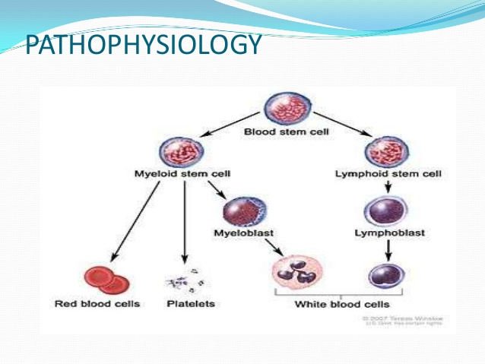
Leukemia ….

Slide 79
Etiology
Idiopathic
Genetic factors
  Hereditary (siblings have more risk)
  Chromosomal abnormality; down syndrome (trisomy 21)
Environmental factors
  Chemicals e.g. benzene, aromatic hydrocarbons …
  Infections e.g. HTLV-1- T-cell leukemia, EBV- ALL
  Radiating chemicals
Notes:
HTLV-1➔Human T-Cell Leukemia-lymphoma Virus -1

Slide 80
Clinical Features
ALL and AML share many clinical features.
In the majority of cases the initial symptoms are present for less than 3 months and are the consequence of bone marrow failure, i.e
  Symptoms of anemia such as tiredness, weakness, shortness of breath on exertion
  Recurrent infection
  Abrupt onset of fever & bleeding (ALL)

Slide 81
Clinical Features …
  Bruising and/or bleeding related to low platelet count
  lymph node enlargement and/or symptoms relating to enlargement of the liver and spleen.
  Symptoms related to hypoperfusion of the lungs and brain due to occlusion of microcirculation of these organs by blast cells.
  Sternal pain (unique feature of AML)

Slide 82
Diagnostic methods
Complete blood count will show
  Low Hemoglobin level
  WBC count -often very high, but occasionally decreased or normal
  Low Platelet count
Peripheral blood film shows characteristic leukemic cells
  immature lymph blasts (ALL)
  Immature myeloblasts (granulocytes) (AML)
Bone marrow aspiration

Slide 83
Treatment
Chemotherapy
Supportive therapy
  Treat anemia
  Control infections (hand hygiene, avoid crowds & injuries)
  Prevention of hemorrhage
  Encourage high protein diet, fiber and fluids
  Avoid hot drinks and spicy foods(ALL)
Notes:
ALL➔ Vincristine

Slide 84
Lymphoma
Lymphomas are neoplasms of Lymphoid origin
It is characterized by the abnormal proliferation of B or T cells in lymphoid tissue
Typically causing lymphadenopathy
Arise from
  B cells -85%
  T cells – most of the reminder
  NK cells - rare
  Other extra sites of involvement

Slide 85
Types of Lymphoma
They are often classified according to the degree of cell differentiation and the origin of the predominant malignant cell.
Two types of lymphoma
  NHL 85%
  HL15%

Slide 86
Non-Hodgkin Lymphoma : Etiopathogenesis
Chromosomal translocation
Associations to infections
  EBV : Burkitt, Hodgkin & sinonasal lymphomas,
  HCV : Lymphoplasmacytic lymphoma
  KSHV : body cavity (Kaposi) lymphoma in HIV
  H. pylori : MALT lymphoma
Immunodeficiency/suppression,
Environmental factors:
  Pesticides, herbicides, solvents, wood preservatives, dusts …
  Chemotherapy, radiation exposure

Slide 87
NHL : epidemiology
Incidence rate is increasing 2x since 1970s partly due to:
  HIV & other immunosuppression
  Increased awareness & diagnosis
Is the most prevalent hematologic neoplasm.
7th in frequency among all cancers.
The disease is more common in men, >50yrs

Slide 88
Clinical manifestations : NHL
1. Low-grade lymphomas
Painless, slow progressive peripheral LAP is the commonest symptom
  Not contagious
  Spontaneous regression can occur
Fatigue, weakness
2. Intermediate- & high-grade lymphomas
Lymphadenopathy (most)
Extranodal involvement
  GI sys, GUS, thyroid & CNS
  Waldeyer ring,
  skin, bone marrow,

Slide 89
NHL : Clinical manifestation …
B-symptoms occur in 35% are associated with adverse prognosis
  Unexplained Fever T>38⁰ C &
  drenching night sweating for > 2 weeks
  Unexplained weight loss >10% from baseline within 6months
High-grade & lymphoplasmacytic lymphomas often manifest with:
  Mediastinal mass, cough, chest pain &
  Leptomeningeal disease with cranial nerve palsies

Slide 90
NHL : P/E
Low grade lymphoma
  Peripheral lymphadenopathy
  Splenomegaly 40%
  Hepatomegaly
Intermediate- or high-grade
  Rapidly growing or Bulky lymphadenopathy
  Hepato-/splenomegaly
  Large abdominal mass (Burkitt)
  Testicular mass
  Skin lesions (e.g. mycosis fungoides T-cell)

Slide 91
BURKITT LYMPHOMA
Highly aggressive NHL (B-cell lymphoma)
The most rapidly progressive human cancer
High propensity to metastasize to CNS, bone marrow
Peripheral LAP or Large intra-abdominal or retroperitoneal masses with
  Intestinal obstruction
  Obstructive hydro nephrosis

Slide 92
Burkett lymphoma…
Three subtypes
  Endemic (African type)
  Sporadic
  HIV associated
Frequent in African children (endemic form): Jaw or facial bone (orbit) involvement in 50%.
The disease is curable in 75%.
Therefore, diagnosis should be fast
Aggressive treatment be commenced with in 48 hours ideally.

Slide 93
Clinical features
Both the endemic and non-endemic affect children or young adult
In both forms, the disease rarely arises in lymph nodes
In African patients, involvement of the maxilla or mandible is the common mode of presentation
In North America, abdominal tumors are common

Slide 94
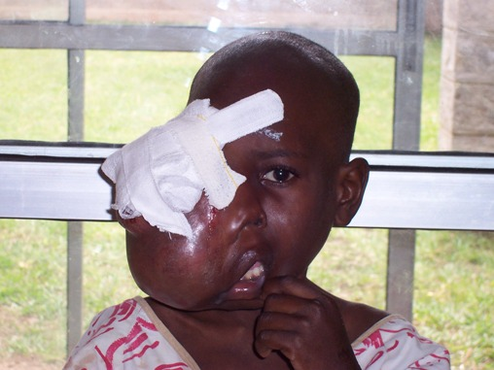

Slide 95
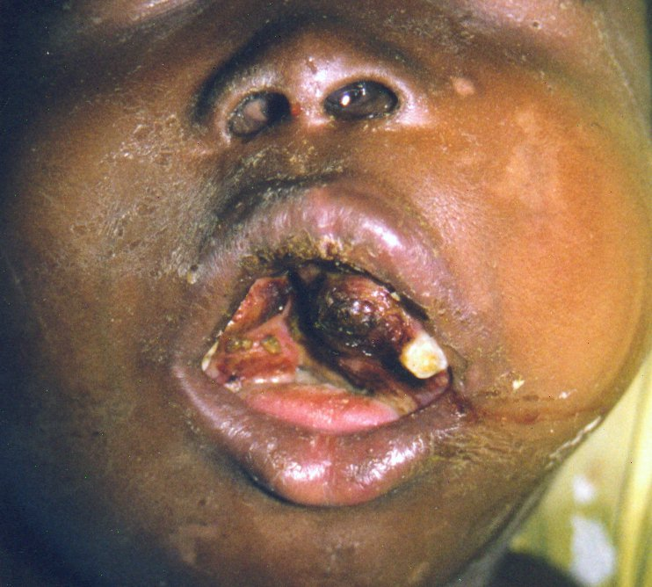

Slide 96
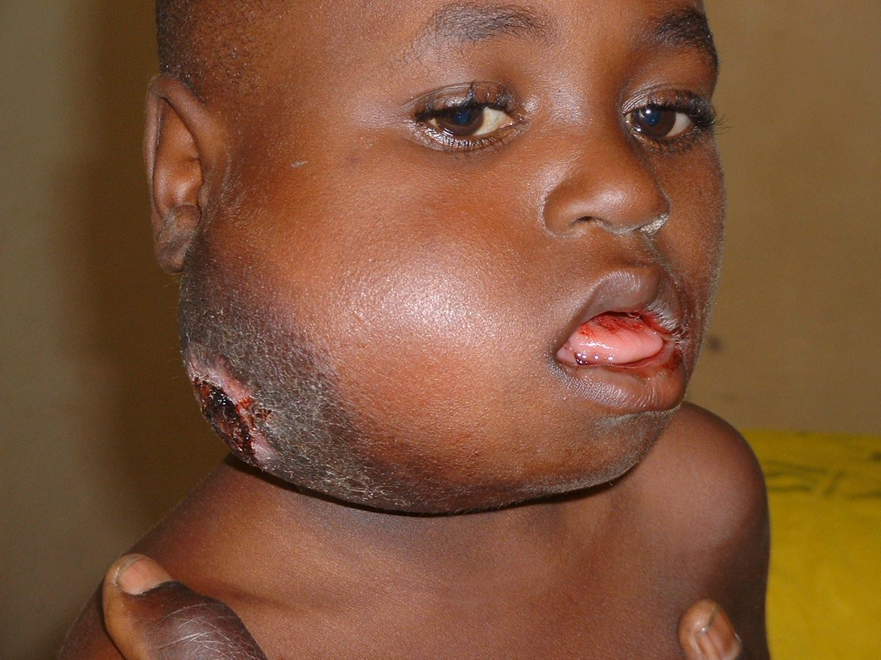
Histologically, the African and nonendemic diseases are identical, although there are clinical and virologic differences

Slide 97
MORPHOLOGY
The tumor cells are monotonous, are intermediate in size between small lymphocytes and large non-cleaved cells
A high mitotic rate is very characteristic of this tumour, as is cell death, accounting for the presence of numerous tissue macrophages containing ingested nuclear debris.
➔ ‘starry sky’ appearance

Slide 98
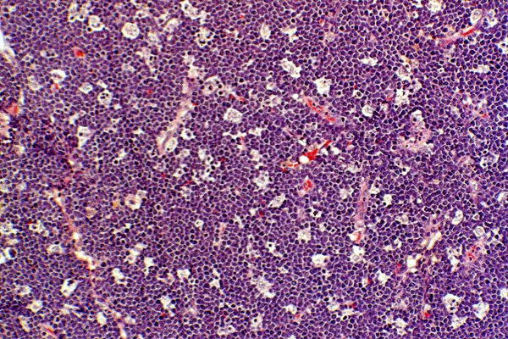


Slide 99
Prognosis
Burkitt lymphoma is a high-grade tumor that is among the fastest growing human neoplasms
With Very aggressive chemotherapy regimens, the majority of patients can be cured

Slide 100
Diagnosis: NHL
Excisional lymph node biopsy :
  is required to establish the pathologic diagnosis
  FNA or Needle core biopsies are insufficient as the diagnosis relies on careful assessment of altered nodal architecture, accompanying lymphomatous infiltrates.
B. Biopsy of Extranodal sites :
  is important in 35% i.e. when it is the primary presenting site.
C. Bilateral bone marrow biopsy : for staging rather than for diagnosis.
  Bilateral b/c disease involvement can be patchy .

Slide 101
NHL : Workup should include
CBC
LDH, + Serum chemistries
HIV, HBV tests
CXR, Ultrsound
CT Scan of Neck, Chest, abdomen & pelvis
Other tests depend on:
clinical findings & sub-type of NHL
LP for CSF analysis indicated if :
Neurologic signs
Primary CNS lymphoma
HIV-related lymphoma
Evidence of epidural, paranasal sinuses or nasopharyngeal involvement,
Also MRI : brain & spinal cord in those patients
Immunophenotypic analysis, Cytogenetic studies help to further classify the subtypes

Slide 102
NHL : complications
Cytopenias secondary to :
  Bone marrow infiltration or autoimmune destructions
Bleeding due to: thrombocytopenia, DIC or tumor invasion into vessels.
Infection : neutropenia
Pleural effusion & lung parenchymal lesions
Spinal cord compression
GI bleeding, perforation
Pain due to tumor invasion

Slide 103
NHL: Staging
Is important in selecting treating & determining prognosis
Necessary investigation for staging:
  CT scan of neck, chest, abdomen, & pelvis
  Bilateral bone marrow biopsy
Staging is based on number of lymph node regions, extra lymphoid organ involved and the relation to the diaphragm.

Slide 104
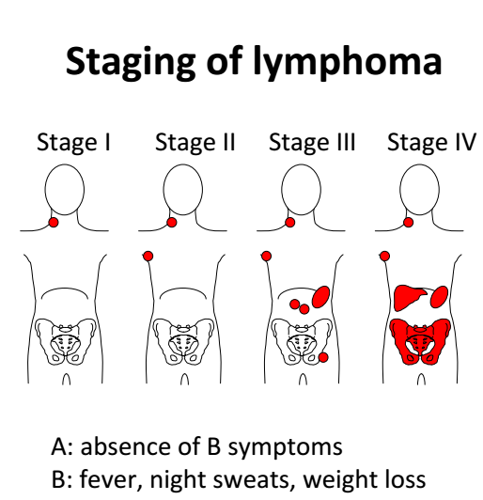
Ann Arbor 4 stages classification of Lymphomas (NHL & HL)
I. Single lymph node region or
extralymphatic organ or site
II. ≥ 2 lymph node regions on same side of diaphragm or plus single extralymphatic organ
III. involves lymph nodes regions on both sides of the diaphragm or accompanied by extralymphatic organ or site, Spleen or both
IV. Disseminated or multifocal
NB. Bone marrow or liver involvement is Stage IV.

Slide 105
NHL: Treatment
Treatment varies greatly based on tumor stage, phenotype, histologic grade, symptoms, performance status of the patient, patient & comorbidities.
Includes
  Watchful observation without drug therapy (asymptomatic indolent lymphoma)
  Radiotherapy
  chemotherapy (single or combination)
  Monoclonal antibodies (Rituximab)
Notes:
Indolent type – incurable
Moderate to high aggressive – high chance of cure

Slide 106
HODGKIN LYMPHOMA
It is a lymphoma, which is a cancer of the lymph system.
The first detailed account of the pathology of Hodgkin's lymphoma was given by Thomas Hodgkin in 1832
HL arises almost invariably in a single node or chain of nodes and spreads characteristically to the anatomically contiguous nodes

Slide 107
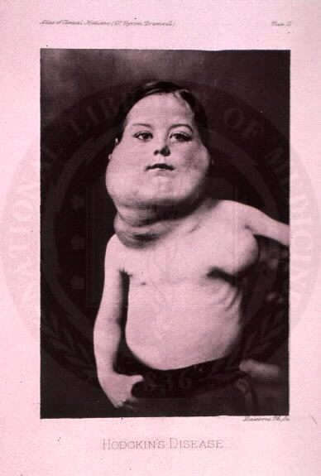
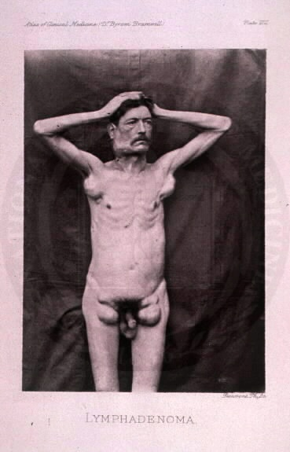
Classical Hodgkin Lymphoma

Slide 108
Characteristic Feature
The presence of distinctive neoplastic giant cells called Reed-Sternberg (RS) cells admixed with a variable infiltrate of reactive, nonmalignant inflammatory cells
Some additional features:
  Clear bimodal age distribution:
    initial peak is 15-34 yrs , then after 55 yrs.
  30 % have evidence of EBV infection.
  HIV + ve has higher incidence of HL (also in NHL)
  Siblings of affected individuals have 5X increased risk.
Of all the lymphomas, HL is potentially the most curable type
Notes:
Hodgkin lymphoma Characterized by Reed-Sternberg cells, which make it different from all the other forms of lymphoma.

Slide 109
Clinical Differences b/n HL & NHL
Hodgkin Lymphoma | Non-Hodgkin Lymphoma
Orderly spread by contiguity | Non contiguous spread
Mesenteric nodes and Waldayer ring rarely involved (rare GI presentation) | Waldeyer ring and mesenteric nodes commonly involved (GI presentation)
Extranodal involvement uncommon | Extranodal involvement common
Few reactive cells | Many reactive tumor cells
B-symptoms are common | B-symptoms are rare
BM involvement | Rare BM involvement

Slide 110
Hodgkin Lymphoma : Clinical features
Asymptomatic LAP above the diaphragm in 80%
Inguinal LAP in 10%
Waldeyer ring (back of throat/tonsils) LAP
Occipital LAP
Constitutional B-symptoms in 40%
Infrequent but specific features
1. Pel-Ebstein fever :
  high fever for 1-2wks then
  an afebrile period of 1-2wks
2. Pain in the affected L. Node:
  precipitated by alcohol seen <10%
Paraneoplastic CNS syndromes:
  Cerebellar degenerations, GBS, Neuropathy …
Most other manifestations are similar to NHL

Slide 111
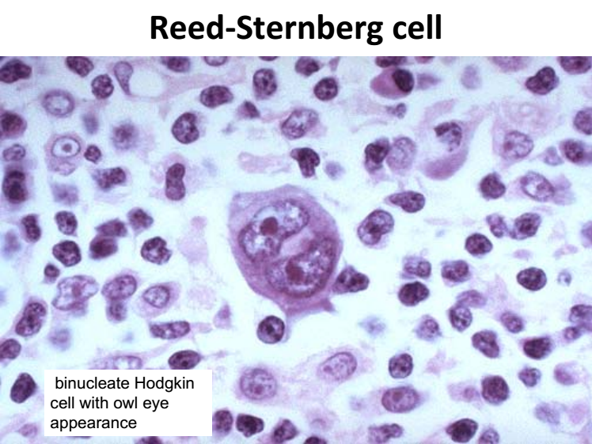

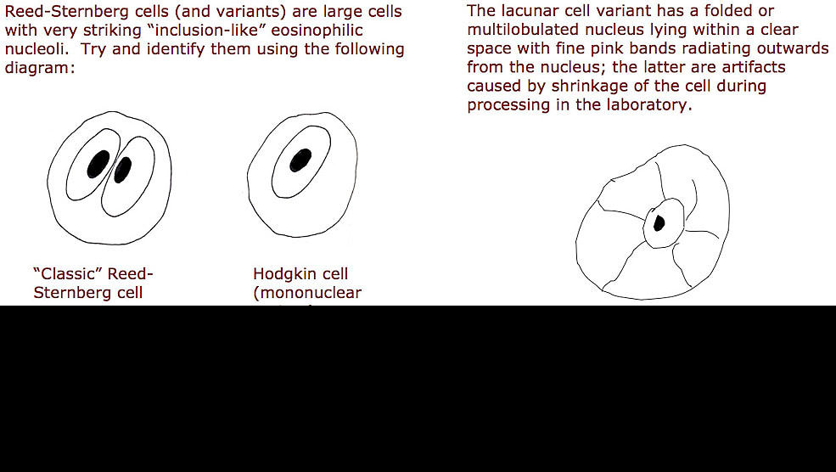
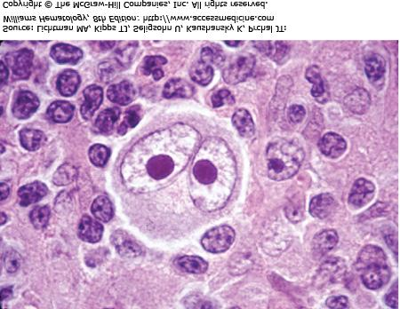
Hodgkin Lymphoma: Diagnosis
Lymph node excisional biopsy for the typical Red-Sternberg cells.
Bone marrow biopsy in:
  old age, advanced disease stage,
  systemic symptoms, or
  a high risk histology.
MRI or LP only for + CNS symptoms
In general, most of the clinical and lab manifestation as well as staging system is similar to NHL.

Slide 112
Hodgkin Lymphoma: Prognosis
Largely depend on the stage of the disease
  Indolent => incurable
  Aggressive => curable
Other factors that influence prognosis
  Age of the patient
  Presence or absence of B-symptoms
  ESR elevation

Slide 113
Treatment
  Surgery- cure, control, palliate
  Hormonal therapy
  Chemotherapy
  Radiation therapy
  Immunotherapy
  Bone Marrow Transplant
Notes:
Chemo goal is to kill cancer outright and or to inhibit growth of cancer cells.
-primary→ chemo is expected to control or cure the cancer; can be given actue treatment or long term control
-adjuvant→ chemo complements another therapy; for example, cheom to reduce a tumor can make surgery more effective.
-palliative→ chemo can be used to slow tumor growth for pain control and symptom relief

Slide 114
Nursing Interventions
Assess patients on chemotherapy for;
  Weight loss
  Frequent infection
  Skin problems
  Pain
  Hair Loss
  Fatigue
  Disturbance in body image/ depression

Slide 115
Nursing Interventions …
Maintain Tissue Integrity
  Handle skin gently
  Do NOT rub affected area
  Lotion may be applied
  Wash skin only with SOAP and Water
  Avoid ALCOHOL-based rinses
Management of Alopecia
  Alopecia begins within 2 weeks of therapy
  Regrowth within 8 weeks of termination
  Provide information that hair loss is temporary BUT anticipate change in texture and color

Slide 116
Nursing Intervention…
Promote Nutrition
  Consider patient’s preferences
  Provide small frequent meals
  Oral hygiene PRIOR to mealtime
  Vitamin supplements
  High calorie & protein diet
Relieve pain
Decrease fatigue
Improve body image – therapeutic communication
Monitor for complications such as infection (fever), bleeding

Slide 117
THANKS!

Slide 118
THROMBOCYTOPENIA
Thrombocytopenia occurs when there is
  decreased production of platelets
  increased destruction of platelets, or
  increased sequestration of platelets in the spleen
The three most common types in critically ill patients are
  Heparin-induced thrombocytopenia (HIT)
  Thrombotic thrombocytopenic purpura (TTP), and
  Immune thrombocytopenic purpura (ITP)

Slide 119
Heparin-induced thrombocytopenia (HIT)
Although many medications can induce thrombocytopenia, heparin is the most common medication used in the critical care unit that is associated with thrombocytopenia.
Anticoagulation with continuous IV heparin carries the greatest risk, but any type of heparin therapy can cause thrombocytopenia.
HIT typically appears 4 to 14 days after initiation of heparin therapy, but it can occur as early as 10 hours after administration if the patient has been exposed to heparin within the previous 100 days, or several days after withdrawal of all forms of heparin.

Slide 120
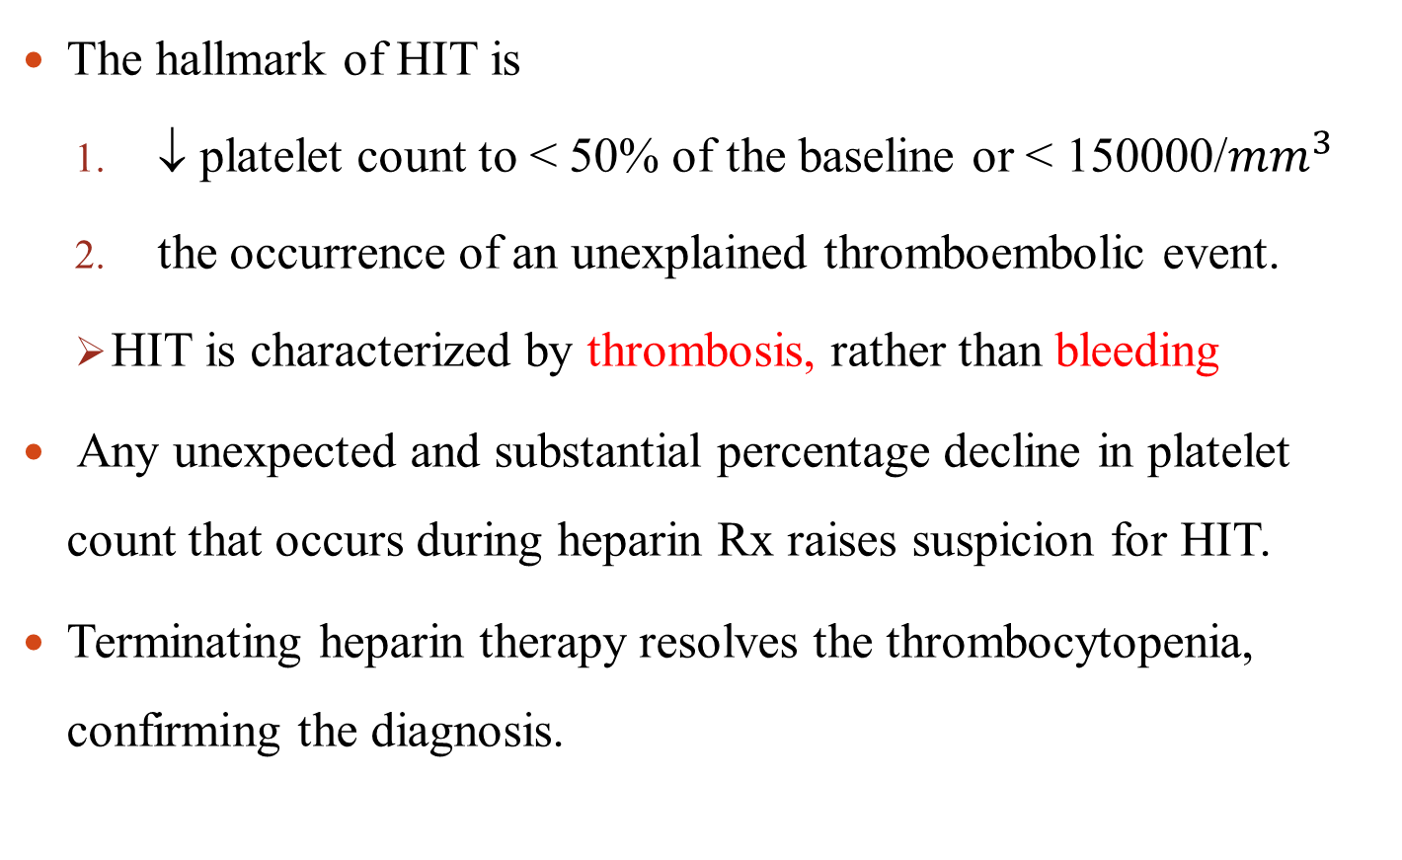
HIT …
The hallmark of HIT is
  ↓ platelet count to < 50% of the baseline or < 150000/${mm}^{3}$
  the occurrence of an unexplained thromboembolic event.
  HIT is characterized by thrombosis, rather than bleeding
Any unexpected and substantial percentage decline in platelet count that occurs during heparin Rx raises suspicion for HIT.
Terminating heparin therapy resolves the thrombocytopenia, confirming the diagnosis.
Notes:
mm

Slide 121
CLOTING DISORDERS
Disseminated Intravascular Coagulation
Pathophysiology
Disseminated intravascular coagulation (DIC) involves a series of events that result in severe hemorrhage.
As its name implies, this syndrome is a catastrophic, overwhelming state of accelerated clotting throughout the peripheral blood vessels.
In a short period, all of the clotting factors and platelet supplies are exhausted, and clots can no longer be formed.
This results in bleeding from nearly every bodily route possible.
DIC is not a disease; it is a syndrome that develops secondary to some other severe physical problem.
Once this deadly syndrome develops, the progression of symptoms is rapid

Slide 122
Massive clotting in blood vessels leads to organ and limb necrosis.
Organs most often affected include the kidneys, brain, and the lungs
DIC is usually acute in onset, although in some patients it becomes a chronic condition.
The prognosis depends on early diagnosis and intervention and the severity of the hemorrhaging.
DIC has a very high mortality rate.

Slide 123
THROMBOCYTHEMIA
It is a stem cell disorder within the bone marrow.
Is a marked increase in platelet production (>600,000/mm3)
Platelet size may be abnormal, but platelet survival is typically normal.
Women are more affected (2:1)
Tends to occur later in life (>65 years).

Slide 124
Clinical manifestations
Usually asymptomatic; diagnosed as the result of elevated platelet count on a CBC.
Symptoms primarily occur from hemorrhage or vascular occlusion.
This occlusion can occur in large vessels (cerebrovascular, coronary, or peripheral arteries) and deep veins, as well as in the microcirculation
Notes:
Symptoms occur most often when the platelet count exceeds 1 million/mm3.

Slide 125
Clinical manifestations …
Headaches
Splenomegaly
Bleeding typically does not occur unless the platelet count exceeds 1.5 million/mm3.
  It results from a deficiency in von Willebrand factor (vWF) as the platelet count increases

Slide 126
Treatment
In younger patients with no risk factors, low-dose aspirin therapy may be sufficient to prevent thrombotic complications
Interferon alpha 2b
Platelet pheresis
Notes:
nterferon-alfa-2b has been shown to lower platelet
counts by an unknown mechanism. The medication is administered
subcutaneously at varying frequency, commonly
three times per week. Significant side effects, such as fatigue,
weakness, memory deficits, dizziness, anemia, and
liver dysfunction, limit its usefulness.
Rarely, the occlusive symptoms are so great that the
platelet count must be reduced immediately. When necessary,
platelet pheresis (see later discussion) can reduce the
amount of circulating platelets, but only transiently. The
extent to which symptoms and complications (eg, thromboses)
are reduced by pheresis is unclear.

Slide 127
Nursing management
Health education on risks of hemorrhage and thrombosis.
Monitor S/S of thrombosis, particularly the neurologic manifestations
Assess for risk factors for thrombosis (obesity, hypertension, hyperlipidemia, and smoking)
Instruct patients about medications (eg, aspirin, NSAIDs) and others that alter platelet function.
Notes:
Monitor S/S of thrombosis, particularly the neurologic manifestations, such as visual changes, numbness, tingling, and weakness.

Slide 128
Hemophilia
Hemophilia is an X-linked recessive hemorrhagic disease
It happens because of a defect in one of the clotting factor genes on the X-chromosome.
It mostly affects men
Females may be carriers of hemophilia, but they are unlikely to have the disorder.
Patients are more susceptible to internal bleeding.
Notes:
Hemophilia is an X-linked recessive hemorrhagic disease due to mutations in the F8 gene (hemophilia A or classic hemophilia) or F9 gene (hemophilia B)

Slide 129
Types
Two major types
Hemophiliac A (classical)
  Lack of factor VIII
  accounts for about 80% of hemophilia cases
  Commonest hereditary disorder
Hemophiliac B (Christ mass disease)
  Lack of factor IX
Notes:
For a girl to have hemophilia, she must have the abnormal gene on both of her X chromosomes, and this is very rare.
The disorder can also develop if the body forms antibodies to clotting factors in the blood that then stop the clotting factors from working

Slide 130
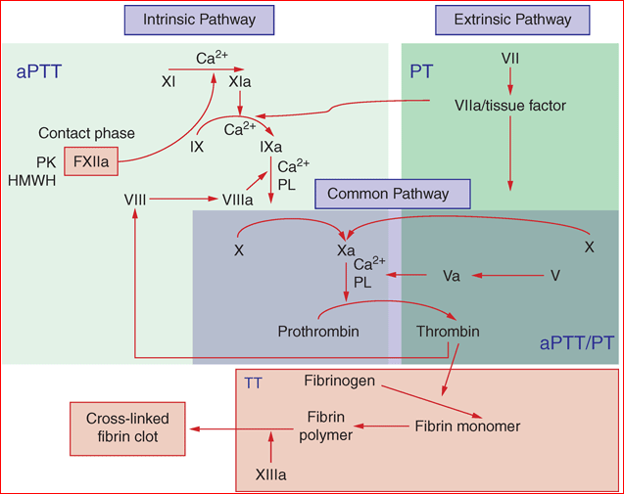
Pathophysiology

Slide 131
Hemophilia …
Clinical manifestations
Clinically, hemophilia A and hemophilia B are indistinguishable
Spontaneous nose bleeding or severe bleeding after minor trauma
  Bleeding after circumcision (usually the first sign)
Signs of internal bleeding
  Abdominal, chest, or flank pain
  Hematuria or hematemesis
  Tarry stools
  Hematomas on the extremities, the torso, or both

Slide 132
Hemophilia …
Clinical manifestations …
Spontaneous intracerebral hemorrhage is important cause of death
  Symptoms of brain bleeding can include headaches, vomiting, lethargy, behavioral changes, clumsiness, vision problems, paralysis, and seizures.
Recurrent painful hemarthroses and muscle hematomas
  Pain and swelling in a weight bearing joint, such as the hip, knee, and ankle (75% of all bleedings in hemophilia patients occur into joints)

Slide 133
Hemophilia …
Diagnosis
  Typical clinical presentation
  Activated partial thromboplastin time(APTT)
  Factor VIII/IX clotting assay
Treatment:
  Factor VIII/IX replacement or treatment with Desmopressin.
  Spontaneous bleeding is usually controlled if patient’s factor VIII activity is > 20%.

Slide 134
Nursing care
There is no cure for hemophilia, but to reduce the risk of excessive bleeding and to protect joints;
  regular exercise
  avoid blood thinners, such as aspirin, NSAIDs, and heparin
  practicing good dental hygiene
Provide emotional support
Monitor V/S
Monitor signs of decreased tissue perfusion

Slide 135
Deep Vein Thrombosis
DVT occurs when a blood clot (thrombus) forms in one or more of the deep veins, usually in the legs.
It can cause leg pain or swelling, but also can occur with no symptoms
DVT can be very serious and is potentially life-threatening.

Slide 136
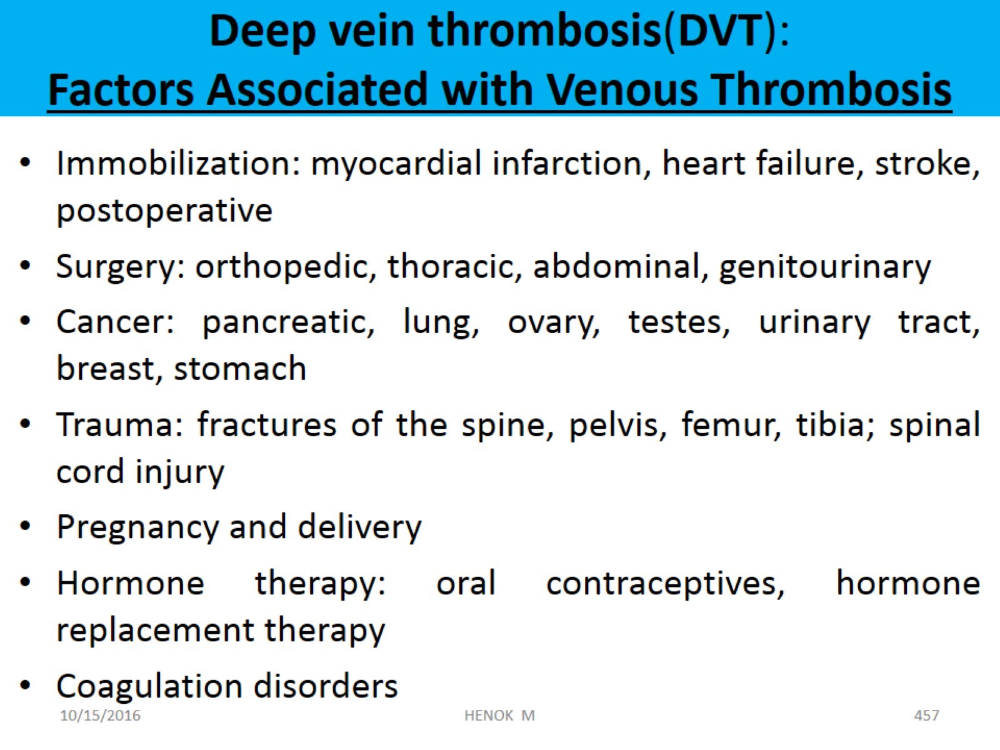
Deep vein thrombosis(DVT):
Factors Associated with Venous Thrombosis

Slide 137
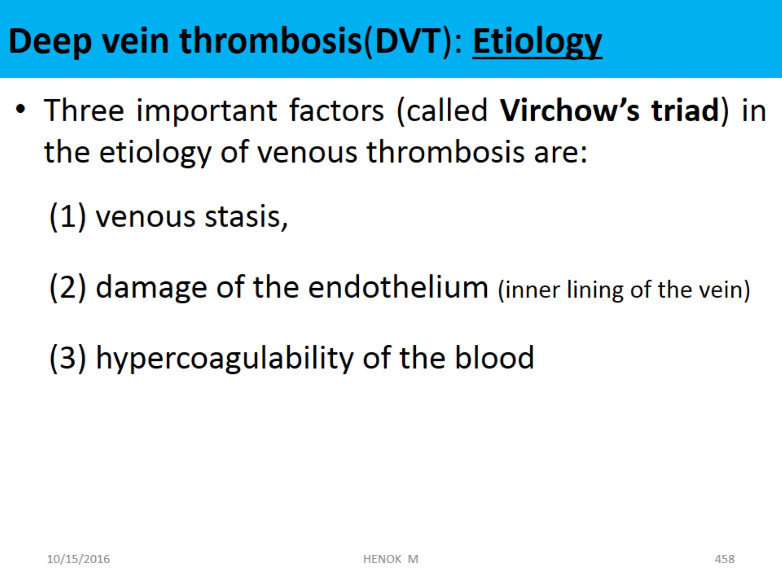
Deep vein thrombosis(DVT): Etiology

Slide 138
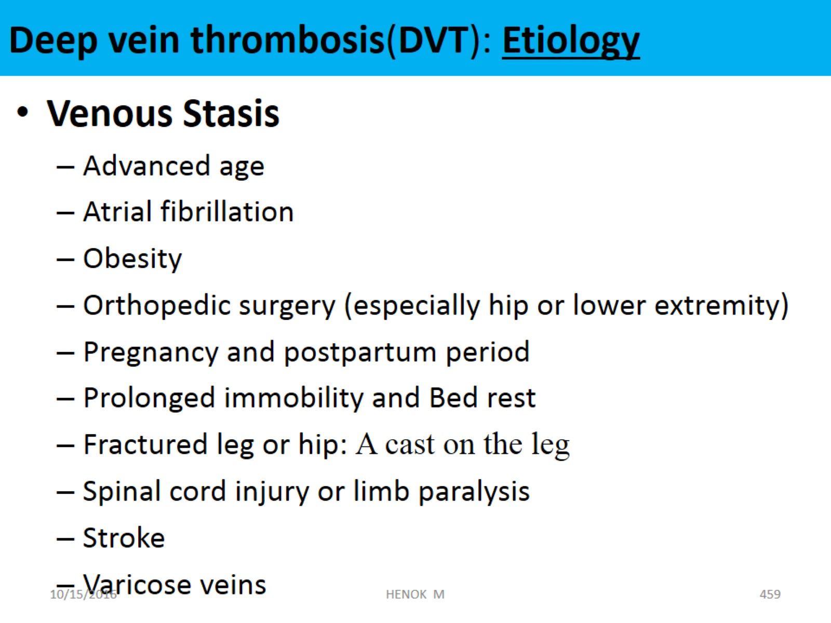
Deep vein thrombosis(DVT): Etiology

Slide 139
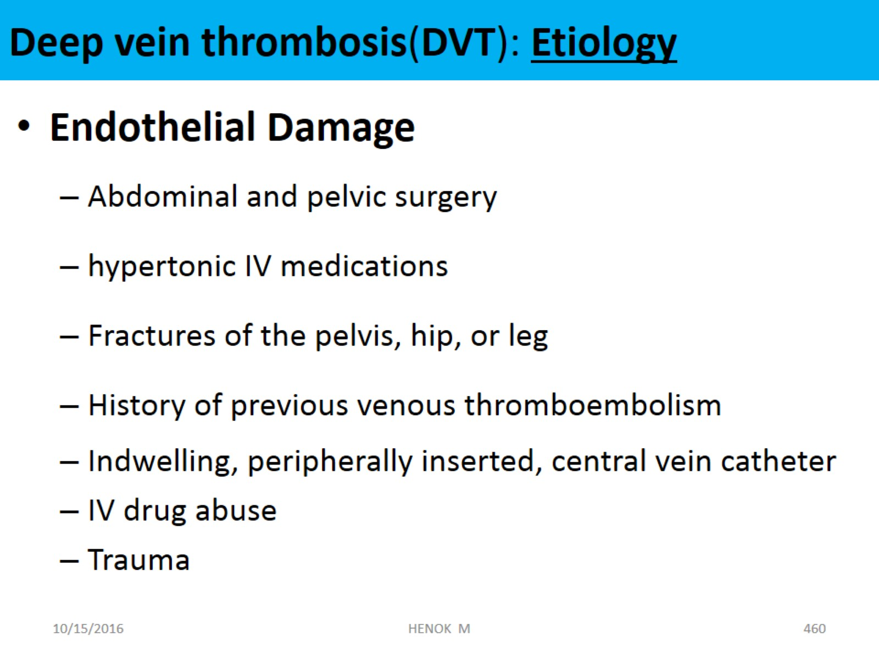
Deep vein thrombosis(DVT): Etiology

Slide 140
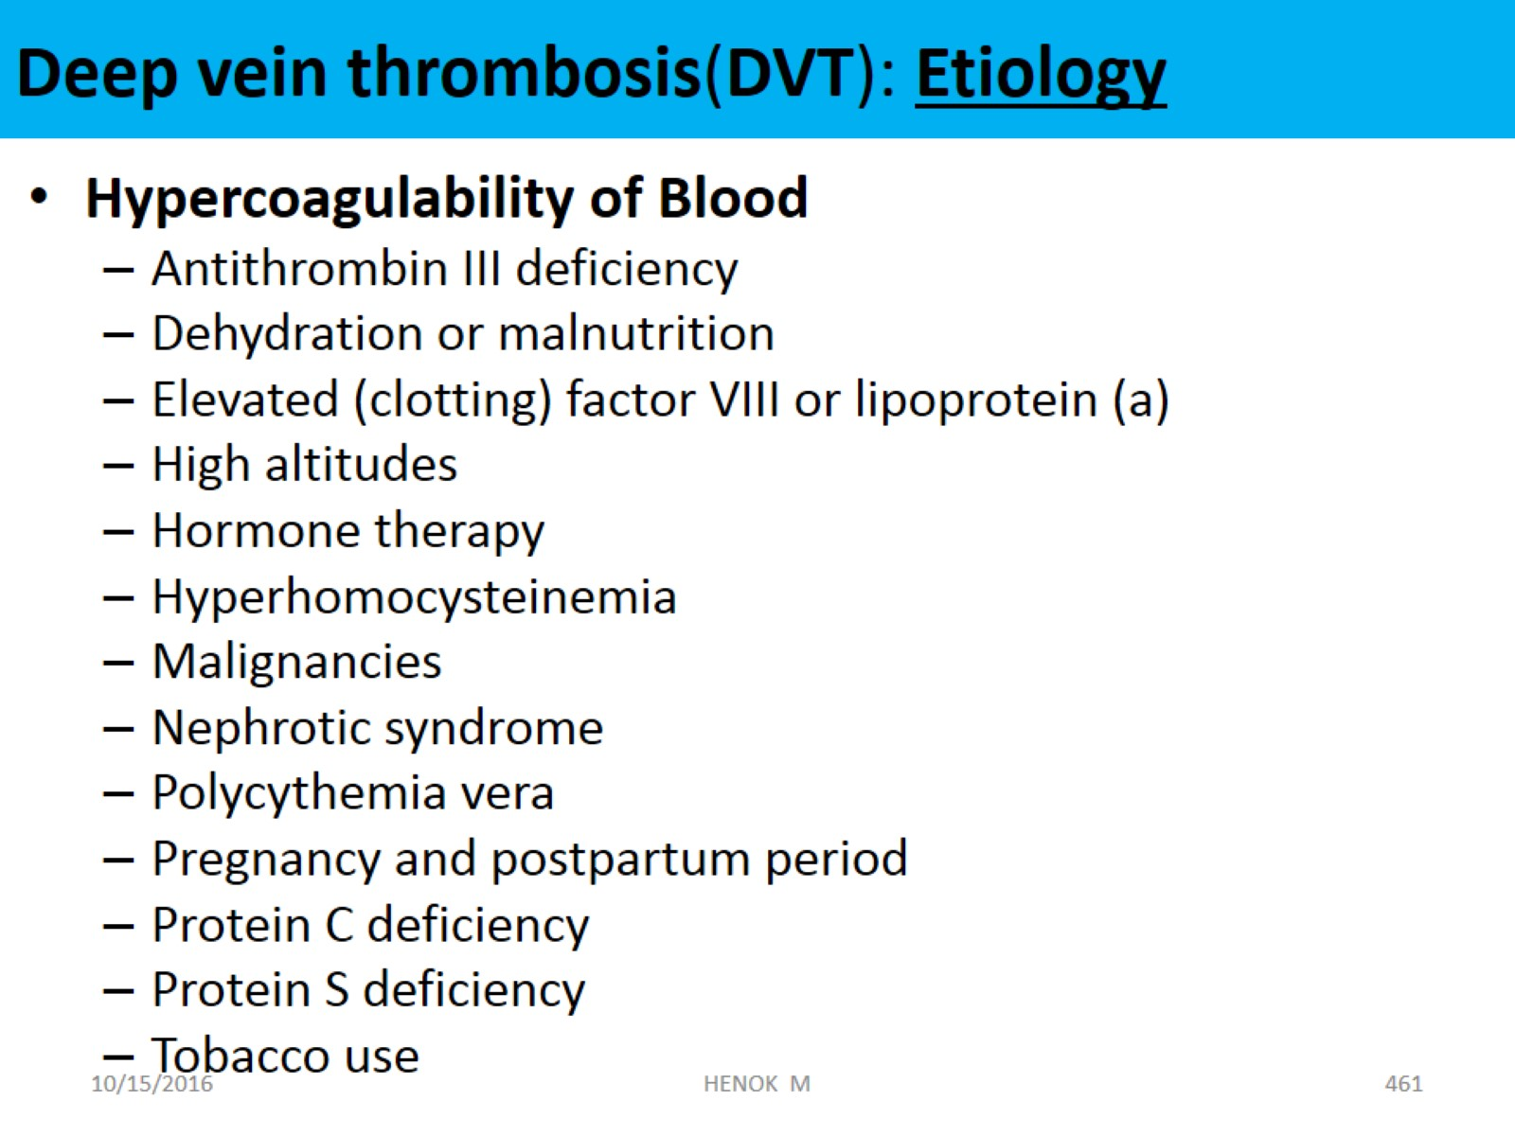
Deep vein thrombosis(DVT): Etiology

Slide 141
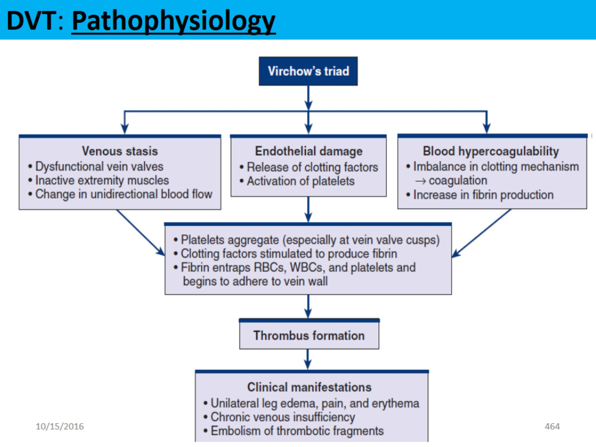
DVT: Pathophysiology

Slide 142
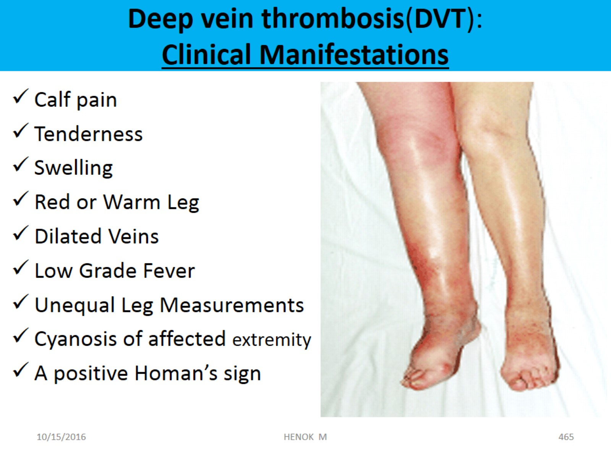
Deep vein thrombosis(DVT):
Clinical Manifestations

Slide 143
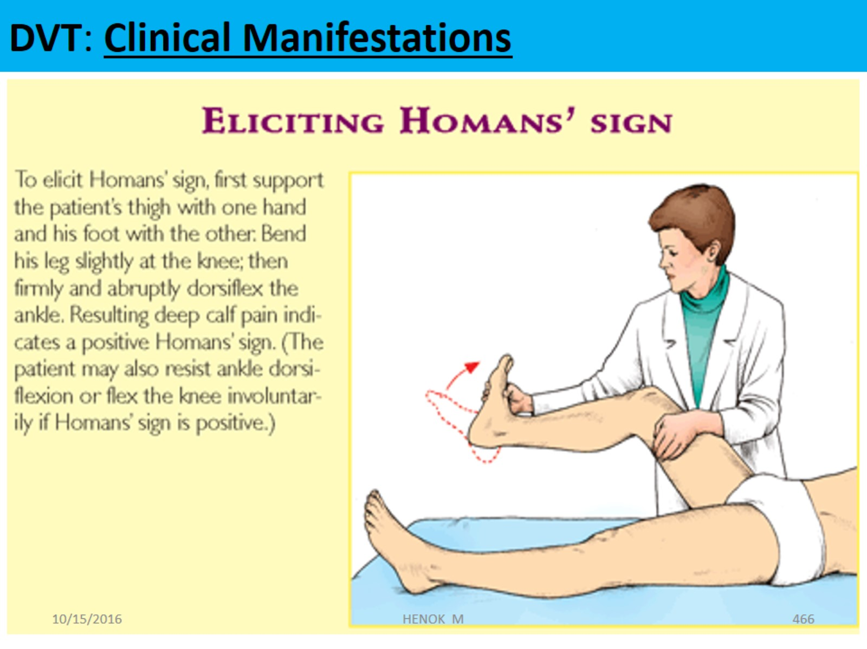
DVT: Clinical Manifestations

Slide 144
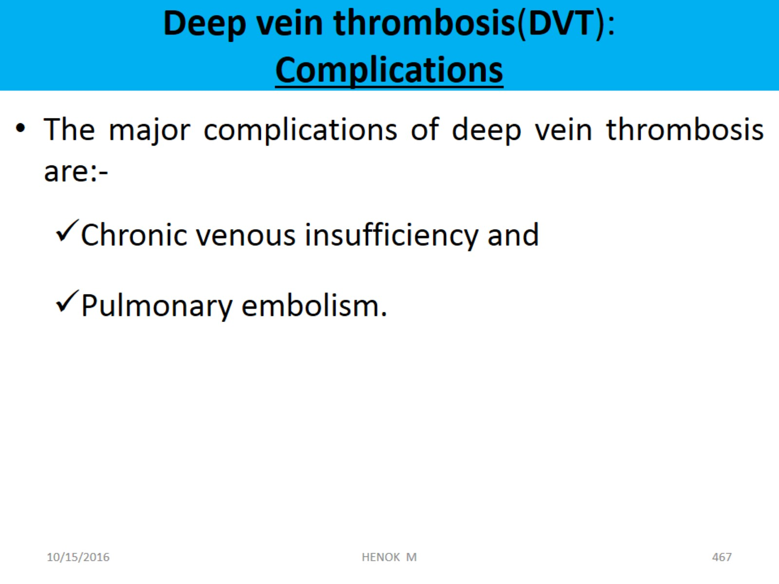
Deep vein thrombosis(DVT):
Complications

Slide 145
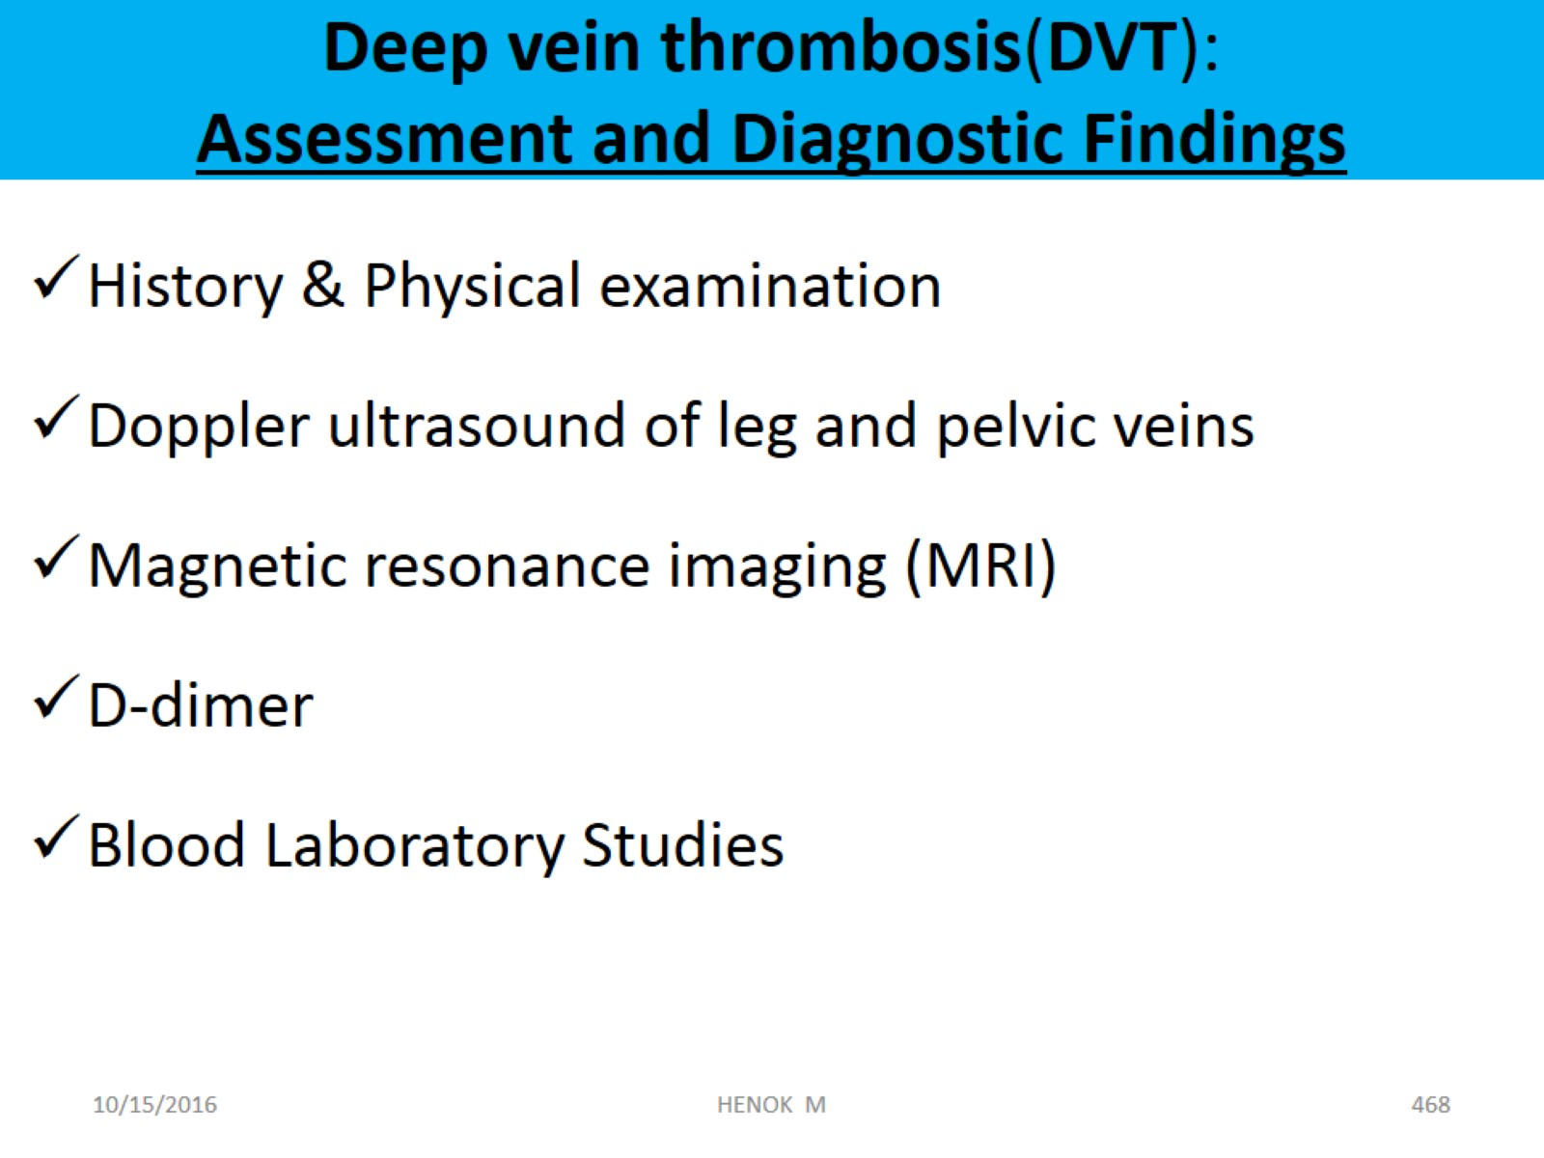
Deep vein thrombosis(DVT):
Assessment and Diagnostic Findings

Slide 146
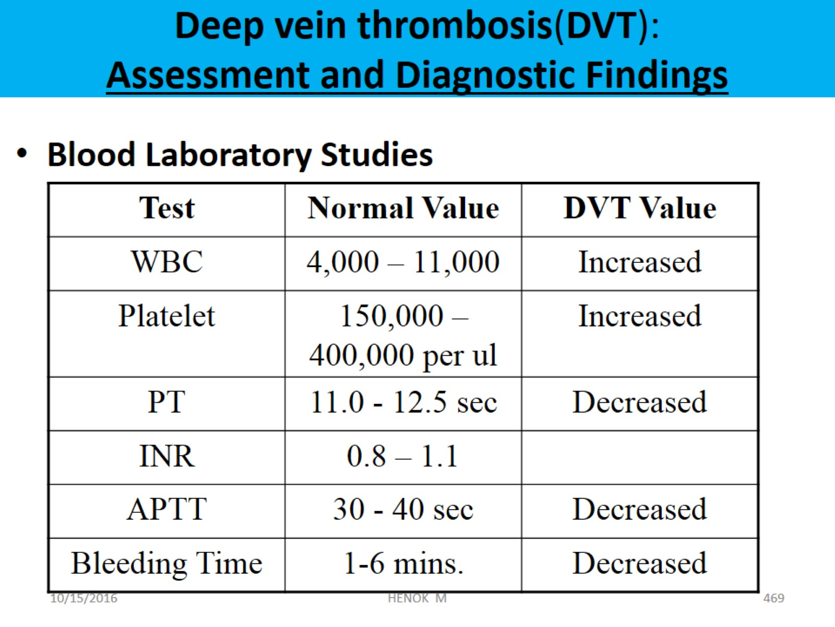
Deep vein thrombosis(DVT):
Assessment and Diagnostic Findings

Slide 147
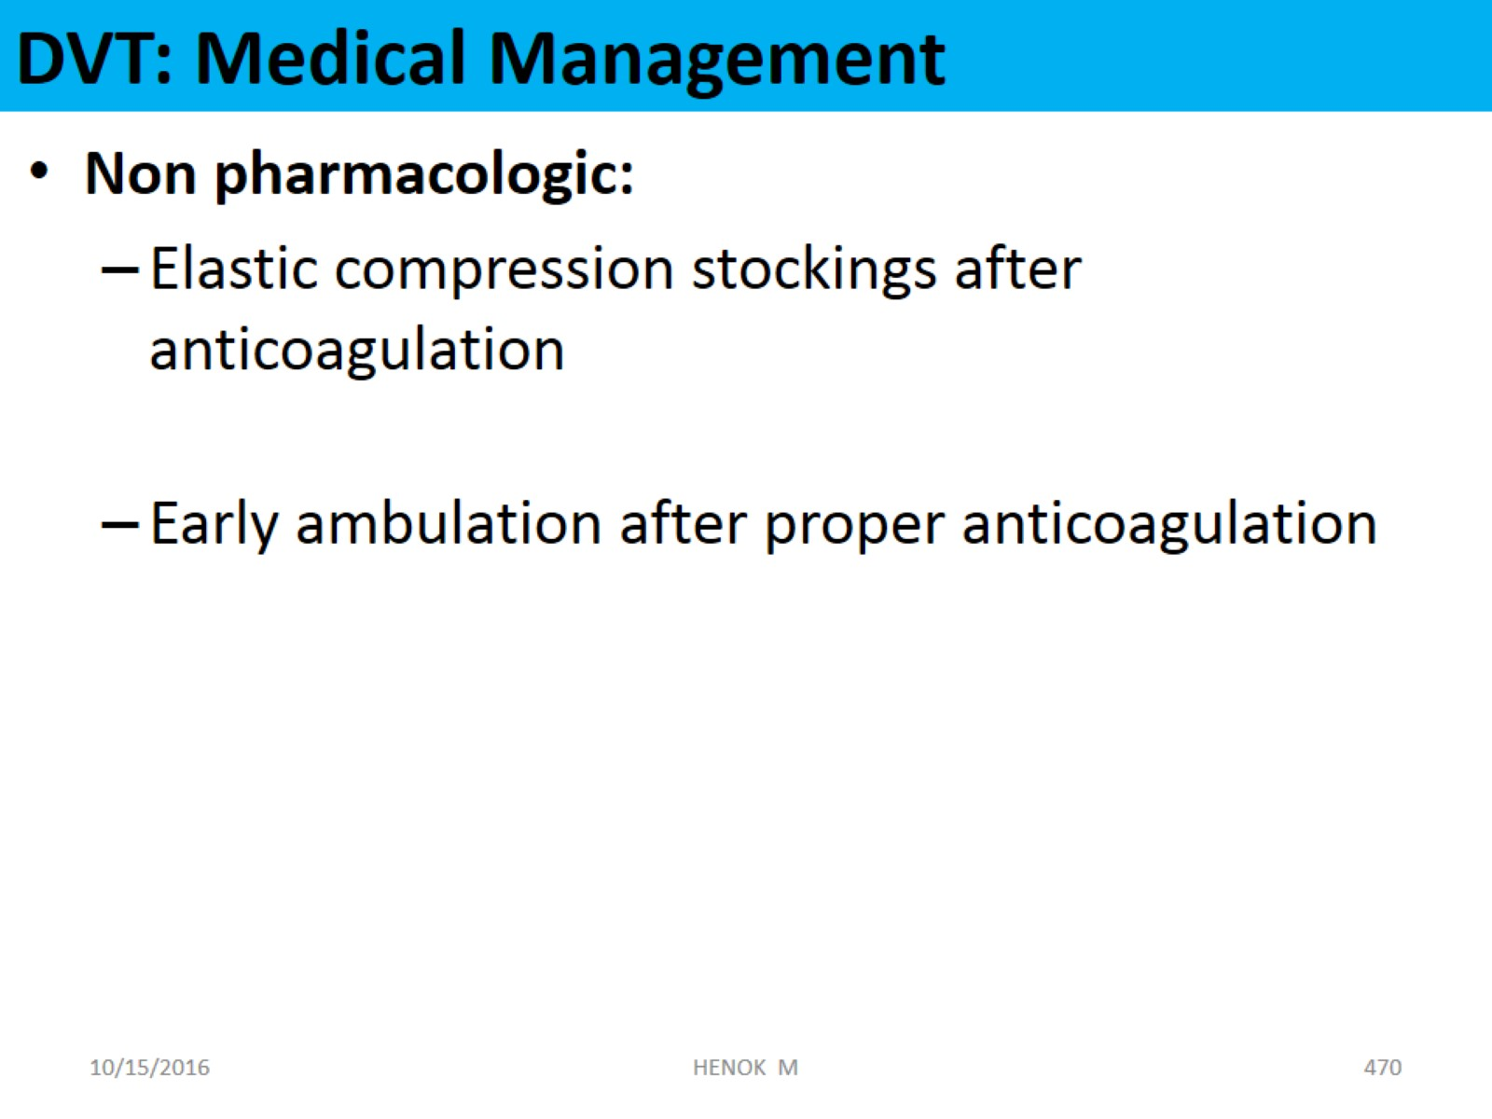
DVT: Medical Management

Slide 148
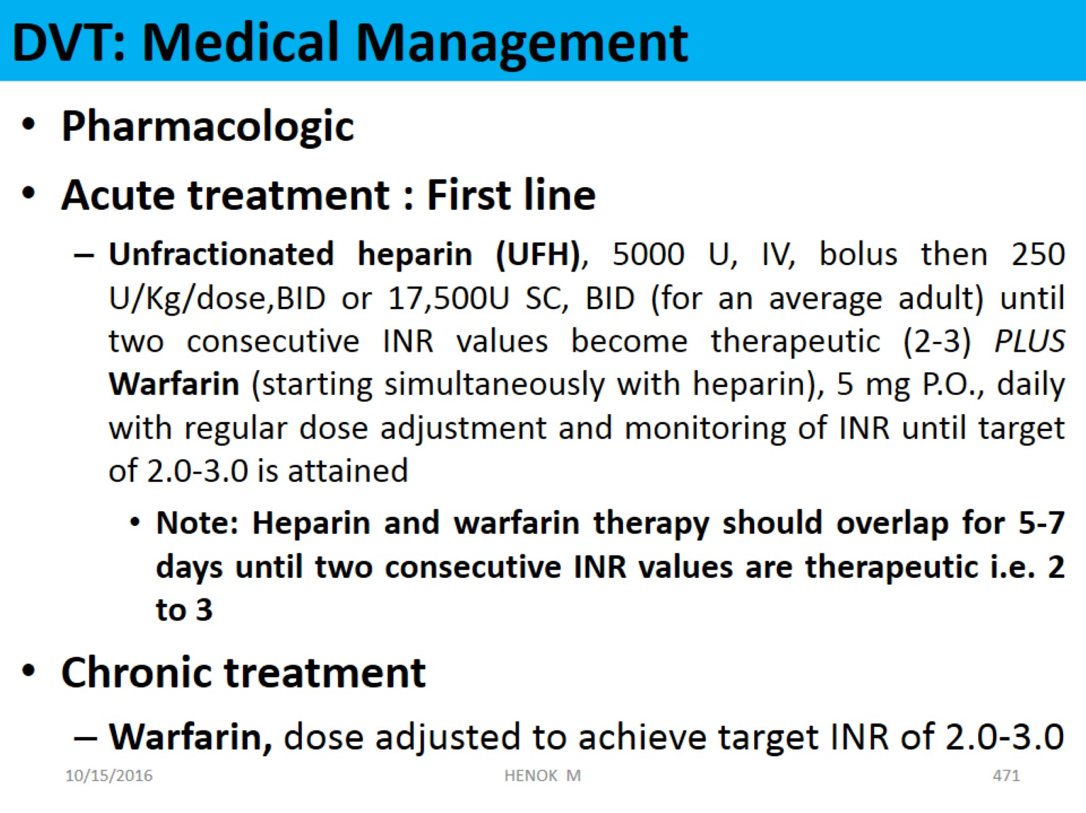
DVT: Medical Management

Slide 149
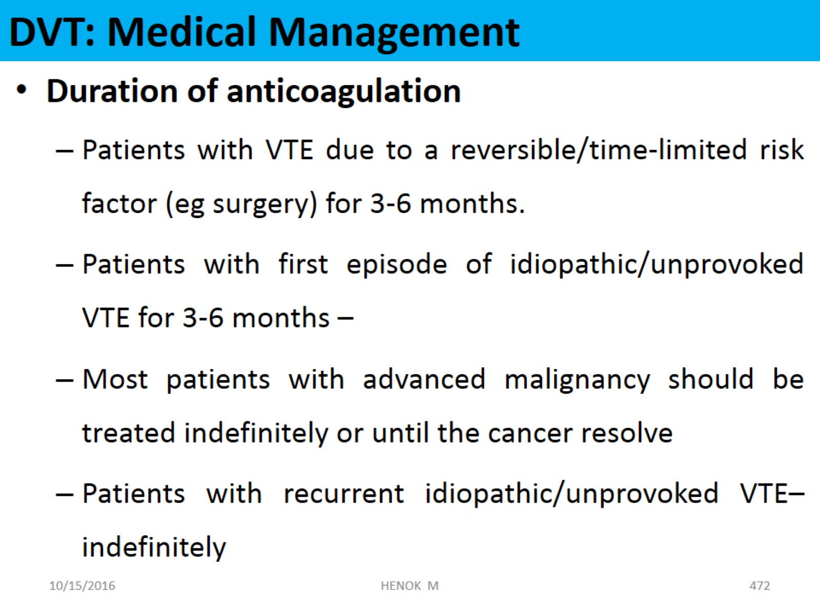
DVT: Medical Management

Slide 150
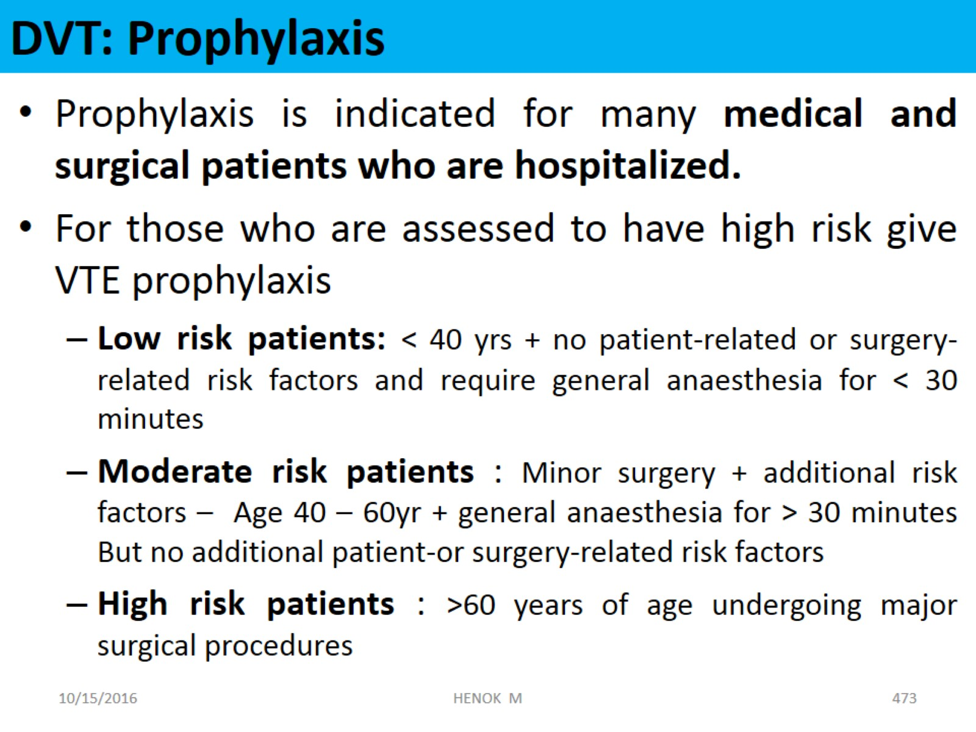
DVT: Prophylaxis

Slide 151
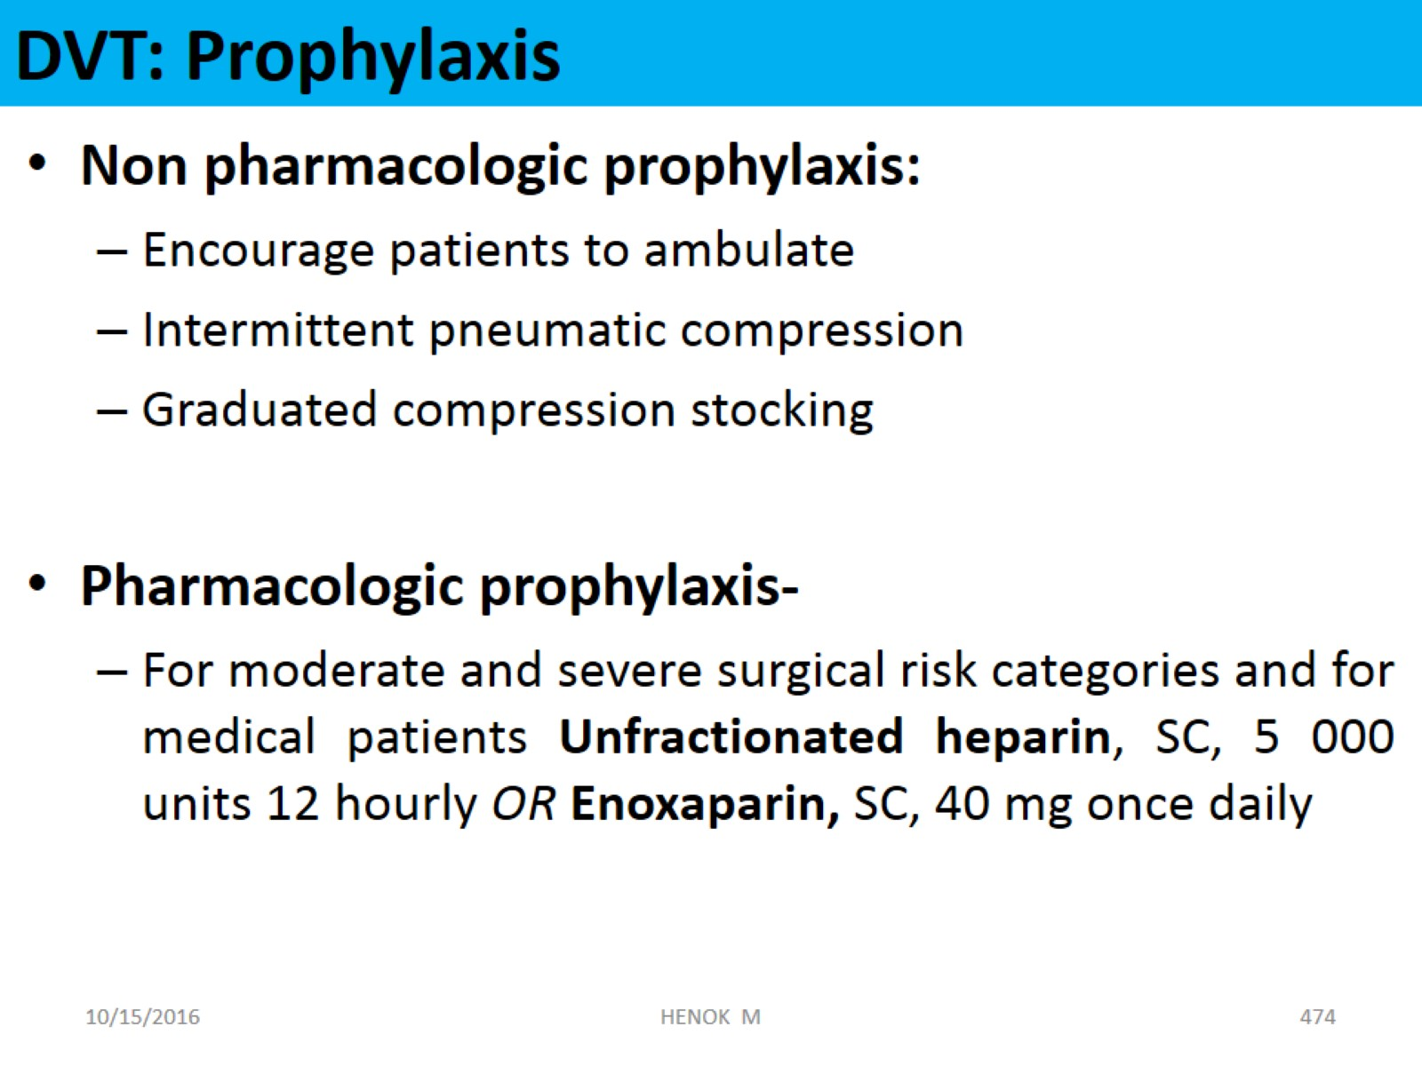
DVT: Prophylaxis

Slide 152
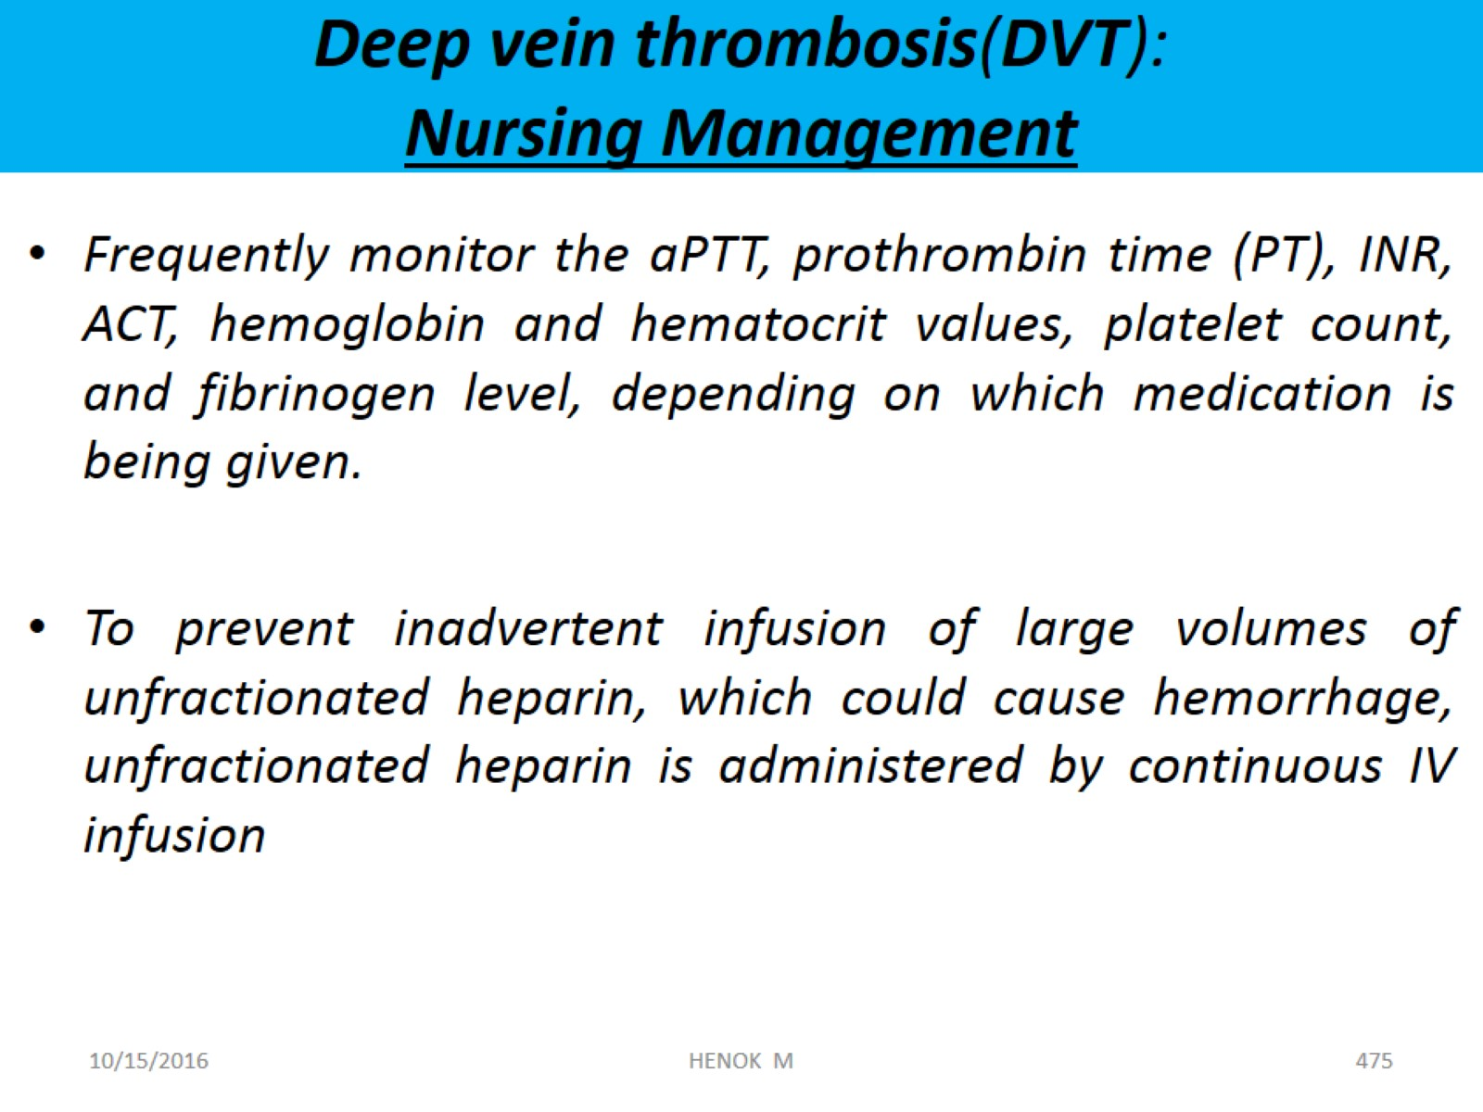
Deep vein thrombosis(DVT):
Nursing Management

Slide 153
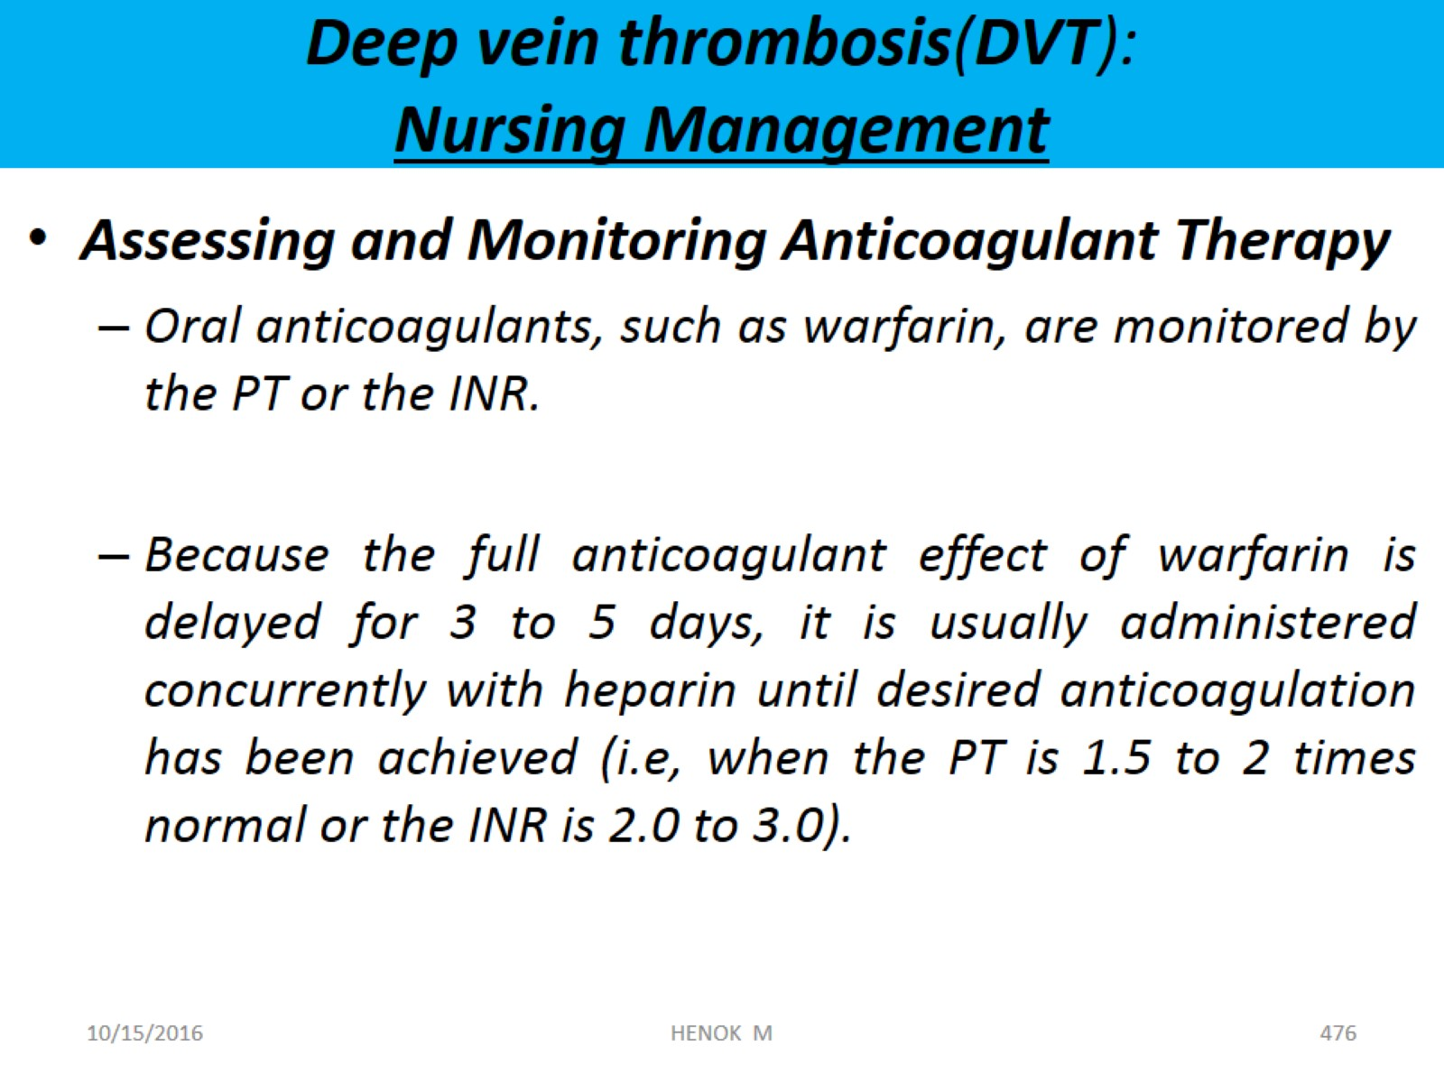
Deep vein thrombosis(DVT):
Nursing Management

Slide 154
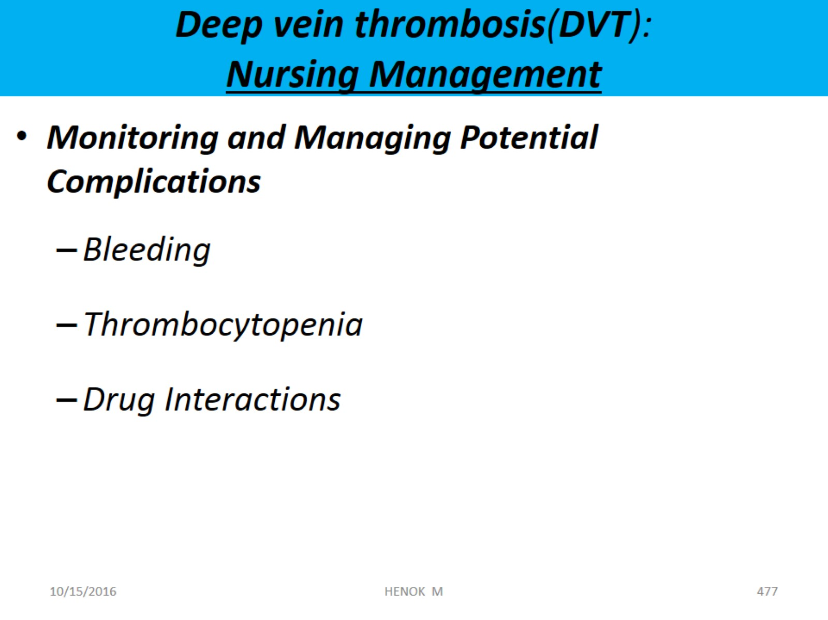
Deep vein thrombosis(DVT):
Nursing Management

Slide 155
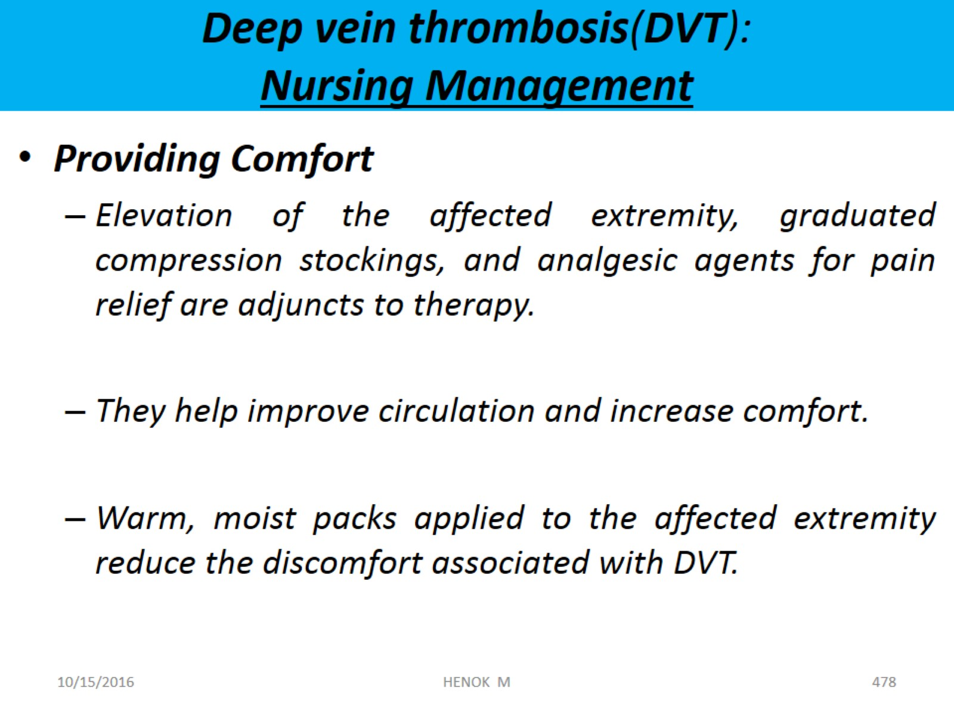
Deep vein thrombosis(DVT):
Nursing Management

Slide 156
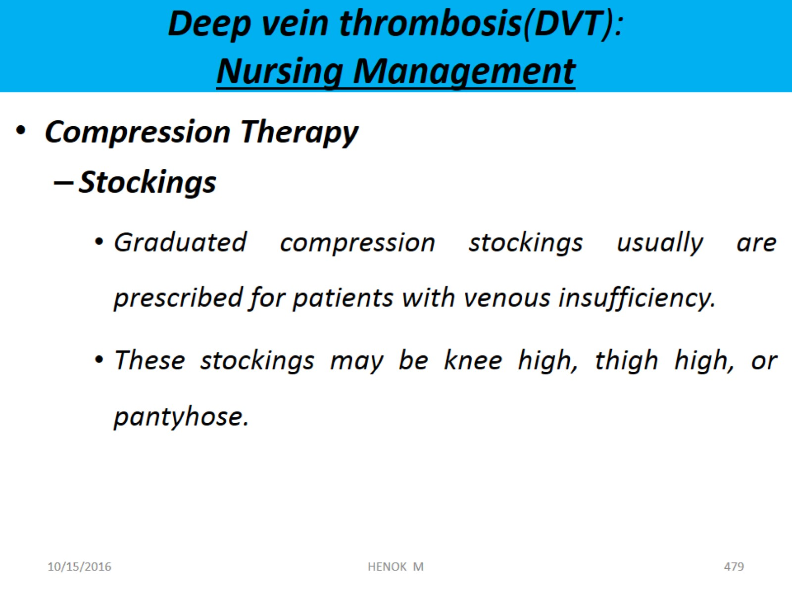
Deep vein thrombosis(DVT):
Nursing Management

Slide 157
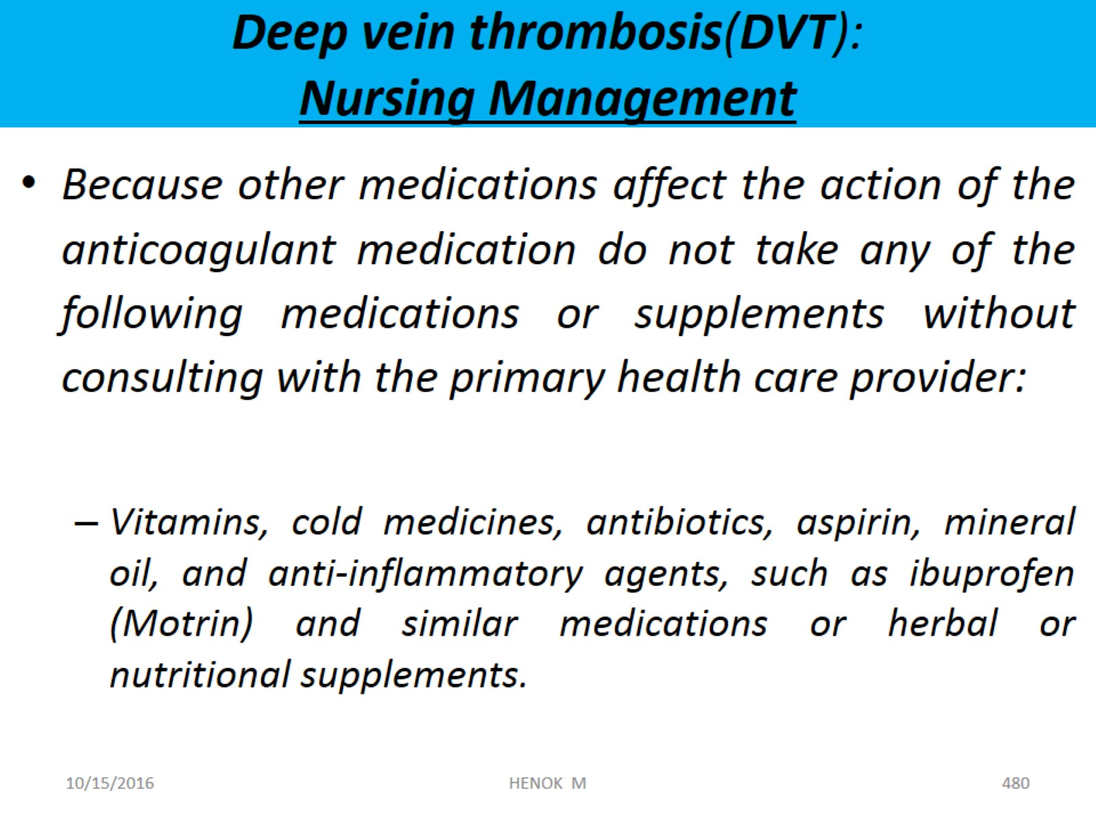
Deep vein thrombosis(DVT):
Nursing Management

Slide 158
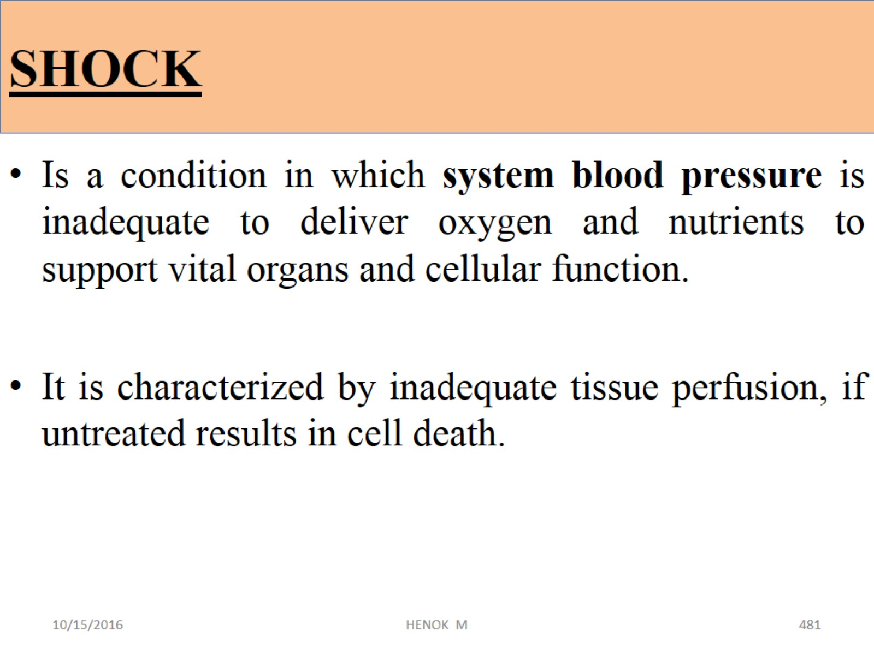
SHOCK
i.e. If not recognized and corrected as early as possible, shock may rapidly progress to an irreversible state with subsequent multi-organ failure and death.

Slide 159

SHOCK
SHOCK …

Slide 160

Types of shock

Slide 161

Types of shock: Hypovolemic shock
HYPOVOLUMIC SHOCK

Slide 162

Types of shock
SHOCK …

Slide 163

Types of shock
CARDIOGENIC SHOCK

Slide 164

Types of shock
SHOCK …

Slide 165

Types of shock
CIRCULATORY (DISTRIBUTIVE) SHOCK

Slide 166

Types of shock
SHOCK …

Slide 167

Types of shock: Circulatory shock
SHOCK …

Slide 168

Types of shock: Circulatory shock
SHOCK …

Slide 169

Types of shock: Circulatory shock
SHOCK …

Slide 170

SHOCK:
SHOCK …
Compensatory phase➔ stage 1
The point at which organ damage is so severe that the patient does not respond to treatment and cannot survive.
Despite treatment, BP remains low.

Slide 171

SHOCK…Signs and Symptoms

Slide 172
Findings | Stages of shock
 | Stage 1 | Stage 2 | Stage 3
Blood pressure | Normal | Systolic 80–90 mm Hg Requires fluids resuscitation to support BP | Requires mechanical or pharmacologic support
Heart rate | >100 bpm | > 150 bpm | Erratic or asystole
Respiratory status | 20 breaths/min Pa CO2 < 32mmHg | Rapid, shallow respirations; crackles Pa O2 <80mmHg Pa CO2 >45mmHg | Erratic or asystole Requires intubation and MV and oxygenation
Skin | Cold, clammy | Mottled, petechiae | Jaundice
Urinary output | Decreased | 0.5 mL/kg/h | Anuric, requires dialysis
Mentation | Confusion | Lethargy | unconscious
Acid–base balance | Respiratory alkalosis | Metabolic acidosis | Profound acidosis

Slide 173

Medical management: Hypovolemic shock

Slide 174

Medical management: Cardiologic shock

Slide 175

Medical management: Circulatory shock

Slide 176
Circulatory shock …
Anaphylactic shock
  Epinephrine – for vasoconstriction
  Diphenhydramine – to reverse the effect of histamine (Antihistamines)
  Albuterol – to reverse histamine induced bronchoconstriction (optional)
  Iv fluids to restore fluid volume
  QUIZ - 4.pptx

Slide 177

MALARIA
Malaria is an acute infection of the blood caused by protozoa of the genus plasmodium
It is derived from Italian word ma’aria = bad air
Etiology: malaria is caused by 5 species of plasmodium:
  P. falciparum (the most common and dangerous).
  P. vivax.
  P. ovale.
  P. malaria.
  P. knowlesi → found in forested regions of southeast Asia

Slide 178
Epidemiology
Endemic in tropical and sub-tropical countries
Affects 40% of the world population.
Children less 5 years of age, pregnant women and travelers to endemic areas are risk groups.
Malaria is a major public health problem in Ethiopia
Plasmodium falciparum 60% and vivax 40% are common in Ethiopia.
The most serious and life-threatening disease occurs from Plasmodium Falciparum infection.

Slide 179
Mode of transmission
The major mode of transmission is by the bite of an infective female anopheles mosquito, which sucks blood for egg maturation.
  Mosquitoes are infective as long as infective gametocytes are present in the blood of patients.
  Once infected, mosquito remains infective for life.
Blood transfusion, hypodermic needles, organ transplantation and mother to fetus transmission is possible.
  Since there is no pre-erythrocytic (tissue) cycle, the incubation period is short.
Notes:
Incubation period- Varies with species
Plasmodium falciparum 7-14 days
Plasmodium virvax 8-14 days
Plasmodium ovale 8-14 days
Plasmodium malariae 7-30 days

Slide 180
Does Malaria affects all individuals' equally?
All persons are susceptible for malaria except in some host-resistance factors:
  Increased splenic clearance reaction
  Hyperpyrexia- which is said to be schizontcidal
  Sickle cell traits are resistant to plasmodium falciparum
  Duffy blood group deficiency (Duffy antigen negative red blood cells) lack receptor for plasmodium vivax.
Notes:
Because of passive immunity infants are resistant in early life.

Slide 181
Lifecycle:
Revise your
parasitology lecture note
Infective stage for human?
Infective stage for mosquito?
Stages (pathogenesis)

Slide 182
Clinical Manifestation
Fever, chills, rigors, sweating, severe headache, generalized body and joint pain
Nausea and or vomiting, loss of appetite, abdominal pain (especially in children)
Irritability and refusal to feed (in infants), flu-like symptoms
Splenomegaly, Pallor, jaundice
Confusion, hallucinations etc.

Slide 183
Diagnostic methods
Clinical manifestation and epidemiological grounds
  Clinical diagnosis of malaria is made in a patient who has fever and lives in malaria-endemic areas or has a history of travel within the last 30 days to malaria-endemic areas.
Blood film for hemoparasite or RDT
CBC, Blood culture to rule out sepsis
Chest X-ray to rule out pneumonia
CT scan to rule out stroke

Slide 184
Treatment
Malaria treatment based on clinical diagnosis must be the last option when there is no RDT or blood film microscopy
Treatment is based on severity of malaria

Slide 185
1. Treatment of uncomplicated malaria
Treatment
 | First line | Alternative
P.f | Artemether + Lumefantrine, 20mg + 120mg po BID for 3days | Quinine 10mg/kg PO for 7days
P. Vivax | Chloroquine, 1g at 0 & 24hrs followed by 500mg at 48 hrs P.O, PLUS Primaquine 15mg/d for 14days | Artemether + Lumefantrine, po BID or Quinine 10mg/kg TID for 7 days
Mixed (P.f & P.v) | Artemether + Lumefantrine, 20mg + 120mg | Quinine, 10mg/kg TID for 7 days

Slide 186
Note
Artemether + Lumefantrine, 20mg + 120mg found in fixed dose combination
  It is not recommended for infants weighing <5KG and pregnant mothers in the first trimester
  It should preferably be taken with food or fluids; fatty meal or milk improves absorption of the medicine

Slide 187
2. Treatment of complicated/severe Malaria
Severe malaria is defined as detection of falciparum spp and one of the following complications
Coma
Convulsion
Hypoglycemia
Pulmonary edema
Hypotension/shock
Bleeding/DIC
Extreme weakness (prostration)
Renal failure - oliguria
Acidosis
Severe anemia (Hgb<6mg/dl)
Jaundice
Hemoglobinuria (black water fever)
Hyperparasitemia

Slide 188
Rx of complicated Malaria ..
First line
  Artsunate, 2.4mg/Kg IV or IM given on admission (time = 0), then repeat at 12 hours, and 24 hours, then once a day for up to 5 days
  Artsunate must be reconstituted in two steps:
    initially with sodium bicarbonate solution (Provided), then with 5ml of 5% glucose (D5W) solution.
  Artsunate is a powder from 60mg vials; Full reconstitution results in either 6ml (IV concentration 10mg/ml) or 3ml (for IM injection concentration 20mg/ml) of injectable Artsunate dosed by weight.

Slide 189

Dose regimen of Artsunate
Weight (Kg) | IV10mg/ml | IM 20mg/ml
0-8 | 1ml | 0.5ml
9-12 | 2ml | 1ml
13-16 | 3ml | 1.5ml
17-18 | 4ml | 2ml
1-21 | 5ml | 2.5ml
22-25 | 6ml | 3ml
26-29 | 7ml | 3.5ml
30-33 | 8ml | 4ml
34-37 | 9ml | 4.5ml
38-41 | 10ml | 5ml
42-46 | 11ml | 5.5ml
47+ | 12ml | 6ml

Slide 190
Rx of complicated Malaria …
Alternatives
Artemether, IM 3.2mg/kg loading dose on the first day followed by 1.6mg/kg daily for five days OR
Quinine:
  Loading dose: 20mg/kg in 500ml of isotonic saline or 5% dextrose over 4 hours (4ml/minute).
  Maintenance dose: should be given 8 hours after the loading dose at a dose of 10mg /kg and it should be given 8 hourly diluted in 500 ml of isotonic saline or 5% dextrose over 4 hours

Slide 191
Prevention of Malaria
Chemotherapy of cases
Chemoprophylaxis
Vector control
  Avoiding mosquito breeding sites (drainage)
  Residual DDT spray or other chemicals
  Personal protection against mosquito bite (use of bed nets, etc.)

Slide 192
Prevention of Malaria
Chemo-prophylaxis
For P. Falciparum:
  First line: Mefloquine, 5mg/kg weekly (1tab for adults, begin 2weeks before travel to malariuos area and for 4 weeks after leaving the area.
  Alternatives: Doxycycline, 100mg daily for adults; begin 1-2 days before travel to malarious areas, to be taken daily while at the area and for 4 weeks after leaving the area.
For P.vivax
  Primaquine phosphate, 15mg base P.O., QD for 14 days after travel
Notes:
Mefloquine, 5mg base per kg weekly (1tab for adults, begin 2weeks before travel to malariuos area, take weekly on the same day while in the area and for 4 weeks after leaving the area.

Slide 193

Summary
April 25th World Malaria Day
Malaria is an infection of liver and RBCs.
Caused by 5 different species of plasmodium.
Malaria is one of the most serious problems.
Symptoms: Fever( which may be periodic), chills, sweeting, hemolytic anemia and splenomegaly.
Diagnosis is by seeing plasmodium in a peripheral blood smear.
Treatment and prophylaxis depend on the species

Slide 194

Thanks for your
attention

Slide 195
References
Brunner and Suddarth's Textbook of Medical-Surgical Nursing 12th edition
Medical - Surgical Nursing - Patient Centered Collaborative Plan 7E 2013
Understanding Medical Surgical Nursing (Williams) 5E 2015
Lippincott manual of nursing practice, 9th edition, 2010
FMHACA, Standard Treatment Guidelines For General Hospital, 3rd Edition, 2014
FMOH, National Cancer Control Plan Of Ethiopia, 2016-2020
Hematology in clinical practice 4th Edition

