Slide 1

GENITOURINARY SYSTEM DISORDERS
For 2nd year compN students, March 2020
By: Wuhabie T.

Slide 2
Lecture Outline
Anatomic and Physiologic Overview of Renal system
Assessment of Renal and Urinary Tract Function
Urinary Tract Infections
Management of Patients With Renal Disorders
  Acute Glomerulonephritis
  Chronic Glomerulonephritis
  Nephrotic syndrome
  Kidney stone (Renal Calculi)
  Acute Renal Failure
  Chronic Renal Failure

Slide 3
Lecture Outline…
Male reproductive disorders
Prostatitis
Benign Prostatic Hyperplasia
Cancer of the Prostate
Epididymitis
Orchitis
Testicular Torsion
Testicular Cancer
Hydrocele
Varicocele
Erectile Dysfunction (Impotence)
Priapism

Slide 4
Objectives
At the end , you will be able to:
Review the Anatomy and physiology of the renal system
Perform history and physical examination of RS
Discuss upper and lower urinary tract disorders
Manage patient’s with renal problems

Slide 5

ANATOMIC AND PHYSIOLOGIC OVERVIEW
THE RENAL SYSTEM
10-March

Slide 6
The urinary system consists of:
Two kidneys:
  This organ extracts wastes from the blood, balance body fluids and form urine.
Two ureters:
  This tube conducts urine from the kidneys to the urinary bladder.
The urinary bladder:
  This reservoir receives and stores the urine brought to it by the two ureters.
The urethra:
  This tube conducts urine from the bladder to the out side of the body for elimination.

Slide 7
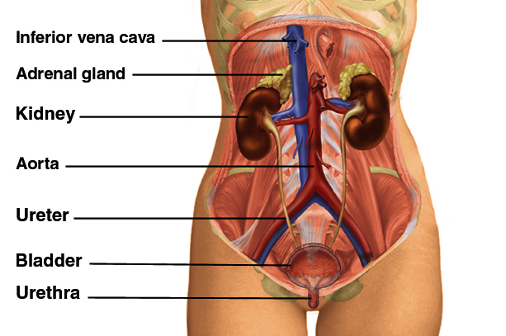
The Urinary System

Slide 8
Anatomy of the Kidney
The kidneys lie against the posterior abdominal wall at the level of vertebrae T12 to L3.
The right kidney is slightly lower than the left because of the space occupied by the liver above it.
Each kidney weighs about 160 g and measures about 12 cm long, 5 cm wide, and 2.5 cm thick—about the size of a bar of bath soap.

Slide 9

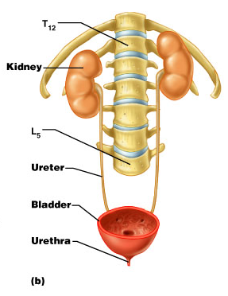
Anatomy of the Kidney
Hilum
12 cm
2.5cm
5cm
Notes:
160g

Slide 10
The Nephron
Each kidney contains about 1.2 million functional units called nephrons.
A nephron consists of two principal parts: -
  A renal corpuscle where the blood plasma is filtered and
  Long renal tubule that processes this filtrate into urine.
Notes:
If you can understand the function of one nephron, you will understand nearly everything about the function of the kidney.

Slide 11
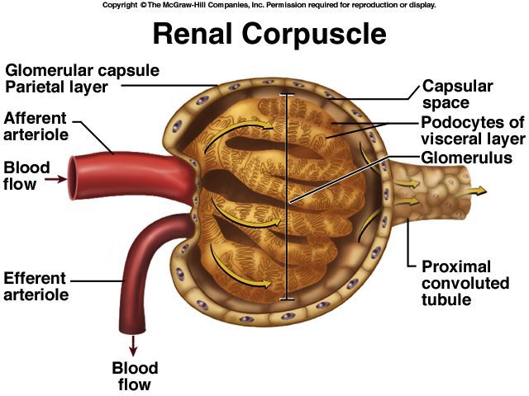
Notes:
The efferent arteriole is narrow than the afferent one for two reasons:
1- It raises the preesure of the blood coming from renal artery which will help in glomerular filtration.
2-It gives the incoming blood extra amount of time to get filtered

Slide 12
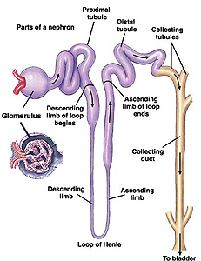
Renal tubule

Slide 13
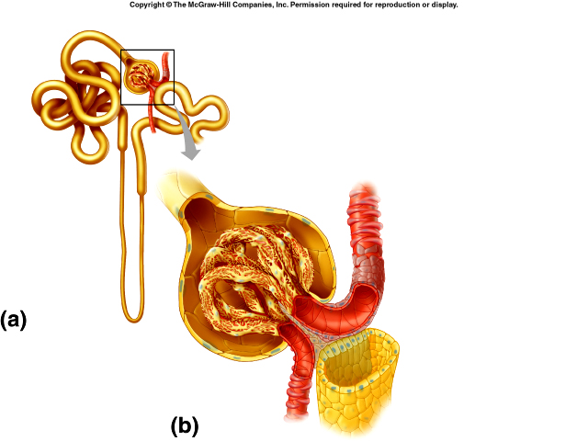
The Nephron: Juxtaglomerular Apparatus
Notes:
Juxtaglomerular Apparatus: The distal end of the renal tubule passes next to the glomerulus to form the juxtaglomerular apparatus (juxta means “next to”). The juxtaglomerular apparatus (JGA) consists of cells located in and around the glomerulus and the glomerular capsule.

Slide 14
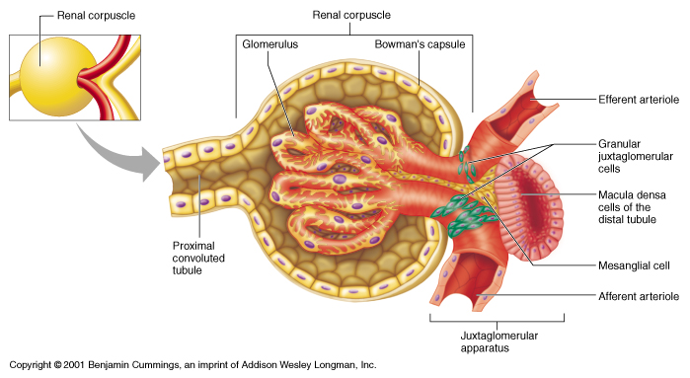
The Nephron…JGA
Notes:
The cells of the macula densa are sensitive to the concentration of sodium chloride in the late thick ascending limb. A decrease in sodium chloride concentration initiates a signal from the macula densa that has two effects: (1) it decreases resistance to blood flow in the afferent arterioles via vasodilation, which increases glomerular capillary hydrostatic pressure and helps return glomerulus filtration rate (GFR) toward normal, and (2) it increases renin release from the juxtaglomerular cells of the afferent and efferent arterioles, which are the major storage sites for renin.^{[1]}

Slide 15
Urine formation
Urine formation is a result of three processes:
  Glomerular filtration
  Tubular reabsorption
  Tubular secretion

Slide 16
Urine formation

Slide 17
Urine formation
Notes:
Polyuria>3.5liters /day

Slide 19
The Nephron…
Notes:
There is also a K+/H+ exchange mechanism in the cortical collecting tubules of the kidney. When plasma potassium levels are increased, K+ is secreted into the urine and H+ is reabsorbed into the blood, producing a decrease in pH and metabolic acidosis. Conversely, when potassium levels are low, K+ is reabsorbed and H+ is secreted in the urine, leading to metabolic alkalosis.

Slide 20
The Ureters
The renal pelvis funnels urine into the ureter, a retroperitoneal, muscular tube that extends to the urinary bladder.
Each ureter is approximately 25 to 30.5 cm long and 0.2 to 0.8 cm in diameter.
The ureters pass dorsal to the bladder and enter it from below, passing obliquely through its muscular wall.
Notes:
The ureters are two slender tubes each 25 to 30 cm (10 to 12 inches) long and 6 mm (. inch) in diameter.

Slide 21
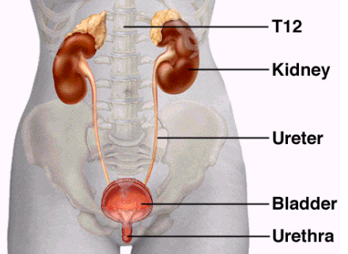
The Ureters
Ureteropelvic junction(UPJ)
ureterovesical junction(UVJ)
Notes:
In the upper third of the ureter, at the point at which the renal pelvis becomes the ureter, is a narrowing known as the ureteropelvic junction (UPJ). The ureter also narrows as it bends toward the abdominal wall (aortoiliac bend). • Each ureter narrows at the point it enters the bladder; this point is called the ureterovesical junction (UVJ).

Slide 22
Functions of Urinary System
Regulation of Water Excretion
Antidiuretic Hormone(ADH)
Osmolarity and Osmolality
Regulate pH in blood(Acid–Base Balance)
Regulation of Electrolyte Excretion(K+, Na+, etc)
Autoregulation of Blood Pressure
  The renin–aldosterone- angiotensin system
Notes:
-Osmolality is a measure of the osmoles (Osm) of solute per kilogram of solvent (osmol/kg or Osm/kg),osmolarity is defined as the number of osmoles of solute per liter (L) of solution (osmol/L or Osm/L).

Slide 23
  The renin–aldosterone- angiotensin system

Slide 24
Functions of Urinary System…
Renal Clearance:- Creatinine clearance
Regulation of Red Blood Cell Production
Vitamin D Synthesis
Secretion of Prostaglandins
Urine Storage and Bladder Emptying
Excretion of Waste Products-
  Urea, creatinine, phosphates, sulfates, uric acid

Slide 25
Assessment of the Renal and
Urinary Tract Systems
Health History
  Common Symptoms
    Pain
    A burning sensation during urination
    Changes in Voiding
    Gastrointestinal Symptoms
    Unexplained Anemia
  Past Health History
    Medications
    Surgery or Other Treatments
  Family History and Genetic Risk

Slide 26
  Assessment of the Renal….
  Changes in Voiding
  Anuria
  Oliguria
  Polyuria
  Dysuria
  Urgency
  Frequency
  Hesitancy
  Nocturia

Slide 27
Assessment of the Renal….
Physical Assessment
  Inspection
    Skin
    Mouth
    Face and extremities
    Abdomen
    Weight
    General state of health
  Palpation
    Rarely palpable
    If the kidney is palpable, note its size, contour, and tenderness.

Slide 28
Physical Assessment….Palpation

Slide 29
Physical Assessment….Palpation

Slide 30
Physical Assessment
  Percussion
    Helps assess pain or tenderness
    If CVA tenderness and pain are present, it may indicate a kidney infection or polycystic kidney disease.

Slide 31
Physical Assessment: Percussion: CVAT

Slide 32
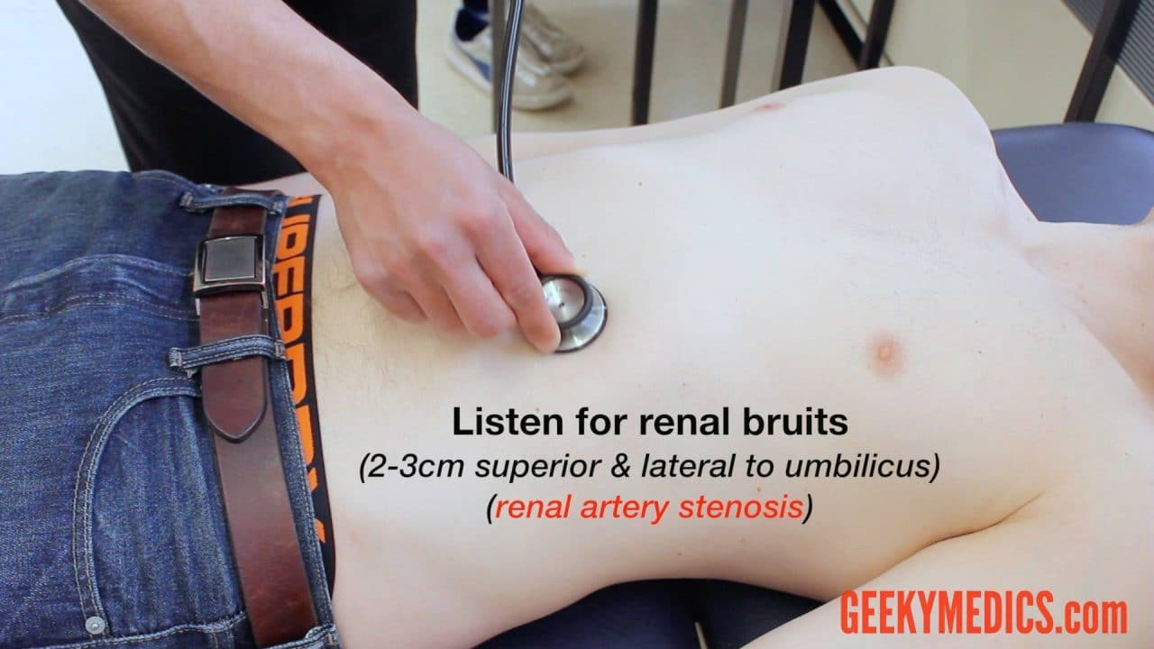
Physical Assessment
  Auscultation: Auscultate the renal arteries for a bruit. Use the diaphragm of the stethoscope

Slide 33
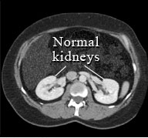
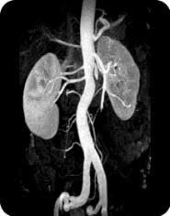
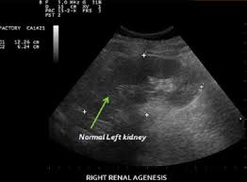
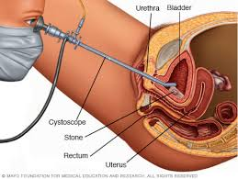
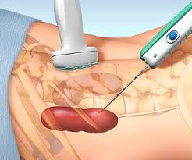
CT scan of kidneys
MRI of kidneys
Renal ultrasound
Cystoscopy
Renal biopsy
Notes:
GFR: 90–120 mL/min
- Cystoscopy is a procedure that allows your doctor to examine the lining of your bladder and the tube that carries urine out of your body (urethra).
- A hollow tube (cystoscope) equipped with a lens is inserted into your urethra and slowly advanced into your bladder.

Slide 34
Diagnostic Evaluation: Urinalysis
An examination of the constituents of a sample of urine in order to establish a baseline, to provide data for diagnosis, or to monitor results of treatment.
Urine examination includes the following:
  Urine color
  Urine clarity and odor
  Urine pH and specific gravity
  Tests to detect protein, glucose, and ketone bodies in the urine
  Microscopic examination to detect RBCs, white blood cells, casts, crystals , and bacteria

Slide 35
Diagnostic Evaluation: Renal function test
Blood urea nitrogen (BUN):
  Normal values: 5–25 mg/dL
Creatinine (serum):
  Normal value: Serum: 0.5–1.5 mg/dL. (Older adults and women may have decreased values due to decreased muscle mass.)
BUN/creatinine ratio:
  Normal BUN/creatinine ratio is 10:1
Creatinine clearance:
  Reference interval: 70-135 mL/min/1.73 m2

Slide 36
MANAGEMENT OF PATIENTS WITH
URINARY TRACT DISORDERS

Slide 37
Objectives
@ the end you will be able to:
Identify upper and lower UTIs
Explain the predisposing causes, symptoms, laboratory
abnormalities, and treatment of urinary tract infections
(UTIs).
Compare and contrast the pathophysiology, clinical manifestations,medical management, and nursing management for patients with renal disorders.
Explain the predisposing causes, symptoms, treatment,
and teaching for kidney stones.
Describe the nursing management of patients with acute and chronic renal failure.
Compare and contrast the renal replacement therapies including hemodialysis, peritoneal dialysis, and kidney transplantation.

Slide 38
Outlines
URINARY TRACT INFECTIONS
.
❖ Lower UTI
Urethritis
Cystitis
❖ Upper UTI
Ureteritis
Pyelonephritis
Glomerular diseases:
Glomerulonephritis
Nephrotic syndrome
Urolithiasis
Renal failure:
Acute Renal failure
Chronic Renal failure

Slide 39
Urinary tract infection
Urinary tract infection is the presence of microbial pathogens in the normally sterile urinary tract.
Infections are overwhelmingly bacterial although fungi (Candida),viruses(Adenoviruses) and parasites may cause UTI.
Pathogens usually enter the urinary tract by ascending from the mucous membranes of the perineal area into the lower urinary tract.
Hematogenous spread of infection to the urinary tract is rare.

Slide 40
Risk Factors for UTI
Female
  Short, straight urethra
  Proximity of urinary meatus to vagina and anus
  Sexual intercourse
  Use of diaphragm and spermicidal compounds for birth control
  Pregnancy
Male
  Being uncircumcised
Both
  Aging
  Urinary tract obstruction
  Vesicoureteral reflux
  Genetic factors
  Catheterization

Slide 41
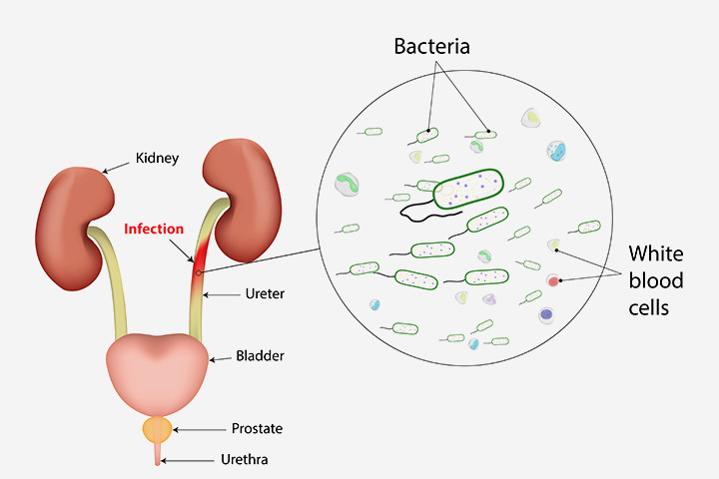
CAUSES OF URINARY TRACT INFECTIONS
  Escherichia coli*
  Enterococcus
  Klebsiella
  Enterobacter
  Proteus
  Pseudomonas
  Staphylococcus
  Serratia
  Candida albicans

Slide 42
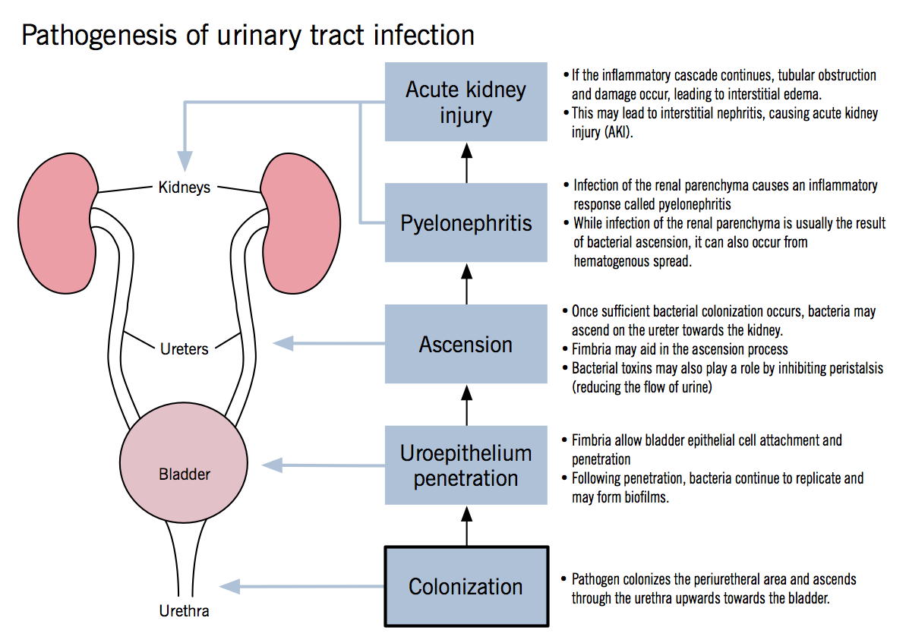

Slide 43
Classifying Urinary Tract Infections
Lower UTIs
  Cystitis
  Prostatitis
  Urethritis
Upper UTIs
  Ureteritis
  Acute pyelonephritis
  Chronic pyelonephritis
  Renal abscess
  Interstitial nephritis
  Perirenal abscess

Slide 44
CYSTITIS
Inflammation of the urinary bladder
The mucosa becomes hyperemic (red) and may hemorrhage and the inflammatory response causes pus to form.
Causes
  Bacteria – E .coli
  Fungi and viruses

Slide 45
CYSTITIS…
Manifestations of Cystitis
  Fever
  Dysuria
  Pyuria
  Frequency
  Hematuria
  Urgency
  Suprapubic discomfort
  Nocturia
  Urine may have a foul odor

Slide 46
CYSTITIS…
Diagnosis
  Clinical
  Urinalysis
  Culture, and sensitivity
Medical Treatment
  A mild analgesic such as acetaminophen is useful for relieving discomfort.
  Antibiotics

Slide 47
Medical Management:
Cystitis and urethritis
High fluid intake (2 liters daily)
Potassium citrate mixture 10ml 3x/d in 1/2 glass of water. It alkalinizes the urine and relive pain
Antibiotics
  Ciprofloxacin 500 mg BID for 1-3 days or
  Norfloxacin 400mg BID for 1-3 days

Slide 48
Ureteritis
Ureteritis refers to inflammation of the ureter.
The ureter rarely is infected alone, but there is either a pyelonephritis or a cystitis associated with it.

Slide 49
Etiology
Most commonly infectious from an associated cystitis
Ascending urinary tract infections; the most common causative agents are Escherichia coli and Aerobacter aerogenes
Chronic inflammation secondary to ureteric stents
Direct spread from adjacent organs
(e.g. in appendicitis, diverticulitis, inflammatory bowel disease etc)
Haematogenous spread

Slide 50
Etiology …
Congenital anatomical abnormalities(e.g. duplication,stenosis,tortuous and/or missing valve )
Certain neurological complications of diseases like multiple sclerosis, diabetic neuropathy, stroke, spasticity
Cancer of the lining of the ureter
Kidney stone that has migrated into the ureter or
Trauma (accidental cutting during pelvic surgical procedures such as hysterectomies, or gun shot wounds).

Slide 51
Clinical presentation
Patients may present with symptoms of cystitis or pyelonephritis with suprapubic/flank pain, dysuria, hematuria and/or fever.
White cell count may also be elevated
Diagnosis
Hx
PE
Urinalysis

Slide 52
Treatment
Antibiotics
Ureter revision and implantation
Surgery to remove a dead end piece
A cancer has to mostly be eradicated with fairly invasive surgery, possibly followed by radiotherapy or chemotherapy.

Slide 53
Pyelonephritis
Pyelonephritis is a bacterial infection of the renal pelvis, tubules, and interstitial tissue of one or both kidneys.
Results from an infection that ascends to kidney from lower urinary tract.
Pathogenic bacteria from a bladder infection can ascend into the kidney, resulting in pyelonephritis.
Pyelonephritis may be acute or chronic.

Slide 54
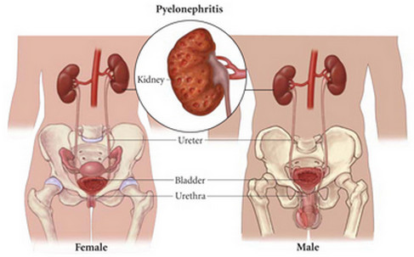
Pyelonephritis

Slide 55
Pyelonephritis
Risk factors:
  Vesicoureteral reflux, Renal calculi, pregnancy
  Urinary tract obstruction, stricture-BPH
  Urinary tract trauma, scarring- catheterization..
  Chronic diseases, i.e. diabetes mellitus

Slide 56
Pyelonephritis
Acute pyelonephritis is a bacterial infection of the kidney; usually results from an infection that ascends to the kidney from the lower urinary tract.
Chronic pyelonephritis is associated with nonbacterial infections and inflammatory processes that may be metabolic, chemical, or immunologic in origin.

Slide 57
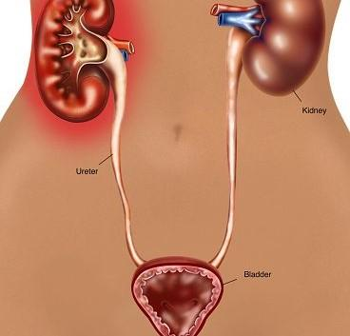
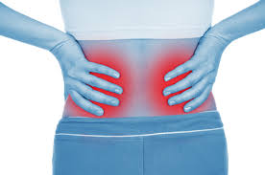
Acute Pyelonephritis
Clinical Manifestations
  Flank pain, CVAT, anorexia, tachycardia
  Chills and fever (T⁰=38.9⁰C or higher)
  Malaise, nausea, vomiting, hematuria
  Urinary frequency, urgency, dysuria
Manifestations in older adults
  Change in behavior
  Acute confusion
  Incontinence
  General deterioration in condition

Slide 58
Acute Pyelonephritis…
Diagnostic
  History and physical examination
  Urinalysis
  Urine for culture and sensitivity
  Imaging studies: ultrasound (initially), CT scan
  CBC count with WBC differential
  Blood culture (if bacteremia is suspected)
  Percussion for flank (costovertebral angle [CVA]) pain

Slide 59
Acute Pyelonephritis…
Differential Diagnosis
  Acute appendicitis
  Salpingitis
  Cholecystitis
  Diverticulitis
  Perinephrotic abcess

Slide 60
Acute Pyelonephritis: Management
Mild Symptoms (Uncomplicated Infection)
  Outpatient management or short hospitalization
  Empirically selected broad-spectrum antibiotics:
  ampicillin, vancomycin combined with an aminoglycoside
  (e.g. gentamicin)
  Switch to sensitivity-guided therapy:
  trimethoprim/ sulfamethoxazole (Bactrim, Septra)
  Fluoroquinolones: ciprofloxacin, norfloxacin
  Adequate fluid intake
  NSAIDs or antipyretic drugs
  Follow-up

Slide 61
Acute Pyelonephritis: Management
Severe Symptoms (complicated Infection)
  Hospitalization
  Parenteral antibiotics
  Oral antibiotics when patient tolerates oral intake
  Adequate fluid intake (parenteral initially; switch to oral fluids as nausea, vomiting, and dehydration subside)
  NSAIDs or antipyretic drugs to reverse fever and relieve discomfort
  Follow-up urine culture and imaging studies

Slide 62
CHRONIC PYELONEPHRITIS
Chronic pyelonephritis involves chronic inflammation and scarring of the tubules and interstitial tissues of the kidney.
In chronic pyelonephritis the kidneys become small, atrophic, and shrunken and lose function due to fibrosis (scarring).
Repeated bouts of acute pyelonephritis may lead to chronic pyelonephritis.
It is a common cause of chronic kidney disease.
Hypertension can develop as kidney tissue is destroyed.

Slide 63
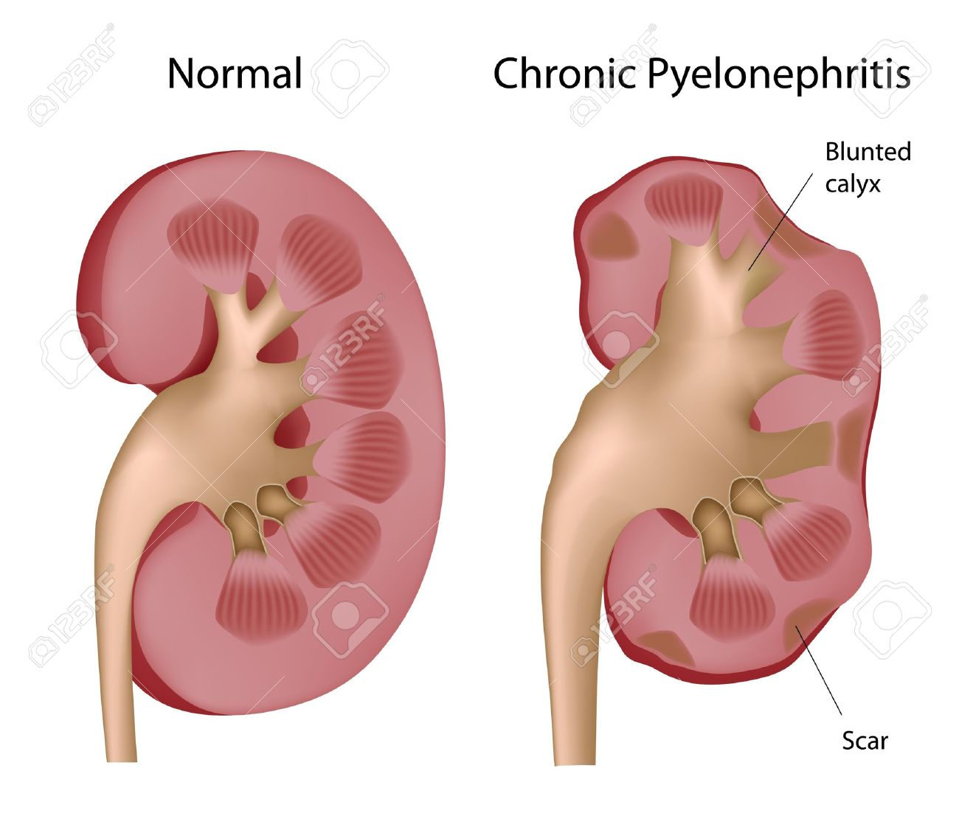
CHRONIC PYELONEPHRITIS…

Slide 64
CHRONIC PYELONEPHRITIS…
Clinical manifestations
  The patient with chronic pyelonephritis may be asymptomatic
  May have mild manifestations such as urinary frequency, dysuria, and flank pain.

Slide 65
CHRONIC PYELONEPHRITIS…
Diagnostic Tests
  Urinalysis
  Intravenous pyelography (IVP)
  Renal ultrasound: alternative to ivp
  Cystoscope
  Urine culture: mostly E.Coli
  WBC with differential
  Renal function test

Slide 66
CHRONIC PYELONEPHRITIS…
Management
  Uncomplicated infection of lower urinary tract - treated with short course antibiotics
  Upper urinary tract infections - require longer treatment (≥2 weeks) to eradicate the infecting organism.
  Severe illness – need hospitalization and IV antibiotics.
  Antibiotics: Ciprofloxacin, Cotri
  Intravenous antibiotics used include: ciprofloxacin, gentamycin, ceftriaxone, ampicillin

Slide 67
PYELONEPHRITIS: Nursing care
Monitor renal function
Encourage fluid intake
Empty bladder every 3 – 4 hours
Cleanse perineal area from front to back
Void before and after sexual intercourse
Maintain integrity of perineal tissues

Slide 68
Management of Patients With Renal Disorders
  Acute Glomerulonephritis
  Chronic Glomerulonephritis
  Nephrotic syndrome
  Acute Renal Failure
  Chronic Renal Failure

Slide 69
Acute Glomerulonephritis
Glomerulonephritis is an inflammation of the glomerular capillaries that can occur in acute and chronic forms.
The acute nephritic syndrome is the clinical manifestation of glomerular inflammation.
Is more common in children, but it can occur at nearly any age.
Acute postinfectious glomerulonephritis (also known as acute poststreptococcal glomerulonephritis) is the most common form.

Slide 70
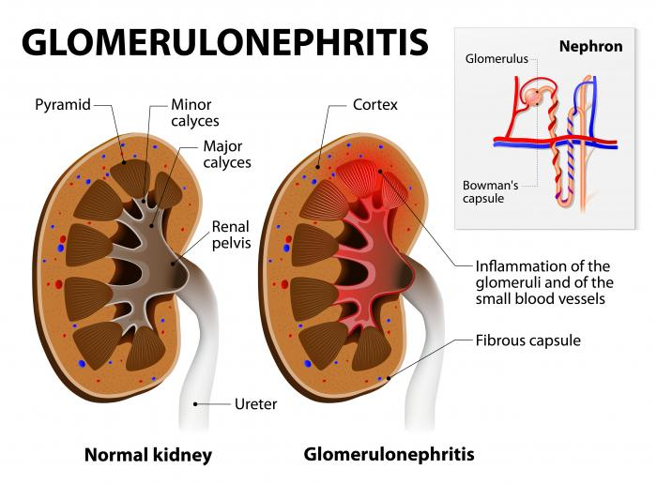
Acute Glomerulonephritis…

Slide 71
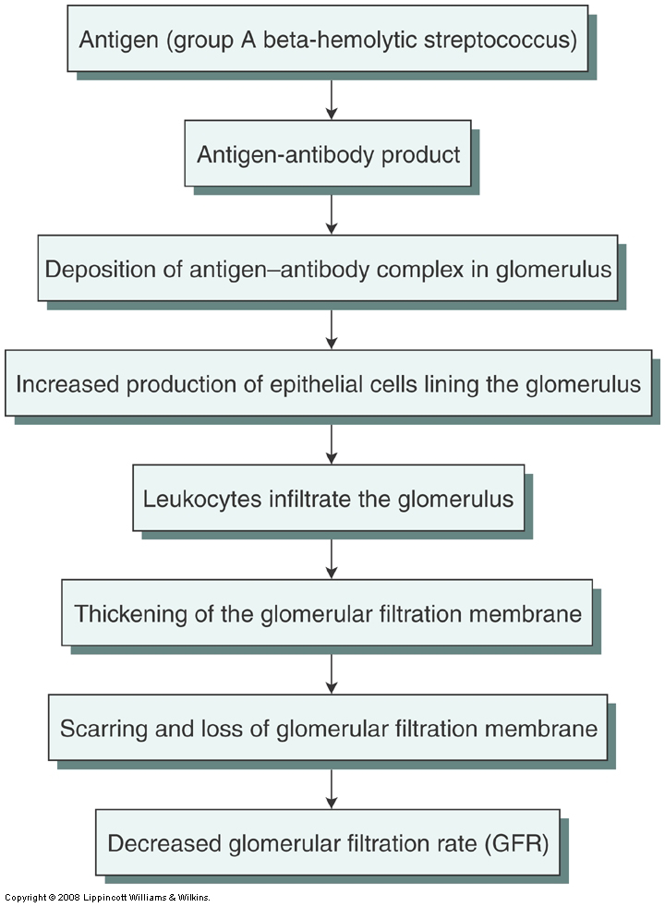
Acute Glomerulonephritis: Pathophysiology

Slide 72
Acute Glomerulonephritis…
Clinical Manifestations
  Proteinuria
  Edema
  Hematuria
  Azotemia
  Salt and water retention(HTN)
  Fatigue, anorexia, nausea, and vomiting
  Headache

Slide 73
Acute Glomerulonephritis…
Complications
  Hypertensive encephalopathy
  Heart failure
  Pulmonary edema
  Rapidly progressive glomerulonephritis
  Chronic glomerulonephritis
  ESRD

Slide 74
Acute Glomerulonephritis…
Assessment and Diagnostic Findings
  Throat or skin cultures
  Erythrocyte sedimentation rate (ESR) elevated
  KUB abdominal imaging
  Ig G and Ig A = elevated in serum
  Urinalysis
  A kidney biopsy
  CT scan

Slide 75
Acute Glomerulonephritis…
Medical and Nursing Management
  Bed rest
  Salt(Sodium) free diet
  Dietary protein is restricted
  Daily record of input and output
  Corticosteroids: Predinisone
  Antihypertensive medications: Nifedipine
  Antibiotics: Penicillin
  Diuretics: Fursumide

Slide 76
Acute Glomerulonephritis…
Nursing management
  Give carbohydrates
  Measure and record intake and output.
  Fluids are given according to the patient's fluid losses and daily body weight.
  Patient education about the disease process, explanations of laboratory and other diagnostic tests, and preparation for safe and effective self-care at home.

Slide 77
Chronic Glomerulonephritis
May be due to repeated episodes of acute nephritic syndrome.
Typically the result of progressive glomerular disorders such as RPGN, lupus nephritis, or diabetic nephropathy.
Slow, progressive destruction of the glomeruli and a gradual decline in renal function.
The kidneys decrease in size symmetrically. Scar tissue distort the cortex, making the surface of the kidney rough and irregular.
Eventually, entire nephrons are lost.

Slide 78
Chronic Glomerulonephritis …
Symptoms develop slowly over time.
Progresses insidiously toward renal failure in 2 to 30 years.
Patients are often unaware that progressive kidney impairment is occurring.
May also be diagnosed when hypertension and impaired renal function are found coincidentally during a routine physical examination or treatment for an unrelated disorder.

Slide 79
Chronic Glomerulonephritis …
Clinical Manifestations
  Haematuria, Proteinuria
  Elevated BUN and serum creatinine
  Uremic symptoms, such as slurred speech, ataxia, tremors, or asterixis.
  Headaches, dizziness, and digestive disturbances.
  Yellow-gray pigmentation of the skin
  Periorbital and peripheral edema
  Retinal findings: hemorrhage, exudate, narrowed tortuous arterioles, and papilledema
  Symptoms of anemia and heart failure

Slide 80
Chronic Glomerulonephritis …
Assessment and Diagnostic Findings
  Laboratory abnormalities
  Chest x-rays may show cardiac enlargement and pulmonary edema.
  The electrocardiogram (ECG) changes
  CT scan and MRI

Slide 81
Chronic Glomerulonephritis …
Medical Management
  Management of symptoms guides the treatment.
    Antihypertensive agents to reduce blood pressure
    Diuretic medications
    Antibiotics are prescribed for the patient with post streptococcal glomerulonephritis
    Corticosteroids: Predinisone
    Immunosuppressive therapy is used to treat acute inflammatory processes
    Dialysis

Slide 82
Chronic Glomerulonephritis …
Nursing managements
  Monitor vital signs at least every 4 hours
  Record intake and output every 4 to 8 hours
  Restricted activity may be recommended during the acute phase of post streptococcal glomerulonephritis.
  Monitor serum electrolytes, hemoglobin and hematocrit, BUN, and creatinine.
  Monitor CBC, focusing on the WBC and differential
  Sodium intake may be restricted to 1 to 2 g per day.
  Dietary protein may be restricted if azotemia is present.

Slide 83
Nephrotic Syndrome(NS)
It is a condition of increased glomerular permeability that allows larger molecules to pass through the membrane into the urine and then be excreted.
Results when the glomerulus is excessively permeable to plasma protein, causing proteinuria.
Characterized by massive proteinuria (>3.5 g/day) along with an associated hypoalbuminemia (<3 g/dL), generalized edema, and hyperlipidemia (cholesterol > 300 mg/dL).

Slide 84
Nephrotic Syndrome(NS): Pathophysiology

Slide 85
Nephrotic Syndrome cause

Slide 86
Nephrotic Syndrome…
Clinical Manifestations
  Massive proteinuria
  Hypoalbuminemia
  Edema (facial and periorbital)
  Hyperlipidemia
  Lipiduria
  Increased coagulation
  Irritability, headache, and malaise.
  Reduced kidney function

Slide 87
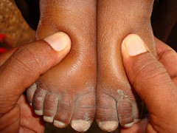
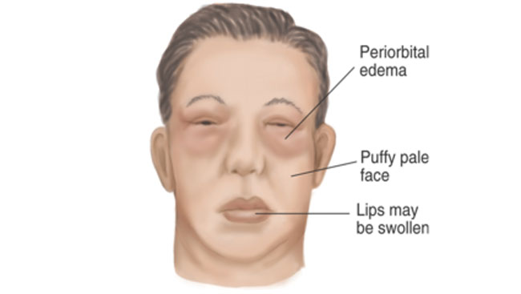
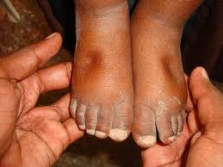
Nephrotic Syndrome…
Clinical Mn: Edema

Slide 88
Nephrotic Syndrome…
Assessment and Diagnostic Findings
  History and physical examination
  Proteinuria (predominately albumin) exceeding 3.5 g/day is the hallmark of the diagnosis of nephrotic syndrome.
  Serum albumin less than 3g/dl and total serum protein less than 6g/dl
  LDL increase but HDL is usually normal
  Urinalysis
  A needle biopsy of the kidney

Slide 89
Nephrotic Syndrome…
Complications
  Infection
  Thromboembolism: Pulmonary emboli
  Accelerated atherosclerosis
  ARF
  Anemia

Slide 90
Nephrotic Syndrome…
Differential diagnosis
  Heart failure
  Liver failure
  Abdominal tuberculosis

Slide 91
Nephrotic Syndrome…
Medical Management
  Restriction of salt and water intake
  Corticosteroids and cyclophosphamide
  Antibiotics for streptococcal infection
  Administer loop diuretics: Furosemide
  Treat pulmonary edema: Oxygen
  BP stabilization to decrease proteinuria: ACE inhibitor
  Lipid-lowering agents:colestipol (Colestid) and lovastatin (Mevacor)
  If thrombosis is detected, anticoagulant therapy
  Dialysis

Slide 92
Nephrotic Syndrome…
Nursing Management
  Assess the edema by weighing the patient daily
  Accurately recording of intake and output
  Clean the edematous skin carefully. Avoid trauma to the skin.
  Monitor the effectiveness of diuretic therapy.
  Encourage better dietary intake.
  Teach the patient to avoid exposure to persons with known infections.

Slide 93
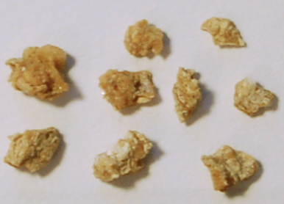
Kidney stone (Renal Calculi)
Masses of crystals and protein.
Formed when the urine becomes supersaturated with a salt.
Stones are classified by their:
  Location in urinary system
    Nephrolithiasis
    Urolithiasis
  Composition of crystals
    Calcium oxalate, Struvite
    Uric acid, cysteine
Stones < 5 mm are readily passed in the urine.

Slide 94
Kidney stone…
The term calculus refers to the stone, and lithiasis refers to stone formation.
Most calculi originate in the kidney (nephrolithiasis) and travel through the ureters to the bladder (urolithiasis).
Urolithiasis is the presence of calculi (stones) in the urinary tract
Nephrolithiasis is the formation of stones in the kidney.
Formation of stones in the ureter is ureterolithiasis.

Slide 95
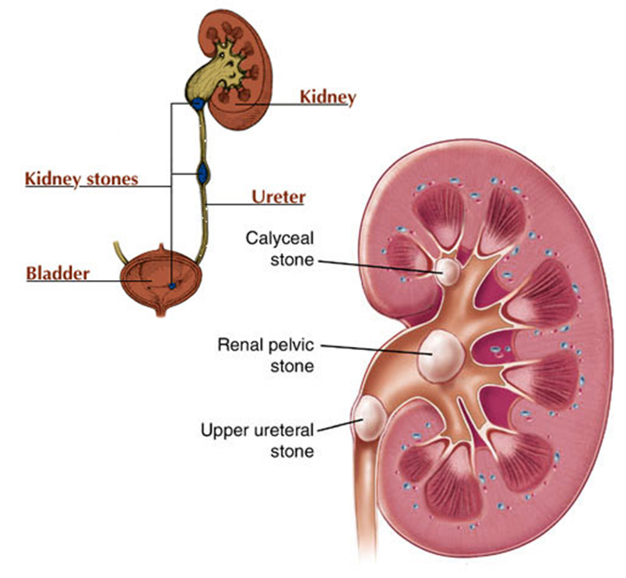
Kidney stone…

Slide 96
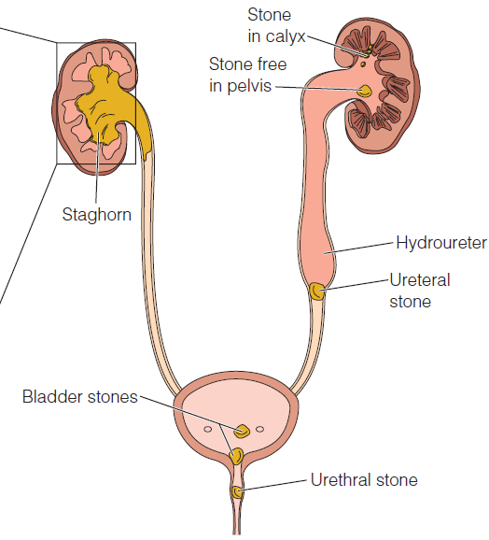
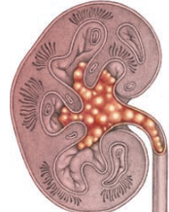
Fig. Development and location of calculi within the urinary tract
Notes:
Staghorn calculus- is a cast of the innermost part of the kidney -the calyx and renal pelvis.
Complications :
Obstruction of urine flow ( urine stasis) – infection
Hydronephrosis - distension of the renal pelvis and calyces
Hydroureter - distension of the ureter

Slide 97
Kidney stone…
Risk factors:
  Age
  Race
  Climate
  Family history of stones, gout, urine stasis
  Chronic dehydration
  UTI – damaged tissue is site for stone formation
  Diet -Large intake of calcium, proteins, vit D
  Immobility, urinary stasis
  Hyperparathyroidism
  Medications
  Altered urine pH
  Lack of kidney substance that inhibits calculi formation

Slide 98
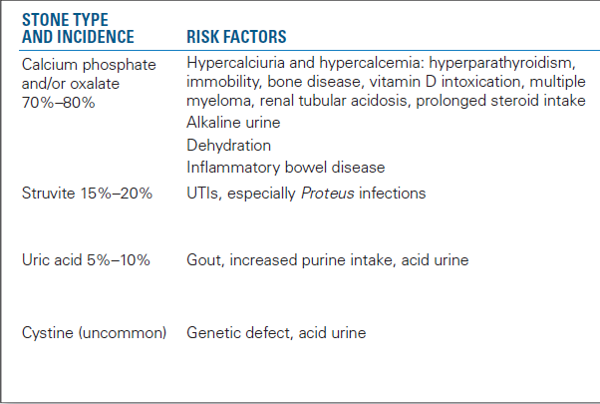
Kidney stone…
Notes:
Incidence=CaSUC

Slide 99
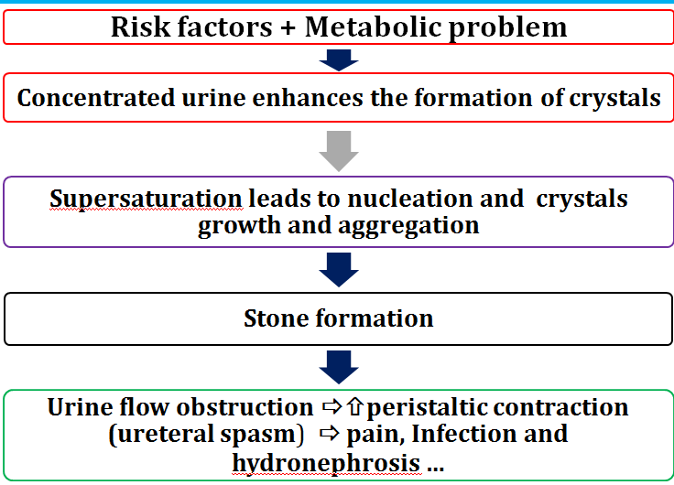
Pathophysiology of renal calculi

Slide 100
Renal Calculi: Clinical Manifestations
Kidney stones
  Often asymptomatic
  Dull aching flank pain
  Microscopic hematuria
  Manifestations of UTI
Ureteral stones
  Renal colic:
  Acute, severe flank pain on affected side
  Often radiates to suprapubic region, groin, and external genitals
  Nausea, vomiting, pallor, and cool, clammy skin….may go to shock
Bladder stones
  May be asymptomatic
  Dull suprapubic pain, possibly associated with exercise or voiding
  Gross or microscopic hematuria
  Manifestations of UTI

Slide 101
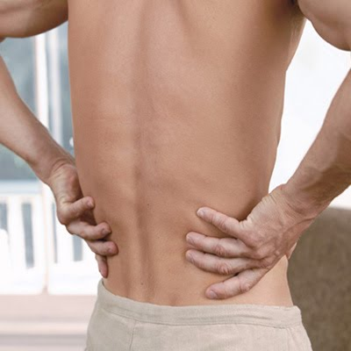
Renal Calculi…
Complications
  Hydronephrosis
  Hydroureter
  Urinary stasis
  Infection

Slide 102
Renal Calculi…
Assessment and Diagnostic Findings
  History and physical exam
  Urinalysis
  Urine calcium, uric acid, and oxalate levels
  Serum calcium, phosphorus, and uric acid
  KUB x-ray of the lower abdomen
  Renal ultrasonography
  Computed tomography (CT) scan of the kidney

Slide 103
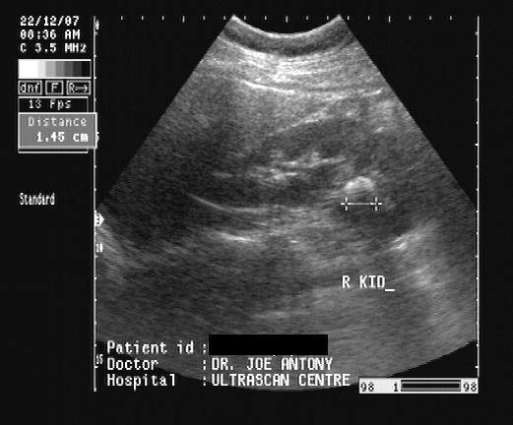
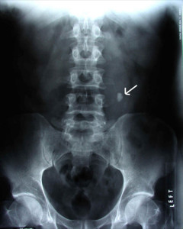
Renal Calculi…
  Renal ultrasonography and X- ray

Slide 104
Renal Calculi…
The goals of management are:
  To relieve the pain
  To eradicate the stone
  Determine the stone type
  Prevent nephron destruction
  Control infection and relieve any obstruction

Slide 105
Renal Calculi…
Management
  Drug therapy
  Nutritional Therapy
  Fluid Management
  Lithotripsy
  Surgical management

Slide 106
Renal Calculi…
Medical Management: Drug therapy
  For all types of stone: Managing Pain
    Opioid analgesics or parenteral NSAIDs and
    Antispasmodics(α-adrenergic Blockers: terazosin).
  Uric acid stones
    Allopurinol for hyperuricosuria
  Calcium phosphate and/or oxalate stones
    Thiazide diuretics, phosphates
  Struvite stones
    Antibiotic therapy for UTI
  Cysteine stones
    Penicillamine, sodium bicarbonate

Slide 107
Renal Calculi…
Medical Management: Fluid Management
  Fluid intake is the mainstay of most medical therapy for renal stones.
  Water is the preferred fluid.
  Increased fluid intake of 2.5 to 3.0 L per day is recommended, regardless of stone composition.
  Fluid intake should be spaced throughout the day and evening.
  A urine output exceeding 2 L/day is advisable.

Slide 108
Renal Calculi…
Medical Management: Nutritional Therapy
  Calcium Stones
    Reduce calcium in diet
    A low-sodium diet is recommended
  Uric Acid Stones
    The patient with uric acid stones requires a diet low in purines.
    Foods that tend to alkalinize the urine may be recommended.
  Cystine Stones
    A low-protein diet is prescribed, the urine is alkalinized, and fluid intake is increased.

Slide 109
Renal Calculi…
Medical Management: Nutritional Therapy
  Oxalate Stones
    A dilute urine is maintained and the intake of oxalate is limited
  Struvite (magnesium ammonium phosphate)
    Limit high-phosphate foods, such as dairy products, organ meats, and whole grains.
      Reduction of urinary phosphate content may help prevent these stones from forming.

Slide 110
Renal Calculi…
Management
  Lithotripsy: (shattering of the calculus)
    Is the use of sound, laser, or dry shock waves to break the stone into small fragments.
  Extracorporealshockwavelithotripsy(ESWL)
    Used to disintegrate (break) into smaller fragments allowing it to pass through the urinary tract.

Slide 111
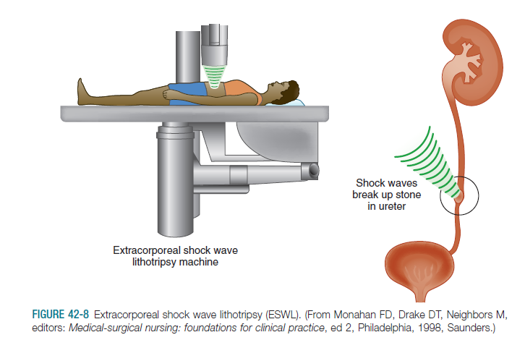
Renal Calculi…
Extracorporeal shock wave lithotripsy(ESWL):

Slide 112
Renal Calculi…
Surgical therapy:is needed to remove a kidney stone if it:
  Doesn’t pass after a reasonable period of time and causes constant pain
  Is too large to pass on its own or is caught in a difficult place
  Blocks the flow of urine
  Causes an ongoing urinary tract infection
  Damages kidney tissue or causes constant bleeding
  Has grown larger, as seen on follow-up x rays

Slide 113
Renal Calculi…
Surgical Therapy includes
  Percutaneous ureterolithotomy or nephrolithotomy
  Open Surgical Procedures
    Nephrolithotomy (Kidney)
    Pyelolithotomy (Renal Pelvis)
    Ureterolithotomy (Ureter)

Slide 114
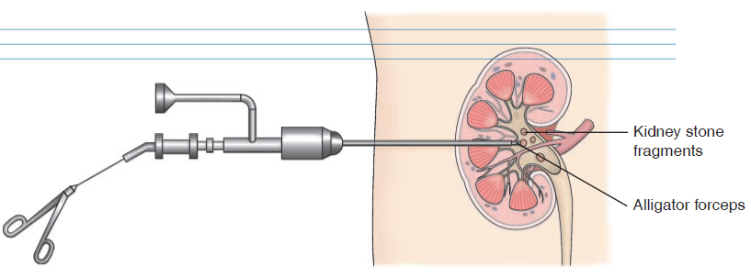
Renal Calculi: Management
  Percutaneous ureterolithotomy or nephrolithotomy

Slide 115
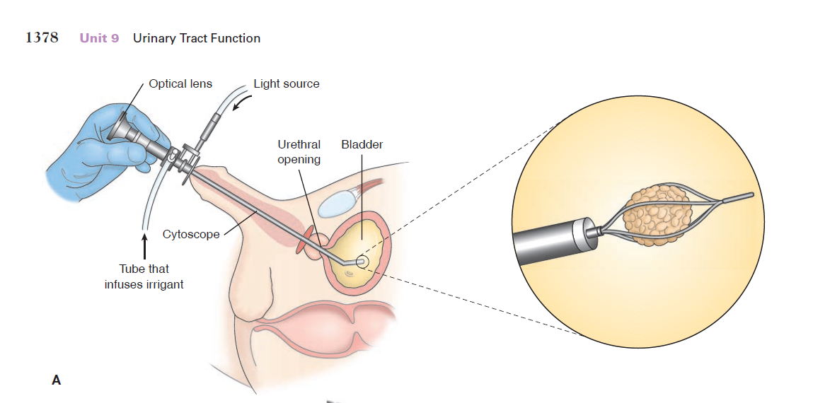
Management…
Cystoscopy

Slide 116
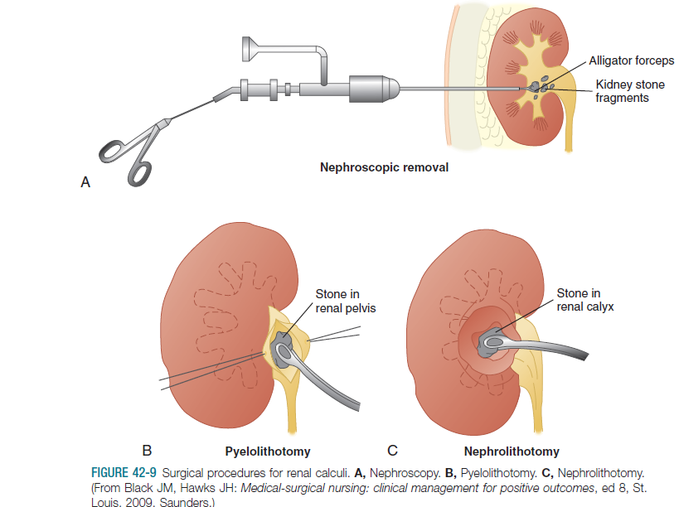
Management…
  Open Surgical Procedures

Slide 117
Renal Calculi…
Management
  Patient Education
    Hydration
      Drink 3 liters of fluid per day (14 cups)
      Lemonade (citrate decrease stone formation)
    Diet
      Low sodium and protein
      Watch amounts of oxalate
    Exercise/Increase Activity

Slide 118
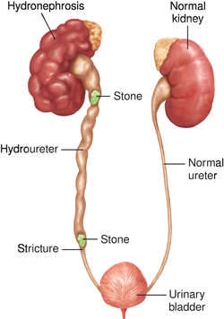
Renal Calculi…
Complications
  Hydronephrosis
  Hydroureter

Slide 119
Renal Failure
Renal failure is a medical condition in which the kidneys fail to adequately filter waste products from the blood.
Renal failure results when the kidneys cannot remove the body's metabolic wastes or perform their regulatory functions.
Renal failure is a systemic disease and is a final common pathway of many different kidney and urinary tract diseases.

Slide 120
Renal Failure…
Classification
  Acute Kidney Injury(AKI)
    Previously called acute renal failure (ARF)
  Chronic Kidney Disease (CKD)
    Chronic kidney diseases(CKD)

Slide 121
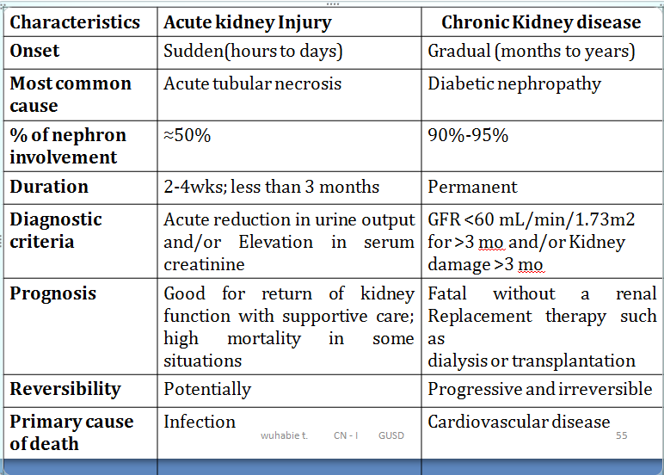
Comparison of acute kidney injury and chronic kidney disease

Slide 122
Acute kidney injury
The entire range of the syndrome, ranging from a slight deterioration in kidney function to severe impairment
The kidneys fail to adequately filter waste products from the blood
Rapid loss of kidney function
Rise in serum creatinine and/or a reduction in urine output
It is potentially reversible
The mortality rate for ARF in seriously ill patients is up to 60%.

Slide 123
Acute Renal Failure: Pathophysiology
Causes of Acute renal failure
Pre renal failure(50%)- decreased blood flow to kidney
  Decrease cardiac output (HF, shock, Sepsis)
  Vasoconstriction
Intra renal failure(40%)- damage to filtering structures
  Damage to the nephron: Glomerulonephritis
  Acute tubular necrosis: Ischemia, Drug/toxins, Hemolysis
Post renal failure(5-10% ): Result of an obstruction somewhere distal to the kidney
  Renal calculi: back flow of urine
  Bladder cancer
  BPH, BOO

Slide 124
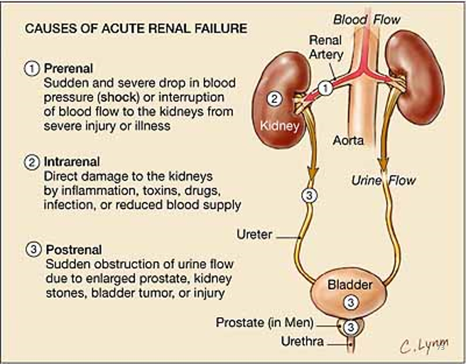

Slide 125
Acute Renal Failure…
Phases of Acute Renal Failure
  The course of ATN or acute tubular injury can be divided into four phases:
    Onset or initiating phase: (0-2 days)
    Oliguric phase: (8-14 days)
    Recovery phase ( Diuresis): (4-6 months)

Slide 126
Acute Renal Failure…
Phases of Acute Renal Failure
  Onset or initiating phase
    The initiation phase may last hours to days
    It begins with the initiating event and ends when tubular injury occurs.
    Characterized by increasing BUN and serum creatinine with normal to decreased urine output(<=30 ml/hr).

Slide 127
Acute Renal Failure…
    Phases of Acute Renal Failure
      Oliguric phase
        Urine output of 100- 400mL/24hr
        Serum BUN and creatinine increase
        Electrolyte abnormalities ( K, P, and Ca)
        Metabolic acidosis(bicarbonate decrease)
        Anemia, Edema and hypertension
        Confusion, lethargy, hyperreflexia, and possible seizures or coma
        Anorexia, nausea and vomiting

Slide 128
Acute Renal Failure…
Recovery phase
  The period during which repair of renal tissue takes place.
  Gradual increase in urine output and a fall in serum creatinine
  Diuresis often occurs before renal function has fully returned to normal.
  Gradual return of the GFR to normal.
  Renal function improves rapidly during the first 5 to 25 days and continues to improve for up to 1 year.
  If complete recovery does not occur, renal insufficiency or chronic renal failure may develop

Slide 129
Acute Renal Failure…
Clinical Manifestations
  Decreased urine output
  Urine may be pink or reddish in color
  Edema (face, arms, legs, feet, eyes)
  Flank pain/Pelvic pain
  Poor appetite (nausea, vomiting)
  Dry itchy skin, easy bruising, fatigue
  Seizures/LOC , shortness of breath
  Sudden weight gain
  Itching ,bone damage, muscle cramps- Hyperphosphatemia
  Abnormal heart rhythms and muscle paralysis-hyperkalemia

Slide 130
RIFLE CLASSIFICATION FOR STAGING ACUTE KIDNEY INJURY

Slide 131
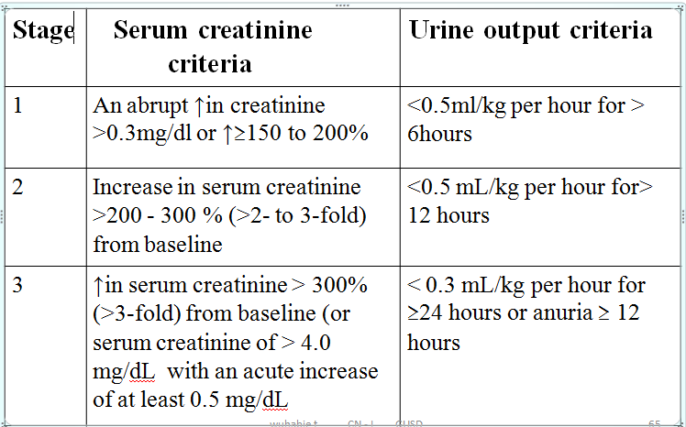
Acute Kidney Injury Network (AKIN) Criteria

Slide 132
Acute Renal Failure…
Assessment and Diagnostic Findings
  Urinalysis
  Serum creatinine, BUN, BUN/creatinine ratio, and eGFR
  Serum electrolytes: Hyperkalemia, Hyponatremia, Hyperphosphatemia, Hypocalcemia
  Arterial blood gases: metabolic acidosis
  CBC shows reduced RBCs, moderate anemia, and a low hematocrit.

Slide 133
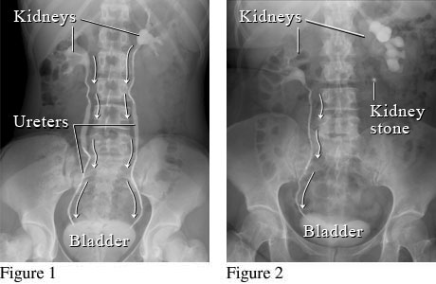
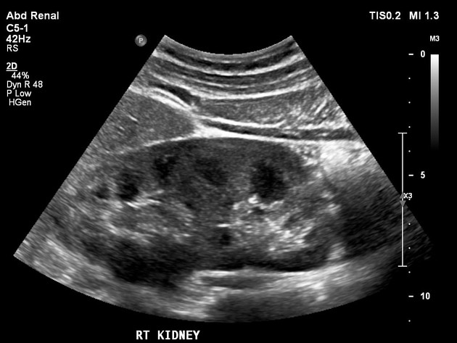
Acute Renal Failure…
  Imaging Studies/Procedures
    Renal ultrasonography
    X-rays, CT scan or MRI
    Renal biopsy

Slide 134
Acute Renal Failure: Medical Treatment
Management includes:
  Treating depending on the cause of the failure
  Eliminating the underlying cause
  Maintaining fluid balance
  Avoiding fluid excesses
  Eliminate nephrotoxic drugs
  Prevent further damage
  Control symptoms and to prevent complications
  When indicated, providing renal replacement therapy

Slide 135
Medical Treatment…
Treatment depends on the cause of the failure.
  Prerenal AKI
    BP and blood volume must be restored.
  Intrarenal AKI
    Is based on efforts to stimulate urine production with intravenous fluids and with dopamine, furosemide, or both.
  Postrenal AKI
    Treated by removal of the cause (typically an obstruction).

Slide 136
Medical Treatment…
Correcting acidosis: Sodium bicarbonate( HCO3-)
Correcting hemolytic abnormalities
  Blood transfusion may be required
Restoring fluid and electrolyte balance
  Hyperkalemia is very common
Strict monitoring on
  Intake and output daily
  Weight (Hydration for prerenal failure)
Serial monitoring of labs
  BUN/Creatinine/Osmolality etc..

Slide 137
Medical Treatment…
Drug Therapy
  Oliguria: Diuretics: furosemide (Lasix)
  ACE inhibitors or ARBs are used to control arterial pressures.
  Regular doses of antacids, histamine H2-receptor antagonists or a proton-pump inhibitor are often ordered to prevent GI hemorrhage.

Slide 138
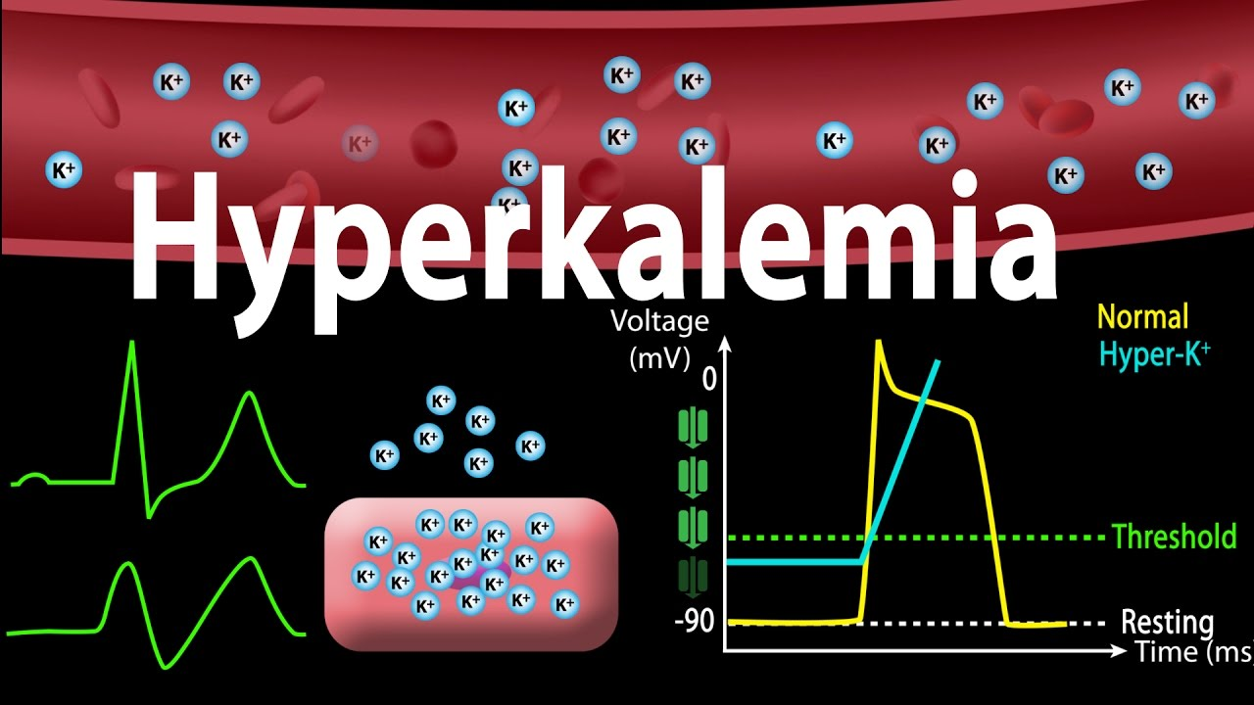
Medical Treatment…
Life Threatening Emergency in AKI!!

Slide 139
Medical Treatment…
Hyperkalemia Treatment
  Calcium gluconate IV
  Sodium Bicarbonate
  Insulin/glucose
  Sodium polystyrene sulfonate (Kayexalate)
  Lasix
  Dietary Restriction
  Hemodialysis

Slide 140
Medical Treatment…
Hyperphosphatemia
  Aluminum hydroxide, an antacid, is used to control hyperphosphatemia in renal failure.
  It binds with phosphates in the GI tract, which are then excreted in the feces.

Slide 141
Medical Treatment…
Fluid Management
  Fluid balance is carefully monitored and daily fluid intake should be calculated.
  Once vascular volume and renal perfusion are restored, fluid intake is usually restricted.
  Adequate renal blood flow in patients with prerenal causes of ARF may be restored by IV fluids or transfusions of blood products.

Slide 142
Medical Treatment…
Nutrition Therapy
  The patient with ARF needs adequate nutrients and calories.
  A primary nutritional goal in AKI is to maintain adequate caloric intake (providing 30 to 35 kcal/ kg).
  Proteins may be limited to 0.6 g per kilogram of body weight per day.
    Dietary proteins should be of high biologic value (rich in essential amino acids).
  Carbohydrates are increased
  Reduce food containing K,P, Na
Notes:
Nutritional therapy
Maintain adequate nutrition
Protein restriction/limitation to 0.6 g/kg/d
Fat intake(30-40% of the tatal calory)
Provide COH
Na,k and P restriction

Slide 143
Medical Treatment…
  Nutrition Therapy…
  Dietary fat intake is increased so that the patient receives at least 30% to 40% of total calories from fat.
  Foods and fluids containing potassium or phosphorus (eg, bananas, citrus fruits and juices, coffee) are restricted.
  Sodium is restricted as needed to prevent edema, hypertension, and HF.

Slide 144
Medical Treatment…
Dialysis Therapies
  Dialysis is the diffusion of solute molecules across a semipermeable membrane from an area of higher solute concentration to one of lower concentration.
  It is used to remove excess fluid and metabolic waste products in renal failure.
  Early use of dialysis can reduce the rate of complications.
  It can be hemodialysis or peritoneal dialysis.

Slide 145
Medical Treatment…
Dialysis Therapies
  Indications of dialysis in ARF
    Sever hyperkalemia(>7mmol/L)
    Severe metabolic acidosis(PH < 7.2)
    Fluid overload not controlled by conservative measures causing pulmonary edema
    Uremic encephalopathy(seizure)
    Uremic pericarditis
    Blood urea above 200mg/dl
    Creatinine above 10mg/dl

Slide 146
Medical Treatment…
Nursing diagnoses
  Excess fluid volume related to kidney failure and fluid retention
  Fluid Volume deficient
  Fatigue related to anemia, metabolic acidosis, an uremic toxins
  Risk for infection related to altered immune responses secondary to kidney failure
  Imbalanced Nutrition: Less than Body Requirements
  Anxiety related to disease processes
  Potential complication: dysrhythmias related to electrolyte imbalances

Slide 147
Medical Treatment…
Monitoring Fluid and Electrolyte Balance
  Monitor I/O, lab. Results, hyperkalemia symptoms
Reducing Metabolic Rate: Bed rest
Promoting Pulmonary Function
Maintain adequate nutrition
Preventing Infection
Providing Skin Care
Assess for signs of heart failure

Slide 148
Chronic Kidney Disease
It is progressive, irreversible deterioration in renal function.
At this stage kidney is unable to:
  Excrete metabolic wastes (uremia, azotemia)
  Regulate fluid and electrolyte balance
CKD can be defined as a decreased GFR less than 60 mL/min/1.73 m2 for longer than 3 months.
Diabetes mellitus is the leading cause of CKD.

Slide 149
Chronic Kidney Disease
Persons at Risks- patients who have:
  Diabetics – diabetic nephropathy
  Hypertension
  Family history of kidney diseases
  Chronic glomerulonephritis
  Pyelonephritis
  Cardiovascular diseases
  Obesity (BMI > 30)
  Smoking
  Elderly > 60 years

Slide 150
Chronic Kidney Disease
The most common causes of chronic renal failure (USRDS, 2008).

Slide 151
Stages of Chronic Kidney Disease

Slide 152
CKD: Pathophysiology
Nephron damage is progressive.
When nephrons are damaged, they can’t function.
Healthy nephrons compensate for damaged nephrons by enlarging and increasing their clearance capacity.
The kidneys can maintain relatively normal function until about 75% of the nephrons are nonfunctional.
Eventually, the healthy glomeruli are so overburdened they become sclerotic and stiff, leading to their destruction as well.
If this condition continues unchecked, toxins accumulate and produce potentially fatal changes in all major organ systems.
Notes:
Pathophysiology :Risk factor…progressive nephron damage…loss of kidney function….azotemia…organ damage

Slide 153
Chronic Kidney Disease
Clinical Manifestations
  Azotemia (BUN and serum creatinine levels increase)
  Uremia manifestations:
    Metallic taste in the mouth
    Anorexia, Nausea Vomiting
    Uremic “frost” on skin, Itching
    Fatigue and lethargy
    Hiccups, Edema, Dyspnea
    Muscle cramps, Paresthesias
    Pericarditis
  Insulin Resistance: hyperglycemia and hyperinsulinemia
  Elevated Triglycerides

Slide 154
Chronic Kidney Disease
Clinical Manifestations…
  Electrolyte and Acid-Base Imbalances
  Manifestations of HF
  Lethargy, irritability, confusion and peripheral neuropathy
  Anemia, infection, and bleeding tendencies
  Skin manifestations: itching, dryness, pale, uremic frost
  Anorexia, nausea, vomiting, constipation, and diarrhea.

Slide 155
Chronic Kidney Disease
Assessment and Diagnostic Findings
  History and physical examination
  Urinalysis
  Urine culture
  BUN and serum creatinine
  eGFR
  Serum electrolytes
  CBC: Hematocrit and hemoglobin levels
  Lipid profile
  Renal ultrasound and Kidney biopsy

Slide 156
CKD: Medical Management
Treatment of chronic kidney disease aims:
  To promote elimination of wastes
  Maintenance of fluid balance
  Management of the systemic effects of the disease

Slide 157
CKD: Medical Management…
Pharmacologic Therapy
  IV glucose and insulin, calcium carbonate, calcium acetate, or sodium polystyrene sulfonate to treat hyperkalemia
  Calcium, active vitamin D, and oral phosphate binders to treat hypocalcemia
  Synthetic erythropoietin(Epo) and Iron supplements
  Anti-seizure Agents: IV diazepam (Valium)
  Antihypertensive and lipid lowering agents
  A multiple vitamin preparations: anorexia

Slide 158
CKD: Medical Management…
Nutrition and Fluid Management
  Protein is restriction
  Adequate caloric intake
  Vitamin supplementation
  Water Restriction: Water and sodium intake are regulated to maintain the extracellular fluid volume at normal levels.
  Sodium and Potassium
  Phosphate Restriction

Slide 159
CKD: Medical Management…
Renal Replacement Therapies
  It is needed when the pathologic changes of stage 4 and stage 5 chronic kidney disease (CKD) are life threatening.
  It is also considered when pharmacologic and dietary management strategies are no longer effective to maintain fluid and electrolyte balance and prevent uremia
    Dialysis
    Kidney transplantation

Slide 160
CKD: Nursing interventions
Managing Fluid Volume
Preventing Pulmonary Edema
Increasing Cardiac Output
Enhancing Nutrition
Preventing Infection
Preventing Injury
Minimizing Fatigue
Reducing Anxiety

Slide 161
DIALYSIS
Dialysis is the passage of molecules through a semipermeable membrane into a special solution called dialysate solution.
Small molecules such as urea, creatinine, and electrolytes pass out of the blood, across a membrane, and into a solution.
It is the method of removing toxic substances from the blood when the kidneys are unable to do so.

Slide 162
DIALYSIS
The goals of dialysis are to do the following:
  Remove the end products of protein metabolism from the blood
  Maintain safe concentrations of serum electrolytes
  Correct acidosis and replenish the body’s bicarbonate buffer system
  Remove excess fluid from the blood

Slide 163
DIALYSIS
When to start dialysis:-
  Dialysis is begun when the patient’s uremia can no longer be adequately treated with conservative medical management.
  Generally dialysis is initiated when the GFR is less than 15 mL/ min/1.73 m2.
  Certain uremic complications, including encephalopathy, neuropathies, uncontrolled hyperkalemia, pericarditis, and accelerated hypertension, indicate a need for immediate dialysis.

Slide 164
DIALYSIS
Two primary means of dialysis are:
  Hemodialysis
  Peritoneal dialysis

Slide 165
HEMODIALYSIS
Hemodialysis (HD) is the most common renal replacement therapy used with ESKD and kidney failure.
HD involves passing the patient’s blood through an artificial semipermeable membrane to perform the filtering and excretion functions of the kidney.
It involves treatments three times a week with the average treatment duration of 3 to 4 hours in an outpatient setting.

Slide 167
HEMODIALYSIS…
Vascular Access
  To perform HD, a very rapid blood flow is required, and access to a large blood vessel is essential.
  The types of vascular access include:
    Permanent
      Arteriovenous fistulas (AVFs)
      Arteriovenous grafts (AVGs)
    Temporary
      Hemodialysis catheter (dual lumen)

Slide 168
HEMODIALYSIS…
Complications associated with hemodialysis:
  Disequilibrium syndrome
  Hypotension: most frequent complication
    r/t changes in serum osmolality, rapid removal of fluid from vascular compartment, vasodilation
  Hypertension- fluid overload, kidney injury, stress
  Bleeding: r/t altered platelet function associated with uremia & use of heparin during dialysis.

Slide 169
HEMODIALYSIS…
  Infection
  Air embolism
  Muscle cramps
  Dysrhythmias and angina: Fluid and electrolyte removal can precipitate dysrhythmias and angina inpatients with underlying cardiac disease.

Slide 170
PERITONEAL DIALYSIS
Peritoneal dialysis uses the patient’s own peritoneum as a semipermeable dialyzing membrane.
Fluid is instilled into the peritoneal cavity; waste products are drawn into the fluid, which is then drained from the peritoneal cavity.
PD usually takes 36 to 48 hours to achieve what hemodialysis accomplishes in 6 to 8 hours.

Slide 171
PERITONEAL DIALYSIS…
Treatment of choice for patients, who are:
  Unable to undergo hemodialysis /renal transplantation
  Susceptible to rapid fluid, electrolyte, and metabolic changes during hemodialysis
  At risk for adverse effects of systemic heparin

Slide 172
PERITONEAL DIALYSIS…

Slide 173
PERITONEAL DIALYSIS…
Complications of Peritoneal Dialysis
  Exit Site Infection
  Peritonitis
  Hernias
  Lower Back Problems
  Bleeding
  Protein Loss
  Catheter malfunction, obstruction
  Dialysate leak
  GI bloating, distention, nausea
  Hypervolemia, hypovolemia

Slide 174
KIDNEY TRANSPLANT
Kidney transplantation involves transplanting a kidney from a living donor or deceased donor to a recipient who no longer has renal function.
Kidney transplant has become the treatment of choice for many patients with ESRD.
The first kidney transplant was performed in 1954; the donor and recipient were identical twins.
A healthy kidney may be obtained from a live donor (usually a relative) or from a cadaver.
Kidney transplant improves both survival and quality of life for the patient with ESRD.

Slide 175
KIDNEY TRANSPLANT…
Kidney transplantation involves transplanting a kidney from a living donor or deceased donor to a recipient who no longer has renal function.
Kidney transplant has become the treatment of choice for many patients with ESRD.
The first kidney transplant was performed in 1954; the donor and recipient were identical twins.
A healthy kidney may be obtained from a live donor (usually a relative) or from a cadaver.
Kidney transplant improves both survival and quality of life for the patient with ESRD.

Slide 176
KIDNEY TRANSPLANT…
The patient’s native kidneys are not usually removed.
During Renal transplantation:
  The transplanted kidney is placed in the iliac fossa.
  The renal artery of the donated kidney is sutured to the ileac artery
  The renal vein is sutured to the iliac vein.
  The ureter of the donated kidney is sutured to the bladder

Slide 177
KIDNEY TRANSPLANT…
Nursing Managements
  Assessing the Patient for Transplant Rejection
    Immunosuppressive Drug Therapy
  Preventing Infection
  Monitoring Urinary Function
  Addressing Psychological Concerns
  Monitoring and Managing Potential Complications
    Rejection, infection, GI ulceration and corticosteroid-induced bleeding
  Promoting Home and Community-Based Care

Slide 178
MALE REPRODUCTIVE
DISORDER

Slide 179
Objectives
@ the end the students will be able to:
List the etiologies of prostate,penile and testicular disorders
Identify the clinical manifestations of each male reproductive disorders
Make an accurate diagnosis of male reproductive disorders
Give an appropriate nursing intervention
Design appropriate methods of prevention of male reproductive problems

Slide 180
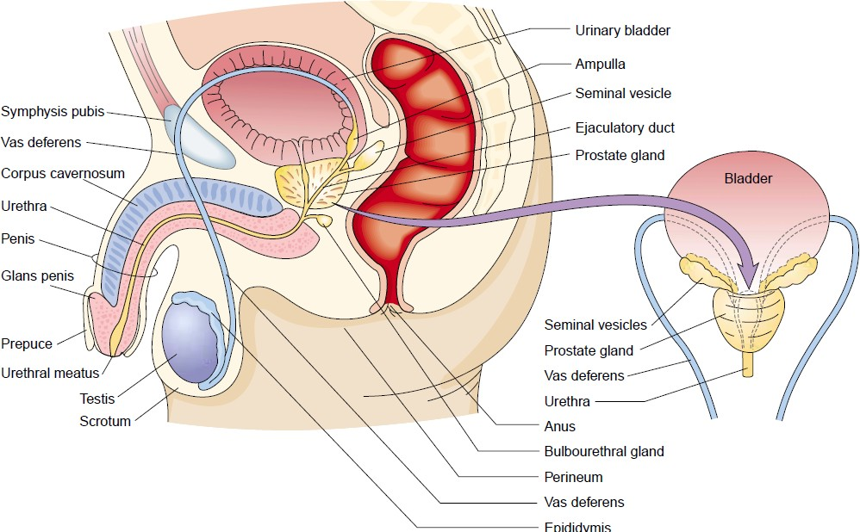
Male reproductive system

Slide 181
Prostatitis

Slide 182
Prostatitis
Is an inflammation of the prostate gland caused by infectious agents or other conditions (urethral stricture, prostatic hyperplasia)
E. Coli is the most commonly isolated organism in prostatitis
It may be acute or chronic

Slide 183
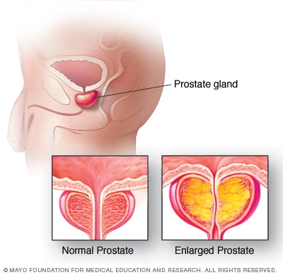

Slide 184
Acute bacterial prostatitis
Affects young men.
It also associated with an indwelling urethral catheter
Characterized by:-
  fever,
  chills,
  dysuria and
  tense extreme tender prostate,
  urinary symptoms such as frequency, urgency and nocturia may occur
Notes:
Gram stain and culture of urine helps to identify the etiologic agent
In non catheter associated case the infection is generally due to E. coli or klebsiella

Slide 185
Chronic prostatitis
Common in men with a history of recurrent bacteremia.
It is a major cause of relapsing urinary tract infection in men
It is usually presented by mild symptoms
Prostate usually fells normal on palpation
Intermittently, infection spreads to the bladder producing frequency, urgency and dysuria
Diagnosis is established by culture from the expressed prostatic secretion or post massage urine

Slide 186
Cause /risk factors
Bacteria
Being young and middle age
Previous prostitis
Urethral infection
Pelvic trauma
Previous catherization
Had HIV
Previous prostate biopsy

Slide 187
Clinical presentation
Dysuria / burning sensation on urination
Difficulty of urination( dribbling, hesitant of urination
Frequency (night most) and urgency
Cloudy or bloody urine
Pain in the abdomen, groin, lower back, b/n scrotum and rectum
Painful ejaculation and flu like bacterial symptoms like fever ,chill…

Slide 188
Assessment and diagnosis
Careful patients history
Culture of prostatic fluid or tissue
Urine semen, and blood tests for infection
Prostate biopsy
Ultrasound of prostate
Cystoscopy - look inside
Notes:
Collect a divided urinary specimen for urine culture
the patient voids 10-15 ml of urine to the first container this urine represents urethral urine
Then, without interrupting the urinary stream, collect 50-75 ml of urine in a second container, which represents bladder urine

Slide 189
Complications
Swelling of the prostate gland/ abscess
Semen abnormality (chronic)
Urinary retention
Epididymitis
Bacteremia
pyelonephritis

Slide 190
Management and nursing intervention
Broad-spectrum antibiotic for 10-14 days
Bed rest to alleviate symptoms quickly
Analgesic agents and antispasmodic medication
Bladder sedatives to relieve bladder irritability
Sitz baths to relieve pain and spasm
Stool softener to prevent pain from straining

Slide 191
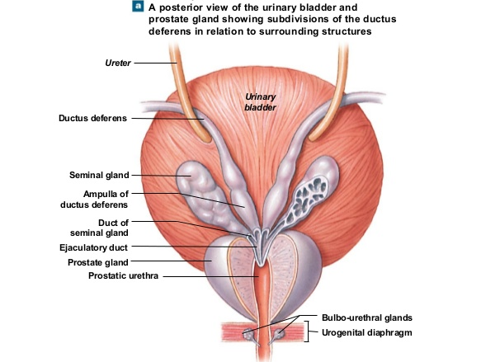
Seminal vesicle and prostate gland

Slide 192
Benign Prostatic Hyperplasia (BPH)
Noncancerous enlargement of the prostate gland
The growth of the prostate will compress the urethra and block the flow of urine
It is a common diseases in aging men older than 40 years of age.
By the time they reach 60 years of age, 50% of men have BPH.
It affects as many as 90% of men by 85 years of age.

Slide 193
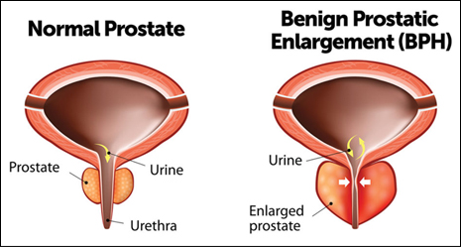
BPH …

Slide 194
  Risk factors
    Unknown
    Aging
    Family history
    Alcohol, smoking
    Hormonal effects related to aging
      Androgen is important for both normal & abnormal growth of the prostate
      90% of prostatic androgen is in form of DHT( from testicular androgen & 10% from adrenal androgen)

Slide 195
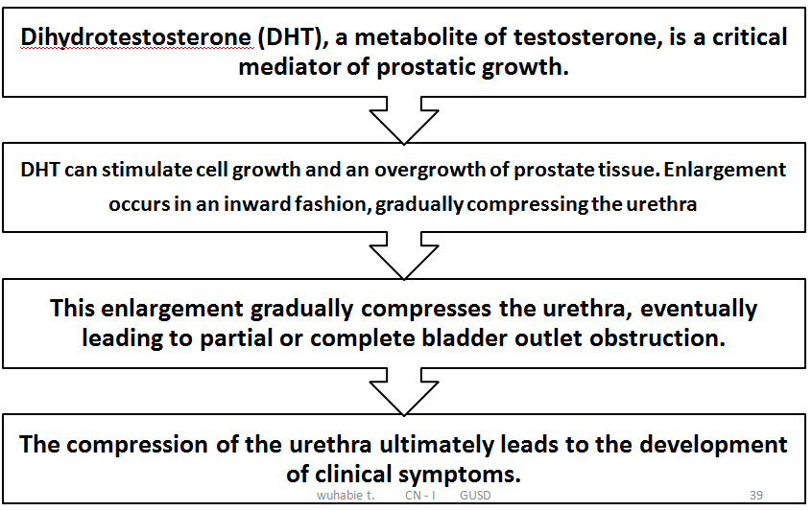
BPH: Pathophysiology

Slide 196
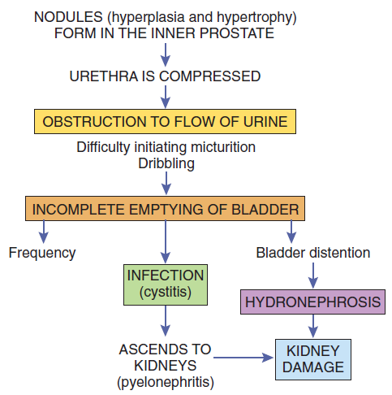
BPH: Pathophysiology

Slide 197

BPH…
Benign prostatic hyperplasia (BPH) grows inward, causing narrowing of the urethra.

Slide 198
Clinical Manifestations
  Difficulty in starting (hesitancy) and continuing urination
  Reduced force and size of the urinary stream (“weak” stream)
  Sensation of incomplete bladder emptying
  Straining to begin urination
  Post-void (after voiding) dribbling or leaking
  Urgency, nocturia, dysuria, hematuria, and sometimes urge or overflow incontinence.
  Impaired renal function, fatigue, nausea, vomiting, anorexia, and abdominal discomfort

Slide 199
Assessment and Diagnostic Findings
  Health history and physical examination
  Abdominal examination: Bladder distention, dullness, tenderness
  DRE (digital rectal examination) will show
    Prostate size can be estimated
    Normally the prostate is soft, symmetric and mobile
    In BPH- the prostate is asymmetrical and enlarged
  Imaging studies: Ultrasound - Determine bladder & prostate size, degree of hydronephrosis

Slide 200


Assessment …
DRE (digital rectal examination) and bladder ultrasound

Slide 201
  Assessment …
U/A (WBC, RBC, bacteria, Hematuria ):
signs of infection
Prostate-specific antigen(PSA)- R/O prostate ca
  Is an indicator of prostatic cancer if it is elevated
  Normal serum PSA level is < 4 ng/mL
  prostatic cancer which can coexist with BPH
  Large BPH may have slightly elevated PSA
Renal function test: BUN and creatinine

Slide 202

Notes:
PVR
Amount of urine remaining in the bladder after voiding
Ultrasonography or postvoiding catheterisation (>100 mL is considered high)
Uroflowmetry, which measures urine flow rate. Normal is greater than 14 mL/sec. A finding of less than 10 mL/sec indicates obstruction.

Slide 203
Differential diagnosis
Cancer of the bladder UTI
Prostate cancer
Neurological bladder
Bladder stone
Uretere stone
Tumor of ureter

Slide 204
Complications
  Acute urinary retention
  Urinary tract infection (UTI)
  Calculi : bladder stones
  Hydronephrosis
  Renal failure

Slide 205
BPH: Management
The goals of medical management of BPH are to:
    Improve quality of life
    Improve urine flow
    Relieve obstruction
    Prevent disease progression, and
    Minimize complications.

Slide 206
Medical Management
  For acute cases, a urologist may insert a
    Urinary catheter; a stylet may be needed to pass through the obstruction, or
    Suprapubic cystostomy (incision and catheter placement in the bladder through the abdomen wall) may be needed

Slide 207
Medical Management
  Drug Therapy
    5α-Reductase inhibitors (e.g., finasteride [Proscar], dutasteride [Avodart], dutasteride plus tamsulosin [Jalyn])
    α-Adrenergic receptor blockers (e.g., silodosin [Rapaflo], alfuzosin [Uroxatral], doxazosin [Cardura], prazosin [Minipress], terazosin [Hytrin], tamsulosin [Flomax])
    Erectogenic Drugs: Tadalafil (Cialis)
Notes:
Dutasteride 0.5 mg/d (a non-selective type I and II 5α- reductase inhibitor) or
Finasteride 5mg/d ( a selective type II 5α-reductase inhibitor) to decrease the size of the prostate
Alpha-adrenergic blockers (Ex. prazosin , doxazosin , tamsulosin , and terazosin) to relax the muscles and promote urination

Slide 208

Algorithm for selection of treatment of BPH

Slide 209
Surgical Treatment
  Transurethral Resection of Prostate (TURP)
    Use of excision and cauterization to remove prostate tissue cystoscopically.
    Remains the standard for treatment of BPH.
  Open Prostatectomy
    Involves the surgical removal of the inner portion of the prostate via a suprapubic or perineal approach for large prostate glands.

Slide 210

Surgical Treatment…

Slide 211
Nursing care of patient undergoing prostatectomy
Preoperative Nursing Interventions
  Informed consent
  Reduce anxiety
  Reduce discomfort
  Cross match and grouping
  NPO
  Enema
  Catheterization

Slide 212
Initial post-op care in the hospital
  Urethral Catheter
    The urethral catheter drains the bladder and allows the bladder to heal to the urethra.
    In general it will stay in place for 7 – 10 days, but can be longer if the connection between the bladder and urethra needs additional healing time.

Slide 213
Postoperative Nursing Interventions
  Maintaining Fluid Balance
  Relieving Pain
  Bladder irrigation
  Monitoring and Managing Potential Complications
      Hemorrhage and shock
      Infection
      Deep vein thrombosis
      Catheter obstruction
      Sexual dysfunction

Slide 214
Bladder irrigation
  18- 22-Fr three-way catheter with a 30- to 45- mL balloon usually is inserted following surgery.
  Continuous bladder irrigation
  Importance of bladder irrigation
    Prevent urinary tract obstruction by flushing of small blood clot after surgery.
    To treat irritated, inflamed or infected bladder lining
Notes:
Bloody urine during irrigation indicates blood clot, decreased output, obstruction or bleeding
Maintain the rate of flow of irrigating fluid to keep the output light pink or colorless.

Slide 215

A three way system for bladder irrigation

Slide 216
Bladder irrigation…
  Special consideration during bladder irrigation
    Monitor input and output
    Output should be exceed input
    If Input > Output
      Stop irrigation
      Assess patient
      Notify the surgeon

Slide 217
Patient education
About :
  Teach pelvic floor exercises
    Strengthen muscle tone to hold urine after catheter is removed
  Semen will come out when he urinates
    Retrograde ejaculation into bladder after surgery
  To talk with urologist if erection problems occur

Slide 218
Complications associated with prostate surgery
    Clot formation
    bladder spasms
    infection
    Urinary incontinence
    Hemorrhage and
    impotency

Slide 219
Prostate cancer

Slide 220
Prostate cancer
Is the most common cancer in males above the age of 65 years
The majority of prostatic cancers are arise from the peripheral zone of the gland
It gives rise to urinary obstruction late in the disease processes
It has a tendency to metastasize to bone and lymph nodes

Slide 221
Risk factors
Increasing age, family predisposition and a diet high in red meat and fat
Etiology
Unknown but some factors suggested like:
  Dietary, virus infections
  Changed in hormonal environment

Slide 222
Clinical picture
Asymptomatic in the early stage.
Symptoms of urinary obstruction occur: like difficulty and frequency of urination, urine retention and decreased size and force of urinary stream
Hematuria
Backache, hip pain, perineal and rectal discomfort and leg pain
Anemia, Weight loss, weakness, nausea and oliguria occur when there is metastasis.

Slide 223
Assessment and diagnosis
Early detection of the cancer results a high cure rate
Routine DRE for every man older than 40 year is very important to detect any abnormality of the prostate (stony hard and fixed prostate indicate advanced lesion)
Prostate specific antigen test (PSA) also important screening test from blood with DRE.
Histological examination of tissue confirm the diagnosis
Trans rectal ultrasound, skeletal X-rays, renal function test and CT scan

Slide 224
Management
Radical prostatectomy
Radiation therapy
Hormonal therapy
Cryosurgery of the prostate
  Used to ablate prostate cancer in patients who could not physically tolerate surgery or in those with recurrent prostate cancer

Slide 225
Surgical procedures include
Transurethral resection of the prostate, the most common one
  Suprapubic prostatectomy
  Perineal prostatectomy
  Retropubic prostatectomy
✄ Transurethral incision of the prostate

Slide 226
Post OP complications and the nursing management
Hemorrhage
Infection
Perforation, Sepsis and Incontinence
Sexual dysfunction
Reassure the patient that the usual level of sexual function will return

Slide 227
Epididymitis

Slide 228
Epididymitis
Is an infection of the epididymis
Is usually the result of descending infection from the infected prostate or urinary tract or it results as a complication of gonorrhea
Acute epididymitis is almost always unilateral
In sexually active men under age 35, acute epididymitis is caused most frequently by chlamydia trachomatis and less commonly by N. gonorrhea

Slide 229


Slide 230
Causes
Bacterial( E.coli, pseudomonas, proteus, klebsella species. Chlamydia (sexual active)
Virus( mumps virus , coxsackievirus , varicella, CMV ...infections
Granulomatus ,T. pallidum, M.tuberculosis, M. leprae
Trauma/ surgery/ BOO/ stricture
UTI
Recurrent and untreated acute epididymitis( chronic )
Idiopathic ( due to obstruction of prostate and urethra…)

Slide 231
Clinical picture
Gradual onset of Unilateral pain and soreness in the inguinal canal
Dysuria, frequency ,urgency, but no nausea and vomiting like testicular torsion
Pain and swelling in the scrotum and the groin in acute but not in chronic epididymitis

Slide 232
Clinical manifestation…
Epididymis becomes swollen and extremely painful
Elevated temperature and chills
Urine may contain pus and bacteria

Slide 233
Complication
Scrotal abscess
Testicular infarction
Infertility
Testicular atrophy
Fistula
Recurrence

Slide 234
Treatment
Treat the patient as well as the partner with antibiotic
  Ofloxacin 300 mg PO bid for 10 days is an optimal agent for syndrome-based treatment of epididymitis
  Other drugs include ceftriaxone IM, followed by doxycline 100mg PO bid for 10 days
Epididymectomy: for patients with recurrent episodes of epididymitis

Slide 235
Nursing management
Bed rest
Elevate the scrotum
Intermittent cold compresses to the scrotum
Avoid straining, lifting and sexual stimulation until the infection is under control
Later, local heat or sitz baths may resolve the inflammation

Slide 236
Orchitis

Slide 237
Orchitis
Is an inflammation of the tests
It may affects one or both testes
Mostly occurred with epididymitis
The problem may be caused by trauma or infection from epididymitis, UTI, STI, or systemic diseases such as influenza, infectious mononucleosis, tuberculosis, gout, pneumonia, or mumps (after puberty).
Congenital UT abnormality may also a cause

Slide 238


Slide 239
Cause
Bacteria Caused by pyogenic (mycobacterium leprae),
STD
Virus : Mumps virus is the most common cause
Parasitic
Traumatic
unknown factor

Slide 240
Clinical Presentation
  The tests is painful and tender, one or both testis
  Testes is enlarged several times its normal size in one or both
  Fever is common
  Testicular atrophy develops in half of the affected men
  Nausea and vomiting , malaise
  Painful urination and ejaculation
  Abnormal discharge

Slide 241
Cont…
P/E of testicular Revealed:
  Enlargement of testis
  Tenderness
  Erythematous and edematous scrotal skin
  Swollen lymph nodes of groin

Slide 242
Complication
Testicular atrophy
Scrotal abscess
Infertility
Death of testicular tissue

Slide 243
Management
Therapy is directed at the specific infecting organism
Rest
Advice safe sex & Immunization as prevention
Elevation of the scrotum
Ice packs to reduce scrotal edema
Anti inflammatory drugs
Antibiotics for infection causes

Slide 244
Testicular Torsion
Rotation of the testis
Twists the blood vessels in the spermatic cord
Impedes the arterial and venous supply to the testicle and surrounding structures in the scrotum.
The patient presents with sudden pain in the testicle, developing over 1 to 2 hours, with or without a predisposing event.
Nausea, lightheadedness, and swelling of the scrotum may develop.

Slide 245
…Ctd
On physical examination, testicular tenderness, an elevated testis, a thickened spermatic cord, and a swollen, painful scrotum may be present.
If the torsion cannot be reduced manually, surgery to untwist the spermatic cord and anchor both testes in their correct position to prevent recurrence should occur within 6 hours of the onset of symptoms in order to save the testis.
After 6 hours of impaired blood supply, the risk for loss of the testicle increases.

Slide 246
Testicular Cancer
Testicular cancer is the most common cancer in men between the ages of 15 and 40 years, although it can occur in males of any age.
It is a highly treatable and usually curable form of cancer, with a cure rate of greater than 90% for all stages of the disease (ACS, 2009).

Slide 247
Risk factors
Age
Cryptorchidism
Genetic predisposition, especially in identical twins and brothers
Klinefelter syndrome
Cancer of the other testicle
Other risk factors under investigation, including occupa- tional risks, presence of multiple atypical naevi, HIV infec- tion, cancer in situ, body size and maternal hormone use (American Cancer Society, 2012).

Slide 248
Classifi cation of Testicular Tumors
The testicles contain several types of cells, each of which may develop into one or more types of cancer.
The type of cancer determines the appropriate treatment and affects the prognosis.
Testicular cancers are classifi ed as germinal, having
their origins within the germ cells of the gonads (testes) or nongerminal (stromal).

Slide 249
1.Germinal Tumors
More than 90% of all cancers of the testicle are germinal
Further classifi ed as seminomas or nonseminomas.
Seminomas
develop from the sperm-producing cells of the testes
account for 50% of tumors.
tend to remain localized

Slide 250
Nonseminomas
grow quickly.
tend to develop earlier in life than seminomas, usually occurring in men in their 20s.
NB:Many tumors are mixtures of at least two different
tumor types.

Slide 251
2.Nongerminal Tumors
Testicular cancer may also develop in the supportive and hormone-producing tissues, or stroma, of the testicles.
The two main types of stromal tumors are Leydig cell tumors and Sertoli cell tumors.
These tumors infrequently spread beyond the testicle.

Slide 252
Stages
The simplest way to stage a testicular tumor is as follows:
• Stage I—tumor only in the testicles
• Stage II—tumor spread to abdominal lymph nodes
• Stage III—tumor spread past lymph nodes, usually
to the lungs, liver, bones, and/or brain.

Slide 253

Manifestations

Slide 254
Diagnosis
Diagnosis may be made by various laboratory tests.
Serum studies are done to identify tumour markers.
i.e (bhCG) and (AFP)
Tumor marker levels in the blood are used for diagnosis, staging, and monitoring the response to treatment.
Lactate dehydrogenase (LDH) levels
Ultrasound examination
A CT of the abdomen and pelvis.
A chest X-ray is also performed to assess for lung metastasis.
Tissue biopsy

Slide 255
Medical Management
Chemotherapy
Radiation
Surgery

Slide 256
Hydrocele
A hydrocele is a collection of fluid in the scrotal sac.
Hydroceles are not dangerous and generally do not cause pain.
The cause is not known, and they can happen at any point during the lifetime.
No treatment is necessary unless the hydrocele is so large that it causes discomfort or embarrassment or is a threat to the blood supply to the testicles.
If treatment is needed, the HCP can perform a needle aspiration, or surgically drain the fluid.

Slide 257
Varicocele
A varicocele is a condition sometimes called varicose veins
of the scrotum.
The main blood supply to the testicles travels along the spermatic cord.
The veins become dilated, and when the man is standing, the area in the scrotum begins to feel like a “bag of worms.”
The patient may report a pulling sensation, a dull ache, or scrotal pain.

Slide 258
…ctd
The sensations are most often felt when standing up.
Most varicoceles occur on the left side
A varicocele is often not discovered until a couple is unable to conceive.
The most successful treatment is surgical repair of the varicose veins.

Slide 259
Erectile Dysfunction (Impotence)
Erectile dysfunction, also called impotence, is the inability to achieve or maintain an erect penis (Seftel, Miner,Kloner, et al., 2007).
Erectile dysfunction means that a man cannot obtain or keep a usable erection that is firm enough and long-lasting enough for satisfactory sexual intercourse.

Slide 260
Causes
1. Psychogenic: anxiety, fatigue, depression, pressure to perform sexually, negative body image, absence of desire, privacy, and trust and relationship issues.
2. Organic
Cardiovascular disease - Heart disease, Atherosclerosis, Metabolic syndrome, Stroke
Endocrine disease (diabetes, pituitary tumors, testosterone deficiency, hyperthyroidism, and hypothyroidism),

Slide 261
…Ctd
Cirrhosis,
Chronic renal failure,
Genitourinary conditions (radical pelvic surgery),
Hematologic conditions (Hodgkin lymphoma, leukemia),
Neurologic disorders (neuropathies, parkinsonism, spinal cord injury, multiple sclerosis),
Trauma to the pelvic or genital area,
Lifestyle - Tobacco use, Alcohol use, Drug use (marijuana, cocaine, others), Excessive caffeine use
Medications

Slide 262
…ctd
For a man to have a usable erection, several conditions must be met:
1. Circulatory system-The most common cause
2. Nervous system
3. Hormonal system
4. Limbic system

Slide 263
Diagnostic Tests
History - including medical-surgical history; use of medications, including any substance abuse; lifestyle patterns; and sexual history.
Physical examination - evidence of genital disorders, hormonal imbalance (such as hair patterns or enlarged breasts), surgical interventions, decreased circulation, and lack of nerve sensation.
Blood tests - evaluate glucose levels; testosterone; evidence of liver, heart,or kidney disorders; signs of infection; or blood disorders

Slide 264
Therapeutic Measures
Pharmacologic- Oral medication
Phosphodiesterase-5 (PDE-5) inhibitors - oral medications that are used to treat erectile dysfunction, are first-line therapy.
Sildenafil (Viagra) - 50 mg - 100 mg po/d 30 minute to 4 hours b4 sexual intercourse.
Vardenafil (Levitra) – 10-20mg po/d 1hr before sexual intercourse
Vardenafil (Levitra) – 5-20mg po/d taken before sex

Slide 265
…ctd
Injection (alprostadil, papaverine, phentolamine)
Urethral suppository (alprostadil)
Non Pharmacologic :
Penile implants(Semi-rigid rod, Inflatable, Soft silicone)
Negative-Pressure(vacuum) Devices

Slide 266
Priapism
Priapism is a persistent erection that causes the penis to become large, hard, and painful.
It results from either neural or vascular causes, including sickle cell thrombosis, leukemic cell infi ltration, and tumor invasion of the penis or its vessels.
It may occur with use of medications that affect the central nervous system, antihypertensive agents, antidepressant medications, and substances injected into the penis to treat ED.

Slide 267
…Ctd
Priapism is a true urologic emergency.
The goal of therapy is to improve venous drainage of the corpora cavernosa to prevent ischemia, fi brosis, and impotence.
The corpora may be irrigated with an anticoagulant, which allows stagnant blood to be aspirated.
Shunting procedures to divert the blood from the turgid corpora cavernosa to the venous system or into the corpus spongiosum–glans penis compartment may be attempted.

Slide 268
Reading assignment
Hypospadias
Epispadias
Phimosis
Paraphimosis
Balanitis
Balanoposthitis
Cryptorchidism
Circumcision

Slide 269
THE END!!!

Slide 270
References
Brunner and Suddarth's Textbook of Medical-Surgical Nursing 12th edition,2010
Understanding Medical Surgical Nursing 5E 2015
Lippincott manual of nursing practice, 9th edition, 2010
Adult Health Medical-surgical Nursing 1E,2013
FMHACA, Standard Treatment Guidelines For General Hospital, 3rd Edition, 2014

