Slide 1
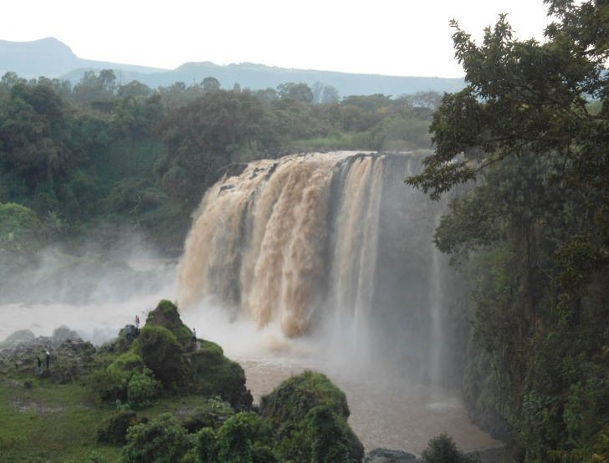
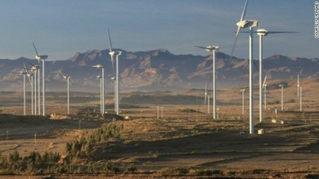
CDM PROJECT POTENTIAL & CURRENT
STATUS IN SUB-SAHARAN AFRICA:
A LESSON TO ETHIOPIA
Getinet Assabu (Ph.D.)
Debre Markos University
College of Agriculture and Natural Resources
Department of Natural Resources Management

Slide 2
Outline
Climate change and climate variability
The Kyoto Protocol –framework of the carbon market
CDM & the CDM Project Cycle
Global Synopsis of CDM projects
The CDM Project Potential in Sub-Saharan Africa
CDM potentials and implementation challenges in Ethiopia

Slide 3
Climate change and climate variability
Climate is the aggregated pattern of weather; meaning averages, extremes, temporal and spatial distribution of…
temperature (hot & cold)
precipitation
humid & dry
drizzles & downpours
snowfall, snowpack, & snowmelt
blizzards, tornadoes, & typhoons
Global average temperature is just one measure of the state of the global climate as expressed in the patterns.

Slide 4
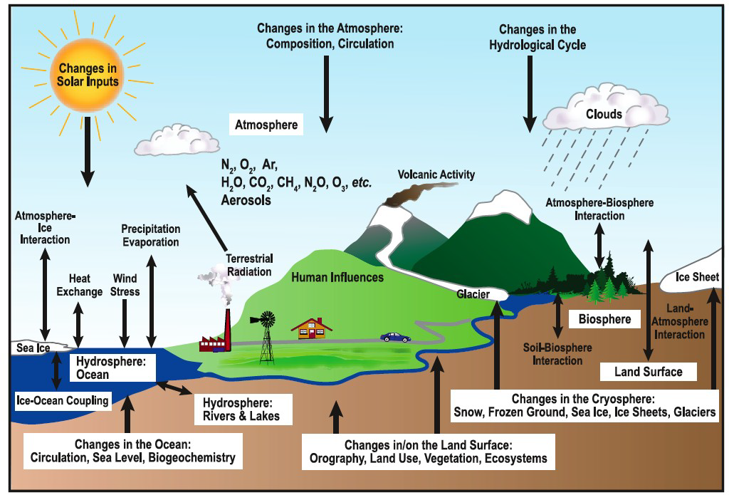
What changes the earth’s climate ?
    Exchanges of energy, momentum and matter,
    such as water and carbon, connect the components
    of the climate system and lead to interactions between them.

Slide 5
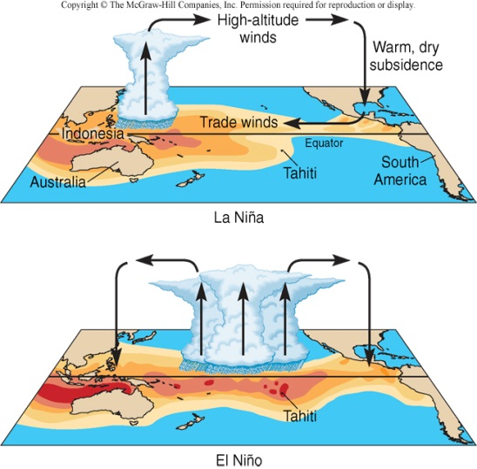
Climate change and climate variability ……. Cont’d
Climate variability refers to the natural variations in climate from the average state, and occurs over both space and time.
Natural climate variability occurs as a result of;
  variations in atmospheric and ocean circulations,
  larger modes of variability such as
  the El Niño – Southern Oscillation, and
  events such as volcanic eruptions
  and changes in incoming solar
  radiation.
IPCC defines climate change as the general shifts in climate, including temperature, precipitation, winds, and other factors.
Global warming (as well as global cooling) refers specifically to any change in the global average surface temperature.

Slide 6
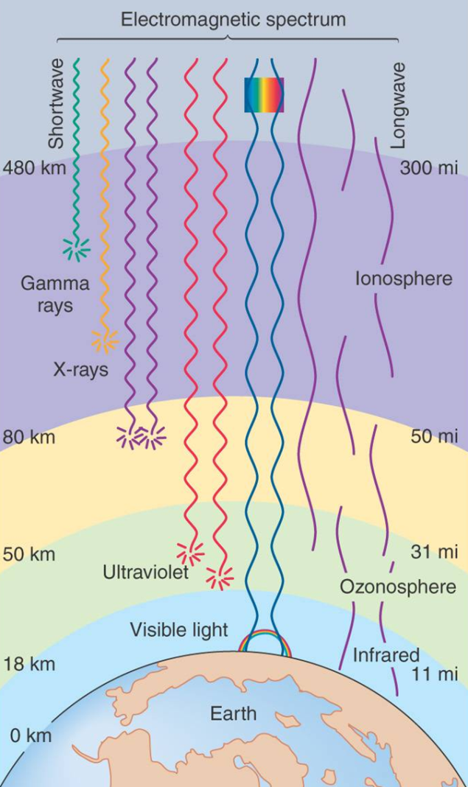
Climate change and climate variability ……. Cont’d
The climate system is driven to a large extent by external components which include
    the incoming energy from the Sun,
    the outgoing energy radiated from Earth, and
    exchanges of energy among the atmosphere, land, oceans, ice, and living things.

Slide 7
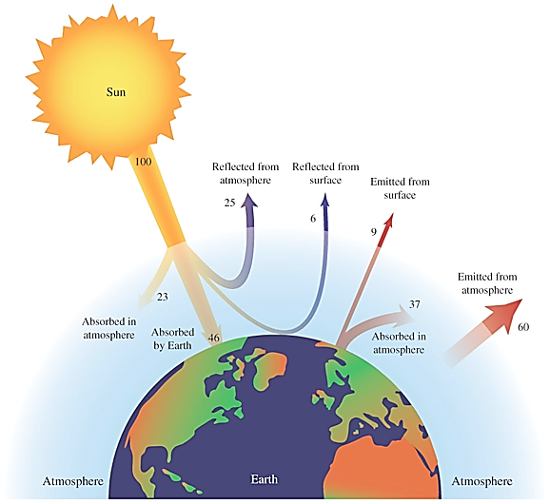
Climate change and climate variability ……. Cont’d
The Earth is about 33^{O}C warmer than expected if we consider only the amount of solar energy received and reflected.
Trace atmospheric gases, H₂O and CO₂, andothers trap infrared radiation that would otherwise be re-emitted into space.

Slide 8
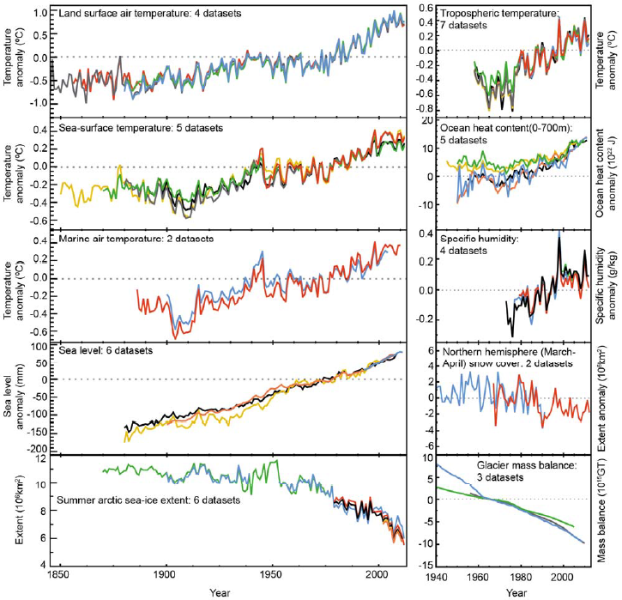
Evidences of global climate change
Each of the past three decades has been warmer than all the previous decades in the instrumental record, and the decade of the 2000’s has been the warmest.
The global combined land and ocean temperature data show an increase of about 0.89°C [0.69–1.08] over the period 1901–2012 and about 0.72°C [0.49- 0.89] over the period 1951–2012 ( IPCC ,2013)
Multiple complementary indicators of a changing global climate.

Slide 9
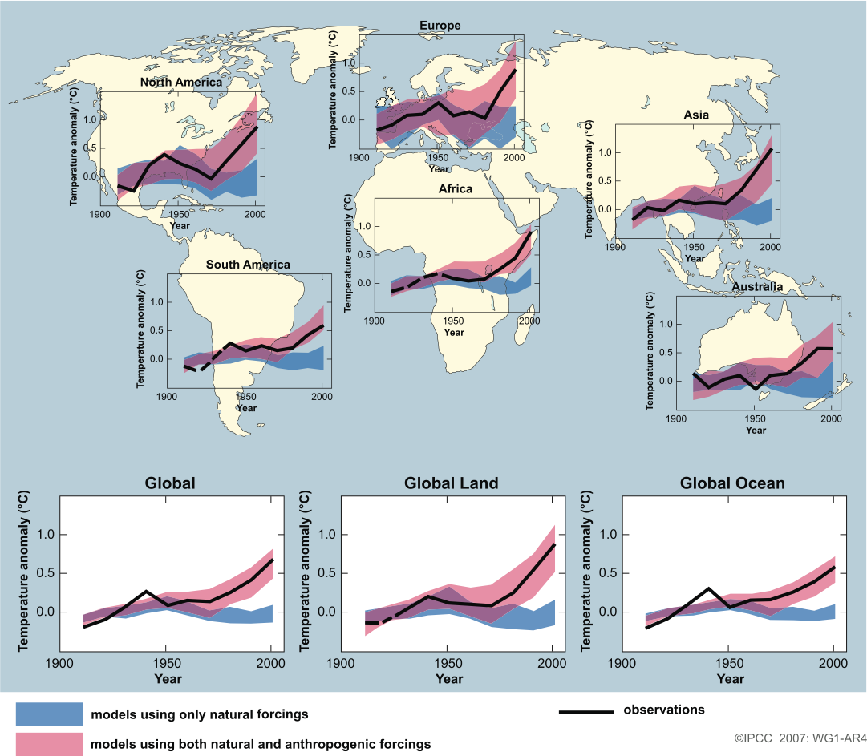
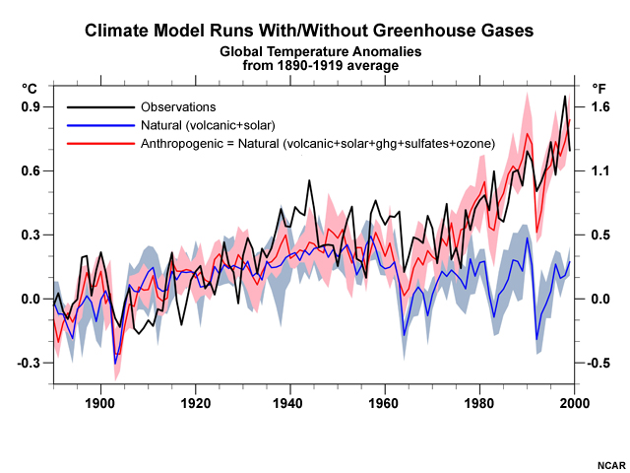
Indicators of global climate change ………….Cont’d
Warming is not due to natural causes
  Human produced greenhouse gases are most plausible explanation

Slide 10
International Response to climate change
Human Response to Climate Change
ADAPTATION
MITIGATION
Involves developing ways to protect people and places by reducing their vulnerability to climate impacts.
Involves attempts to slow the process of global climate change by lowering the level of green house gases in the atmosphere

Slide 11
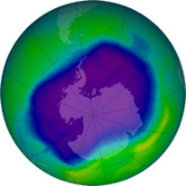

Timeline of international response to climate change
1997: COP 3
Kyoto Protocol adopted/signed
2012: COP18
Amendments to the KP (KP 2nd commitment period 2013 – 2020 )
1992: UNFCCC established
2005:COP11 Kyoto entered into force; REDD introduced
2007: COP13 Bali Roadmap
1990
1995
2000
2005
2007
2010
2012
1988:
IPCC established
2012:
KP 1st commitment period ends
1994:
UNFCCC entered into force
2008:
KP 1st commitment period begins

Slide 12
The UNFCCC and the Kyoto Protocol
UNFCCC (adopted in 1992):-
one of the three international treaties (+ CBD & UNCCD) born at the UN Conference on Environment and Development in 1992 in Rio, Brazil, known as the ‘Rio Earth summit’ in response to the escalating climate impacts.
UNFCCC aims to stabilize atmospheric concentration of GHGs at a level that would prevent dangerous anthropogenic interference with the climate system.
Rio Convention was strengthened with a Kyoto Protocol, where developed countries took legally binding obligations to cut their emissions by 5.2% below 1990 levels by 2008-2012 in aggregate.

Slide 13
1. UNFCCC and ----Cont’d
When adopting the Kyoto Protocol in 1997, Parties to (UNFCCC) established the (CDM) with the twin goals of :
contributing to the sustainable development of developing countries and
assisting developed countries to meet their emission limitation targets.
This was expected to result by 2012 in over one billion tonnes of CO₂eq of emission reductions from project activities and programmes in over 70 countries.

Slide 14
Amendments to the Kyoto Protocol
The Doha climate change conference (COP18) adopted amendments to the Kyoto Protocol relating to second commitment period (CP2) in Doha, Qatar in December 2012 in the following key aspects.
CP2 will be eight years long, running from 2013 - 2020;
Parties taking on commitments in CP2 (CP2 Parties) are required to reduce their aggregate emissions by 18 % below 1990 levels in CP2.
the list of greenhouse gases regulated by the Kyoto Protocol is now expanded so that it also covers Nitrogen triflouride (NF₃).

Slide 15
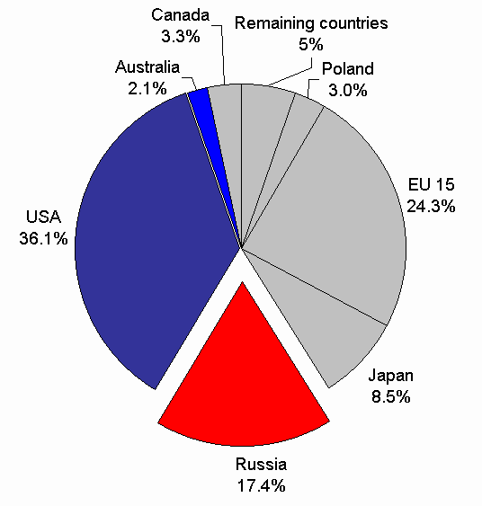
2. The Kyoto Protocol –Framework of the Carbon Market
Countries with commitments under the Kyoto Protocol to limit or reduce greenhouse gas emissions must meet their targets primarily through national measures.
Three market-based mechanisms were introduced to help countries meet their emission targets, and to encourage developing countries and the private sector to contribute to emission reduction efforts.

Slide 16
The Kyoto Flexible mechanisms
The Kyoto Protocol introduces three market based flexible mechanisms for the emissions reduction:
    Joint Implementation (JI),
    Emission Trading Scheme (ETS) and
    Clean Development Mechanism (CDM)

Slide 17

What is emissions trading ?
What options are most cost-effective?
Company A can reduce 1000 tons
of CO₂eq. at $2/ton = $2000
Sell
1000 tons CO₂eq
at $4/ton = $4000
$2000 Profit
Company A - Seller
Company B can reduce 1000 tons CO₂eq. at $6/ton = $6000
Buy
$2000 Savings
Company B - Buyer

Slide 18
The Kyoto Flexible mechanisms Cont’d
Emission Trading (ET) countries are entitled to transfer parts of their allowable emission ,
“Assigned Amount Units (AAU)”.
Joint implementation (JI) - countries can claim credit for emission reduction accumulated from investment in other developed countries and thereby transfer of equivalent “Emission Reduction Units (ERU)” is permitted between these countries.

Slide 19
3. CDM and the CDM Project Cycle
CDM is a project-based mechanism designed to promote investment in projects that reduce or sequester emissions of (GHG) in developing countries.
The CDM will allow developed countries to acquire certified emission reductions (CERs) via GHG mitigation projects in developing countries.
Notes:
.

Slide 20
-------Cont’d
Potential projects that can be accepted as CDM projects are in the sectors of:
(Renewable/alternate energy and energy efficiency (demand and supply side).
(Landfill gas capture, Recycling and Energy from solid waste etc.)
( Alternative fuel vehicles, Mass transit systems , Cleaner engines
Industrial processes (, Fertilizer, Textile etc.)
Land Use, Land Use Change and Forestry (watershed management, sustainable forest management, afforestation and reforestation)
Agricultural and livestock practices and any other project resulting in GHG mitigation or carbon sequestration

Slide 21
CDM Project Eligibility Criteria
Be implemented in a non-Annex I country that is a party to the Kyoto Protocol.
The projects should promote sustainable development in host countries;
The projects should result in real, measurable and long-term benefits towards climate change mitigation; and
The emission reduction should be additional to what would have otherwise occurred without the projects.
All parties involved must approve the projects;

Slide 22
  CDM Requirements
  Has the country ratified the Kyoto Protocol?
  Does the country have a functioning DNA?
  Does the project contribute to SD?
  Does the project result in GHG reductions?
  Are the emission reductions real and measurable?
  Is the project additional?
  Does the project result in a diversion of ODA?
  Is the project mitigation or A/R sinks?
  No nuclear!
CDM project Cycle
All CDM projects must go through the CDM project cycle with special requirements of qualifying and supervision of the project.

Slide 23
CDM project Cycle
1. Project Design and Formulation
Project
2. National approval
Project design document
3. Validation/ registration of PDD
Operational Entity A
Activities and responsible institutions in the CDM project cycle
4. Project
Financing
Investors
Project Participants
5. Monitoring
Operational Entity B
6. Certification /Verification
Verification Report/
Certification report /
Request for CERs
7. Issuance of CERs
EB/
Registry

Slide 24
CDM project Cycle-----Cont’d
A CDM project must prove that it is different from
  the baseline ( scenario that reasonably represents anthropogenic GHG emissions that would most likely have occurred in the absence of the CDM project ) and
  the additionality requirements are met.
  This is seen from the point of view of:
  Environmental additionality; which refers to long-term real and measurable reduction.
  Technology additionality; refers to transfer of environmentally safe and sound technology and
  Investment additionality - no diversion of ODAs

Slide 25
CDM project Cycle-----Cont’d
.
1. Validation of project design, baseline and monitoring plan
2. Verification / Certification of emission reductions
Emissions baseline
GHG emissions
(tCO₂eq)
ADDITIONAL
EMISSION
REDUCTIONS
Emissions after the project
Project implementation
Years

Slide 26
4. Global Overview of CDM Projects
In total, 7,293 projects were registered under the CDM in 89 countries by the end of September 2013, and about 1,170 further projects are undergoing validation (UNFCCC 2013).

Slide 27
Global Overview of CDM Projects --------Cont’d
By the end of the Kyoto Protocol’s first commitment period)
1.38 billion certified emission reductions (CERs) had been issued and stands ready to further contribute through the crediting of a further 1.4 to 6.2 billion emission reductions by 2020.
Leveraged an estimated USD 315 billion in capital investment to underpin climate mitigation efforts and support the achievement of a range of sustainable development outcomes for host parties,
Contributed to the development of 110 gigawatts of new renewable energy capacity

Slide 28
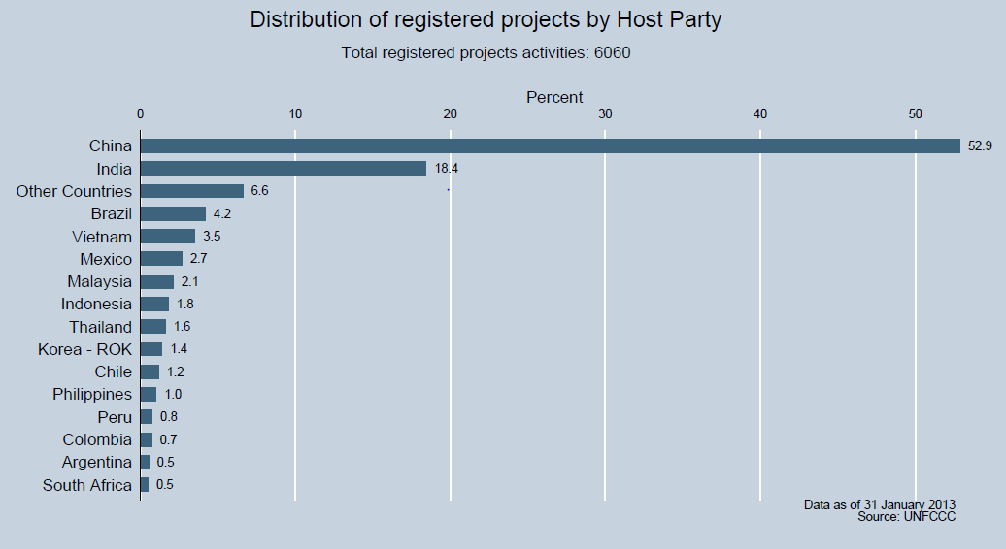
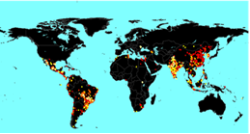
5. The CDM Project Potential in Sub-Saharan Africa
While the CDM remains one of the most celebrated policy instruments of the KP, developing countries especially those in Sub Saharan Africa (SSA) have still witnessed disparity in the distribution of CDM projects .

Slide 29
The CDM Project Potential IN SSA ……Cont’d
Out of 6060 registered projects as of January 2013, only 1.9% were in Africa, compared to 85.3% for Asia and the Pacific in which South Africa had the most projects with 85, followed by the Ivory Coast with 38 and Kenya with 32.

Slide 30
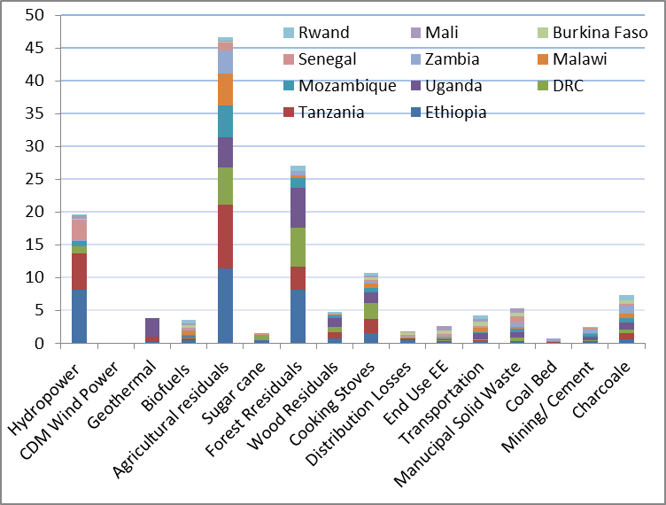
The CDM Project Potential in SSA ……. Cont’d
The carbon market study by Arens C. and Burian M. ( 2012) across 11 East African countries shows that ;
Ethiopia comes first with an estimated potential for 32.0 million (CERs) per year., in the energetic use of agricultural residues followed by hydropower, forest residues and cooking stoves,
Followed by Tanzania (24,500kCERs/y), DRC (18,000kCERs/y) and Uganda (17,650kCERs/y) in the same sectors

Slide 31
The Humbo and Lake Turkana CDM projects
Humbo forest reclamation project restore over 2,700 hectares of degraded forest through the planting and maintenance of new trees thereby reducing carbon emissions by an estimated 880,000 metric tonnes over the next 30 years.
The project, while also supporting local income and employment generation, will earn project participants around 30,000 CERs per year.
The Lake Turkana wind power project in Kenya is a 582 million Euro project backed by the African Development Bank, which when completed will be the largest wind farm in Africa with a capacity of 300 megawatts of power. The will earn the project participants an estimated 736,615 CERs each year.

Slide 32
6. CDM Potential and Implementation Challenges in Ethiopia
Based on the 2010 World Development Indicator, the country’s CO₂ emissions stand at 6.70 Mt/year.
If current practices prevail, GHG emissions in Ethiopia will more than double from 150 Mt CO₂eq to 400 Mt CO₂eq in 2030 (FDRE, 2011).

Slide 33
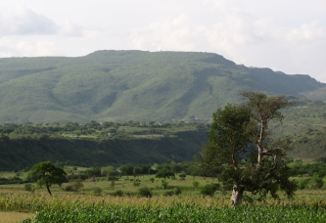
CDM Potential ….Cont’d
Humbo is the largest World Bank forestry project in Africa to gain CDM registration .
Hills of the Humbo Project area before intervention (2006) and after the project (2009) (Photo courtesy UNFCCC)
Restores over 2,700 hectares of degraded forest through the planting and maintenance of new trees.

Slide 34
CDM Potential ….Cont’d
The World Bank's BioCarbon Fund will purchase 165,000 tonnes worth of these carbon credits.
The sale of carbon credits under the BioCarbon Fund will provide an income stream of more than US$700,000 to the Ethiopian local communities for 10 years.
The project is expected to remove an estimated 880,000 metric tonnes of carbon dioxide from the atmosphere over the next 30 years.

Slide 35
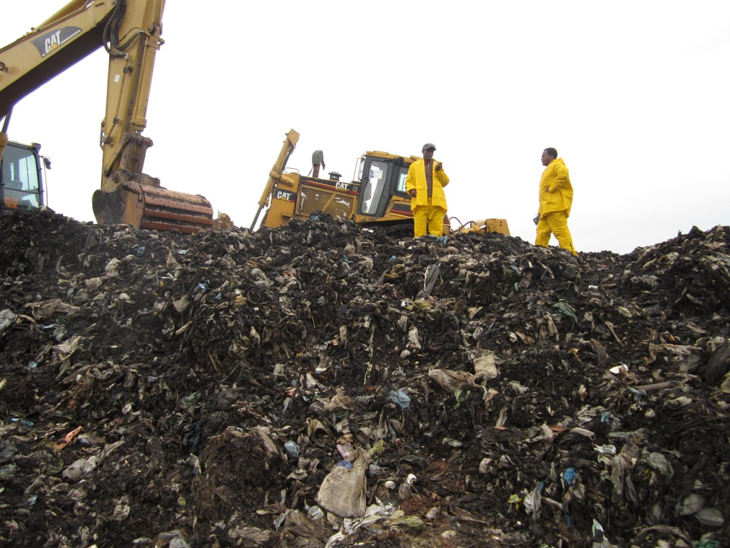
II) Methane Capture and Flaring from Addis Ababa Repi open dump fill
Repi/ Koshe/ waste disposal site for households and industrial waste produced in and around the premises of Addis Ababa has high proportion of organic and biodegradable component in the waste.
As a result, methane is uncontrollably released into the atmosphere leading to poor conditions in the local environment.

Slide 36
III) Clinker Optimization in cement types production at Derba MIDROC cement Plant
The proposed project activity reduces GHG emissions by reducing the GHG intensity in cement produced, through utilizing additives from mining to displace some clinker share which would otherwise have resulted in GHG emissions (UNFCCC 2012).
This substitution results in reduced emission of CO₂ from:-
Reduced burning of limestone / reduced decarbonisation reaction in clinker making
Reduced need of kiln fuel consumption used for enacting the de-carbonization reaction in clinker making

Slide 37

III) Clinker Optimization in cement types production at Derba MIDROC cement Plant
Clinker production is inherently associated with GHG emission from calcinations of limestone (i.e. with main reaction equation of CaCO₃→ CaO+CO₂), emission from burning kiln fuel and electricity consumption for running process equipment.
The greenhouse gas targeted for emission reduction is CO2.The estimated maximum annual emission reduction is about 683,176tCO₂e.

Slide 38
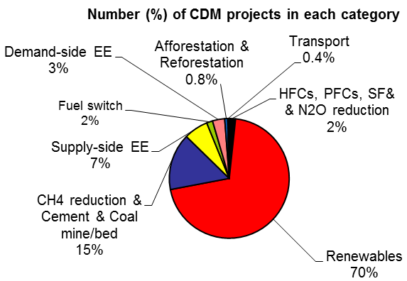
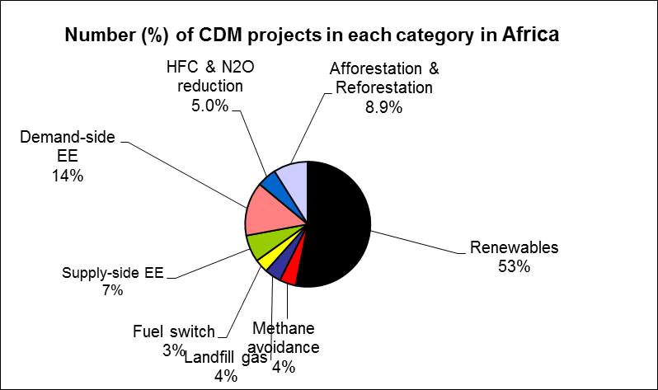
CDM Opportunities and Challenges in Ethiopia
Ethiopia has considerable CDM potential in the form of:
Afforestation / reforestation
Renewable energy, (mini-hydro and perhaps wind – particularly in an off-grid context as the Ethiopian grid is already very 'clean' (hydro-powered).
Urban landfill (methane flaring and/or electricity generation)
Agricultural residues (e.g. co-generation using bagasse; use of coffee, floriculture, forest and other residues as feedstock in kilns and furnaces, or as feedstock in bio-digesters)
Industrial fuel-switching

Slide 39
CDM Implementation Challenges in Ethiopia
CDM-specific capacity barriers
  Lack of awareness and insufficient capacity in policymakers, DNA staff members, PDD project developers, local experts.
  Difficulty to prove baseline and addionality requirements due to data shortage
Financial barriers
Access to funding for capital investment and project transaction cost (PDD development & commence project)
Low carbon prices for AR CDM ( eg. Humbo CDM project)

Slide 40
CDM Implementation Challenges in Ethiopia
Structural and institutional barriers
  The lengthy requirement of CDM projects
  Insufficient capacity in host Parties, national legislative and policy frameworks such as the land tenure problems.
Uncertainty about the modalities of the continuation of the CDM after 2012
  Parties indicated that Kyoto mechanisms should continue
Awareness-raising and confidence-building amongst potential overseas investors and carbon buyers.

