Slide 1
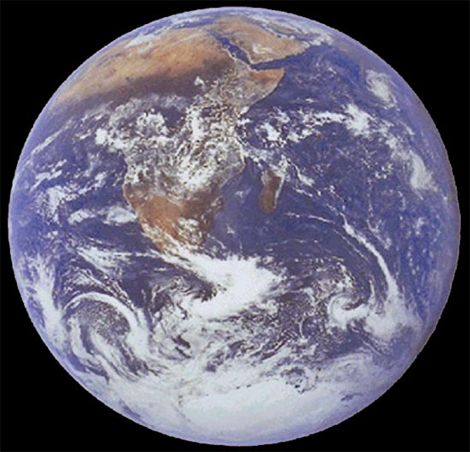
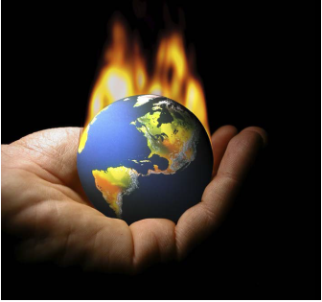
Climate Change
Vulnerability , Adaptation & Mitigation: Horn/East Africa
By
Getinet Assabu (Ph.D.)
Debre Markos University
College of Agriculture and Natural Resources
Department of Natural Resources Management

Slide 2
Content
Introduction
Vulnerability to Climate Change
Responses to CC: Adaptation & Mitigation
Regional and National Responses

Slide 4
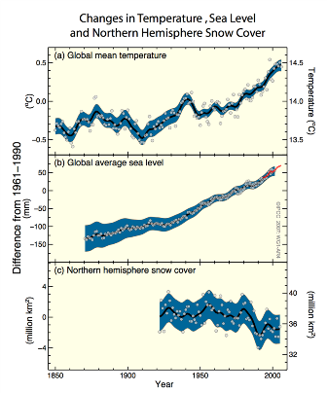
Introduction: Direct Observation of Many Changes
Signals a Warming World
Global mean temperature
Global average sea level Rising
Warming is Unequivocal - – meaning beyond doubt
Northern hemisphere Snow cover – melting faster
Many other observed change consistent with the warming
Notes:
Warming of the climate system is unequivocal, as it is now evident from observations of increases in global average air and ocean temperatures, widespread melting of snow and ice, raising global mean sea level .
Observed rise of Sea level rise and decrease of snow and ice extent are consistent with warming; IPCC has demonstrated that changes are global particularly in respect of temperature rises, Polar ice caps are melting fast, and this now includes the ice caps of Antarctica,
IPCC: Eleven of the last twelve years (1995-2006) rank among the twelve warmest years in the instrumental record of global surface temperature (since 1850). The 100-year linear trend (1906-2005) of 0.74 [0.56 to 0.92]°C1 is larger than the corresponding trend of 0.6 [0.4 to 0.8]°C (1901-2000) given in the Third Assessment Report (TAR) (Figure SPM.1). The temperature increase is widespread over the globe and is greater at higher northern latitudes. Land regions have warmed faster than the oceans (Figures SPM.2, SPM.4). {1.1, 1.2}.
Rising sea level is consistent with warming (Figure SPM.1). Global average sea level has risen since 1961 at an
average rate of 1.8 [1.3 to 2.3] mm/yr and since 1993 at 3.1 [2.4 to 3.8] mm/yr, with contributions from thermal expansion, melting glaciers and ice caps, and the polar ice sheets. Whether the faster rate for 1993 to 2003 reflects decadal variation or an increase in the longer-term trend is unclear. {1.1}
Observed decreases in snow and ice extent are also consistent with warming (Figure SPM.1). Satellite data since 1978 show that annual average Arctic sea ice extent has shrunk by 2.7 [2.1 to 3.3]% per decade, with larger decreases in summer of 7.4 [5.0 to 9.8]% per decade. Mountain glaciers and snow cover on average have declined in both hemispheres. {1.1}
Figure SPM.1. Observed changes in (a) global average surface temperature; (b) global average sea level from tide gauge (blue) and satellite (red) data and (c) Northern Hemisphere snow cover for March-April. All differences are relative to corresponding averages for the period 1961-
1990. Smoothed curves represent decadal averaged values while circles show yearly values. The shaded areas are the uncertainty intervals
estimated from a comprehensive analysis of known uncertainties (a and b) and from the time series (c). {Figure 1.1}
In fact, the evidence is so strong that the IPCC calls today’s warming unequivocal – meaning it is beyond doubt.

Slide 5
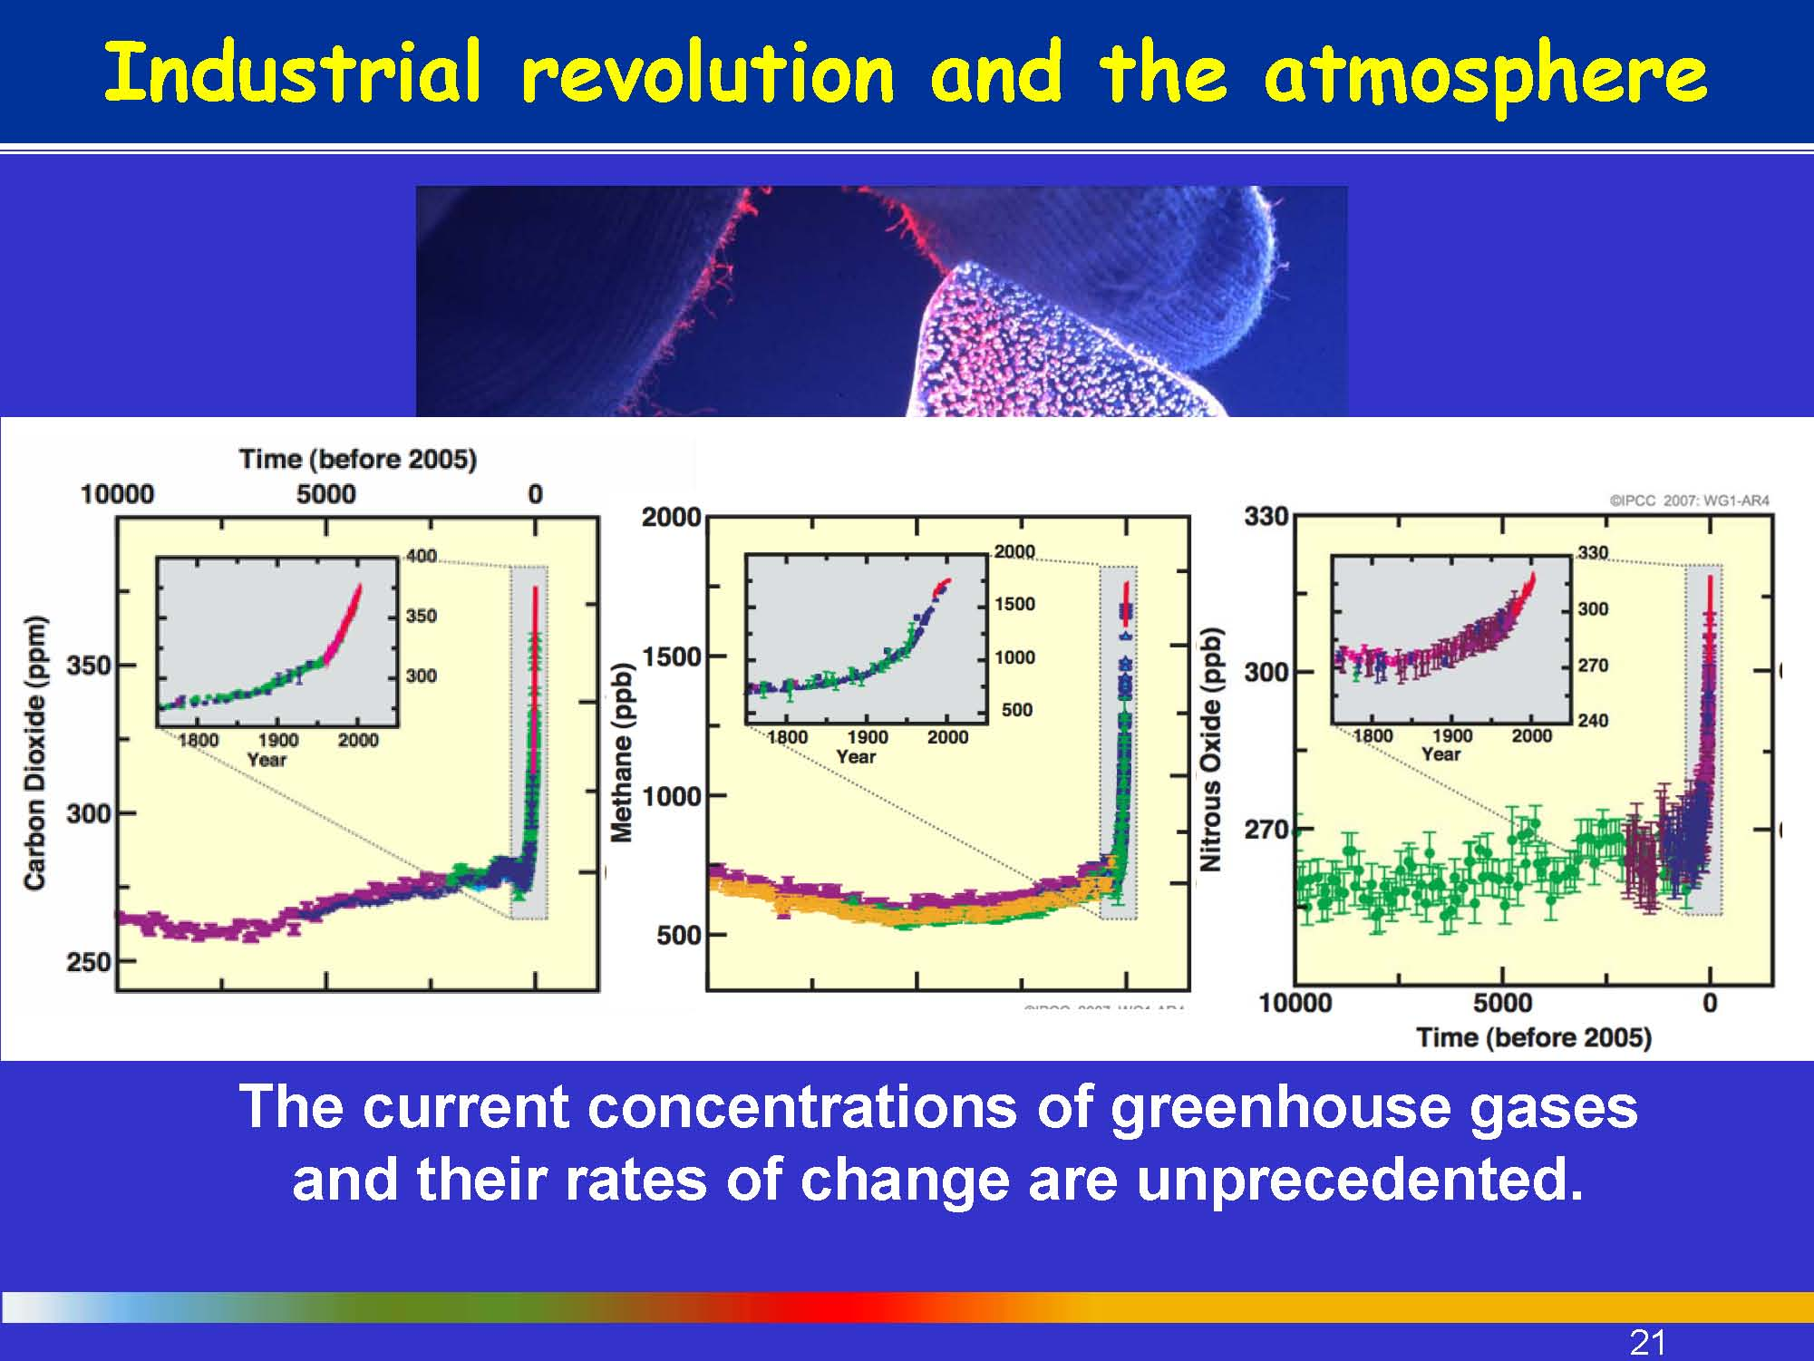
Very high confidence for the net effect of human activities on warming since 1750.
Fig. Change in GHGs from Ice Core and Modern times

Slide 6
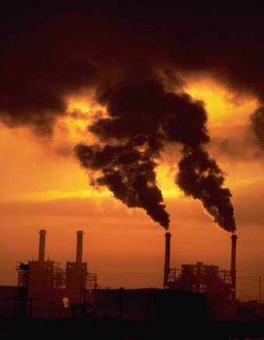
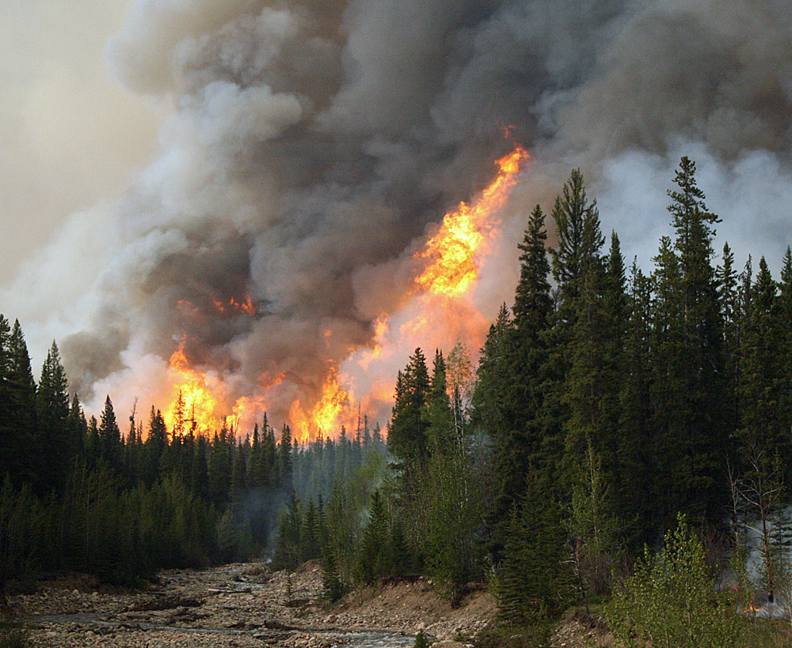
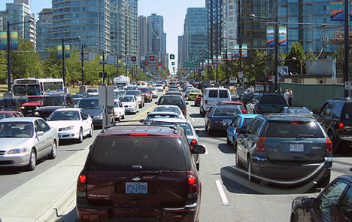
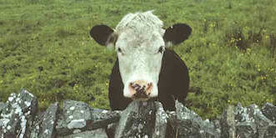
Major Sources of GHGs
Industry Pollution
Deforestation
Transport Sector Pollution
Intensive Agriculture

Slide 7
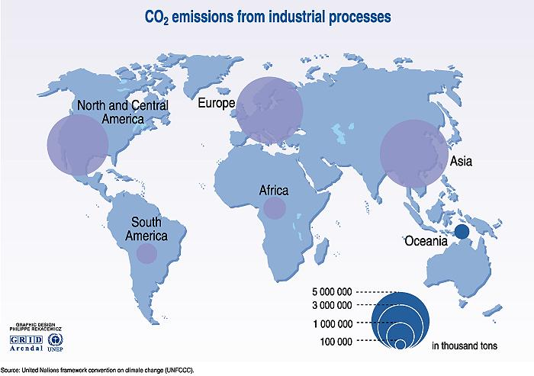
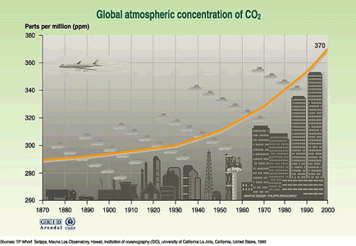
CO₂ is the largest contributor: increased by 30% since preindustrial times.
The last 128 yrs of data suggest the Earth is 0.7 – 0.8 ºC warmer
Notes:
Africa’s contribution is less

Slide 8
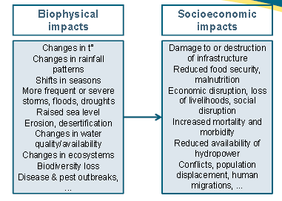
Impacts of CC/Variability/Hazards

Slide 9
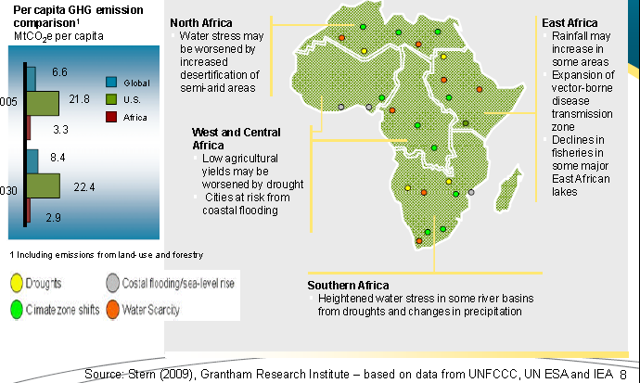
Potential Impacts of CC on Africa’s Development
Current development Issues may be worsened by CC

Slide 10
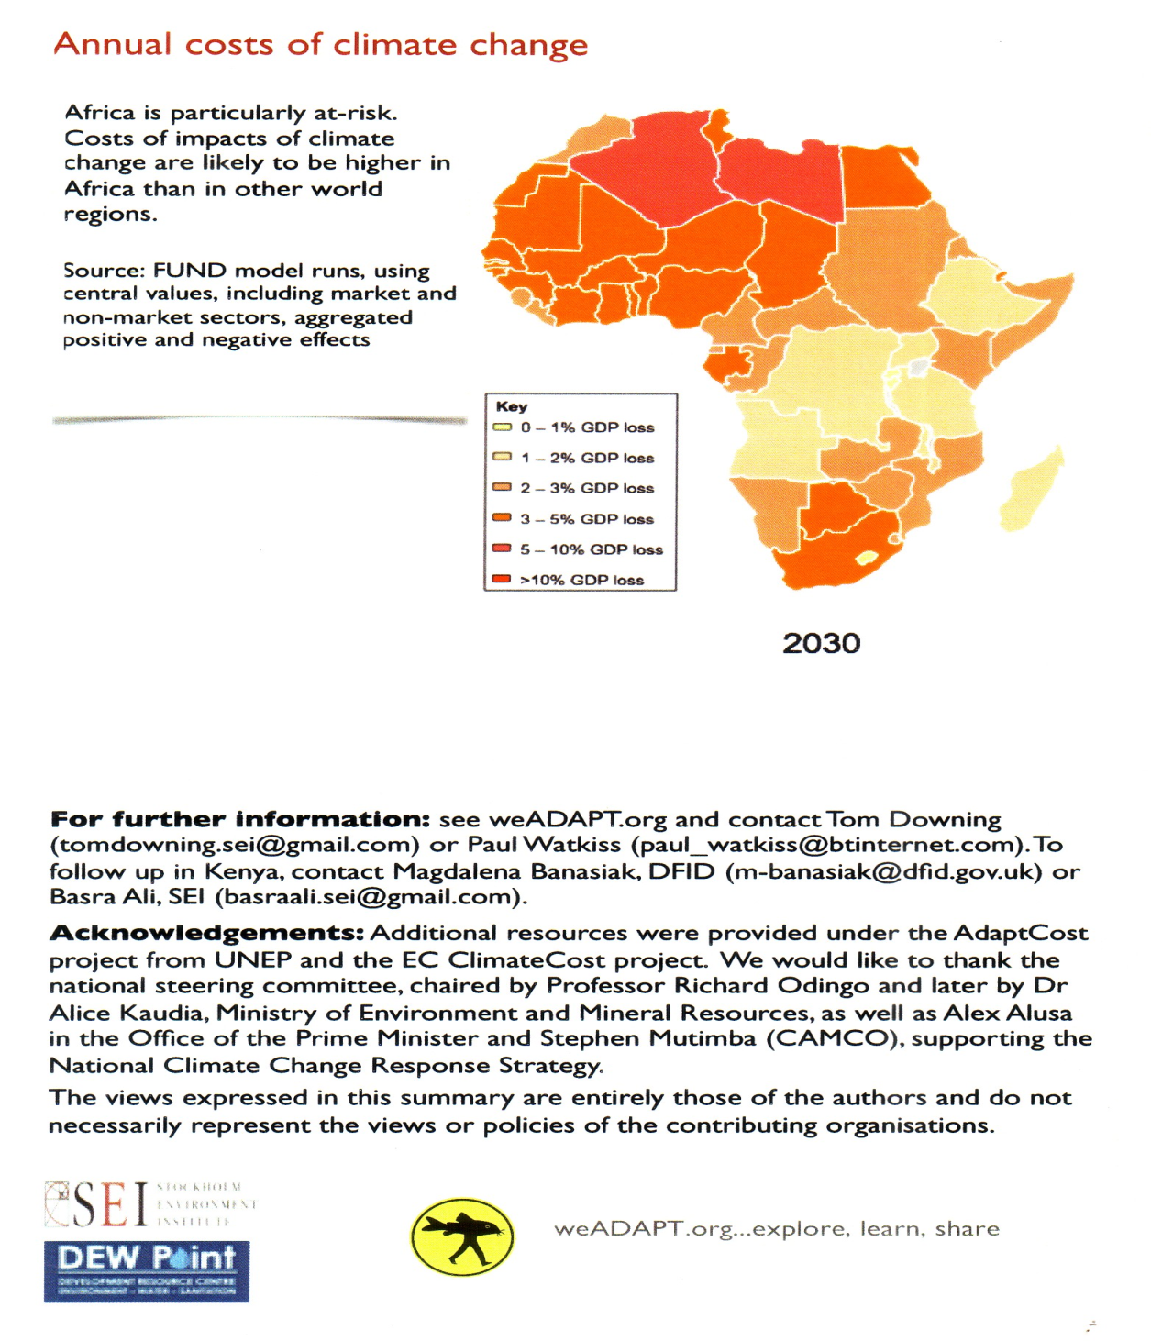
Stern Report:
If temperatures rise by 5 ⁰C, up to 10% of global output could be lost.
The poorest countries would lose more than 10% of their output

Slide 11
Vulnerability to Climate Change
Who/What is vulnerable most?
Various approaches defining vulnerability

Slide 12
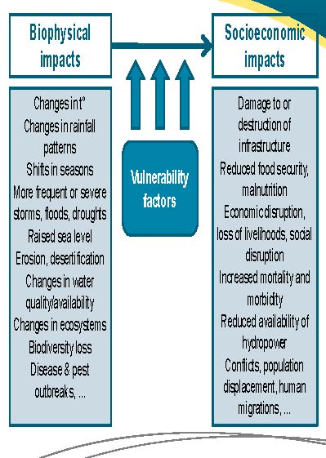
Biophysical & Socioeconomic Impacts of CC
Notes:
8. The biophysical impacts of climate change, which may vary significantly with location, include:
‐changes in average and/or extreme temperature and rainfall patterns, shifts in seasons; ‐increased frequency and/or severity of extreme weather events; ‐raised sea levels, increased coastal and river bank erosion; ‐acceleration in desertification and soil erosion processes; ‐decrease in the availability and quality of water, changes in the levels of groundwater, surface water drainage patterns and permafrost; ‐loss of habitats and changes in ecosystems, biodiversity loss; ‐increased frequency and/or severity of disease and pest outbreaks; ‐changes in atmospheric pollution patterns (EC 2009a).
9. These biophysical effects may in turn lead to socio‐economic impacts, such as:
‐damage to or destruction of infrastructure; ‐reduction in the availability of energy (hydropower); ‐economic disruption, loss of livelihoods and social disruption; ‐reduced food security, increased malnutrition; ‐increased mortality and morbidity; ‐increased probability and intensity of conflicts; ‐population displacement and human migrations (EC 2009a).
Vulnerability factors influence the way in which the biophysical effects and impacts of climate change generate socio‐economic impacts. Poor countries, and the poor and socially vulnerable within each country, are disproportionately vulnerable to the effects of climate change as they cumulate vulnerability factors, including: dependence on natural resources for livelihoods; lack of financial resources; poor health and education levels; poor or no access to infrastructure, essential services and social safety nets; gender‐based inequalities; and exposure to degraded ecosystems, social inequities, poor governance practices and weak institutions (World Bank 2010a, World Bank 2010g).

Slide 13
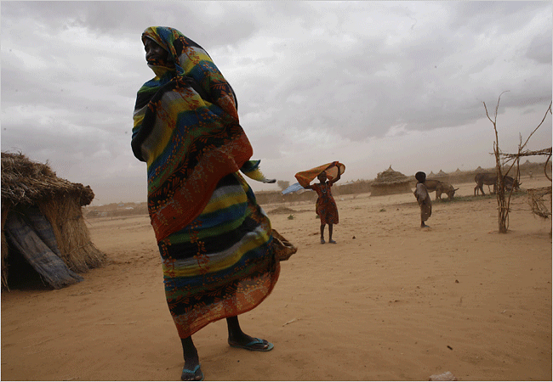
Vulnerability
It is the degree to which a system is susceptible to, or unable to cope with, adverse effects of CC, including climate variability and extremes (IPCC).
  It is the risk of adverse things happening
Vulnerability is a function of three factors:
  Exposure
  Sensitivity
  Adaptive capacity
Exposure:
-the magnitude, character and rate of CC in a given area
Notes:
Vulnerability concerns the risk of adverse things happening. Climate change is likely to have some benefits, but vulnerability is not concerned with that.
Vulnerability, according to the IPCC definition, is an integrated measure of the expected magnitude of adverse effects to a system caused by a given level of certain external stressors.
Vulnerability, according to this, includes an external dimension, which is represented here by the ‘exposure’ of a system to climate variations, as well as an internal dimension, which comprises its ‘sensitivity’ and its ‘adaptive capacity’ to these stressors.
Developing countries are the most vulnerable to the impacts of climate changes (IPCC, 2007b; Stern, 2006; UN, 2008), given:
their sensitivity − the degree by which their systems (livelihood activity & its resource-base) are affected or responsive to climate – and
their exposure to environmental stresses
their low mitigation and adaptive capacity, that is the ability to reduce the negative impacts, to capture any benefits of climate change and to ensure resilience to future shocks.
Adaptive capacity strengthens resilience and reduces vulnerability to a wide range of climate-related changes.
Climate change will have wide-ranging effects on the environment, and on socio-economic and related sectors, including water resources, agriculture and food security, human health, terrestrial ecosystems and biodiversity and coastal zones. Developing countries are particularly vulnerable to climate change because of the sensitivity of their fragile environments; small changes in climate can cause large environmental changes. With an economy closely tied to their natural-resource-base and climate-sensitive sectors such as agriculture, water, and forestry, developing countries like Ethiopia faces a major threat because of the projected changes in climate. Crucial sectors in Ethiopia like agriculture, water resources, health, sanitation, and rural development are likely to be affected by climate change. Thus, a project is required in this regard. The focus will be, for example, on assessing the impact in term of distinctive types of vulnerabilities: physical, economic, infrastructure and social across different sector of the economy.

Slide 14
Climate Hazards/Variability/Change Vs Impacts
Vulnerability: Climate sensitivity, poverty, natural resources, lack of information, etc.
Hazards
Variability
Change
Impacts
Capacity: Resources, Income, ideas, literacy, power, information, support systems, etc.
Notes:
In Ethiopia, the major causes for vulnerability to climate variability and change include: very high dependence on rainfed agriculture which is very sensitive to climate variability and change; under-development of water resources; low health service coverage; high population growth rate; low economic development level; low adaptive capacity; inadequate road infrastructure in drought prone areas; weak institutions and lack of aware
Spell out the differences between hazards, variability and change?
The same hazard or climate change will not have the same impact on two different countries/ communities or people. The impact of each hazard, variability or change is defined by its interaction with the vulnerability and capacity of each group. So for example drought will not impact the lives of civil servants in Addis in the same way as it does farmers in Dabat or pastoralists in Afar. Those whose livelihoods are sensitive to climate change will be worse impacted. Those who have fertile land will be less affected than those whose land cannot produce enough in a good year.
We call the facts which affect the impacts of climate hazards, variability and change “vulnerability” and “capacity”

Slide 15
Disaster = Hazard x Vulnerability
Capacity
A Scientific basis for
Disaster Risk Management
Capacity or Resilience
D = H x V/C
D = f (Hazard, Vulnerability/capacity)

Slide 16
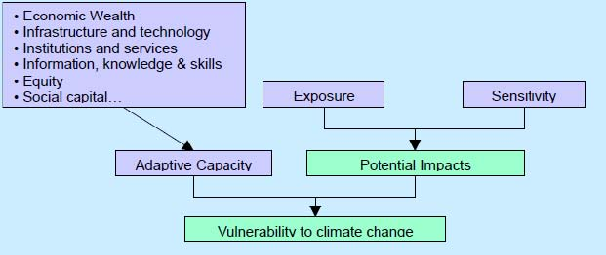
Vulnerability to CC (IPCC TAR)
Source: Stern, 2006
Notes:
To determine how countries are equipped to deal with the inevitable impacts of climate change requires an understanding of each country’s adaptive capacity. A country’s adaptive capacity is its talent and willingness to take the initiative in making adjustments to reduce the negative impacts of climate change. Fundamentally, adaptive capacity is the ability to respond to climate changes and then to initiate responses to these climate changes.
Adaptive capacity in ecological systems is related to genetic diversity, biological diversity, and the heterogeneity of landscape mosaics (Carpenter et al., 2001; Peterson et al., 1998; Bengtsson et al., 2002). In social systems, the existence of institutions and networks that learn and store knowledge and
experience, create flexibility in problem-solving and balance power among interest groups play an important role in adaptive capacity (Scheffer et al., 2000; Berkes et al., 2002). Systems with high adaptive capacity are able to re-configure themselves without significant declines in crucial functions in
relation to primary productivity, hydrological cycles, social relations and economic prosperity.
Adaptive capacity can be best understood with reference to vulnerability and resilience (Dayton-Johnson, 2004). Vulnerability is the tendency for people, ecosystems, communities, etc. to be damaged; while resilience is the opposite of vulnerability, and refers to the ability of people, ecosystems, communities,
etc. to resist or recover from damage. Vulnerability and resilience are two sides of the same coin (SOPAC, 2004). Something is vulnerable to the extent that it is not resilient.

Slide 17
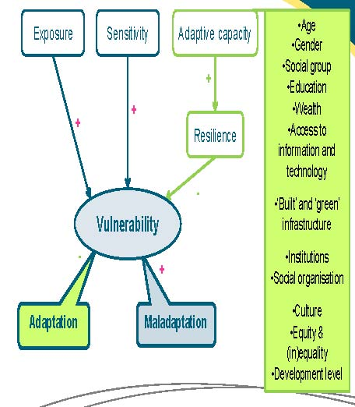
Vulnerability
Notes:
Vulnerability to climate change is the extent to which a system, individual or group of people is susceptible to, and unable to cope with, the adverse effects of climate change. Vulnerability to climate change depends on:
‐exposure to climate hazards (i.e. the extent to which a system, individual or group is exposed to the physical manifestations of climate change, considering that their character, magnitude and likelihood and the rate of variation of climate differ across regions of the world):
‐sensitivity to its effects (i.e. the degree to which a system, individual or group is affected, either positively or negatively, directly or indirectly);
‐and adaptive capacity (Brooks 2003, IPCC 2007c, EC 2009b, OECD 2009a).
5. Adaptive capacity is the extent to which a system, individual or group has the capabilities, and/or has access to the information, resources and institutions, required to cope with existing or anticipated external stresses – and in this specific context, to adapt to climate change, notably through the adoption of risk prevention and management measures (Brooks 2003, IPCC 2007c, EC 2009b, OECD 2009a). It has also been defined as ‘the property of a system to adjust its characteristics or behaviour, in order to expand its coping range under existing climate variability, or future climate conditions’ (Brooks & Adger 2004: 168). Note that adaptive capacity can be ‘generic’ (i.e. supportive of a positive reaction to stresses of various types), or specific to climate change‐related stresses (Burton & van Aalst 2004). Increased adaptive capacity leads to improved resilience, i.e. the ability of a system, individual or group to absorb disturbances, and adapt to stress and change (IPCC 2007c); it determines the ability to access and successfully implement adaptation options (Klein et al 2005).
6. Adaptive capacity (and therefore also vulnerability) is strongly influenced by factors such as:
‐wealth, age, gender, social group; ‐education and skills; ‐access to information and technology; ‐‘built’ and ‘green’ infrastructure¹; ‐institutions and social organisation; ‐cultural norms; ‐equity and (in)equality; ‐the ‘development level’ in general (Brooks & Adger 2004, IPCC 2007c, EC 2009a, OECD 2009a).
7. Maladaptation is an inadequate response to climate change, by which ‘business‐as‐usual’ development interventions that overlook the implications of climate change inadvertently result in increased vulnerability (e.g. building new infrastructure and settlements in flood‐prone areas). The term also designates an inadequate adaptation response, which fails to reduce vulnerability to climate change and instead ends up increasing it, displacing it or reducing the future potential for adaptation. For example, maladaptation may result from developing oversized irrigation systems in areas likely to suffer from increasing water scarcity; or building infrastructure such as sea walls that accelerate coastal erosion elsewhere along the coast and, by providing a false sense of security, end up encouraging development in high‐risk areas (Burton & van Aalst 2004, EEA 2007, EC 2009b, OECD 2009a, Olhoff & Schaer 2010, World Bank 2010a). Besides disregard for the potential impacts of climate change, one of the factors that may give rise to maladaptation is uncertainty; and ‘adaptation which can be successful at a specific temporal or spatial scale can become maladaptation at a different spatial and temporal scope’ (EEA 2007: 21).

Slide 18
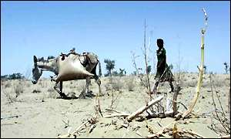
Sensitivity
The degree by which a system is affected (+/-) or responsive to climate-related stimuli.
Biophysical effect of CC
  Change in crop yield, energy demand
It considers the socioeconomic context, e.g., the agriculture system
Grain crops typically are sensitive (esp. if rain fed) - Manufacturing is much less sensitive to climate change
Notes:
Sensitivity is basically the biophysical effect of climate change; but sensitivity can be changed by socioeconomic changes. For example, new crop varieties could be more or less sensitive to climate change.

Slide 19
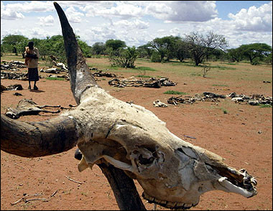
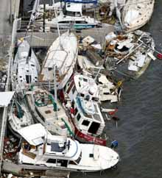
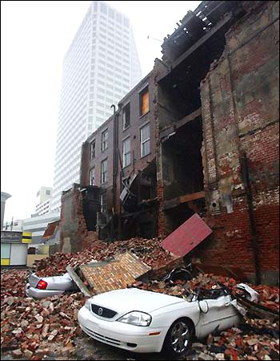
Sensitivity cont.

Slide 20

Adaptive Capacity
  The capacity of a system to reduce the negative impacts, to capture any benefits that may come with CC and to ensure resilience and reduce vulnerability to future shocks.
Function of:
  Wealth
  Technology
  Education
  Institutions
  Information
  Infrastructure
  “Social capital”
Having adaptive capacity does not mean it is used effectively
Notes:
Adaptive capacity is the capability to adapt. The factors listed under the second bullet are from the IPCC Third Assessment Report (Smit et al., 2001). Having capacity does not guarantee it will be used effectively (a good evacuation plan may not be effectively implemented).

Slide 21
Key Vulnerability
IPCC (AR4) identified seven(7) criteria for identifying key vulnerabilities:
  Magnitude of impacts;
  Timing of impacts;
  Persistence and reversibility of impacts;
  Likelihood (estimates of uncertainty) of impacts and vulnerabilities, and confidence in those estimates;
  Potential for adaptation;
  Distributional aspects of impacts and vulnerabilities; and
  Importance of the system(s) at risk

Slide 22
Who are most vulnerable and why?
Those who live in marginalised and more hazard prone areas- deforested hillsides, flood plains, etc.
Those who depend on climate-sensitive resources and ecosystems for their livelihoods- agriculture, fisheries, forests
Those with limited assets to enable them to respond to the impacts of climate change- lower adaptive capacity
Credit: Innocent Hitayezu/ Oxfam GB
Notes:
Rwanda: Chriselliea Nzabonimpa, farmer, community leader, and mother of five checks her crops (beans, maize and cassava) which remain dried out due to irregular rainfall. She thinks this is a worrying pattern for subsistence farmers.

Slide 23
Most Vulnerable
Regions and Sectors (IPCC)
Most vulnerable regions:
  Africa, Asian mega-deltas, small islands, the Arctic
Most vulnerable sectors:
  water in the dry tropics
  agriculture in low latitudes
  human health in poor countries
  where activities depend on sensitive ecosystems, like mountains
In all countries, even those with high incomes, some are especially at risk:
  the poor, young children, the elderly, the marginalized.
Notes:
IPCC named most vulnerable regions and sectors (mentioned above)
-where activities depend on sensitive ecosystems, especially: tundra, boreal, mountains; or ecosystems already stressed: e.g. mangroves, coral reefs.
Vulnerable sectors/systems, regions and Groups:
Some systems, sectors and regions are likely to be especially affected by climate change, including
Particular ecosystems:
terrestrial: tundra, boreal forest and mountain regions because of sensitivity to warming; mediterranean-type ecosystems because of reduction in rainfall; and tropical rainforests where precipitation declines
- coastal: mangroves and salt marshes, due to multiple stresses
- marine: coral reefs due to multiple stresses; the sea ice biome because of sensitivity to warming
water resources in some dry regions at mid-latitudes and in the dry tropics, due to changes in rainfall &evapotranspiration, and in areas dependent on snow and ice melt
agriculture in low latitudes, due to reduced water availability
low-lying coastal systems, due to threat of sea level rise and increased risk from extreme weather events
human health in populations with low adaptive capacity.
Vulnerable Regions:
the Arctic, because of the impacts of high rates of projected warming on natural systems and human communities
Africa, because of low adaptive capacity and projected climate change impacts (multiple stress)
Asian and African megadeltas, due to large populations and high exposure to sea level rise, storm surges and river flooding.
Vulnerable Groups
Within other areas, even those with high incomes, some people (such as the poor, young children and the elderly) can be particularly at risk, and also some areas and some activities.

Slide 24
Rural Communities Are Vulnerable
Rural communities (or developing countries) are more at risk from CC impacts as compared with urban dwellers (or developed countries)
This is because of their flimsy resource -based, and generally simple livelihoods
Quite often the impacts may exceed the natural coping/adaptive capacity of rural communities

Slide 25
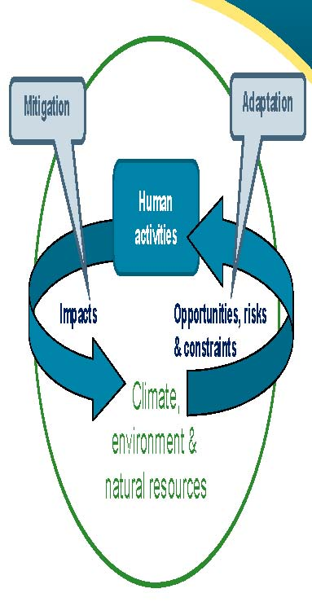
Response to CC: Adaptation and Mitigation
Notes:
Human activities and the environment (in the wider sense, including climate and natural resources) are in constant interaction. On the one hand, the environment is a source of opportunities, risks and constraints for human activities; adaptation addresses these opportunities, risks and constraints. On the other hand, human activities exercise pressure and generate impacts on the natural environment; mitigation addresses these pressures and impacts, in particular for minimising negative impacts.
Adaptation to climate change involves adopting measures to protect natural and human systems against the actual and expected harmful effects of climate change, to exploit any opportunities it may generate, and to ensure the sustainability of investment and development interventions in more difficult climatic conditions; it aims to reduce sensitivity and vulnerability to the effects of climate change (Klein et al 2005, IPCC 2007a, EC 2009b, World Bank 2010a).
Climate change mitigation involves reducing greenhouse gas (GHG) emissions and/or enhancing the capacity of ‘sinks’ for GHGs (i.e. processes and mechanisms that remove greenhouse gases or their precursors from the atmosphere), for the ultimate purpose of stabilising their concentration in the atmosphere; it aims to reduce global exposure to the effects of climate change (IPCC 2007d, EC 2009b).

Slide 26
Responses ……
Adaptation –
  a process of adjustment in natural or human systems in response to actual or expected climatic stimuli or their effects, which moderates harm or exploits beneficial opportunities (IPCC)
Mitigation –
  Measures to address global CC, including interventions or policies to reduce emissions and/or enhance sinks of GHGs..
Notes:
Mitigation – actions that reduce the emissions of GHG by direct reduction, alternative energy sources to reduce use of fossil fuels, new technologies to improve efficiency of fossil fuel use, and to reduce emissions e.g. by ‘carbon capture’ (sequestration, storage)
Adaptation – a process of adjustment of the natural or human systems in response to actual or expected climatic stimuli or their effects, which moderates harm or exploits beneficial opportunities.
Adaptation is about reducing the risks posed by CC to people’s lives and livelihoods (DFID, 2006)

Slide 27
Response Measures: Inter-linkage
Human interference
CLIMATE CHANGE including variability
Exposure,
Sensitivity
Initial Impacts or Effects
MITIGATION
of climate change via
GHG sources and sinks
I M P A C T S
V U L N E R A B I L I T I E S
Autonomous Adjustments
Planned
ADAPTATION
to the impacts and vulnerabilities
Residual or Net Impacts
Policy responses
Source: IPCC, 2001

Slide 28
Types of Adaptation:
Anticipatory- before things get desperately bad
Reactive- after things have gotten really bad
Planned- organized by government or civil society.
Autonomous – everyone goes in their own direction
Private- individuals/HH pay the bill
Public- shared cost

Slide 29
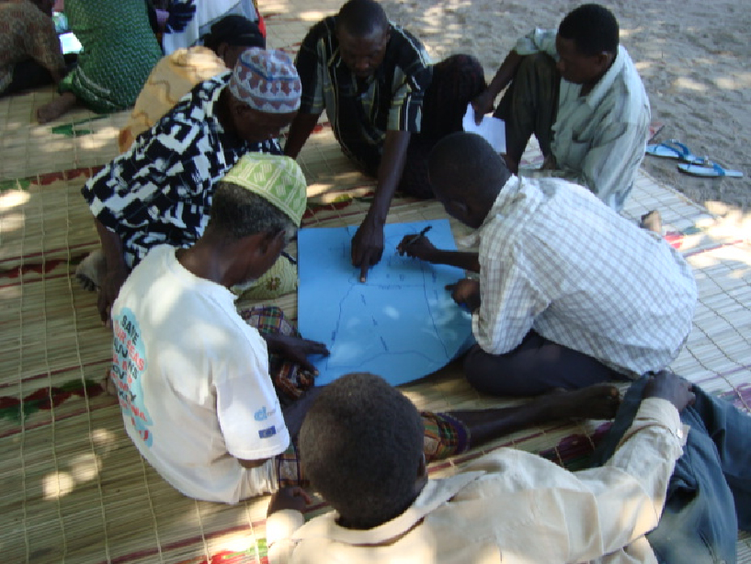
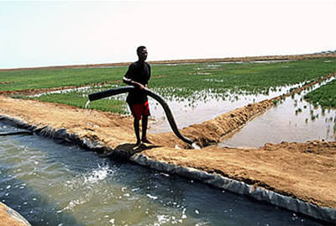
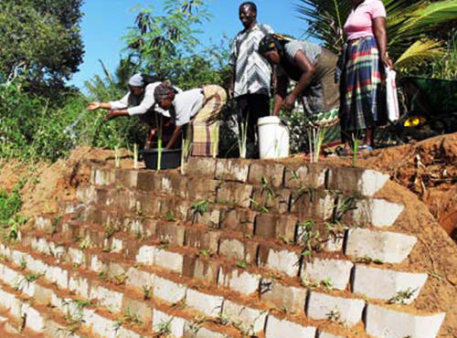
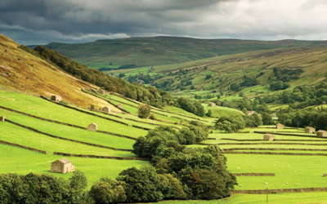
Some Adaptation Options
Planning with Communities
Developing Irrigation Potentials
Developing Flood Protections
Soil and Water Conservations
Notes:
Adaptation to frequent floods, sea level rise, coastal zone erosion requires planning.
Adaptations such as altered cultivars and planting times allow low- and mid- to high-latitude cereal yields to be maintained at or above baseline yields for modest warming

Slide 30
Adaptation
Limits to adaptation (No understood yet):
  Certain risks can not be reduced
  More serious impacts go beyond adaptive capacity
  Cost of adaptation hardly known
Adaptation alone is not expected to cope with all the projected effects of climate change,
Notes:
Options for successful adaptation diminish and the associated costs increase with increasing CC.

Slide 31
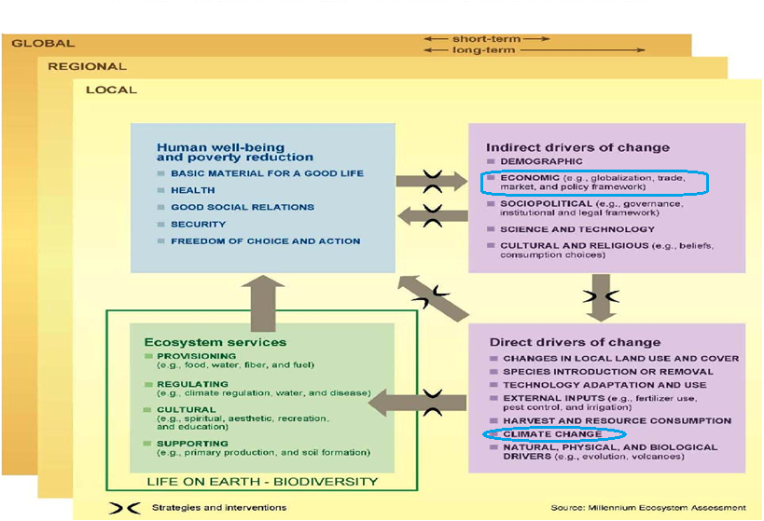
Environment – climate change –development linkages
Climate change:
- an environmental issue
- a development issue
Notes:
12. Figure 1.1, from the Millennium Ecosystem Assessment (2005), provides a good illustration of the linkages between economic activities, climate change, environmental change, human well‐being and poverty reduction. Figure 1.1 – Conceptual framework of interactions between ecosystem services, human well‐being and poverty reduction, and drivers of change.
13. Economic activities, one of the indirect drivers of ecosystem changes, are a key cause of climate change which is in turn a direct driver of changes in ecosystem services. Climate change affects human well‐being and the outcome of poverty reduction efforts, directly and through its effects on ecosystem services. Climate change is both a development issue and an environmental issue.

Slide 32
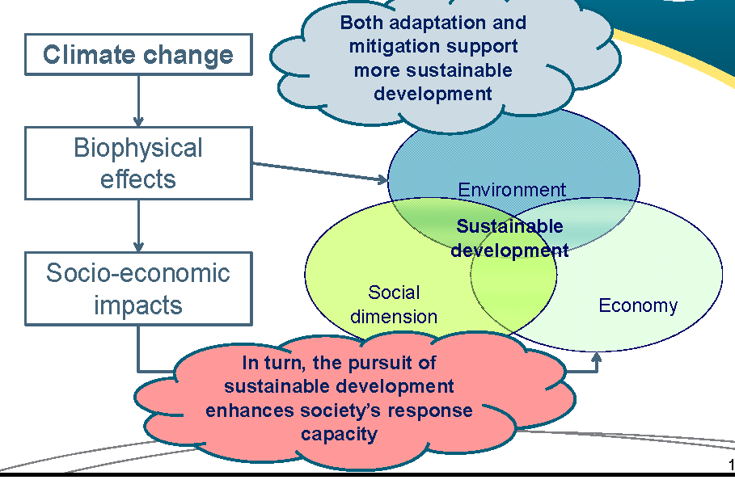
Climate Change and sustainable development
Notes:
14. The wide range of biophysical effects and socio‐economic impacts of climate change, if not addressed, threaten all three pillars (economic, social and environmental) of sustainable development (EC 2009b), as illustrated by Figure 1.2. Both adaptation to climate change and climate change mitigation can support more sustainable development – while the pursuit of sustainable development can enhance society’s response capacity in terms of both adaptation and mitigation (IPCC 2007c).

Slide 33
Climate Change and Environment
Climate change is a theme to be addressed
with other environmental issues:
CC exacerbâtes certain environnemental trends
and problems,
    e.g. desertification, freshwater scarcity, loss of biodiversity, air pollution
  Environmental management has an impact on CC
    e.g. waste management, soil management, land use planning and management
Notes:
15. Climate is a critical aspect of the environment. Climate change should be addressed with other environmental issues, for two main reasons:
‐It exacerbates a wide range of existing environmental trends and problems (e.g. desertification, freshwater scarcity, loss of biodiversity, air pollution).
‐The way we manage environment‐related issues (e.g. waste management, soil management, land use planning and management) has an impact on climate change.

Slide 34
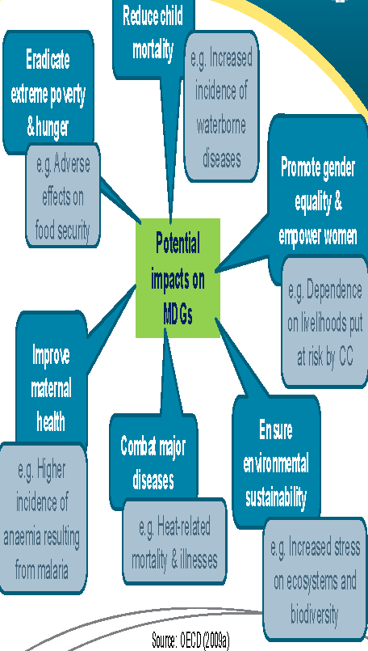
Climate Change and MDGs
Notes:
16. Through its multiple potential biophysical and socio‐economic impacts, climate change may also threaten the achievement of the Millennium Development Goals (MDGs) (OECD 2009a). Table 1.2 provides illustrations of the potential impacts of climate change on the MDGs. Again, both adaptation and mitigation efforts can support the achievement of the MDGs.
Because of the many linkages between climate change and development, in practice many adaptation measures overlap with development measures – and climate policy overlaps with development policy, even if their time horizons differ (Burton & van Aalst 2004, Klein et al 2005, OECD 2009a). Development, notably through achieving the MDGs, is critical to reducing vulnerability to climate change (Fankhauser & Schmidt‐Traub 2010, World Bank 2010c, World Bank 2010g) – and the factors that constrain or facilitate adaptation are often the same factors that constrain or facilitate development. Most development processes can bridge the ‘adaptation deficit’, i.e. the failures in managing and adapting to current climate variability and risks², thereby preparing the ground for adaptation to climate change. However, ‘development‐as‐usual’ is not always conducive to adaptation: the need for flexibility (i.e. possibility of adjustments to evolving conditions) and for avoiding anything that might increase future vulnerability must be kept in mind (Burton & van Aalst 2004, Sperling et al 2008).

Slide 35
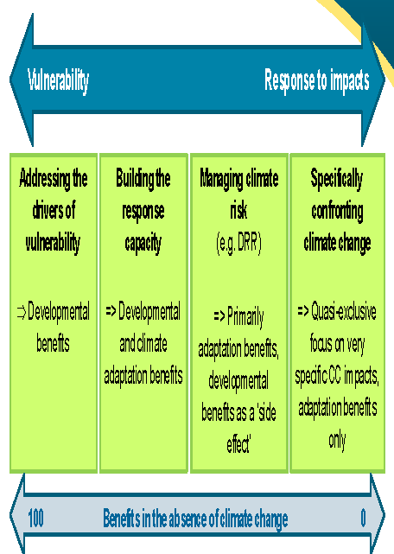
The Development–Adaptation Continuum
Notes:
18. There is a continuum between development and adaptation measures (see Figure 1.3), from measures focused on vulnerability to those focused on addressing specific climate impacts:
‐Some measures address the drivers of vulnerability, and deliver primarily developmental benefits (e.g. any measures aimed at reducing poverty and enhancing human development).
‐Some measures help build the response capacity, producing benefits in terms of both climate change adaptation and overall development (e.g. awareness raising on climate–development linkages, institutional building, development of weather and climate monitoring systems, improvements in natural resource management and land use planning practices).
‐Some measures, focused on managing climate risks, involve developmental benefits as a positive ‘side effect’ (e.g. climate risk screening and assessment and climate proofing of projects and infrastructure resulting in improved resilience to current climate conditions);
‐Some measures, focused quasi exclusively on confronting very specific climate change impacts, deliver adaptation benefits only (e.g. relocation in view of expected sea level rise, building of dikes) (McGray et al 2007, OECD 2009a, Olhoff & Schaer 2010).
19. Other typologies of adaptation measures exist. The UNFCCC, for instance, distinguishes measures that foster behavioural change, technological and engineering solutions, risk management and vulnerability reduction strategies, research, and capacity building. Table 1.3. gives examples of adaptation options based on this classification. Note that these are examples only, not blueprints or pre‐defined measures to be integrated in policies and strategies: relevant adaptation measures are very much context‐specific and must result from the process of mainstreaming climate change into policies and development plans.

Slide 36
Moving to climate-resilient, low-emission development

Slide 37
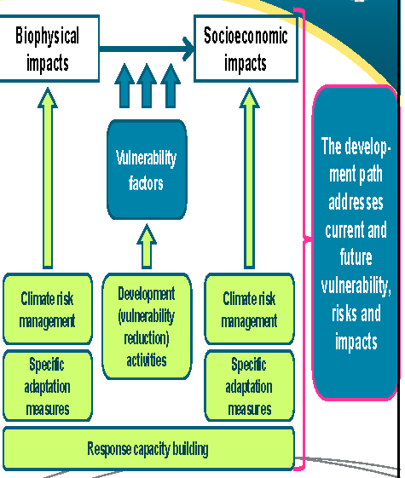
Climate-resilient development
Notes:
20. Climate‐resilient development requires addressing climate vulnerability, risks and impacts in development planning and budgeting and in the implementation and monitoring of developments strategies, programmes and projects. It rests on the implementation of development activities aimed at addressing vulnerability factors, and of climate risk management and specific adaptation measures focused on the biophysical and socio‐economic impacts of climate change. Capacity building underpins all types of measures. Climate‐resilient development ‘implies that adaptation to climate change should not be seen as a separate process, but a continuous and integrated one that addresses present and future climate risks’ (Sperling et al 2008: 6) and that adaptation and development should be implemented in a fully integrated manner (Fankhauser & Schmidt‐Traub 2010). The ultimate goal is to ensure that the chosen development path adequately addresses both current and future vulnerability, risks and impacts.
21. Recommendations for achieving climate‐resilient development include:
‐improving governance mechanisms, including stakeholder participation;
‐providing better access to information and planning processes, across all levels of governance;
‐building on past strategies to cope with climate variability, as long as they do not result in maladaptation;
‐investing in enabling policies (e.g. land use planning and management, natural resources management, support for technology transfer and adoption) that enhance sector‐specific interventions;
‐promoting multi‐sector investments to build resilience in targeted geographical regions;
‐implementing pro‐poor social policy interventions and adaptation options that generate sustainable development co‐benefits;
‐and combining ‘soft’ (social, environmental) adaptation options⁴ with ‘hard’ (infrastructure­ based) adaptation options, keeping in mind the needs of the poorest and most vulnerable (World Bank 2010g).

Slide 38
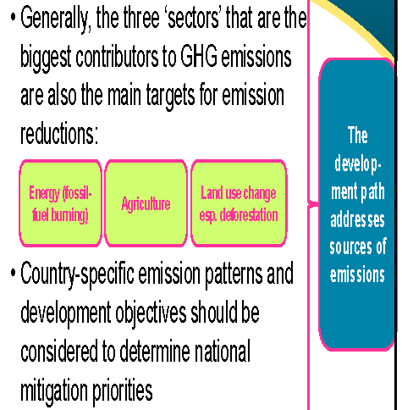
Low-emission development
Notes:
22. Low‐emission development requires addressing sources of GHG emissions, and developing or enhancing carbon sinks, to support the objective of stabilising atmospheric GHG concentrations ‘at a level that would prevent dangerous anthropogenic interference with the climate system’ (UNFCCC, Art. 2). At the global level, the three ‘sectors’ that are the biggest contributors to GHG emissions (namely energy generated from fossil fuel burning, agriculture, and land use change – especially deforestation) are also the main choices for emission reductions (Herzog 2005). Globally, the largest potential for curbing GHG emissions lies in:
‐improving energy efficiency (across all uses/sectors);
‐relying more on low‐carbon technologies to generate heat and power;
‐opting for more sustainable modes of transport;
‐curbing deforestation (and stopping desertification);
‐and modifying agricultural practices (e.g. more efficient use of nitrogen‐based fertilisers, improved management of manure) (IPCC 2007d, Stern 2007, EC 2009a, McKinsey & Company 2009).
23. At the national level, country‐specific patterns of emissions and circumstances (including development objectives and priorities) should be considered when determining national priorities for mitigation. Developing countries should also consider the existence of opportunities linked to international carbon finance flows. The ultimate goal is to ensure that the chosen development path addresses sources of emissions.

Slide 39
NAPAs and NAMAs
Many developing countries have submitted their NAPAs & NAMAs to the UNFCCC
  NAPAs = national adaptation programs of action
    Help LDCs build national capacities and identify priority adaptation projects with developmental benefits
  NAMAs = nationally appropriate mitigation actions
    These voluntary mitigation measures are consistent with a country’s development strategy, and are meant to put it on a more sustainable development path
These are good for addressing the climate challenge without compromising development objectives
Notes:
The Bali Action Plan requires Annex 1 countries to provide financial, technical and capacity building
support to non-Annex 1 countries in identifying and implementing their nationally appropriate
mitigation actions (NAMAs).
24. Many developing countries have submitted their national adaptation programmes of action (NAPAs) and nationally appropriate mitigation actions (NAMAs) to the UNFCCC Secretariat:
‐NAPAs were promoted to help least developed countries (LDCs) raise awareness, build national capacities and identify priority adaptation projects with developmental benefits. Non‐LDCs have not prepared NAPAs, but many have national climate action plans or equivalent documents – and the majority of UNFCCC signatory countries have now submitted their first (and increasingly their second) National Communications under the Convention.
‐NAMAs are voluntary mitigation measures consistent with a country’s development strategy, that are meant to put it on a more sustainable development path.

Slide 40
Adaptation and Mitigation: Seizing Opportunities
Green growth
  ‘A way to pursue economic growth and development, while preventing environmental degradation, biodiversity loss and unsustainable natural resource use’ Source: OECD (2010b)
Green jobs
Adaptation and mitigation as ‘opportunities’: development co-benefits
  e.g. renewable energy
    may reduce pollution from fossil fuel burning, with significant environmental and health benefits
    making the national economy less exposed to external shocks and increases in the price of imported fuels
  e.g. forestry (REDD+)
Notes:
25. Climate adaptation and mitigation should not be seen only as a constraint but also as a source of opportunity. In many instances, the adoption of adaptation and mitigation measures actually makes a positive contribution to development objectives, and creates opportunities such as green growth, green jobs and development co‐benefits (EC 2009a).
26. Green growth can be defined as ‘a way to pursue economic growth and development, while preventing environmental degradation, biodiversity loss and unsustainable natural resource use’ (OECD 2010b). It provides a way of rethinking the traditional tradeoffs between economic development/improved living standards and environmental sustainability, with the perspective of promoting and accelerating sustainable growth. Green growth is relevant to developed and developing countries alike and should be part of the mainstreaming process. It entails:
‐the use of a mix of policy instruments to create adequate incentives and disincentives (e.g. regulations and standards, market‐based incentives such as tradable permits or payment for environmental services, taxes and subsidies, information‐based instruments);
‐long‐term, stable support for research and development (R&D) and innovation;
‐support for the diffusion of clean technologies and related knowledge – and the removal of barriers to clean technology adoption (e.g. trade barriers, regulatory barriers, skills barriers, market failure barriers, environmentally harmful subsidies, policy inconsistencies);
‐support for technology transfers (e.g. financing mechanisms for global public goods, joint R&D initiatives);
‐the management of the negative employment and distribution effects of the transition to a greener economy, which may require significant re‐allocations of capital and labour;
‐and the development of new performance assessment frameworks (PAFs), with indicators related to the environmental efficiency of production and consumption, stocks of natural assets, environmental quality and quality of life, and the effectiveness of green growth policy responses and instruments (Dervis et al 2009, OECD 2010b).
27. One of the ways for ‘climate‐compatible’ development to be conducive to pro‐poor economic growth is to encourage the creation of ‘green jobs’,. Green jobs may be associated with both adaptation and mitigation. Possible sectors for the creation of such jobs include (renewabi.e. jobs associated with the deployment of clean technologies and the adoption of improved environmental practicesle) energy supply, public transport, manufacturing (e.g. clean technology equipment), construction (e.g. climate proofing of buildings and other infrastructure, retrofitting of buildings for improved thermal insulation), materials management (e.g. resource efficiency and recycling), retail (e.g. promotion of locally produced goods), agriculture (e.g. soil conservation, water efficiency) and forestry (e.g. afforestation, reforestation, sustainable forestry, agroforestry). Active training and capacity building policies are required to support the development of green jobs (UNEP 2008, EC 2009a).
28. The development co‐benefits (also known as ‘ancillary benefits’) of climate change adaptation and mitigation should be specifically considered from a multidimensional perspective, including economic growth, poverty reduction, gender equality and environmental sustainability (Perch 2010). For instance:
‐The development of renewable energy sources may reduce pollution from fossil fuel burning, with significant environmental and health benefits – while making the national economy less exposed to external shocks and increases in the price of imported fuels.
‐Projects, programmes and strategies developed in the context of REDD+ (the global initiative for Reducing emissions from deforestation and forest degradation) may deliver benefits in terms of forest‐and forestry‐related livelihoods and the preservation or restoration of important ecosystem services – provided they are conceived with the participation of forest‐dependent people and local communities.
‐Adaptation measures for agriculture, and measures for reducing emissions from agricultural soils, may improve the livelihoods of farmers, including the many women involved in subsistence agriculture, by improving yields, reducing soil erosion and degradation, or improving water quality and availability.
‐Adaptation to future climate change may entail immediate benefits in terms of reduced vulnerability to current climate risks (EEA 2007, Agrawala & Fankhauser 2008).
29. Adaptation and mitigation are both essential; they are like two sides of a coin, the complementary elements of the response to climate change (IPCC 2007c). Recent economic analysis shows that ‘the total costs of climate change are the lowest when both mitigation and adaptation are undertaken in conjunction’ (Agrawala et al 2010: 4).

Slide 41
Adaptation and Mitigation: Developing Synergies
Quite frequently adaptation and mitigation measures are congruent and can produce a double stream of benefits
  e.g. reduced tillage agriculture enhances carbon sequestration in soils while supporting soil moisture retention, thus increasing resilience to dry spells
  e.g. sustainable reforestation may simultaneously enhance carbon stocks and, by offering new livelihood opportunities, enhance the adaptive capacity of local communities
Notes:
30. There are both potential synergies and potential conflicts or trade‐offs between adaptation and mitigation responses:
‐Although adaptation and mitigation are quite different in nature (Klein et al 2005), sometimes adaptation and mitigation measures are congruent, so that mitigation produces a double stream of benefits. For instance, reduced tillage agriculture enhances carbon sequestration in soils while supporting soil moisture retention, thus increasing resilience to dry spells; and sustainable reforestation may simultaneously enhance carbon stocks and, by offering new livelihood opportunities, enhance the adaptive capacity of local communities.
‐Mitigation measures should be compatible with adaptation policies and requirements, avoid increasing vulnerability to climate change, and rely on environmentally sustainable practices. Biofuels or agrofuels, for example, are often presented as a good mitigation option, but in practice, depending on local circumstances, may be a threat to food security, water availability and ecosystems.
‐Similarly, adaptation measures should be designed and selected taking emissions into account. For example, when opting for agricultural intensification in support of improved food security, emissions associated with the use of fertilisers should be considered; similarly, when deploying cooling systems for adapting to heat waves, users should consider emissions from fossil energy.

Slide 42
Adaptation and Mitigation: Ensuring Complementarity
Mitigation should :
  Be compatible with adaptation policies and requirements
  Rely on environmentally sustainable practices
    e.g. unsustainable agrofuels may be a threat to food security, water availability and ecosystems
  Not result in increased vulnerability to climate change
Adaptation should :
  Take emissions into account
    e.g. agricultural intensification for improved food security may increase emissions from the use of fertilisers
    e.g. the increased adoption of air conditioning to adapt to heat waves may result in increased emissions from fossil energy use

Slide 43
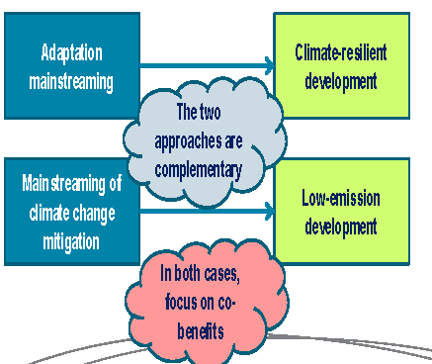
Moving to climate-resilient, low-emission development
Both climate-resilient development and low emission development result from mainstreaming CC in policy making and planning
Notes:
Climate change mainstreaming is at the heart of the process of moving to climate‐resilient, low‐emission development (IPCC 2007c): climate‐resilient development results from adaptation mainstreaming, while low‐emission development results from a process of mainstreaming climate change mitigation in all policy‐making and planning activities. (For explanations on the concept of mainstreaming, see Module 2.) In both cases, focusing on co‐benefits can create powerful incentives for initiating and sustaining the mainstreaming process.

Slide 44
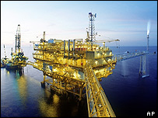
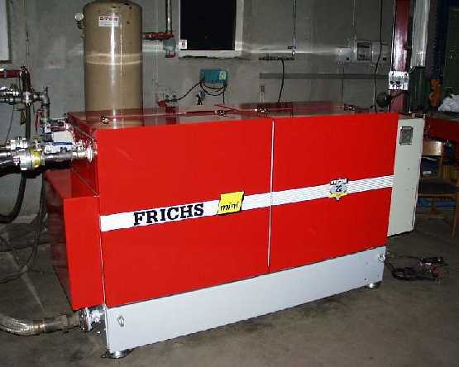
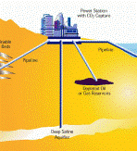
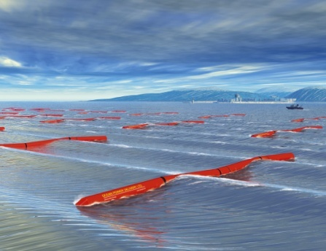
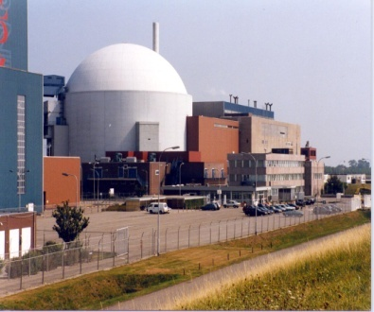
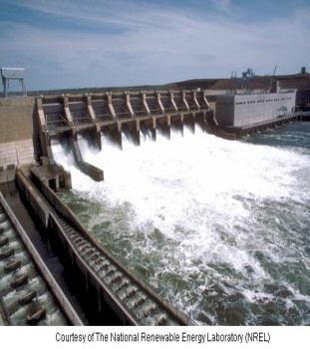
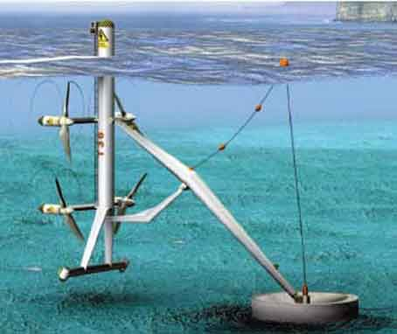
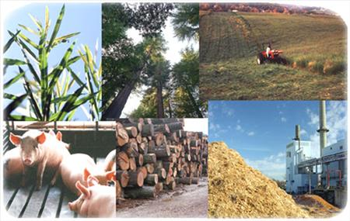
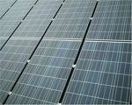
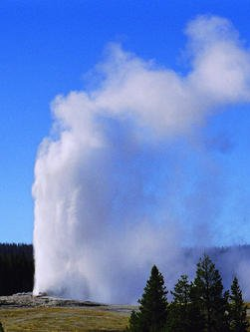
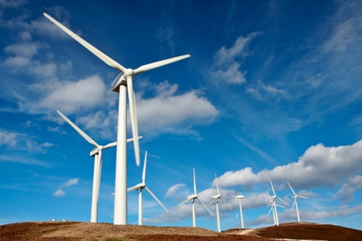
Commercial energy supply mitigation technologies
NOW
2030
Notes:
Improved supply and distribution efficiency
fuel switching from coal to gas;
nuclear power;
(4,5,6,7) renewable heat and power (hydropower, wind, bioenergy and geothermal);
10.solar
8. early applications of carbon dioxide capture and storage (CCS) (e.g. storage of removed CO2 from natural gas);
To be Commercialized before 2030
CCS for gas, biomass and coal-fired electricity generating facilities; advanced nuclear power; advanced renewable energy, including tidal and wave energy, concentrating solar, and solar photovoltaics
Mitigation in Energy Supply

Slide 45

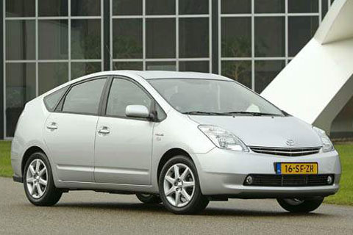

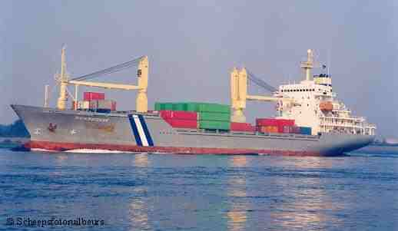

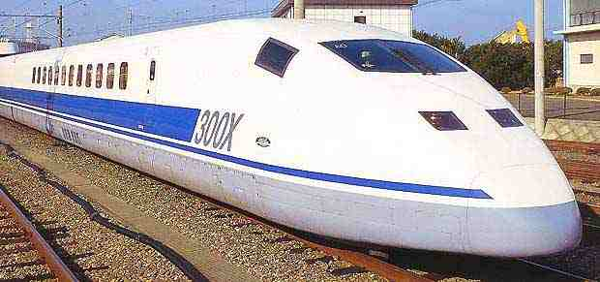
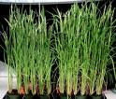
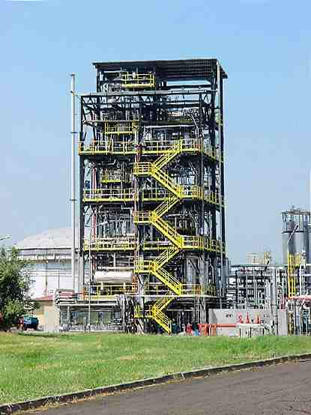


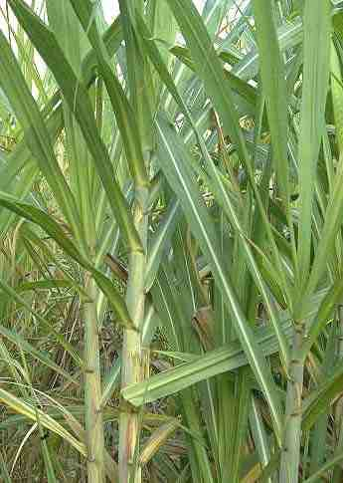






Commercial transport mitigation technologies
NOW
2030
Notes:
Available:
More fuel-efficient vehicles; hybrid vehicles; cleaner diesel vehicles; biofuels; modal shifts from road transport to rail and public transport systems; non-motorised transport (cycling, walking); land-use and transport planning;
To be Commercialized before 2030
second generation biofuels; higher efficiency aircraft; advanced electric and hybrid vehicles with more powerful and reliable batteries
Encourage shifts from road to rail transport and from private to public transport systems;
Promote more fuel efficient vehicles, hybrid vehicles (which use electricity rather than fuel) and cleaner diesel vehicles;
Further develop bio-fuels, above all second/third generation;
Encourage non-motorized transport, such as cycling and walking.

Slide 46
Potential Mitigation in Industry
More efficient end-use electrical equipment;
Heat and power recovery;
Material recycling and substitution;
Control of non-CO2 emissions;
A wide array of process-specific technologies

Slide 47
Potential Mitigation in Waste
Eco-design of products and packaging;
Reduce, reuse, recycle and recover waste;
Compost organic waste;
Control wastewater treatment;
Recover methane from landfills to produce energy;
Recover energy from waste incineration.
Notes:
Some impact assessments had been done for scenarios in which future atmospheric concs of GHGs are stabilized.
They provide some indications of damages avoided or vulnerabilities and risks reduced for different amounts of emissions reduction.

Slide 48
Non-technical options include, changes in lifestyle, behaviour cultural patterns, and consumer choice in buildings
Non-technical Mitigation Options:
Examples:
Change a light: regular by compact fluorescent light bulbs
Turn off electronic devices: when not in use
Drive less: Walk, bike, take public transport,…
Check your tires: improves your car’s fuel efficiency
Recycle more: 3Rs
Avoid products with a lot of packaging
Use less hot water
Plant a tree
Notes:
Non-technical Mitigation Options:
Changes in occupants behaviour, cultural patterns and consumer choice in buildings.
Behaviour of staff in industrial organizations in light of reward systems
Reduction of car usage and efficient driving style, in relation to urban planning and availability of public transport
Examples:
Change a light: Replacing six regular light bulbs with compact fluorescent light bulbs will save 400kg of carbon dioxide a year.
Turn off electronic devices: Simply turning off your television, DVD player, stereo, and computer when you’re not using them will save you thousands of kilograms of carbon dioxide a year.
Drive less: Walk, bike, carpool or take public transport more often. You’ll save 1.5kg of carbon dioxide for every 5km you don’t drive!
Check your tyres: Keeping your tyres inflated properly can improve your car’s fuel efficiency. Every litre of petrol saved keeps 2.5kg of carbon dioxide out of the atmosphere
Recycle more: You can save 1,000kg of carbon dioxide per year by recycling just half of your household waste.
Avoid products with a lot of packaging: You can save 545kg of carbon dioxide if you cut down your garbage by 10%.
Use less hot water: It takes a lot of energy to heat water - use less hot water by installing an energy efficient triple A rated showerhead (3 tonnes of carbon dioxide saved per year) and washing your clothes in cold or warm water (225kg saved per year).
Plant a tree: A single tree will absorb one tonne of carbon dioxide over its lifetime.

Slide 49
Response to Climate Change: Mechanisms
Mitigation
Adaptation
Reduction of GHGs by Annex-I Country Parties
All countries need to adapt to adverse effects of climate change
First Commitment Period 2008-2012
Developed countries shall provide resources to developing countries to meet cost of adaptation
Kyoto Protocol (KP)
Mechanisms
Clean Development Mechanism
Joint Implementation
Emission Trading
Finance and Technology
No-comprehensive mechanism
Existing Funding Mechanisms
LDCF and SCCF (UNFCCC)
Adaptation Fund (KP)
GEF Trust Fund (Finance for technology transfer)
Green climate fund (COP16)
Post Kyoto
  REDD⁺ (Adopted at COP16)
Notes:
WAYS TO ACHIEVE TARGETS
Countries may buy and sell GHG emissions "units" and "credits" – emissions trading
Provides a system for financing emissions-reducing or emissions-avoiding projects in developing nations - CDM
For Avoided deforestation – REDD; with forest enhancement (REDD⁺)
Responses
Shared Vision
Mitigation
Developed Countries – MRV
Developing Countries – MRV, supported by finance and technology
Introduces REDD – reduced emissions from Deforestation and devegetation
Adaptation
Technology Transfer for mitigation and adaptation
Financial Flow and Investment

Slide 50
WAYS TO ACHIEVE TARGETS
Countries may buy and sell GHG emissions "units" and "credits" – emissions trading
Industrialized countries are granted "emissions reduction units" for financing projects in other developed countries – joint implementation
Provides a system for financing emissions-reducing or emissions-avoiding projects in developing nations - CDM
In Addition, for Avoided forest deforestation & Degradation – REDD; with forest enhancement (REDD⁺)
Parties may partially compensate for their emissions by increasing "sinks" -- forests, which remove carbon dioxide from the atmosphere in own or foreign countries. - Aforestation/reforestation
Notes:
The Kyoto Protocol establishes three cooperative mechanisms designed to assist Annex 1 parties in
reducing their emissions levels by achieving cost effective reductions in other countries than they would
domestically. These are the (1) International Emission Trading (2) Joint Implementation and the Clean
Development Mechanism (CDM). The CDM established under Article 12 of the Protocol has the following
twin objectives:
• to assist Parties not included in Annex I in achieving sustainable development and in contributing to
the ultimate objective of the Convention, and
• to assist Parties included in Annex I in achieving compliance with their quantified emission limitation
and reduction commitments under Article 3.
Climate change is global in its causes and consequences, and international collective action will be critical in driving
an effective, efficient and equitable response on the scale required. This response
will require deeper international co-operation in many areas - most notably in creating
price signals and markets for carbon, spurring technology research, development
and deployment, and promoting adaptation, particularly for developing countries.
Discussions under REDD+ have succeeded
in mobilizing attention and resources for the sector to address the climate change mitigation issues,
i.e. those related to reducing deforestation and degradation, enhancing carbon stocks, improving the
protection of forests, and enhancing sustainable management of forest resources. This is now relevant
especially since REDD+ was adopted at the COP16 of the UNFCCC negotiations (

Slide 51
Mitigation Opportunities and Challenges
Opportunity from REDD^{+:}
  Reducing Emissions from Deforestation and Forest Degradation (REDD) and its variances such as REDD+ (and now REDD++) present forest-dependent communities with opportunities to benefi t monetarily from sustainably using their forests.
  Existing national forest programs (NFPS) in many African countries and programs/projects/activities that implement various international agreements, initiatives and conventions (like CBD, UNCCD, etc) all target the key components of REDD+
Notes:
The Kyoto Protocol establishes three cooperative mechanisms designed to assist Annex 1 parties in
reducing their emissions levels by achieving cost effective reductions in other countries than they would
domestically. These are the (1) International Emission Trading (2) Joint Implementation and the Clean
Development Mechanism (CDM). The CDM established under Article 12 of the Protocol has the following
twin objectives:
• to assist Parties not included in Annex I in achieving sustainable development and in contributing to
the ultimate objective of the Convention, and
• to assist Parties included in Annex I in achieving compliance with their quantified emission limitation
and reduction commitments under Article 3.
Climate change is global in its causes and consequences, and international collective action will be critical in driving
an effective, efficient and equitable response on the scale required. This response
will require deeper international co-operation in many areas - most notably in creating
price signals and markets for carbon, spurring technology research, development
and deployment, and promoting adaptation, particularly for developing countries.
Discussions under REDD+ have succeeded
in mobilizing attention and resources for the sector to address the climate change mitigation issues,
i.e. those related to reducing deforestation and degradation, enhancing carbon stocks, improving the
protection of forests, and enhancing sustainable management of forest resources. This is now relevant
especially since REDD+ was adopted at the COP16 of the UNFCCC negotiations (

Slide 52
The Clean Development Mechanism (CDM)
It has two main Objectives:
    to assist non-Annex I Parties in achieving SD and in contributing to the ultimate objective of the convention, and
    to assist annex I Parties in achieving compliance with their quantified emission limitation and reduction commitments.
However, Sub-Saharan Africa has not benefited from CDM due to:
  lack of underlying finance,
  small size of projects,
  weak institutional environment and
  lack of human capacity to develop projects
    E.g., UNEP reported, in May 2011, Africa had 166 CDM versus 5067 CDM projects for the Asia-Pacific region
The industrial sector should be appraised on how the CDM works because the sector stands a chance to benefit from the mechanism
Notes:
The Kyoto Protocol establishes three cooperative mechanisms designed to assist Annex 1 parties in
reducing their emissions levels by achieving cost effective reductions in other countries than they would
domestically. These are the (1) International Emission Trading (2) Joint Implementation and the Clean
Development Mechanism (CDM). The CDM established under Article 12 of the Protocol has the following
twin objectives:
• to assist Parties not included in Annex I in achieving sustainable development and in contributing to
the ultimate objective of the Convention, and
• to assist Parties included in Annex I in achieving compliance with their quantified emission limitation
and reduction commitments under Article 3.
Climate change is global in its causes and consequences, and international collective action will be critical in driving
an effective, efficient and equitable response on the scale required. This response
will require deeper international co-operation in many areas - most notably in creating
price signals and markets for carbon, spurring technology research, development
and deployment, and promoting adaptation, particularly for developing countries.
Discussions under REDD+ have succeeded
in mobilizing attention and resources for the sector to address the climate change mitigation issues,
i.e. those related to reducing deforestation and degradation, enhancing carbon stocks, improving the
protection of forests, and enhancing sustainable management of forest resources. This is now relevant
especially since REDD+ was adopted at the COP16 of the UNFCCC negotiations (

Slide 53
Ethiopia’s Response to CC
Ethiopia has:
  ratified the UNFCCC (1994) and its instrument, the Kyoto Protocol (2005),
Submitted to the UNFCC:
  Initial national communications (in 2001)
  National Adaptation Program of Action (NAPA) (in 2007)
  Nationally Appropriate Mitigation Action (NAMA) in January 2010.
Prepared a new “Ethiopian Program of Adaptation to Climate Change‟ (EPACC), which replaced the project-based NAPA,
Developed a national “Climate Resilient Green Economy‟ (CRGE) strategy.
Developed a 5 year GTP (2010/11-2014/15). which directly addresses CC and environment in a separate section

Slide 54

Kenya National Climate Change Action Plan (2010)

Slide 55
Kenya’s NAMA

Slide 56

THANK YOU ALL

Slide 60
EPACC (Ethiopian Program of Adaptation to CC)
Climate Change/Environmental Issues Addressed
  Adequately captured the growing threat of CC in Ethiopia and clearly spells out the need to mainstream CC in all spheres of development policy making and planning at all phases and stages of the planning and implementation process.
  Clearly states the urgency of taking practical adaptation and mitigation actions in the various social and economic sectors.
  However, the role of non-state actors in the planning, design and implementation of activities mentioned in the work program is not clearly spelled out.

Slide 61
Ethiopian NAMA
Paid special attention to unleashing the huge potential of the country’s water, land, wind and geothermal energy resources for the purpose of generating electricity for road and rail transport and household consumption, and managing urban wastes.
Failed to include important mitigation actions in land use planning, energy efficiency, fiscal incentives and traffic management regulatory policy measures.

Slide 62
Ethiopian NAMA
Paid special attention to unleashing the huge potential of the country’s water, land, wind and geothermal energy resources for the purpose of generating electricity for road and rail transport and household consumption, and managing urban wastes.
Failed to include important mitigation actions in land use planning, energy efficiency, fiscal incentives and traffic management regulatory policy measures.

