Slide 1
REDD+: The Global Mechanism, Challenges and Opportunities

Slide 2
The Role of Forests in Climate Change

Slide 3

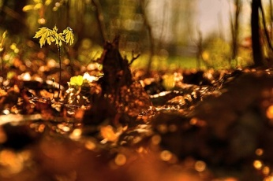

Contents
What are the signs that climate change is occurring?
What causes climate change?
What is the role of forests in climate change?

Slide 4
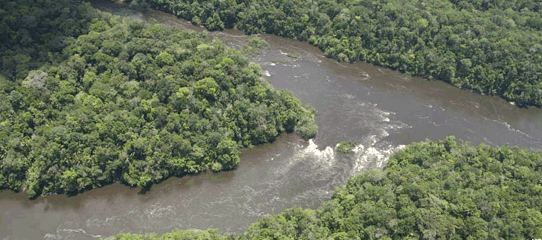
Part 1:
What is Climate Change? And what are the signs of Climate Change?

Slide 5
What is Climate Change?
Climate Change = Any significant change in measures of climate (such as temperature or precipitation) lasting for an extended period of time (typically decades)
United Nations Forum Convention on Climate Change (UNFCCC) defines Climate Change as ‘a change of climate which is attributed directly or indirectly to human activity that alters the composition of the global atmosphere’

Slide 6
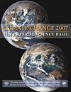
Climate Change is happening
“Warming of the climate system is unequivocal, as is now evident from observations of increases in global average air and ocean temperatures, widespread melting of snow and ice, and rising global average sea level” (IPCC Fourth Assessment Report, 2007)
“Most of the observed increase in global average temperatures since the mid 20th century is very likely due to observed increases in anthropogenic greenhouse gas concentrations” (IPCC, 2007)
Notes:
In the last year and a half, there were two important documents that brought increased international attention to the problem of climate change and the need to urgently take action to reduce climate change impacts.
November 2007
Stern Oct 2006
First, the Intergovernmental Panel on Climate Change (IPCC), an independent body of >3000 scientists, reported that there was now ‘unequivocal’ evidence that the climate system was warming- with observations of increases in air and ocean temperature, metling snow and idea and rising sea levels.
Second, the Stern report on the Economics of Climate Change, highlighted the fact that if the glocal community doesn’t act now, the overall costs and risk of climate change are enormous- the equivalen of losing at least 5% of the global GDP each year, now and forever’.
Together these publications
The IPCC fourth assessment report, which was written by >3000 scientists, reported that there was now UNEQUIVOCAL evidence that the global climate is change, as was evident from observations …
A second publication, written by Sir Nicolas Stern on the Economics of Climate Change, highlighted the urgency of addressing
Quote from IPCC (definitive quote on global warming is happening...”)
IPCC in 2007 stated... “key conclusion from report that global changes occuring with high certainty and quickly and by humans”...
look in intro to report

Slide 7
Global and continental temperature change
Observed temperatures
Model predictions
(including natural and human drivers)
Model predictions
(including only natural drivers)
Notes:
These changes in temperature are occuring across all continents.
Temperature increases have occurred in all regions, but are greater in higher northern latitudes
Land areas have warmed faster than the oceans
This graph from the latest Intergovernmental Panel of Climate Change (IPCC) show the observed changes in global and continental surface temperatures across the world, with the black lines showing the documented change in temperature.
The red lines show the
These graphs show the observed continental and global-scale changes in surface tempratures, with the black lines showing the actual
This graph shows the
Surface air temperatures have increased approximately by 1F during the 20th century
Both globla air and ocean temperatures are increasing across the world, with a mean rise in temperature of 0.8 C since 1800’2
1990s were the hottest decade on record
Ocean temperature have increased to depth of 3000m
Atmospheric water vapour has increased (warmer water holds more area)
Rising temperatures:
Sea level rises
Changes in atmospheric concentrations of CO2, CH4 and NOx
Changes in aerosols
During the last hundred years, the sea level has risen 4-8 inches
Will likely increase 1.6 – 6.8 oC before 2100.

Slide 8
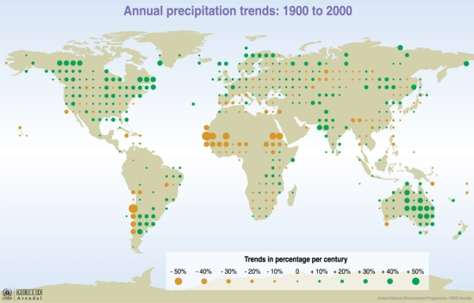
Changes in precipitation patterns
Less rain
More rain
http://maps.grida.no/go/graphic/precipitation_changes_trends_over_land_from_1900_to_2000
Notes:
There have also been marked changes in precipitation patterns worldwide, due to changes in surface temperatures of oceans and land, changes in wind patterns and movements of ocean currents.
This map shows the trends in annual precipitation over the last century, with yellow dots representing areas that are experierncing decreases in rainfall, and green areas representing areas that are experiencing increased rainfall. The size of the dots represents the magnitude of the change.
As you can see from the map, the changes in precipitation are quite variable geographically.
Some parts of the world, lke the eastern regions of North and South America, northern Europe, and northern and central Asia are experiencing increased (and often heavier) rainfall. IN addition, not only are these regions experiencing more rainfall, they often experience much heavier rainstorms (potentially cuasing flooding and damage)
Globally, the area under drought has increased since 1970’s.
While others- such as the Sahel, the Meditteranean, and nothern and central Asia are receiving less precipitation and suffering longer and more sver droughts.
Some regions of the world are experining much greater levels of precipitation
smaller and use “Precipitation changes: trends over land from 1900-2000
Surface air temperatures have increased approximately by 1F during the 20th century
Both globla air and ocean temperatures are increasing across the world, with a mean rise in temperature of 0.8 C since 1800’2
1990s were the hottest decade on record
Ocean temperature have increased to depth of 3000m
Atmospheric water vapour has increased (warmer water holds more area)
Rising temperatures:
Sea level rises
Changes in atmospheric concentrations of CO2, CH4 and NOx
Changes in aerosols
During the last hundred years, the sea level has risen 4-8 inches
Will likely increase 1.6 – 6.8 oC before 2100.

Slide 9
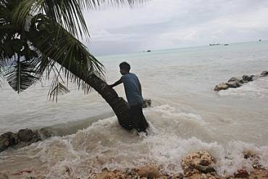
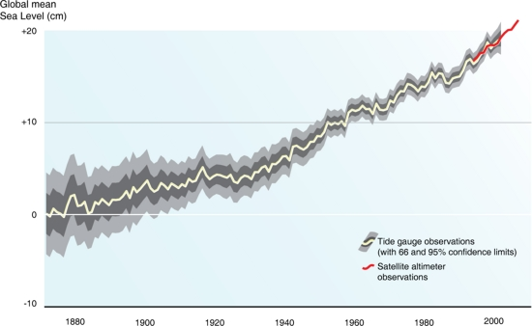
Rising sea levels
+ 3.1 mm per year
Sea levels are rising due to thermal expansion and melting glaciers and ice caps
Average global sea levels have risen 17 cm during 20th century and may rise 28-58 cm by 2100
http://maps.grida.no/go/graphic/trends-in-sea-level-1870-2006
Global mean sea level rise from 1870 - 2006
Notes:
Across the world, the warming tempratures are melting glaciers and causing sea water to expand, resulting in increases in the overall sea level.
IN the last 100 years, global sea levels have risn an average of 17 cm, and are projected to rise 28-58 by 2100.
From 1961 to 1993, sea levels rose at a rate of 1.8 mm/yr; and since 1993 at a rate of 3.1 mm/ya
Sea levels are rising due to thermal expansion and melting glaciers and icecaps
These rising seas level pose risk to people and ecosystems living in coastal areas and low-lying islands
Another sign of climate change are the rising sea levels.
(island info – UN Office of the High Representative for the Least Developed Countries, Landlocked Developing Countries and Small Island Developing States, 2007, UN NY)
(graph and text to right)
put in “Trends in sea level, 1870 – 2006
sea levels have risen 17 cm during 20th century
projected to rise 28-58 cm by end of 21st century
http://www.ipcc.ch/graphics/gr-ar4-syr.htm
graph of sea level in se usa (http://www.gfdl.noaa.gov/~tk/climate_dynamics/climate_impact_webpage.html)
Sea levels are rising due to a combination of :
thermal expansion (water expands as it gets hotter)
Glaciers melting
Greenland ice sheet melting
Antartic ice sheet melting
Rate of sea level rise is increasing: from 1961-1993, sea levels rose an average of 0.4 mm/yr’ from 1993 to 2003, sea levels have risen 1.6 mm/yr (

Slide 10
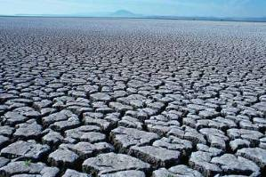
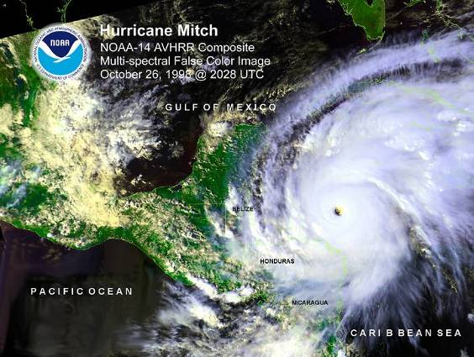
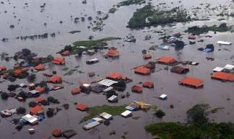
More extreme weather events
Severe droughts
and heat waves
Stronger
storms
Heavy rains
Notes:
statistics from IPCC physical science of climate change, 2007 (http://www.ipcc.ch/pdf/assessment-report/ar4/wg1/ar4-wg1-spm.pdf)
Greater frequency of:
Heat waves
Heavy precipitation events
Tropical Cyclones in North Atlantic
Strong storms
Rising intensity of storms, forest fires, droughts, flooding, heat waves

Slide 11
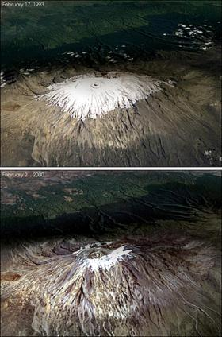
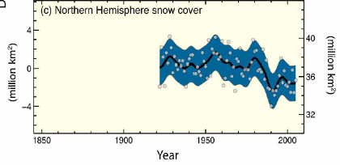
Decreasing snow cover and melting glaciers
Kilimanjaro 1993
Decreasing snow cover
Kilimanjaro 2000
http://www.mounteverest.net/news.php?id=1361
Notes:
82% of Mt. Kilimanjaro’s glacier has disappeared since first surveyed in 1912
Another sign of climate change is that worldwide, snow cover is melting and glaciers are retreating.
The graph on the left shows the change in area of land (in millions of km) globally that is under snow cover- and it is clear that this area has declined significantly in recent years.
In addition to losses in snow cover, glaciers are melting in almost all regions of the world- often at a very alarming rate.
For example, Moutn Kilimanjaro in Kenya has lost almost 82% of its glacier, and much of this melting has occurred in the last decade (as seen in the photo above).
left graphic (Image by NASA of Kilimanjaro's rapidly melting glacier. 82% of it has disappeared since it was first surveyed back in 1912. The image shows the difference in only seven years. ) (http://www.mounteverest.net/news.php?id=1361)
right graphic (http://www.ipcc.ch/graphics/gr-ar4-syr.htm)
Mountain glaciers and snow cover have declined
The Arctic provides a striking illustration of the impacts of climate change on people and places. Sea ice has shrunk substantially, and coastal ice melts three weeks earlier than it did just 30 years ago. The area of sea lost since 1979 is greater than California, Texas and Maryland combined.
The bald truth is that Earth’s polar ice caps are melting at an alarming rate. The cause? Global climate change.

Slide 12
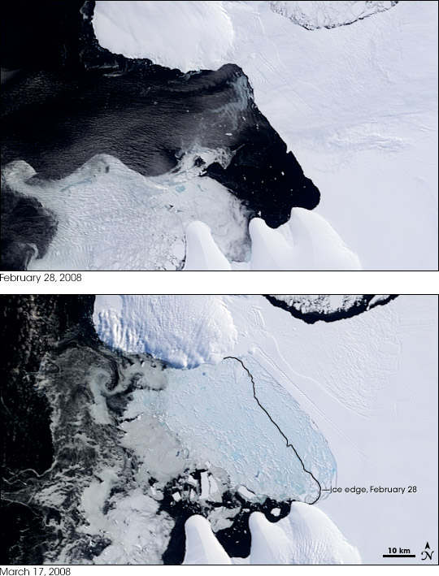
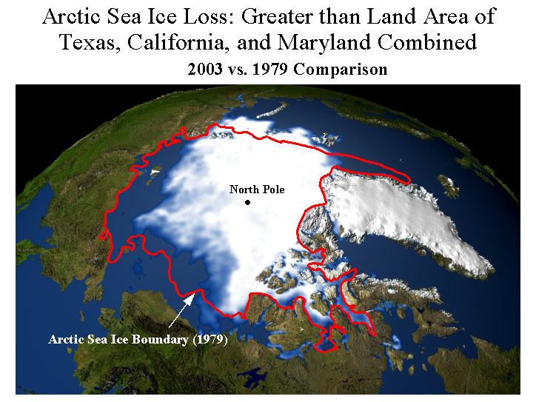
Warming of poles and loss of sea ice
Collapse of Wilkins Ice Shelf, Antarctica
http://earthobservatory.nasa.gov/Study/WilkinsIceSheet/
Notes:
Wilkins Ice Shelf (indication of increasing warming temps/happening quicker than expected – scientists did not expect ice shelf to break for another 15 years)
Arctic temperature has increased at twice global average rate in past 100 years
Average Arctic sea ice extent has shrunk by 2.7% per decade
Aerial foto- intact on Feb 28th- top is intact; bottom is with all of the debris
part that broke off (160 square miles) is 7 times size of manhattan
Warming expected to be greatest at the poles (2-3X global average) and least in the tropics
a
Warming of the Artic slide 9
Artic temperatures increased at twice the global average rate in the past 100 years.
Average Artic sea ice xtent has shrunk by 2.7% per decade
Collapsing ice shelves in the Antartic slide 10 (or combine with slide 9)
Mention recent collapse of the large ice shelf in Antartic
left graphic (http://www.ipcc.ch/graphics/gr-ar4-syr.htm)
Mountain glaciers and snow cover have declined
The Arctic provides a striking illustration of the impacts of climate change on people and places. Sea ice has shrunk substantially, and coastal ice melts three weeks earlier than it did just 30 years ago. The area of sea lost since 1979 is greater than California, Texas and Maryland combined.
The bald truth is that Earth’s polar ice caps are melting at an alarming rate. The cause? Global climate change.

Slide 13
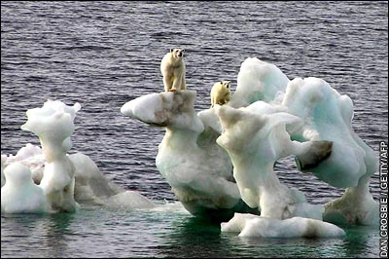
Changes in ecosystems
Earlier timing of spring events
Poleward and upward shifts in plant and animal communities
Loss of polar and montane habitats

Slide 14
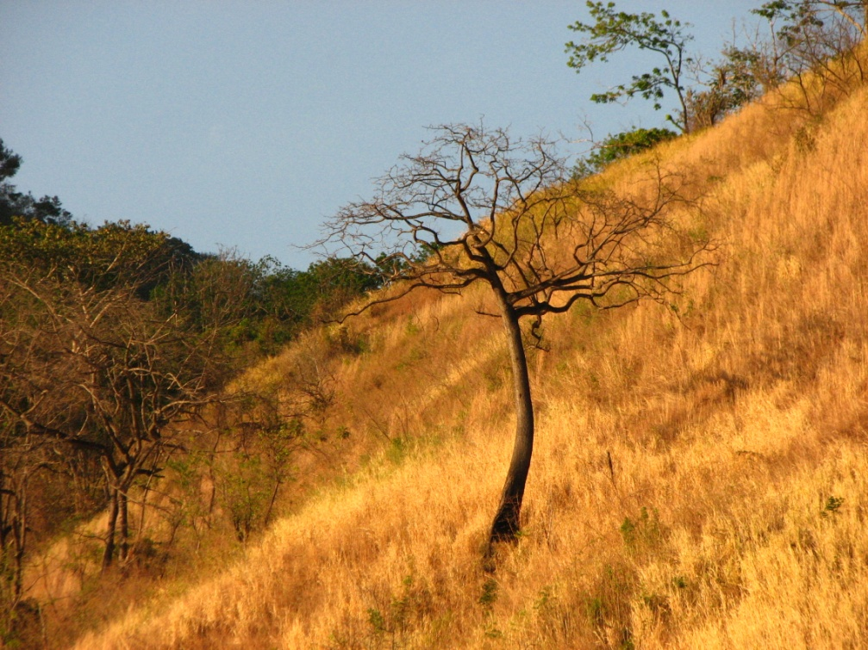
Part 2:
What causes climate change and where are greenhouse gas emissions occurring?

Slide 15
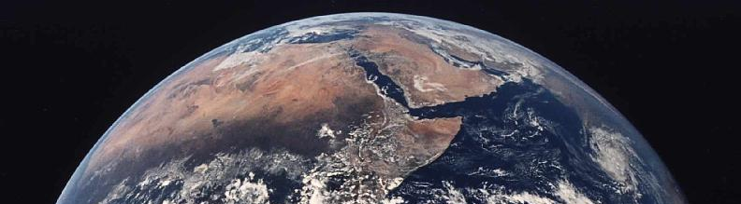
What is causing climate change?
The natural greenhouse effect
Some energy is reflected back into space
Solar energy from the sun passes through the atmosphere
Greenhouse Gases (GHGs) trap some of the heat, warming the earth
GHGs
Earth’s surface is heated by the sun and radiates out heat back towards space

Slide 16
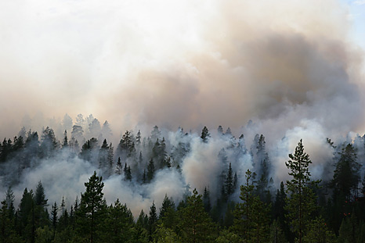
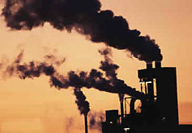
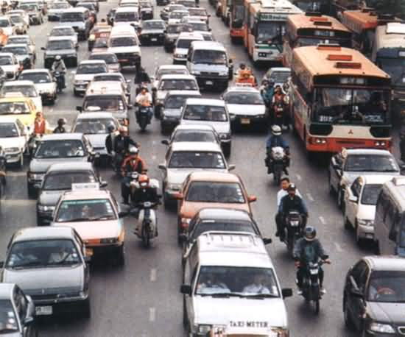
The enhanced greenhouse effect
Less infrared radiation (heat) escapes to space
Higher levels of GHGs trap more heat in atmosphere, leading to temperature increases
GHGs
GHGs
GHG
GHG
GHG

Slide 17
What human activities generate GHGs?
Greenhouse Gas | Industrial Sources | Land Use Sources
Carbon dioxide (CO₂) | fossil fuel combustion and cement manufacturing | Deforestation and burning of forests
Methane (CH₄) | Landfills, coal mining, natural gas production | Conversion of wetlands Rice paddies Livestock production
Nitrous oxide (N₂O) | Fossil fuel combustion Nitric acid production | Fertilizer use Burning of biomass
Hydrofluorocarbons (HFCs) | Industrial processes Manufacturing | ---
Perfluorocarbons (PFCs) | Industrial processes Manufacturing | ---
Sulphur hexafluoride (SF₆) | Electrical transmission and distribution systems | ----
Notes:
N₂O, HFC, PFC, SF₆ info from http://www.epa.gov/climatechange/glossary.html#N2O

Slide 18
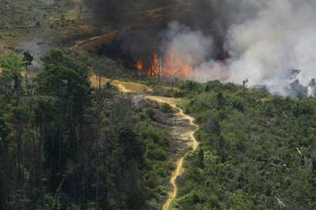
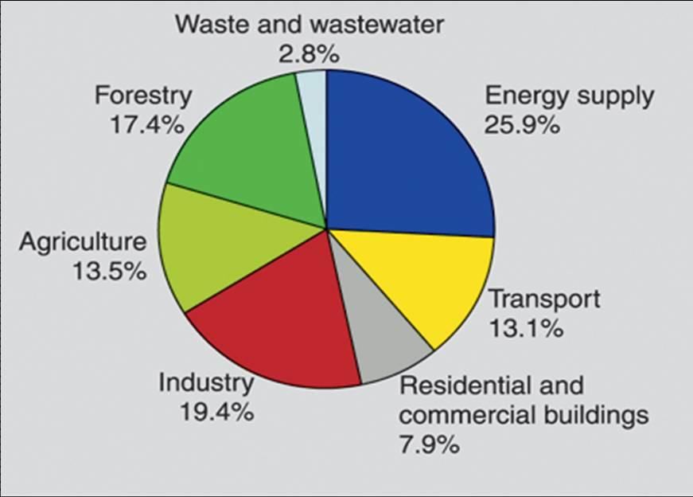
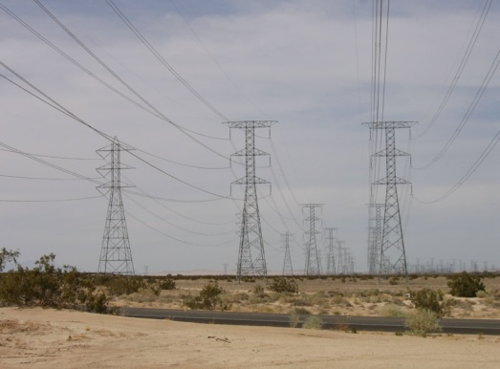
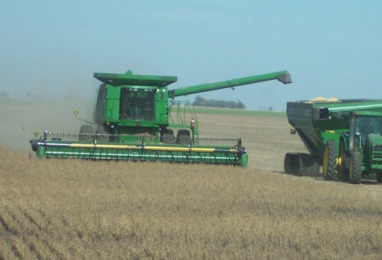
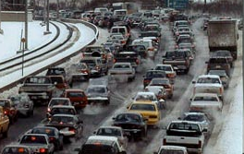
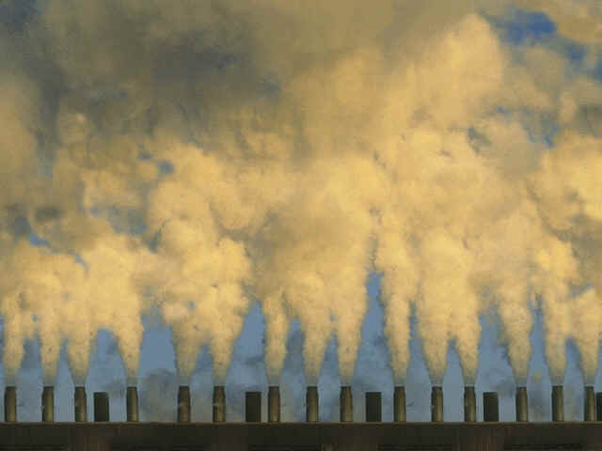
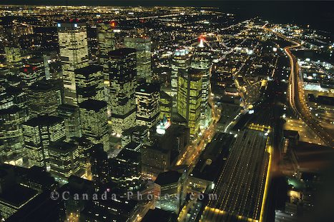
Which sectors produce greenhouse gases?
Source: IPCC Fourth Assessment Report, 2007
Notes:
(smokestacks: www.nasa.gov; cars: www.cwac.net; fires: www.greeenpeace.org.uk; tractor: www.state.sd.us/DOA/;

Slide 19
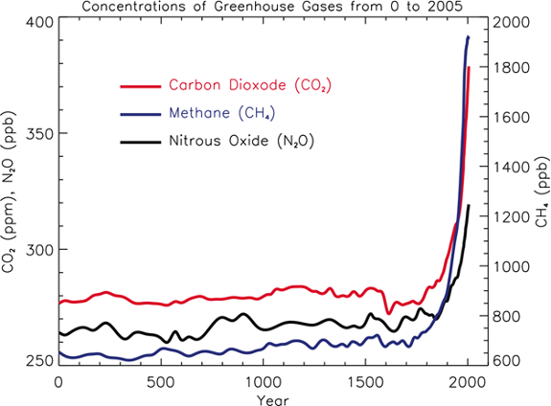
How rapidly are GHG concentrations rising?
Start Industrial
era
CO₂ levels are the highest in last 650,000 years
In the last 50 yrs, CO₂ levels have grown more rapidly than ever before
CO₂ levels are increasing 1.5- 2 ppm/yr
Notes:
Current data (379 ppm) from: http://www.ipcc.ch/cc_science_paris0707.ppt#344,2,Slide 2

Slide 20
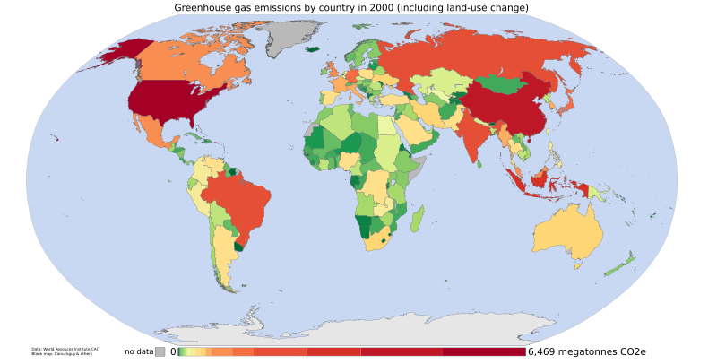
Where are greenhouse gases being emitted?
Low
emissions
High
emissions
Source: World Resources Institute's CAIT 4.0 database
Notes:
All countries emit GHG’s and contribute to climate change, but levels vary greatly

Slide 21
The sources of emissions differ across developing versus developed countries
Sources of emissions
Greatest source of GHG = fossil fuels
Land use change (deforestation) is a major source (second only to fossil fuels)
Source: World Resource Institute (Navigating the numbers)
Notes:
“Navigating the Numbers: Greenhouse Gas Data and International Climate Policy”
World Resources Institute
Kevin A. Baumert, Timothy Herzog, and Jonathan Pershing
http://www.wri.org/climate/pubs_description.cfm?pid=4093 Accessed 10/16/07
th

Slide 22
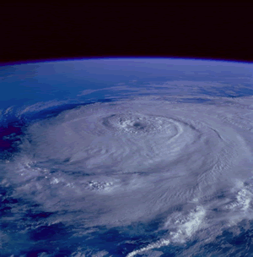

Part 3:
Forests in the global carbon cycle

Slide 23
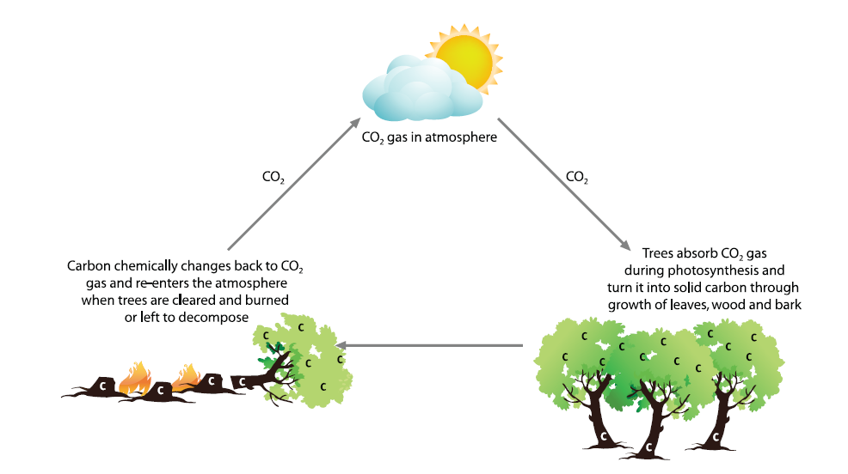
Forests Store and Emit Carbon
Notes:
Forests play a dual role in climate change. Forests can be a source of greenhouse gases, emitting carbon dioxide to the atmosphere when they are burned or destroyed and forests can also act as a “sink,” removing carbon dioxide from the atmosphere and storing it as carbon in their biomass as they grow.
Forests and other terrestrial systems annually absorb approximately 2.6 gigatons of carbon (GtC), or 9.53 gigatons of carbon dioxide equivalent (GtCO2e),7 while deforestation and degradation of forests emit approximately 1.6GtC (5.87 GtCO2e), for net absorption of 1GtC (3.67 GtCO2e) (IPCC, 2007a).
The 1.6GtC emitted by deforestation and degradation of forests accounts for 17.4 percent of total emissions from all sectors, more than the emissions of the entire global transportation sector (see Figure 6) (IPCC, 2007b).
Source: N. Virgilio, TNC

Slide 24

Extent of forests globally
30% of earth’s land surface is forest (4 billion hectares)
Forest area by biome
 | Area forest cover
Tropical |  | 16~17 M km2
Temperate |  | 9~10 M km2
Boreal |  | 15~16 M km2
Source: G. B. Bonan Science 320, 1444 -1449 (2008)
Notes:
About 4 billion hectares of the earth’s surface is forest. Much of the world’s remaining forest cover is in the tropics, approximately 16 to 17 million km 2 (or 1.6 to 1.7 billion hectares). Boreal forest area is nearly as vast, however the extent of land use change in the boreal forest (primarily through burning, logging, and pest) is not of the same magnitude.

Slide 25
Forest carbon globally
45% of terrestrial carbon is stored in earth’s forests
Carbon stock by biome
 | % terrestrial C
Tropical |  | ~25%
Temperate |  | ~10%
Boreal |  | ~5%
Forests absorb 2.6 gigatons C (9.5 gT CO2) per year
Emissions from tropical deforestation 1.5 gigatons C per year
Source: G. B. Bonan Science 320, 1444 -1449 (2008)
Notes:
Forests absorb tremendous quantities of CO2. It is estimated that Earth’s forests can sequester 33% of human-caused emissions. Forests have their work cut out for them. The trouble is that the increasing production of human-caused emissions is projected to far out pace the storage capacity of forests, unless there is dramatic change that leads to stopping deforestation. More than 80% of the emissions from land use change come from developing country forests.
Forests and peatlands store more than twice the global total of CO2e in the atmosphere, or more than 100 years of human emissions. Tropical forests are one of the world’s most productive long-term carbon sinks – stopping deforestation is thus an urgent priority – to reduce their role as the most productive CO2 sources.

Slide 26
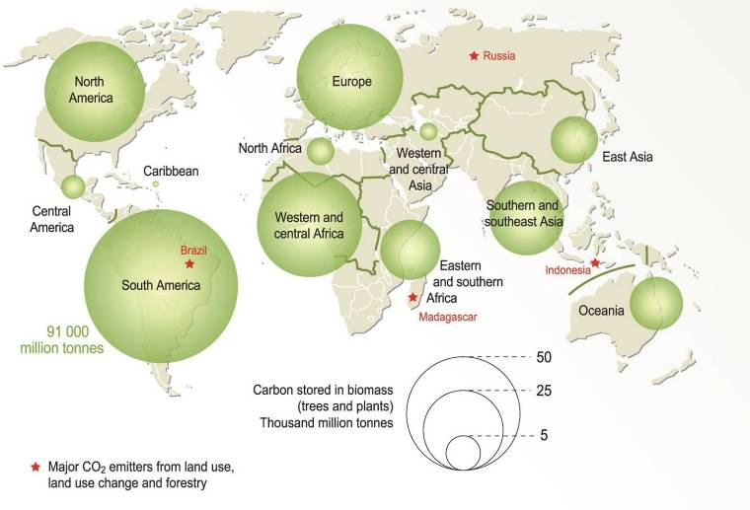
Carbon Stored in the World Forests
Notes:
Source: Bournay, E., UNEP/GRID-Arendal, http://maps.grida.no/go/graphic/carbon-inventory

Slide 27
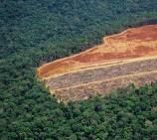
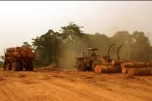
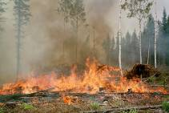
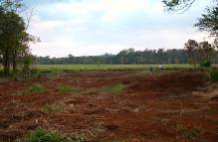
Human Intervention
Emissions (GtC yr^{–1}) due to changes in land use (IPCC 2007)
Human activities causing CO2 emission
Deforestation
Timber harvesting
Soil degradation
Fire

Slide 28

Part 6:
Climate change mitigation through forestry

Slide 29
Options for mitigating climate change
Increasing carbon sinks
Ecosystem service: carbon sequestration
Avoiding reducing sinks
Mitigation Activities
Reducing emissions from productive activities
Ecosystem service: emissions reduction
Bioenergy and biofuels

Slide 30
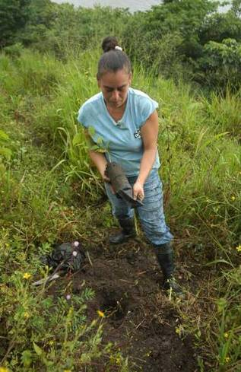
Rates of carbon sequestration: Afforestation/Reforestation
t CO2/ha/yr captured
2 - 7
7 - 26
15 – 51
7 - 15
11 - 44
Planted Forest Type | t C/ha/yr Captured
Boreal – 60 year rotation | ½ - 2
Temperate – 15 to 60 year rotation | 2 – 7
Tropics – Eucalyptus, 5 – 16 year old | 4 - 14
Tropics – Teak, 25 – 75 years old | 2 – 4
Tropics – Pine, 5 – 30 years old | 3 - 12
Notes:
The amounts of carbon that can be sequestered are greatest, as seen here, from planting trees in the tropics. Naturally, the fast growing species, such as eucalyptus and pine will capture the most carbon.

Slide 31
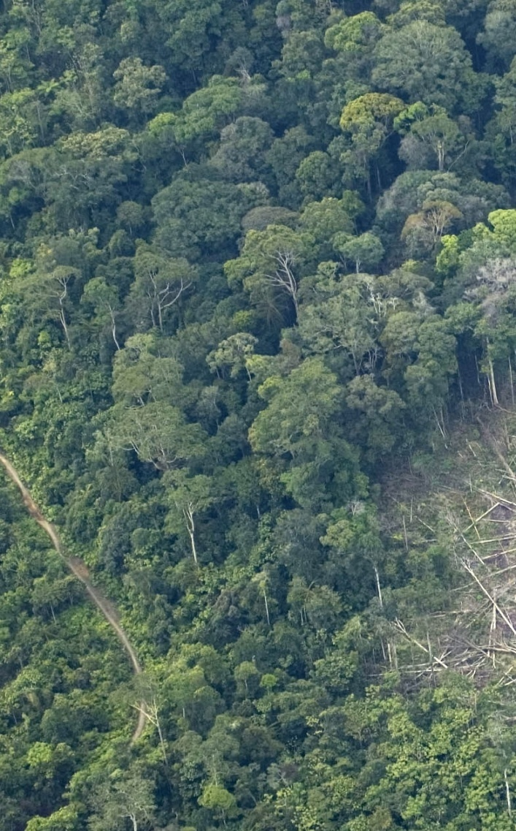
Rates of emissions reductions: Avoided Deforestation
t CO2/ha avoided
569 - 734
220 - 257
92 - 184
330 - 569
231 - 350
350 - 734
81 - 147
Tropical Forest Type | t C/ha avoided
Africa - lowland moist forest | 155-200
Africa - seasonal forest | 60-70
Africa - dry forest | 25-50
America - lowland moist forest | 90-155
America - secondary or logged | 63-95
Asia - lowland moist forest | 95-200
Asia - dry forest | 22-40
Notes:
The amounts of CO2 that can be conserved through avoiding deforestation are greatest in the lowland moist forests (rainforests) of the tropics.

Slide 32
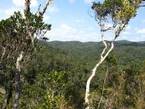
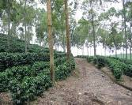
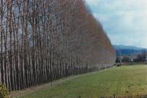
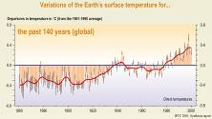
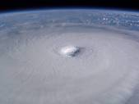
Forests and Climate Change: Mitigation & Adaptation
Remove carbon from the atmosphere, reduce green house gas
emissions from deforestation
MITIGATION
Natural forest, forest plantation, agroforestry systems, agricultural systems, etc.
Climate change
ADAPTATION
Reduce climate change impacts and vulnerability

Slide 33
Conclusions
There are already clear signs of climate change
These changes impact all regions of the world and almost all aspects of human life
The rate of climate change and its impacts are projected to increase significantly over the next few decades
Urgent and immediate action is required both to mitigate the rate of climate change, and to help communities adapt to the ongoing changes
Deforestation and land use change contributes approx. 20% of global GHG emissions
Forest conservation, restoration and reforestation can help mitigate climate change by reducing emissions and increasing CO2 uptake (but other mitigation options are also necessary).
Notes:
There are already clear signs of significant climate change- from increasing temperatures to melting glaciers to rising sea levelsMitigation efforts over the next 2-3 decades will largely determine the long-term increases in temperature and the corresponding climate change impacts

Slide 34







Thank you!
REDD Training Course

Slide 35
Some useful references
Houghton, John Theodore. Global warming: the complete briefing. 2nd ed. Cambridge U.K.; New York: Cambridge University Press, 1997.
Climate Change 2007: The Physical Science Basis.
  Fourth Assessment Report of the Intergovernmental Panel on Climate Change (IPCC, 2007): http://www.ipcc.ch/
Climate Change Science from the UNFCCC
  Website with information and links: http://unfccc.int/essential_background/background_publications_htmlpdf/items/2625.php
Climate Change and Biodiversity
  Book by Thomas Lovejoy and Lee Hannah (2005)
CICERO - Center for International Climate and Environmental Research
  http://www.cicero.uio.no/home/index_e.aspx
Climate Change Science Blog
  http://www.realclimate.org/

Slide 36
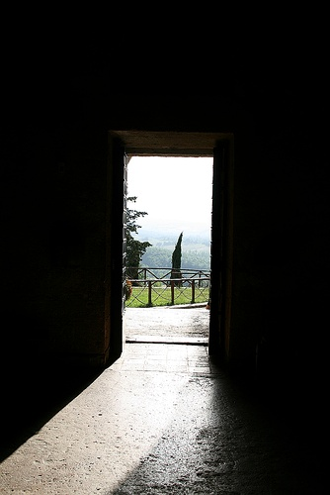
Contributors
Contributors to this presentation include:
  Mario Chacon, Conservation International
  Jeff Hayward, Rainforest Alliance
  Olaf Zerbock, Conservation International
  Celia Harvey, Conservation International

