Slide 1
Advanced Research Methods
General Course Description:
Definition of research;
Concept of research;
Basic concepts and definitions of natural resources management and sustainable development
  Classification of Natural Resources
  Natural Resources degradation
  Land (soil) Resources Degradation
  Forest resources degradation
  Water resources degradation
  Environmental degradation
  Sustainable natural resources management

Slide 2
Concepts of research methods in Environment and Climate change
Experimental designs and layout on natural resources
Research trial and observations;
Collection, processing and analysis of data;
Measures of experimental variability;
Research planning
Problem identification
Writing research proposals
Experimentation
  Experimental designs for single-factor experiments in NRM
  Experimental designs for two-factor experiments in NRM
  Managing Field experiments
  Managing Greenhouse experiments
  Managing Laboratory experiments

Slide 3
Data analysis and Interpretation
Missing data and Data trend analysis
Data analysis :
  Analysis of variance (ANOVA)
  Mean separation
  Correlation and regression analysis
  t-test
  Chi square test
  Statistical packages (SPSS, SAS, MS-Excel)
Interpretation
Interpretation and summarization of results;
Scientific report writing and
developing a research proposal
Presentation of research results

Slide 4
General Objectives
To familiarize students about
Research methodology,
Develop and improve skills in scientific writing
To evaluate and explain the relevance of published work in the context of their own research interests;
Chosen topics and be able to create hypotheses of their own when literature doesn’t exist.
Effectively and systematically perform a literature search for primary research articles related to their own chosen topics

Slide 5
Conti.
Your research method depends on
The question that you wish to answer, and
The philosophy that underpins your view of research
The best place to start is introduction to research methods
This sets out
The basic principles of research design, and
The role of the researcher.
Overall to introduce about designing research which explains how to approach research, and what to think about in designing your research.
It sets out some possible research approaches, including experimental and quasi-experimental designs, survey research
Then you need to make a decision about whether your research will be quantitative or qualitative or mixed or ….

Slide 6
CHAPTER 1. THE PHILOSOPHY OF RESEARCH
1.1. Definitions of Research
What is a research?
Why a research / the need for research?
1.2. Differentiating research methods and research methodology

Slide 7
Definition of research
Research is an essential and powerful tool in leading man Towards progress
From its name, the word ‘Research’ is comprises of two words = Re + Search. Meaning to search again.
It is a systematic investigation or activity to gain new knowledge of the already existing facts.
Research is responsible for bringing to light new knowledge.
It is responsible for correcting the present mistakes, removing existing misconceptions and adding new learning to the existing fund of knowledge.
Towards a new approach (i.e. from conventional to scientific) and new world
Without systematic research there would have been very little progress.

Slide 8
Additional definitions
As John W. Best; “The secret of our cultural development has been research, pushing back the areas of ignorance by discovering new truths, which, in turn, lead to better ways of doing things and better products.”
“Research is an endeavor / attempt to discover, develop and verify knowledge. It is an intellectual process that has developed over hundreds of years ever changing in purpose and form and always researching to truth.”
J. Francis Rummel, Research is: An honest, exhaustive, intelligent searching for facts and their meanings or implications with reference to a given problem.
P.M. Cook : “Research may be defined as a method of studying problems whose solutions are to be derived partly or wholly from facts.”

Slide 9
Conti.
W.S. Monroes : “Research is considered to be the more formal, systematic intensive process of carrying on the scientific method of analysis.
It involves a more systematic structure of investigation, usually resulting in some sort of formal record of procedures and a report of results or conclusion.”
John W. Best :“Research comprises defining and redefining problems, formulating hypothesis or suggested solutions, collecting, organizing and evaluating data, making deductions and reaching conclusions and at last careful testing the conclusions to determine whether they fit the formulated hypothesis.”

Slide 10
Conti.
Clifford Woody: “Research is a systematic effort to gain new knowledge.”
P.V. Younge : Scientific research leads to progress in some field of life to fined new products, new facts, new concepts and new ways of doing things are being found due to ever-increasing significant research in the physical, the biological, the social and the psychological fields.

Slide 11
Researches are
Considered as a combination of those activities which are removed from day to day life and are pursued by those persons who are gifted in intellect and sincere in search of knowledge.
But it is not correct to say that the research is restricted to such type of persons, however, it is correct to say that major contribution of research comes from highly gifted and committed workers
Because it needs a comprehensive approach's through employing various discipline
Thus the research is not at all mysterious and is carried on by hundreds of thousands of average individuals.

Slide 12
Conti.
Research is also considered as the application of scientific method in solving the problems.
It is a systematic, formal and intensive process of carrying on the scientific method of analysis.
There are many ways of obtaining knowledge.
They are intuition, exposure, and authority, logical manipulation of basic assumptions, informed guesses, observation, and reasoning by analogy.
E.g. Aquifer system can be compared to bank account
Groundwater in the aquifer is analogous to the many in the account
One of the branches of research known as empirical research is highly goal-oriented technique.

Slide 13
Purpose of Research
The purpose of research is to discover answers to questions through the application of scientific procedure.
The main aim of research is to find out the truth which is hidden and which has not been discovered as yet. Though each research study has its own specific purpose, some general objectives of research below:
To gain familiarity with a phenomenon or to achieve new insights into it. (Studies with this object in view are termed as exploratory or formative research studies).
To portray accurately the characteristics of a particular individual, situation or a group. (Studies with this object in view are known as descriptive research studies).
To determine the frequency with which something occurs or with which it is associated with something else.
To test a hypothesis of a causal relationship between variables. e.g. relation between groundwater-climate and human impacts

Slide 14
Characteristics of Research
Research has its own characteristics:
Research is directed toward the solution of a problem.
Research requires expertise.
Research emphasizes the development of generalizations, principles, or theories that will be helpful in predicting future occurrences.
Research is based upon observable experience or empirical evidences.
Research demands accurate observation and description.

Slide 15
Research
involves gathering new data from primary or first-hand sources or
using existing data for a new purpose.
is characterized by carefully designed procedures that apply rigorous analysis.
involves the quest for answers to un-solved problems.
strives to be objective and logical, applying every possible test to validate the procedures employed the data collected and the conclusions reached.
is needs carefully recorded and collected data.

Slide 16
Research steps
Research process consists of series of actions or robust steps
These actions or steps are:
Formulating the Research Problem
At the very outset, the researcher must decide the general area of interest or aspect of a subject matter that he would like to inquire into and then research problem should be formulated.
Usually, begins with problem observations followed by Identification of topics relevant to the observed problems

Slide 17
Problems
The problems lie everywhere around us.
They even lie at our door step and in our backyards. Human nature is so complicated, that
A problem solved for one individual may still exist for another individual,
A problem solved for one class/ school/teacher/ situation/ system/time etc., still remains
A problem solved for the time being may reappear with a lapse of time.
We become habitual of living in the age of problems i.e. we are so much surrounded by the problem that we suffers from ,”problem blindness”.
But in order to solve the problem or making research we need to demarcate the problem.

Slide 18
Selection of problems
Selection of problem is not the first step in research but identification of the problem is the first step in research.
Selection of problem is governed by reflective thinking. It is wrong to think that identification of a problem means to select a topic of a research or statement of the problem.
A topic or statement of the problem and research problem are not the synonyms but they are inclusive / or comprehensives.
The problem concerns with the functioning of the broader area of field studied, whereas a topic or title or statement of the problem is the verbal statement of the problem.
The topic is the definition of the problem which delimits or pin points the task of a researcher.
e.g. the problem is groundwater deteriorations, then come to the title and topics

Slide 19
Conti.
It is the usual practice of the researcher that they select the topic of the study from different sources especially from research abstracts.
They do not identify the problem, but a problem is made on the basis of the topic.
It results that they have no active involvement in their research activities, whatever, they do, do mechanically.

Slide 20
Definitions of the Problem:
The obstacles which hinder our path are regarded as problem. Different definitions of the problem by different authors are given below;
John Geoffery: “Problem is the obstacle in the path of satisfying our needs.”
John. G. Tornsand : “Problem is a question which is to be solved.”
Whitney: “To define a problem means to put a fence around it, to separate it by careful distinctions from like questions found in related situations of need.”
J.C. Townsend: “A problem is a question proposed for a solution generally speaking a problem exists when there is a no available answer to same question.”
F.N. Kerlinger: “A problem is an interrogative sentence or statement that asks: What relation exists between two or more variables?”

Slide 21
Conti.
Monero and Engelhart: “To define a problem means to specify it in detail and with precision each question and subordinate question to be answered is to be specified, the limits of the investigation must be determined.
Frequently, it is necessary to review previous studies in order to determine just what is to be done. Sometimes it is necessary to formulate the point of view or educational theory on which the investigation is to be based. If certain assumptions are made, they must be explicitly noted.”

Slide 22
Identification of a Research Problem:
Steps to be followed in identifying a research problem;
Determining the field of research in which a researcher is powerful to do the research work.
The researcher should develop the mastery on the area or it should be the field of his specialization.
He should review the research conducted in area to know the recent trend and studies are being conducted in the area.

Slide 23
Conti.
On the basis of review, he should consider the priority field of the study.
He should draw an analogy and insight in identifying a problem or employ his personal experience of the field in locating the problem. He may take help of supervisor or expert of the field.
He should pin point specific aspect of the problem which is to be investigated.

Slide 24
Sources of the Problem:
The classroom, school, home, community and other agencies of education are obvious sources.
Social developments and technological changes are constantly bringing forth new problems and opportunities for research.
Record of previous research such specialized sources as the encyclopedias of educational, research abstracts, research bulletins, research reports, journals of researches, dissertations and many similar publications are rich sources of research problems.

Slide 25
Problem source
Text book assignments, special assignments, reports and term papers will suggest additional areas of needed research.
Discussions-Classroom discussions, seminars and exchange of ideas with faculty members and fellow scholars and students will suggest many stimulating problems to be solved, close professional relationships, academic discussions and constructive academic climate are especially advantageous opportunities.
Questioning attitude: A questioning attitude towards prevailing practices and research oriented academic experience will effectively promote problem awareness.

Slide 26
Conti.
The most practical source of problem is to consult supervisor, experts of the field and most experienced persons of the field. They may suggest most significant problems of the area. He can discuss certain issues of the area to emerge a problem.
Although research problems should not be assigned or they should not be proposed and allotted by a guide but consultation with the more experienced faculty member or research worker is a desirable practice.
One of the most important functions of the research guide is to help the student clarify his thinking, achieve a sense of focus and develop a manageable problem from one that may be vague and too complex.

Slide 27
Statement of the Problem:
Kerlinger has identified following three criteria of good problem statements;
A problem should be concerned with relation between two or more variables.
It should be stated ‘clearly and unambiguously in question form’.
It should be amenable/ or willing or agreeable to empirical testing.
Meeting these criteria in his problem statement will result, in a clear and summarized idea of what the researcher wants to do. This sets the state for further planning.

Slide 28
Research Assumptions
Any research and its method incorporate several assumptions and approximations that may not represent the real world particularly with parameter estimation, recharge estimation, data inadequacy and errors.
Because it is quite difficult to represent all valuable hug data sets accurately or it is not feasible to feed the complexities of the natural system in to a computer model.
Instead simplifying the actual system being examine and organizes the data via inclusions of assumptions is necessary so the system can be analyzed effectively.
e.g. Model conceptualizing that aids to simplify the field problem and organize the associated field data so that the system can be analyzed more easily in a better understanding manner of site condition
However, apart from to data adequacy and quality, skills and level of details; reliability of the result depends on the dimension of the designed assumptions

Slide 29
Objectives of Assumptions about the Problem:
1. To make the research work feasible.
2. To delimit the scope of the problem.
e.g. aquifer boundary conditions
3. To establish the proper frame of reference
e.g. model framework
Aspects of Delimiting/ or delineating or bounding / demarcating a Problem:
1.Bound to certain variables that should be mentioned clearly in the problem.
2.Bound to the area or level as primary level, secondary level, college or university level.
3.Bound to size of sample, considering the time, energy and money.

Slide 30
Conti.
4. Delimited to the best method only.
5. Delimited to the best available tool for measuring the variable. E.g. available model type, skill or familiarize with the model
6. Delimited to the most appropriate techniques.
7. Other delimitations particular to a problem.
As the above delimitations help the researcher for conducting the study, the findings of studies also confine to these delimitations.

Slide 31
Evaluation of the Problem:
When considering a problem a researcher is required to ask himself a series of questions about it. These are helpful in the evaluation of the problem on the basis of personal suitability of the researcher and social value of the problem.
Following questions must be answered affirmatively before the study is under Taken:
1. Is the Problem Researchable?
2. Is the Problem New?

Slide 32
Conti.
3. Is the Problem Significant?
4. Is the Problem Feasible for the Particular Researcher?
In order to be feasible, a problem should agree with the following:
a) Research competencies of the Researcher
b) Interest & enthusiasm / eagerness of the Researcher
c) Financial consideration in the Project
d) Time requirement for the Project
e) Administrative considerations in the Project.

Slide 33
2. Extensive Literature Survey:
Once formulated the problem; the researcher should undertake extensive literature survey connected with the problem.
For this purpose, the abstracting and indexing journals and published or unpublished bibliographies are the first place to go to academic journals, conference proceedings, government reports, books etc. must be tapped depending on the nature of the problem.
Review literature relevant to their field or interests and determine how research findings are useful in forming their understanding of their work, social, local and global environment.

Slide 34
3. Development of Working Hypothesis:
After extensive literature survey, researcher should state in clear terms the working hypothesis or hypotheses.
e.g. what are the possible derivers for decaling of water table over an area under consideration?
Or possible factors led to dry surface water (lake, etc.)
Working hypothesis is tentative assumption made in order to draw out and test its logical or empirical consequences. It’s very important or it provides the focal point for research.

Slide 35
Formulation of Hypothesis
The word hypothesis consists of two words –Hypo + Thesis. ‘Hypo’ means tentative or subject to the verification.
‘Thesis’ means statement about solution of the problem.
Meaning of the term hypothesis is a tentative statement about the solution of the problem.
Hypothesis offers a solution of the problem that is to be verified empirically and based on some rationale.
Again, ’hypo’ means the composition of two or more variables which are to be verified and ‘thesis’ means position of these variables in the specific frame of reference.

Slide 36
There are a number of definitions about hypothesis
J.S. Mill: “Any supposition which we make in order to endeavor to deduce conclusions in accordance with facts which are known to be real under the idea that if the conclusions to which the hypothesis leads are known truths, the hypothesis itself either must be or at least likely to be true.”
Lundberg: “A hypothesis is a tentative generalization the validity of which remains to be tested. In its most elementary stage the hypothesis may be any hunch, guess, imaginative idea which becomes basis for further investigation.”

Slide 37
Definitions of hypothesis
Barr and Scates: “A hypothesis is a statement temporarily accepted as true in the light of what is, at the time, known about a phenomenon, and it is employed as a basis for action in the search for new, truth, when the hypothesis is fully established, it may take the form of facts, principles and theories.”
Gorge J. Mouly: “Hypothesis is an assumption whose testability is to be tested on the basis of the compatibility of its implications with empirical evidence and previous knowledge.”

Slide 38
Functions of Hypothesis:
Hypothesis may have several functions
It is a temporary solution of a problem concerning with some truth which enables an investigator to start his research works.
(ii) It offers a basis in establishing the specifics what to study for and may provide possible solutions to the problem.
(iii) It may lead to formulate another hypothesis.
(iv) A preliminary hypothesis may take the shape of final hypothesis.

Slide 39
Conti.
(v) Each hypothesis provides the investigator with definite statement which may be objectively tested and accepted or rejected and leads for interpreting results and drawing conclusions that is related to original purpose.
(vi) It sensitizes the researcher so that he should work selectively, and have very realistic approach to the problem.
(vii) It offers the simple means for collecting evidences for verification.

Slide 40
Generally,
Without hypothesis, a research is unfocussed research and remains like a random empirical wandering.

Slide 41
Forms of Hypothesis:
(i) Question form:
A hypothesis stated as a question represents the simplest level of empirical observation. It fails to fit most definitions of hypothesis. It frequently appears in the list. There are cases of simple investigation which can be adequately implemented by raising a question, rather than dichotomizing the hypothesis forms into acceptable / reject able categories.

Slide 42
Conti.
(ii) Declarative Statement : A hypothesis developed as a declarative statement provides an anticipated relationship or difference between variables. Such a hypothesis developer has examined existing evidence which led him to believe that a difference may be anticipated as additional evidence. It is merely a declaration of the independent variables effect on the criterion variable.
(iii) Directional Hypothesis : A directional hypothesis connotes an expected direction in the relationship or difference between variables. This type of hypothesis developer appears more certain of anticipated evidence. If seeking a tenable hypothesis is the general interest of the researcher, this hypothesis is less safe than the others because it reveals two possible conditions. First that the problem of seeking relationship between variables is so obvious that additional evidence is scarcely needed. Secondly, researcher has examined the variables very thoroughly and the available evidence supports the statement of a particular anticipated outcome.

Slide 43
Conti.
(iv) Non –Directional Hypothesis or Null Hypothesis: This hypothesis is stated in the null form which is an assertion that no relationship or no difference exists between or among the variables.
Null hypothesis is a statistical hypothesis testable within the framework of probability theory. It is a non-directional form of hypothesis.

Slide 44
Conti.
There is a trend to employ or develop null hypothesis in research in most of the disciplines. A null hypothesis tentatively states that on the basis of evidence tested there is no difference.
If the null hypothesis is rejected, there is a difference but we do not know the alternative or the differences. In this the researcher has not to anticipate or give the rational for the declaration or directional form. It does not make researcher biased or prejudiced.
you may be objective about the expected outcomes of the research or findings.

Slide 45
Identifications of variables and their types
A Variable is a concept which can take on different quantitative values.
A Variable is a quantity which can vary from one individual to another.
The quantity which can vary from person to person.
It is any feature or aspect of an event, function or process that, by its presence and nature, affects some other event or process, which is being studied.
For example; height, weight, income, age etc.
The main focus of the scientific study is therefore, to analyze the functional relationship of the variables.
Types of variables
(i) Continuous Variable:
It is that which can assume any numerical value within a specific range.
e.g. 10 - 100 (number. Unit or … )

Slide 46
(ii) Discrete Variable:
A variable for which the individual values fall on the scale only with distinct gaps is called a discrete variable.
e.g. 4 – 8; 8 – 12; 12 – 16 ……
(iii) Dependent Variable
If one variable depends or is a consequence of other, it is termed as dependent variable. Criterion variable is the basis on which the effectiveness of the experimental variable is studied.
e.g. groundwater level depends on Human effect, Rainfall, geology, tectonic, ……
Rainfall also depends on Temperature, wind, humidity, location, ….
(iv) Independent Variable or Experimental Variable:
The variable that is antecedent to the dependent variable.
The variable whose effect is going to be known

Slide 47
(v) Controlled Variable:
The effectiveness of an experimental variable is examined by comparing with other variable
e.g. Groundwater level as controlled for model calibration
(vi) Confounding Variable: Those aspects of study or sample, that might influence the dependent variable (outcome measures), and whose effect may be confused with the effects of the independent variable.
Especially if more variables are difficult to simulate
E.g. land use in GW level (difficult to model), irrigation back water on recharge
Two types: Intervening and extraneous variable.
(vii) Intervening Variable: There are a number of abstract variables in educational/social experiments, which intervene the effect of experimental or criterion variable.
For controlling intervening variable appropriate research design should be used. Intervening variables are hard if not impossible, to observe because they usually have to do with an individual’s feelings like stress, fatigue, excitement ….. etc.

Slide 48
(viii) Extraneous Variable:
Independent variables that are not related to the purpose of the study, but may affect the dependent variable
e.g. watershed management, back recharge from irrigation
Whatever effect is noticed on dependent variable as a result of extraneous variable(s) is technically described as an ‘experimental error.’
A study must always be so designed that the effect upon the dependent variable is attributed entirely to the independent variables and not to some extraneous variable(s).
When the dependent variable is not free from the influence of extraneous variable(s), the relationship between the dependent and independent variable is said to be confounded by an extraneous variable(s).

Slide 49
Conti.
Actually this is a statistical hypothesis which is self- explanatory. Null hypothesis means zero hypotheses. A researcher has not to do anything in developing it. While research hypothesis is second step in the process of reflective thinking.
A null hypothesis in an appropriate form is order to accommodate the object of inquiry for extracting this information. It does not necessarily reflect the expectations of the researcher so much as the utility of the null form as the best fitted to the logic of chance in statistical knowledge or science.
It is the no difference form, i.e. there is no difference or relationship between or among variables under certain conditions.

Slide 50
Conti.

Slide 51
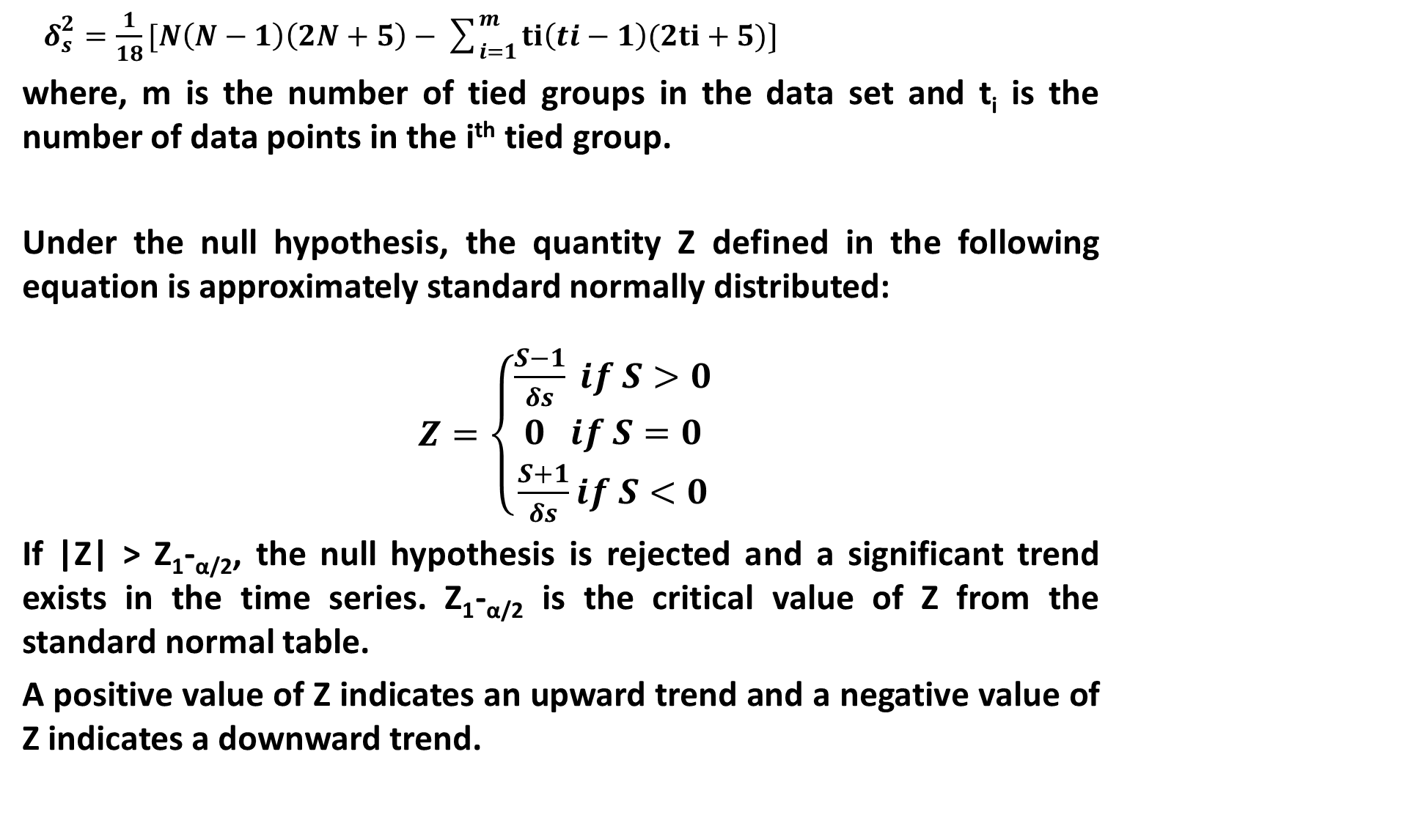
the variance of S, Var (S), for the situation where there may be ties (i.e., equal values) in the x values is given by
$δ_{s}^{2}=\frac{1}{18}[N\left(N−1\right)\left(2N+5\right)−\sum_{i=1}^{m}{ti\left(ti−1\right)(2ti+5)〕}$
where, m is the number of tied groups in the data set and t_{i} is the number of data points in the i^{th} tied group.
Under the null hypothesis, the quantity Z defined in the following equation is approximately standard normally distributed:
$Z=\left\{\begin{aligned}\frac{S−1}{δs} if S>0 \\ 0 if S=0 \\ \frac{S+1}{δs}if S<0\end{aligned}\right.$
If |Z| > Z₁-_{α/2}, the null hypothesis is rejected and a significant trend exists in the time series. Z₁-_{α/2} is the critical value of Z from the standard normal table.
A positive value of Z indicates an upward trend and a negative value of Z indicates a downward trend.

Slide 52
Difficulties in the Formulation of Useful Hypothesis:
difficulties in the formulation of hypothesis:
1. Absence of knowledge of a clear theoretical framework. E.g. about groundwater potential
2. Lack of ability to make use of the theoretical framework logically.
3. Lack of acquaintance with available research technique resulting in failure to be able to phrase the hypothesis properly.

Slide 53
4th Preparing the Research Design:
Once formulating hypothesis we have to prepare a research design
we have to state the conceptual structure within which research would be conducted
The preparation of such a design facilitates research to be as efficient as possible yielding maximal information.
This helps to provide for the collection of relevant evidence with optimum effort, time and expenditure
But how all these can be achieved depends mainly on the research purpose, level of details and etc.

Slide 54
Research design
A research design is simply the framework or plan for a study that is used as a guide in collecting and analyzing the data. It is a blueprint that is followed in completing a study.
Or a blue print for collection measurement and analysis of data. Actually it is a map that is usually developed to guide the research.
“Research design is a master plan specifying the methods and procedures for collection and analyzing the needed information.”
Or it is, structure and strategy of investigation conceived so as to obtain answers to research questions and to control variance.”
e.g. Evaluation of groundwater potential and the prioritized chapters

Slide 55
Generally,
Thus we can say that a research design is the arrangement of condition for collection and analysis of data in a manner that aims to generalize the findings of the sample on the population.
Purpose of a Research Design:
(i) To minimize the expenditure:
Research design carries an important influence on the reliability of the results attained. It therefore provides a solid base for the whole research.

Slide 56
Conti.
(ii) To facilitate the smooth scaling:
Research design is needed because it facilitates the smooth scaling of the various research operations, thereby making research as efficient as possible yielding maximal information with minimal expenditure of effort, time and money.
(iii) To collect the relevant data and technique:
Research design stands for advance planning of the methods to be adopted for collecting the relevant data and the techniques to be used in their analysis, keeping in view the objective of the research and the availability of staff time and money. Poor preparation of research design upset the entire project.

Slide 57
Conti.
(iv) To provide blue print for plans:
Research design is needed due to the fact that it allows for the smooth working of many research operations.
Just as for better economical and attractive construction of a house need a blue print and a map of that, similarly we needs a blue print or a design for the smooth flow of operation of research.
(v) To provide an overview to other experts:
A research design provides an overview of all the research process and with the help of the design we can take the help and views of experts of that field .The design helps the investigator to organize his ideas , which helps to recognize and fix his faults.

Slide 58
Conti.
(vi) To provide a direction:
A research design provides a proper or particular direction to the other executives and others who are helping us into the process. The researcher studies available, literature and learns about new (alternative approaches.
Characteristics of Good Research Design:
A good research design minimizes bias and maximizes the reliability of the data collected and analyzed. best design gives the smallest experimental error or
yields maximum information and provides an opportunity for considering different aspects of a problem is considered to be the most appropriate and efficient design.
A good research design possesses the following characteristics;
(i) Objectivity:
It refers to the findings related to the method of data collection and scoring of the responses. The research design should permit the measuring instruments which are fairly objective in which every observer or judge scoring the performance must precisely give the same report. In other words, the objectivity of the procedure may be judged by the degree of agreement between the final scores assigned to different individuals by more than one independent observer. This ensures the objectivity of the collected data which shall be capable of analysis and interpretation.

Slide 59
(ii) Reliability:
It refers to consistency throughout a series of measurements. For example, if a respondent gives out a response to a particular item, he is expected to give the same response to that item even if he is asked repeatedly. If he is changing his response to the same item, the consistency will be lost. So the researcher should frame the items in a questionnaire in such a way that it provides consistency or reliability.
(iii) Validity:
Any measuring device or instrument is said to be valid when it measures what it is expected to measure. For example, an intelligence test conducted for measuring the IQ should measure only the intelligence and nothing else and the questionnaire shall be framed accordingly.

Slide 60
(iv) Generalizability
:
It means how best the data collected from the samples can be utilized for drawing certain generalizations applicable to a large group from which sample is drawn.
e.g. Rainfall data for about 10 years and > 30 years
Thus a research design helps an investigator to generalize his findings provided he has taken due care in defining the population, selecting the sample, deriving appropriate statistical analysis etc. while preparing the research design. Thus a good research design is one which is methodologically prepared and should ensure that generalization is possible. For ensuring the generalization we should confirm that our research problem has the following characteristics;
a) The problem is clearly formulated.
b) The population is clearly defined.
c) Most appropriate techniques of sample selection are used to form an appropriate sample.
d) Appropriate statistical analysis has been carried out.
e) The findings of the study are capable of generalizations.

Slide 61
(v) Adequate Information:
The most important requirement of good research design is that it should provide adequate information so that the research problem can be analyzed on a wide perspective. An ideal design should take into account important factors like;
(i) Identifying the exact research problem to be studied
(ii) The objective of the research
(iii) The process of obtaining information
(iv) The availability of adequate and skilled manpower and
(v) The availability of adequate financial resources for carrying research.
(vi) Other Features:
Some other important features of a good research design are flexibility, adaptability, efficiency, being economic and so on. A good research design should minimize bias and maximize reliability and generalization.

Slide 62
5th Determining Sample Design:
A sample design is a definite plan determined before any data is actually collected for obtaining a sample from a given population.in census inquiry we involve a great deal of time, money and energy so it is not possible in practice under many circumstances.
Sample designs can be either probability or non-probability.
With probability samples each element has a known probability of being included in the sample but the non-probability samples do not allow the researchers to determine this probability.

Slide 63
6th Collecting the Data:
There are several ways of collecting the appropriate data which differ considerably in context of cost, time and other resources at the disposal of the researcher. Primary data can be collected either through experiment or through survey. In case of survey, data can be collected by any one or more of the following ways;
By observation,
• Through personal interview,
• Through telephonic interviews,
• By mailing of questionnaires or
• Through schedules.

Slide 64
7th Execution of a Project
Execution of project is a very important step in the research process. If the execution of the project proceeds on correct lines, the data to be collected would be adequate and dependable.
A careful watch should be kept for unanticipated factors in order to keep the survey realistic as much as possible.

Slide 65
8th Analysis of Data (next chapter)
The analysis of data requires a number of closely related operations such as establishment of categories, the application of these categories to raw data through coding, tabulation and then drawing statistical inference.
Analysis work after tabulation is generally based on the computation of various percentages; coefficients etc., by applying various well defined statistical formulae.
In the process of analysis, relationships of differences supporting or conflicting with original or new hypothesis should be subjected to tests of significance to determine with what validity data can be said to indicate any conclusions.

Slide 66
9th Hypothesis Testing:
After analyzing the data, the researcher is in a position to test the hypothesis, if any, he had formulated earlier. Do the facts support the hypothesis or they happen to be contrary? This is the usual question which is to be answered by applying various tests like ‘t’ test, ’F’ test etc.
F test have been developed by statisticians for the purpose .Hypothesis testing will result in either accepting the hypothesis or in rejecting it. If the researcher had no hypothesis to start with, generalizations established on the basis of data may be stated.

Slide 67
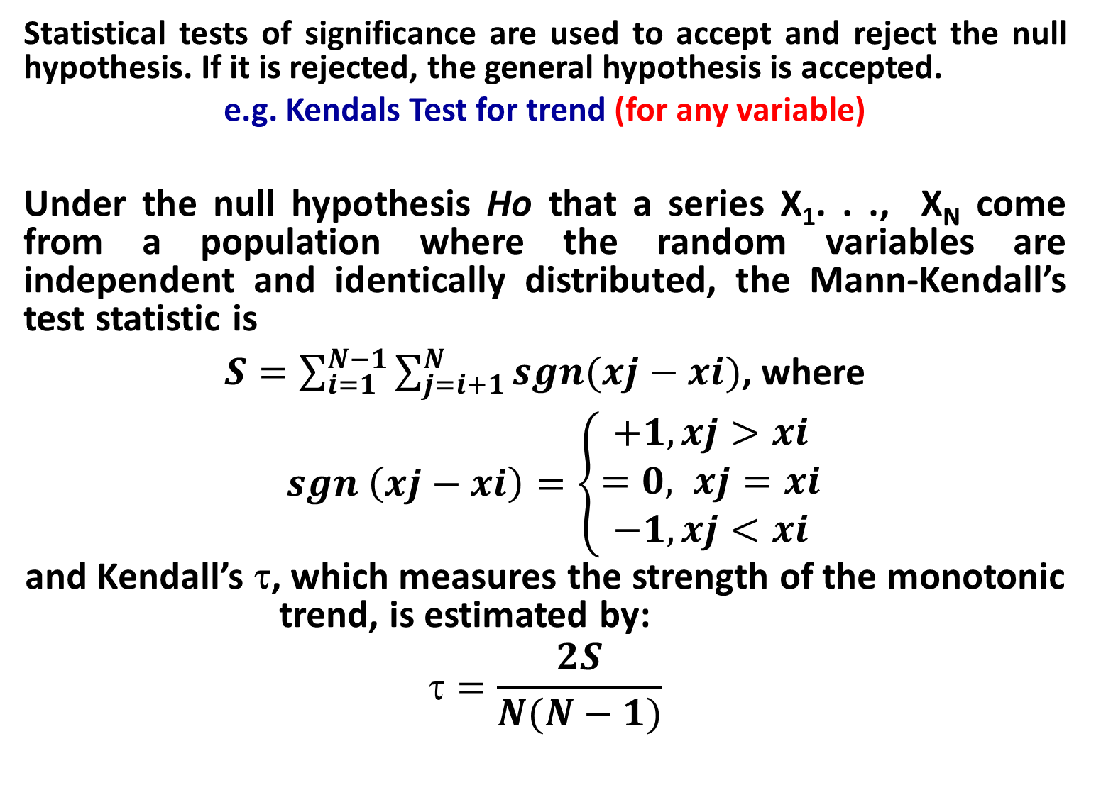
Conti.
Statistical tests of significance are used to accept and reject the null hypothesis. If it is rejected, the general hypothesis is accepted.
e.g. Kendals Test for trend (for any variable)
Under the null hypothesis Ho that a series X₁. . ., X_{N} come from a population where the random variables are independent and identically distributed, the Mann-Kendall’s test statistic is
$S=\sum_{i=1}^{N−1}{\sum_{j=i+1}^{N}{sgn(xj−xi)}}$, where
$sgn \left(xj−xi\right)=\left\{\begin{aligned}+1, xj>xi \\ =0, xj=xi \\ −1, xj<xi\end{aligned}\right.$
and Kendall’s τ, which measures the strength of the monotonic trend, is estimated by:
$$=\frac{2S}{N(N−1)}$$

Slide 68
Additional example.
For groundwater trend assessment
The coefficient of determination (r²) explained the degree of fit between calculated and the recorded water level curves
While, level of statistical significance (P-value<0.05) indicates the level of significance of each variable by assessing whether the means and measure of dispersion of two variables are statistically different from each other or not.

Slide 69
10. Generalizations and Interpretation
If a hypothesis is tested and upheld several times, it may be possible for the researcher to arrive at generalization i.e. to build a theory.
As a matter of fact, the real value of research lies in its ability to arrive at certain generalizations. If the researcher had no hypothesis to start with, he might seek to explain his findings on the basis of some theory. It is known as interpretation.

Slide 70
1.2. Differentiating research methods and research methodology

