Slide 1


Slide 2
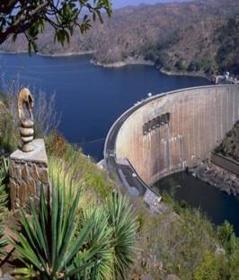
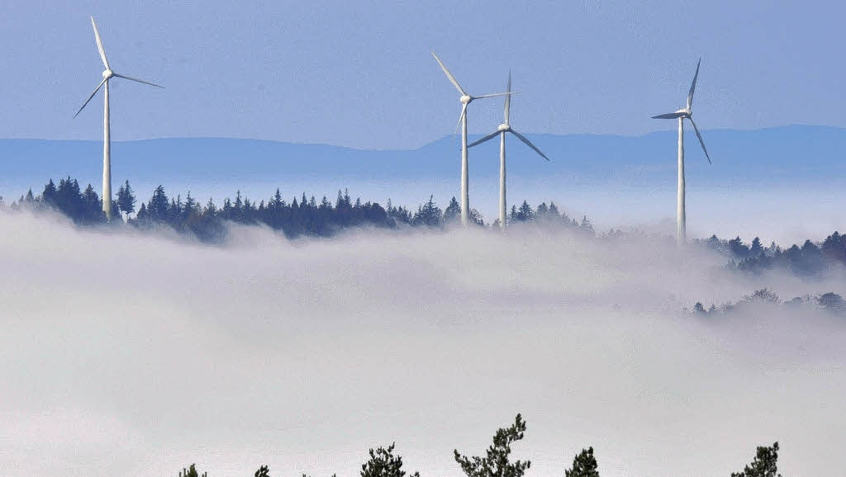
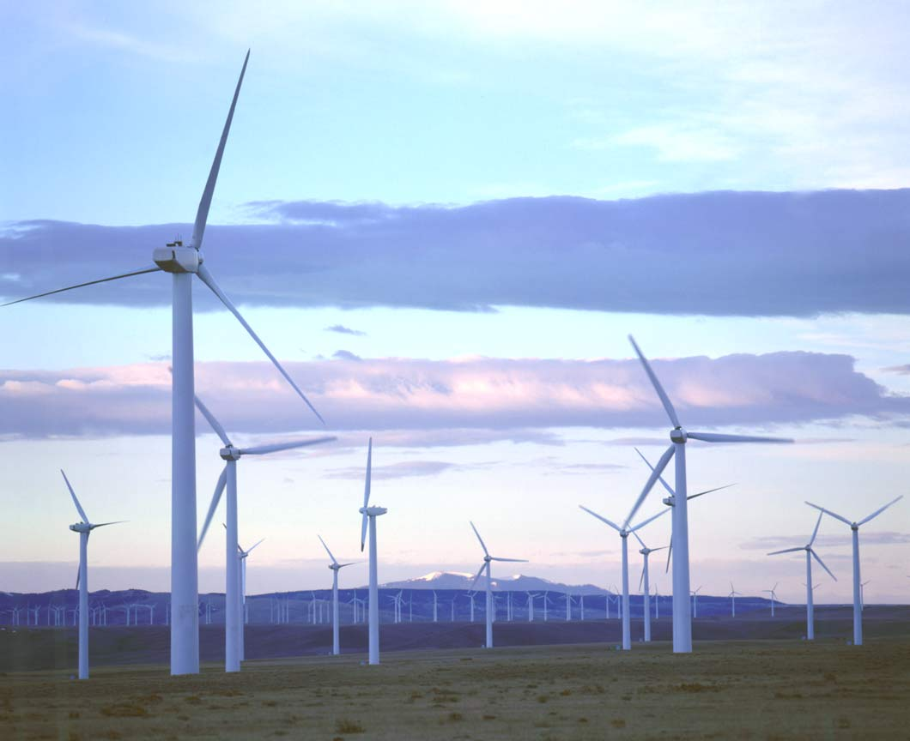

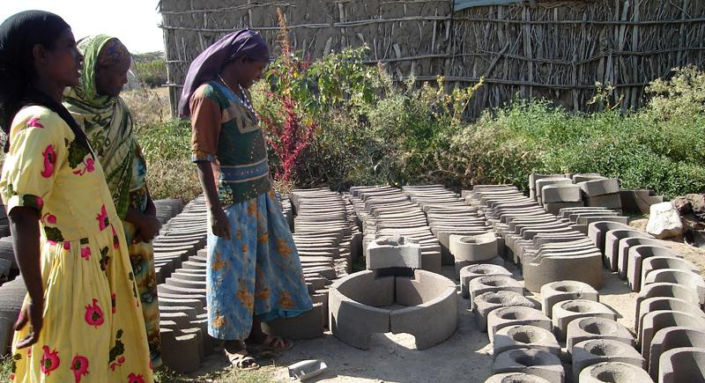
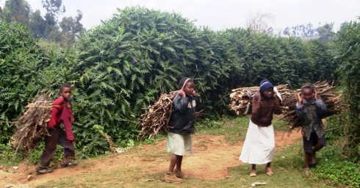
Renewable Energy Production and Management
NaRM3121

Slide 3
Chapter objectives: At the end of this chapter you should be able to:
  Understand what energy is and its concepts
  The linkages between energy, development and environment
  Global issues associated with the production and use if energy
  Understand about energy poverty and energy and poverty

Slide 4
Start up/ discussion question (3-5 minutes).
What do you understand by energy, development and environment nexus?
LG Dualcool.mp4

Slide 5
1. Introduction to energy resources
Concepts and principles of energy
Energy is the ability to do work (J)
  Eg.
Power – is the energy produced per unit of time (W)
  Eg.
Renewable energy- energy that is collected from resources which are naturally replenished on a human time scale; such as sunlight, wind

Slide 6
Energy is the driving force for the universe.
Energy is involved in all life cycles, -------- essential in agriculture as much as in all other productive activities.
An elementary food chain already shows the need for energy:
  harvesting needs energy from the human body in work,
  cooking needs energy from biomass in a fire.
  The food, in its turn, provides the human body with energy.

Slide 7
Other sectors of rural life require energy as well.
The provision of shelter, space heating, water lifting, and the construction of roads, schools and hospitals, all require.
  Development often implies additional energy, and also different forms of energy, like electricity.

Slide 8
  Forms of energy
Energy is found in different forms, such as light, heat, sound, and motion.
Potential Energy: is stored energy and the energy of position, or gravitational energy.
Eg, Reservoir
Chemical energy is energy stored in the bonds of atoms and molecules.
Eg. Battery, biomass

Slide 9
Nuclear energy is energy stored in the nucleus of an atom;
Eg. Nuclear power plants
Gravitational energy is the energy of position or place.
Eg. Rock resting at the top of a hill
2. Kinetic energy: Kinetic energy is motion; it is the motion of waves, electrons, atoms, molecules, substances, and objects

Slide 10
Electrical energy: is the movement of electrons.
Radiant energy is electromagnetic energy that travels in transverse waves. Eg. Solar energy
Heat/thermal energy: the internal energy in a substance.
  vibration and movement of atoms and molecules within a substance. Eg. Geothermal energy

Slide 11
Classification of energy based on sources
Primary Energy sources: - Primary energy sources are those that are either found or stored in nature.
  Examples include coal, oil, natural gas, and biomass (such as wood).
Secondary Energy: - Primary energy sources are mostly converted in industrial utilities into secondary energy sources via energy conversion;
  Eg. coal, oil or gas converted into steam and electricity.

Slide 12
Delivered/final energy; amount of useable energy delivered to the customer.
  Eg. Electric Meter
Useful energy: amount of energy attributed to the amount of work accomplished.
Eg.

Slide 13
Commercial Energy: - The energy sources that are available in the market for a definite price
  electricity, coal and refined petroleum products.
  Basis for industrial, agricultural, transport and commercial development in the modern world.
In the industrialized countries, commercialized fuels are predominant source not only for economic production, but also for many household tasks.

Slide 14
Non-Commercial Energy: - The energy sources that are not available in the commercial market for a price.
Eg: fuels such as firewood, dung cake and agricultural wastes, which are traditionally gathered, and not bought at a price used especially in rural households.
  →traditional fuels

Slide 15
Non-commercial energy is often ignored in energy accounting.
Firewood, agro waste in rural areas, solar energy for water heating, for drying grain, animal power for transport, wind energy for lifting water ……

Slide 16
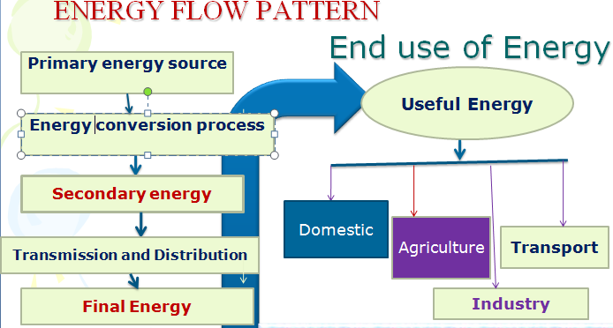
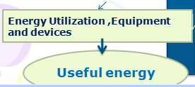

Slide 17
What is the Energy flow pattern of charcoal?
1.wood ---- primary
2. conversion i.e. charcoal kiln -------→ charcoal 2º form
3. transport to market ----------@ market what consumer buys is final energy
4. consumer eventually converts (stoves) the charcoal into heat for cooking.
  heat is the useful energy.

Slide 18
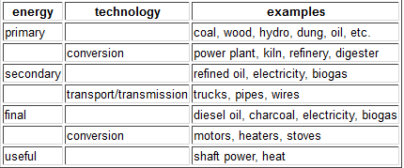
Energy flow pattern

Slide 19
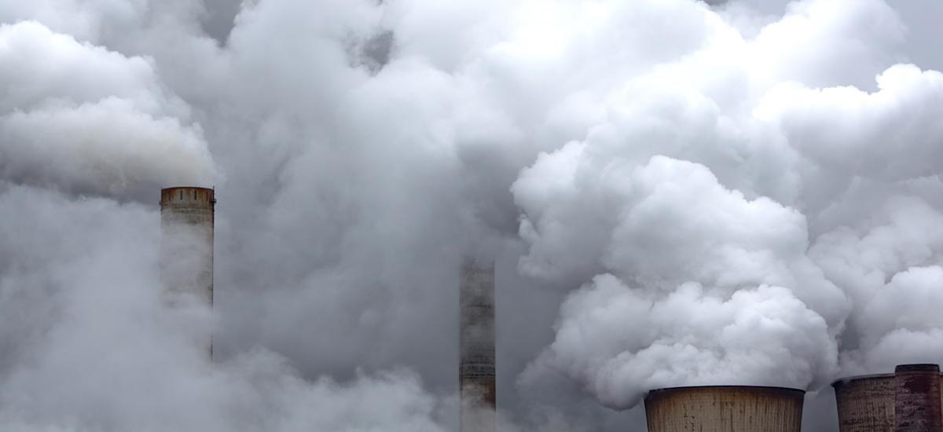
Energy and Development

Slide 20
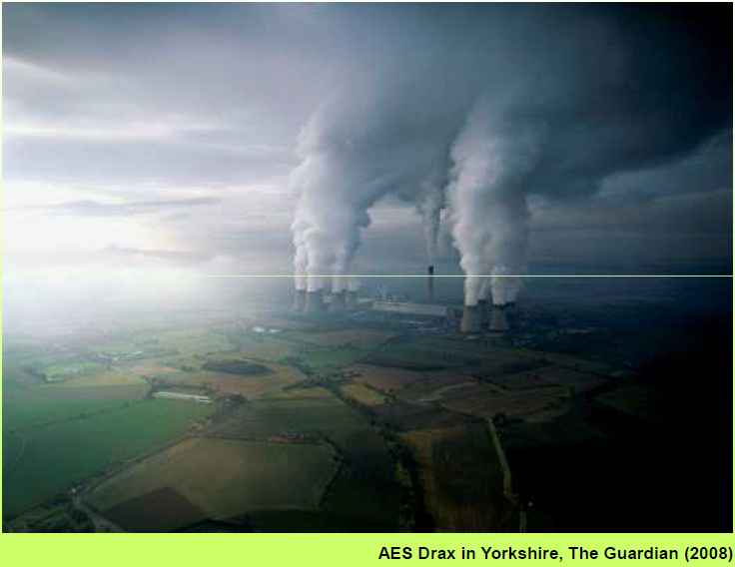
  The biggest English Polluter
Notes:
Coal fired power station, biomass vs petcoke - 4000 MW i,.e 7% of uk energys supply - 7.5 mill tones

Slide 21
Energy is the raw material needed to fuel any country’s economy growth.
Advanced economies have capacity:
  develop new sources of energy production or
  to secure imports of foreign energy to meet their needs.
Poorer countries lack this essential capacity to:
  Lights to read by
  refrigeration to store medicines and food,
  transportation to get products to market
> 2 billion people

Slide 22
The world’s poorest inhabitants are particularly ill-equipped to adapt to:
  high energy prices and
  the increasingly volatile fluctuations of global energy markets
  Lack of fund due to purchases of foreign oil often is paid in U.S. dollars
hurted disproportionately b/c energy intensive manufacturing economy
eg. Micro and small scale enterprises

Slide 23
The linkages among energy, other inputs, and economic activity clearly change significantly as an economy moves through different stages of development.
  harvested biological sources (wood, dung, sunshine and human effort (also biologically powered)--Lowest
  processed biofuels (charcoal), animal power – intermediate
  Commercial fossil fuels and electricity -- advanced stages of industrialization and development.
Intensity
+
Switching
Notes:
Industrialization , not only used more energy but used energy in different forms, typically, switching

Slide 24
Energy Ladder
An energy ladder shows the improvement of energy use corresponding to an increase in the household income.
Basically, as income increases, the energy types used by households would be
  cleaner and more efficient, but
  more expensive as moving from traditional biomasses to electricity.

Slide 25
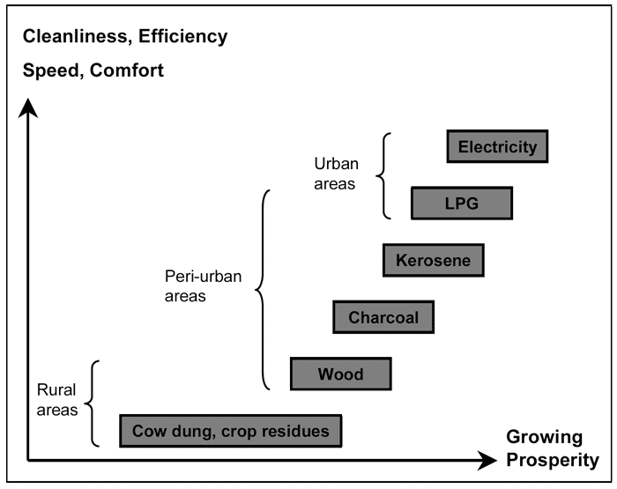
The energy ladder
Notes:
LPG: butane or propane flammable mix of hydrocarbon gases used as fuel in heating appliances, cooking equip. and vehicles.

Slide 26
Inequity in energy use
Inequities in per capita electricity use are larger than the inequities in per capita primary energy use.
In 2005, the average citizen in the OECD countries used 8,365 kwh of electricity where as
  the average citizen in China used 1,802 kwh,
  The ‘’ ‘’ elsewhere in Asia used 646 kwh,
  the ‘’ ‘’ in Latin America used 1,695 kwh and
  the ‘’ ‘ ‘ in Africa used 563 kwh.
Unsustainable utilization of energy resources and higher energy footprint in the developed world
  Sustainable development?

Slide 27
Small increases in energy consumption are often associated with dramatic improvements in quality of life.
At the local level, modern energy services help to
  reduce drudgery of women’s labor,
  improve health and education, and
  stimulate micro-enterprises.
At the national level, energy services facilitate
  economic development by underpinning industrial growth and
  providing access to global markets and trade.

Slide 28
The importance of energy services for social development is reflected in the association between energy consumption and human development.
Studies show the strong correlation between commercial energy consumption and UNDP’s Human Development Index.
  index is composed of human development indicators that reflect achievements in the most basic human capabilities:
    leading a long life (life expectancy),
    educational achievement, and
    enjoying a decent standard of living (income, measured in purchasing power parity terms).

Slide 29
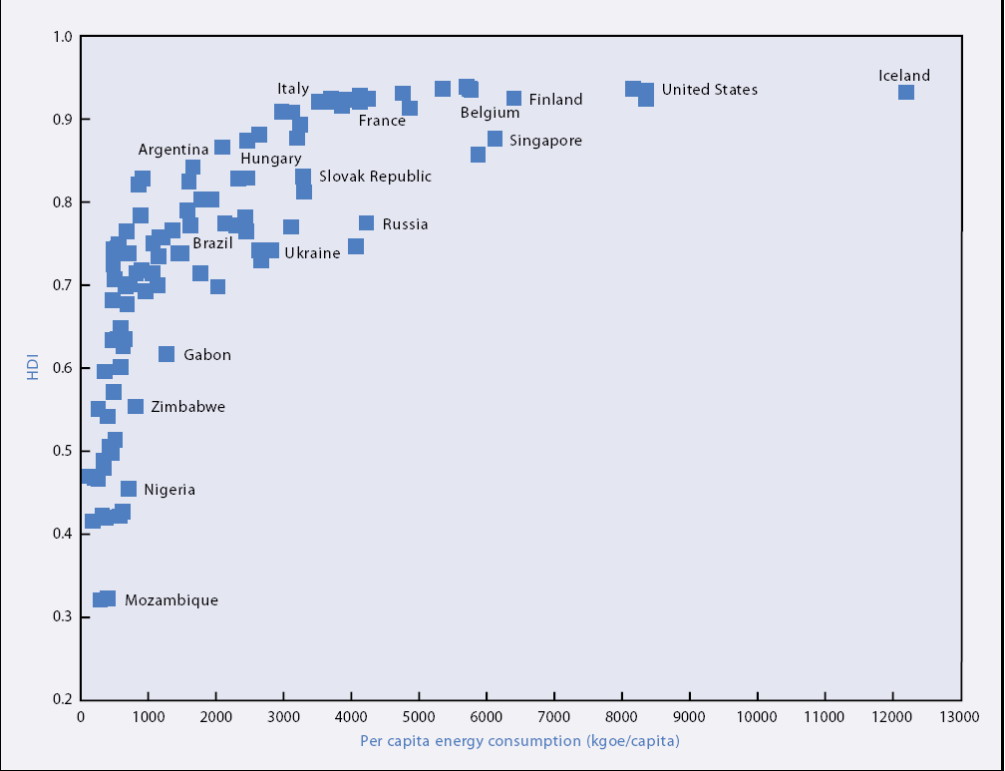
Relationship to HDI and per Capita Energy use

Slide 30
Contribution of energy to achieve MDGs
MDG hyperlink.docx

Slide 31
Energy poverty
Energy consumption and efficiency vary dramatically in different parts of the world.
Average annual per-capita consumption of modern energy was 1,519 kilograms of oil equivalent (kgoe) excluding traditional biomass and waste.
the average in high-income countries is 5,228 kgoe,
in low-income countries it is only 250 kgoe.

Slide 32
Energy poverty is lack of access to modern energy services.
It refers to the situation of large numbers of people in developing countries whose well-being is negatively affected by
  very low consumption of energy,
  use of unclean or polluting fuels, and
  excessive time spent collecting fuel to meet basic needs.

Slide 33
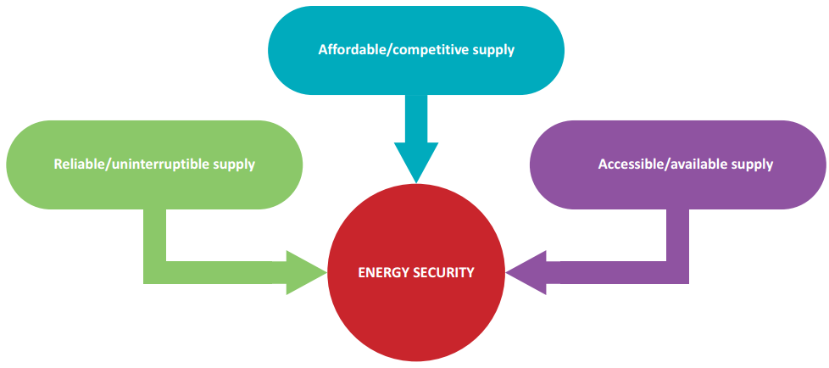
Energy security is the uninterrupted availability of energy sources at an affordable price.

Slide 34
Traditional biomass and waste account for 10.6 % of total global primary energy supply.
  In low-income countries ---- 49.4 % of the supply,
  with some countries approaching 90 %.
For the world’s poor, the only source of energy that is available and affordable is “traditional biomass”
  poorest segment of the population lacks access even to these primitive fuels.

Slide 35
Without modern energy, opportunities for economic development and improved living standards are constrained.
Women and children in developing countries suffer disproportionately. ---- ???
In general energy supplies is key to
    economic development and
    transition from subsistence agricultural economies to modern industrial
    improved social and economic well-being,
    important to industrial and commercial wealth generation.
    relieving poverty,
    improving human welfare and raising living standards

Slide 36
Global energy maters?
Energy and climate change
Approximately 90% of the world’s energy demand is currently supplied by non-renewable sources.
All activities involving energy production, conversion and transportation have adverse impacts.
Can you list out some of them?
  Destruction of natural resources and habitats,
  the contamination of soil and water,
  (hazardous) waste land filling and air pollution.

Slide 37
Burning fossil fuels for energy generates
  air pollutants like carbon oxides,
  sulphur dioxide,
  nitrogen oxides and
  respirable dusts.
The world is facing twin energy-related threats:
  not having adequate and secure supplies of energy at affordable prices, and
  that of environmental harm caused by consuming too much of it.

Slide 38
Energy related environmental problems
1. Greenhouse gas emissions
Energy‑related GHG emissions remain dominant, accounting for majority of the total emissions.
With the largest emitting sector
  electricity and heat production, followed by transport.
1.1. Carbon dioxide (CO2) : CO2 levels are increasing primarily because of the combustion of fossil fuels.
What is the safe level of CO2 in the atmosphere?

Slide 39
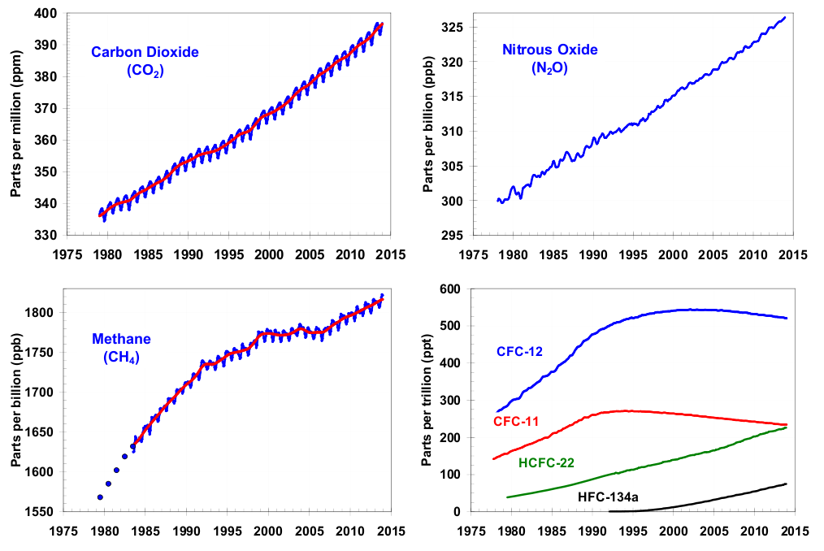
Source : NOAA - AGGI
Notes:
Dichlorodifluoromethane is a colorless gas usually sold under the brand name Freon-12, and a chlorofluorocarbon halomethane used as a refrigerant and aerosol spray propellant.

Slide 40
1.2. Methane: using natural gas (which is mostly CH₄, some of which is released when it is extracted, transported, and used).

Slide 41
The Issue – Increasing concentrations of greenhouse gases in Earth’s atmosphere represent a long-term commitment by society to living in a changing climate and, ultimately, a warmer world.
The Problem – Climate change has disruptive and uncertain consequences.
  Agriculture, water supply, transportation,
  coastal communities, the economy,
  energy, ecosystems, and national security.

Slide 42
1.4. Land degradation and deforestation
Land degradation, deforestation, and desertification are the most visible and immediate environmental concern in many developing countries.
Wood is the primary fuel source in most of the developing countries - > 90% of energy needs.
  Increasing population --high energy dd and deforestation.
  Expansion of agriculture – in the expense of forests

Slide 43
1.5. Indoor Air Pollution
Household energy and indoor air pollution pose a substantial threat to the health of the world’s poor.
Households reliant on biomass and coal generally use
  the fuel indoors,
  in open fires or poorly functioning stoves,
  and usually with inadequate venting of smoke.

Slide 44
The smoke from biomass fuel and coal contains a large number of pollutants that are dangerous to health,
  Particulate matter,
  CO, N2O, SO2,
  formaldehyde, and
  carcinogens such as benzo pyrene and benzene.
    Acute respiratory infections in children, and chronic lung disease in adults
Women and children suffer a lot from indoor air pollution???

Slide 45
  1.6. Marine pollution
Oil pollution from coastal refineries, offshore installations and maritime transport put significant pressures on the marine environment.
Consistency of spilled oil can cause surface contamination and smother marine biota.
  its chemical components can cause acute toxic effects and long-term impacts. – POPs

Slide 46
  1.7. Air pollution
Energy production and consumption contributes to
  Primary air pollutants CO, CO2, NOx, Particulate matter, ashes….
  acidifying of water bodies and
  Soil pollution ,
  emissions of tropospheric ozone precursors
Reading Assignment: Read details on Energy related Environmental Problems from the course Climate Change Adaptation and Mitigation Handout

Slide 47


Slide 48
2. Energy sources and trends

Slide 49
Chapter objective: At the end of this chapter you are expected to:
  Understand historical background and trends in energy use
  Understand global energy use trends
  Review national Energy use status
  Analyze future energy needs
  Familiarize with the types of renewable energy
  Compare and analyze renewable and non- renewable energy source

Slide 50
2.1. Types of energy resources
Renewable energy (non-conventional or alternative) is energy that is collected from resources which are naturally replenished on a human timescale such as sunlight, wind, tides, waves and geothermal heat.
Renewable energy refers to energy resource that occurs naturally in the environment and can be harnessed for human benefit.

Slide 51
A non-renewable resource (conventional or finite resource) is a resource that does not renew itself at a sufficient rate for sustainable economic extraction in meaningful human time-frames.
Eg. carbon-based, organically-derived fuel.
  coal, petroleum..

Slide 52
Renewables contributed 19 % to energy consumption.
Exist over wide geographic area in contrast to conventional sources.
  energy security,
  climate change mitigation, and
  economic benefits.
Renewable technologies are more suited to
  rural and remote areas and
  developing countries.
Lift poorest nations to new levels of prosperity.

Slide 53
Characteristics of RE:
Basically renewable energy is
  Indigenous (not imported form of energy)
  Labor intensive (create employment)
  Suitable for decentralized application?
  Environmental friendly (pollution free)
  Help to fight global warming (global CC)
  Directly associated with sustainability
  Not marketable to on a world scale like petrol
  Provide a correct mix or complementarily

Slide 54
Types of renewable energy
Biomass Energy
1. Biomass is the term used for all organic material originating from plants (including algae), trees and crops and is essentially the collection and storage of the sun’s energy through photosynthesis.
Biomass energy (bioenergy): the conversion of biomass into useful forms of energy such as heat, electricity and liquid fuels
  Used directly or indirectly.
Supply 0 -20 % of energy supply globallly and up to 90% in some regions.
4th largest source of energy behind oil and coal.

Slide 55
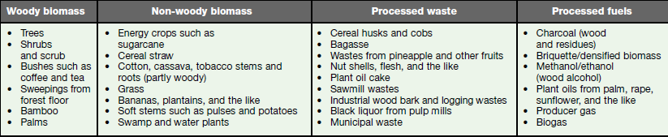
Sources
Animal biomass: Animal manure which is used as cooking fuel or as feedstock for biogas generation.
Plant biomass: woody, non-woody, processed waste, or processed fuel;
Forestry plantations, natural forests,
natural woodlands.
Products or by-products of agroindustrial activities.
Energy conversion technologies

Slide 56
The precise amount of biomass used for energy is unknown? Why?

Slide 57
2. Biofuel
Biofuels are energy sources made from living things, or the waste that living things produce.
Biofuel is a fuel that is derived from biological materials, such as plants and animals by conversion technologies.
  Fuel derived from organic matter directly from plants, or
  indirectly from agricultural, commercial, domestic, and/or industrial wastes).

Slide 58
Thermal conversion, chemical conversion, and biochemical conversion.
This biomass can be converted to convenient energy containing substances.
  result in fuel in solid, liquid, or gas form.
Gaining popularity because of rising oil prices and the need for energy security.

Slide 59
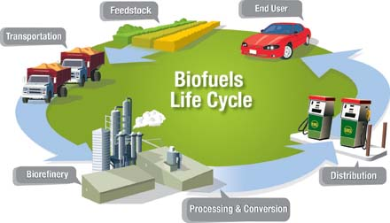
Biofuels life cycle

Slide 60

1. Bioethanol (oxidized fuel)
is an alcohol made from feed stocks (such as corn, sugar cane, or cellulosic material).
is an alcohol made by fermentation, mostly from carbohydrates produced in sugar or starch crops.
  a metabolic process that consumes sugar in the absence of oxygen.
Notes:
In industrialized countries produced from food crops like corn, While in developing world it is produced from sugarcane (molasses)

Slide 61
  Cellulosic biomass, derived from non-food sources, such as trees and grasses, is also being developed as a feedstock for ethanol production.
Ethanol used as a fuel for vehicles in its pure form, but it is gasoline additive to increase purity and improve vehicle emissions. (USA, Brazil, Ethiopia)

Slide 62
2. Biodiesel
Biodiesel refers to a vegetable oil - or animal fat-based diesel fuel consisting of long-chain alkyl (methyl, ethyl, or propyl) esters.
Biodiesel is a renewable fuel made from seed oils (canola, sunflower, soybean, etc.), reclaimed vegetable or animal fats, or algae.
  Is a vegetable oil - or animal fat-based diesel fuel.
Ester –hydrocarbon radical derived from an alkane by removal of a hydrogen atom.
Alkane- saturated OHs including methane, ethane (C2H6), propane (C3H8),
Notes:
Ester –hydrocarbon radical derived from an alkane by removal of a hydrogen atom.
an organic compound made by replacing the hydrogen of an acid by an alkyl or other organic group. Many naturally occurring fats and essential oils are esters of fatty acids.

Slide 63
Biodiesel is typically made by chemically reacting lipids (e.g., vegetable oil, animal fat) with an alcohol producing fatty acid esters - Transesterification-
  Is the reaction of the ester with an alcohol in the presence of an acid catalyst.
Used as a fuel for vehicles in its pure form, but it is usually used as a diesel additive to reduce levels of particulates, carbon monoxide, and hydrocarbons from diesel-powered vehicles.

Slide 64

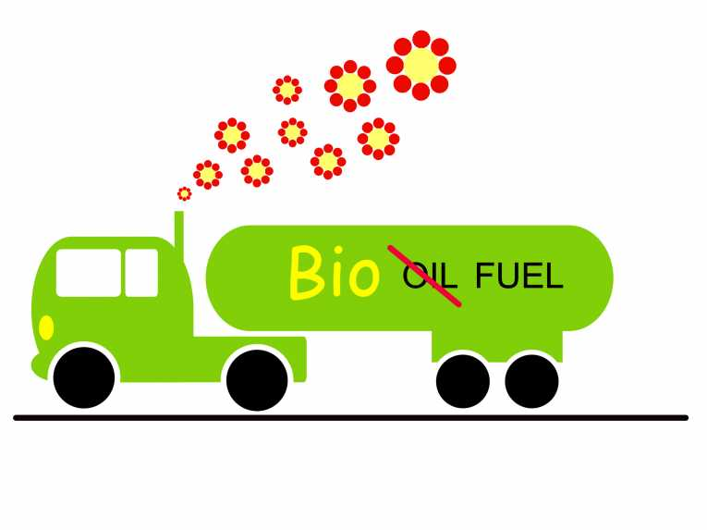
It can be used as a fuel for vehicles in its pure form, but it is usually used as a diesel additive to:
  reduce levels of particulates,
  carbon monoxide, and
  hydrocarbons from diesel-powered
  vehicles.

Slide 65
3. Biogas
Biogas: gaseous fuel, especially methane, produced by the fermentation of organic matter anaerobically by methanotroph bacteria.
Facilities that deal with large quantities of or­ganic waste can employ anaerobic digesters and/or
  gas collection systems to capture biogas, which can be used as a source of on-site bioheat and/or biopower.
  Cooking and lighting

Slide 66
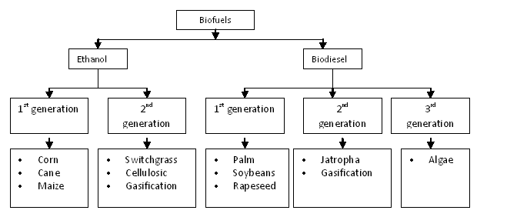
Types of biofuel
low-cost
high-energy
renewable feedstock.
Food crops
Energy crops
Food crops
Energy crops
?

Slide 67

Biofuels are associated with socieconomic, environmental and technical debates
  moderating oil prices,
  the "food vs fuel" debate,
  poverty reduction potential,
  Reduce carbon emissions levels,
  sustainable biofuel production,
  Tackle deforestation and soil erosion,
  loss of biodiversity?
  rural unskilled employment, and
  nitrous oxide (NO2) emissions.

Slide 68
Why Use Biofuels?
It provides a market for excess production of vegetable oils and animal fats.
It decreases the country's dependence on imported petroleum.
It is renewable and does not contribute to global warming due to its closed carbon cycle.
It provides substantial reductions in carbon monoxide, unburned hydrocarbons, and particulate
emissions from diesel engines.

Slide 69
3. Hydropower
Is power derived from the energy of falling and running water, which is harness for useful purposes.
Hydro-power plants convert the energy in flowing water into electricity.
  Uses a dam on a river to retain a large reservoir of water when released through turbines to generate power.

Slide 70
It is a proven, predictable and typically price-competitive technology.
Relatively high initial investment, long lifespan with very low operation and maintenance costs. Eg. Ethiopia
Through hydropower, the energy in falling water is converted into electricity without “using up” the water.

Slide 71
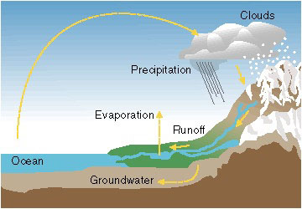
Hydropower energy is ultimately derived from the sun, which drives the water cycle. In the water cycle, rivers are recharged in a continuous cycle.
Because of the force of gravity, water flows from high points to low points. There is kinetic energy embodied in the flow of water.

Slide 72




Kinetic energy is the energy of motion. Any moving object has kinetic energy.

Slide 73

Humans first learned to harness the kinetic energy in water by using waterwheels.
A waterwheel is a revolving wheel fitted with blades, buckets, or vanes.
Waterwheels convert the kinetic energy of flowing water to mechanical energy.
How hydropower was harnessesd?

Slide 74
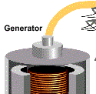
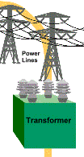







The mechanical energy produced by the turbine is converted into electric energy using a turbine generator.
Inside the generator, the shaft of the turbine spins a magnet inside coils of copper wire.
-- moving a magnet near a conductor causes an electric current.
How a Hydroelectric Power System Works

Slide 75
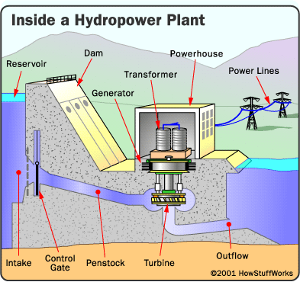
Internal view of hydropower plant

Slide 76
How much electricity can be generated
by a hydroelectric power plant?
The amount of electricity that can be generated by a hydropower plant depends on two factors:
flow rate - the quantity of water flowing in a given time; and
head - the height from which the water falls.
The greater the flow and head, the more electricity produced.

Slide 77
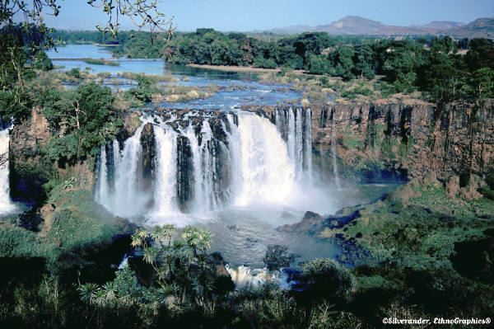
Flow Rate = the quantity of water flowing
When more water flows through a turbine, more electricity can be produced.
The flow rate depends on the size of the river and the amount of water flowing in it.
Power production is considered to be directly proportional to river flow.
  That is, twice as much water flowing will produce twice as much electricity.

Slide 78
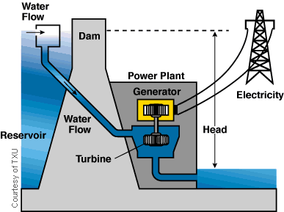
Head = the height from which water falls
The farther the water falls, the more power it has.
The higher the dam, the farther the water falls, producing more hydroelectric power.
Power production is also directly proportional to head.
That is, water falling twice as far will produce twice as much electricity.
It is important to note that when determining head, hydrologists take into account the pressure behind the water.
Water behind the dam puts pressure on the falling water.

Slide 79
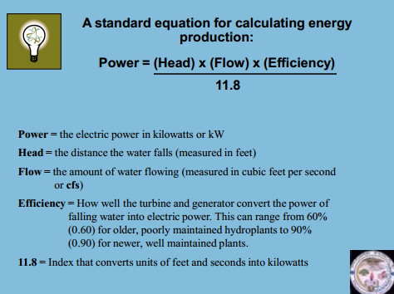

Slide 80
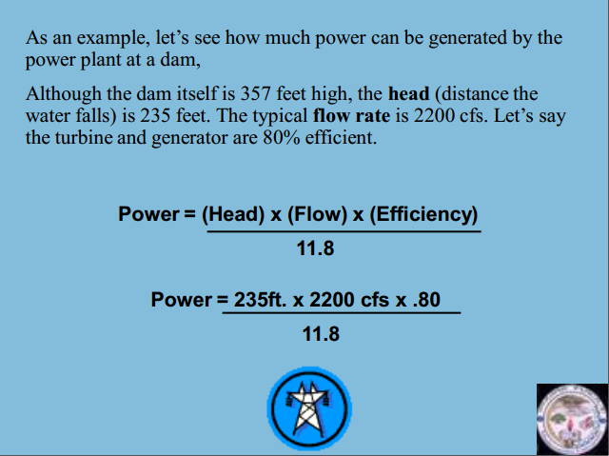

Slide 81
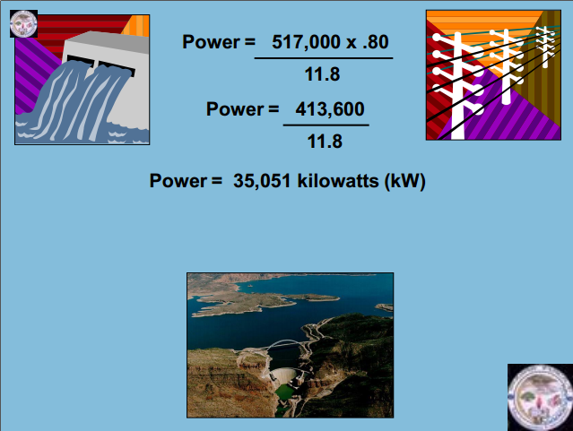

Slide 82
Hydropower offers significant potential for carbon emissions reductions.
Discharged water used for other purposes
  Agriculture
  Irrigation and
  Water in the reservoir as potential tourism destination.

Slide 83


Installation of new large hydropower projects today is very controversial because of their negative environmental impacts. These include:
Upstream flooding
decreased water quality and flow
reduced quality of upstream and downstream environments

Slide 84

Low Impact Hydropower
A hydropower project is considered low impact if it considers these environmental factors:
river flow
water quality
watershed
protection
fish passage
and protection
threatened and
endangered species
protection
cultural resource
protection
recreation
facilities recommended
for removal

Slide 85
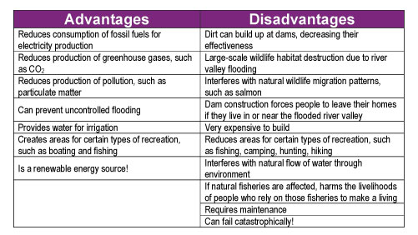

Slide 86

Because the water cycle is continuous, hydropower is a renewable energy source.

Slide 87
Ethiopia's Hydropower Potential
Tis Abay I Power Station - 12 MW
Tis Abay II Power Station - 73 MW
Koka Power Station - 43 MW
Awash II Power Station - 32 MW
Awash III Power Station - 32 MW
Fincha Power Station - 100 MW
Melka Wakena Power Station - 150 MW
Sor Power Station - 5 MW
Gilgel Gibe I Power Station - 184 MW
Tekeze Power Station - 300 MW
Gilgel Gibe II Power Station - 420 MW
Beles Power Station - 460 MW
Fincha Amerti Neshe Power Station - 97MW
GRED – 6000 MW

Slide 88
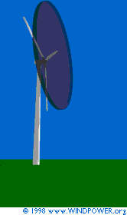

4. Wind energy

Slide 89
Wind power
Wind power is extracted from air flow using wind turbines to produce mechanical or electrical power.
  A wind turbine is name for a device that converts kinetic energy from the wind into electrical power.
The wind is created by the movement of atmospheric air mass as a results of variation of atmospheric pressure,
  which results from the difference in solar heating of different parts of the earth surface.

Slide 90
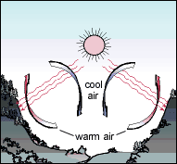
Where Does the Wind Come From?
The wind is a by-product of solar energy.
Approximately 2% of the sun's energy reaching the earth is converted into wind energy.
The surface of the earth heats and cools unevenly, creating atmospheric pressure zones that make air flow from high- to low-pressure areas.
    hot air rises, it expands, becomes less dense, and is then replaced by denser, cooler air

Slide 91
Humanity’s primary energy sources for pumping water and milling grain for several millennia.
Alternative to fossil fuels, winde energy is:
  plentiful, renewable, widely distributed,
  clean, produces no GHG emission during operation and
  uses little land.
The effects on the environment are generally less problematic than those from other power sources.

Slide 92
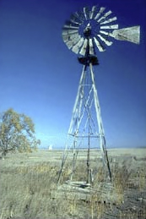
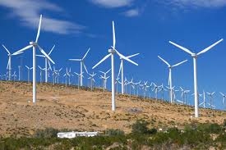
Wind mill for pumping water vs Wind turbines/farm

Slide 93
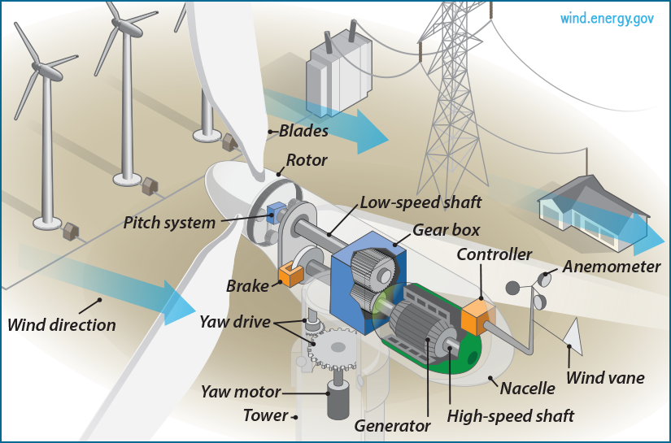
Wind turbine labels (http://energy.gov/eere/wind/how-does-wind-turbine-work, http://energy.gov/eere/wind/inside-wind-turbine-0 )

Slide 94
Main components of a Wind Turbine
Rotor
The portion of the wind turbine that collects energy from the wind is called the rotor.
The rotor usually consists of two or more wooden, fiberglass or metal blades (new design) which rotate about an axis.
The blades are attached to the hub, which in turn is attached to the main shaft.

Slide 95
Gear box: Wind turbines rotate typically between 40 rpm and 400 rpm.
Generators typically rotates at 1,200 to 1,800 rpm.
Most wind turbines require a step-up gear-box for efficient generator operation (electricity production).
Generator: Converts the rotational mechanical power to electrical power.

Slide 96
Typical Wind Turbine Operation
0 ~ 10 mph --- Wind speed is too low for generating power.
    Turbine is not operational. Rotor is locked.
10 ~ 25 mph --- 10 mph is the minimum operational speed. It is called “Cut-in speed”. In 10 ~ 25 mph wind, generated power increases with the wind speed.
25 ~ 50 mph --- Typical wind turbines reach the rated power (maximum operating power) at wind speed of 25mph (called Rated wind speed).
Further increase in wind speed will not result in substantially higher generated power by design.
This is accomplished by, for example, pitching the blade angle to reduce the turbine efficiency.
> 50 mph --- Turbine is shut down when wind speed is higher than 50mph (called “Cut-out” speed) to prevent structure failure.

Slide 97
Wind power by its nature is intermittent.
  storage or back-up is inevitably involved.
(a) connection to an electricity grid system, which may be on a large or small (mini-grid) scale;
(b) incorporating other electricity producing energy systems (from conventional generating stations through diesel generators to other renewable energy systems);
storage systems such as batteries

Slide 98
Categories of wind energy systems
Grid-connected electricity generating,
Stand-alone electricity generating
Mechanical systems
  Eg. Wind mill

Slide 99
Wind technology does not have fuel requirements as do coal, gas, and petroleum generating technologies.
For wind resources to be useful for electricity generation, the site must
  have sufficiently powerful winds,
  be located near existing transmission networks,
  be economically competitive with respect to alternative energy sources.

Slide 100
While the technical potential of wind energy to fulfill energy services is substantial
the economic potential of wind energy remains dependent on
  the cost of wind turbine systems and
  the economics of alternative options.

Slide 101
Ethiopian potential
Ashegoda - 120 MW
Adama 1 - 51 MW
Adama 2 – 153 MW
Total = ?
Overall potential Ethiopia has good wind resources with velocities ranging from 7 to 9 m/s.
estimated to be 10,000 MW

Slide 102
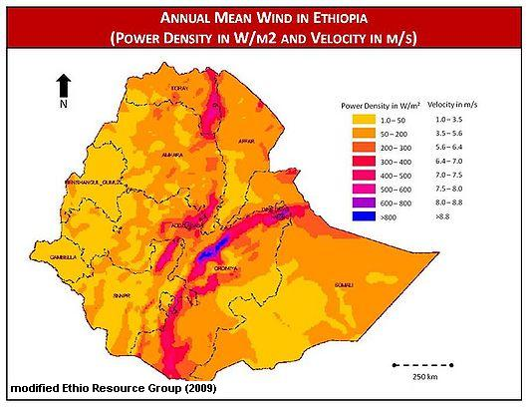
Overall wind power potential

Slide 103
Advantage of wind
It's a clean fuel source
Wind energy is a domestic source of energy
It's sustainable.
Wind power is cost effective.
Wind turbines can be built on existing farms or ranches.

Slide 104
Disadvantage
Wind power must still compete with conventional generation sources on a cost basis.
The strength of the wind is not constant and it varies from zero to storm force.
Good wind sites are often located in remote locations, far from cities where the electricity is needed.
The turbine blades may damage local wildlife.
Turbines may cause noise and aesthetic pollution.
Wind resource development may not be the most profitable use of the land.

Slide 105
4. Solar power
Solar power is the conversion of energy from sunlight into electricity, either directly using photovoltaics, or indirectly using concentrated solar power.
  the use of solar radiation for practical ends.
Solar energy: radiant light is harnessed using a range of ever-evolving technologies such as solar heating, photovoltaics, concentrated solar power.

Slide 106
List of solar applications includes space heating and cooling through solar architecture, daylighting, solar hot water, solar cooking, and high temperature process heat for industrial purposes.

Slide 107
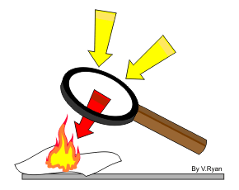
A simple example of the
power of the sun can be
seen by using a magnifying
glass to focus the suns rays
on a piece of paper.
Before long the paper ignites
Into flames.

Slide 108
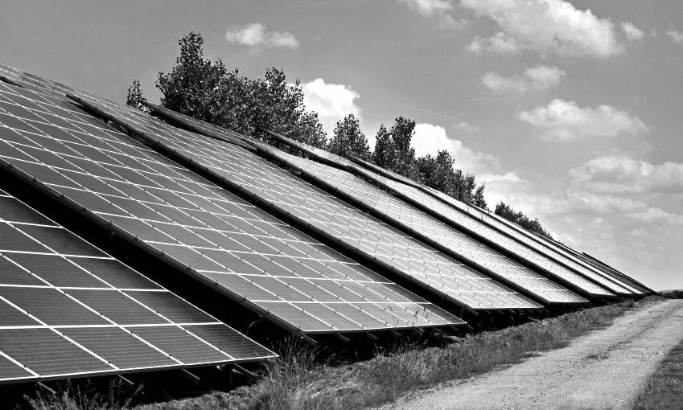
Solar panels
To harvest the solar energy, the most common way is to use solar panels.
  Panels for concentrating the energy in the radiation.

Slide 109
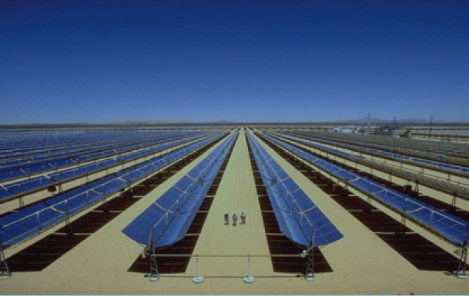
Solar panels

Slide 110
The photovoltaic effect is the creation of voltage/electric current in a material upon exposure to light and is a physical and chemical phenomenon.
Two ways to make electricity from solar energy:
Photovoltaic (PV) : light + volt (measurement of electricity)
A solar cell, or photovoltaic cell (PV), is a device that converts light into electric current using the photovoltaic effect.
  A photovoltaic cell (PV cell) is a specialized semiconductor diode that converts visible light into direct current (DC).
  converts light directly into electricity

Slide 111
Electricity is produced when radiant energy from the sun strikes the solar cell, causing the electrons to move around.
The action of the electrons starts an electric current.
The conversion of sunlight into electricity takes place silently and instantly
  No need of mechanical parts
Notes:
The photovoltaic effect is the creation of voltage/electric current in a material upon exposure to light and is a physical and chemical phenomenon. Thephotovoltaic effect is closely related to the photoelectric effect.

Slide 112
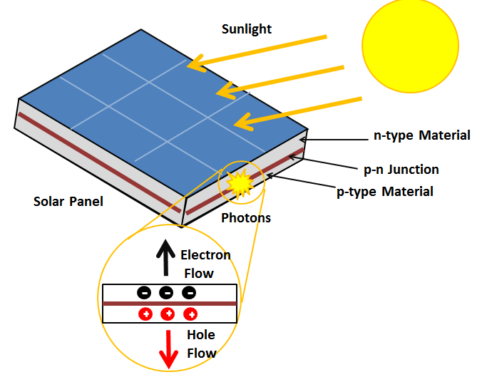
The photovoltaic effect

Slide 113
Solar cells are made up of silicon.
Solar cells can supply energy to anything that is powered by batteries or electrical power. (cost?)
Solar-powered toys, calculators, and roadside telephone call boxes all use solar cells to convert sunlight into electricity.

Slide 114
2. Solar Thermal Electricity
Concentrated solar power (CSP, also known as "concentrated solar thermal") plants use solar thermal energy to make steam, that is thereafter converted into electricity by a turbine.
Like solar cells, solar thermal systems, also called concentrated solar power (CSP), use solar energy to produce electricity.

Slide 115
Most solar thermal systems use a solar collector with a mirrored surface to focus sunlight onto a receiver that heats a liquid.
The super-heated liquid is used to make steam to produce electricity in the same way that coal plants do.

Slide 116
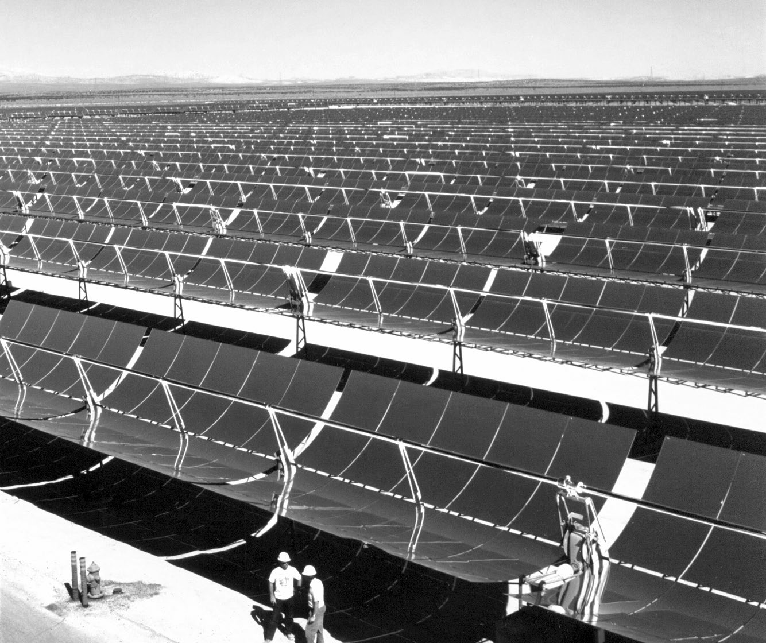
Solar Thermal Electricity
Parabolic troughs concentrate the sun’s radiant energy, heating fluid that is used to create steam.
The steam turns a generator, which produces electricity.

Slide 117
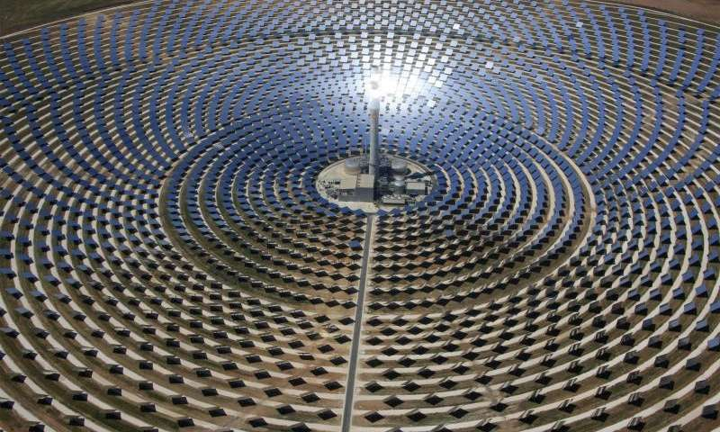
The Gemasolar solar power plant, situated near Seville in Spain.

Slide 118
Solar energy has great potential for the future.
Solar energy is free, and its supplies are unlimited.
It does not pollute or otherwise damage the environment.
It cannot be controlled by any one nation or industry.

Slide 119
Advantages and Disadvantages
Advantages
Solar power is source of clean energy (No noise or air pollution)
It does not produce pollution or GHG or carbon compounds.
Solar power would be a lot safer for the environment and a lot better for the health of people.
Energy reaching the earth is incredible. By one calculation, 30 days of sunshine striking the Earth have the energy equivalent of the total of all the planet’s fossil fuels, both used and unused!
Sunlight is a free abundant source particularly for us Ethiopian!

Slide 120
Disadvantages
Sun does not shine consistently.
Solar energy is a diffuse source. Addressed by approaching the problem through:
1) collection, 2) conversion, 3) storage.
Expensive to produce because of the high cost of semi- conducting materials
Solar Power, unlike hydroelectric, biomass, wave it can not be controlled by human. Thus the regional and seasonal effect on solar power is greater than the other renewable resources ( @ night, season ( like summer in Ethiopia) etc...).

Slide 121
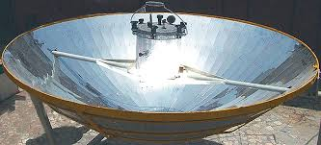
Assignment –construct a solar cooker from locally available materials.

Slide 122
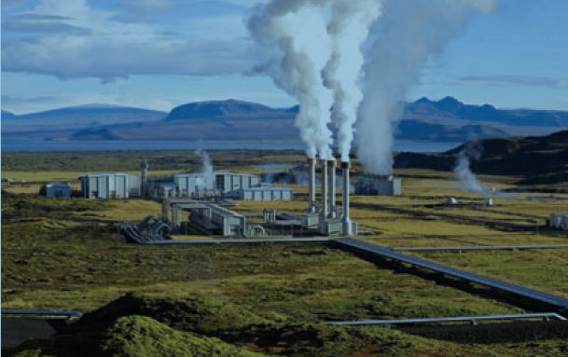
6. Geothermal energy

Slide 123
Geothermal energy
Is energy from thermal energy generated and stored in the Earth.
Thermal energy is the energy that determines the temperature of matter – 6000OC.
Earth's geothermal energy originates mainly from radioactive decay of minerals (80%).
The geothermal gradient, which is the difference in temperature between the core of the planet and its surface, drives a continuous conduction of thermal energy in the form of heat from the core to the surface.

Slide 124
WHERE IS GEOTHERMAL ENERGY FOUND ?
Most geothermal reservoirs are deep underground with no visible clues showing above ground.
The most active geothermal resources are usually found along major plate boundaries where earthquakes and volcanoes are concentrated.

Slide 125
Geothermal power stations are similar to other steam turbine thermal powerstations – heat from a fuel source (in geothermal's case, the earth's core) is used to heat water or another working fluid.
The working fluid is then used to turn a turbine of a generator, thereby producing electricity.

Slide 126
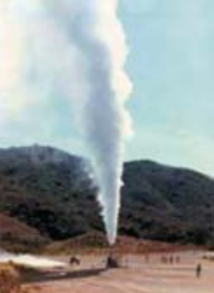
Discharging well Aluto-Langano
Total Depth = 2.5 km.
Max. Temperature = 350°C.

Slide 127
Geothermal energy can sometimes find its way to the surface in the form of:
  volcanoes and fumaroles (holes where volcanic gases are released)
  hot springs and
  geysers
Notes:
Fumarole: opening near volcano (hot Sulphur gases emerge)

Slide 128
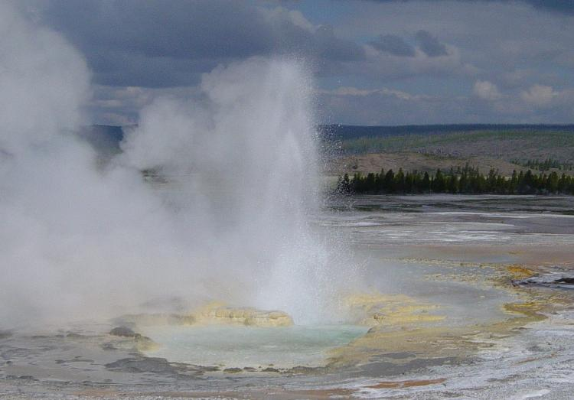
A geyser is a type of hot spring that erupts periodically, ejecting a column of hot water and steam into the air.

Slide 129
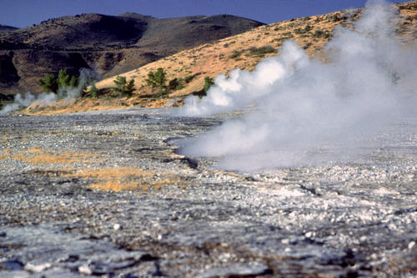
Hot spring
A spring of naturally hot water, typically heated by subterranean volcanic activity.

Slide 130
Uses of Geothermal Energy
There are different ways of tapping geothermal energy:
Direct use:
Geothermal heat found near the surface of the Earth can be used directly for
    Bathing (steam) and
    heating buildings

Slide 131
2) Electricity production:
Geothermal power plants access the underground steam or hot water from wells drilled a mile or more into the earth.
The steam or hot water is piped up from the well to drive a conventional steam turbine, which powers an electric generator.
Typically, the water is then returned to the ground to recharge the reservoir and com plete the renewable energy cycle.

Slide 132
Ethiopia’s Situation
Ethiopia could possibly generate more than 5000 MW of electric power from geothermal resources alone.
Ethiopian Rift Valley and in the Afar depression, which are both part of the Great East African Rift System.
16 geothermal prospect areas are judged to have potential for high temperature steam suited to electricity generation.

Slide 133
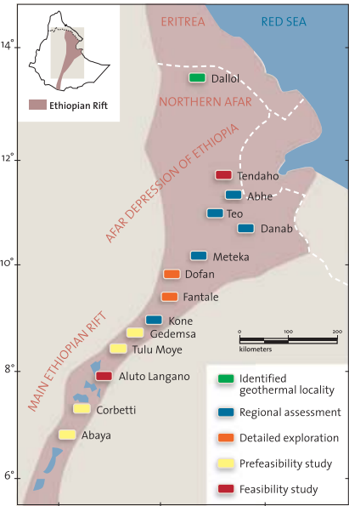

Slide 134
Why geothermal energy is said renewable?
  the heat emanating from the interior of the Earth is essentially limitless.
  Hydrological cycle

Slide 135
What are other renewable energy resources? List exclusively.
tidal power
Reading assignment.
Read in detail and discuss in your groups.
Notes:
tidal…

Slide 136
Global energy use pattern
World energy consumption refers to the total energy used by all of human civilization.
Typically measured per capita per year,
it involves all energy harnessed from every energy source applied towards humanity's endeavors across every industrial and technological sector, across every country.
  implications for humanity's social-economic-political sphere

Slide 137
According to IEA data from 1990 to 2008, the average energy use per person increased 10% while world population increased 27%.
Regional energy use also grew from 1990 to 2008:
  the Middle East increased by 170%,
  China by 146%,
  India by 91%,
  Africa by 70%,
  the USA by 20%, and
  world overall grew by 39%.

Slide 138
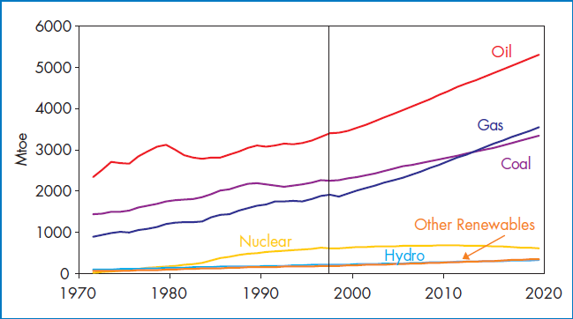
World Primary Energy Supply by Fuel, 1971-2020

Slide 139
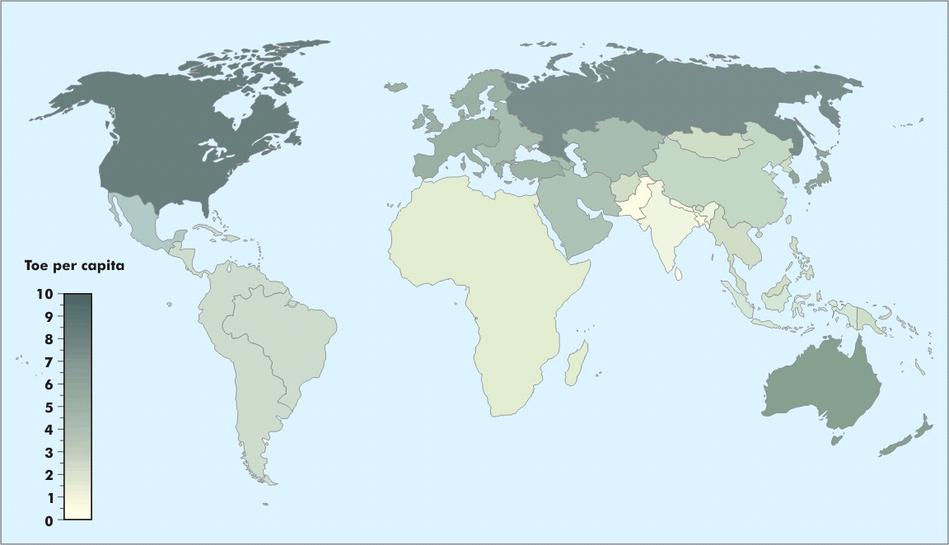
Per Capita Primary Energy Use, 2030
Per capita energy use remains much lower in developing countries
Notes:
Despite relatively strong growth in energy use in developing regions, per capita consumption remains much lower than in the rest of the world.
By 2030, per capita primary energy consumption averages a mere 1.2 toe in developing regions, compared with 5.4 toe in the OECD and 4.7 toe in the transition economies.
With some exceptions, energy use remains concentrated in the northern hemisphere

Slide 140
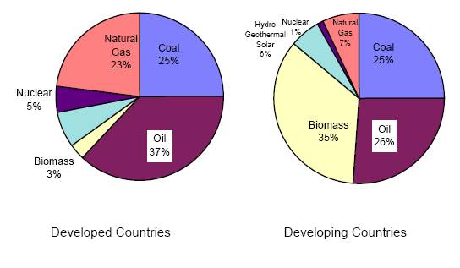
Share of Different Energy Resources in Developed and in developing countries

Slide 141
Energy Consumption in Africa
* Biomass refers to combustible renewable (mainly fuelwood, charcoal and agro-residues) and waste. Source: IEA, 2005

Slide 142
National energy use status
Biomass energy (fuelwood, charcoal, wood, waste wood, crop residues and animal dung) accounted for 89 % of total national energy consumption in 2006.
The national energy consumption is met merely
  Petroleum fuels 7.6% and
  Electricity 1.1% of.
Characterized by predominance of the household sector, accounting for 89% gross energy consumption in 2006.
  wood, animal dung and agricultural residues
What is the problem????
Notes:
Policy to meet off-grid energy ss to rural ares. i.e. renewables
Industry derived economy will be deprived.

Slide 143
Petroleum fuels are mainly used in the transport sector with a smaller share of the demand from the
  household sector (kerosene for cooking and lighting)
  industrial sector (fuel oil for thermal energy).

Slide 144

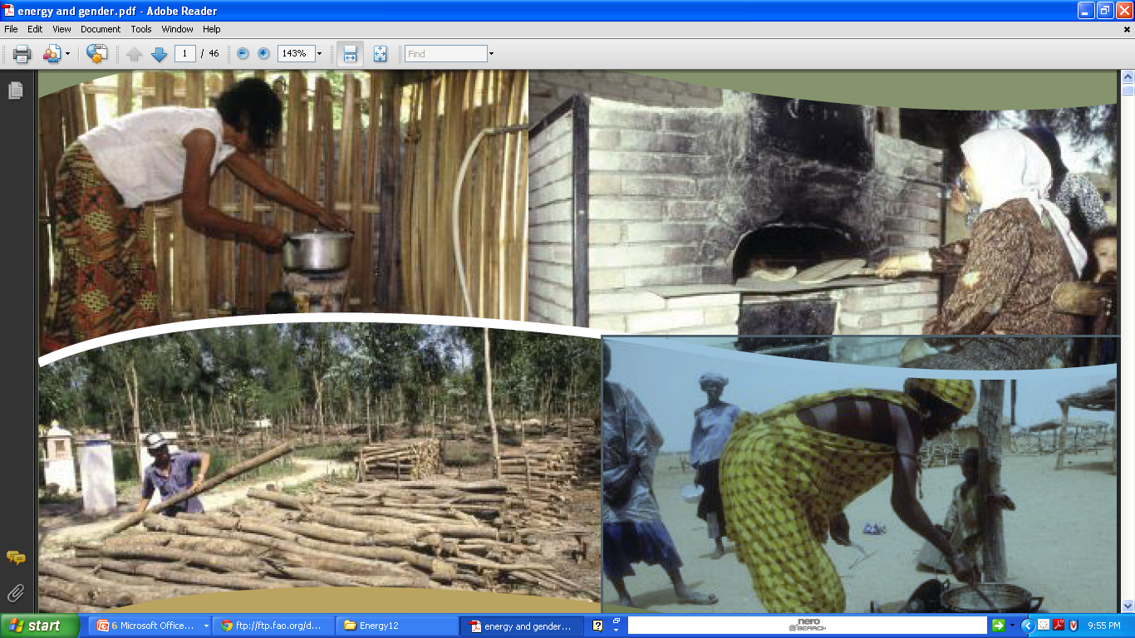
Consumption pattern in Ethiopia
The energy balance of the country as of 1995/96 reveals that total energy consumption in Ethiopia was estimated at about 50 million tones of wood equivalent
The consumption of energy is dominated by traditional energy sources
  Fuelwood, charcoal, dung, crop residue
Energy system is very primitive.
Heavy Dependency on Traditional Biomass and Human Energy

Slide 145
Energy Situation in Ethiopia
Rich in renewable energy resources, but least consumer of modern energy globally
Energy infrastructure very weak and poor integrated networks
Very high level of suppressed demand for modern energy services
Energy investments very low and geared to exports
Little use and/or Access to Modern Energy Forms
Decentralized and Dispersed Energy Requirement
Lack of Basic Energy Infrastructure
Low energy efficiency utilization in all sector

Slide 146

Wire net to protect falling of transmission line.

Slide 147

??? Energy Poverty ???

Slide 148
Energy supply in the country remains a major challenge for both electrical and non-electrical energy services because:
They cannot afford the initial fee for the connection to the grid, (high payment for biomass)
The quality of power supply is so bad (‘brownouts’ or voltage spikes) that they make services unreliable or even damage the appliances.

Slide 149

Energy resource potential of the country
About 92 per cent of electricity supply in the country is from hydroelectricity, which is exploited < 3%

Slide 150

Biomass energy consumption by sector
Approximately 96 percent of the biomass fuel was consumed by households, 3 percent by services and 1 percent by agriculture.

Slide 151

Petroleum fuels are mainly used in the transport sector (80 % of the total consumption of petroleum products) .
A smaller share of the demand from the household sector (kerosene for cooking and lighting) and industrial sector (fuel oil for thermal energy).

Slide 152

The electricity sector is also characterized by the predominance of the household sector, which in 2006 accounted for 89 % of total final energy consumption.

Slide 153

Trends in energy supply and consumption
The reduction in kerosene and electricity users for cooking is accompanied by an increase in the number of households cooking with fuel-wood and charcoal.
a large proportion of kerosene and electric users may have shifted to fuelwood and charcoal …..?
a shift towards a less convenient and efficient fuel suggests price may have been the main driver.

Slide 154

Trends in source of fuels for cooking, 1996 - 2004

Slide 155

The overall energy demand is expected to grow by approximately 5 % per year and will reach over 2 million Tera Joules in 2030.
Projected overall energy demand until 2030.

Slide 156

Notes:
April 22

Slide 157

“The costs of not acting to tackle climate change are far greater than the costs of action.”

Slide 158

Nature is made not only for human beings, but for animals and wildlife too!
Stop Deforestation! Protect Nature!

Slide 159
Discussion point
What are the factors leading to increased energy consumption?

Slide 160
How and why is the demand for energy changing?
Factors leading to increased energy consumption
  Population increase
  Improved standards of living
  Industrialisation / economic development
  Rural to urban migration
  All these are summarized as
  Economic
  Social
  Technological

Slide 161

A. Economic
For all countries, no matter what their present stage of development, demands for energy are rising.
World marketed energy consumption is projected to grow by 57 % between 2004 and 2030.
Economic growth depends on energy
All economies are increasing their demands for energy.
This is especially true of newly emerging economies where energy for manufacturing is the main growth.

Slide 162




The number of appliances and gadgets owned in the world increases daily, all needing energy.
Underlying all these are needs for transport, cooking, heating, air conditioning and lighting.

Slide 163


B. Social
In developed economies, as well as getting to and from work, people want to travel to see friends, enjoy pastimes and go on holidays.
Entertainment, even staying at home and watching TV, requires energy.
To make life easier and free up time for leisure, labour saving devices are needed. All these needs energy

Slide 164



C. Technological
For many of the social reasons above technology has produced equipment that requires energy.
Car ownership grows continuously throughout the world.
Growing international trade has led to the transport of goods by air, sea and all forms of land transport where all means's need Energy

Slide 165
The WEO projections lead to the following major conclusions:
  world energy use and related CO2 emissions will continue to increase steadily;
  fossil fuels will account for 90% of the world primary energy mix by 2020
  the shares of different regions in world-energy demand will shift significantly, with the OECD share declining in favour of developing countries;

Slide 166
  a sharp increase will occur in international trade in energy, especially oil and gas;
  the reliance on imported oil and gas of the main consuming regions, including the OECD and dynamic Asian economies, will increase substantially,
  power generation in developing countries will account for nearly one third of the increase in global emissions to 2020.

Slide 167
Comparison of renewable and non-renewable energy sources
Advantages of Renewable Sources:
1. The sun, wind, geothermal, ocean energy are available in the abundant quantity and free to use.
2. The non-renewable sources of energy that we are using are limited and are bound to expire one day.
3. Renewable sources can cost less than consuming the local electrical supply. In the long run, the prices of electricity are expected to soar since they are based on the prices of crude oil, so renewable sources can cut electricity bills.

Slide 168
4. Renewable sources have low carbon emissions, therefore they are considered as green and environment friendly.
5. Renewable helps in stimulating the economy and creating job opportunities. The money that is used to build these plants can provide jobs to thousands of people.
6. No don’t have to rely on any third country for the supply of renewable sources as in case of non-renewable sources.

Slide 169
7. Various tax incentives in the form of tax waivers, credit deductions are available for individuals and businesses who want to go green.
Disadvantages of Renewable Sources:
1. It is not easy to set up a plant as the initial costs are quite steep.
2. Solar energy can be used during the day time and not during night or rainy season

Slide 170
3. Geothermal energy which can be used to generate electricity has side effects too.
  toxic chemicals beneath the earth surface onto the top and can create environmental changes.
4. Hydroelectric provide pure form of energy but building dams across the river which is quite expensive can affect natural flow and affect wildlife.
5. To use wind energy, there is a need to rely on strong winds therefore we have to choose suitable site to operate them.
  affect bird population as they are quite high.

Slide 171
Advantages of Non Renewable Sources:
1. It is possible to use small amount of nuclear energy to produce large amount of power.
2. They are considered as cheap when converting from one type of energy to another.

Slide 172
Disadvantages of Non Renewable Sources:
1. Non-renewable sources will expire some day and we have to use our endangered resources to create more non-renewable sources of energy.
2. The speed at which such resources are being utilized can have serious environmental changes.
3. Non-renewable sources release toxic gases in the air when burnt which are the major cause for global warming.
4. Since these sources are going to expire soon, prices of these sources are soaring day by day.

Slide 174


3. BIOENERGY RESOURCES

Slide 175
Chapter objectives: At the end of this chapter you should be able to:
  Familiarize yourselves with the concept of bioenergy
  Familiarize yourselves with various types of bioenergy resources
  Identify and select appropriate feedstock for bioenergy development
  Familiarize yourselves with various types and characteristics of biofuel plants
  Familiarize yourselves with bio-oil production process

Slide 176
What is bioenergy?
Bioenergy is renewable energy made available from materials derived from biological sources.
Bioenergy is becoming an increasingly attractive energy choice because of :
  high or volatile fossil fuel prices,
  concerns about national energy independence,
  the impacts of conventional energy use on the environ­ment, and global climate change.

Slide 177
More production and use of bioenergy can:
  improve environmental quality;
  provide opportunities for economic growth, rural areas;
  support state energy and environmental goals; and
  increase domestic energy supplies.

Slide 178
3.1. What are Biomass Feedstocks?
A feedstock is a material used as the basis for manu­facture of another product.
Biomass feedstocks are sources of organic matter that are used as key inputs in production processes to create bioenergy.
Eg. Cow dung is feed stock for biogas production
Both agricul­tural/energy crops and waste/opportunity fuels can be used as biomass feedstocks.

Slide 179
Cellulosic Feedstocks
Cellulosic feedstocks contain fiber, or cellulose, which is the main constituent of plant cell walls that is broken down into sugars or other intermediate products that can be converted to bioenergy.
include opportunity fuels (e.g., wood waste, crop residues) and energy crops
  reduce the waste stream.

Slide 180
i. Wood waste
Wood waste includes
  mill residues from primary timber processing at sawmills, paper manu­facturing, saw dust and
    secondary wood products industries such as furniture makers.
  It also includes construction wood waste, yard waste, urban tree residue, and
  dis­carded consumer wood products that would otherwise be sent to landfills.

Slide 181
Biomass Pelletization
is a standard method for the production of high density, solid energy carriers from biomass.
Pellets: popular type of biomass fuel with a small, rounded compressed mass of biomass.

Slide 182
ii. Animal manure
Anaerobic digestion technology is a powerful tool for managing organic farm waste, particularly cow, swine and chicken manure.
Methanotrophes produce CO2 and Ch4.
  Reduces waste volume,
  Reduces odor,
  Yields energy in the form of methane, or biogas
  Supplimental biofertilizer.

Slide 183
iii. Crop residues
Planted crops like corn, wheat, soybeans, cotton, sorghum, barley, oats, and rice leave residues like Husk, corn cobs following the harvest of many traditional agricultural crops, resi­dues such as crop stalks, leaves, cobs, and straw are left in the field.
Some of these residues could be collected and used as bioenergy feedstocks.
  As feed stock for biogas.

Slide 184
iv. Organic waste/Opportunity Fuels
Biomass feedstocks from waste materials are often referred to as “opportunity” fuels.
  because they would otherwise go unused or be disposed of;
  bioenergy production is an opportunity to use these materials productively.

Slide 185
Wastewater treatment plants (WWTPs): anaerobic degradation of organic wastes results in the release of CO2 and CH4 (Biogas)
Anaerobic digesters can be used during treatment of wastewater to break down effluent and release biogas, which can then be collected for subsequent use as a source of bioenergy.

Slide 186
b. Landfills. As the organic waste buried in landfills decomposes, a gas mixture of carbon dioxide (CO2) and methane (CH4) is produced.
  Gas recovery systems can be used to collect landfill emissions,
  providing usable biogas for electricity generation, direct use to offset fossil fuels,
  upgrade to pipe­line/containerized quality gas,

Slide 187
c. Food processing wastes. Food processing wastes, kitchen refuse include nut shells, rice hulls, fruit pits (any type), cotton trash, meat processing residues, and cheese whey.
Agricultural and food wastes is added to digesters to provide enhanced waste management and increased biogas generation.

Slide 188
d. Municipal solid waste(MSW)—trash or garbage from every day activity.
MSW can be collected at land­fills, dried, and burned in high-temperature boilers to generate steam and electricity.
Mass burn incineration is the typical method used to recover energy.

Slide 189
3.2. Biofuel plants
3.2.1. Jatropha - Botanical description
Jatropha is a tall bush/ shrub or small tree that can grow up to 6 meters tall, belonging to the Euphorbiaceae family.
Its lifespan is in the range of 50 years.
The tree is a deciduous wood type with leaves falling off under conditions of stress.
It takes three to five years before jatropha produces yields, but after that harvesting is possible every six to twelve months.

Slide 190
Ecology
Seeds from fruits that are left on the ground surrounding the mother plant seldom germinate and develop.
The fruit and seeds are poisonous and not eaten or collected by animals.
  Jatropha, therefore, is not naturally dispersed.

Slide 191
Jatropha is a resilient perennial plant that can adapt to many ecological conditions.
  It can withstand periods of stress (cold weather/ severe drought
  Can withstand conditions of severe drought and low soil fertility,
  Leaves shed by the plant and stem remains green and photosynthetically active
  the plant can survive periods of more than a year without rain
  Is resistant to diseases and pests.

Slide 192

Jatropha plant and its seeds

Slide 193
It is a plant that produces seeds with high oil content.
The seeds are toxic and in principle non edible.
Capable of growing in marginal soil, it can also help to reclaim problematic lands and restore eroded areas.
As it is not a food or forage crop, it plays an important role in deterring cattle.
  and thereby protects other valuable food or cash crops.

Slide 194
Jatropha seeds can be pressed into bio-oil that has good characteristics for direct combustion in compressed ignition engines or for the production of biodiesel.
The bio-oil can also be the basis for soap making.
The pressed residue of the seeds (presscake) is a good fertilizer and can also be used for biogas production.

Slide 195
Jatropha and local development
The production of seeds and processing into biofuel provide extra job opportunities.
Jatropha biofuel can be used for cooking and transport and can give local communities energy independence.
Any excess biofuel that is produced can be sold.
The oil can also be used for soap production, providing a profitable rural activity.

Slide 196
Jatropha production should only take place when there is sufficient land for local food production.
Intercropping jatropha with food crops is also a good option; the extra investments in agriculture will increase food production as well.
Generally, pure plant oil yield varies between 400 liters and 2.200 liters per hectare.

Slide 197
The jatropha seeds have to be harvested manually and can be stored for months after drying.
They can later be pressed anywhere in the world.
The fact that the seeds can be stored makes it an interesting smallholder crop.

Slide 198
Mechanical oil extraction
One way is mechanical expression using a machine to exert pressure on the oilseeds in order to remove the oil.
A second method for oil removal is solvent extraction, where a solvent is added to pre- crushed seeds in which the oil dissolves.
The oil can later be recovered from the solvent.
In industrial oil mills, theses two processes, Mechanical expression and solvent extraction are often combined to obtain the highest yields.

Slide 199


Ram press

Slide 200
Applications
Jatropha oil has a range of uses which includes uses as:
  liquid fuel,
  for soap production and
  biocides (insecticide, fungicide and nematicide).
The oil can be directly used in older diesel engines or new big motors running at constant speed (e.g. pumps, generator), blending with fossil diesel and/or other fossil fuels.

Slide 201
The oil can also be transesterified into Jatropha biodiesel that can be used in fossil diesel engines or diesel engines with adapted parameters.
About 30% of the seed weight is pure plant oil.

Slide 202
Soap- making: The pure (untreated) oil can be used as fuel or for soap production.
Lamps and stoves: By introducing clean and alternatives like plant oils such as jatropha oil for cooking and lighting, the use of conventional fuels could be strongly reduced.

Slide 203

Three types of designs
1. The first uses the solid jatropha seed kernels as fuel.
UB-16 stove directly fired with jatropha seeds,

Slide 204

2. The second method uses the jatropha oil in modified kerosene stoves with a wick.
The wheel brand stove, typical example of adapted kerosene stove

Slide 205

3. The third method utilizes the jatropha oil, vaporized and sprayed under pressure into a specially designed stove.
Protos plant oil stove

Slide 206
3. Diesel engines: oil should comply with some standards to minimize the chance of engine damage.

Slide 207


3.2.2. Sugarcane

Slide 208
Sugarcane, a complex hybrid of Saccharum spp., is a tropical perennial grass most often grown for the production of sugar and molasses. i.e.
First-generation ethanol - extraction of sugars
Second-generation ethanol – bagasse

Slide 209


Molasses is the dark, sweet, syrupy byproduct made during the extraction of sugars from sugarcane.
By-products of sugar production

Slide 210
Sugarcane ethanol is an alcohol-based fuel produced by the fermentation of sugarcane juice and molasses.
It is a clean,
affordable and
low-carbon biofuel
leading renewable fuel for the transportation sector.

Slide 211
Ethanol can be used two ways:
Blended with gasoline: at levels ranging from 5-25 % to :
  reduce petroleum use,
  boost octane ratings and
  cut tailpipe emissions
Pure ethanol – a fuel made up of 85 -100 % ethanol depending on country specifications – can be used in specially designed engines

Slide 212
Production of ethanol
Ethanol is manufactured by production of biomass materials through fermentation.
The production process consists of three main stages:
  Conversion of biomass to fermentable sugars
    Saccharification/hydrolysis
  Fermentation of sugars to ethanol
    Yeast
  Separation and purification of the ethanol
    Distilation to remove water

Slide 213

Flow diagram – ethanol production from Sugarcane

Slide 214
Benefits of Ethanol
Cleaner Air. Ethanol adds oxygen to gasoline which helps reduce air pollution and harmful emissions in tailpipe exhaust
Reduced Greenhouse Gas Emissions - Compared to gasoline, sugarcane ethanol cuts carbon dioxide emissions by 90 percent on average.
Better Performance. Ethanol is a high-octane fuel that helps prevent engine knocking and generates more power in higher compression engines.

Slide 215
Lower Petroleum Usage. Ethanol reduces global dependence on oil.
Bio-ethanol is usually obtained from the conversion of carbon-based feedstock.
  Agricultural feedstocks are considered renewable

Slide 216
A typical constraint for sugar cane production is availability of water.
The climatic conditions ideal for sugar cane production are plentiful precipitation that eliminates the need for irrigation.

Slide 217

3.2.3. Oil crops/plants

Slide 218
Oil crops – are crops that give seeds with high oil content.
Castor Bean: Ricinus communis belongs to Euphorbiaceae family, common to all the warm regions of the world.
It is a fast growing fibrous non-wood plant with non-edible oil crop native to eastern Africa, especially the Ethiopian area.

Slide 219


Castor seeds contain 40–55% oil, the highest among all cultivated oil crops.

Slide 220
This crop is cultivated for its seeds, which contain up to 45% of a fast-drying natural oil rich in ricinoleic acid used mainly in medicines industry.
Biodiesel obtained from castor oil has a lower cost compared to the ones obtained from other oils due to its solvability in alcohol transesterification occurs without heating.
The biodiesel produced from castor bean also satisfies the relevant quality standards.

Slide 221
Castor Oil and its Properties
Castor beans are cultivated for their seeds yielding a viscous, pale yellow nonvolatile and nondrying castor
oil.
Comparative analysis showed that the values of
viscosity, density, thermal conductivity, and pour point for castor oil are good.

Slide 222

Physical properties of castor oil

Slide 223
Castor oil uses include:
Lubricants
Hydraulic and brake fluids
Feedstock for industrial processes:
Adhesives
Detergents
Fuels: biodiesel

Slide 224
Biodiesel production will result in huge volumes of glycerol, that will have to be used to add value to the
process.
Eg. Medicine
Gun powder (nitration)
Glycerol – colorless, odorless, sweet tasting and non toxic polyol (multiple hydroxyl group)

Slide 225
Fuel and biodiesel. Castor is considered to be one of the most promising nonedible oil crops, due to its high annual seed production and yield, and since it can be grown on marginal land and in semiarid climate.

Slide 226
Polymer materials. Castor oil and its derivatives can be used in the synthesis of renewable monomers and polymers.
Soaps, waxes, and greases. Castor oil has been used to
produce soaps.
Fertilizers

Slide 227


Slide 228
b. Soybean
Soybean a Papilionaceae family plant is the most
important grain legume in terms of production and international trade.
In addition to high protein content (40%), the soybean seeds contain 18–23% oil and thus add to the
importance of the species as an edible oil yielding crop.
Soybean accounted for 57% of the world’s oilseed production.

Slide 229



Slide 230
c. Sunflower
Sunflower: an Asteraceae family plant is native to
the temperate North America, which is the centre of diversity for this important edible oil-yielding species.
Sunflower is grown in all continents. Europe and America account for nearly 70% of total area and 80% of total production.

Slide 231


Slide 232
3.3. Short-rotation forestry/energy forestry/short rotation coppice?
Short-rotation forestry: silvicultural practice under which high-density, sustainable plantations of fast-growing tree species produce woody biomass on agricultural land or on fertile but degraded forest land.
  High density planting
planting a site and then felling the trees when they have reached a size of typically 10-20 cm diameter at breast height.
  promote the growth of multiple stems
  regular cycle of roughly 2-4 years

Slide 233
Grown as an energy crop in power stations alone or in combination with other fuels as coal.
  Trees planted for quick growth and easy harvesting.
stem wood only would be removed from the site, with bark stripped during harvesting and left on site with other residues to return nutrients to the soil.
Woody biomass?

Slide 234
Trees are grown
  as single stems or as
  coppice systems, with
a rotation period of less than 30 years and with an annual woody production of at least 10 tonnes of dry matter or 25 m³per hectare.

Slide 235
The biomass produced is used for construction, pulp and paper, fodder and energy.
Wood from short-rotation forestry may replace
  wood from tropical forests and
  from protected forest areas and thus
  help conserve valuable natural forests for future generations.

Slide 236
Options in Ethiopia
Some 12 000 ha of Eucalyptus globulus plantations have been established near Addis Ababa.
Annual production has varied from 13 to 46 m³ per hectare, with the maximum mean annual increment for coppice and single-stem stands reached after 14 years and 18 to 19 years, respectively .

Slide 237
Bamboo and fast-growing tree species such as Eucalyptus, Cordia, Cupressus, Shinus and Gmelina species and hybrid poplars could be used to filter waste water and sewage sludge used for irrigation and fertilization. Such plantations would be especially needed around Addis Ababa.

Slide 238
Ethiopia has hundreds of thousands of hectares of bamboo stands (highland bamboo, Yushane alpine, and lowland bamboo, Oxytenanthera abyssinica) in very remote areas where unemployment is high.
The wood and bamboo produced through short-rotation forestry can be used for fuelwood, construction material, paper, particle board and many other products

Slide 239
Short-rotation forestry produces large amounts of biomass for energy and paper through the use of fast-growing tree species.
The full growth potential of a tree species is realized by creating .
  optimal water and nutrient conditions,
  eliminating competition by herbaceous plants and other tree species, and
  preventing biotic and abiotic damage.

Slide 240
Land that can be used for this type of plantation includes
  agricultural land that is no longer needed for agriculture because of overproduction;
  clear-cut forest land in tropical and temperate areas; and degraded land, especially in many developing countries.
The methods used should be accepted from environmental, economic and aesthetic points of view.

Slide 241
Production from short-rotation forestry facilitates protection of valuable natural forests by meeting needs for wood resources.

Slide 242
b. Oil Palm
d. Sunflower
e. Microalgae
f. Rapeseed/canola

Slide 243

5. Bioenergy technologies

Slide 244
Chapter objectives: At the end of this chapter you should be able to:
  Understand various bioenergy conversion technologies
  Understand the processes in the conversion process
  Analyze the linkage between waste, energy and environment

Slide 245
Introduction
Dominant biomass conversion technology - direct combustion of biomass as fuel wood, charcoal, agricultural, forest and process resides.
  poor environmental consideration and
  low efficiency.
New technologies for generating modern energy services like electricity, gas, and liquid fuels from biomass.
  Conversion process they use or
  The end product produced

Slide 246
A. Anaerobic Digestion – Digester Biogas
AD is the consequence of a series of metabolic interactions among various groups of microorganisms.
Anaerobic biodegradation of organic material proceeds in the absence of oxygen and the presence of anaerobic microorganisms.
is the common name for the gas produced either in specifically designed anaerobic digesters or in landfills by capturing the naturally produced methane.
  Contains 60% CH4 and 40% CO2 (energy-rich biogas)
  effluent (or digest) residue
main products

Slide 247
Overview of the anaerobic digestion process
Combustible gas can be produced from biomass through low temperature biological processes anaerobic digestion.
i. Hydrolysis: this step breaks down complex organic maters such as carbohydrates, proteins and lipids in to soluble organic molecules such as sugars, aminoacids and fatty acids by extracellular enzymes.
  Polymer breakdown stage.

Slide 248
Eg. the cellulose consisting of polymerized glucose is broken down to dimeric → monomeric sugar molecules (glucose) by cellulolytic bacteria.
i.e Polysccharide → Di/Monosaccharide
The hydrolyzed substrates become available for
  cell transport and
  can be degraded easily by fermentative bacteria in the following acidogenesis stage.

Slide 249
ii. Acidogenesis
Acid forming bacteria convert soluble organics to carboxylic groups (-COOH).
In a stable anaerobic digester, the main degradation path way results in acetate (salt of acetic acid), carbon dioxide and hydrogen.
Intermediates like VFAs and alcohols are also produced.

Slide 250
Initial acid phase of digestion – last about two weeks.
C₆H₁₂O₆ + 2 H₂O → 2 CH₃COOH + 2 CO₂ + 4 H₂
(Acetic acid)
C₆H₁₂O₆→ CH₃CH₂CH₂COOH + 2 CO₂ + 2 H₂
(Butyric acid)

Slide 251
iii. Acetogenesis
Acetogenesis occurs through carbohydrate fermentation through which acetate is the main product.
Acetogenesis provides the two main substrates for the last step in the methanogenic conversion of organic material, hydrogen and acetate.
Both the acidogenesis and acetogenesis produce the methanogenic substrates, acetate, H₂ and CO₂.
  Acid forming stages

Slide 252
iv. Methanogenesis
In methanogenesis step, acetate and H₂/CO₂ are converted to CH₄ and CO₂ with trace quantities of other gases (hydrogen sulphides, ammonia, nitrogen) by methanogenic archaea).
Methane is produced by methanogens
i.e. by cleavage of acetic acid molecules to carbon dioxide and methane,
CH3COOH → CH4 + CO2

Slide 253

Stages of methane fermentation process

Slide 254
Clean Development Mechanism and Biodigetsers
Biogas production is one of the numbers of tools that may be used to alleviate the problems of global warming, energy security and waste management.
As biogas digesters can reduce CO2 emissions from fuel wood burning, it is possible to apply for funding from CDM.
CDM funding can be a substantial source for funding of the biogas digester programs.

Slide 255
In countries like Ethiopia, where woody biomass represents the principal form of cooking and lighting fuel in rural areas, biogas offers an attractive option to replace unsustainable utilization of wood and charcoal thereby reducing the CO2 emission.
Such countries can also benefit from the CDM project through their National Biogas Programs (14,000).
  commercially viable, market-oriented biogas sector for reducing carbon emissions and creating access to efficient domestic energy.
This shows that the energy conversion of waste and bio mass is one of the key actions to meet the purposes of the Kyoto protocol.

Slide 256
B. Pyrolysis-Pyrolysis kiln
Pyrolysis is a thermo-chemical decomposition process in which organic material is converted and results in the production of:
  charcoal (solid), bio-oil (liquid), and fuel gas products in the absence of oxygen.
In pyrolysis systems,
  biomass is heated up to a temperature of 400-600°C to vaporize a portion of the material, leaving a char behind.
Bio-oil is produced by condensing part of the gases formed by the process.

Slide 257
C. Briquetting – Briquetting machine
Briquetting is a way to convert loose biomass residues, such as sawdust, straw or rice husk, into high density solid blocks that can be used as a fuel.
Biomass briquettes (including pellets, which are very small briquettes) replace fossil fuels or wood for cooking and industrial processes.
They are cleaner and easier to handle, and cut greenhouse gas emissions.

Slide 258


Biomass briquettes (video) Biomass pellets burning in an industrial furnace

Slide 259

Briquetting steps: quality (moisture content and raw material)

Slide 260
What are the benefits of briquetting?
Briquetting is a way to make use of biomass residues that would otherwise go to waste,
Replace the use of wood and charcoal (often produced unsustainably) and fossil fuels, thus cutting GHG emissions.
Briquettes are easier to store and use for cooking than wood, because they are uniform in size and composition.
They are much cleaner to handle than charcoal or coal, and produce less local air pollution.

Slide 261
Bio-briquettes are characterized with high heat emission, longevity of burning process, low ash content and ecological compatibility.
Briquette parameter | Value
Briquette density, t/m³ | 1,0 – 2,0
Ash content, % | 0,5 – 1,5
CO2 emission | 50 times less than coal; 15 times less than natural gas;
Sulfur emission,% | 0,032
Sawdust briquette after the burning, emits into atmosphere 50 times less CO2 than coal and 15 times less CO2 than natural gas. Sulfur emission into the atmosphere is 0,032%, which practically doesn’t contaminate atmosphere.

Slide 262
D. Carbonization – carbonization kiln
Is a technology to obtain charcoal as the main product by heating solid biomass as bark, bamboo, rice husks… at 400-600C in almost or complete absence of oxygen.
It can afford tar and combustible gases as by products.
  Customarily charcoal making.
The residue after combustion is biochar.
Biochar is a name for charcoal when it is used for particular purposes, especially as a soil amendment.
  Stores CO2 in the soil.

Slide 263
The first step in carbonization in the kiln is
  drying out of the wood at 100°C or below to zero moisture content.
  The temperature of the oven dry wood is then raised to about 280°C.
The energy for these steps comes from partial combustion of some of the wood charged to the kiln or pit and it is an energy absorbing or endothermic reaction.

Slide 264
When the wood is dry and heated to around 280°C, it begins to spontaneously break down to produce
  charcoal plus water vapour,
  methanol,
  acetic acid and more complex chemicals, chiefly in the form of tars.
This process of spontaneous breakdown or carbonization continues until only the carbonised residue called charcoal (char) remains.

Slide 265

CARBONIZATION

Slide 266
Biochar is under investigation as an approach to
carbon sequestration to produce negative carbon dioxide emissions.
  Has potential to help mitigate climate change, via carbon sequestration.
Biochar can increase soil fertility, increase agricultural productivity, and provide protection against
soil-borne diseases.
Biochar is a stable solid, rich in carbon and can endure in soil for thousands of years.

Slide 267
E. Gasification - Gasifier
Gasification is a process that converts organic or fossil fuel based carbonaceous materials into carbon monoxide, hydrogen and carbon dioxide (>700 °C).
  Producer gas/syngas
Best and most promising technologies to produce electric energy: both as far as efficiency and environmental impact are concerned.

Slide 268
Gasifier - the reactor which is used for gasification purposes.
Each plant is subdivided into three sections, where three stages of the productive process are carried out: gasification, gas turbine and thermal cycle.
During gasification, the wet biomass is conveyed into a drier making excess water evaporate.
After being dried, biomass proceeds to the gasifier, where it is transformed in a synthetic gas composed of
CO, H2 and CH4.

Slide 269

Gasification –
Basic Process Chemistry
Schematic

Slide 270
Then the synthetic gas is cooled and filtered to eliminate dust and contaminants.
After being compressed, it is ready to operate the gas turbine where it will be burnt to derive heat.
In the last section of the plant a boiler recovers the heat from the gas turbine and produces steam for another turbine, which will operate the electric current generator.

Slide 271
Producer gas can be used to
  run internal combustion engines,
  substitute for furnace oil in direct heat applications and
  Produce methanol – an extremely attractive chemical which is useful both as fuel for heat engines as well as chemical feedstock for industries.

Slide 272
What are the combustion products from complete combustion of biomass n?
  nitrogen, water vapor, carbon dioxide and surplus of oxygen.
The key to gasifier design is to create conditions such that
biomass is reduced to charcoal and,
charcoal is converted at suitable temperature to produce CO and H2.

Slide 273
Process Zones
Four distinct processes take place in a gasifier as the fuel makes its way to gasification.
a) Drying of fuel
b) Pyrolysis – a process in which tar and other volatiles are driven off
c) Combustion
d) Reduction

Slide 274
E. Incineration of organic wastes for energy – Incinerator
Incineration is a high temperature thermal oxidation process which can be used to convert toxic and hazardous organic or partially organic wastes into inorganic matter-----1
A waste treatment technology, which includes the combustion of waste at high temperatures for recovering energy----2
Incineration coupled with high temperature waste treatments are recognized as thermal treatments.

Slide 275
During the process of incineration, the waste material that is treated is converted in to ash, flue gas, and heat.
The heat generated by incineration can be used to generate electric power.
Incineration with energy recovery is one of several waste-to-energy (WtE) technologies.

Slide 276
Incinerators reduce the solid mass of the original waste by 80–85%.
  Does not replace the need for landfilling but it reduced the amount to be thrown in it.
Incineration comes with a number of benefits in specific areas like medical wastes and other life risking waste.
In this process, toxins are destroyed when waste is treated with high temperature.

Slide 277

For clean wastes, heat recovery can be achieved
through steam generation

Slide 278

For clean wastes, heat recovery can be achieved
through steam generation

Slide 279
4. Production and management of Biofuel plants
Chapter objectives: At the end of this chapter you should be able to:
  Familiarize yourself with energy criteria for species selection: oil yield, oil/gas density, calorific values
  Undertand te criteria for species and site matching
  Come up with the idea how to achieve sustainable biofuel production

Slide 280
4.1. Oil characteristics
The quality of the oil is very important in order to guarantee the correct operation of the vehicles, in particular the injectors, piston rings and lubrication oil stability.
Vegetable oils have a higher density than diesel on an average of 12%, but lower energy content with a calorific value around 10% inferior.
  Heavier oils are more difficult to pump.

Slide 281
Cetane number is a measure of the ignition quality of a diesel fuel, i.e. the fuel's readiness to ignite.
Fuels with a high Cetane number will have short ignition delays which correspond to greater efficiency.
Engines started with a low Cetane number fuel may suffer from engine knock and blow white clouds of smoke during engine ignition in severely cold weather.
The Cetane number for most plant oils, it is around 10–20% lower than that of fossil diesel.

Slide 282
Cetane is the chemical compound with chemical formula n-C₁₆H₃₄, today named hexadecane according to IUPAC rules.
Cetane ignites very easily under compression, so it was assigned a cetane number of 100, while alpha-methyl naphthalene was assigned a cetane number of 0.
Two standards
EN 590
ASTM D975 as diesel fuel standard and the minimum cetane number is set at 40,
Notes:
ASTM – American society for testing materials

Slide 283
EN 590 is a standard published by the European Committee for Standardization that describes the physical properties that all automotive diesel fuel must meet if it is to be sold in the European Union and several other European countries.
EN Standard.docx

Slide 284
Kinematic viscosity and density are important characteristics to consider because they affect
  the fuel spray characteristics through flow resistance inside the injection system and in the nozzle holes.
High viscosity causes poor fuel atomization during the spraying process,
  which in turn increases the engine coke deposits, demands more energy in order to pump the fuel and wears fuel pump elements and injectors.
For plant oils viscosity is higher and volatility lower than for fossil diesel.

Slide 285
Flash point temperature is the lowest temperature at which the vapour of a combustible liquid can be ignited in air.
The flash point of vegetable oils is much higher than that of diesel. This makes its ignition relatively difficult, but its transportation and handling is much safer.
Fuel | Flash point | Autoignition temperature
Ethanol (70%) | 16.6 °C (61.9 °F)^{[6]} | 363 °C (685 °F)^{[6]}
Gasoline (petrol) | −43 °C (−45 °F)^{[7]} | 280 °C (536 °F)^{[8]}
Diesel (2-D) | >52 °C (126 °F)^{[7]} | 256 °C (493 °F)^{[8]}
Jet fuel (A/A-1) | >38 °C (100 °F) | 210 °C (410 °F)
Kerosene | >38–72 °C (100–162 °F) | 220 °C (428 °F)
Vegetable oil (canola) | 327 °C (621 °F) | 424 °C (795 °F)^{[9]}
Biodiesel | >130 °C (266 °F)

Slide 286

A fuel readily burning at room temperature.
Flash point Vs Pour point video show
(11) flash point temperature of biofuels - YouTube.MP4
Biodiesel Cloud Point - YouTube.MP4

Slide 287
The Pour Point of a liquid is the lowest temperature at which it will pour or flow under prescribed conditions.
  is the temperature below which the liquid loses its flow characteristics.
Plant oils show a higher flash point temperature and lower pour point temperature in respect to fossil diesel.
Crude oils have a pour point temperature of 30C.
Soy biodiesel has a cloud point of 1°C

Slide 288
Crop | Oil (kg/ha) | Oil (L/ha) | Oil per seeds^{[nc 1]} (kg/100 kg) | Melting Range (°C) |  |  | Iodine number | Cetane number
 |  |  |  | Oil / Fat | Methyl Ester | Ethyl Ester
Corn (maize) | 145 | 172 |  | -5 | -10 | -12 | 115 - 124 | 53
Soybean | 375 | 446 | 14 | -16 - -12 | -10 | -12 | 125 - 140 | 53
Sunflowers | 800 | 952 | 32 | -18 - -17 | -12 | -14 | 125 - 135 | 52
Rapeseed | 1,000 | 1,190 | 37 | -10 - 5 | -10 - 0 | -12 - -2 | 97 - 115 | 55 - 58
Castor beans | 1,188 | 1,413 | (Seed)50 | -18 |  |  | 85
Jatropha | 1,590 | 1,892
Oil palm | 5,000 | 5,950 | 20-(Kernal)36 | 20 - 40 | -8 - 21 | -8 - 18 | 12 - 95 | 65 - 85
Algae |  | 95,000
Crop | Oil (kg/ha) | Oil (L/ha) | Oil per seeds^{[nc 1]} (kg/100 kg) | Melting Range (°C) | Iodine number | Cetane number | Crop | Oil (kg/ha)

Slide 289
4.2. Sustainable production and management of biofuel crops
Site selection
Biofuel crops are highly adaptable to different ecological conditions.
They are well adapted to arid and semi-arid conditions.
Most crops can grow easily on marginal lands
Consider wastelands to be land presently incapable of sustaining food production.

Slide 290
Estimates of degraded and abandoned land generally lie between 700 and 1,000 Mha which is equivalent to about half the world's present arable land.
The extent of this "available" land has led scientists to highlight its potential for use in mitigating the greenhouse effect by managing it to become a carbon sink.
Wastelands are regarded as having a good potential for storing carbon in trees due to the relatively low levels of carbon in their soils and vegetation.

Slide 291
Propagation and plantation establishment
Jatropha can be propagated by generative (direct seeding) and vegetative (cuttings) methods.
  show high initial establishment success and survival.
For quick establishment of:
  living fences,
  erosion control and
  the achievement of early seed yields direct planting of cuttings can be used.

Slide 292
Management practices
Yield can be increased by several management and cultivation activities such as pruning, fertilizer application and irrigation.
Seed yield
Biotechnology to optimize production.
The yield is depend on site characteristics (rainfall, soil type and soil fertility) genetics and management (propagation method, spacing, pruning, fertilizing…

Slide 293
Jatropha exhibits great variability in productivity between individual plants and decline in productivity has been reported as plantations age.

Slide 294
Biofuels have a limited ability to replace fossil fuels and should not be regarded as a ‘silver bullet’ to deal with transport emissions.
  offer the prospect of increased market competition and oil price moderation.
Using transportation fuels more efficiently is also an integral part of a sustainable transport strategy.
  Eg. Cuba, the power of community – How Cuba survived peak oil? (1991 - USSR)
  Mass transit sytem from every vehicle
  Camel(300) –pulled by tractor
  donkey cart
  Health – dr + hositals construction
  Food - fruit, vegetable, urban agr. (ttransporting food)
Ethiopia – Biofuel strategy

Slide 295
Points that lead to achievement….
  Available and suitable land
  Labor force
  Strategic location to export market
  International Support

Slide 296
Issues for sustainable Biofuel
Land Demarcation/Zoning for Feedstock Growing Sites
Capacity Building
Awareness of local producers (limited information)
Research and Development (no data has compiled)
Policy and Regulation
Sustainable Biofuel Development (where and how to
integrate with sustainable land management)
Infrastructure (any development can’t be achieved without infrastructure)
Financing

Slide 297
1. Stimulating Feedstock Enhancement
Zonation of ethanol and biodiesel feedstock growing area
Define the best varieties of crops
Encourage cooperatives, farmers and out growers. And link international market with local producers
Support local large & small scale biofuel producer
Focus to attract foreign investment
Integrate biofuel development with extension program

Slide 298
2. Stimulating Demand for Biofuel
The target for biofuel to blend with fossil fuels
Encourage to give speedy approach to adopt legislative
proposal to promote public procurement of clean and efficient vehicles
Identification of other uses of biofuels and additional support for household use

Slide 299
3. Ensure Environmental Sustainability of
Biofuel Production
3.1. Feedstock production
• Conserve Natural Resources
• Protect Forest Ecosystem
• Encourage Sustainable Crops Production Management Practices
• Improve the use of degraded lands

Slide 300
3.2. Processing, Distribution, and End Use
Develop Licensing Procedures
Promote Use of Renewable Process Energ
Encourage Rapid Transition to High-Blend Fuels
Encourage Biofuel for Range of Uses

Slide 301
4. Capacity Building
Integrate the development of biofuel with vocational
and higher education scheme
Arrange a mechanism to capacitate farmers and
cooperatives on the production, process, handling,
storing and use of biofuels
Arrange a capacity building mechanisms for policy
makers, regulators and other actors

Slide 302
5.Support Research and Development
Feedstock Production
Advance alternatives to chemical inputs
Feedstock Collection and Handling
Optimize feedstock storage and transport methods
Processing
Maximize efficiency of input use
Advance Biorefinery Concept
Fuel Distribution and End Use
Biofuel distribution methods need to be integrated with
the existing systems or may require some modifications

Slide 303
6. Renewable energy Resource and its Environmental impact
Chapter objectives: At the end of this chapter you should be able to:
  Understand the environmental impacts of various renewable energy resources production and consumption
  Comprehend about energy conservation

Slide 304
6.1. Environmental impacts of various energy resources
Environmental Impacts of Wind Power
Land Use
Less than 1 acre per megawatt is disturbed permanently and less than 3.5 acres per megawatt are disturbed temporarily during construction.
  Locating on brownfields (abandoned or underused industrial land)

Slide 305
Depending on their location, offshore installations may compete with a variety of other ocean activities, such as fishing, recreational activities, sand and gravel extraction, oil and gas extraction, navigation, and aquaculture.
Employing best practices in planning and siting can help minimize potential land use impacts of offshore and land-based wind projects.

Slide 306
Wildlife and Habitat
Bird deaths from collisions with wind turbines and from habitat disruption.
  Low impact and do not pose a threat to species populations.
Public Health and Community
Sound and visual impact
minimizing blade surface imperfections and using sound-absorbent materials
Aesthetics
Graceful sculptures;
  to others, they are eyesores that compromise the natural landscape.

Slide 307
Water Use
There is no water impact associated with the operation of wind turbines.
  manufacturing processes,
Life-Cycle Global Warming Emissions
No global warming emissions associated with operating wind turbines
  materials production, materials transportation, on-site construction and assembly, operation and maintenance, and decommissioning and dismantlement.
life-cycle global warming emissions are between 0.02 and 0.04 pounds of CO2 E per kwh.
  Coal (1.4-3.6 pds of CO2 E)
  express the impact of each different greenhouse gasin terms of the amount of CO2 that would create the same amount of warming.

Slide 308
Geothermal
Water Quality and Use
Hot water pumped from the ground contains high levels of sulfur, salt, and other minerals.
Water is also used by geothermal plants for cooling.
  1,700 and 4,000 gallons of water per megawatt-hour.
Air Emissions
Geothermal plants emit hydrogen sulfide, carbon dioxide, ammonia, methane, and boron.
  SO2 emissions from geothermal plants are approximately 30 times lower per Mwh than from coal plants,

Slide 309
Land Use
Land subsidence, a phenomenon in which the land surface sinks, is sometimes caused by the removal of water from geothermal reservoirs.
Earthquake risk
  siting plants an appropriate distance away from major fault lines.
Life-Cycle Global Warming Emissions
In open-loop geothermal systems, approximately 10 % of the air emissions are CO2, and a smaller amount of emissions are CH4.
Estimates of global warming emissions for open-loop systems are approximately 0.1 pounds of CO₂e/KWh.

Slide 310
Hydropower
Land Use
  Change in LU
  Flooding
  Relocation/resettling
Wildlife Impacts
WL migration pattern disturbance
Emission
  Evaporation

Slide 311
Life-cycle Global Warming Emissions
Global warming emissions are produced during the installation and dismantling of hydroelectric power plants.
  emit between 0.01 and 0.03 pounds of carbon dioxide equivalent per kilowatt-hour.

Slide 312
Environmental impacts of solar power
land use and habitat loss, water use, and the use of hazardous materials in manufacturing
  larger utility-scale solar facilities can raise concerns about land degradation and habitat loss.
  there is less opportunity for solar projects to share land with agricultural uses eg. Wind farms
Water Use
  All manufacturing processes, some water is used to manufacture solar PV components.

Slide 313
Hazardous Materials
PV cell manufacturing process releases hydrochloric acid, sulfuric acid, nitric acid, hydrogen fluoride,
Workers also face risks associated with inhaling silicon dust.
  these materials could pose serious environmental or public health threats.

Slide 314
Life-Cycle Global Warming Emissions
no global warming emissions associated with generating electricity.
life-cycle warming emissions: manufacturing, materials transportation, installation, maintenance, and decommissioning and dismantlement.

Slide 315
6.2. Energy supply
The main goal of all energy transformations is to provide energy services that improve quality of life (e.g. health, life expectancy and comfort) and productivity.
Balance between supply and demand – assignment for every country

Slide 316
Energy supply is the delivery of fuels or transformed fuels to point of consumption.
  extraction, generation, transmission, distribution and storage of fuels.
    It is also sometimes called energy flow.
This supply of energy can be disrupted by several factors, including imposition of higher energy prices due to action by OPEC or other cartel, war, political disputes, economic disputes, or physical damage to the energy infrastructure due to terrorism.
The security of the energy supply is a major concern of national security and energy law.

Slide 317
Energy consumption is the consumption of energy or power for productive purposes.
Energy conservation is the practice of decreasing the quantity of energy used.
It may be achieved through efficient energy use, in which case
  energy use is decreased while achieving a similar outcome, or
  by reduced consumption of energy services.

Slide 318
With energy efficiency, you don't have to sacrifice comfort to save energy.
Energy conservation involves a change in behavior to save energy (turning off the lights, powering down computers and electronic equipment at night, lowering the thermostat in winter and raising it in summer)

Slide 319
Energy conservation may result in increase of financial capital, environmental value, national security, personal security, and human comfort.
Individuals and organizations that are direct consumers of energy may want to conserve energy in order to reduce energy costs and promote economic security.
Industrial and commercial users may want to increase efficiency and thus maximize profit.

Slide 320
Energy conservation refers to reducing energy consumption through using less of an energy service.
Energy conservation differs from efficient energy use, which refers to using less energy for a constant service. Eg., driving less is an example of energy conservation. Driving the same amount with a higher mileage vehicle is an example of energy efficiency.
  energy reduction techniques.

Slide 321
Energy conservation result in increased environmental quality, national security, personal financial security and higher savings.
  It is at the top of the sustainable energy hierarchy.
  lowers energy costs by preventing future resource depletion.

Slide 322

The Energy Hierarchy is a classification of energy options, prioritised to assist progress towards a more sustainable energy system.
Energy Hierarchy

Slide 323
Twenty things you do to conserve energy!
Turn your refrigerator down
Set your clothes washer to the warm or cold water setting
Turn down your water heater thermostat.
Select the most energy-efficient models when you replace your old appliances.
Be careful not to overheat or overcool rooms.
Clean or replace air filters as recommended.
Buy energy-efficient compact fluorescent bulbs for your most-used lights.
Wrap your water heater in an insulating jacket

Slide 324
Use less hot water by installing low-flow shower heads.
Weatherize your home or apartment
Whenever possible, walk, bike, or use mass transit.
Insulate your walls and ceilings.
Plant shade trees and paint your house according to weather situation.
Practice some of energy conservation tips to save our world!

Slide 325
It is “A three legged stool”
  1) Conservation – Use less!
  2) Improve Efficiency – Technology and “do more with less”
  3) Renewable Energy – Invest in the future

Slide 326
Advantages of energy conservation
Less need to secure oil and natural gas overseas costing hundreds of billions of dollars
Fewer power plants and liquid natural gas ports are needed
Less air pollution
Less drilling for oil
Less global warming and attendant environmental destruction
It has also avoided CO2 and environmental pollution.
Energy conservation cost is low considering the massive amounts of energy production that are being saved by conservation.
In this new era of global warming and high energy costs and energy shortages, the public must be informed and politicians sought who are sensitive to these issues.

Slide 327
Case eg. Compact Fluorescents or Long Fluorescents using plasma discharges use only 1/4 of the energy and heat of incandescent lights, which derive their light from heating filaments hot enough to emit visible light.
last 8 to 15 times longer
CFL has higher purchase price
But saves 5 times higher its purchase price through its lifespan

Slide 328

Thank you!

Slide 329


