Slide 1
AGROFORESTRY SYSTEMS AND PRACTICES NaRM2102
March ,2020

Slide 2
Course outline
Introduction
Classification of Agroforestry systems
Agroforestry systems in tropics
Agroforestry systems and practices
Agroforestry Species
Soil and Agroforestry
Component interaction
Socio economic and cultural aspects of Agroforestry
Agroforestry evaluation
Diagnosis and Design methodologies

Slide 3
Course Objectives
To describe various Agroforestry systems and practices
To understand roles of Agroforestry
To describe Multi-purpose tree species (MPTs)
To understand different products and services of Agroforestry systems
To understand different component interactions in Agroforestry

Slide 4
1.Introduction
1.1 Definition and concept of Agroforestry
AF is a collective name for all land use systems and practices where woody perennials are deliberately grown on the same land management unit with agricultural crops and/or animal, either in spatial mixture or in temporal sequences (Lundgren, 1987)

Slide 5
AF is a dynamic ecologically based natural resources management system that through integration of trees on farms and in the agricultural landscape diversifies and sustains production for increased social, economic and environmental benefits (ICRAF, 1997)

Slide 6
These definitions implies that:
AF involves 2 or more species of plants (or animals), at least one is a woody perennial
Always has two or more outputs
The cycle is always more than one year
More complex than monocropping system (ecological and economically)

Slide 7
A scientific definition of Agroforestry should stress two characteristics common to all forms of agroforestry and separate them from the other forms of land use
The deliberate growing of woody perennials on the same unit of land as agricultural crops and/or animals, either in some form of spatial mixture or sequence
There must be a significant interaction (positive and/or negative) between the woody and non-woody components of the system, either ecological and/or economical.

Slide 8
Attributes of Agroforestry
Productivity : The land + Components
Increased output of tree products
Improved yields of associated crops
Reduction of cropping system inputs
Increased labor efficiency.
Sustainability : Conserving the production potential of resources
Adoptability : Improved or new agroforestry technologies that are introduced into new areas should conform to local farming practices

Slide 9
1.2 History of Agroforestry
Cultivating trees with agricultural crops in intimate combination with one another is ancient practice farmers use throughout the world.
Temperate environments (Europeans)
Cutting/burning of forest; burn the slash and shifting cultivation
Cultivating food crops on cleared area; plant trees before, along with or after sowing agricultural crops

Slide 10
In Central America, it has been a traditional practice for a long time for farmers to plant an average of two dozen species of plants on plot no larger than one-tenth of a hectare.
Asia practices a complex and somewhat sophisticated type of shifting cultivation.
In clearing the forest for agricultural use, they deliberately spared certain trees which, by the end of the rice growing season, provided a partial canopy of new foliage to prevent excessive exposure of the soil to the sun.

Slide 11
Moist tropics:
Created “plant mixtures” (mimic diversity and structurally complexity of tropical forest)
Over story: coconut, papaya
Mid story: bananas, citrus
Shrubs: coffee, cacao
Annuals: maize, beans, squash
In southern Nigeria: Yams, maize, pumpkins, and beans were typically grown together under a cover of scattered trees.
Trees integrated into agricultural systems, but objective = food production .

Slide 12
Origin of Agroforestry
1970’s:
Green revolution–but didn’t benefit poor farmers (irrigation, pesticides, fertilizers, seed, land tenure).
World Bank re-evaluated development policies– concern for the rural poor → social forestry program.
FAO assessment of forestry programs – identified role of forestry in supporting agriculture → new policies to promote trees and forests into farming systems.
New research showing that intercropping more effective than monoculture systems (IARCs, IITA)

Slide 13
1970s →1980’s
Growing concern over deforestation in the tropics (loss of ecosystem stability & traditional cultures)
Creation of the International Development Research Center (IDRC) of Canada (1977)
Emphasized need for greater interdependence of forest and agriculture in low-income tropical countries
Recommended creation of international council for research

Slide 14
International Center for Research in Agroforestry (ICRAF) – 1977 in Nairobi, Kenya
Key role in research and dissemination
1990’s – present
Application of Agroforestry concepts to temperate regions (developed world) - sustainable land use
Broader focus on diverse “ecosystem services”
Fuel, food, feed, fodder
Carbon sequestration / climate change
Biomass for befouls
Watershed protection (water quality & supply, erosion control, soil fertility)

Slide 15
1.3 Benefits and limitations of Agroforestry
1.3.1 Benefits
Environmental/ecological benefits
Better protection of crops and lives from environmental hazards such as flood, drought, cyclone etc.
Conserve biodiversity
Improve microclimate- such as reduce soil temperature, reduces evaporation of soil moisture
Purification of air and water/reduction of pollution
Reduce use of chemical fertilizer
Reduce pressure on forests
Protect lands through reduction of surface run-off and soil erosion

Slide 16
Increase soil nutrients through addition of decomposition of litterfall
More efficient recycling of nutrients by deep- rooted trees
Improve soil structure through the constant addition of organic matter from decomposed litter

Slide 17
Economic benefits
Diversifies the range of outputs of a given area
Increase the value of outputs from a given area of land
Reduces incidence of total crop failure, common to single or monocropping systems
Spread the needs for labour inputs more evenly through the year
Provides productive use of underutilized land, labor and capital
Increases levels of farm incomes due to improved and sustained productivity

Slide 18
Social benefits
Improved in rural living standards from sustained employment higher incomes
Improved in nutrition and health due to increased quality and diversify of food outputs
Stabilization and improvement of upland communities through elimination of the need to shift sites of farm activities
Bio-aesthetic
For landscape and beautification purposes

Slide 19
1.3.2 Limitations
Environmental aspect
Possible competition of trees with food crops for space, sunlight, moisture and nutrients which may reduce food crops yields
Damage to food crops during tree harvest operation
Potential trees to serve as hosts of insect pests that are harmful to food crops
Rapid regeneration by prolific trees, which may displace food crops and take over entire fields

Slide 20
Socioeconomic aspects
Requirement of more labour inputs, which may cause scarcity at times in other farm activities
Competition between tree and food crops, which could cause aggregate yields to be lower than those of a single crop
Longer period required for trees to grow to maturity and acquire an economic value

Slide 21
Ways to overcome the limitations of AF
By selecting legume trees that have small or light crowns so that sufficient sunlight will reach the food crops for photosynthesis
By selecting tree species that are deep-rooted so that they will absorb moisture and nutrients from the deeper subsoil while the food crops receive their share from the surface layer of the soil
By spacing the trees farther apart to reduce their competitive effects on the food crops

Slide 22
1.4 Roles of Agroforestry
1.Productive role- implies yielding one or more products that usually meet basic needs of local peoples or social objectives
2.Protective role- protecting and maintaining the production of food, energy, shelter, raw materials, and cash, etc through soil erosion control, water conservation ,soil fertility maintenance/ improvement , nutrient cycling etc and modification of microclimate

Slide 23
1.5 Community, farm and social forestry
The terms emphasize the self-help aspect - people's participation - in tree planting activities
Social forestry: is the practice of using trees and/or tree planting specifically to pursue social objectives.
Usually betterment of the poor, through delivery of the benefits (of trees and/or tree planting) to the local people
It is sometimes described as "tree growing by the people, for the people."

Slide 24
Community forestry :A form of social forestry that tree planting activities undertaken by a community on communal (common) lands.
It is based on the local people's direct participation in the process, either by growing trees themselves, or by processing the tree products locally.
Farm forestry: is commercial tree growing by farmers on their own land.
The major distinction between Agroforestry and other terms(social, community and farm forestry)
Agroforestry emphasizes the interactive association between woody perennials (trees and shrubs) with agricultural crops and/or animals for multiple products and services; the other terms refer to tree planting, often as woodlots

Slide 25
Chapter Two Classification of Agroforestry systems

Slide 26
Purpose of classification
To understand and evaluate existing Agroforestry systems
To develop action plan for their improvement
Bases of classification:
Structural
Functional
Socio-economic
Ecological

Slide 27
2.1.Structural classification
Refers to the composition and arrangement of components
I .Composition of components
A. Agrisilviculture –tree + crop
B. Silvopastoral –tree + pasture
C. Agrosilvopastoral -tree + crop + pasture

Slide 28
Agri-silviculture
Silvo-pastoral
Agro-silvo- pastoral

Slide 29
D. Other systems
Apiculture with trees: nectar producing trees frequently visited by honeybees are planted on the boundary of the agricultural fields
Aquaforestry: In this system, various trees and shrubs preferred by fish are planted on the boundary and around fish ponds. Tree leaves are used as feed for fish.
The main role of this system is fish production and bund stabilization around fish ponds
Mixed wood lots: MPTs are grown mixed or separately planted for various purposes such as wood, fodder, soil conservation, soil reclamation

Slide 30
II. The arrangement of components
Spatial arrangements
Spatial mixed (dense vs sparse)
Spatial zoned
Temporal arrangements
Sequential - conventional shifting cultivation
Simultaneous

Slide 31
Temporal arrangement of components
Temporal Arrangement | Schematic illustration | Examples
Coincident | _______________________ ----- ------ ----- ----- ----- --- | Coffee under shade trees, pasture under trees
Concomitant | _______________________ --- --- --- --- --- | Taungya
Intermittent (space dominant) | _______________________ -- -- -- -- -- -- -- -- -- | Annual crops under trees
Interpolated (space and time dominant) | _______________________ -- -- - -- -- -- -- --- -- -- -- -- -- -- -- -- -- -- -- -- -- -- -- -- | Homegarden
Separate (time dominant) | __________ -- -- -- -- -- -- -- | Improved fallow species in shifting cultivation

Slide 32
2.2 Functional Classification
Productive role
Protective role
Therefore, all agro forestry systems have both productive and protective roles, though in varying degrees
Depending on the relative dominance of the particular role, the system can be productive or protective

Slide 33
2.3 Ecological classification
refers to the environmental condition and ecological suitability of systems
highland(humid &subhumid)- Production systems involving plantation crops such as coffee, tea, use of woody perennials in soil conservation and improved fallow
low land(humid & subhumid, arid &semi arid)- Homegardens, Trees on rangelands and pastures, improved fallow, shifting cultivation and Multipurpose woodlots, Various forms of silvopastoral systems, wind breaks and shelterbelts

Slide 34
2.4 Socio economic classifications
refers to the level of inputs of management (low input, high input) or intensity or scale of management and commercial goals (subsistence, commercial, intermediate)
Based on the socio-economic criteria; there are three important categories of systems: commercial, intermediate and subsistence systems
I . Commercial agroforestry systems
major aim of the system is production of the output (usually a single commodity) for sale.
the scale of operations is often medium to large and land ownership may be government, corporate or private; labor is normally paid or otherwise contracted.
Examples, include commercial production of agricultural plantation crops such as rubber, oil palm, and coconut, with permanent under stories of food crops.

Slide 35
II. Intermediate Agroforestry systems
"Intermediate" Agroforestry systems are those that are intermediate between commercial and subsistence scales of production and management, i.e.,
production of perennial cash crops and subsistence crops undertaken on medium-to-small-sized farms where the cash crops satisfy cash needs, and the food crops meet the family's food needs.
The main features distinguishing the intermediate system from the commercial system at one end and from the subsistence system on the other are land holding size and level of economic property.
III. Subsistence Agroforestry systems
Subsistence farmers define as those who produce most of what they consume, or consume most of what they produce. Farmers who do not, or cannot, produce enough for the needs of their families are also usually considered under this category.

Slide 36
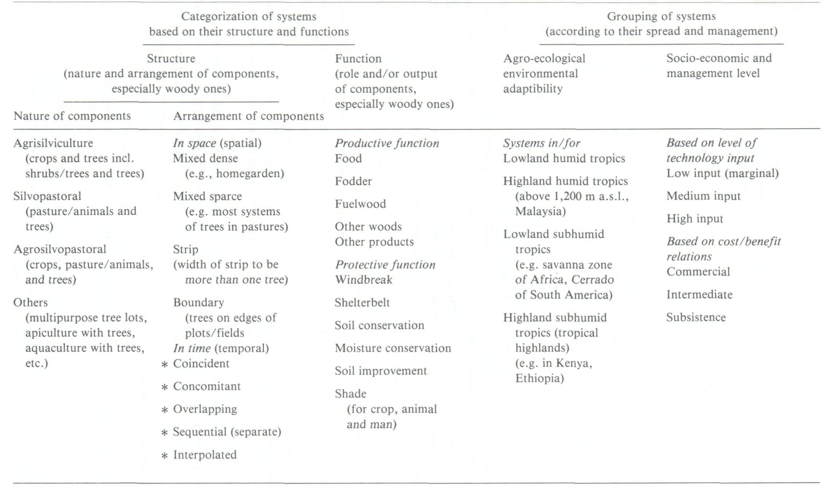
Major approaches to classification of Agroforestry systems and practices. Source: Nair (1985a)

Slide 37
2.5 Agroforestry system, practices and technology
System refers to a type of land use specific to an area and described according to its biotechnical or socio-economic aspects.
E.g. an agricultural system, or a forestry system denotes a type of agricultural or forestry land use of the locality
AF system described in terms of its main components, level of management and nature of output.
AF practice denotes a distinctive arrangement of components in space and time.
AF technology refers innovation or improvement, usually through scientific intervention, to either modify an existing system or practice, or develop a new one

Slide 38
Chapter Three Agroforestry systems in tropics
3.1. The tropical environment
The major climatic parameters that determine the environment of a location in the tropics are rainfall (quantity and distribution) and temperature regimes.
The major ecological regions recognized in the FAO
Temperate
Mediterranean
Arid and semiarid
Sub humid tropical (lowland)
Humid tropical (lowland) and highland.

Slide 39
Main characteristics of the major ecological regions of agroforestry importance in the tropics and subtropics. Source: Nair (1989).

Slide 40
3.2. Ecological spread of Agroforestry systems
Humid Lowlands | Semiarid Lowlands | Highlands
Shifting cultivation | Silvopastoral systems | Soil conservation hedges
Taungya | Windbreaks and shelterbelts | Silvopastoral combinations
Plantation-crop combinations | Multipurpose trees for fuel and fodder | Plantation-crop combinations
Multilayer tree gardens | Mutlipurpose trees on farmlands
Intercropping systems

Slide 41
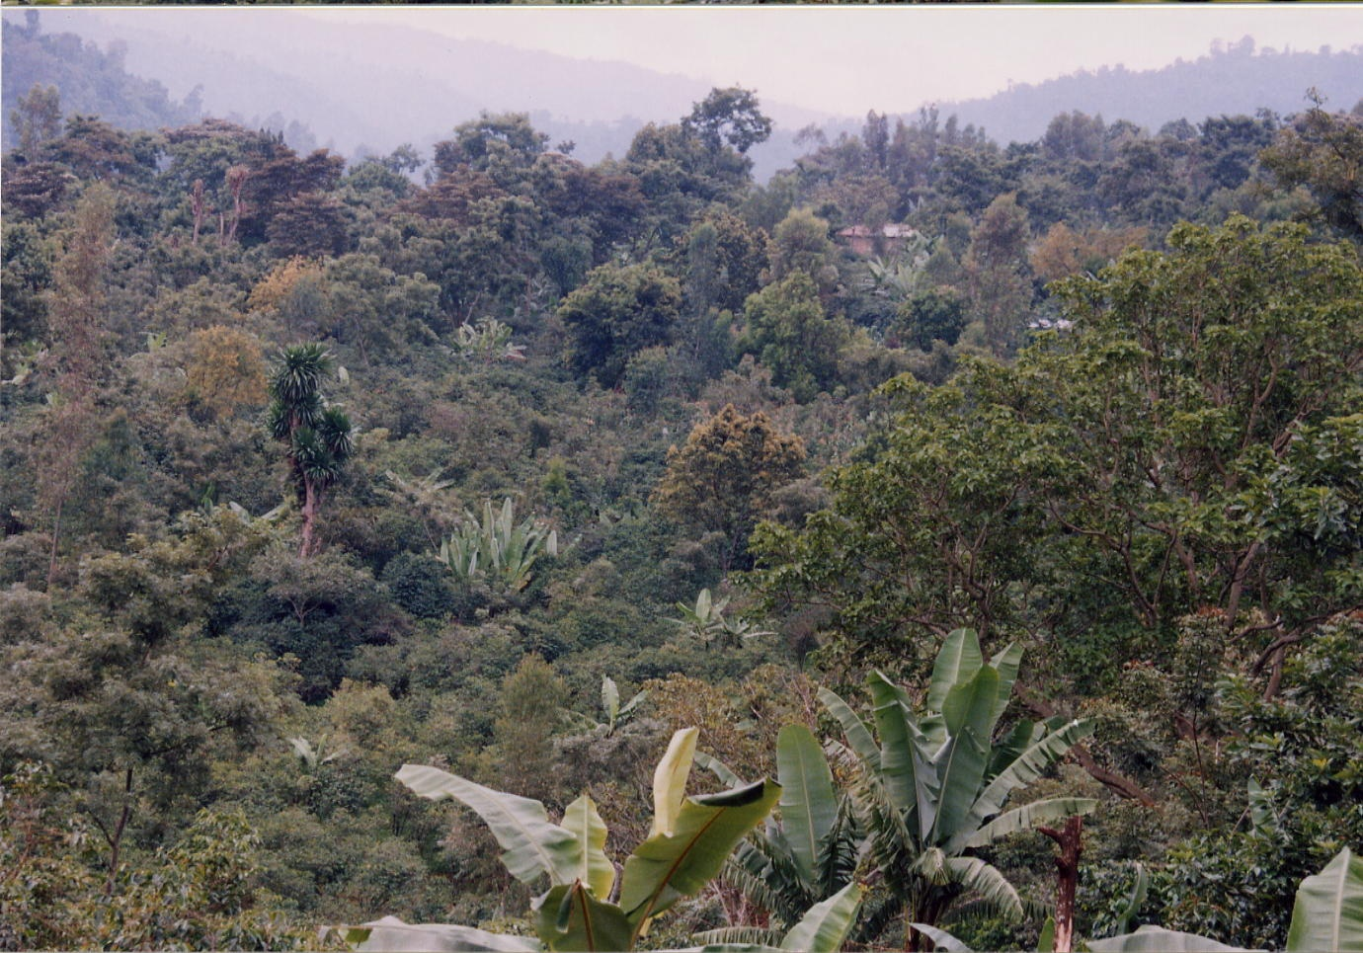
Chapter Four
Agroforestry species

Slide 42
The most important characteristic that determines the place of a species in AF is its amenability to integrated combination cultures (i.e., intercropping)
MPTs are those trees and shrubs which are deliberately kept and managed for more than one preferred use, product, and/or service

Slide 43
4.1 Important biophysical and socio-economic attributes of Agroforestry tree species
Intrinsic attributes – this is basically biophysical which any one cannot deny
E.g. -The phonology of Faihderbia Albida
- The light crown for Cordia africana
Ascribed attribute – the socio-economic interpretation of intrinsic biophysical attributes
E.g. Moringa olifera can be used for medicine, food, etc in some where but could not be used for such purpose in other place.

Slide 44
Ideotype is a biological model which is expected to perform in a predictable manner within a defined environment. It specifies the ideal attribute of plant for particular purpose.
Examples
Ideotype for silvopastoral system
Desired services and products
Fodder, fuel wood, as well as shade and shelter for livestock and people
Required characteristics
A species that sheds it leaves outside the dry seasons or evergreen
Round crown
Browse resistant
less Dense foliage
Leaves and pods should provide a high quality fodder
Large pods
Throns should be as small as possible

Slide 45
Criterias for suitable multipurpose tree/shrub species selection for Agroforestry
1. A high rate of biomass production
2. Dense net work of fine roots
3. The existence of deep roots
4. A high rate of nitrogen fixation
6. An appreciable nutrient content in the foliage & root system
7. Absence of toxic substances in the litter or root residues
8. A capacity to grew on poor soil, for soil reclamation
9. Absence of sever competition
10. Low invasiveness

Slide 46
Chapter Five
Agroforestry systems and practices

Slide 47
5.1 Common Agrisilvicultural practices
A. Improved Fallow
It is a rotational system that uses preferred tree species as the fallow species (as opposed to colonization by natural vegetation), in rotation with cultivated crops as in traditional shifting cultivation. Or
It is the replacement/enhancement of natural fallow vegetation by introduction of trees/shrubs for the purpose of fallow improvement.

Slide 49
Characteristics of a good fallow plant
Quick growth to close the canopy quickly
Suppress weeds, pests or diseases, and minimize erosion
High biomass production; litter breaks down
N2 fixing and deep rooted
Efficient absorption of nutrients
No problems with clearing
Supplies products that make its use attractive (fruits, stakes, folk medicines, feed etc.)

Slide 50
B . Shifting cultivation
It refers to farming or agricultural systems in which land under natural vegetation is cleared, cropped with agricultural crops for a few years, and then left untended while the natural vegetation regenerates.
In developing countries with low population densities, where the farmer had enough land at his disposal and freedom to cultivate anywhere .
under the strain of increasing population pressure, the fallow periods became drastically reduced and the system degenerated, resulting in serious soil erosion and a decline in the soil's fertility and productivity.
the length of the agricultural cycle can last only as long as the soil sustains reasonable crop yields.

Slide 51
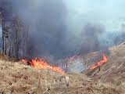
2 to 4 years of cropping
more than 10 years of fallow cycle

Slide 52
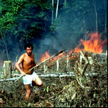
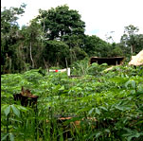

Slide 53
C.Taungya
It is a practice where farmers were allowed to grow crops between the trees in the first year (1-4 yrs) of forest plantations.
The design purpose of a taungya would be either to increase productivity or decrease costs.
Advantages of taungya are:-
It reduces weeding costs in the first few years
Provides a source of income that helps compensate for the costs of plantation establishment
The trees can benefit from fertilizers or other inputs used for the crop,
With more intense activity with in plantation, the tree are more closely monitored than they normally would be and potential problems would noticed before any major damage occurs

Slide 55
D. Alley cropping / hedge row intercropping
It involves managing rows of woody plants with annual crops planted in alleys between
The woody plants are cut regularly and leaves and twigs are used as mulch on the cropped alleys in order to reduce evaporation from the soil surface, suppress weeds and /or add nutrients and organic matter to the top soil.
Where nitrogen is required for crop production, nitrogen –fixing plants might be the main components of the hedgerows

Slide 56
The primary purpose of alley cropping is to maintain or increase crop yields by improvement of the soil microclimate and weed control.
Farmers may also obtain tree products from hedgerows including fuel wood, building poles, food, medicine, and fodder and on slopping land, the hedgerows and pruning may help to control erosion.

Slide 59
E. Scattered multipurpose trees on crop lands/Parkland AF
It is a practice in that annual crops are commonly raised below the trees.
The recommended number of trees are 15-50 trees per ha (100 tree/ha Faidherbia albida)
Primary design purpose for many common parklands would be crop facilitation and because the tree must exhibit a high degree of tree-crop compatibility
Advantages in parkland are:
Reduced soil temperatures,
Wetter soils
Higher levels of N,P,K, sodium, sulfur , higher water infiltration rates
Lower bulk density of the soil and
Greater water-holding capacity for the soil below the tree canopy

Slide 61
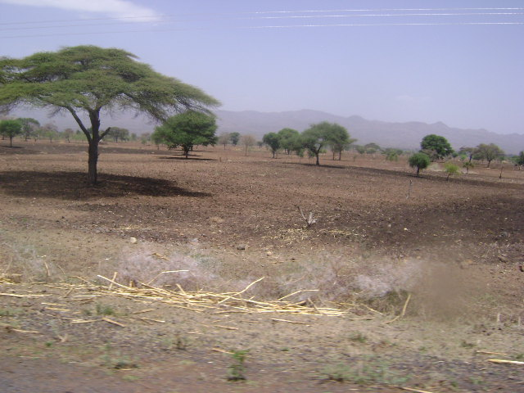

Slide 62
F. Shelter belts, wind breaks and live fences
These are perennial arboreal belts designed to optimally reduce wind speed to the benefit of crops/vegetables/ fruits on the leeward side
Effective in semi arid areas but in all wind prone areas
Reduce wind velocity
Reduce Evaporation
Increase overall soil moisture conservation
Reduce sand blessing effect
Reduce mechanical damage

Slide 64
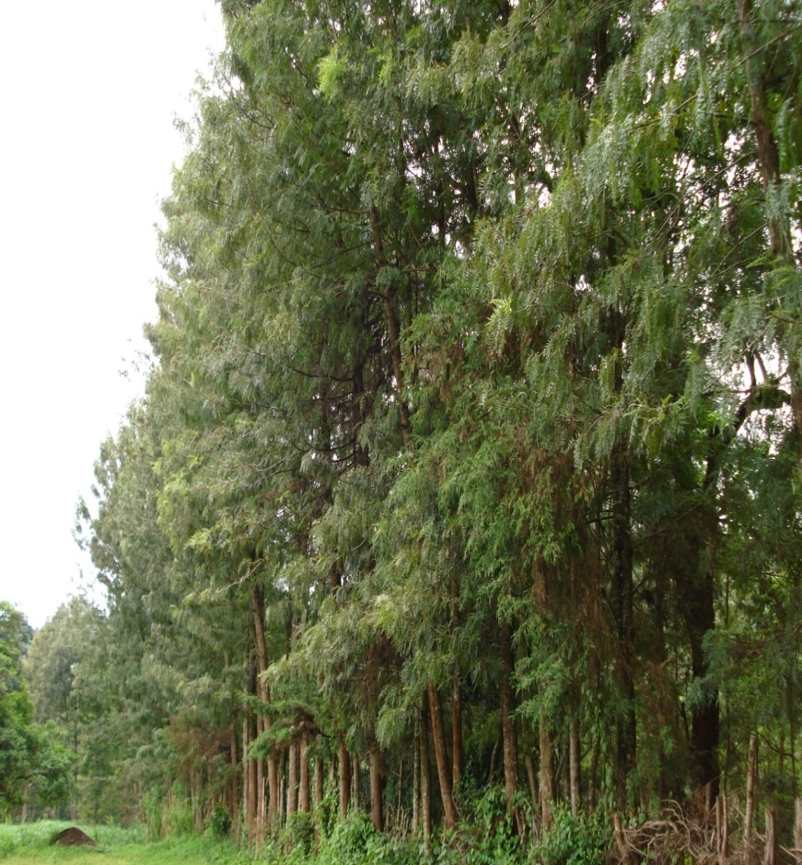
Live fence

Slide 65
G . Trees on erosion control structures
Trees on grass strips
Trees on ditch-and-bank-structures
Trees on terraces

Slide 68
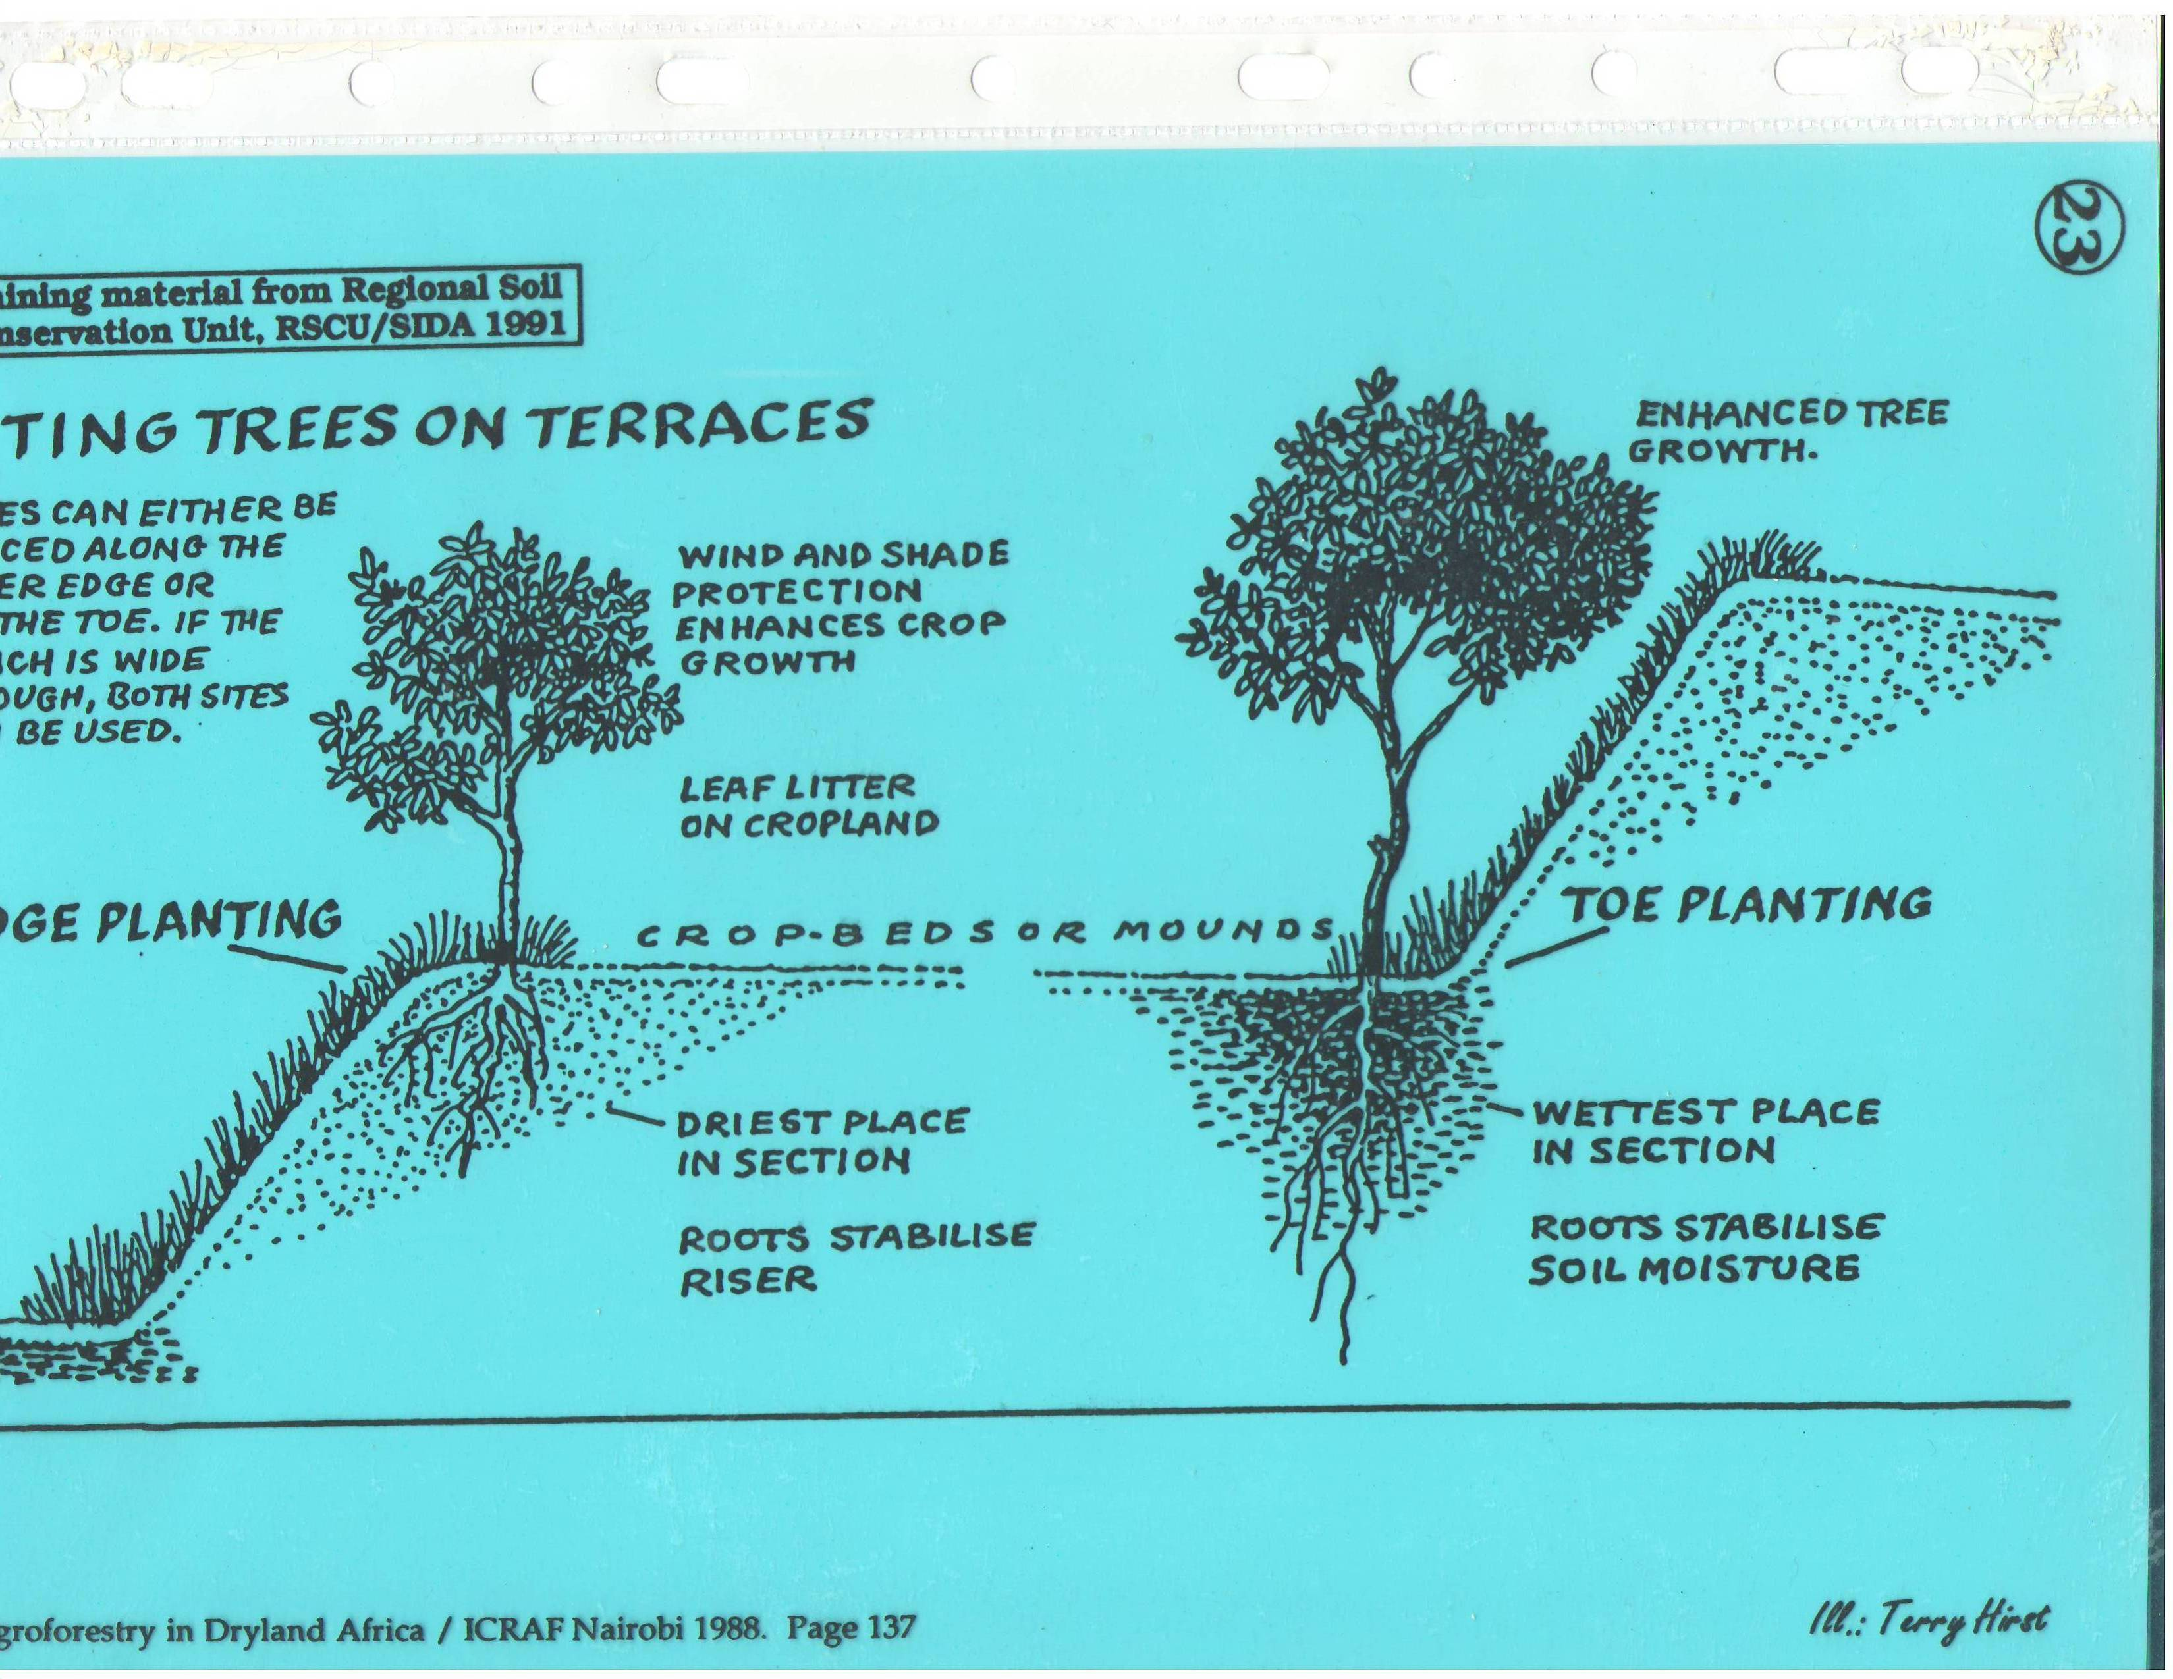

Slide 71
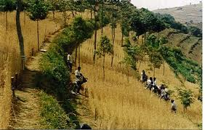
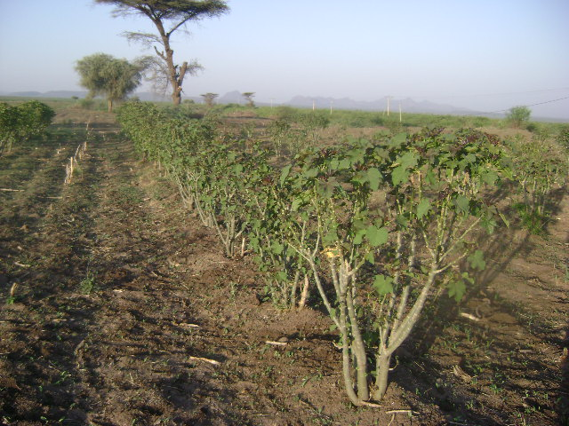
H . Contour hedgerows
It is a type of hedgerow intercropping, practiced on sloping land and with the primary objective of soil and water conservation.

Slide 72
I . Reclamation Agroforestry
Physical and chemical constraints to plant growth severely limit the productivity of vast areas of land in the world
Water logging ,acidity ,aridity ,salinity and alkalinity, and the presence of excessive amounts of clay ,sand ,or gravel are some of the constraints
Agroforestry techniques involving planting multipurpose trees that are tolerant to these adverse soil conditions have been suggested as management option for reclamation of such areas.
For example, several general of economically useful trees have been identified as capable of growing in saline –alkaline conditions ,including casuarinas and prosopis
Acid tolerant trees and shrubs useful for Agro forestry include Gmelina arborea, Erthrina spp
Tree species potential for soil amelioration in salt affected soils include Acacia nilotica, Acacia tortolis, Prosopis juliflora, Eucalyptus spp

Slide 73
5.2 Silvopastural systems
Trees provide long-term returns, while livestock generate an annual income.
Silvopasture systems are conducive to promoting forest management, while generating forage production in the understory that is suitable for livestock grazing.
Research has documented that many cool and warm season grasses and legumes yield high levels of quality forage when grown under as much as 50 % shade.

Slide 74
A. Trees on Rangeland or Pasture
Plantation of tree species with multipurpose uses in a random manner or pattern on pastures and rangelands, grazing of animals on rangelands and gathering of herbaceous plants for feed production.
Woody species uses for building material and fuel, feed leaves and shade
Various herbaceous plants that provide nutritional value and can be eaten by animals well be used.

Slide 76
B. Protein Banks
This refers to the cultivation of plants with nutritional feed value.
This practice referred to as feed banks.
Woody species under which herbaceous plants with feed value can be cultivated.

Slide 79
C. Plantation crops with pasture and animals
This system involves the grazing of small and large livestock on plantation land.
In forested areas, it is possible to start animal grazing 10-15 years following the planting of trees.
The most common example is animal grazing under pine plantation

Slide 80
5.3 Agrosilvopastural systems
A. Homegarden
It is a system where multi-purpose trees and shrubs are found in close association with perennial or annual agricultural plants and with animals.
They are near to dwelling places and are intensively managed by family labor.
It is a small scale, supplementary food production system by and for household members that mimics a natural, multi-layered ecosystem.
In comparison to the homegardens in the humid tropics, homegardens under sub-humid or semi-arid climates are less dense and have a multistrata nature which is less pronounced because of the small number of large trees

Slide 82
B. Multipurpose Woody Hedgerows
Woody hedgerows have been planted on agricultural terrains in order to provide branches and leaves as feed, grazing for animals and protection of land.
This production system includes ligneous species varieties with predominance of fruit trees and seasonal vegetable plants geared toward nutritional production.
In addition, it includes herbaceous plants with feed value and edible by animals.

Slide 83
C. Multipurpose Woodlots
This production technique prefers the cultivation of multipurpose woody species that provide wood for building material and fuel, feed leaves and shade.
It involves herbaceous plant varieties that have feed value and are edible by animals

Slide 84
5.4 Others Agroforestry systems
Aquaforestry- the integration of trees and shrubs with fish.
Entomoforestry- the integration of trees and shrubs with the beneficial insects(bees, silkworms).

Slide 85
Major Agroforestry practices and their main characteristics.
note: w = woody; h = herbaceous; f = fodder for grazing; and a = animals. Source: Nair (1991).

Slide 87
5.5 Characterizing traditional Agroforestry practices in Ethiopia
1.Based on edaphic and climatic factors
There was a technical committee for agro forestry in Ethiopia (1990) which was part of AFNETA (agro Forestry net work for tropical Africa) established having it’s main focus to study potentials of agro forestry in the highlands (in this case having >1500 m.a.s.l)
The emphasis is given to those areas due to the fact that this region is consisting 88% of the human and 2/3 of the livestock populations and, 95% of the cultivated land of the country

Slide 88
This committee classifies the highlands into three main agro ecological zones based on rain fall, altitude, and farming intensity
1. high potential perennial zones(HPP)
An ecological zone with warm, humid, and length of growing period >240 days
2. high potential cereal zones(HPC)
An ecological zone with intermediate climate and having length of growing period >180 days

Slide 89
3. low potential cereal zones(LPC)
An ecological zone with high variability of rainfall, occasional drought and length of growing period 90-150 days
4. Agropastoral and pastoral dry lands (arid and semi arid lands)
This is based on the length of growing period (LGP) which is a function such things as precipitation, evaporation, temperature and stored moisture in the soil.
The farming system agro –ecological classification is a modern system of plant growth potential classification

Slide 90
Agro ecological zones | HPP | HPC | LPC
Altitude(m.a.s.l) | >2500 | 2500 | <2500
Rain fall(mm) | 900-2000 ,bimodal | 700-1500 ,unimodal | 700-100 ,unimodal
Temperature(o_{c}) | 15-20 | 10-20 | 15-20 , 10-20
Growing period (days) | >240 | >180 | 90-150
Degradation | Limited | Moderate to sever | Wide spread

Slide 91
2. Based on farming practices
1.In high potential perennial zones(HPP)
A.ENSET –coffee-cereal-livestock system(in areas of 1500-2500m.a.s.l)
hilly topography and intensive farming systems(labor and land) mostly fond in wolita,sidamo,gedio zones
hilly ,extensive farming systems found in areas of wolkite, jimma areas
B.FOREST –coffee-enset livestock system(1500-2000m.a.s.l)
hilly extensive farming systems found in areas of jimma ,agaro,beadle
C. Enset-barley- livestock system (2500-3000m.a.s.l)
hilly ,extensive farming systems in gurage and goffa highlands

Slide 92
2.In the high potential cereal zones(HPC)
scattered trees on agricultural lands (i.e. acacia trees)
scattered trees on grazing lands (i.e. acacia, croton ,cordial,albizia,etc)
farm wood lots based on taungya( wood lands)
beekeeping vis a-vis crop lands
natural fallow (not too short for tree regeneration)
chat/food crops/livestock systems(agriculture in harar mid lands)
mixed cereal-livestock systems(1500-2500 m.a.s.l)
flat ,intensive in areas of rift valley floor, parts of arsi/bale,centeral plateau

Slide 93
hilly, intensive farming systems in areas of hararghe highlands, parts of central plateau,bahir dar,mota
barley –livestock farming system(2500-3000 m.a.s.l)
flat ,intensive farming system in parts of arsi/bale areas
flat ,intensive farming system in parts of central plateau, addis ababa,debre birhan)
hilly, intensive farming systems in areas of wollega ,debre birhan,debre sina
Hilly, intensive farming systems in mertolemariam area

Slide 94
hilly, intensive farming systems in areas of hararghe highlands, parts of central plateau,bahir dar,mota
Barley –livestock farming system(2500-3000 m.a.s.l)
flat ,intensive farming system in parts of arsi/bale areas
flat ,intensive farming system in parts of central plateau, addis ababa,debre birhan)
hilly, intensive farming systems in areas of wollega ,debre birhan,debre sina
Hilly, intensive farming systems in mertolemariam area

Slide 95
3. in low potential cereal zone (LPC)
A. mixed cereal –livestock systems (1500-2500 m.a.s.l)
flat ,intensive farming system in parts of tigray,wollo
hilly, intensive farming systems in areas of north wollo
B. barley –livestock system (2500-3000 m.a.s.l)
hilly, intensive farming systems in areas of semein mountain, north gonder, wollo
4.in the agro pastoral and pastoral zones
agrisilvopasture(in the uplands), and
silvopasture(in the more drier zones

Slide 96
Land use systems with some features of agro forestry are the following:
scattered trees in croplands
scattered trees in grazing /range lands
gum Arabic wood lands with beekeeping

Slide 97
Chapter Six
Soil and Agroforestry

Slide 98
6.1 Effect of trees on soil
6.1.1 Beneficial effects
Additions to the soil
Maintenance or increase of organic matter: organic matter addition to soils by trees is believed to be through continuous degeneration or sloughing-off of roots of standing (live) trees.
Nitrogen fixation:
Nutrient uptake: trees are more efficient than herbaceous plants in taking up nutrients released by the weathering of deeper soil horizons.
Atmospheric input: nutrients dissolved in rainfall (wet deposition) and those contained in dust (dry deposition).
Trees reduce wind speed considerably and thus provide favorable conditions for dry deposition.
II. Reduction of losses from the soil
Protection from erosion
Nutrient retrieval (Enhanced nutrient-use efficiency): tree-root systems intercept, absorb, and recycle nutrients in the soil that would otherwise be lost through leaching, thereby making a more closed nutrient cycle.

Slide 99
Processes by which trees maintain or improve soil

Slide 100
III. Effect on physical and chemical properties of soil
Maintenance or improvement of physical properties: soil structure, porosity, moisture retention, and erosion resistance
Modification of extremes of soil temperature
Reduction of acidity: Trees tend to moderate the effects of leaching through the addition of bases to the soil surface.
Effects of shading: Shade lowers ground-surface temperatures, which may reduce the rate of loss of soil organic matter by oxidation
Ground surface litter-cover greatly reduces the high ground-surface temperatures of bare soils which sometimes exceed 50°C.

Slide 101
6.1.2 Adverse effects
Loss of organic matter and nutrients in tree harvest: the depletion of soil resources by fast growing trees, and the effect of this depletion on subsequent forest rotations.
Trees accumulate large quantities of nutrients in their biomass, part of which is removed in harvest.
Nutrient competition between trees and crops
Moisture competition between trees and crops
Production of substances which inhibit germination or growth

Slide 102
6.2 Nutrient cycling in Agroforestry systems
A. Forest ecosystems - closed and efficient nutrient cycling systems
high rates of turnover and low rates of outputs or losses from the system
they are self-sustaining.
B. Agricultural systems are often open or "leaky," meaning that the turnover within the system is relatively low and losses as well as inputs are comparatively high.
C . Agroforestry systems falls between these two extremes more nutrients in the system are re-used by plants (compared to agricultural systems) before being lost from the system.

Slide 103
The major difference between Agroforestry and other land-use systems is transfer or turn-over of nutrients within the system from one component to the other and
The possibility of managing the system or its components to facilitate increased rates of turn-over without affecting the overall productivity of the system.

Slide 104
Nutrient cycling in Agroforestry

Slide 105
6.3 Soil Organic Matter
Soil organic matter (SOM) is the fraction of the soil consisting of plant and animal residues in various stages of decomposition. Organic matter contains mainly organic carbon and nitrogen.
Carbon is a source of energy and nitrogen is a source of protein for microorganisms in the soil. SOM consists of three distinct parts.
Living organic matter (about 15%) consists mainly of decomposers
Dead organic matter (about 15%) serve as food for living organisms and include dead microbes, old plant roots, crop residues and bodies of larger insects and animals.
Very dead organic matter (about 70%) are well decomposed, dark coloured organic substances also called humus. Humus continues to decompose, but at a very slow rate.

Slide 106
Organic matter decomposition refers mainly to the conversion of litter to humus through the activity of soil micro organisms.
6.4 Role of Roots
Tree-root systems intercept, absorb, and recycle nutrients in the soil that would otherwise be lost through leaching, thereby making a more closed nutrient cycle.
Mycorrhizal associations is symbiotic associations between roots and soil fungi, are also important in soil-plant relationships.
Mycorrhizae absorb carbohydrates from the host plant, and, in turn, function as an expanded root system which increases nutrient absorption.
They penetrate a large proportion of the soil, facilitating the uptake of nutrients, which can move only short distances by diffusion.

Slide 107
Chapter Seven Component Interaction
Component interaction is the influence of one component of a system on the performance of the other components as well as the system as a whole
The types of interactions have often described on the basis of net effect of interactions
These concept of observable net effects can be expressed by terms such as complementary, supplementary, and competitive

Slide 108
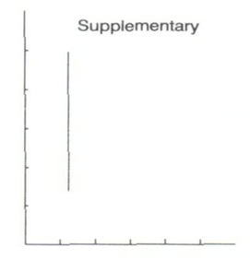
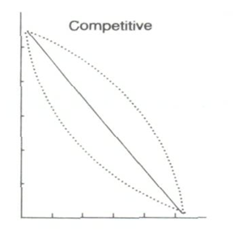
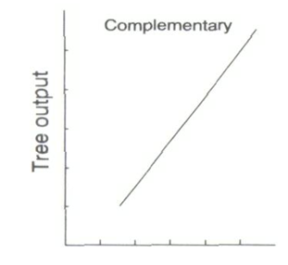
Crop/livestock output

Slide 109
The net results of an interaction can be positive (beneficial or production-enhancing) and negative (harmful or production-decreasing)
Interactions represent processes at the tree-crop interface (TCI) and tree-animal interface (TAI)

Slide 110
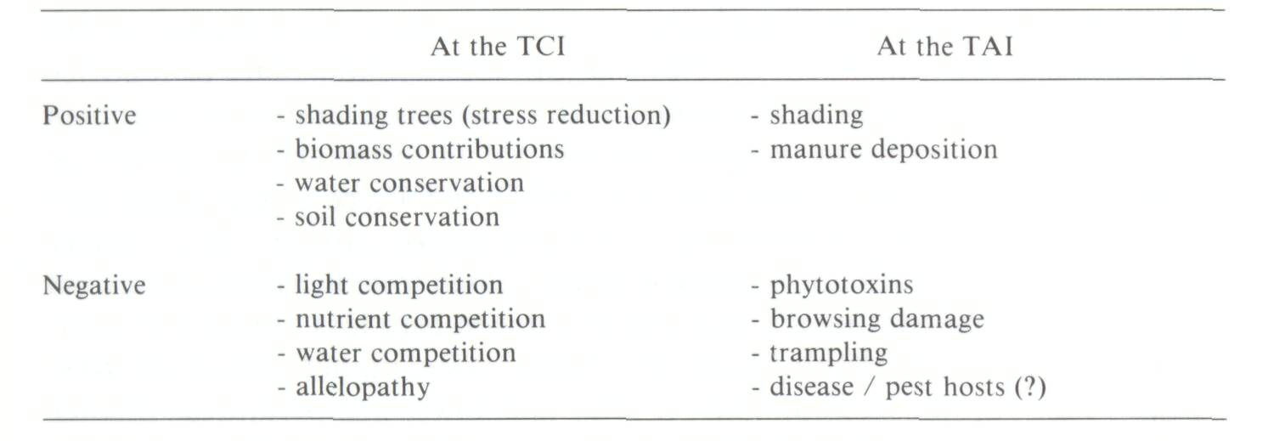
The major positive and negative effects at the tree-crop interface (TCI) and the tree-animal interface (TAI)

Slide 111
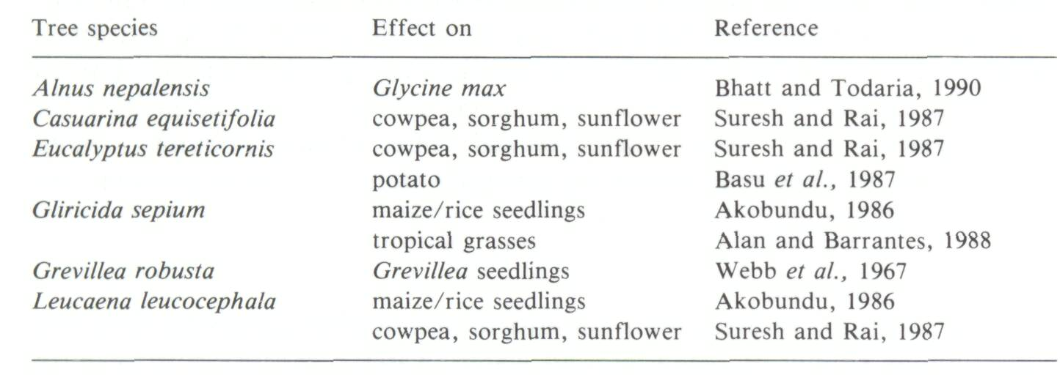
Some examples of Agroforestry tree species reported to have allelopathic effects

Slide 112
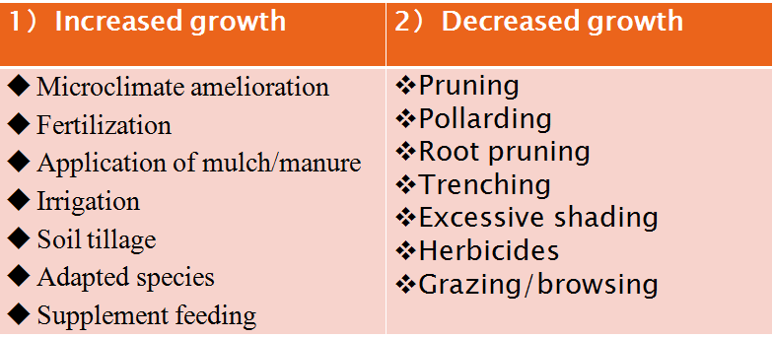
Management options can be growth-enhancing or growth-reducing according to their effect on the targeted component

Slide 113
Chapter Eight SOCIO-ECONOMIC & CULTURAL ASPECTS OF AF
8.1 Economic aspect
Though it is long term, AF is highly profitable and deserves continued attention.
supply products
boost the family's cash income
reduced need to spend cash on buying commodities which can be produced on farm if AF systems are fully developed and adopted

Slide 114
Economic aspect of AF considers the following parameters
Family income
Employment status
Livestock possession
Supplementary income
Farm expenditure

Slide 115
8.2 Social aspect
Having better financial income will give much opportunity and probability of getting social services. E.g.
Access to quality education service
Access to Health care
Reducing work load to females/gender sensitive
Generally, economic & social benefits are highly interlinked
Therefore, adoption of Af systems give better probability of improving social services of the household.

Slide 116
Social aspect of Agroforestry considers the following parameters
Festivals
Food habits
Communication exposure
Migration

Slide 117
8.3 Cultural aspect
The perception & attitude of farmers towards adoption & implementation of AF systems is +ve.
Most communities have their own bylaws in which they administer the utilization of tree from the AF system.
In Areas like Wenago, cutting trees with out replacing immediately is considered as taboo
Generally, Planting trees & practicing AF systems is becoming as culture mainly in the Southern part of our country.

Slide 118
Chapter Nine Evaluation of Agroforestry

Slide 119
9.1 Evaluation of Agroforestry systems
Evaluations of the merits and advantages of Agroforestry system in comparison with other Agroforestry system or other land-use systems is needed.
Any evaluation should be based on a specific set of criteria that, in turn, can be applied to the attributes under consideration.
Since the basic attributes or goals of all Agroforestry systems are productivity, sustainability, and adoptability; criterias for evaluating Agroforestry systems should be based on these attributes.

Slide 120
9.1.1 Productivity evaluation
The obvious approach for evaluation of this attribute would be to express the productivity of the different outputs in measurable, quantitative, and meaningful terms.
Land Equivalent Ratio (LER) and Harvest Index (HI) are two productivity measurements that are commonly used by agronomists.

Slide 121
A. Land equivalent ratio(LER)
It helps to judge the relative performance of a component of a crop combination compared to sole stands of that species.
The term LER is derived from its indication of relative land requirements for intercrops versus monocultures.
LER is the sum of relative yields of the component species.
In simple Agroforestry situations, LER can be expressed, as suggested by Rao and Coe (1992) as:
LER = Ci/Cs + Ti/Ts
Where, Ci = crop yield under intercropping
Cs = crop yield under sole cropping
Ti= tree yield under intercropping, and
Ts = tree yield under sole system
To compute LER, the relative yields of all components of the mixture may be summed.
When LER is 1, there is no additional production advantage of mixed culture;
When LER is less than 1, there is disadvantage; and
When LER is more than 1, there is advantage.

Slide 122
Example
Assume 4 tons of maize ha⁻¹ and 10 tons of Leucaena fodder ha⁻¹ are obtained when the two species are grown separately as sole crops and 3.2 tons ha⁻¹ of maize and 4 tons ha⁻¹ of Leucaena fodder are obtained from one hectare when the two species are grown together in a hedgerow intercropping scheme. Calculates the LER and interpret the results?
Answer: given: Cs =4t/ha, Ci=3.2t/ha, Ts=10ton/ha and Ti=4t/ha
LER= Ci/Cs + Ti/Ts
= (3.2t/ha/4t/ha) +(4t/ha/10ton/ha)
=0.8+0.4=1.2
So, intercropping in hedgerow is advantage than sole crops, i.e. Agroforestry is more advantageous than monocropping.

Slide 123
One of the main attributes of Agroforestry is the sustainability factor and LER, usually being a sum of relative yields of components over one crop season, does not reflect the long-term productivity of the system.
One way to overcome this difficulty would be to observe the changes in LER from year to year over a long period of time and then use the data as the basis for a sustainability index.
B. Harvest index
Harvest index is used to denote the fraction of economically useful products of a plant in relation to its total productivity/biomass:
Harvest index= Economic productivity
Biological productivity
But this term has little or no applicability in Agroforestry systems for several reasons.
First, in harvest index calculations, only above-ground dry matter is considered. Below-ground dry matter production (particularly roots) is very important too, because of its role in maintenance of soil organic matter.
Secondly, the mass of dry matter (and therefore harvest index) is no indication of the economic value of the product.
Another point is that most harvest index calculations are based on a single season's growth (productivity).
In Agroforestry combinations, some components are not harvested until several years after planting.

Slide 124
Integrating such productivity data over time and adding such adjusted values to harvest-index calculations not only complicates the calculations, but also distorts the concept of the term.
9.1.2 Sustainability evaluation
It is a concept that incorporates the long-term concerns of the society with the basic short-term needs of the world’s poor.
Agricultural sustainability encompasses the interaction among agriculture, household economies, the environment, society, and agricultural policies.

Slide 125
The Technical Advisory Committee (TAC) of the Consultative Group on International Agricultural Research (CGIAR) states that sustainable agriculture "should involve the successful management of resources for agriculture to satisfy changing human needs while maintaining or enhancing the quality of the environment and conserving natural resources" (CIMMYT, 1989).
The World Commission on Environment and Development report defined sustainable development as "development that meets the needs of the present without compromising the ability of future generations to meet their own needs" (WCED, 1987).
In production-oriented systems, sustainability can be considered as the maintenance of production over time, without degradation of the natural base on which that production is dependent.

Slide 126
Since sustainability deals with productivity of the system over time, there are three main issues to be considered: productivity changes over time, the time-frame being considered, and the costs (e.g. ecological, social, economic, and agronomic) associated with management and maintenance of production.
9.1.3 Adoptability evaluation
Adoptability evaluations have been attempted in some Agroforestry technology dissemination projects. For example, Miiler and Scherr (1990) undertook a review of Agroforestry technology monitoring and evaluation in 165 projects worldwide and suggested a planning approach to the design of effective and adoptable project interventions. This approach had three steps: farmer evaluation, field evaluations, and field testing.

Slide 127
Chapter Ten Diagnosis and Design Methodology
Diagnosis and Design(D&D) is a methodology for the diagnosis of land management problems and the design of Agroforestry solution.
A clear statement of the problem is often all that is needed to suggest a solution.
It was developed by ICRAF to assist Agroforestry researchers and development fieldworkers to plan and implement effective research and development projects.
There is an adage/saying in the medical profession that "diagnosis must precede treatment." Anyone concerned with problem-solving applies this principle in one way or another.
D & D is simply a systematic approach to the application of this principle in Agroforestry.

Slide 128
10.1 Basic Procedures of D & D Methodology
D&D Stages | Basic questions to answer | Key factors to consider | Mode of inquiry
Prediagnostic | Definition of the land use system and site selection (which system to focus on?) | Distinctive combination of resources, technology and land user objectives | Seeing and comparing different land use systems
 | How does the system work? (how is it organized, how does it function to achieve its objective?) | Production objectives and strategies, arrangement of components | Analysis and describing the system
Diagnostic | How well does the system work? (What are its problems, limiting constraints, problem-generating syndromes & intervention points?) | Problems in meeting system objectives (production shortfalls, sustainability problems) | Diagnostic interviews and direct field observations
 |  | Causal factors, constraints and intervention points | Troubleshooting the problem subsystems
Design& evaluation | How to improve the system? (what is needed to improve system performance) | Specifications for problem solving or performance enhancing interventions | Iterative design and evaluation of alternatives
Planning | What to do to develop and disseminate the improved system? | Research and development needs, extension needs | Research design, project planning
Implementation | How to adjust to new information? | Feedback from on-station research, on-farm trials and special studies | Re diagnosis and redesign in the light of new information

Slide 129
10.2 Key features of D & D
Flexibility: D & D is a discovery procedure which can be adapted to fit the needs and resources of a wide variety of land users.
Speed: D & D has been designed to allow for a "rapid appraisal" application at the planning stage of a project with in-depth analysis occurring during project implementation.
Repetition: D & D is an open-ended learning process. Since initial designs can almost always be improved, the D & D process need not end until further improvements are no longer necessary.
D & D is based on the premise that, by incorporating farmers into research and extension activities, subsequent recommendations and interventions will be more readily adopted.
During the pre-diagnostic and diagnostic stages, a multidisciplinary team of researchers interacts with farmers and other land users either individually or in groups.
These group exercises are used to characterize current Agroforestry practices, identify economic, agronomic, social, and other forms of constraints to production, and discuss alternate production and management strategies.
These activities are needed to identify or elicit farmer perceptions of land-use constraints.

Slide 130
Special efforts are also made to involve women in the diagnostic interviews; by doing so, problems such as fuel wood shortages, which men may be unaware of or not concerned about, receive deserving attention.
Farmer interviews are also useful in initiating linkages and developing trust between farmers and researchers, which is necessary for future program development.
If the Agroforestry technologies that are predicted in the design already exist, the D & D methodology can be used directly as a guide for Agroforestry interventions by extension workers.
If, on the other hand, the desired technologies do not exist or are not fully developed, the designs can provide a basis for identifying the kind of research that needs to be undertaken.
However, in reality, most applications of D & D to date have been for development-oriented projects.

Slide 131
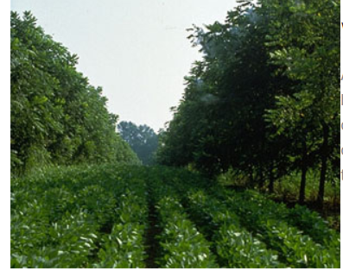
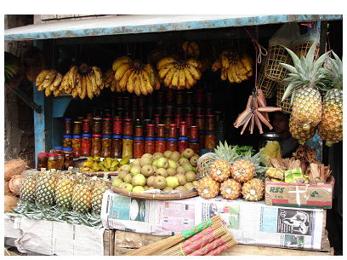
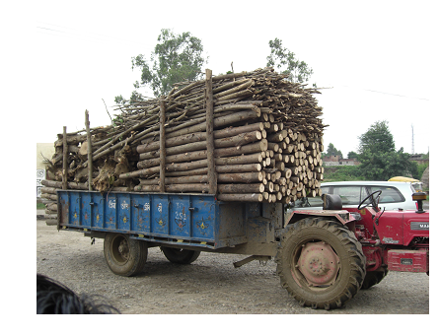
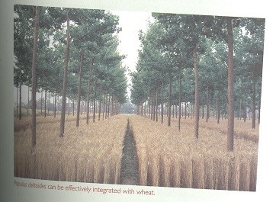
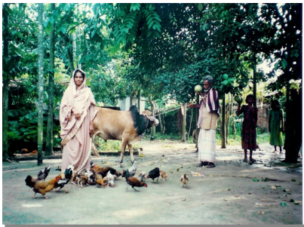
Y O U !!!
T H A N K

