Slide 1
Session Outline
1
2
3
4
5
Food safety & Quality mang’t
Impact of food safety hazards
Introduction
Food safety hazards
Food safety & nutrition linkage
Objectives
Definitions

Slide 2
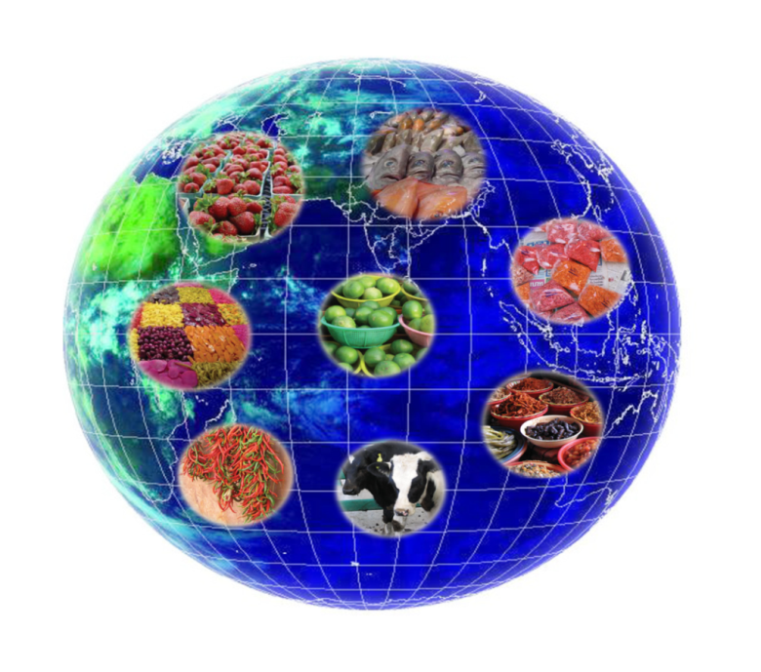
Introduction
Why Food Safety is the Current Global Concerns?
Consumer awareness
Globalization
Market access
Notes:
Consumer awareness, Globalization, Market access

Slide 3
Food safety problems can occur in all types foods along the food value chain.
A safe and nutritious food supply is a vital component of food security.
Food security, is summarized as permanent access to a sufficient, safe, and nutritious food supply needed to maintain an active and healthy lifestyle.

Slide 4
Objectives
At the end of this chapter participants will be able to:
Define basic terms of food safety
Explain food safety hazards in agricultural products
Describe good practices
Recognize food safety and nutrition linkage
Identify impacts of food safety hazards

Slide 5
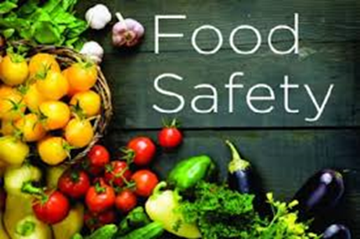
Definition of food safety and related terms
Food safety
It is a component of quality and an assurance that food will not cause adverse harm to the consumer.
Food safety is not negotiable/mandatory.

Slide 6
Foodborne Illness:
Sickness or injury caused by eating food containing a microbiological, chemical or physical hazard(s).

Slide 7
Good Agricultural Practices (GAP’s)?
Practices to ensure environmental, economic and social sustainability for on farm production (and post-production processes) resulting in safe and quality food (FAO, 2003).

Slide 8
Good Hygienic Practices (GHP):
The basic rules for the clean and healthy handling, storage, processing, distribution and final preparation of all food along the food production chain.
Good Manufacturing Practices (GMP’s):
A set of guidelines specifying activities to be undertaken & conditions to be fulfilled in food manufacturing processes
Hazard Analysis Critical Control Point (HACCP)
It is a systematic food safety assurance method to identify, evaluate and control of food hazards.

Slide 9
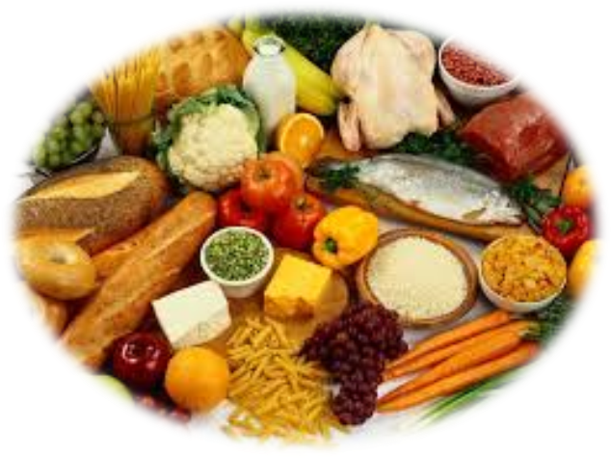
Food Quality versus Food Safety
Food quality??
defined as a total of traits and criteria which characterize food as regards its:
nutritional value,
sensory value,
safety for a consumer’s health

Slide 10
Main factor | Components
Appearance (visual) | Size, Shape & form, color, Gloss, Defects (Morphological, Physical & mechanical, physiological, pathological & entomological)
Texture (Feel) | Firmness, hardness, softness, crispness, succulence, juiciness, mealiness, grittiness, toughness, fibrousness
Flavor (Taste & smell) | Sweetness, sourness (acidity), Astringency, bitterness, aroma, off-flavors & odors
Nutritive value | Carbohydrates, proteins, lipids, vitamins, minerals
Safety | Naturally occurring toxins, contaminants, mycotoxins, microbial contamination

Slide 11
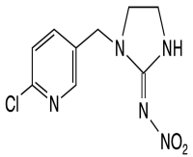
Food Safety Hazards?
Any substance that is reasonably likely to cause injury or illness, when present above an established acceptable level.
There are three recognized categories of food safety hazards:
Chemical
Physical
Biological

Slide 12
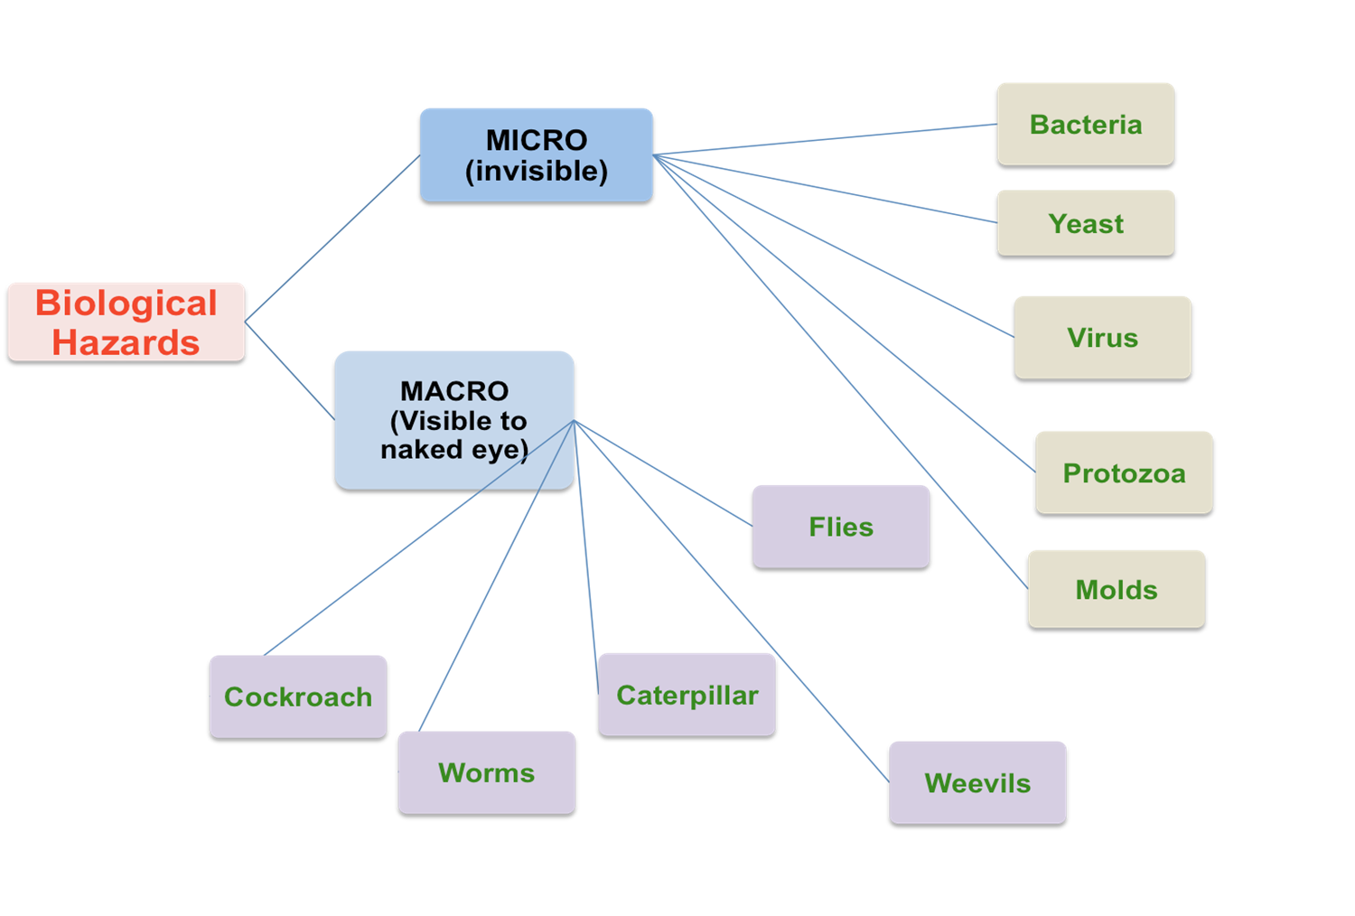
Biological Hazards
Biological hazards:

Slide 13
a. Pathogenic bacteria
Clostridium botulinum & Clostridium perfringens
Bacillus cereus
Brucella abortus, B. suis (mainly animal)
Campylobacter spp.
Escherichia coli (e.g. E. coli O157:H7)
Listeria monocytogenes
Salmonella spp. (e.g., S. typhimurium, S. enteriditis)/poor sanitation
Shigella spp. (e.g., S. dysenteriae)
Staphylococcus aureus
Streptococcus pyogenes

Slide 15
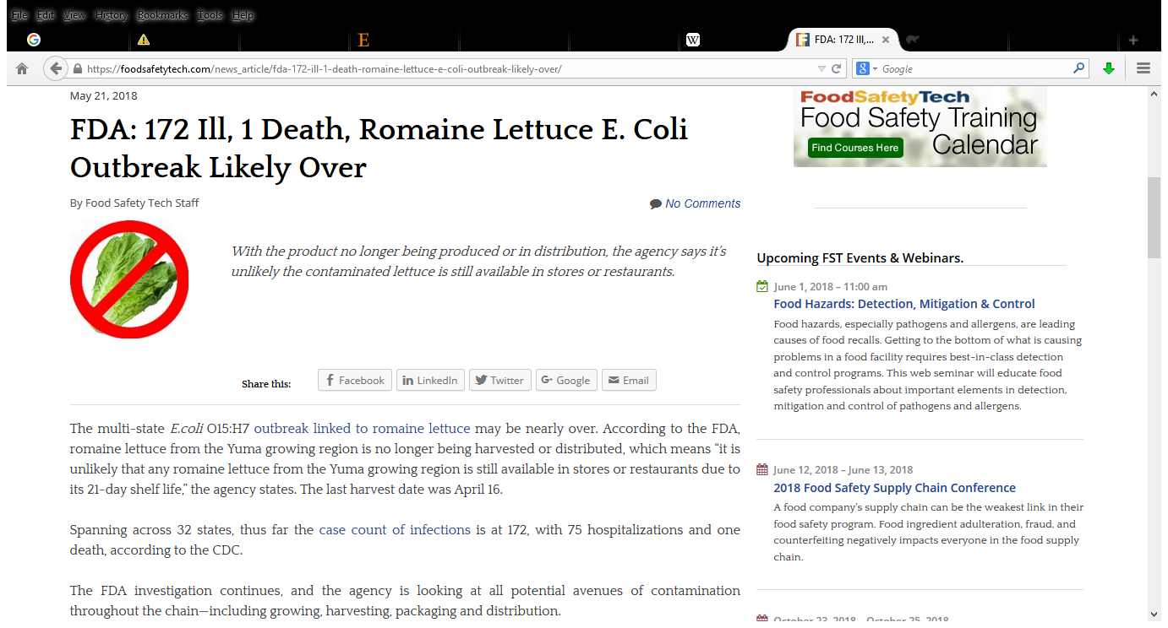
For example,
CDC estimates that Salmonella causes approx. 1.2 million illnesses and 450 deaths every year in the United States.
The Salmonella infection is most common in June, July, and August

Slide 16
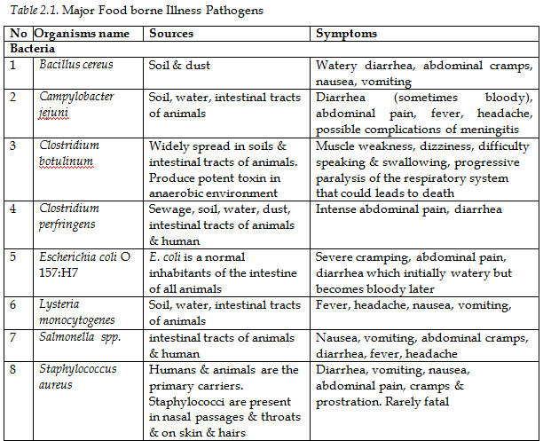

Slide 17
b. Viruses
Foods can be the medium for transmission of certain viruses.
Examples of viruses that are known to be food safety hazards are
Hepatitis A & E viruses
Norwalk group of viruses &
Rotavirus

Slide 18
c. Parasitic Protozoa & Worms
Anasakis simplex
Ascaris lumbricoides
Cryptosporidium parvum
Diphyllobothrium latum
Entamoeba histolytica
Giardia lamblia
Pseudoterranova dicepiens
Taenia solium, T. saginata
Trichinella spiralis

Slide 19
Chemical Hazards
Pesticides (Application + handling)
Herbicides
Insecticides
Fertilizers
Antibiotics
Animal drugs
Cleaning residues
Notes:
Case Scenarios # 2
MRL as a market barrier for developing nations
Coffee ocra toxin
Vegetables grown in industrial area and towns

Slide 20
Inorganic fertilizers and their associated health risks
Amines produced from the nitrogenous fertilizer cause cancer in human beings
Aluminium at high levels leads to birth defects, asthma, Alzheimer and bone diseases.
Calcium toxicity results in developmental and neurological toxicity, growth retardation, cognitive delay, kidney,
nervous and immune system damage.
Cobalt only at high levels leads to lung damage.
Boron causes low sperm count, nose, throat and eye irritation.

Slide 21
Mycotoxins (Afla, Ocra, Patulin)
Naturally occurring toxins
Food additives
Toxic chemicals from industries
Heavy metals

Slide 22
Some examples of Mycotoxin and potential health effect
Mycotoxin | Concern | Health Effect
Patulin | Fruit juices (particularly apple) | Genetic mutations
Ochratoxin A | Cereals, wine, coffee and grapes | Kidney disease
Zearalenone | Cereals | Endocrine system disruption
Aflatoxins | Peanuts, tree nuts and maize, milk, nug | Liver cancer
Trichothecenes | Cereals | Acute vomiting, diarrhoea (if large amount eaten)
Fumonisins | Maize | Kidney and liver disease

Slide 23
Physical Hazards
Physical Hazards:
Any potentially harmful material found in food and likely to cause choking, cuts, injury or other adverse health effects
It include:
naturally present in the food (animal hair, bone chips, leaves, etc)
occurring in agriculture (dirt, manure, leaves, etc)
Objects added during processing (glass, plastic, hair, metal, etc).

Slide 24
GMO

Slide 25
Group Activity-1
Instructions:
Be in three groups
G-1 (Animal Science & RDAE)
G-2 (Plant Science & Agr. Economics)
G-3 (Horticulture & NaRM)
Write your discussion points on flip chart to present for the whole audience
15 min for discussion and 5 min for presentation

Slide 26
Discussion Points
What are the common source of food hazards and the possible remedial actions across the chain?
Animal source foods: poultry, dairy, beef, etc.
Grains:
Fresh fruits and vegetables:
Notes:
Common sources are: 1. Soil and Water 2. Organic and Inorganic Fertilizers 3. Animal Exclusion and Pest Control 4. Worker Health and Hygiene 5. Field, Harvest and handling Sanitation 6. Equipment's and tools 7. Air 8. Handling techniques

Slide 27
Sources of food safety hazards
1. Soil and Water
2. Organic and Inorganic Fertilizers
3. Animal and Pest Control
4. Worker Health and Hygiene
5. Field, Harvest and handling Sanitation
6. Equipment's and tools

Slide 28
Current Food Safety Problems in Ethiopia
What are the current food safety problems in Ethiopia?
Foodborne illness (microorganisms/toxins in food)
Mycotoxin problems (specially Aflatoxin)
Heavy metal accumulation in vegetables
Maximum pesticide residual level

Slide 29
What are the sources?
Inappropriate food handling/preparation/processing
Inappropriate storage conditions (temperature, RH)
Excessive moisture content (MC), lead to rotting
Drying to the recommended MC (e.g. maize 13.5%).
Animal feed contaminated with mycotoxin (aflatoxin)
Aflatoxin B1 and B2 in feed is converted by cattle into aflatoxin M1and M2 and secreted in the milk.
Irrigation with waste water in urban areas

Slide 30
Total aflatoxin recorded from each of the survey districts exceeds international standards
Serve as a wakeup call to create awareness on the aflatoxin problem in the country and its mitigation

Slide 32
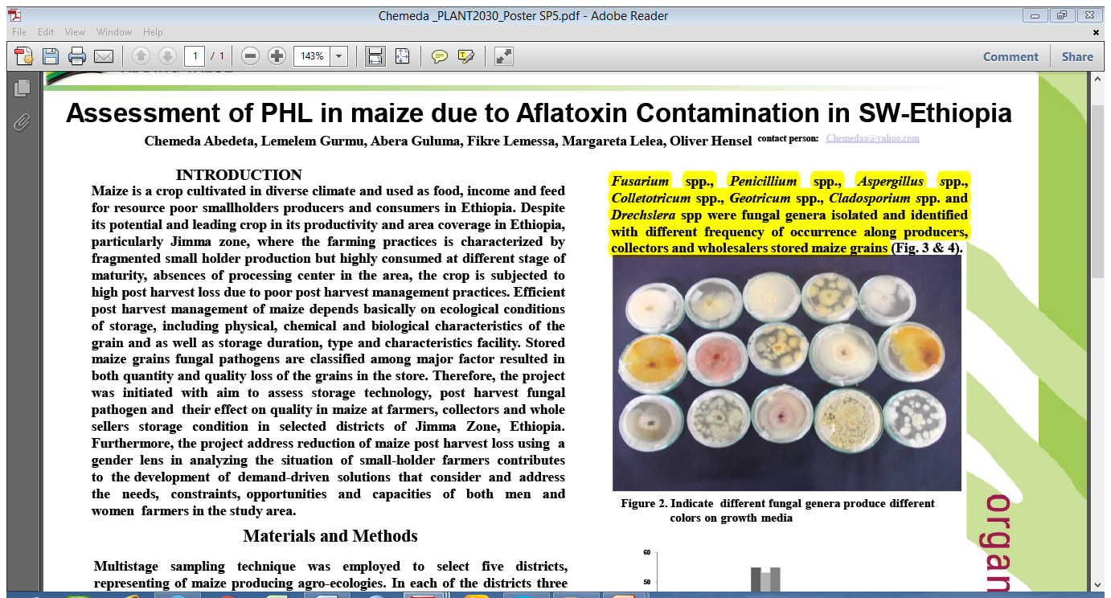

Slide 35
- Occur on cereals, fruits, spices, nuts & livestock products - B1, B2, G1, G2, M1 & M2 - Acute & chronic -We are at risk

Slide 37
There are four major types of aflatoxins:
AFB1, AFB2, AFG1 and AFG2
A. flavus produces aflatoxin B1 and B2
A. parasiticus produces aflatoxin G1 and G2 in addition to B1 and B2.
Aflatoxin B1 is considered to be the most important of four because it is the most toxic
Level of carcinogenicity is B1>G1>B2>G2

Slide 38
Aflatoxin M1 and M2
other significant members of the aflatoxin family
are oxidative forms of aflatoxin B1, which are modified in the digestive tract of some animals and humans and can be isolated from milk.

Slide 39
No appropriate policy
Lack of strong regulatory body
Lack of well equipped lab facilities
Personnel related

Slide 40
If there are forty cups on the table and one cup breaks, how many tea cups are left?
Mary's father has five daughters: 1. Nana, 2.Nene, 3. Nini, 4. Nono. What is the name of the fifth daughter?

Slide 41
Predisposing Factors in grains
Temperature 10-40 ºC
Grain moisture above 13%
Humidity 65-70%
Stress condition results in shrivelled grains which are more susceptible to attach by Aflatoxin producing fungi.
Harvesting methods
Drying methods
Shelling methods
Dusting.
Storage structures .

Slide 42
Mycotoxin Occurrence
Fungal contamination of food products can occur at pre-harvest level or after, during processing,
conditions (moisture, temp., competition with other MOs).
Such fungal contamination can also lead to mycotoxin accumulation.
In tropical countries, contamination of foods with mycotoxins represents an
important limit to the income of farmers and
a major public health concern

Slide 43
The most common fungi found in cassava products belong to genera
Rhyzopus,
Aspergillus,
Fusarium,
Phoma and
Penicillium
F. graminearum
Their corresponding mycotoxins could also be found in cassava.

Slide 44
Safety and Quality Management Systems
Think-pair-share (5 min)
How can the safety and quality of food be managed along the food value chain?

Slide 45
Safety and Quality Management Systems communication
By implementing food quality assurance standards by the food chain members
Obligatory by law
Voluntary to be implemented

Slide 46
Safety and Quality Management Systems
Good Agricultural Practice (GAP) and Good Animal Husbandry (GAH) or Good Veterinary Practice (GVP)
Good Hygiene Practices (GHP)
Good Manufacturing Practices (GMP)
Hazard Analysis & Critical Control Point (HACCP)

Slide 47
Good Agricultural Practice (GAP)
GAP is guidelines, ensure that all agricultural practices, in particular pest and disease control are in accordance with practices such as:
Integrated Crop Management (ICM) and
Integrated Pest Management (IPM)
GAP
focus on the best practices to be used for producing agricultural products
to ensure the quality & safety of the final product

Slide 48
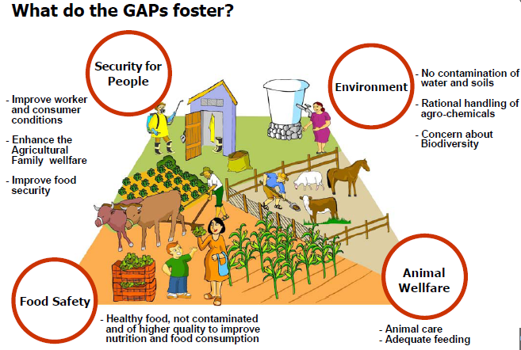
3
2
4
1

Slide 49
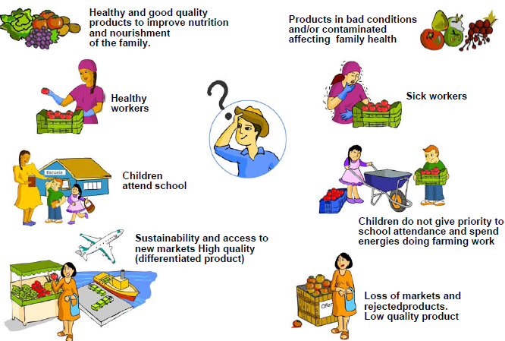
Why GAP?

Slide 50
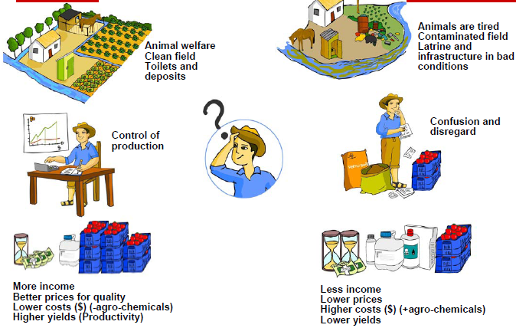

Slide 51
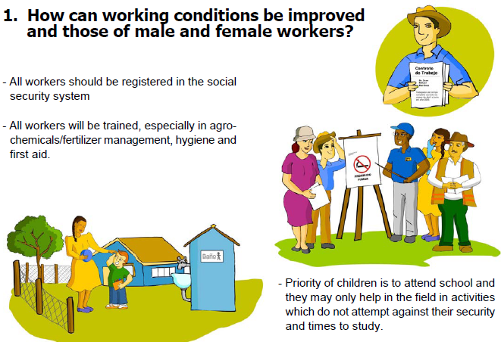
How should GAP be implemented?

Slide 52
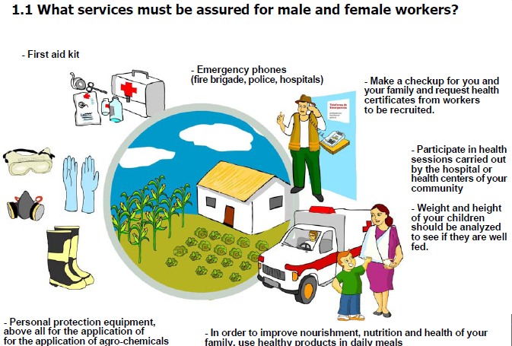

Slide 55
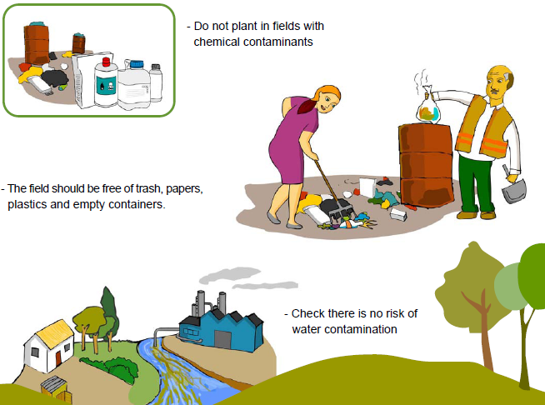

Slide 56
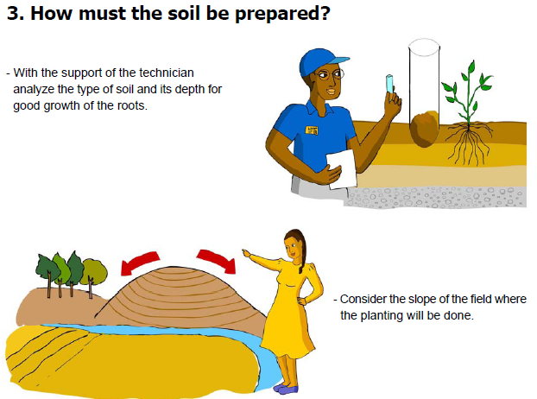

Slide 57
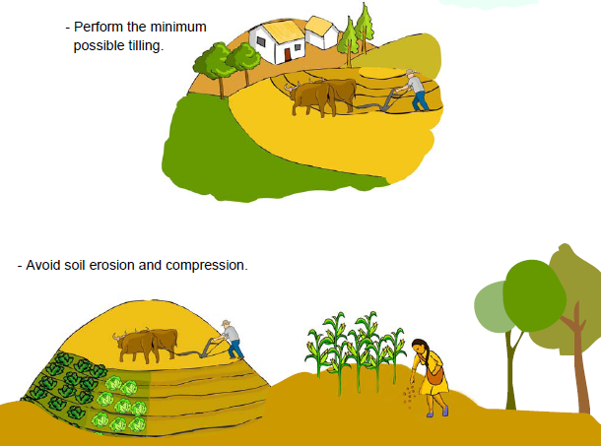

Slide 58
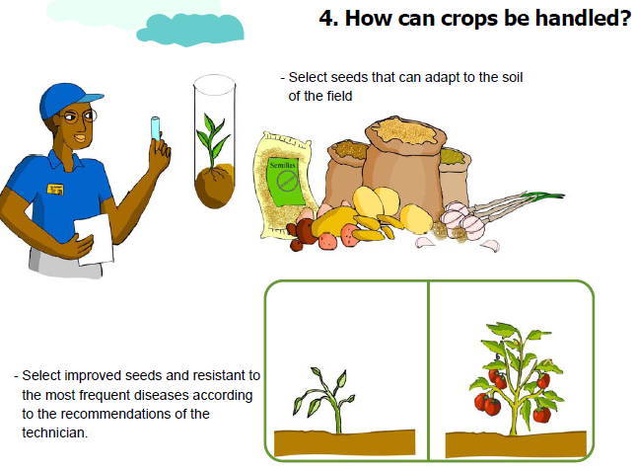

Slide 59
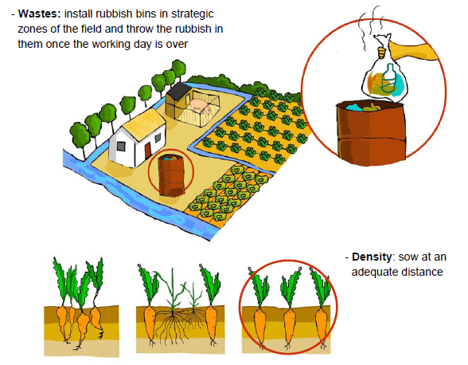

Slide 60
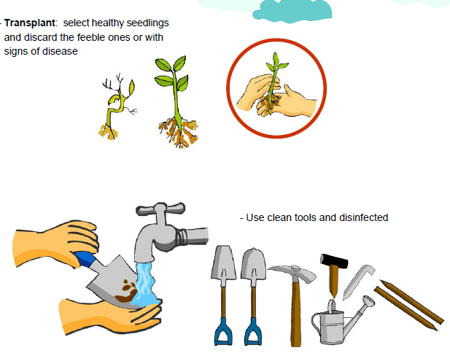

Slide 61
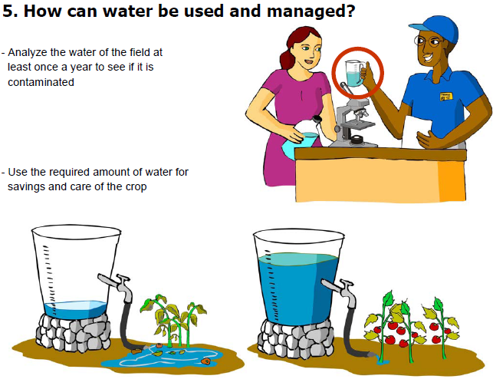

Slide 62
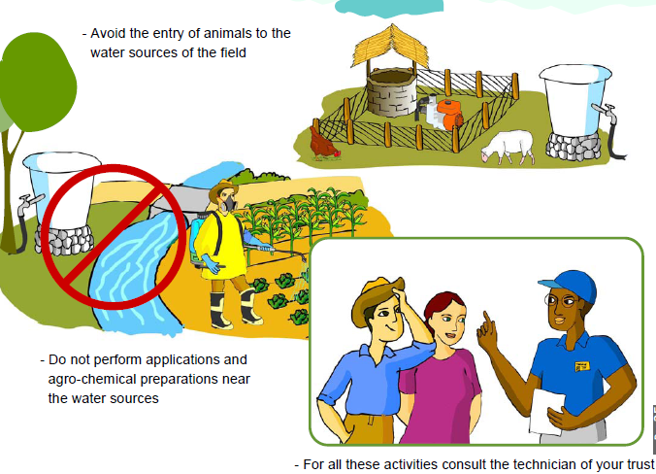

Slide 64
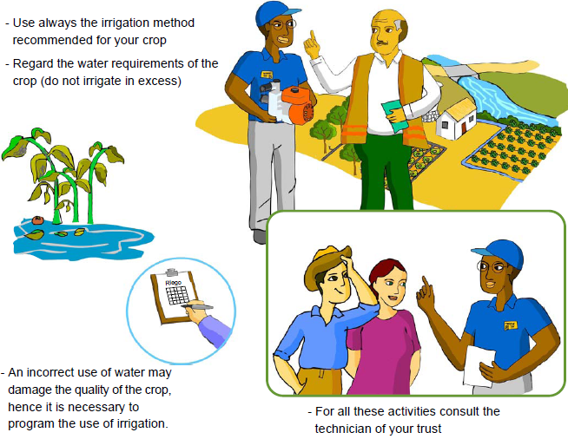

Slide 65
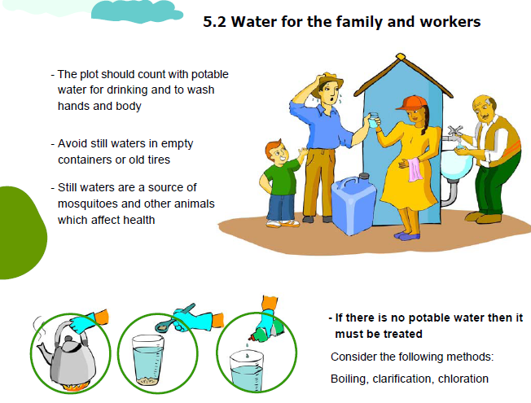

Slide 66
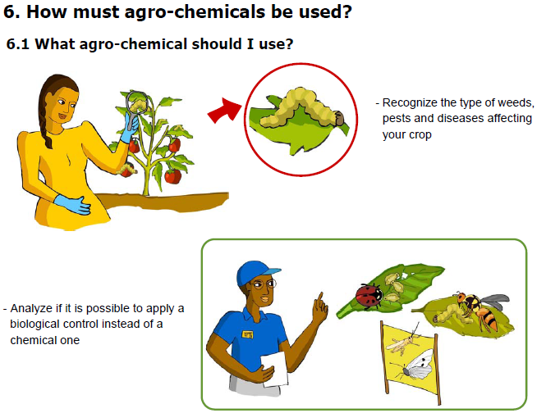

Slide 67
What are your experiences on agro-chemical and animal drugs handling and application in your local areas?

Slide 70
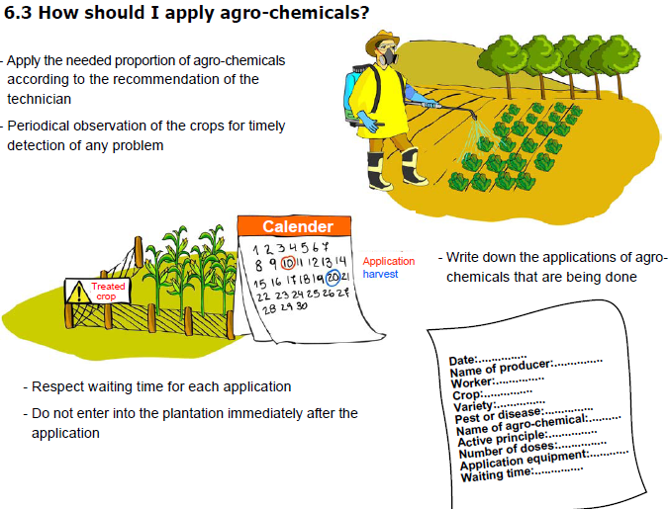

Slide 71
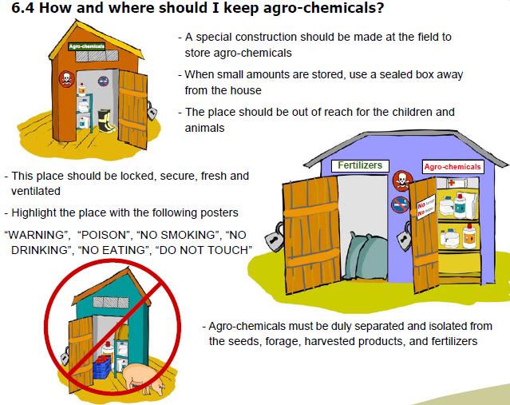

Slide 72
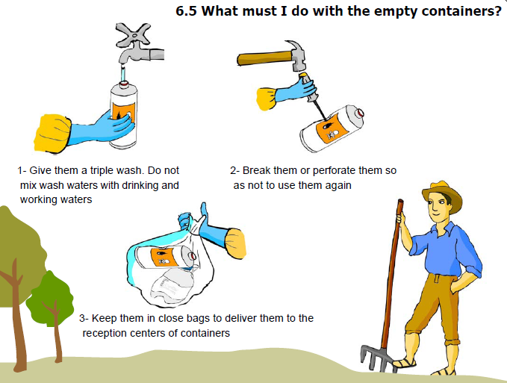

Slide 74
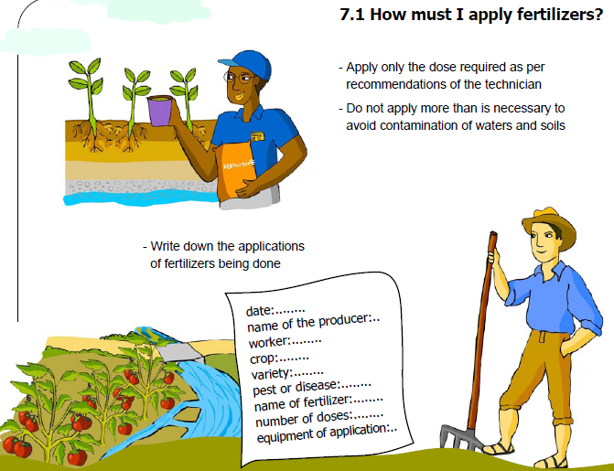

Slide 75
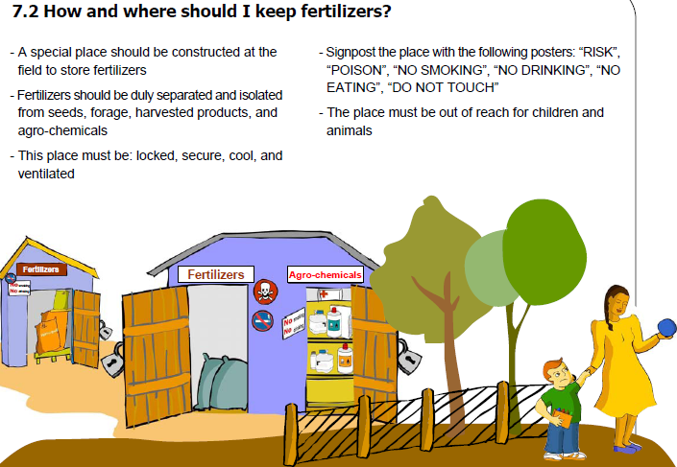

Slide 77
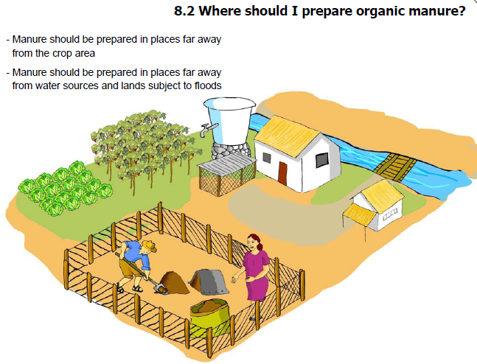

Slide 79
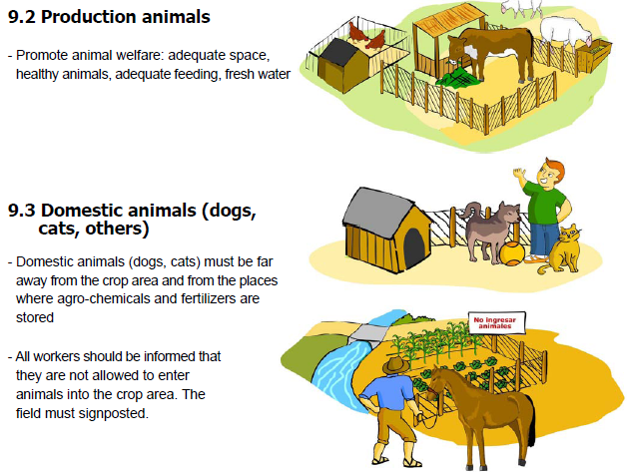

Slide 80
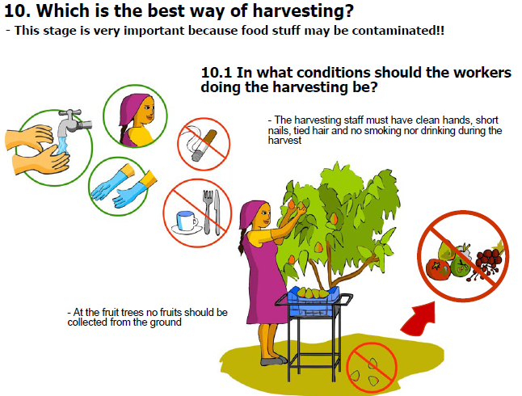

Slide 81
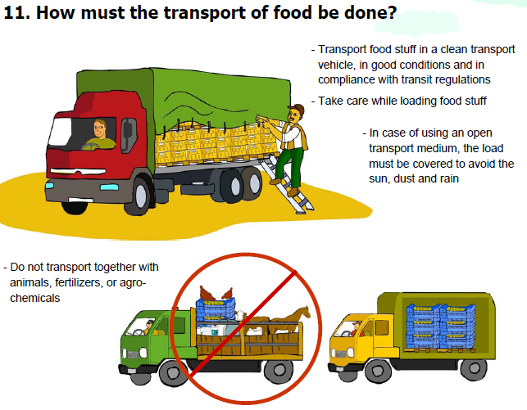

Slide 82
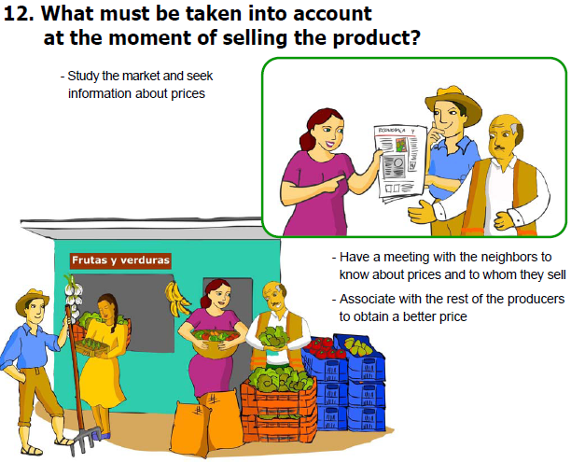

Slide 83
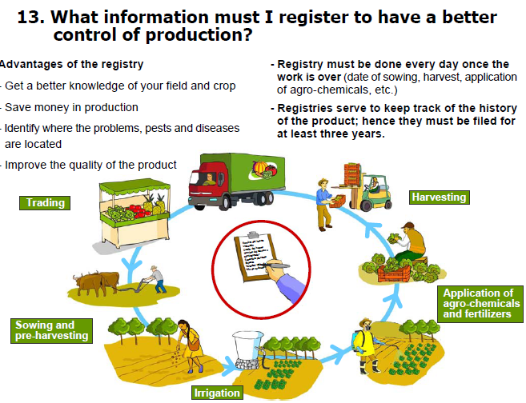

Slide 84
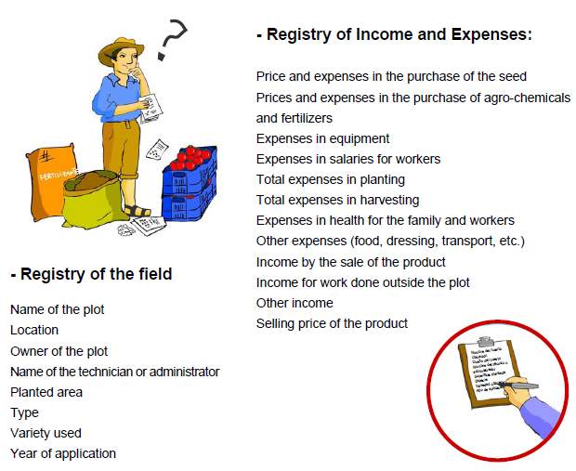

Slide 85
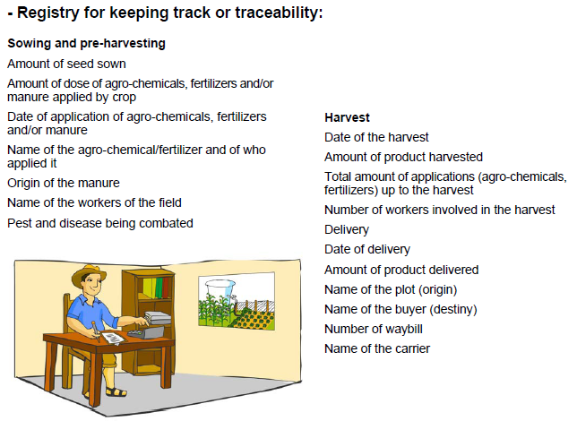

Slide 87
GAP should be implemented
Improve working conditions
Best place to plant (crop rotation, fertility & sanitation)
Soil preparation (slope, tillage, erosion etc…)
Crop handling (improved seeds),
Water management
Agro-chemical handling
Type and quality of organic or chemical fertilizer
Animal in the field
Harvesting and post-harvest handling
Record keeping and traceability

Slide 88
Good Hygiene Practice (GHP)
All practices taken to:
ensure the food safety suitability or constitute a set of guidelines specifying activities to be undertaken and
hygienic conditions to be fulfilled and monitored at all steps of the food chain in order to assure food safety.

Slide 89
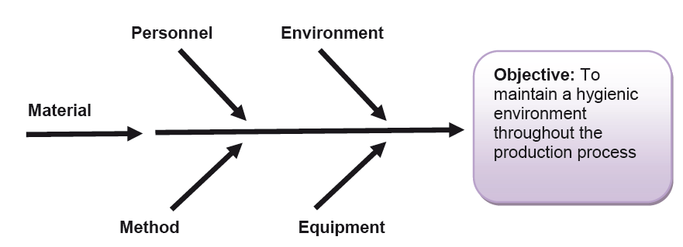
Good Hygiene Practice (GHP)
Ishikawa diagram
Which elements of the process determine the risk of contamination?

Slide 90
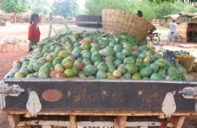
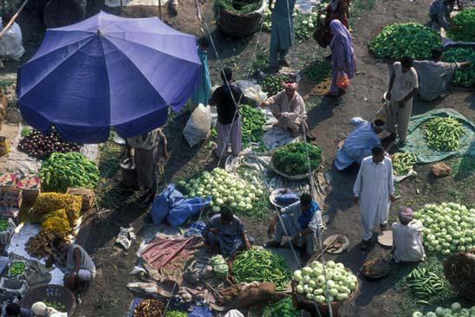
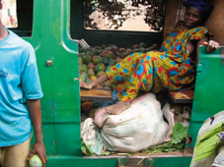
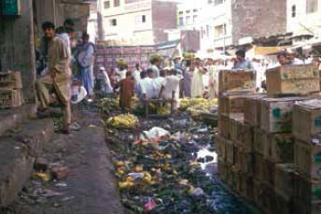
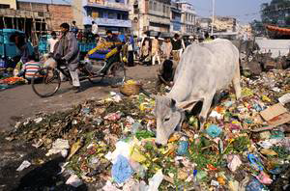
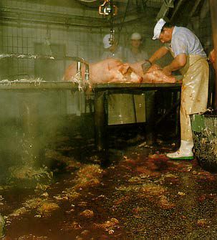

Slide 91
Good Manufacturing Practices (GMP’s)
Assure that the food produced meets the standards of food safety.
General procedures to reduce food safety hazards.
GMP:
Eliminate human errors in the manufacturing environment
Prevent contamination and lowering of product quality
Standardize the product quality

Slide 92
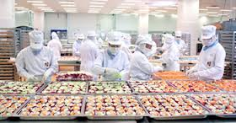

Slide 93
Hazard Analysis Critical Control Point (HACCP)
It is preventive methods applied, to different extents, by most enterprises that export food to
reduce the risk of contamination
assuring food safety
It is the most widely used methods and part of a strong trend in the most developed markets

Slide 94
7 Principles of HACCP Implementation
1. Hazard analysis
2. Determine the Critical Control Points (CCP)
3. Establish critical limits
4. Critical Control Point (CCP) monitoring
5. Corrective actions
6. Establish verification procedures
7. Record keeping procedures

Slide 95
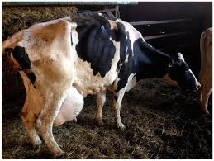
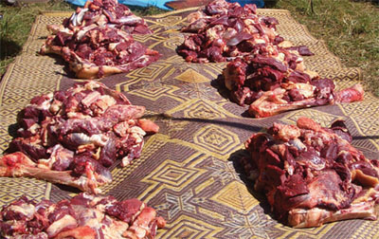
Improving the safety of foods of animal origin involves guidance on good practices in:
animal feeding, animal husbandry, slaughter and handling and processing of animal products

Slide 96
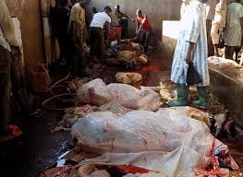
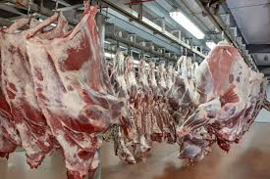

Slide 97
Teams from Animal production, Animal health and Food safety unit should work together
To ensure a science-based and integrated approach to managing food safety risks related to foods of animal origin, including Antimicrobial Resistance (AMR).

Slide 99
What are the solutions?
Utilizing both regulatory and non-regulatory measures to improve food safety practices at all stages of the food chain
Non-regulatory measures:
technical support/training programmes, public education
Regulatory measures:
Set standards/Controlling, and Monitoring and evaluation

Slide 100
Impacts of food safety
Food safety have impacts on:
Food and nutrition security, Health, Economic, Environmental, Political
Chemical residues and microbial contamination continue to pose public health risks and lead to:
trade disruptions with substantial economic and social cost

Slide 101
Health
Aflatoxins are strongly associated with
liver cancer
stunting and immune suppression
Economic
Foodborne disease is a major determinant of export market access, it is increasingly affecting domestic markets

Slide 102
Food safety and Nutrition Linkage
Food safety is the assurance that food will not cause harm to the end user
Food can be unsafe at different points from farm to plate
The vicious cycle of disease and malnutrition, spec. affecting most vulnerable groups affects productivity.

Slide 104
Contaminated food
Could cause disease, immune suppression and stunting
Affects rural incomes and access to food and nutrition security
Food safety, nutrition, food security and public health are linked

Slide 106
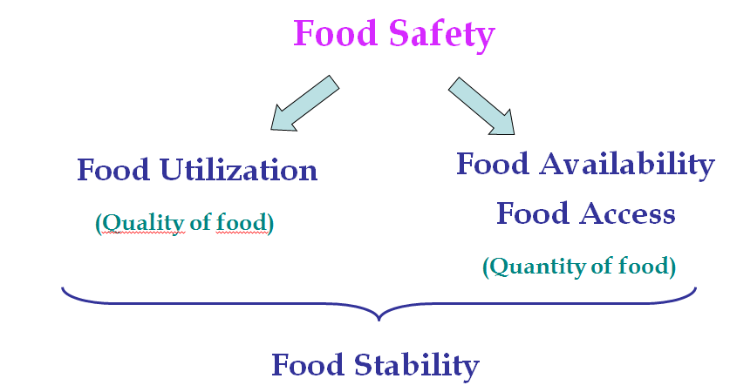
Food safety affects food security pillars
Figure 3.2. Food safety and food nutrition security linkage

Slide 107
Summary
Food Safety- is an assurance that food doesn’t have adverse effects on human
Unsafe/contaminated food could cause disease, immune suppression and stunting
Systems and processes related to food safety and nutrition in food production are linked to their
physical and biological environment

Slide 108
Therefore, apply necessary conditions and measures along the food value chain:
production, processing, storage and distribution
in order to ensure a safe, sound, wholesome product that is fit for human consumption

