Slide 1
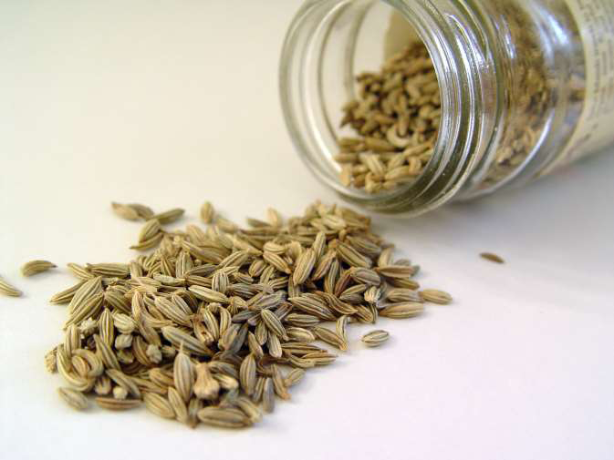
Chapter Five
5. Seed Processing, Storage and Marketing
Content
Seed processing
  Threshing
  Drying
  Cleaning
  Treatment (dressing)
  Grading
  Packing and labeling
Seed storage
Seed Marketing and distribution

Slide 2
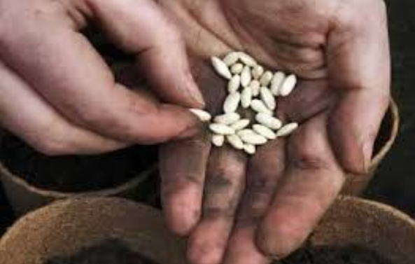
Seed processing
Proper post-harvest processing is critical to maximize yield, longevity, vigor, and overall quality of the seed crop.
Post-harvest practices require special skills and knowledge
Seed lots received from the field
  Often at high MC
  Contain trash materials
  Contain inert material and weed seeds
  Mixed with damaged/broken seeds
  May be contaminated with off type seeds
  May be mixed with other crop seeds

Slide 3
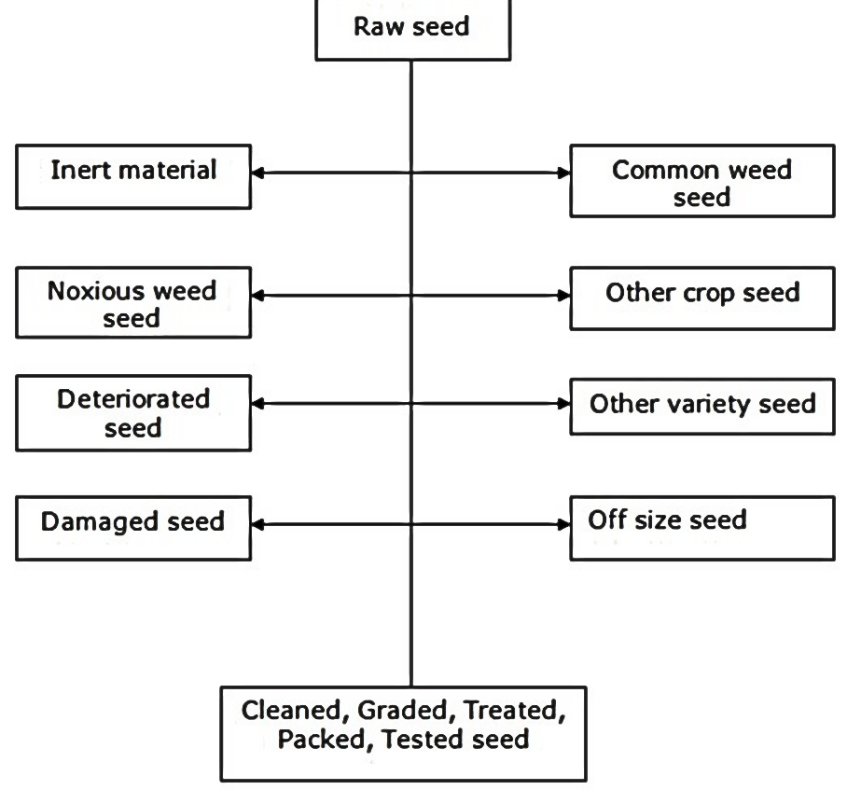
Cont..
Seed processing includes all steps involved in the preparation of harvested seed for storage and/or marketing.
Objectives; removal of
  plant and non-plant debris
  seeds of other crops
  Weed seeds or
  unacceptable seeds of the same origin.

Slide 4
Cont..
In general, seed processing involves:
  Threshing
  Drying
  Cleaning
  Treatment (dressing)
  Grading
  Packaging and labeling

Slide 5
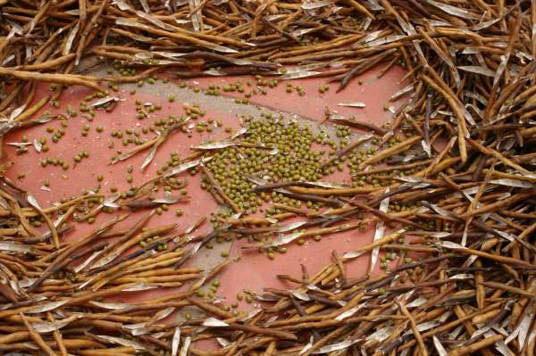
Threshing
Separating the seed from panicles/straw/pod.
Minimize physical damage (affect germination or allow disease infestation)

Slide 6
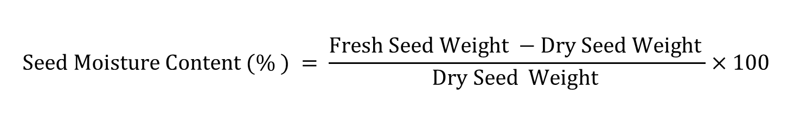
Seed drying
Before/after seed cleaning and before storage and packing
The rate at which a seed lot can be dried depends on;
    Packing character of crops
    Initial moisture content of the seed
Lettuce; relatively quick drier
Carrot, beetroot and swiss chard; medium driers
Cabbage; slow drier
$$Seed Moisture Content (\% ) = \frac{Fresh Seed Weight −Dry Seed Weight }{Dry Seed Weight }×100$$
The drier the seed the higher the storage life.

Slide 7
Seed drying methods
1. Sun or shade drying
The seed is spread on floor, racks, mats etc. in the sun or shade
Waterproof base to avoid transfer of moisture
This method relies solely on ambient conditions, which can dry or increase the seed moisture content depending on wind, temperature and relative humidity.

Slide 8
Cont..
Advantages
  Small quantities of seed can be quickly and efficiently dried
  Inexpensive and requires minimal supervision or attention
Disadvantages
  Weather dependent
  Incomplete drying in humid environment
  Some crop seeds are unable to withstand the high temperature in direct sunlight
  Unless screened from wind, seed can be blown away and lost or mixed with others.

Slide 9
2. Forced air drying (ventilation drying)
Seeds are spread in thin layers on bed, which can be horizontally oriented.
Supporting beds are made of perforated materials (sacking, wood or metal sieves) which permit air movement through the drying seeds.
The drier is oriented with the prevailing wind direction and works on the principle of hot air rising

Slide 10
Cont..
Advantage
  Use natural but ambient air
  Local materials can be used for the constructions of ventilated driers
Disadvantage
  Weather dependent
  Not situated for use in the humid tropics

Slide 11
3. Artificial drying
Allows early harvesting of seed crops
Artificial drying equipment relies on increasing the air flow around the seed, with or without dehumidification of the air by heating or using chemical desiccants.
An artificial drying facility should consist of:
    A fan of sufficient size to deliver a minimum dry air flow
    Efficient heating capacity to raise the air temperature to 35-40⁰C
    Adequate control to maintain the air temperature at 35-40⁰C or less
    Adequate drying capacity compatible with the harvesting rate at which seeds will be received by the plan

Slide 12
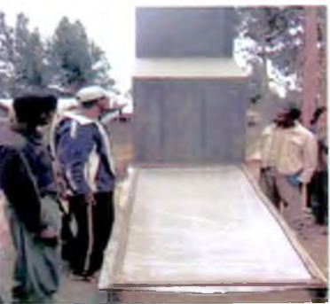
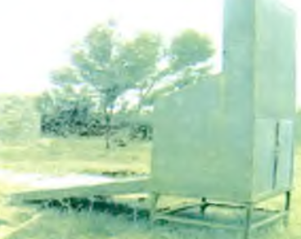
Cont..
Tera farm (a private fruit and vegetable grower) around Debre Birhan
Notes:
Tera farm (a private fruit and vegetable grower) around Debre Birhan to dry vegetable and spice seeds. Seeds are placed in trays at the back side o f the
drier and dried by blowing hot air current from the front. Since the front part o f the drier is covered with black plastic film, hot air is produced in this
part of the drier. This hot air passes through the drier and circulates within seeds, removing the moisture to the outside.

Slide 13
Cont..
Advantages
  Large quantity of seed can be dried
  Allows early harvesting of seed crop
  Provide better control of seed quality in all environments
  Independent of weather conditions
Disadvantages
  Equipment dependent
  Expensive equipment
  Difficult equipment to clean (risk of seed contamination)

Slide 14
Seed Cleaning
The removal of inert matter, other crop seeds (including weeds) to increase marketable value.
Cleaning ensures good seed quality
    Increase purity and germination
    Decrease the number of diseased seeds and improves the visual, commercial and planting quality
The physical differences (relative size, shape, length, density, surface texture, color, affinity to liquids) can be used for seed cleaning.

Slide 15
Separation based on weight (specific gravity)
One of the oldest seed cleaning techniques
When done by hand in the wind; winnowing.
    The process of separating the seed from the chaff
On a small-to-medium scale this is a very effective method to quickly clean seed.

Slide 16
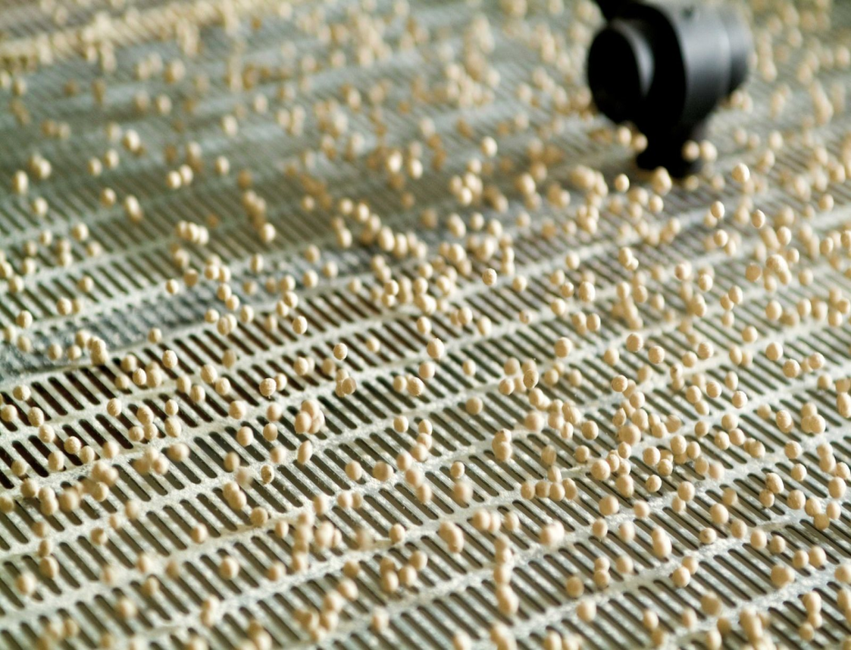
Separation based on size
Screens with various hole sizes
Screens are used to either permit the crop seed to pass through or to retain the crop seed on top of the screen
Hand-held screens are very useful for small to medium scale seed cleaning.

Slide 17
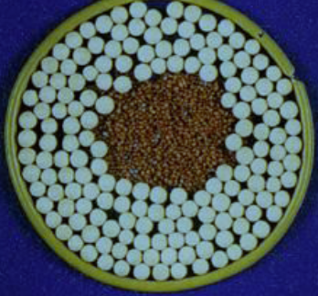
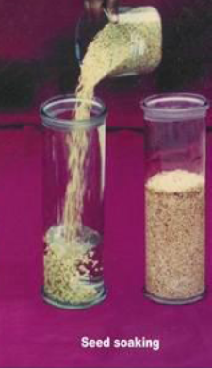
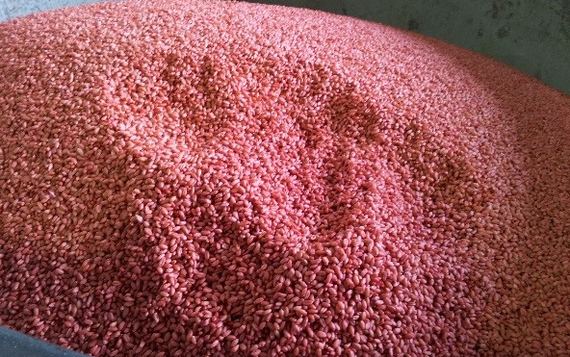
Seed treatment
Application of pesticides to seeds to disinfect and disinfest them from various seed born and soil born pathogens and insect pests.
Purposes;
To combat seed borne diseases and insect pests.
Protection of seeds against soil or air born diseases
Specialized seed treatments
    seed coating
    pelleting
    scarification
    Blending
    aid in germination.
Notes:
Seeds can be soaked in 1 % KCl solution for 12 hours to improve the germination and vigour potential. Inert materials for pelleting : Lime, CaCO3, Chalk powder.

Slide 18
Method of Seed Treatment
Mechanical methods:
  To remove infectious materials mixed with seeds.
  Mechanically treated seed is not completely free from pathogens and requires further treatment.
2. Physical methods:
  Primarily used to kill pathogens rooted deep in to the seeds.
  Include hot water and soak water treatments (more practical) and ultraviolet, infrared, x-ray
  Do not protect seeds against soil born organisms

Slide 19
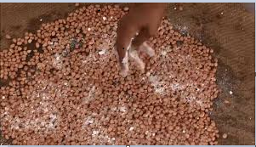
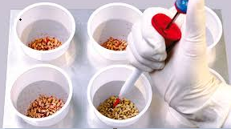
3. Chemical methods (seed dressing)
Insecticide/Fungicide treatment, pelleting, priming and rhizobium inoculation.
Ideally, the chemical should combine the following characteristics:
  Effective against all the major pathogenic organisms;
  Non-toxic to the plant and people, if misused
  Environmental safe (persistence)
  Stable during the storage period
  Systematic in the plant to increase its effective life
  Economically competitive

Slide 20
Seed Grading
Objective; to produce sound even-sized and uniformly shaped seed.
It also improves the appearance of processed seed
Most seed cleaning machines simultaneously grade the seed based on uniform size and shape.

Slide 21
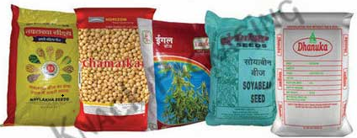
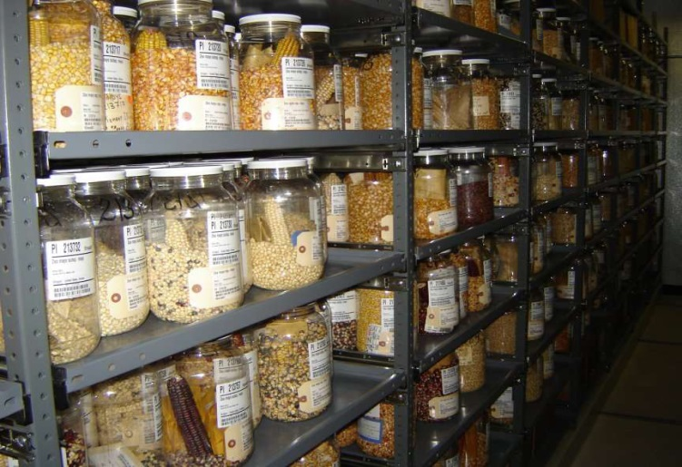
Seed Packing and labeling
The package must be able to protect the seed from physical climatological and biological damage.
The package therefore serves as a:
  Convenient unit of handling, purchase, transport and storage
  Protection against contamination, mechanical damage and loss
  Suitable environment for storage
  Sales promoter (information and advertisement)
Notes:
Packaging is a form of advertising. Clear printing, the use of colour, brand or company logo and well reproduced photographs or images are all important components of design.

Slide 22
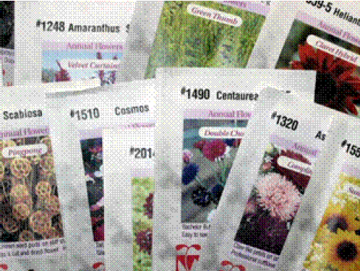
Cont..
Information about the contents of a package including:
  The name of the species (crop name)
  The cultivar
  The grade and the lot reference number
  Date of sealing
  Production year and season
  Minimum germination %
  Quantity

Slide 23
Seed Storage
The storage life of seeds varies with
  Crop type
  Maturity at harvest
  Storage temperature and RH
  Moisture content of seeds
  Harvesting and processing conditions,
  Mechanical damages
NB: Temperature and RH are most important factors

Slide 24
Cont..
High humidity levels cause seeds to increase their respiration rate and use their storage energy.
Furthermore, high incidence of storage fungi and insect pests.
Thus, the seeds should be dried (around 5- 8 %) depending on type of crops before storage

Slide 25
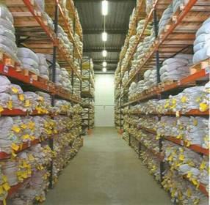
Cont..
  For every rise of 5°C in the range of 0 to 40⁰ C, seed life is reduced by half,
  Low temperature storage to store vegetable seeds longer

Slide 26
Table 1. Satisfactory moisture level of seeds to be stored in vapor proof containers
Vegetable types | Maximum seed moisture (%)
Cabbage and other brassicas | 5
Carrot, parsnip, parsley | 7
Beetroot and swiss chard | 7.5
Spinach | 8
Lettuce | 5.5

Slide 27
Cont..
It is also possible to keep the seeds longer
But, germination capacity will be progressively lowered
Table 2. Life expectancy of vegetable seeds under favorable storage condition
Vegetable types | Years
Beetroot, Cabbage, Cauliflower, Swiss chard | 4
Carrot, Chinese cabbage, kohl rabi | 3
Lettuce | 6
Radish | 5

Slide 28
Seed Marketing and Distribution
One of the key components in seed industry which protects the interest of all parties (breeders, seed producers, seed distributors and farmers) involved in seed business.
Generally, marketing is an activity directed at satisfying needs and wants through the exchange process.
There are four basic components in seed marketing:
  Producers
  Product (Seed)
  Customers
  Competitor: Any other seed producing and supplying agencies.
      offer seed of a higher quality, in right place, right quantity, at right time and acceptable price.

Slide 29
Seed Marketing Activities
Establishment of marketing strategy
Determination of consumers’ need
Accumulation of seed to satisfy needs
Communication with potential consumers
Setting appropriate price
Seed selling & distribution of seed to the consumer
Notes:
Seed marketing strategy is long or short term plan regarding the different activities of the seed company related to market or marketing itself. It is establishment of effective marketing policies on production planning, distribution chain, market promotion activities and seed processing policy. A major function of seed marketing is to facilitate the flow of seeds from the point of production to the consumers (farmers).

Slide 30
Seed Marketing Research/study
Marketing demand forecast
  Who are the customers (target groups)
  Geographical location
  Total cultivated area, seed rate, quality replacement period
  Impact of extension efforts (improved production techniques, and promotion)
  Cultivar preference, package size, kind of packaging, quality and price
  Number and size of competitors
  Kinds of publicity and sale promotion that are most effective

Slide 31
Seed Pricing
Set the price based on total cost of seed production.
Generally, high quality seed should be priced higher than grain.
Factors to be considered in price setting for certified seed:
  Mating system of the crop
  Seed rate
  Multiplicative factors of the crop
  Level of market orientation of crop production
  Difficulty to store as vegetable and fruits –low price
  Difficulty to produce seed - high price
  High incidence of seed transmitted disease - high price
  Specific advantage of seed treatment such as insecticides, fungicides, inoculants, primers etc. - high price

Slide 32

Seed Distribution and Selling
Seeds pass from the producers to the users through marketing channels.

Slide 33
Cont..
Arrangement of seed distribution chains with wholesaler retailer network has the following benefits
    Timely delivery
    Selling initially set price
    More effective than direct distribution by producers
    Feedback mechanism for establishing market demand
    Cost effective for both seller and buyer- share financial load of logistic costs

Slide 34
Cont..
Types of seed distribution systems in Ethiopia
  Farmer to farmer
  Seed enterprise (public and private)
  Co-operatives
  Ministry (bureau) of agriculture
  NGOs

