Slide 1
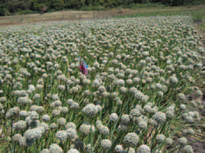
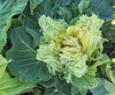
Chapter Four
Seed Production in Selected Vegetable Crops
Outline
Introduction
Tomato (Lycopersicon esculentum)
Onion (Allium cepa L.)
Hot pepper (Capsicum spp.)
Carrot (Daucus carota L.)
Cabbage (Brassica oleracea L var. capitata L.)

Slide 2
Introduction
Vegetable production is becoming important with
    Expanding irrigated agriculture
    Source of income
    Improved food security
    Sources of raw materials
    Generates employment
Commercial producers are also involved in the production, processing and marketing
Rain fed and irrigated condition

Slide 3
Cont..
Generally Ethiopia has favorable climatic conditions for seed production (temperate to tropical vegetables)
The successful seed production depends on the supply of good quality seed.
Cultivation practices for seed production require more detailed attention and special skills compared to field crops.
  cultivation practices, propagation, seed extraction, harvesting and processing

Slide 4
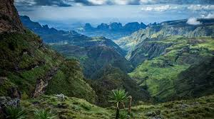
Cont..
Warm season vegetables such as tomato, melon, onion, and capsicum are grown in central and upper rift valley belt under irrigation
where as cool season vegetables like cabbage, garlic, shallot, carrot etc. are grown in the high land areas above 2000 - 3000m.
    Bokoji (Arsi highland)
    Ankober (Northern Shoa)
    Lai Gaint (Southern Gonder)

Slide 5
Cont..
Horticultural Development Enterprise (HDE) produced 229,500 and 2,600 kg vegetable and flower seed, respectively from 1999 to 2007
However, large quantity of vegetable seed is imported annually.
This situation is of great concern to the country.

Slide 6
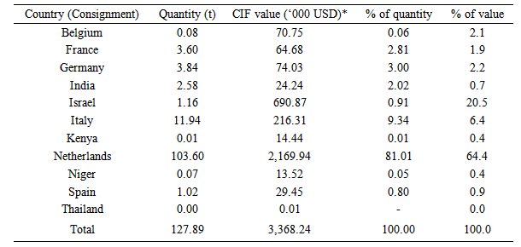
Table 1 . Quantity and value of vegetable seed imported from country of consignment in 2012
Notes:
CIF (Cost Insurance and Freight) is a trade term requiring the seller to arrange the carriage of goods by sea to a port of destination, and provide buyer with documents necessary to obtain the goods from the carrier

Slide 7
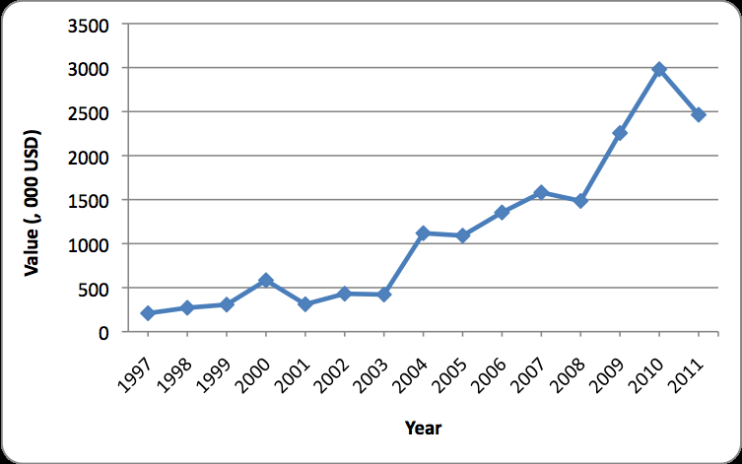
Figure1. Value of vegetable seed import to Ethiopia in the years from 1997 to 2011

Slide 8
Cont..
Most important vegetables have been tested in potential growing sites.
The result indicated that seed of the economically important vegetables could easily be produced in the country.
This indicates that most of the currently imported vegetable seeds could be successfully and easily produced in the country.

Slide 9
Table 2. Potential seed yield of different vegetable crops tested in Ethiopia
No | Vegetable crop | Variety (cultivar) | Potential average seed yield (qt/ha) | Remarks
1 | Onion | Adama red | 10-13
 |  | Melkam | 11-15
 |  | *Red Creole | 2-6
2 | Tomato | Melka shola | 1-1.2 | Processing type (cylindrical)
 |  | Marglobe | 1-1.5 | Fresh market (globular)
3 | Hot pepper | Mareko fana | 2-5
4 | Carrot | Chanteny | 8-12
5 | Beet root | Crimson globe | 7-9
6 | Cabbage | Copenhagen Market | 3-5
7 | Kale | Local | 6-7
Notes:
Melkasa Agricultural Research Center is the main vegetable (tomato, pepper, onion, snap bean) research center. Debre Zeit Agricultural Research Center is working on garlic and shallot. Regional research centers (Bako, Adet, Areka, Sinana, and Hawassa), federal research center (Holeta), and Haramaya University focus more on root and tuber crops such as potato, sweet potato, enset, taro, yam, and cassava (MoA, 2012).

Slide 10
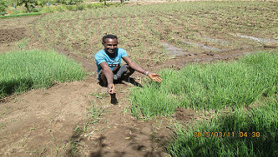
Cont..
However, there is no organization involved in the multiplication and distribution of vegetable seeds
Thus, it is advisable to train vegetable producers on the basic principles of seed production at least for their own requirements.

Slide 11
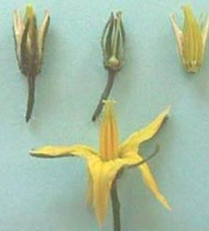
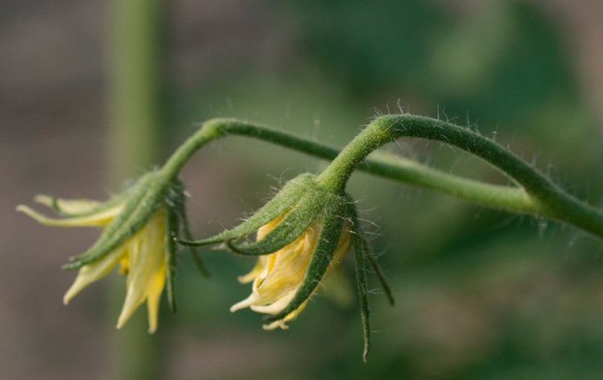
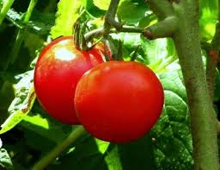
Tomato (Lycopersicon esculentum)
A self-pollinated crop
Insects may cause some degree of crossing
Follows the breeding/improvement methods developed for self-pollinated crops
Varieties have been developed for fresh market and processing (canning)

Slide 12
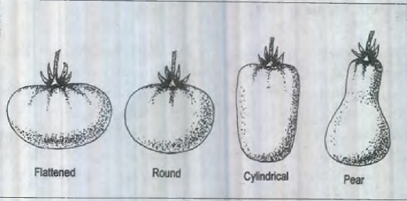
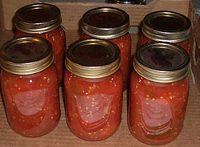
Cont..
Different types (growth habit, fruit shape, etc.) of tomato varieties are produced in Ethiopia.

Slide 13
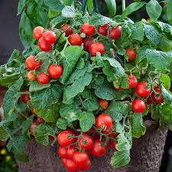
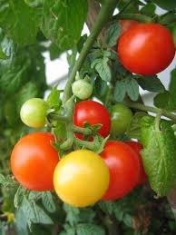
Cont..
Tall set (indeterminate) Vs. the short set (determinate).
The determinate types produce more flowers within a given length of vine within a short period
The indeterminate ones produce fruits and highest yield for long time.

Slide 14
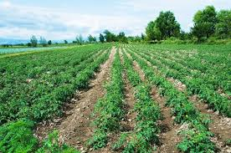
Growth requirements
Tomato requires warm, clear, dry conditions
Altitudes 700 to 2000m.
Optimum temperature 24 to 28°C during the day and 14 to 17°C at night.
High temperature above 40°C during the day and 22°C at night can cause flower drop, poor fruit set and poor quality seed.
Friable and sandy loam soil with pH of 5.8 to 6.8

Slide 15
Cont..
Source of seed-
Obtain breeder's and/or basic seeds from a recognized source (e.g. EARO, ETFRUIT)
Seed rate : 60 gm/25m²
Sow the seeds in raised nursery beds (15-20 cm)
Spacing: 4-5 cm b/n rows
A total of 12 nursery beds (1 x 5m) are needed to raise enough seedlings to transplant 1 ha.
Fertilization = apply Farm Yard Manure (FYM) during land preparation and recommended rate of DAP fertilizer
Notes:
Ethiopian Fruit and Vegetable Marketing Enterprise (Etfruit)

Slide 16
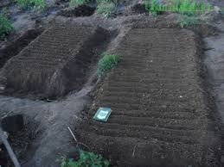
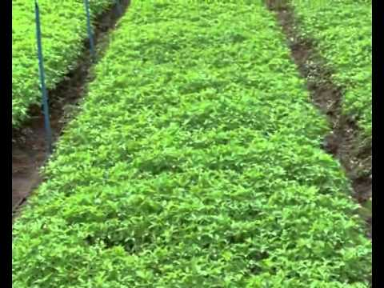
Nursery beds

Slide 17
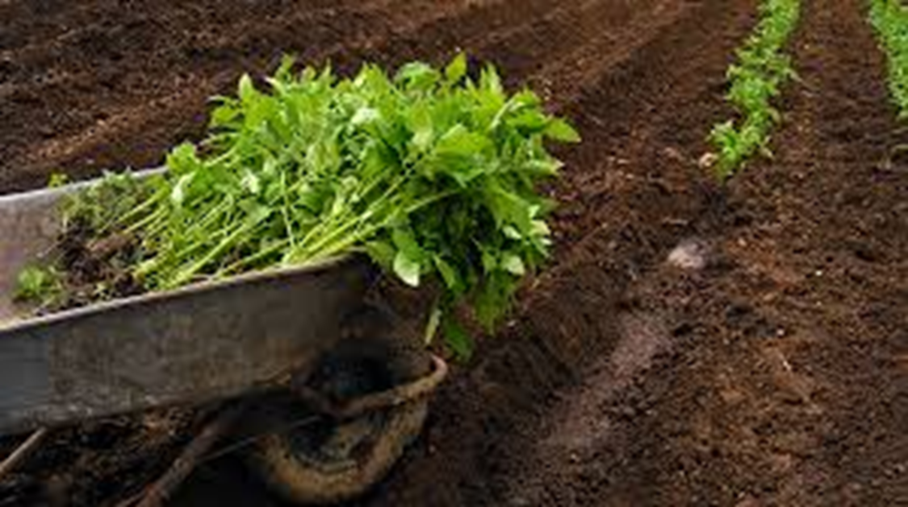
Nursery operations
pest, disease and weed management: (leaf spot , damping-off, cut worms)
watering as required
transplanting: 30-35 DAS (days after sowing)
        12-15 cm height (of seedlings)
Isolation: 50m for basic & 25m for certified seed.
10m may be used if pollinating insects absent
Spacing in the field: 100 cm x 30 cm (33,330 plants/ha)

Slide 18
Field operations
The field operation for seed production is identical whether they are grown for fresh market or processing.
Grown under irrigation in the dry season.
Rainfed; heavy disease incidence and poor seed set.
Should be grown on the same field ones every 2 to 3 years.
Related crops such as potatoes and hot pepper should not be used in the years rotation.
Frequent watering, weeding, cultivation, disease and pest control are essential for good seed yield.

Slide 19
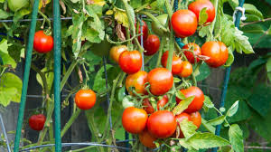
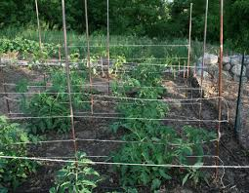
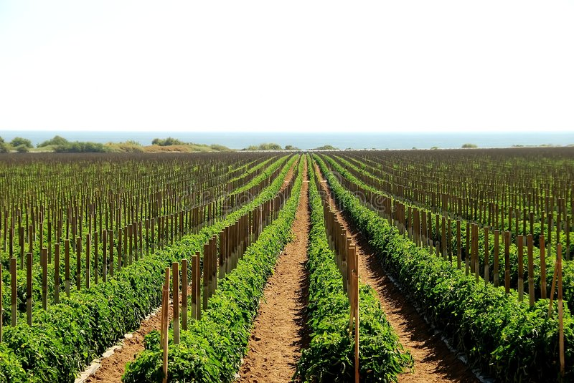
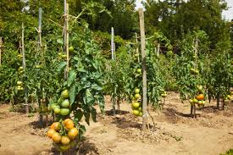
Cont..
Staking is important for tall set varieties to facilitate management practices and to produce high quality seed.

Slide 20
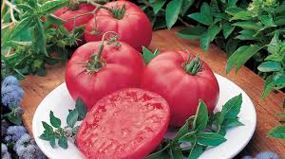
Harvesting & extraction of seed
Depending on cultivars high quality fruits could be harvested from 90 to 120 days after transplanting
Good fruits selected from healthy and true to type plants should be collected for seed extraction.
The fruits must be free from diseases, any physical damage and must be typical to the variety in color, size, shape, etc.

Slide 21
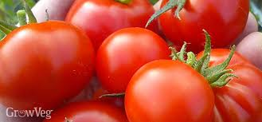

Cont..
The fruit should be red ripen

Slide 22
Extraction methods
Since tomato seeds are embodied in a jelly like substances, their extraction requires special care.
1. Manual extraction
Harvest the fruits in nylon bags
Crush the fruits by trampling with feet
Put the bags of crushed fruits into big plastic containers and allow fermenting
Take out the mass into an open plastic container (e.g. Buckets) then, fill up the container with water and stir the seeds to allow the pieces of flesh and skin sticking on the seeds to float.
Incline the container and gently remove the floating flesh and skin, making sure that the seeds remain at the bottom.
Repeat the washing several times until clean seeds remain at the bottom.

Slide 23
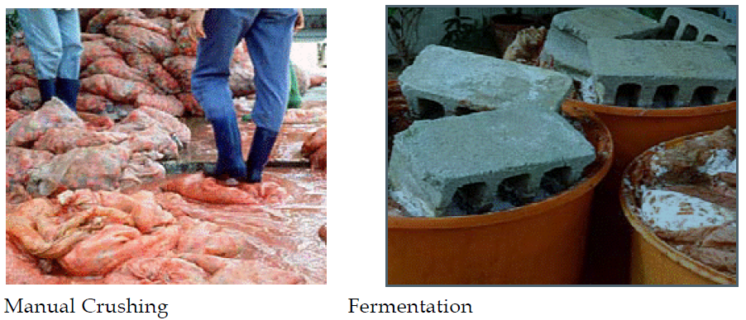
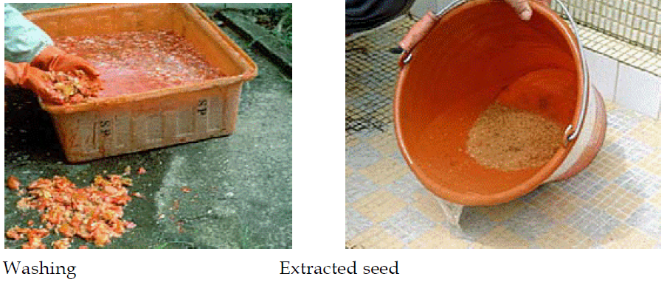

Slide 24
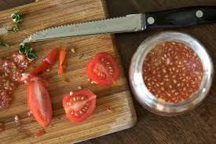
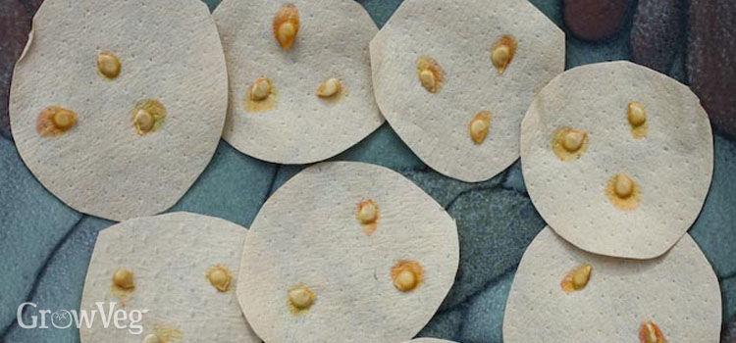
Cont..

Slide 25
2. Mechanical extraction
Mechanical seed extraction is used by large-scale operations.
Procedures
Put the ripe fruits into the mechanical extractor for crushing
Collect the crushed mass (seed + gel-mass), i.e., the juice, pulp + seed) into a suitable container such as buckets
Add 0.7% HCl at the rate of 7 ml/kg seed gel mass
Stir for about 30-40 min., until the gel is dissolved
Pour the acid treated seeds into a clean plastic container e.g. Buckets
Fill in the container with tap water and stir gently to allow the pulp and skin to float
Incline the container and remove the floating material
Collect the seeds that remain at the bottom of the container.

Slide 26
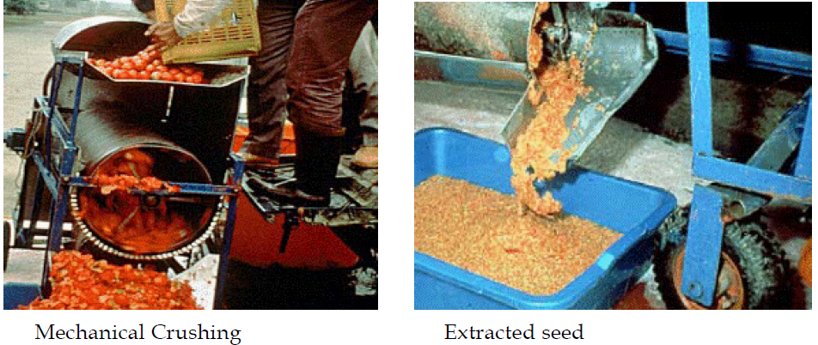
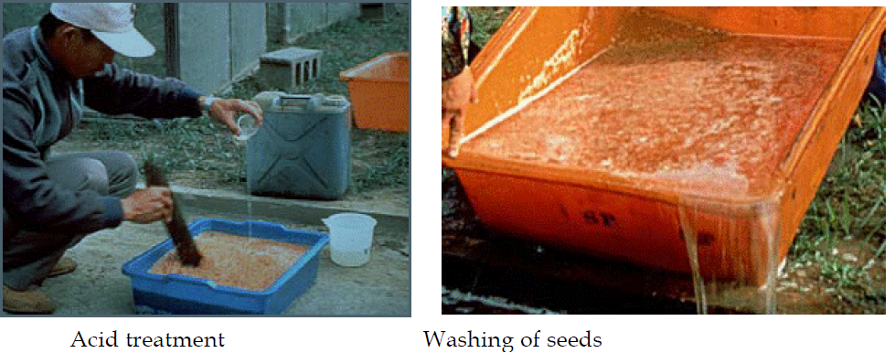

Slide 27
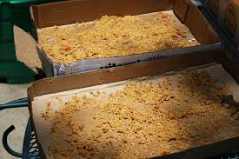
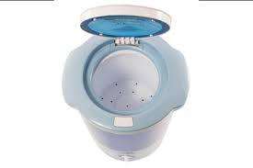
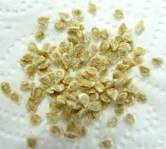
Seed drying
After washing, seeds should be dried as rapidly as possible
Hanging the seeds in the shade for a day
quicker way: place the seeds in a spin dryer.
uniformly spread the partially dried seeds
Loosen any clumps of seeds
Drying continues for three to four days (at 28-30°C).
These procedures will get the seeds to the desired 6-8% moisture content.

Slide 28
Seed yield
The yield of tomato seed vary considerably with varieties, cultural practice and environment.
  Small fruited varieties produce 8 to 10 fruits
  Large fruited produce 3 to 4 fruits per cluster.
  150 to 300 or more seeds per fruit.
The ratio of fruit to seed yield could vary from about 200:1 to 300 :1 and even less for some.
Seed yield: 90 to 125 kg/ha
The 1000 seed weigh is about 2.3 to 2.7 g

Slide 29
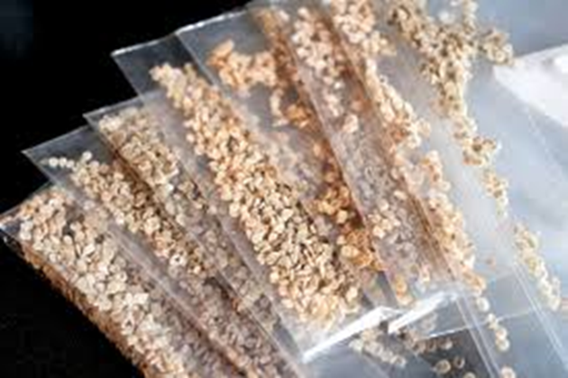
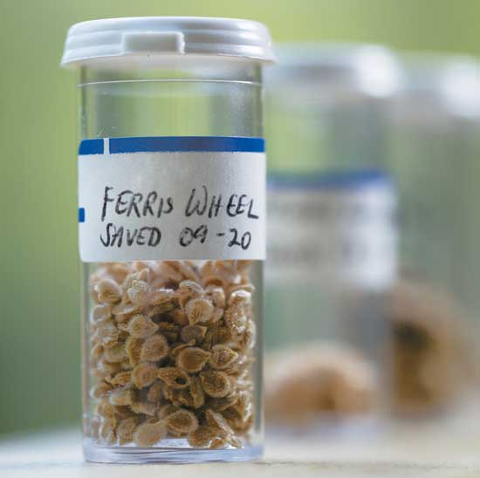
Seed packaging & storage
The dried seed can be stored in plastic or cloth bags
Under commercial production, better stored in a sealed condition.
Retain full viability for about 3 to 4 years when stored at
    room temperature,
    low moisture content (7 to 9% ) and
    relative humidity up to 70 %.

Slide 30
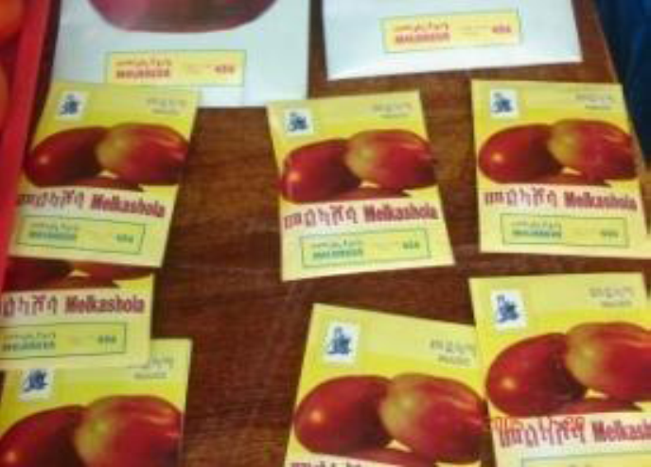
Cont..
label each container
    Name of the variety
    Year of production
    Seed class
    Moisture content, etc.
Store in cool and dry place

